Slide 1


Initiating an Open Access Educational Database in the Arab World:
The experience of Shamaa
UN Libraries, MENA Libraries, and Sustainable Development
UN House ESCWA, Oct 7th, 2019
Rita Maalouf
Executive Director

Slide 2
Table of contents
Shamaa overview
Shamaa in numbers
Developmental Role : Services / Quality
Who is behind Shamaa
Notes:
In this presentation, I will present an overview of Shamaa, some numbers, the developmental role of Shamaa and who is behind shamaa.

Slide 3
Arab Educational Information Network (Shamaa)
شمعة : شبكة المعلومات العربية التربوية
www.shamaa.org
Notes:
Shamaa is the acronym of its name in Arabic: شبكة المعلومات العربية التربوية

Slide 4
Shamaa in a brief Video
One minute
Notes:
Here is a one minute video to introduce shamaa. It is in Arabic.

Slide 5
Shamaa
It is an Arab, not-for-profit organization
Founded in 2007 by an initiative from individuals who believe in the importance of educational research and the importance of documentation and databases.
It is funded by organizations and individual researchers who share Shamaa’s vision.

Slide 6
Shamaa
Main beneficiaries
MA and PhD Education students
Faculty Members
Notes:
All researchers from around the world can benefit from our database but the main beneficiaries are the MA and PhD Education students and of course the Faculty Members in the field of Education and the Humanities

Slide 7
Academic Database in the field of Education
Shamaa
Thesaurus
Open Access
Intern. Standard system
Different types of studies
3 languages
Abstracts
Full Texts
Notes:
So, Shamaa is an open access database. It includes theses, dissertations, articles, conference proceedings, reports in the field of education. The studies are in their original languages (Arabic, English and French). The studies have at least one abstract and we made the full text available when it is possible. The database is running with international standards. We have built our own thesaurus in the lack of a specialized thesaurus.
So, Shamaa offers double services: for the researchers as consumers of knowledge, to benefit from the database; and for the researchers as producers of knowledge, to disseminate their studies through shamaa

Slide 8
Shamaa in numbers

Slide 9




Shamaa at a Glance
Number of covered countries 18
Number of studies 50 644
Full Texts 68 %
Number of indexed Journals 308
Beneficiaries last 4 years 1 Million researchers
Cooperation agreements 84
Strategic Partnerships
Notes:
We are covering 18 countries
We reached fifty thousand records last month
68% of the studies in shamaa are with full text
We are indexing more than 300 journals specialized in education or in humanities
1 million researchers benefited from shamaa during the last 4 years.
We signed 84 agreements with faculties of education or journals or research centers in order to provide shamaa with data…
In addition to 4 partnership agreements:
With ERIC database to be able to include in shamaa the studies about the Arab countries
With EBSCO where you can find shamaa data
With Unesco
And lately with the UN Global Compact Network Lebanon - GCNL

Slide 10
Distribution of Shamaa studies by language
Notes:
As you can see, the documents are mainly in Arabic.
But thirteen percent are in English and 2% in French.

Slide 11
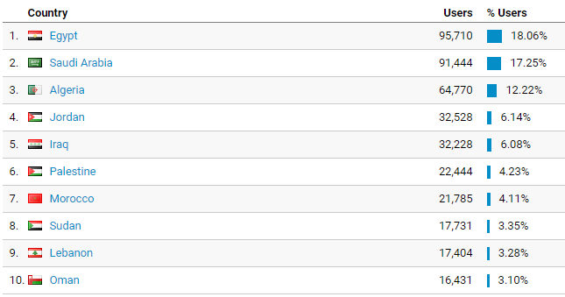
Top 10 Countries visiting Shamaa database last 4 years
Notes:
Here are the top 10 countries visiting shamaa database during the last 4 years

Slide 12
Distribution of studies by country
Notes:
Here is the Distribution of studies by country,
It is worthy to note that Egypt and Saudi Arabia are seemingly underrepresented in the provision of data to be included in Shamaa, while they are the most users benefiting from the database as we see in the previous slide.

Slide 13
Developmental Role : Services / Quality

Slide 14
Shamaa
In 2007, the main goal was to build a database that covers all Educational research in and about the Arab countries, in order to:
  Break the isolation between the countries and within each country regarding educational knowledge
  Enrich university libraries with Arabic database
  Contribute to the dissemination of Arabic educational journals
  Facilitate networking among Arab educational researchers
Notes:
… in view of the lack of Arabic content in the university libraries

Slide 15


Shamaa 10 years later
In 2017, the main goal was expanded to include improving the quality of Educational research in the Arab world by offering new services and reinforcing partnerships as a contribution to the achievement of SDG 4
Notes:
… and of the Goal 17: Partnerships to achieve the Goals, through participation in the UNGCL.

Slide 16
Shamaa developmental role
It is no more only an Educational Database
It also offers various other services to promote ed. research quality
Notes:
I will go quickly on 4 services we are offering to the researchers:

Slide 17






Notes:
A specialized team developed a training kit composed of 5 modules totaling 16 training hours aimed at the development of Master and PhD students skills on:
1- Selecting the appropriate databases and searching for relevant references.
2- Citing sources and presenting references lists according to citation style standards.
3- Preparing an abstract and selecting appropriate keywords
4- Introducing the students to the concepts of author’s copyright and intellectual property.
5- Writing a review of relevant literature.

Slide 18

29 Tutorials on the use of educational information resources
Notes:
Based on the training kit, we produced 29 Tutorials on the use of educational information resources, and they are available online for free.

Slide 19

APA Guide for Thesis and Dissertations in Arabic language
دليل صياغة الأطروحات والرسائل الجامعية العربية: الأخلاقيات والتنظيم والاستشهاد المرجعي
Notes:
The APA Guide for Thesis and Dissertations in Arabic language was also produced based on the needs identified during the training

Slide 20
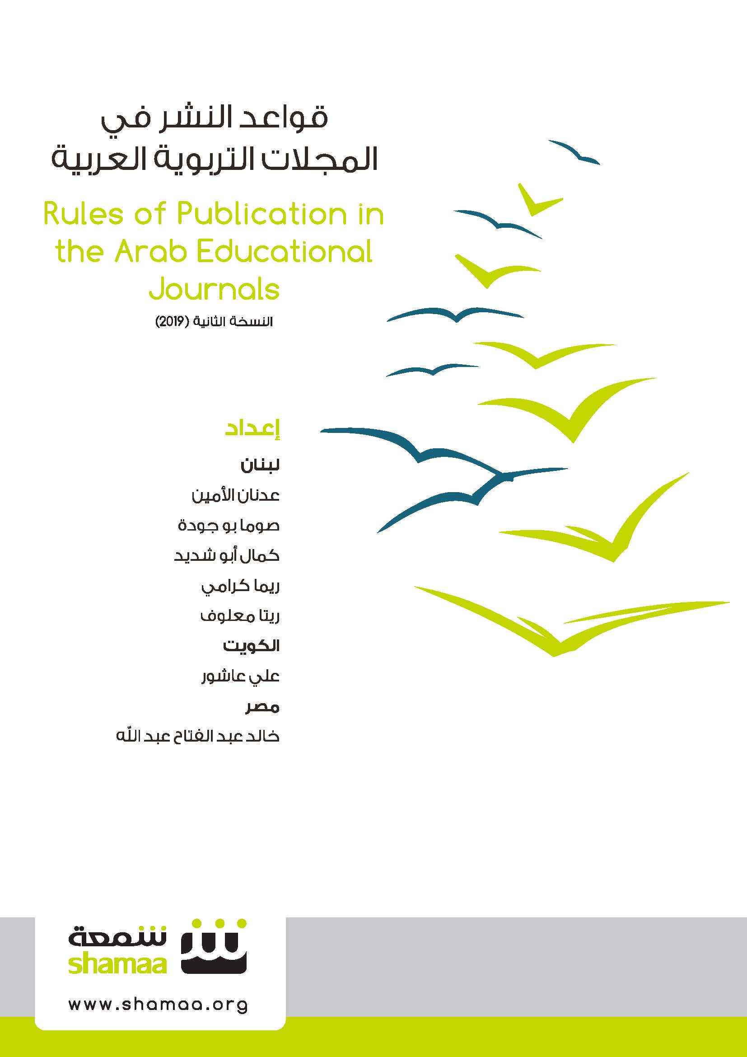
Rules of Publication in the Arab Educational Journals
Notes:
The Rules of Publication in the Arab Educational Journals provide guidelines to the publishers of educational journals.

Slide 21
Who is behind Shamaa

Slide 22
Shamaa's mission and vision could not be achieved without the active involvement of the educational scientific community:
  Students
  Faculty Members
  Faculties of Education
  Educational Research Centers
  Universities
  University Libraries
  Information specialists
  And all who believe in the open access knowledge
Notes:
So please, spread the word about Shamaa in your institutions and solicit them to supply it with data about educational knowledge, such as reports, periodicals, etc.

Slide 23












Shamaa contributors & donors
Dr. Faiza Mohammed AlKharafi
Mr. Sayer Bader AlSayer
¼ Khayrat of Late Mohamed Abdulrahman Al-Bahar
Waqf of Late AbdulRahman Mohamad Al-Bahar
Mr. Adnan Abdul Aziz Al Bahar
Mr. Mahmoud Abdul Khaleq Al-Nouri
Notes:
Here is a list of Shamaa individual and institutional contributors and donors.

Slide 24





Thank you
www.shamaa.org
r.maalouf@shamaa.org
shamaa@shamaa.org
+961-1-611560(1)
@ShamaaDatabase
Shamaa
Arab Educational Information Network (Shamaa)
Shamaa Database

