Slide 1
Geospatial information and GIS for generating and disaggregating SDG indicators using PHC
Roberto Bianchini
UNSD Consultant

Slide 2
Content
Geospatial information, GIS and census data
Data integration
Geocoding
Proposed SDG indicators for the analysis
Disaggregation of SDG indicators and grid systems
Data visualization

Slide 3

Geospatial information and SDGs
  A large number of SDGs have a spatial relevance and can benefit, directly or indirectly, from geospatial information.
  Geospatial information is needed to generate some SDG indicators, also in combination with census data.
  Geospatial data and tools, including GIS, can contribute to the visualisation and the disaggregation of SDG indicators from a geographic perspective.
  Geospatial technology and spatial analysis techniques can support the monitoring of the 2030 Agenda.

Slide 4

Geospatial information and census data
  Census data should be collected with reference to the place of residence and place of enumeration (paras. 2.55, 4.40).
  Location of living quarters (addresses, locality, urban and rural) recommended as a core topic (paras. 4.463- 4.470).
  Location of place of work is recommended as a non-core topic (para. 4.363).
  Location of school, college or university recommended as a non-core topic (para. 3.86).
  Slums, grid squares, and agglomerations are recommended to be identified (paras. 1.37, 3.365, 4.91).

Slide 5
Integrating geoinformation, SDGs and census data
  Geospatial information supports the production and dissemination of SDG indicators and census data.
  Integrated geospatial information and census data can support the computation of some SDG indicators, disaggregated and visualized at small geographic areas.
Geoinformation
Census
SDGs

Slide 6
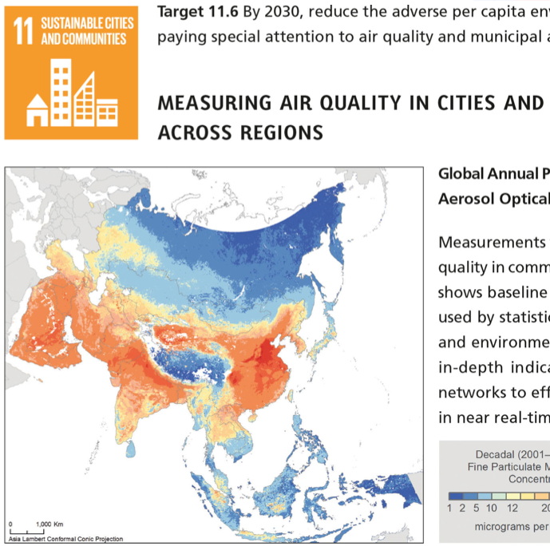
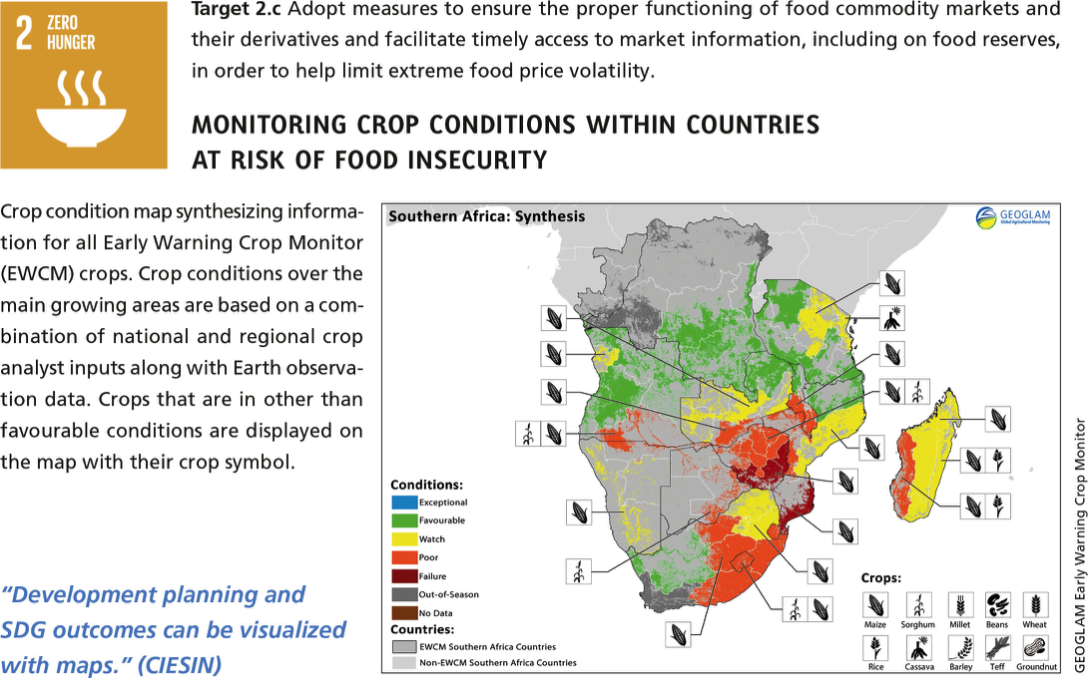
Integrated geospatial data for SDG indicators
  Census data geocoded: geographic coordinates, unique identifiers…
  GIS data and tools: administrative, statistical and geographic areas, software…
  Earth Observation (EO) data: urban and rural, parcels, land, seas, forest, agriculture…
  Mobile data: social interactions, population density, mobility, spending patterns…

Slide 7
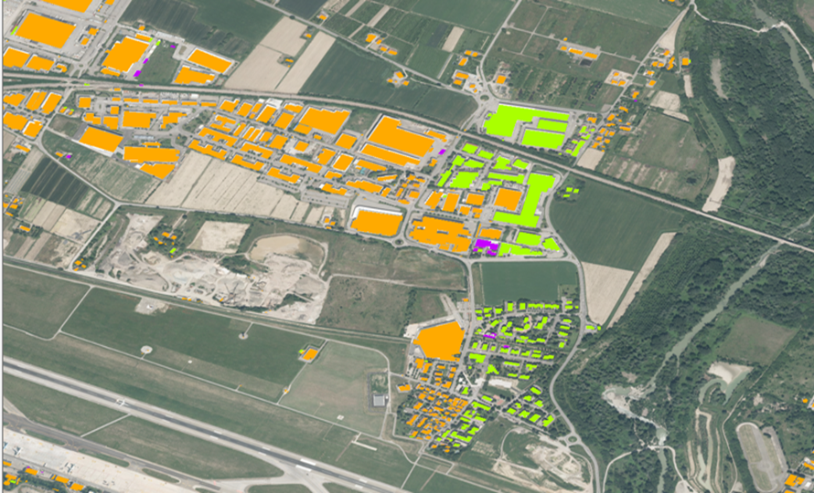
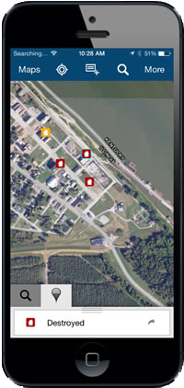
Integrating geospatial data from different sources
Cadastral data
Municipality data
Open Street Map
Field data collected by handheld devices

Slide 8
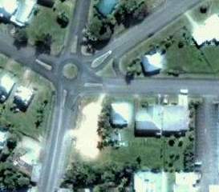

Geocoding of census data
Geocoding: location as the basic unit for the integration, but…which location?
Geocoding methods:
Administrative geography
Statistical geography
Registers
Addresses
Postal zones
Parcels
Grid cells
GPS coordinates
Google plus code
Address / x,y / Plus code
Enumeration Areas / Parcels

Slide 9
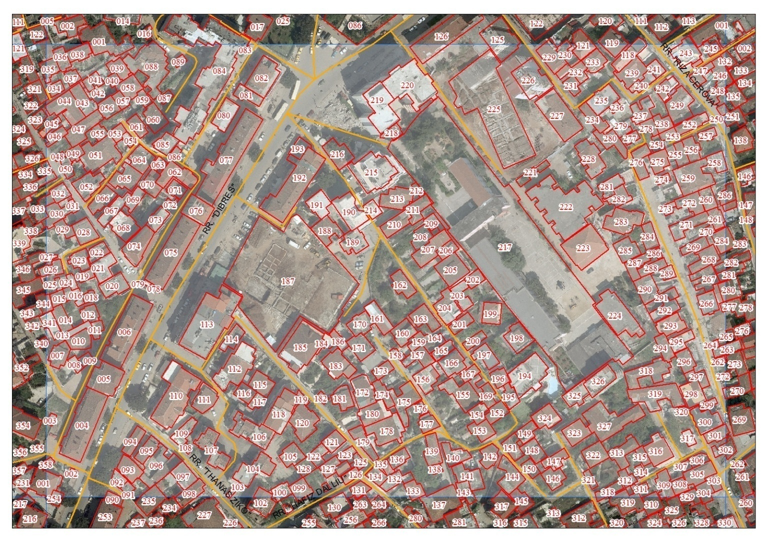
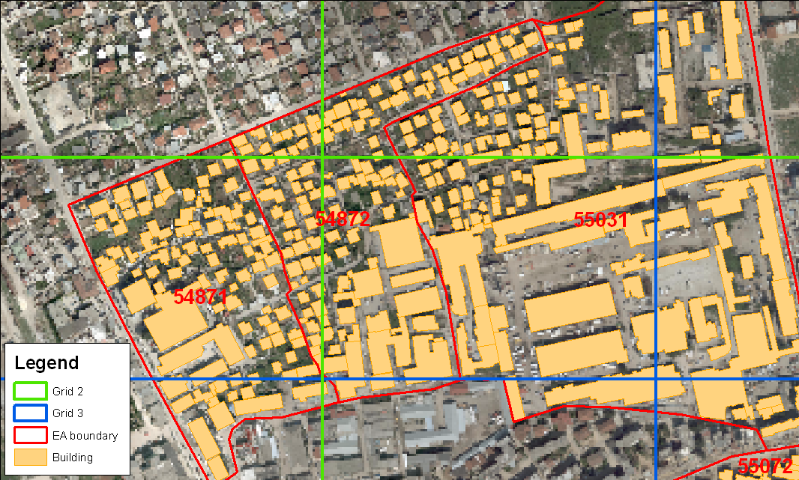
Recommended geocoding method
  Point-based location
Geocoding of buildings:
A – point-based no polygons
B – point-based with polygons
Buildings coded by unique IDs or by grid cells
Building IDs can be reported by enumerators on the census questionnaires
Address / x,y – GPS / Building ID
Enumeration Areas / Parcels

Slide 10


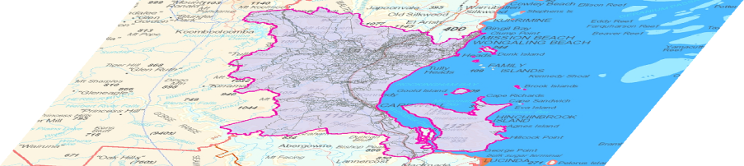
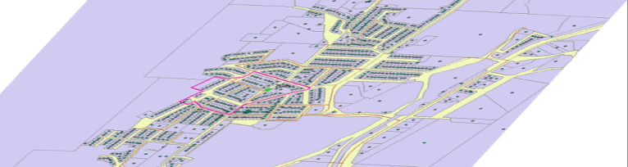
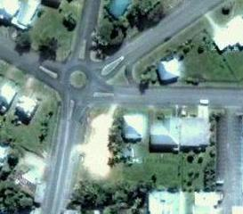
Point-based geocoding of statistical data
Aggregated to Local Government area or higher
Analysis and aggregation / disaggregation across geographies
Building IDs / Coordinates / Plus code
Aggregated to an administrative unit
Aggregated to a district level

Slide 11
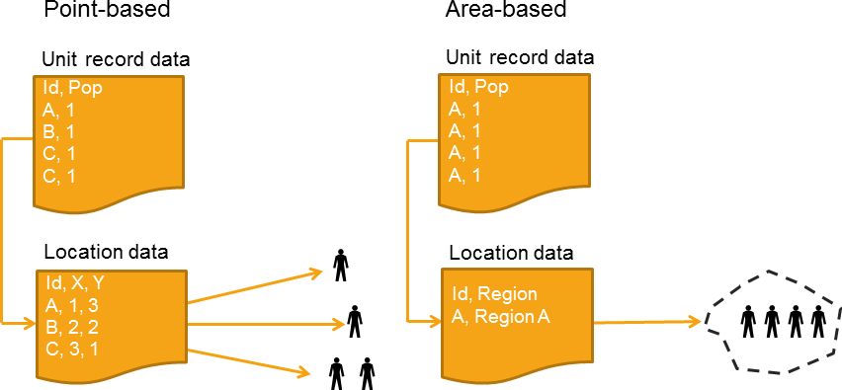
Advantages of point-based geocoding approach
  Census data geocoded by points allow to aggregate data at different spatial levels with high accuracy using GIS tools.
  Census data geocoded by locality or Enumeration Areas/District allow data disaggregation to smaller geographic units, but it is a complex and error-prone process.
  Can integrate census and parcel data through GIS overlay functions.
  Allow distance calculations between places.
  Can support computing SDG indicators and spatial data disaggregation.

Slide 12


The proposed SDG indicators for the analysis
9.1.1
11.2.1
Proportion of population that has convenient access to public transport, by sex, age and persons with disabilities
Proportion of the rural population who live within 2 km of an all-season road
Organisation: World Bank
Organisation: UN-Habitat
11.3.1
11.7.1
Ratio of land consumption rate to population growth rate
Average share of the built-up area of cities that is open space for public use for all, by sex, age and persons with disabilities
Organisation: UN-Habitat
Organisation: UN-Habitat

Slide 13
SDG indicator 9.1.1
Proportion of the rural population who live within 2 km of an all-season road
  Definition: The indicator (commonly known as the Rural Access Index or RAI) measures the share of a country’s rural population that lives within 2 km of an all-season road.
  Methodology: Overly of 3 geospatial datasets: population distribution, road location, and road passability. The RAI is calculated as the rural population within a 2 km buffer of a good road divided by the total rural population of the country.
  Data sources
  - Geospatial data: layers, road network, urban-rural
  - Geospatial technology: GIS for spatial data and overlay functions
  - Household surveys, census (place of residence).

Slide 14
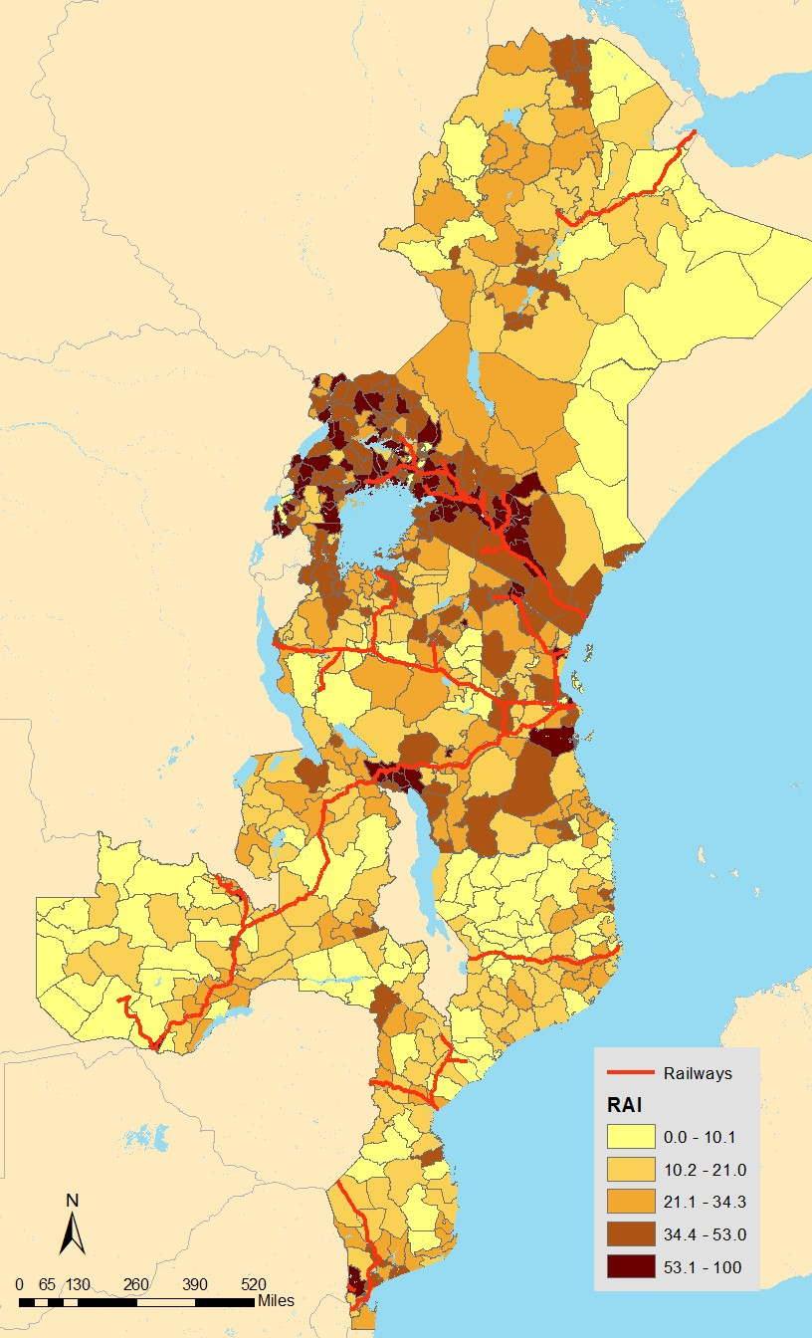
SDG indicator 9.1.1
Proportion of the rural population who live within 2 km of an all-season road
  Computation: The RAI is calculated as the rural population within a 2 km buffer of a good road divided by the total rural population of the country.
  1 – define the spatial distribution of the rural population (from available datasets such as WorldPop, or from point-based/area census data).
  2 – prepare a GIS layer for the road network with attributes on road conditions (from EO or country data).
  3 – generate a 2 km buffer around the road network meeting the conditions and divide the rural population of the buffer with the total rural population.
  Point-based geocoded census data increase data quality of the SDG indicator, at national and sub-national levels.

Slide 15

SDG indicator 11.2.1
Proportion of population that has convenient access to public transport, by sex, age and persons with disabilities
  Definition: proportion of the population that has convenient access to public transport. The access to public transport is considered convenient when an officially recognized stop is accessible within a distance of 0.5 km from a reference point such as a home, school, workplace, market, etc.
  Methodology: Identification of service areas by GIS buffering around each public transport stop (distance based on air, or road network). Once a service buffer is constructed, the next step is to identify the population served by the transport stop.
  Data sources
  - Geospatial data: GIS layers, road network
  - Geospatial technology: GIS for spatial data and overlay functions
  - Census data (place of residence, dwellings, household size).

Slide 16
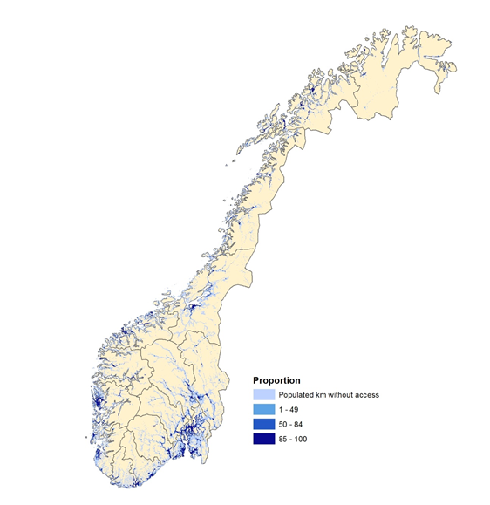
SDG indicator 11.2.1
Proportion of population that has convenient access to public transport, by sex, age and persons with disabilities
  Computation:
  1 – definition of the built-up area of the urban agglomeration with spatial analysis and calculation of the total square kilometers.
  2 – Inventory of the public transport stops and development of a point-based GIS layer.
  3 – generate a buffer area of 500m radius for each stop, and merge with the boundary of the urban agglomeration.
  4 - Overlay population data with access to public transport stop and calculate the corresponding population. Estimate the proportion of population out of the total population of the city.
  Point-based geocoded census data increase data quality of the SDG indicator, at national and local levels.

Slide 17
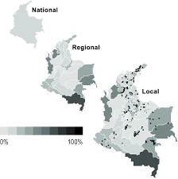
Disaggregation of SDG indicators
  The metadata repository of SDG indicators address the expected spatial disaggregation for each indicator at sub-national levels: locality, urban-rural, urban typologies, intra-urban, or urban expansion.
  Geospatial data and technology play a fundamental role for the geographic disaggregation.
  If census data is geocoded with a point-based method, the integration of geospatial and census data can support effectively the disaggregation of the SDGs indicators from the national to the local level.
  On the contrary, when administrative units or Enumeration/District Areas are the smallest geocoded areas, a grid system should be developed.

Slide 18
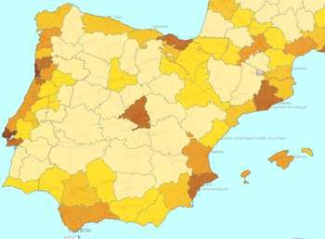
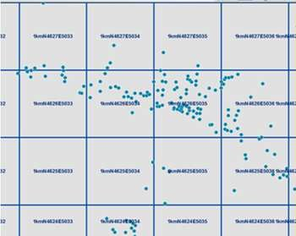
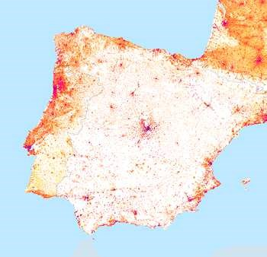
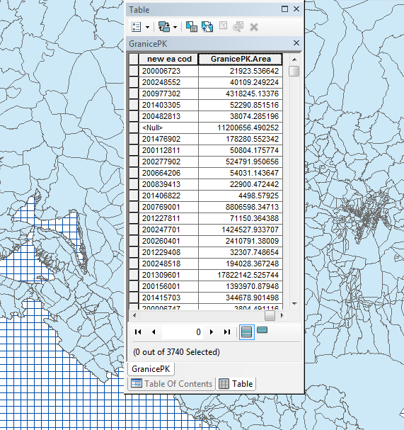
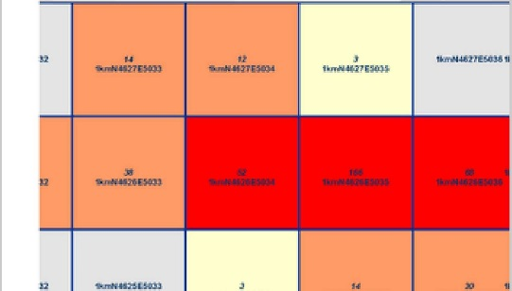
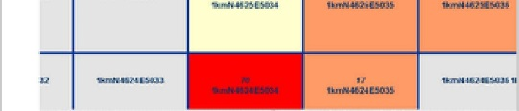
Grid systems for data disaggregation
Aggregation method: from points to grids
Statistical grid data are statistics geographically referenced to a system of grid cells with geographic coordinates and unique IDs.
Disaggregation method: from polygons to grids

Slide 19
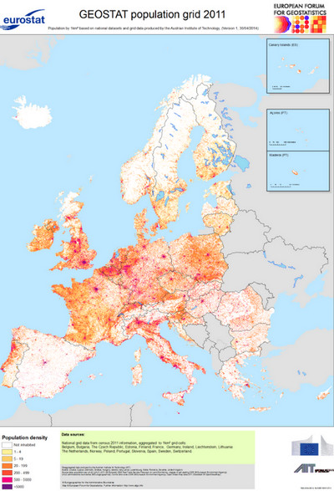
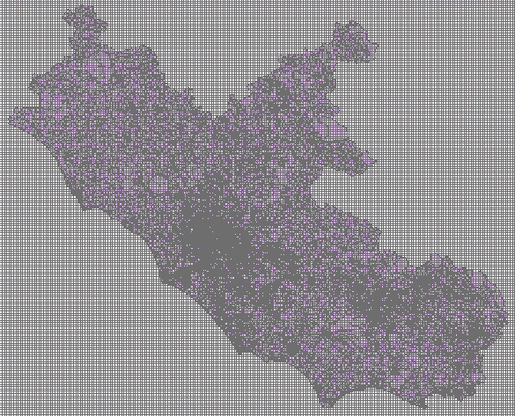
An approach for data disaggregation and urban-rural statistical classification
  The grid is hierarchical, with resolutions of 1 m, 10 m, 100 m, 1,000 m, 10,000 m and 100,000 m.
  Each individual grid cell is identified by a unique grid cell code.
  If point-based location is not available, the ‘disaggregation’ method can be applied instead of the ‘aggregation’ method.
  The grid is constructed in subsequent phases, using GIS tools.
  Grid data may need to be disclosed to ensure data confidentiality, and requires specific skills for the implementation.

Slide 20

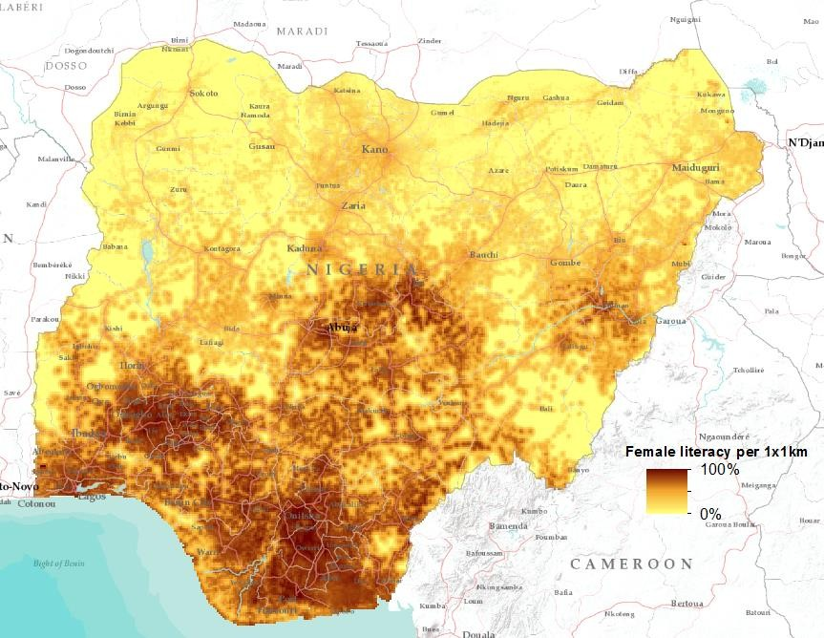

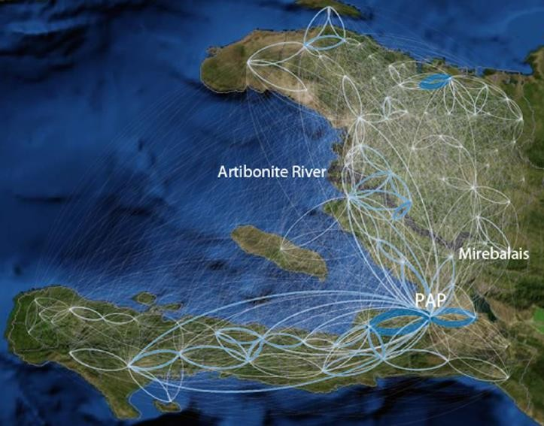



Visualisation of SDG indicators and census data
SDG Platforms for SDG reporting
Percentage of women who are literate per 1x1km grid cell
Mapping movements and connectivity

