Slide 1
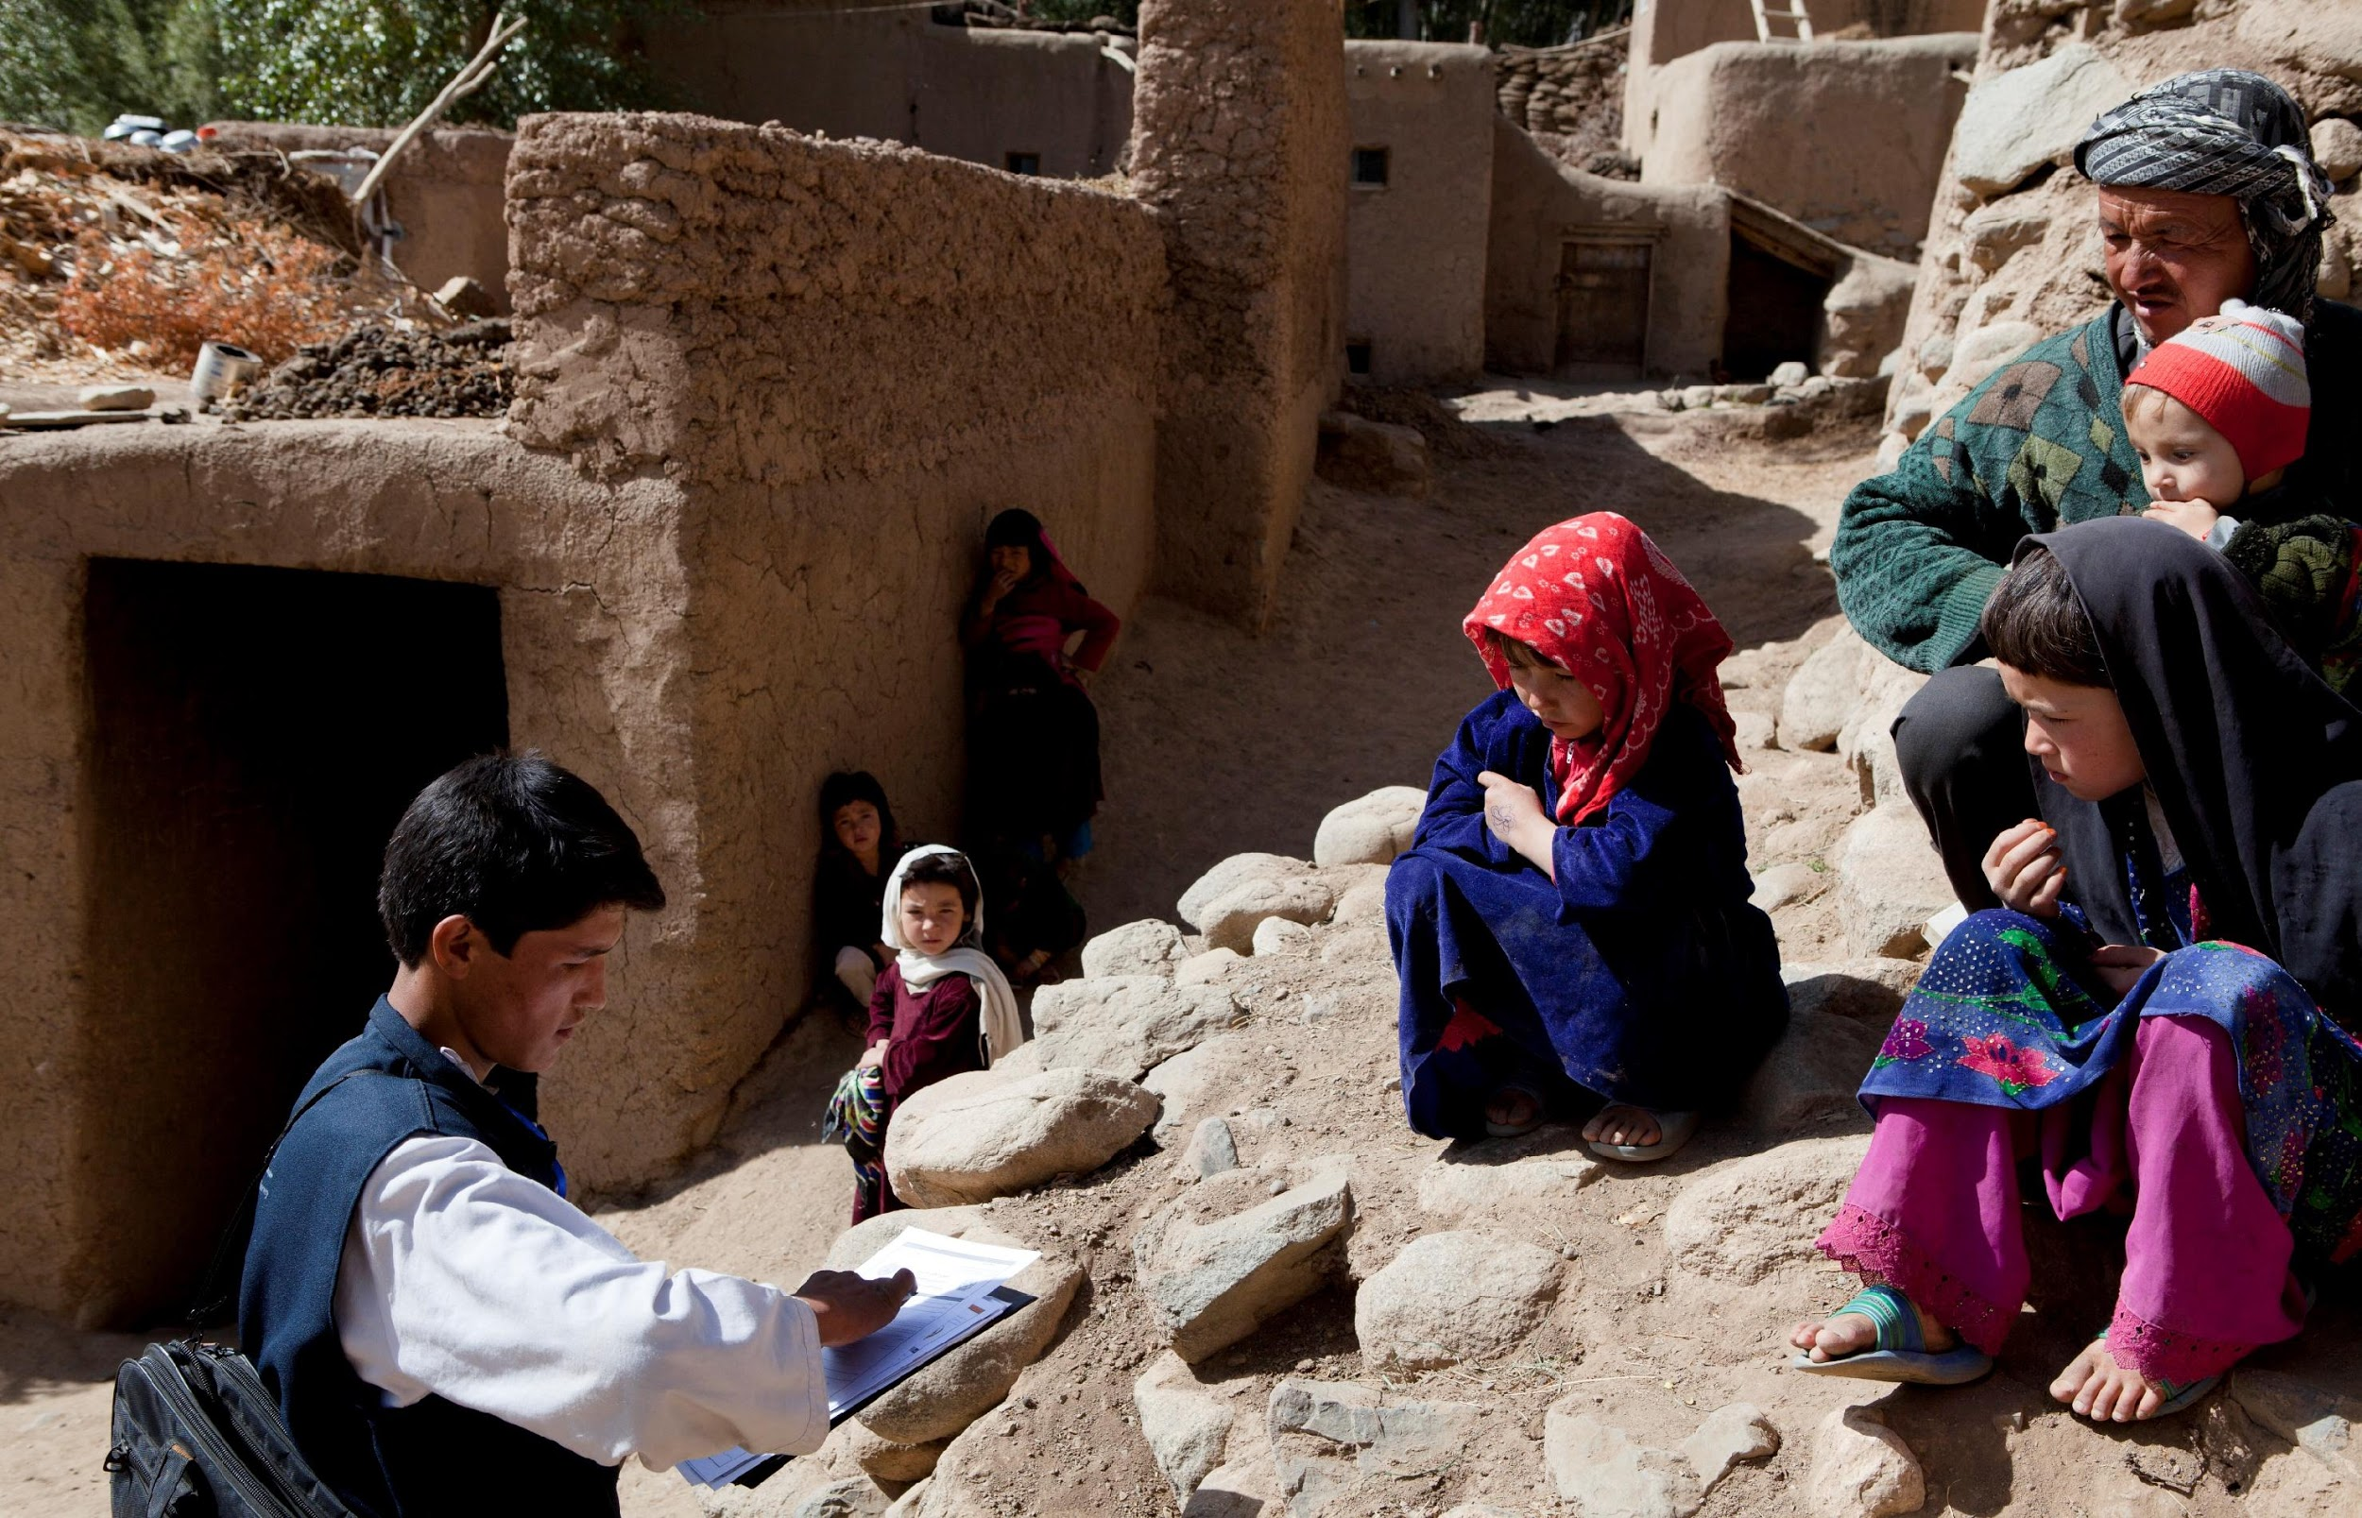
BECAUSE
EVERYONE
COUNTS
Regional Workshop on Measuring SDG Indicators from Population and Housing Censuses and
Civil Registration Data
in Arab Countries
17-19 November 2020
Renee Sorchik
Arab States Regional Office, UNFPA

Slide 2
BECAUSE
EVERYONE
COUNTS
UNFPA Strategy for the 2020 Census Round

Slide 3
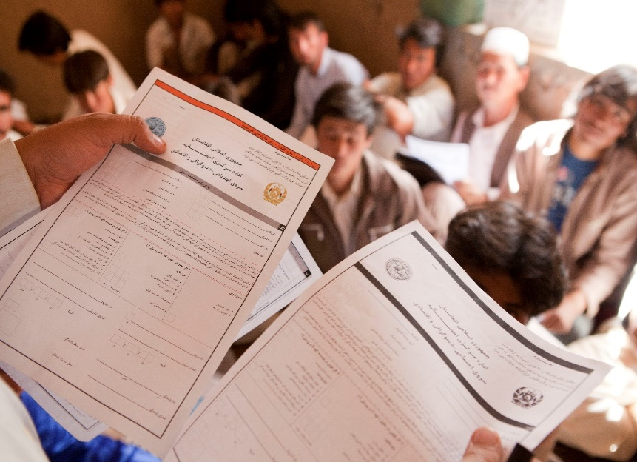
THE STRATEGY
Provide census technical guidance;
Advocate for high resolution geo-referenced census data
Advocate for adoption of innovative census technologies & methodologies;
Strengthen capacity for greater use and dissemination of census data;
Leverage institutional partnerships;
Mobilize resources for census.

Slide 4
GOAL
Strengthen capacity of national statistical systems
Produce & disseminate high quality, timely and disaggregated census data
Informs subnational, national, regional & global development agendas.
Deliver socio-demographic intelligence that

Slide 5
Planning, management and preparatory work
Field operations
Census products and dissemination
Data processing
TECHNICAL GUIDANCE AND SUPPORT
Census technical guidance tools (step-by-step guide, gantt chart)

Slide 6
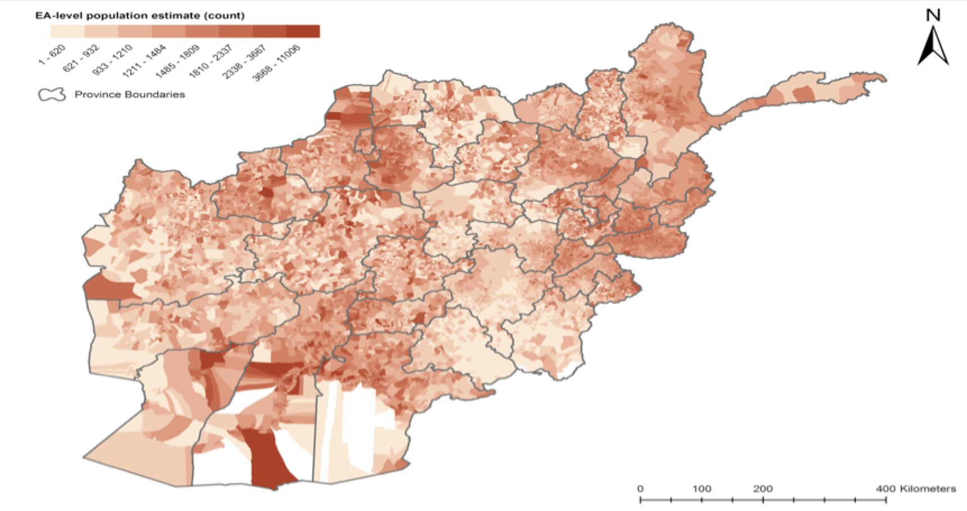
STRENGTHENING CAPACITY FOR UTILIZING CENSUS DATA
Use of census data for SDG monitoring and reporting
Mapping census data at lower geographic levels
Integrating census & survey data for small area estimation

Slide 7
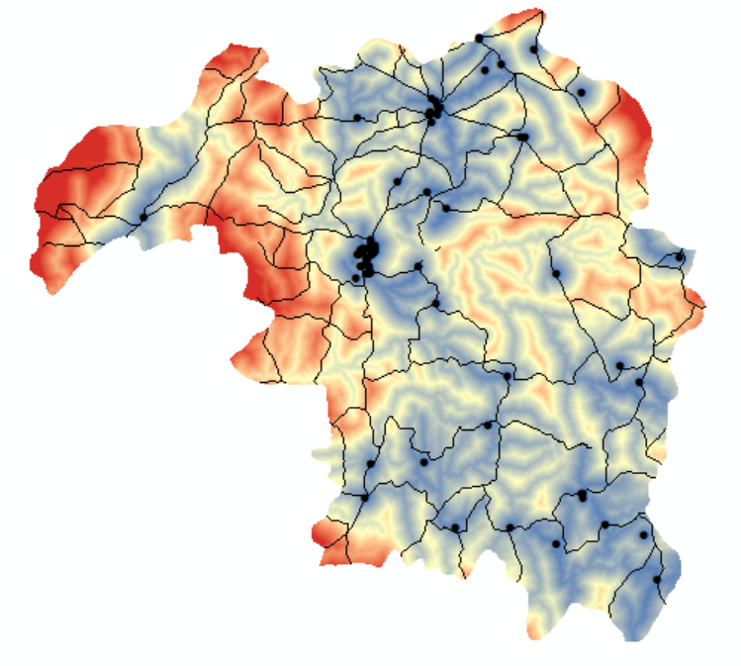
نسبة النساء من سن 15-49 مع الطلب بالارتياح لتنظيم الأسرة
Proportion of Women Aged 15-49
with Demand Satisfied for Family Planning
% Demand Satisfied for Family Planning
Distance (km) to Tertiary HFs

Slide 8
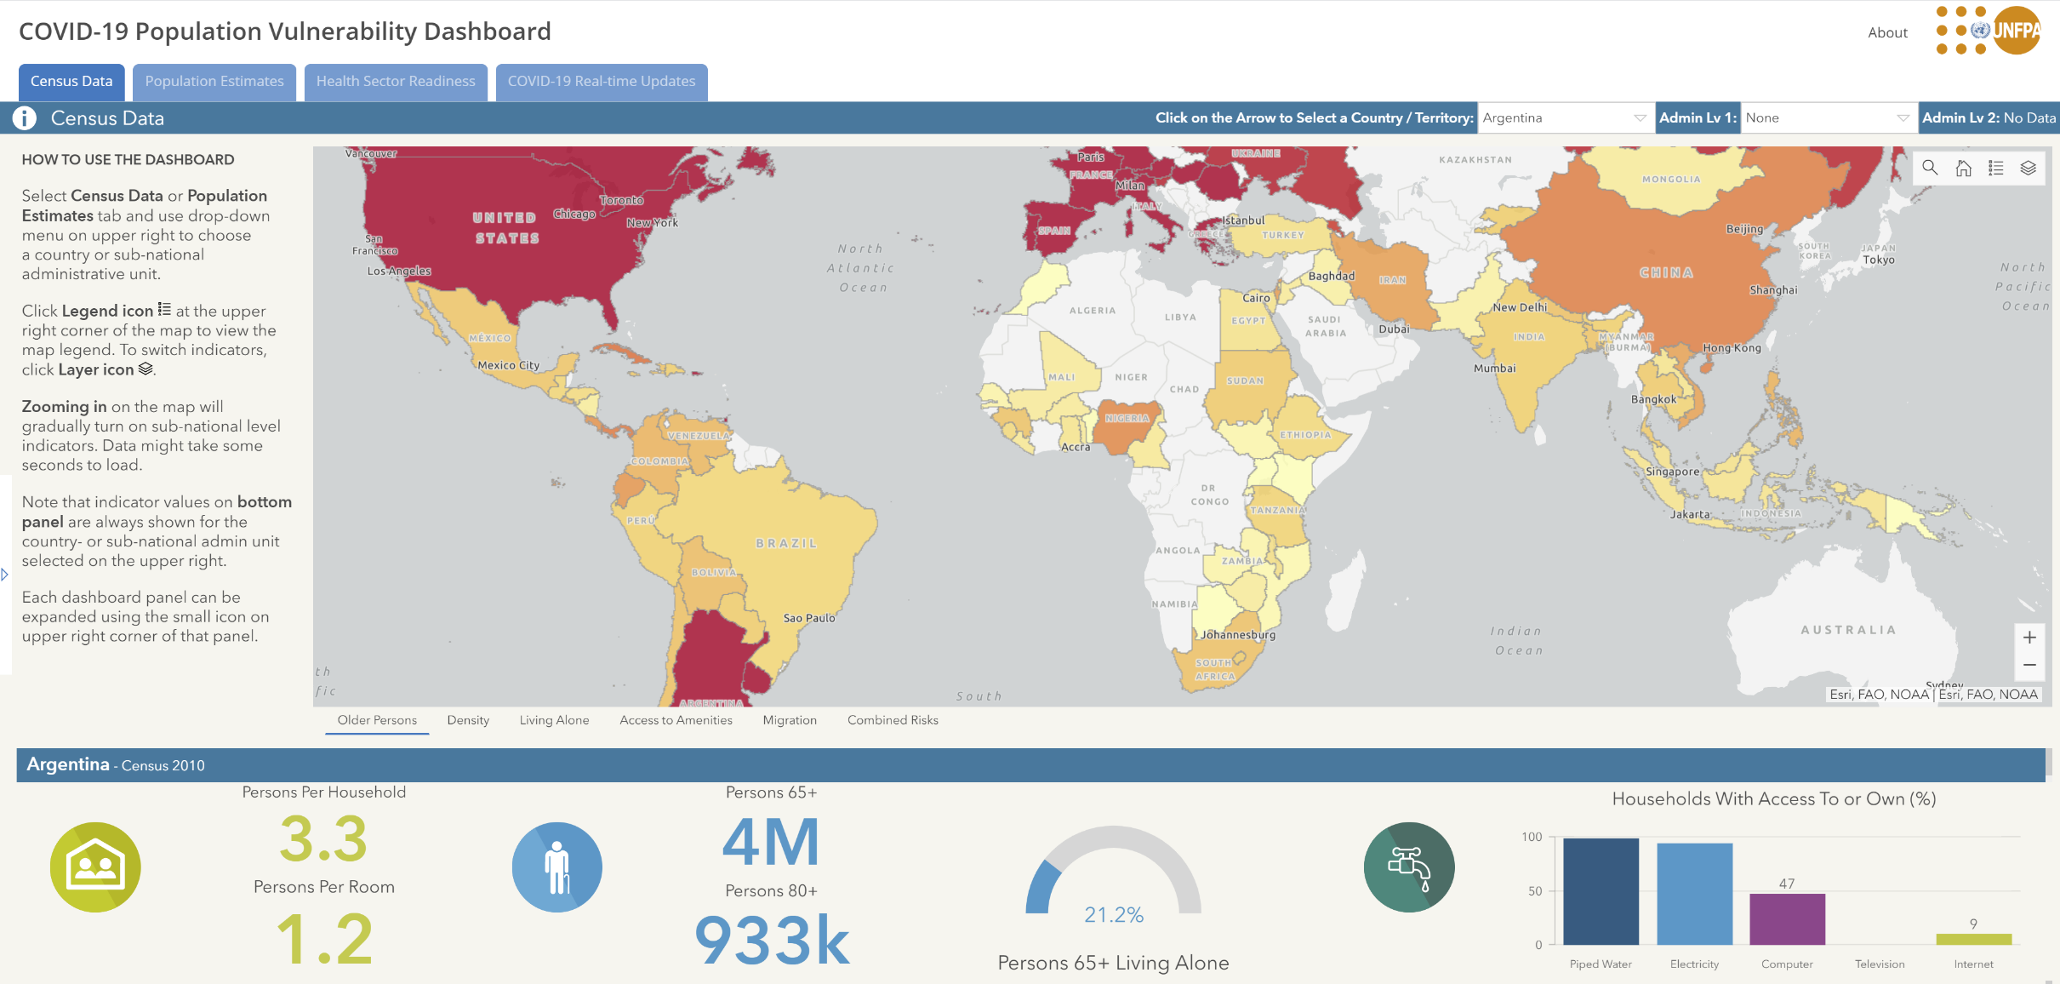
COVID-19 Population Vulnerability Dashboard https://covid19-map.unfpa.org/

Slide 9
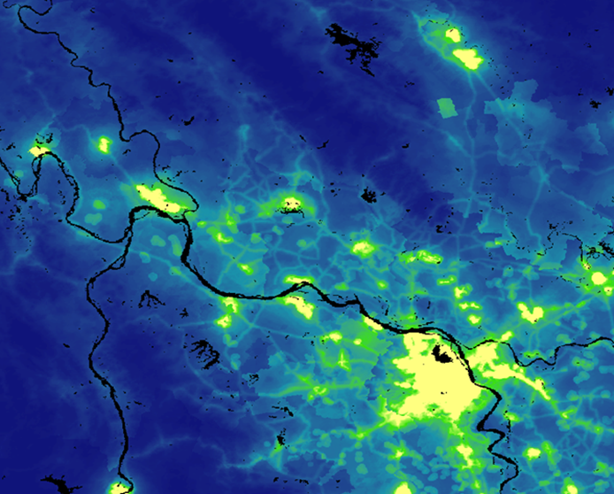
UNFPA CENSUS SUPPORT IN HUMANITARIAN SETTINGS
UNFPA seeks to ensure all countries wishing to complete a census in the 2020 round are able to do so
Modeled population estimates, or a ‘hybrid census,’ is one innovative way UNFPA is providing support to countries with humanitarian situations
‘Hybrid census’ is an innovative method to estimate population counts for a country where a full census is not feasible
Modelling requires some data from partial enumeration or surveys, GIS data and satellite imagery

Slide 10
REGIONAL CENSUS SUPPORT
Regional Virtual Workshop on geospatial information in Census
Guidance note ‘Strengthening Geospatial Information Support to the Census in the Arab Region’
Facilitating South-South cooperation – study tours and capacity building
Iraq study tour to Egypt
CTA in Sudan
Technical and operational support in Iraq
Geospatial support to Morocco

Slide 11
BECAUSE
EVERYONE
COUNTS
CRVS Programme
ConVERGE: Connecting Vital Events Registration and Gender Equality
Amor Laaribi, PhD
Amor Laaribi, PhD

Slide 12
ConVERGE Initiative
Focus on gender dimensions of CRVS Systems
Life-course approach to CRVS and legal Identity: Birth, marriage, divorce + death registration
Gender-sensitive CRVS Strengthening:
Systematic assessment of completeness and quality of civil registration data by sex, age, geography
Improved understanding of the proximate determinants of under-registration of different vital events and their social and economic consequences
Gender-inclusive vital statistics:
Build a culture of vital statistics production, dissemination and usage

Slide 13
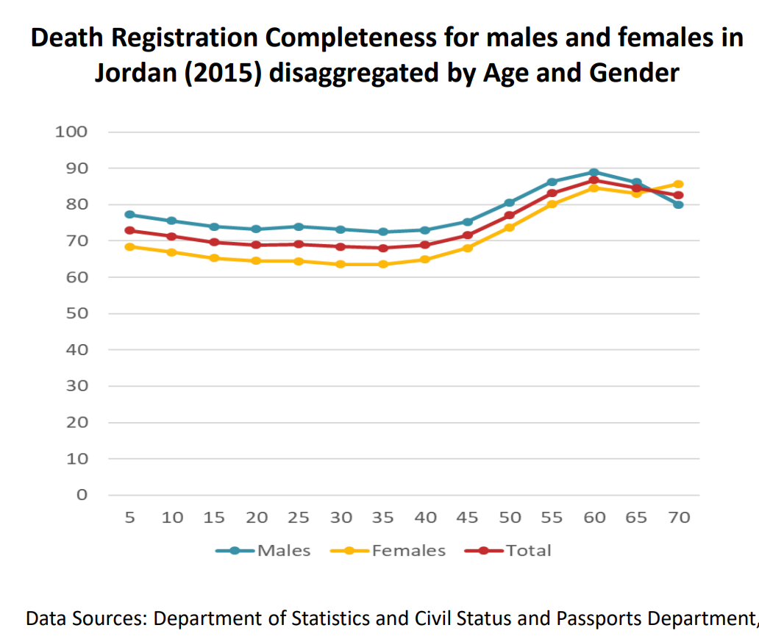
SUPPORTING VITAL STATISTICS PRODUCTION
Vital statistics production and reports in:
Jordan
Morocco
Tunisia
Guidance on assessment of completeness/quality of births, marriages, divorces and deaths – focus on subnational differentials

Slide 14
SUPPORTING SYSTEM STREGTHENING
Stakeholder mapping
Strengthen national CRVS system coordination
Amongst responsible line ministries
Between government entities and international and financial technical partners
Integrate social/behavioral factors (underlying CR under-registration) into CRVS strengthening efforts

Slide 15
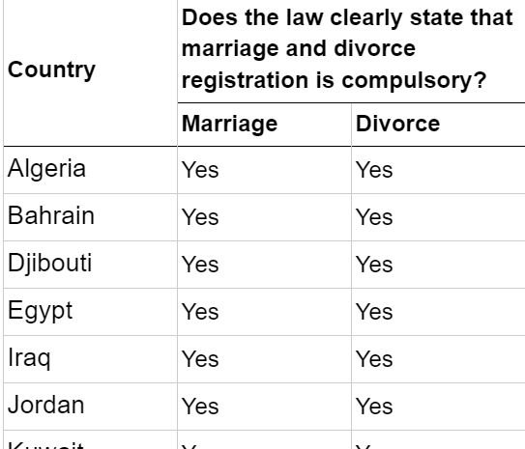
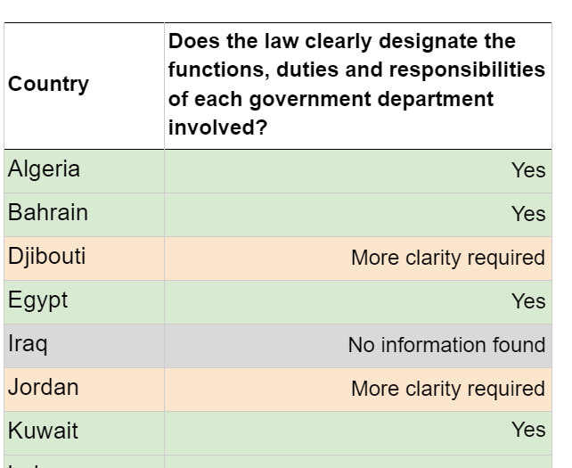
REGIONAL CRVS REPORT
Background - history of CRVS in the region, regional strategy etc.
Mapping of the situation - legal basis, assessments, political commitment, availability of vital statistics
Analysis of findings
Recommendations - summary by country groups based on general themes

Slide 16
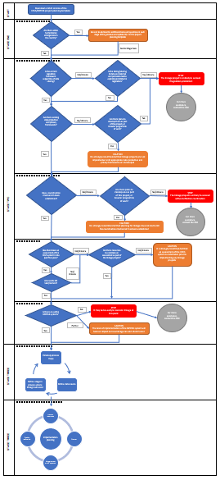
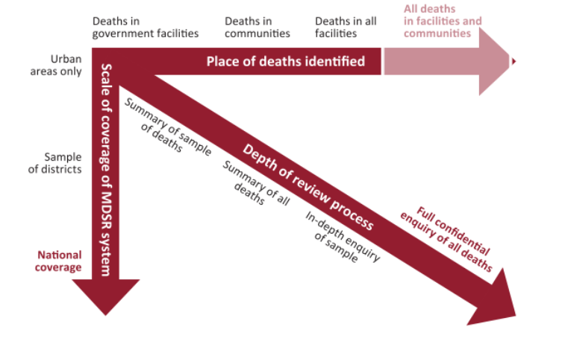
SERIES ON REINFORCING LINKAGES BETWEEN CRVS AND MPDSR SYSTEMS
Part I: A Guidance note for effectively linking CRVS and maternal perinatal death surveillance and response (MPDSR) systems, including in humanitarian settings
Part II: Challenges and recommendations for strengthening CRVS and MPDSR in humanitarian settings
Part III: Country profiles of MPDSR (and CRVS)

Slide 17
Challenges and recommendations for CRVS and MPDSR in humanitarian settings
Background
Key challenges
CRVS systems
Building and strengthening systems
Best practice examples
MPDSR systems
Recommendations and opportunities
Acute settings
Protracted settings
Camp-based humanitarian settings

Slide 18
IMPLEMENTATION
155 programming countries;
128 Country offices, 6 Regional offices & Interdivisional HQ team);
Commitment to those countries missing 2010 census round

Slide 19
BECAUSE
EVERYONE
COUNTS
Thank you

