Slide 1
AUC’s Role In Facilitating Access To Knowledge In The Arab World
Dr. Saleh Almusned
Arabic Union Catalog Director
United Nations Library and Information Network for Knowledge Sharing
(UN LINKS) & Lebanese Library Association (LLA): Open Dialogue
BEIRUT, LEBANON 7 OCTOBER 2019

Slide 2
Arabic Union Catalog (AUC)
The Arabic Union Catalog (AUC) is one of the advanced infrastructures of Arab libraries and information institutions.
It is a comprehensive bibliographic database and a digital repository representing Arab literature in all fields of knowledge.
The AUC is initiated and managed by King Abdulaziz Public Library (KAPL), a non-for-profit organization established by the late King Abdullah Bin Abdulaziz.

Slide 3
Mission
AUC, in cooperation with its members, seeks to serve as a platform for knowledge services that enable them to provide additional and innovative values to their community and maximize the cultural and knowledge impact they achieve, through a flexible collaborative environment of high efficiency and quality.

Slide 4
Vision
Arabic Union Catalog, to be the Arabic Knowledge Services Platform

Slide 5
Sustainable Development and the AUC
Establishing cooperative library community
Enhancing high quality bibliographic and authority control
Arabizing standards and tools for knowledge organization
Spreading best practices
Improving level of services

Slide 6
What is the Arabic Union Catalog (AUC)?
AUC
Bib. Database
Authority Files
Digit. Content
Training & Services

Slide 7
AUC Objectives
The AUC seeks to accomplish several objectives within all Arab libraries, the most important of which are:
Gathering Arabic intellectual heritage in a standard database.
Creating an Arab Union Digital Library to host digital contents of Arabic literature of all languages or act as a gateway to the contents stored in digital repositories in the Arab world.
Unifying Arab efforts seeking to standardize the works of cataloging, classification, and digitization.
Realizing resource partnerships in light of the scarcity of specialists.
Reducing costs resulting from the repetition of the cataloguing processes for the same resource in all libraries.
Contributing to the dissemination of Arabic literature once it is documented in the consolidated database.

Slide 8
Main Initiatives
AUC
Arab National Union Catalogs
Multilingual Support (for main International Languages)
Arab Authors Platform
Enrichment of the Arabic Digital Contents

Slide 9
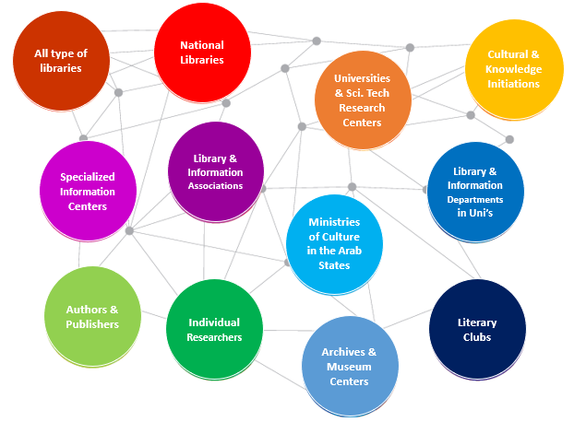
Sectors that AUC Serves

Slide 10
Main Services (Part of the Membership)
Original Cataloging
Copy Cataloging
Training
Technical Support

Slide 11
Advanced Services (Adds-on)
Remote Cataloging Services
AACR2 to RDA Conversion
Re-Classification
Authority Files Update and Enrichment
Retrospective Conversion & QA
Cloud ILS
Could Digital Library
Cloud Collection Development
Specialized Bibliographies
Collection Analysis & Evaluation
Advance Training & Certification Programs
Custom Training (as per needs)
Specialized Diploma Programs
Collection Support & Enhancement
Advanced Technical Services
Specialized Training
Could Services

Slide 12
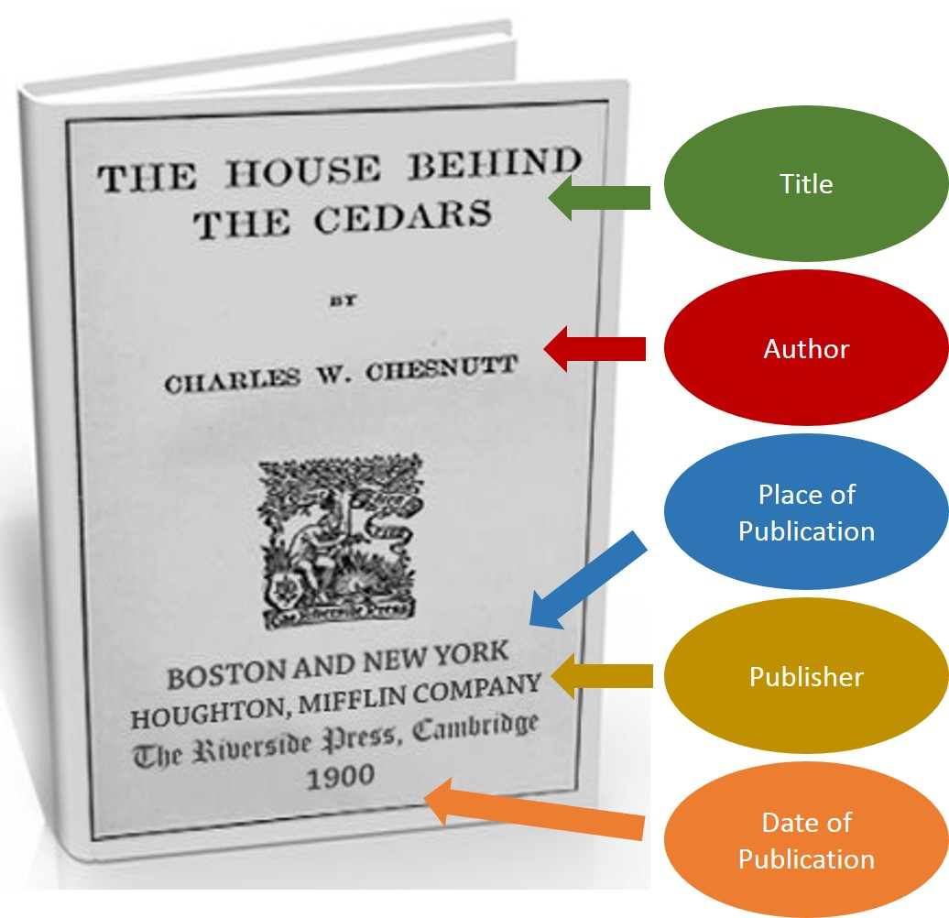
Bibliographic Database
2,350,000 unique bibliographic records
1,700,000 book records
83,000 Manuscript records
170,000 Translated books
125,000 Theses
272,000 Other Materials

Slide 13
Bibliographic Records Growth

Slide 14
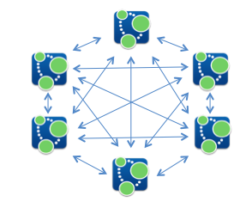
Authority Files
1.35 million Authority records distribute as:
568,000 Personal names
413,000 Subject heading
68,000 Geographic names
200,000 corporate names
25,000 uniform title
52,000 Conference names

Slide 15
Names Authority Records Growth

Slide 16
Subject Heading Authority Records Growth

Slide 17
AUC Members
More than 200 institutions representing 5000 library from 19 countries:
50 Academic libraries
70 Public libraries
30 Special libraries
50 other types

Slide 18
Benefits for Library Members
2.35 million bibliographic records available for downloads (RDA & AARC2)
24 training courses conducted every year.
31 webinars conducted every year.
Many Tools and Guides available for Arab specialists.
More than 100 libraries built their catalogs exclusively from the AUC database.

Slide 19
Benefits To Users
Powerful search engine
Promotion of innovation and creativity
Gateway to all Arabic digital libraries & repositories

Slide 20
AUC Portal Usage
More than two million visitors yearly
More than 4 million-page views yearly
Average session length 10 min
100,000 AUC documents download

Slide 21
Arabic Union Digital Library (AUDL)
AUDL is an AUC initiative that hosts digital contents of interests to Arab users.
Also, its a gateway to access to all Arabic Digital Libraries and Arabic Digital Repositories in the Arab World.

Slide 22
Arabic Union Digital Library (AUDL)
Allows online access to all Arabic digital content from a single access point
Supports and stimulates the digitization of Arabic content
Creates an exhaustive database of Arabic digital content on the web
Unifies the efforts of digitizing the Arabic content
Offers more visibility of the Arabic content through the web

Slide 23
Digital Contents
Actual digital content hosted in the digital library database
Links to digital content found on other digital libraries and digital repositories

Slide 24
AUDL services
More than 200,000 digital content (content on server and links)
Simple and advanced search on the digital content
Browsing the digital collection by type or by subject

Slide 25
Arab Author Platform
It is a free online service provided to Arab Authors & Innovators to promote their innovations and present their intellectual and art-works to a wide range of interested followers.

Slide 26
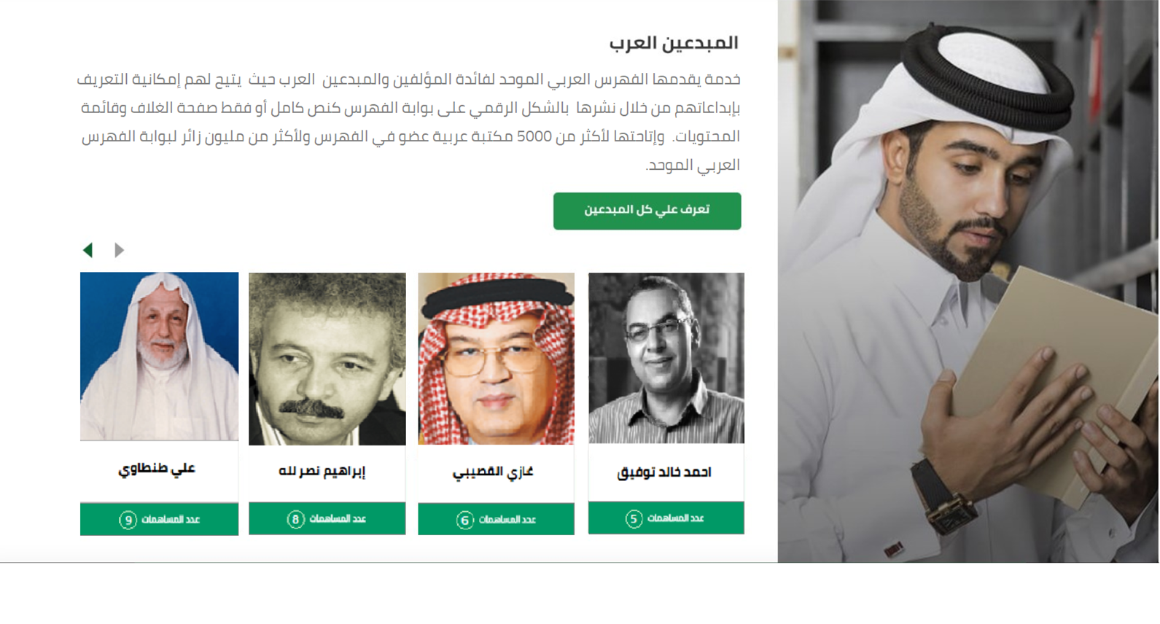
Arab Author Platform
Gives an opportunity to new starting authors and artists to promote their intellectual works.
Encourages young people to publish their creative works.
Encourages people who have personal collections to share what they have with others.

Slide 27
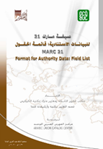
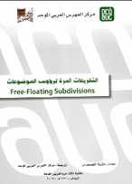
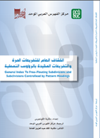
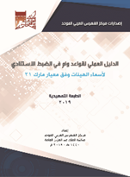
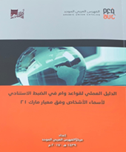
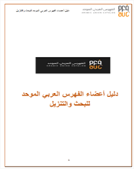
Publications

Slide 28
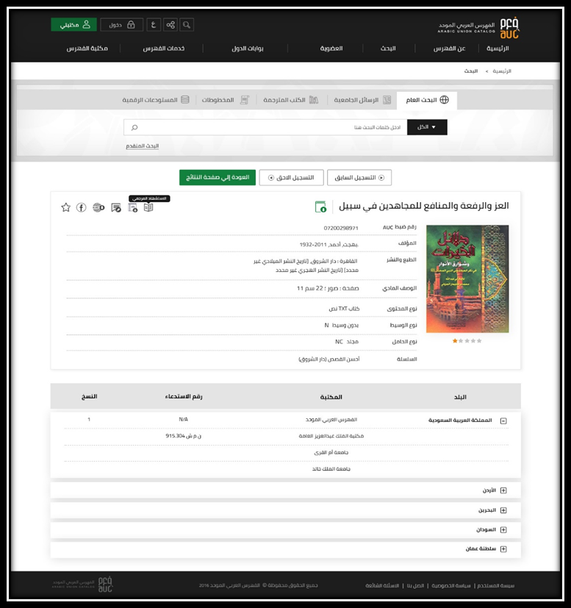
AUC Portal
www.aruc.org

Slide 29
Thank you

