Slide 1
Arabic Searching
and
Web Visibility
Wajdi Tahmoush
Technology Solutions Manager
www.naseej.com

Slide 2
Naseej Solution
A unique processor for Handing Arabic indexing and Searching.
A New Approach for Delivering Web Visibility of Libraries Content.
A Single Unified Search while Keeping Library Data in Place.
Searching Library OPAC and Electronic Resources (Summon and EDS) without losing Arabic Language Handling

Slide 3
Recall & Precision
Recall illustrates the confidence that a search returns all the information you are interested in.
Precision, is the confidence that the results of your search are relevant.
Web users are used to low recall and precision
Achieving high precision and recall when searching unstructured, semi-structured or even perfectly structured data is a very difficult task.
Librarians and library OPAC users are used to, and require very high recall and precision.
Great care and consistent rules (such as AACR2) applied in creating structured catalogue records.
Different Indexes Techniques are used to achieve high recall.
Recall is a real problem for Arabic Language! (Requires Special Arabic Indexer)

Slide 4
Arabic Indexing & Searching
Delivering High Recall and Precision in Searching Arabic is a complicated task
Many Systems implements partial normalization and Truncation Algorithms to enhance Arabic Support.
This will increase the Recall, but will drastically decrease the precision.
Examples: والد، والدولة ؛ يد، بيداء؛ عدن، عدنان
Such systems implements simple default Normalizations for Arabic like Alef; but not the Advanced Normalization like ؤ ئ.
These systems uses the default Lucene light Stemmer Algorithm (Khoja‘s stemmer 11) without consideration for exception words.

Slide 5
Naseej Smart Arabic Processor
Arabic Support is not just Unicode Storage and Retrieval (Blue only implemented by Naseej Smart Processor)
Normalizing and equating different shapes of Arabic characters (أ إ ا، ى ي، ـة ـه، ؤ ئ) and any other normalization required.
Remove all Diacritics
Detects and stem prefixes (ال، بـ، فـ، ك، و، ل)
Detects and stem suffixes (ان، ين، ون، ات، ي، ـة )
Smart processor capable of realizing the order of prefixes. (وال، بال، لل، كال،وبـ، ولل BUT NOT بو،كف، بلـ، لبـ)
Complete and customizable dictionary for prefixes and suffixes handling.

Slide 6
Web Visibility
Naseej Recognized the high requirement for Web Visibility of Arabic Data.
Zepheira introduced the Library.Link Network as an open, decentralized, shared data platform to enhance web visibility
Hard for Library to maintain, and requires continuous Data Synchronization.
Naseej introduced a New Approach (S&D Singe Search):
Reindex Library Data Fully compatible with SEO.
Connects and Search Electronic Resources (SUMMON and EDS).

Slide 7
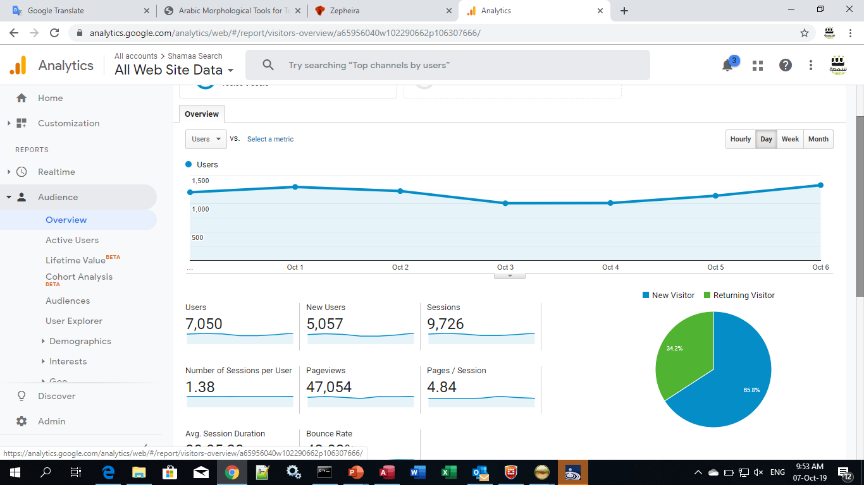
Web Visibility

Slide 8
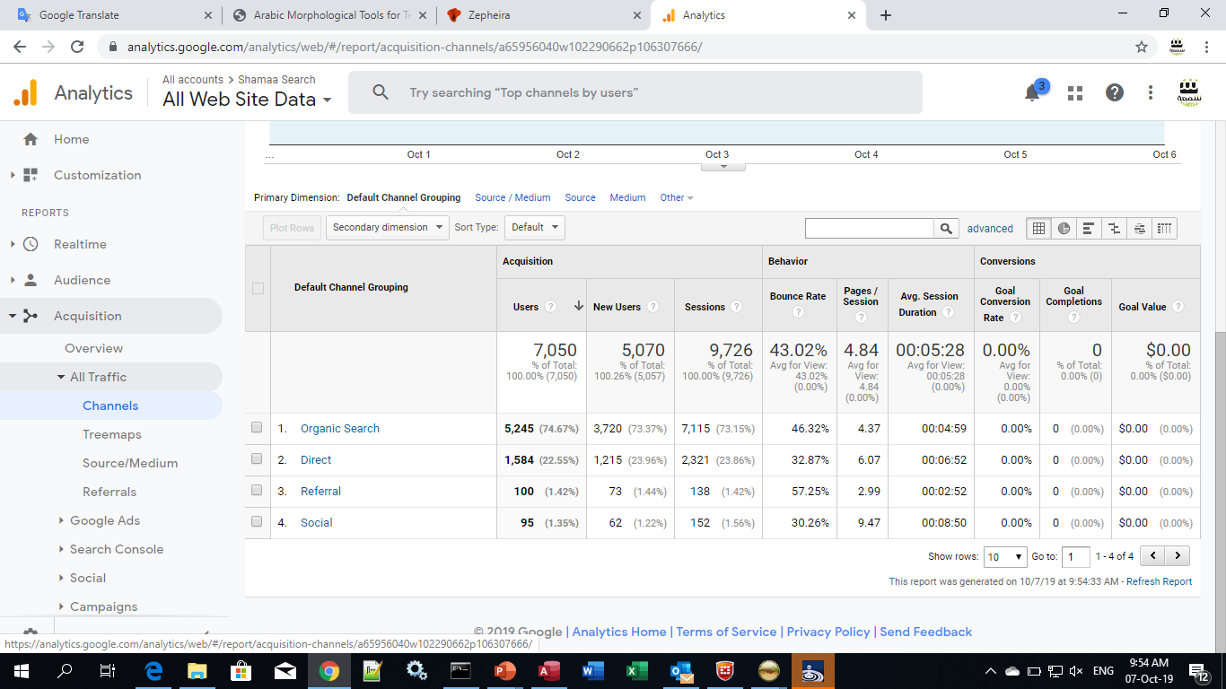
Web Visibility

Slide 9
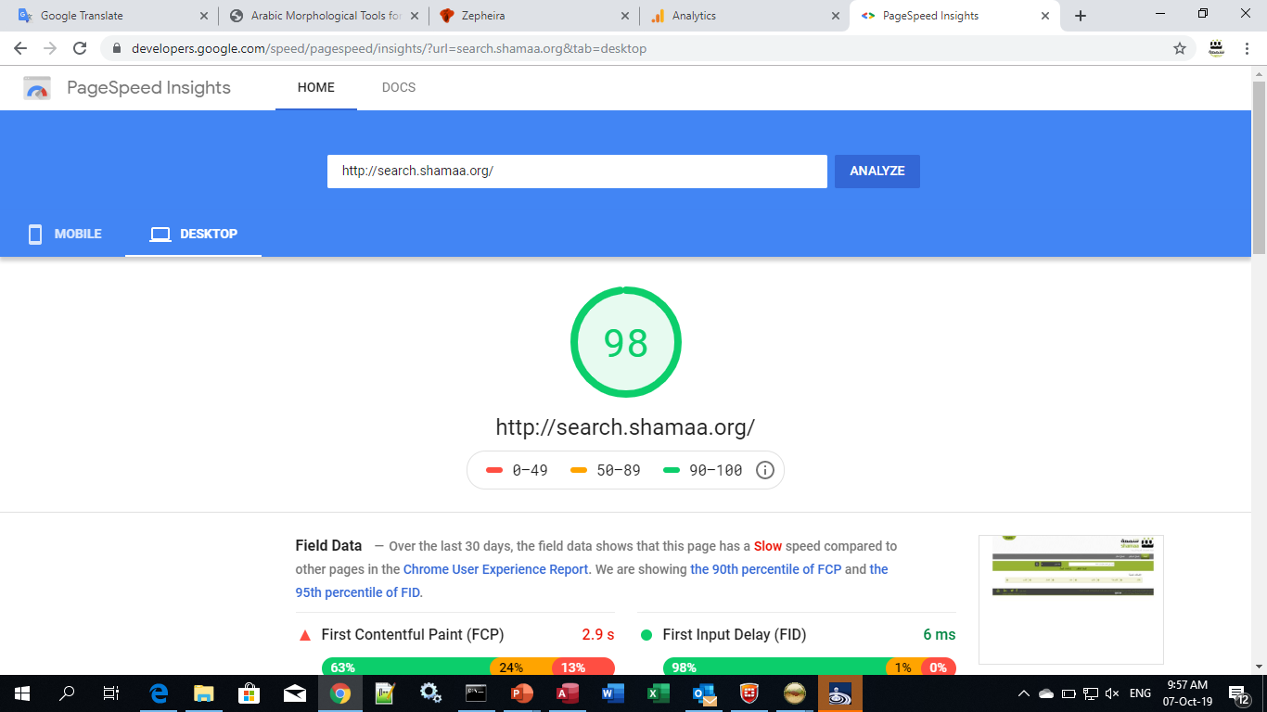
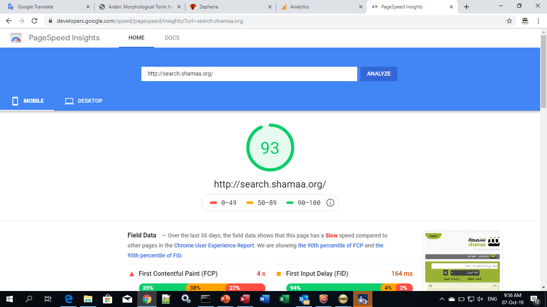
SEO Compatibility

Slide 10
Thank You

