Slide 1
GENDER-BASED VIOLENCE
IN HUMANITARIAN EMERGENCIES

Slide 2
GENDER-BASED VIOLENCE…
Harmful act – against a person’s will
Based on socially-ascribed differences between females and males = gender
Directed against any person – female or male
Majority females: 1 in 3 worldwide
Different forms: sexual, physical, emotional, economic
IPV most common
Exists everywhere – cuts across all barriers

Slide 3
WHAT’S DIFFERENT FOR WOMEN IN EMERGENCIES?
More dangerous - existing vulnerabilities and inequalities exacerbated
Women deliberately targeted
GBV increases - communities disrupted, populations moving, no systems of protection, lack of support services
Emergency services must be flexible, contextual, adaptive – not same as non-emergency services
GBV interventions are NOT an add-on – they are essential from onset of all emergencies
Notes:
Why focus on GBV in emergencies?
In an emergency – many forms of GBV
Early stages = communities disrupted, populations moving, no systems of protection
Most frequently reported = sexual violence (female survivor + male perpetrator)
ESSENTIAL INFORMATION ON GBV IN EMERGENCIES:
Emergency and non-emergency services are NOT the same
Emergency services need to be flexible, contextual, adaptive
GBV intervention is NOT an add-on – it is ESSENTIAL from the beginning of any emergency.
GBV increases in emergencies because of the absence of law and order, lack of support services, increased vulnerabilities, breakdown of community networks, etc.

Slide 4
FORMS OF GBV IN EMERGENCIES (GBViE)
Sexual violence – most immediate and dangerous
  Conflict-related sexual violence (CRSV)
Sexual exploitation and abuse (SEA)
Trafficking and forced prostitution
Forced marriage
Harmful traditional practices
Intimate partner violence

Slide 5
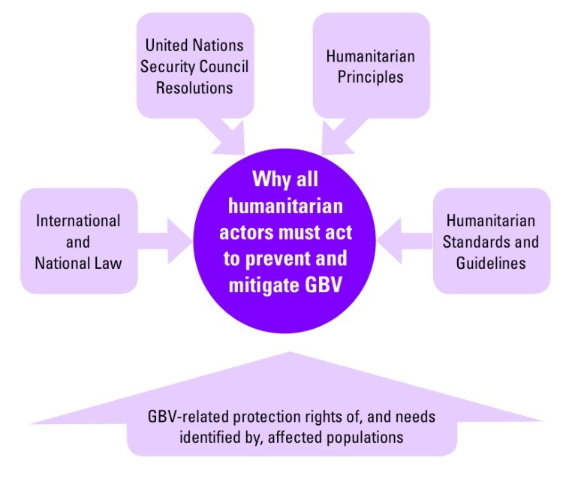
DUTY TO RESPOND…

Slide 6
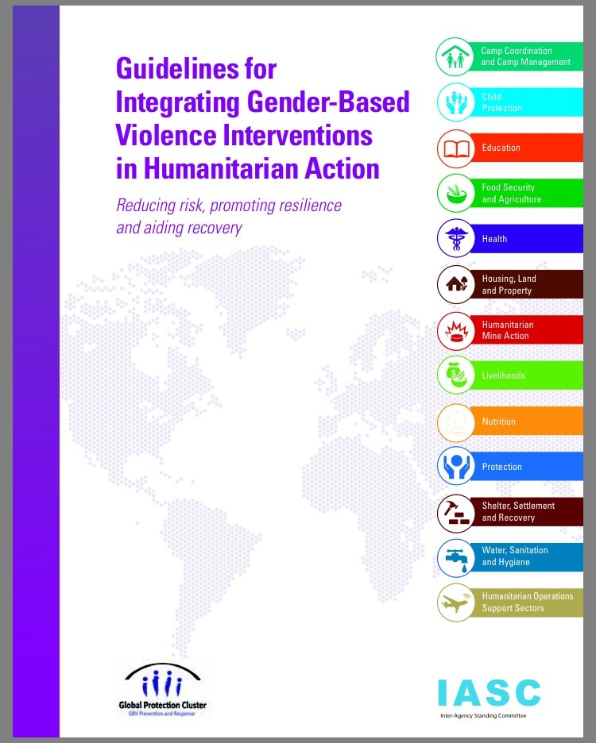
IASC GBV GUIDELINES
Reduce risk = GBV prevention and mitigation in all aspects of humanitarian response
Promote resilience = strengthen systems to prevent and mitigate – and ensure access to support
Aid recovery = support capacities to create lasting solutions

Slide 7
ASSUME GBV IS TAKING PLACE…
GBV is happening everywhere
GBV is underreported everywhere
All humanitarian personnel have the responsibility to:
Assume GBV is taking place
Treat it as a serious and life-threatening protection issue
Take actions described in the Guidelines to minimize GBV risk through their sectoral interventions
Regardless of the presence or absence of concrete “evidence”

Slide 8
WHO ARE THE GUIDELINES FOR?
Main audience: programmers who are not GBV specialists
Government
Humanitarian Coordinators
Humanitarian Country Teams/Inter-Cluster Working Groups
Cluster/Sector Lead Agencies
Cluster/Sector Coordinators
GBV Coordination Mechanisms

Slide 9
ELEMENTS OF ACTION
Assessment, Analysis and Strategic Planning
Resource Mobilization
Implementation
Coordination with Other Humanitarian Sectors
Monitoring and Evaluation
Guidelines focus on prevention and mitigation MORE THAN response – why?

Slide 10
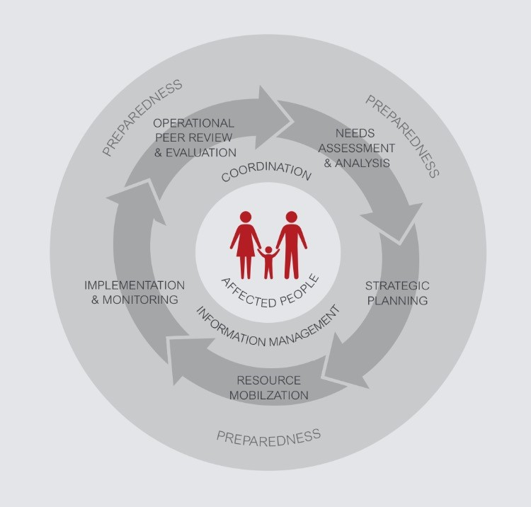
HUMANITARIAN PROGRAM CYCLE
GBV actions integrated throughout HPC
Preparedness + 5 Elements
2 Enablers:
  Coordination
  Information Management

Slide 11
PREPAREDNESS
Identifying potential risks and vulnerable groups
Establishing risk mitigation measures – minimizing consequences
Enhancing capacity for systematic response
Contingency planning
Protocols and policies
Prevention services and supplies
Preparedness is continuous – if not responding, we should be preparing!
Notes:
What do we need to know about GBV prevention and response in preparedness?
Engaging in preparedness actions ensure that GBV actors identify potential risks and vulnerable groups - and establish risk mitigation measures before an emergency takes place.
Preparedness refers to actions that put measures in place to enhance national and local capacity for systematic response to emergencies by mitigating risks and consequences of emergencies – conflict and disaster
The link between humanitarian and development programming should be viewed along a continuum – preparedness helps ensure this
Should be continuous – if not responding, we should be preparing!
Preparedness involves the following:
Contingency Planning: helps actors be ready for what may arise – and be prepared to act
Risk Analysis/Vulnerability Assessment: to identify vulnerable groups, ensure sex and age-disaggregated data (SADD) in assessments
Capacity Assessment/Capacity Building: of GBV actors in preparedness activities, and preparedness actors in GBV activities
Institutionalize capacity building to ensure critical mass of GBV capacity – particularly in the health sector
Preparedness trainings should include how to address GBV in the different stages of the process
Preparedness actors have GBV capacity needs at regional and national levels - including adaptation of training materials and training of the response teams
Public Awareness: and sensitization of non-GBV actors
Policy Framework: to integrate GBV in humanitarian and preparedness policies, and preparedness in GBV policies
Comprehensively address GBV in legislation, policies, and plans on preparedness and management
Ensure budget allocations for their implementation
Protocols: to integrate GBV prevention and response actions
Specific emphasis on security measures for the protection of affected populations, especially females, and support services to help mitigate the risk of sexual violence and other forms of GBV
Guiding documents should indicate clear lines of responsibility for providing the services to respond to GBV, and train the staff that will be in charge of these activities to comply with the protocol
Ensure that established protocols include actions on how to address and mitigate the risk of GBV
Prevention Supplies: in the form of suitable options such as solar radios, whistles, solar lamps, flashlights, lockable storage units, secure money pouches, etc. and provide guidance on distribution
Prevention Services: for instance a hotline
Information Management: to develop assessment tools, monitoring templates and data collection tools which respond to indicators
Also to guide beneficiary targeting, disseminate guidelines, map actors and services, and disseminate materials
Research: and secondary data analysis
Resource Mobilization
Services: needed to respond to GBV during the emergency and recovery
Which organizations will be responsible for providing them?
Participation: of various sectors, stakeholders, and community members in the development of preparedness plans on GBV prevention and response
Coordination: particularly to establish referral systems
Including coordination among preparedness and GBV actors

Slide 12
DISASTER RISK REDUCTION
Prevention + preparedness + response + recovery
Linked to GBV prevention and response
Capacities to prevent and respond to GBV are fundamental to reducing risk
Engage women in efforts to reduce disaster risk – also as decision-makers
Notes:
What is Disaster Risk Reduction (DRR)?
DRR = prevention + preparedness + response + recovery
Systematic approach to identifying, assessing and reducing disaster risk
Understand community and individual vulnerabilities (including that of socially excluded groups such as indigenous communities) and capacities
Minimizes vulnerabilities and risks to mitigate and prepare for the adverse impacts of natural hazards
DRR initiatives:
Identify and address different risks faced by different members of the community
Foster safer and more resilient conditions – particularly for females
Develop capacity to strengthen preparedness, response, and recovery
What is the link between DRR and GBV?
Reducing disaster risk is directly relevant to GBV prevention and response
Capacities to prevent and respond to GBV are fundamental to reducing risk
Focus on specific risks faced by females in the context by referring to GBV prevalence studies (especially risk and protective factors) and reviewing previous humanitarian response reports and assessments to glean lessons learned
Engage females in efforts and initiatives to reduce disaster risk
Ensure females are not only participants, but also decision-makers
GBV as part of an Early Warning System:
GBV as part of early warning for emergency = Changing nature of GBV (escalation of violence or certain types of targeting certain groups) may by one indicator (among others) in an early warning system to predict a humanitarian crisis
An early warning system for GBV = Early warning indicators that tell us that GBV is likely to increase
There are GBV entry points in every aspect of DRR to save lives and increase community resilience:
Work with females (for example: GBV watch groups, adolescent girls groups) in communities – or form and build capacity of such groups on DRR
Engage males taking into account the cultural specificities will help raising awareness around preventing GBV and protecting females
Engage communities in every aspect of DRR
Enhance capacity of GBV service providers
Use and build on existing frameworks, policies, programs identify gaps and formulate relevant policies/plans
Get information out – use Early Warning Systems such as text messaging or radio advertising
Engage national actors and strengthen capacity - including of communities who are the first responders
Identify channels for community intervention - through religious leaders, teachers, community leaders, health workers and others

Slide 13
PEACEBUILDING AND TRANSITION
GBV does not end when the emergency ends – new forms may emerge, work must continue
Prioritize recovery – to restore/improve services, livelihoods, living conditions
Promote prevention and protection
Ensure sustainability of GBV interventions - ensure funding for this
Notes:
GBV actors MUST sustain GBV prevention and response interventions beyond the emergency and into recovery and development, in line with the development strategies in the country.
GBV does not end when the emergency ends – new forms may emerge, and work must continue
Prioritize recovery = to restore/improve facilities, livelihoods, and living conditions
Rehabilitate health and social services to respond to GBV survivors
Ensure cash for work/food for work programs are accessible – mitigate GBV risks
Promote economic empowerment – in all aspects of transition
Transition GBV in emergencies interventions into existing GBV and gender development programming to promote sustainability of interventions
Ensure equity and access in order to avoid inadvertently exacerbating community tensions
How should we address GBV in the transition?
Promote prevention and protection through livelihoods options in the transition
Ensure access to essential services - starting with health and MHPSS
Build capacity of national partners to assume coordination leadership
Participate in transition/recovery groups and discussions or Early Recovery Cluster to ensure that actions protect females and prevent incidents of GBV
Ensure sustainability of GBV interventions developed during emergencies and transition into development, and establish strong platform for transition from humanitarian to development programming

Slide 14
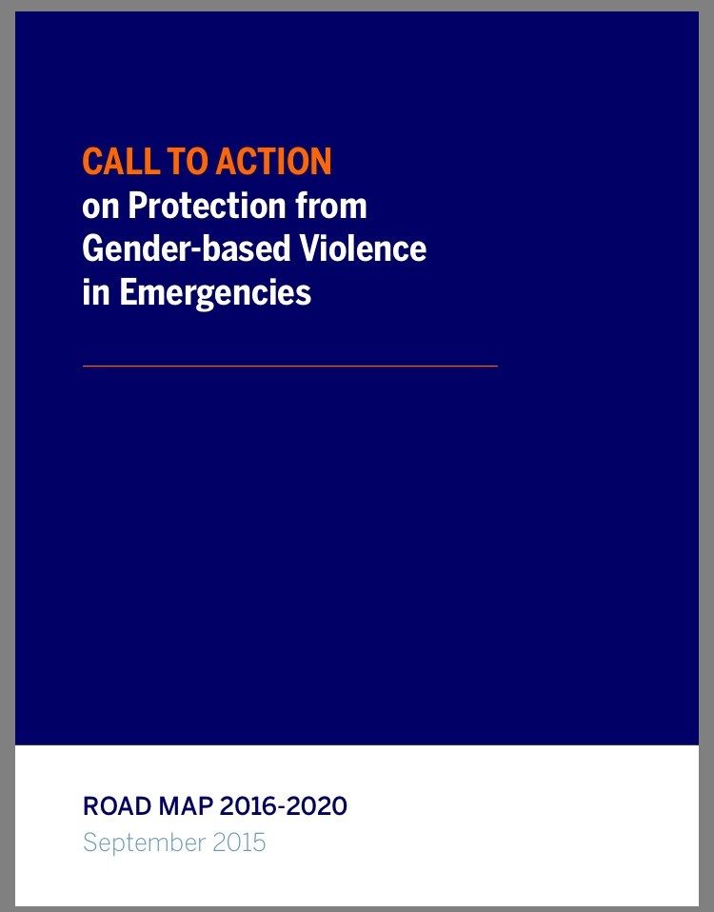
GLOBAL COMMITMENTS
2012:
Preventing Sexual Violence Initiative (UK + UN)
2013:
Safe from the Start (USA)
Call to Action (UK)
2015:
Call to Action Road Map (global – with rotating leadership)

Slide 15
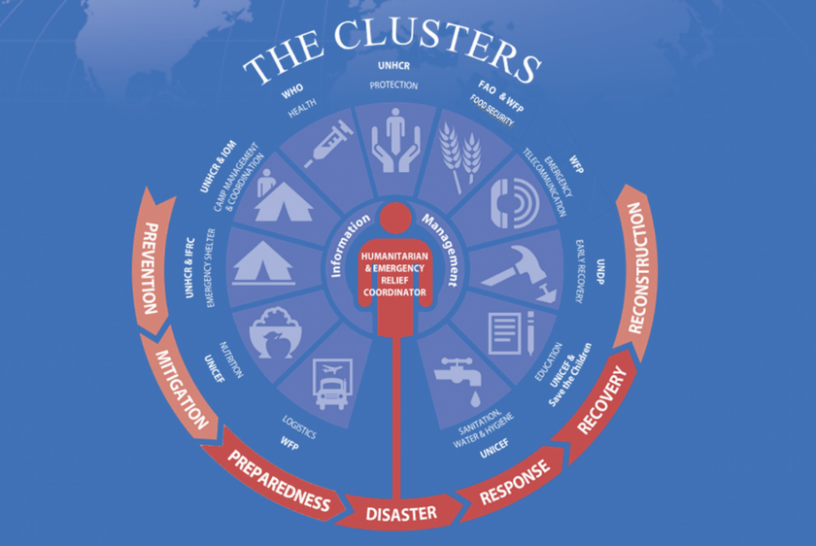
HUMANITARIAN CLUSTER SYSTEM
Strengthens humanitarian response - predictability, accountability and partnership
Cross cutting: gender, HIV&AIDS, human rights, environment
Protection Cluster - Areas of Responsibility (AoRs):
  GBV
  Child protection
  Housing, land and property
  Mine action

Slide 16
GBV AOR
Global forum co-led by UNFPA and UNICEF
Promotes comprehensive and coordinated programming to prevent and respond to GBV in emergencies:
  Supporting life-saving services
  Building knowledge and capacity
  Establishing norms and standards
  Advocating for action, research, accountability – global and local

Slide 17
INTEGRATING GBV ACROSS OTHER CLUSTERS
CCCM: women's center/tent, safe living areas for single women
WASH: separate facilities in different areas, safe water points
Nutrition: safe breastfeeding space, information-sharing on services
Livelihoods: programs for survivors and those at risk
Health: services and supplies for survivors
Education: teachers trained to mitigate risk
Food Security: prevent SEA and transactional sex, safe distribution
Shelter: safe distribution of shelter/NFIs, female-friendly spaces
Telecomm: hotline for survivors, text messages for services and support

Slide 18
GBV COORDINATION MECHANISMS
Mainstreaming GBV throughout humanitarian response
Supporting development of SOPs
Developing information systems for coordination
Developing IEC materials
Making appeals for GBV funding
Building capacity of GBV partners
Conducting assessments, data collection, monitoring, and knowledge management
Conducting advocacy

Slide 19
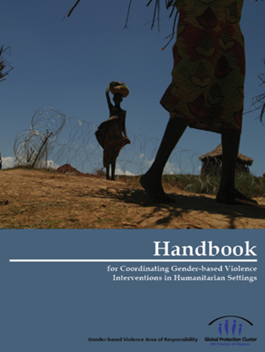
GBV COORDINATION HANDBOOK
Target audience:
  GBV Coordinators
  Individuals/agencies involved in GBV coordination
For comprehensive, effective and ethical GBV programming
Advocacy tool
Supports risk reduction and emergency-preparedness planning

Slide 20
GBV INTERVENTIONS – HOW?
APPROACHES:
  Human rights-based
  Survivor-centered
  Community-based
  Systems-based
GUIDING PRINCIPLES:
  Safety
  Confidentiality
  Respect
  Non-discrimination
= foundation for GBV programming in emergencies

Slide 21
GBV INTERVENTIONS MUST…
UNDERSTAND the causal relationship between:
TYPES of GBV
VULNERABILITIES of populations
NATURE and PHASE of crisis
In order to:
IDENTIFY available RESOURCES and ASSETS

Slide 22
MAINSTREAMING AND PRORAMMING
Mainstreaming:
Applies to ALL actors
Reducing risk
Providing timely, safe, ethical response
Applying principles and approaches
Specialized Programming:
Applies to GBV specialists
Direct service delivery

Slide 23
MULTI-LEVEL RESPONSE
STRUCTURAL = Preventative measures to ensure rights are protected – laws and policies
SYSTEMIC = Systems and strategies to prevent, detect, monitor and respond – multi-sectoral
OPERATIVE = Direct services to meet the needs of survivors
COMMUNITY = Community mobilization to promote and maintain social norms change
Notes:
The multi-level model clarifies responsibilities of actors within the multi-sectoral model to ensure that interventions take place across all the key sectors and at three levels.

Slide 24
MULTI-SECTORAL RESPONSE

Slide 25
HEALTH:
Recognize and address GBV
Administer Clinical Management of Rape (CMR) - post-rape treatment
Administer Minimum Initial Service Package (MISP) in emergencies for SRH and GBV
Connect with MHPSS and other services/support
Notes:
Train health providers to recognize and address GBV
Ensure Clinical Management of Rape (CMR) is accessible and available:
Documentation of Injuries
Collection of forensic evidence
Treatment of injuries
Evaluation for sexually transmitted infections (STIs) and preventive care
Evaluation for risk of pregnancy and prevention
Psychosocial support , counseling and follow-up
Administer “Post-Rape” Treatment Kits:
Part of holistic health care for survivors of sexual violence
Administered by trained health professionals – training is necessary, but kits come with guidelines in case there are no trained professionals to administer contents
Kits include: post- exposure prophylaxis (PEP), emergency contraception, antibiotics, STI preventive treatment, pregnancy tests, etc.
PEP treatment should be started as soon as possible, but maximum within 72 hours of the incident
Ensure Minimum Initial Service Package (MISP):
Coordinated set of priority sexual and reproductive health activities at the onset of an emergency
Designed to: prevent and respond to sexual violence, prevent excess maternal and neonatal mortality and morbidity, reduce HIV transmission, plan for comprehensive RH services
Implementation supported by pre-packaged reproductive health kits of equipment and essential supplies for life saving interventions
Implemented at the onset of a crisis - saves lives and prevents illness, especially for females
Implemented throughout the crisis and into recovery
Connect with Mental Health and Psychosocial Support Services (MHPSS)
Ensure health care providers have access to appropriate technical and material resources
Ensure same sex interviewers for individuals who have been exposed to violence
Respond to immediate health and MHPSS needs
Institute protocols for treatment, referral and data collection and documentation that guarantee confidentiality
Provide GBV treatment free of cost
Provide forensic evidence and testimony in court when authorizedre
Involve and inform community - especially females - in decision-making
Conduct awareness and sensitization strategies for health care providers on GBV Guiding Principles
Ensure access to services – addressing potential barriers such as distance, language and financial issues
Establish protocol for care for caregivers - and train health care providers in its use
Support creation of national guidelines for GBV – specifically sexual violence
Develop key messages to encourage survivors to seek health support
Identify protection concerns and prevention strategies
Referral = for additional assistance and services

Slide 26
COUNSELING:
Address mental health needs
Provide psychosocial support
Promote healing
Provide case management
Refer to other services/support as needed
Notes:
Survivors of GBV may have long-lasting psychological and social effects
MHPSS should seek to promote healing, empowerment, acceptance
MHPSS should be culturally sensitive and adapted to the specific needs of the community
Provide ongoing psychological assistance
Train and supervises psychologists, social workers and community services workers
Facilitate referrals for other services
Quality MHPSS contributes to recovery by allowing the survivor to:
Exercise some control and choice in responding to the violence
Create a safety plan and Holistic Care Action Plan for recovery
Have access to support and resources to meet basic needs
Build resilience and positive coping mechanisms
Access support available from family, friends or others
Be aware of and access available services
What are the key principles of MHPSS?
Protect human rights and equality – GBV Guiding Principles and others
Do no harm
Treat survivors with dignity – provide non--stigmatizing services
Assure supportive attitude
Provide information and manage expectations
Ensure full participation of survivor in decisions
Build on available resources and capacities - ensure referral and accompaniment
Integrate support systems – including multi-layered supports
Special considerations for child survivors

Slide 27
POLICE & SECURITY:
Recognize and address safety and security needs
Address GBV prevention and protection
Ensure appropriate reporting and follow up
Ensure zero tolerance
Refer to other services/support as needed
Notes:
Examples of Security Sector actors:
Institutions and other entities with a role in ensuring the security of the state and its people
State security actors (police, armed forces/military, intelligence), management and oversight bodies (ministries of the interior and defense)
Non-state security actors (traditional authorities, civilians) working for private security companies –and community policing mechanisms
Peacekeepers
Security sector can play an important role in GBV prevention and response – but they can also be perpetrators!
Promote the positive role the security sector can play (where appropriate) while also addressing the challenges
Engage police, military and other security personnel – ideally through creating specialized units to address GBV
Train on appropriate intervention in cases of GBV
Establish measures for survivor safety and confidentiality when reporting
Institute protocols for referrals to other sectors
Collect standardized and disaggregated data on incidents in line with ethical guidelines
Ensure laws/ policies/protocols in place for handling cases, referrals, etc.
Ensure safe and private space for reporting cases and receiving complaints
Arrest the accused person(s), conduct investigations, prepare charges, serve summons and ensure that all potential witnesses appear in court
Advocate for expeditious investigation and prosecution of cases
Explain legal/criminal process to the survivor – protect survivor from perpetrator or community repercussions
Participate in legal and rights awareness education campaigns
Ensure presence of female police officers
Sign a code of conduct and zero tolerance for police violence
Use standardized incident report and form
Promote community policing (through existing networks and structures) and prevention
Ensure basic security oversight – particularly security and protection of females
Assign focal points to participate in GBV coordination groups
Engage security officers in monitoring
Establish community-based security strategies
Disseminate information on services

Slide 28
LEGAL & JUSTICE:
Protect survivors’ rights and support their access to justice
Use existing laws/policies
Monitor cases and judicial processes
Refer to other services/support as needed
Notes:
Legal sector includes formal/non-formal, state/non-state institutions and procedures – also transitional justice, traditional/religious leaders, national judiciaries, lawyers, forensic service providers, survivor advocacy groups
Access to justice means that an individual can have her grievances heard, can receive proper treatment for those grievances in accordance with national and international laws, and can obtain a just and effective remedy to protect her rights on the basis of gender equality and without discrimination
All GBV actors MUST engage the legal and justice sector to protect survivors’ rights and support their access to justice, according to existing laws and policies.
Legal aid for survivors:
Free (or low cost) legal aid: counselling, representation and other court support to survivors – including transportation and accommodation near court
Includes appropriate legal staﬀ - trained in GBV cases
Provides complete legal aid services –accessible to survivors
Reinforces laws that protect females and punish perpetrators – and reviews/revises laws that reinforce GBV
Monitors court cases and judicial processes
Provides orders of protection and other legal safety mechanisms for survivors
Monitors perpetrators’ compliance with court-ordered rehabilitation
Ensures that community is aware of survivors’ legal rights and supports legal consequences for GBV
Ensures respect for the rule of law
Advocates for country to adopt national and international legislation outlawing GBV
Ensures procedures and evidence laws are sensitive to female needs and to GBV
Implements protocols on medico-legal care
Allows civil society organizations to bring cases to court
Includes collaboration with traditional community-based governing bodies
Integrates legal aid services into the general GBV referral system
Ensures females have enough freedom and independence to access the legal aid services – and females trust and are conﬁdent in the legal aid services and staﬀ
Develops mandate delineating scope and services of legal aid is developed
After an emergency,:
Improves state and non-state justice mechanisms to respond to on-going incidents of GBV
Supports creation of mechanisms to address GBV committed during conflict
Ensures that any data collection is safe, ethical, and appropriate

Slide 29
REINTEGRATION & SOCIO-ECONOMIC:
Promote reintegration – family, school, community, society, etc.
Support livelihoods and economic empowerment
Provide access to vocational training, financial lending schemes, job placement and other opportunities
Notes:
Includes education and income-generation projects
Promotes female economic self-sufficiency and reintegration into the community
Support for livelihoods can be both a prevention and response strategy for GBV
Should be included from the onset of an emergency
Presence of female markets is a good barometer of security situation – only if females feel safe
Include support to informal sector – and protection of females in informal employment
Economic empowerment can be used as GBV prevention because:
Decreases risk of GBV – including SEA
Vocational skills training + income generation + land ownership = having REAL control = empowerment
Female needs and protection concerns at forefront
Female control over resources
Expands range of choices for females
Economic empowerment can be used as GBV response because:
Support for survivors by providing economic support in times of crisis
Proactive about prevention and protection – helps to avoid situations that put females at risk
Strengthen resilience and decreases vulnerabilities of families and communities
Increase access to skill-building and support activities to promote self-sufficiency and empowerment
Provide entry point for survivors to receive services and information
Provide outlet for group emotional and healing activities for survivors that may not require more individualized or intensive support
Economic empowerment can present a GBV risk because:
Can increase intimate partner and sexual violence
Threat to established masculinities
Promoting economic stability is good avenue for aid agencies – but should not be short-term income-generation projects with no context and follow-through
Presence of females does not necessarily increase power of females – risk reinforcing gender stereotypes
Risk of cash payment – need for safe storage
Can increase stigma if survivors are isolated for support
Quick-fix solutions – the road of least resistance
Imbalance between short-term visible interventions and long term strategic interventions
Partner with agencies that improve female livelihood opportunities through:
Vocational training
Job placement - including Cash-4-Work programs, distributing information on GBV services - distributing referral cards and information to other females on where to access GBV services, staff of females safe spaces
Other options where relevant, such as: microfinance opportunities, female cooperatives/networks, female financial inclusion

Slide 30
PREVENTION & MITIGATION
Prevention = Actions to stop GBV from occurring
Education and awareness-raising
Gender equality
Engaging communities – especially men and boys
Mitigation = Actions to reduce risk of exposure to GBV
Safe access to shelter, water/sanitation, food and NFIs
Lighting, security patrols, etc.
There is overlap – example: livelihoods
Notes:
How can we prevent GBV?
Preventing GBV is possible – with long term investment
What we can do depends on our contexts, communities and capacities
Ending violence against females requires the full engagement of all members of the community – particularly men and boys – to join together with women and girls.
Prevention activities in humanitarian settings:
Livelihoods
Safe access to cooking fuel
Food security
Safe access to water/sanitation
Safe shelter
Girls’ education
Engaging females in participation and leadership in peace-building
Engaging males to end GBV
Work with police and/or other local security
Work with peacekeepers
Work with armed actors (state and/or non-state)
National and/or local advocacy for policy change
National and/or local awareness raising/behavior change
IASC GBV Guidelines also outline ways that prevention of GBV can be integrated across the humanitarian response
Challenges:
Cultural norms and practices: stigma around GBV and against survivors, patriarchal practices and attitudes, lack of reporting, culture of silence, lack of information, culture of impunity
Limited financial and technical capacity: insufficient funds for programming, low skills of technical staff, lack of available doctors, lack of MHPSS staff, lack of capacity/sensitivity to respond effectively
Legal Aid and Access to Justice: lack of trust, perpetrators not convicted, survivor revictimized, lack of access to justice, lack of awareness of laws,
Coordination: lack of coordination among actors, underserved geographic areas, concentration in capital city, ad hoc prevention and response work
Conflict: high movements of people, displaced population, hard to focus on prevention work, areas hard to reach, continued violence and insecurity

Slide 31
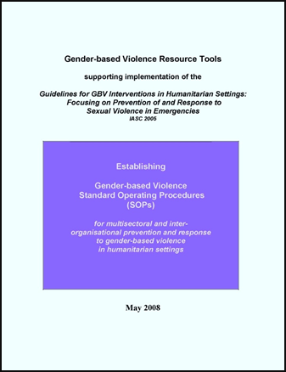
STANDARD OPERATING PROCEDURES
Specific procedures and agreements among organizations
Minimum standards for prevention and response
Plan of action – and roles and responsibilities
A process: capacity building + communication + building partnerships

Slide 32
REFERRAL SYSTEMS
Referral system = referral network + referral pathway
NETWORK of support services for survivors
PATHWAY survivor uses to access support services
SURVIVOR SPEAKS …
… TO SOMEONE ELSE |  | … DIRECTLY TO SERVICE PROVIDER
IMMEDIATE INTERVENTION
SERVICE PROVIDERS MUST: RESPECT GBV GUIDING PRINCIPLES PROVIDE IMMEDIATE SUPPORT REFER FOR URGENT CARE RECOMMEND HOLISTIC CARE
ENTRY POINT: HEALTH WITHIN 72 HOURS ANYTME – FOR EMERGENCY |  | ENTRY POINT: COUNSELING
REFER TO PROTECTION BASED ON SURVIVOR NEED & CHOICE REFER & ACCOMPANY
POLICE & SECURITY |  | LEGAL AID & JUSTICE
AFTER IMMEDIATE INTERVENTION: REFER TO OTHER SERVICES – BASED ON SURVIVOR NEED & CHOICE
HEALTH | COUNSELING | PROTECTION: POLICE & SECURITY LEGAL AID & JUSTICE | BASIC NEEDS: SHELTER SAFE SPACE SOCIO-ECONOMIC SUPPORT

Slide 33

GBV DATA COLLECTION: ETHICS AND SAFETY
Benefits must outweigh risks
Methodology
Referral to services
Safety
Confidentiality
Informed consent
Information-gathering team
Special considerations when involving children
Notes:
Notes:
WHO “Ethical & Safety Recommendations for Researching, Documenting, & Monitoring Sexual Violence in Emergencies (2007)

Slide 34
QUANTITATIVE DATA
GBV Information Management System (GBVIMS)
Common set of tools and guidelines – standardizes how reported GBV case data is managed
Collect, store and analyze reported GBV data safely and ethically
Promotes safety, respect, dignity and consent of GBV survivors
Ensures that humanitarian response to GBV will be informed by high-quality, reliable data

Slide 35
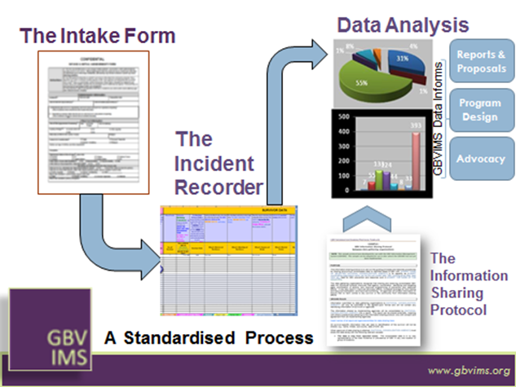
GBVIMS INCIDENT CLASSIFICATION
6 core incident types:
Rape
Sexual assault
Physical assault
Forced marriage
Denial of resources, opportunities and services
Psychological/ emotional abuse

Slide 36
GLOBAL CHALLENGES
Other forms of GBV vs. sexual violence
Engaging men and boys
Supporting male survivors
Adequately addressing at-risk groups and minorities
Engaging SOGI
Prevention – what’s working?

Slide 37
REGIONAL CHALLENGES
Ongoing insecurity
Regional and cross-border nature of emergencies
Donor fatigue
Lack of local capacity to prevent/respond
Insufficient financial commitments to sustain interventions
Short-term approach vs. long-term need
Other forms – trafficking, child marriage

Slide 38
REGIONAL RECOMMENDATIONS
Seek longer-term funding to manage cyclical nature of emergencies
Build local capacity for GBV programming
Ensure holistic approaches that integrate multiple services/support
Address all forms of GBV – based on context
Contextualize – and translate
Address cross-border challenges through multi-country programming and support

Slide 39
ROLE OF IWSAW
5 pillars:
  Education
  Research
  Development
  Outreach
  LAU Engagement
Integrating GBV across our work
Notes:
CEP!!!

