Slide 1
Challenges of e-Publishing
in Arab World
Ali Abdallah – Sales Director – Middle East & North Africa
Ali Abdallah, Sales Director, MENA

Slide 2
EBSCO Arabic Resources
Arab World Research Source: Al-Masder
Arabic eBook Collection: Al Kotob

Slide 3
Licensed Journals from MENA & Other Territories
2015 vs. 2019
Our expectations for 2020

Slide 4
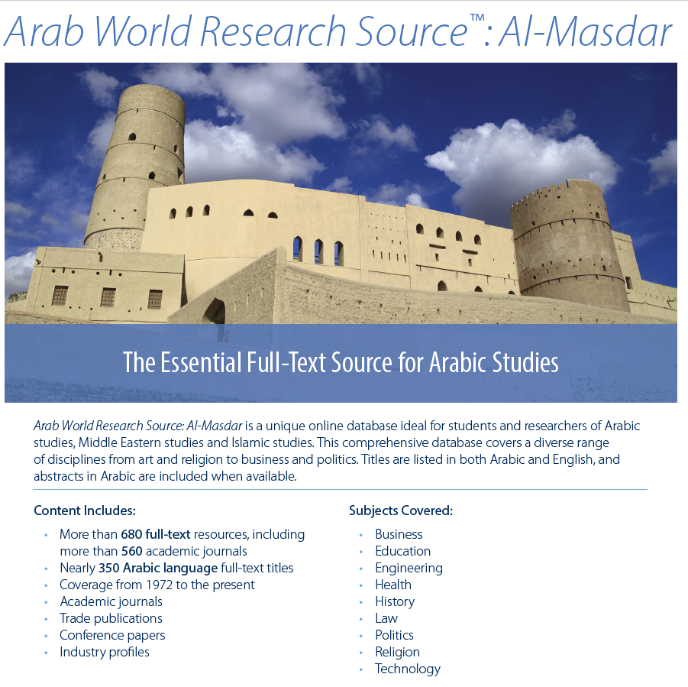

Slide 5
eBook Arabic Collection by EBSCO

Slide 6
Arabic Content: Current Accessing Sites by Country

Slide 7
Partnership & Challenges:
EBSCO, Publishers, Libraries

Slide 8
EBSCO: Increase options for Publishers and libraries
For Publishers
Expands your reach across regions and markets
Cost savings
Professional international sales people
For Libraries
Broad selection of titles, from thousands of publishers
Great range of access models for different subsets of content
Common acquisition and management workflow
Familiar platform means less training
EBSCO Overview

Slide 9
Challenges
Notes:
Jan -Challenges

Slide 10
Challenges and Reasons Publishers: Journals
Legal Departments
Open Access Policy
Misunderstanding of the concept = Concerns about losing subscribers
Consortium/National Repository
Old Generation (some publishers)
Stability of Journals
Missing issue/vol
ISSN problem
Missing metadata
Lack of a right contact or a person of interest
Notes:
Consortium/National Repository
For example: Egyptian Knowledge Bank, Saudi Digital Library, now they collecting the national journals and get the exclusive rights for their own agenda
Developing National Database, or sign licensing agreement with other favorite publisher/aggregator
How we deal with this challenge

Slide 11
Challenges and Reasons Publishers: eBook
Legal Departments
eBooks Standard issue
Misunderstanding of the concept
Old Generation (some publishers)
Missing of suitable format (publisher side)
Sales Models
ISBN
Missing metadata
Lack of a right contact or a person of interest
Notes:
Consortium/National Repository
For example: Egyptian Knowledge Bank, Saudi Digital Library, now they collecting the national journals and get the exclusive rights for their own agenda
Developing National Database, or sign licensing agreement with other favorite publisher/aggregator
How we deal with this challenge

Slide 12
Challenges and Reasons Libraries
Legal Departments
DRM (eBook)
Open Access(Journals & eBook)
Packages and Prices
Missing of some subjects
Value of content
Missing metadata
Subject Index / Subject Heading
Much More.
Notes:
Consortium/National Repository
For example: Egyptian Knowledge Bank, Saudi Digital Library, now they collecting the national journals and get the exclusive rights for their own agenda
Developing National Database, or sign licensing agreement with other favorite publisher/aggregator
How we deal with this challenge

Slide 13
Challenges and Reasons EBSCO
Legal Departments
Licensing cycle
Procedures and Process:
Notes:
Consortium/National Repository
For example: Egyptian Knowledge Bank, Saudi Digital Library, now they collecting the national journals and get the exclusive rights for their own agenda
Developing National Database, or sign licensing agreement with other favorite publisher/aggregator
How we deal with this challenge

Slide 14
EBSCOhost™ Partnership Process
Step 1: Nomination
EBSCO Product Management team selects publications to be included in the databases, based upon scientific and editorial standards, uniqueness of content, and relevance to the database.
-or-
Publishers, Editors or Authors contact EBSCO and ask to participate in the databases.
Full-Text Databases

Slide 15
EBSCOhost™ Partnership Process
Step 2: Title Research
Title lists should be reviewed.
Titles are reviewed by checking 21 fields of information, then report send to PM,
Beall's List Publisher
Beall's List Title
Publication Title
Publisher Name
PID
ISSN Print
ISSN Online
Language(s)
Language(s) of Abstract
Document Type
Issue per Year
Publisher Country
Publisher State/Province
Publisher City
Open Access
Active Status
Last issue date
Primary Subject
Publisher URL
Publication URL
Subscription Price
Full-Text Databases

Slide 16
EBSCOhost™ Partnership Process
Keeping your website up-to-date and informative
Marking clearly what languages are contained in the title
It could be helpful to be included in one of the major Indexes
Full-Text Databases

Slide 17
EBSCOhost™ Partnership Process
Step 3: Evaluation
When EBSCO receives a request to participate, the publication is evaluated. The publication will be rejected If:
We find non-unique content or
Failure to cite sources properly, or
Publication does not meet scientific and editorial standards of quality,
The publication is not relevant to EBSCO products that are being developed
If the publication is good, it is assigned to a suitable EBSCOhost database.
Full-Text Databases

Slide 18
EBSCOhost™ Partnership Process
Step 4: Licensing
After a publication has been nominated or approved, then the EBSCO Content Licensing team contacts the right-holder asking them to sign an agreement.
EBSCO does not include content without proper permission
EBSCO honors international standards of copyright law (Berlin Convention).
Full-Text Databases

Slide 19
EBSCOhost™ Partnership Process
Step 5: Data Acquisition
The newly-licensed titles are set up in EBSCO’s systems and assigned to appropriate databases.
When that is done, EBSCO’s data acquisition team contacts the publisher to begin content delivery.
Delivery is usually done by FTP.
The preferred format for journals is PDF.
Full-Text Databases

Slide 20
EBSCOhost™ Partnership Process
Step 6: Editorial Processing
EBSCO adds editorial enhancements including:
Table of contents
Tagging images
Abstracts
Live links
Keywords
Subject indexing
Creating a searchable PDF
Full-Text Databases

Slide 21
Successes
Notes:
Successes tile slide

Slide 22
ESCWA Publications Available in EBSCOhost
Bulletin of Industrial Statistics for the Arab Countries
Bulletin on Population & Vital Statistics in the Arab Region
Compendium of Environment Statistics in the Arab Region
Compendium of Social Statistics & Indicators
External Trade Bulletin of the Arab Region
National Accounts Studies of the Arab Region
Review of Information & Communications Technology & Development in the Arab Region
Survey of the Economic & Social Developments in the Arab Region
Notes:
Successes -Jan

Slide 23
Successes Stories: FT Journals
Iraqi Ministry of Higher Education and Scientific Research 256 Journals; More to come soon.
Egyptian National Agriculture Library - ENAL
21 journals
Qandeel Educational, the Financial Arm of MBRF
7 journals – Some other projects under discussion
Qatar University Press
3 journals – New promising university press
University of Bahrain: 10 Journals
University of Tehran: 16 journals, waiting more suggestions
More University Presses:
Sultan Qaboos University, King Saud University, King Abdel Azziz University,
Notes:
Successes - To find out collages of the logos of the universities

Slide 24
Successes Stories: eBooks Partners
Notes:
Successes -Jan

Slide 25
Successes Stories: EDS Partners
Notes:
Successes -Jan

Slide 26
Thank you

