Slide 1
Guidelines for the production of statistical data by criminal justice institutions

Slide 2
Actual prevalence of crime
CVS
Disclosed crime
Reported crime
Registered statistics:
- Police
- Prosecution
- Courts
- Prisons
Sentenced crime
Notes:
Generally there are 2 sources of these data, namely survey data and administrative data. Survey data are a great tool to get a better idea of the overall prevalence of crime. Administrative data is limited to what is actually reported to the authorities. The gap between reported crime and actual crime is known as the “dark figure of crime”.
The previous presentation focused on survey data, but administrative data sources can be leveraged for statistical purposes as well and can produce powerful insights for reasons I will explain later in the presentation.
Prevalence differs from incidence in that prevalence includes all cases, both new and pre-existing, in the population at the specified time, whereas incidence is limited to new cases only.

Slide 3
Administrative vs. survey data
Data from Police Records
Crime Victimization Survey Data
Overlapping area
Dark figure of crime
Only covered by police records:
Uncommon crimes, homicides​
Crimes without an evident victim (state, business, ..)​
Victims in the age of < 18​
Non residents​
Only covered by a Victimization Survey:
Crimes not reported to the Police
Crimes not recorded by the Police
Crimes recorded as minor offenses
Notes:
Admin data captures a small amount of data that is missed by surveys. However, this data is absolutely crucial for fully understanding crime as it will include data on homicides and uncommon crimes.

Slide 4
Advantages
Criminal justice institutions produce administrative data
Collected in their day-to-day business
These data can be leveraged for official statistical purposes:
Lower costs
Higher frequency
Timeliness
Highly detailed
Notes:
Statistical surveys are an expensive way of collecting data. Questionnaires have to be developed, samples have to be designed, respondents have to be contacted, responses have to be processed and verified, and results have to be calculated. The running costs of administrative data sources are usually significantly lower and access to admin sources in the public sector is often free of charge.
Administrative sources often allow statistics to be produced more frequently, with no extra response burden, and little extra cost. Administrative sources that are not based on any particular time period, such as those that record events (e.g. like criminal offences) offer considerable flexibility. They allow statistics to be produced for any given period (even daily).
The use of administrative sources also increases the timeliness of statistical outputs by allowing access to more up to date information concerning offences. This is because statistical surveys generally take time to plan, design, conduct a pilot, to analyse the population and optimise the sample etc.. This is particularly the case ad-hoc data collections such as CVS.
High level of detail in the data.

Slide 5
Challenges
Challenges (among others):
Incoherent use of statistical concepts and definitions
Cooperation between data providers
Ensuring privacy and confidentiality
Inconsistencies between sources
Data do not capture the dark figure of crime
Notes:
Rules to register data need to be the same. A strict standardized protocol needs to be defined and followed by all involved actors in the same kind of Offices, for instance Prosecution offices or police departments, so that they register the same variables, using the same codes and the same response items. Naturally, all agencies should also apply the same definitions. For example, when do we label an intentional homicide as femicide?
Data protection is an important issue. All data need to be carefully protected in order to respect privacy and confidential laws. Again, there is a need to establish standardized protocols in order to protect data when collecting, sharing, or using them.
A specific problem where multiple sources are used concerns inconsistencies between those sources. Data from one source may appear to contradict those from another. This may be due to different definitions or classifications, differences in timing, or simply to an error in one source. For example, police records may differ from prosecution records.
Not challenge, more of a constraint: The dark figure of crime is missed by administrative data, as it only counts cases that are reported to the police and acted upon by the criminal justice system. This is where surveys play a key role in bringing to light the full picture.

Slide 6
Use of criminal justice statistics
Operational
To deal with a specific crime or case
To fight crime more broadly
Managerial
Monitor the performance of criminal justice agencies
Research and policy development
Better understand crime trends and patterns
Formulate evidence-based crime prevention policies
Accountability
Enhance public trust
Notes:
Operational (Where did a crime happen? What was the sex, age of the victim/offender, etc.)​
Management (measures of workload and staffing levels, crimes resolved, crimes unresolved, successful prosecutions, what part of the budget is dedicated to preventing organized crime, has increasing the budget had the desired results? etc.)​
Research. What kinds of crimes are occurring and what are the trends? Are there any new crime types that are becoming more important?​
Stats inform the general public on the performance of the criminal justice system​
​
Int. need for data: ​
2021 Kyoto declaration reaffirms the global commitment to evidence-based crime prevention through the collection and analysis of data using systematic and coherent criteria, keeping in mind the ICCS. ​
Data are a key component for monitoring progress on SDG 16. This includes targets on reducing violent crime (16.1), corruption and bribery (16.5) promoting the rule of law and ensuring access to justice for all (16.3), the development of effective, accountable and transparent institutions (16.6) and ensuring public access to information (16.10).​

Slide 7
Criminal justice system
Police
Investigate allegations of criminal conduct, gather evidence and file charges.
Prosecution
Provided with evidence, prepares case for court and conducts prosecution.
Courts
Hold those convicted of a crime
Prison
Hears the case, including testimony and other evidence, determines the case, convicts the accused if found guilty
Notes:
As UNODC, we focus on the criminal justice system.
We typically recognize 4 distinct phases in the CJ process. Great deal of variety between Member States in how the process is organized exactly, but generally most follow this rough diagram.
Police is often first point of contact with official authorities.

Slide 8
Police statistics
First step for most victims
Offer complete picture of reported crime
Reliable information on offender and often on victim
Influenced by willingness to report and investigative decisions
Additional information on effectiveness and fairness
Data can reveal, for example, how many people were victims of specific offences, strength of HR, number of arrests, etc.
Notes:
Any number of reasons why people do not report a crime. Could be considered a personal issue that needs to be resolved privately. Perhaps people don’t believe the police will act. There could be a fear of retaliation. Etc.
Overall, if we have good police data on victims, offenders and offences that can be linked together, we can get a fairly sophisticated idea of crime dynamics and reporting behaviour. This is not necessarily the same as the trend in the underlying phenomenon!
All this information can help in the design of policies and allow us to monitor progress. For example, if as a result of a new GBV policy only the murder of men decreases while the number of killed women remains constant, the approach is not working and should be adjusted.

Slide 9
Prosecution statistics
Reveal how many reported cases are acted upon (attrition)
Can give an idea of the length of proceedings
Associated with other crimes?
How many people are prosecuted and under what charges?
Recidivism
Notes:
Always some level of attrition, but can reveal whether it is elevated above the normal rate.
Say 100 reported cases of financial fraud, but the prosecution only files charges for 20 cases. Why is this the case? Are they understaffed? Lack of evidence? Unfamiliar with the topic and not sure how to proceed? Further (qualitative) research could provide answers to these questions.
Length of proceedings: Want to help victims in a timely manner. If procedures are very lengthy, this can expose victims to additional harm (secondary victimization) and also lower people’s willingness to rely on the criminal justice system. It will be seen as an ineffective and inefficient way of dealing with GBV.
Other crimes: Is there a link with organized criminal activity? (e.g. trafficking in persons)
Recidivism: Do we see the same offenders again and again? Can we design policy to prevent this?

Slide 10
Court statistics
Information on sentenced offenders
Sociodemographic characteristics, charge and sentence details
Measures taken to protect victim
Compensation/restitution for victim
Data models need to be flexible, single case can relate to:
One or more charges (of different types)
One of more victims
One or more offenders
Notes:
Sentence details: Slap on the wrist? Serious consequences?
Linking all of the data together is crucial to get an overview that can inform policymaking.

Slide 11
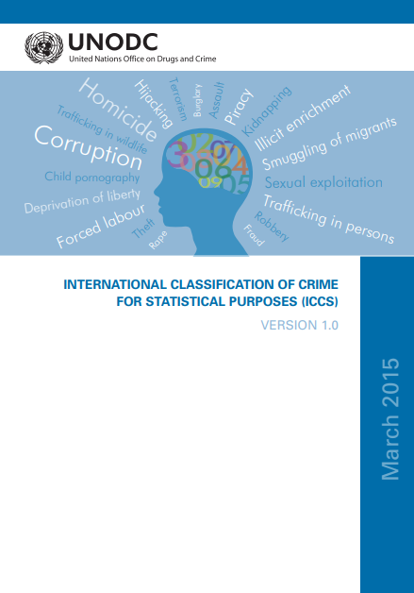
Guidelines
Guidelines aim to offer a basic, international framework
Relevant, feasible, (relatively) simple
Clear guidance on what data to collect
ICCS (disaggregations) incorporated throughout
Three guidelines (police, prosecution/courts, prisons)
Focus on the basic set of variables (the ‘what’)
Fourth guidelines (the ‘how’)
How to build criminal justice statistical system
Goes beyond offence data
Systematizes data collection on a range of activities that go far beyond offense data
Includes data on resources, professional conduct, outreach activities, social reintegration of prisoners, etc.
Notes:
Basic, int framework for collection of admin data for the purpose of producing stats​
​
What should you be measuring based on the core functions of the specific institution and the relevant international standards and norms on criminal justice.​
​
Police out. Pros court + prisons coming soon​
​
Currently starting work on the fourth guidelines. Would be very interested to include country case studies and learn from experiences around the world. If any participants are interested in sharing their experiences, challenges, and lessons learned, please do reach out to me by email or come talk to me after the session.​

Slide 12
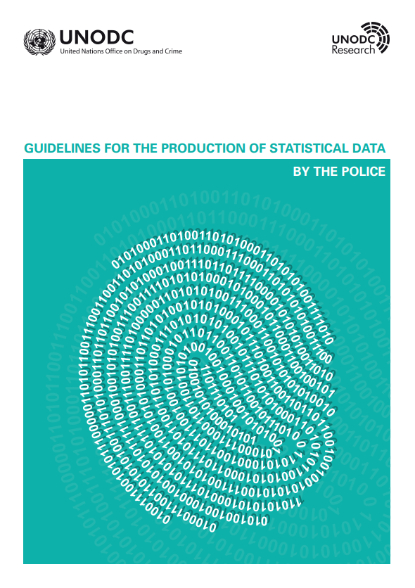
Available now!
Police guidelines
Launched on 28 November 2022

Slide 13
Statistical framework
Resources | Human resources | Financial resources | Physical resources | Staff safety and well-being
Crime statistics | Criminal offences | Arrest and detention | Seizure operations
Other activities | Stop and search | Public assembly | Outreach
Conduct | Use of force and firearms | Professional conduct
Notes:
Identified 4 thematic areas and 12 dimensions

Slide 14
Country example – United Kingdom
Number of incidents involving use of force tactics in the United Kingdom, year ending March 2021
Source: United Kingdom, Home Office, “Police use of force statistics, England and Wales: April 2020 to March 2021”. Available at https://www.gov.uk/government/statistics/police-use-of-force-statistics-england-and-wales-april-2020-to-march-2021/police-use-of-force-statistics-england-and-wales-april-2020-to-march-2021
Notes:
Since 1 April 2017, the Home Office requires all police departments in the United Kingdom to record data on use of force by the police. The purpose of this is to improve information provided to the public on the different types of force used by the police and the context in which use of force occurs. These data also inform the work of the National Police Chiefs’ Council and College of Policing in enhancing tactics, training and equipment in order to improve the safety of officers and people with whom they come into contact.
Data are collected from the 43 police departments in England and Wales. One “use of force incident” refers to one officer’s use of force involving one person. Officers must complete a “use of force report” each time they use force on an individual. A report should include the use of force tactics applied, reasons for using force, impact factors and the location and outcome of the event. The data do not include force used in designated public order events because it is not feasible for officers to provide the same level of detail in such situations as in individual use of force incidents.
During the year ending 31 March 2021, 562,280 use of force incidents were recorded.

Slide 15
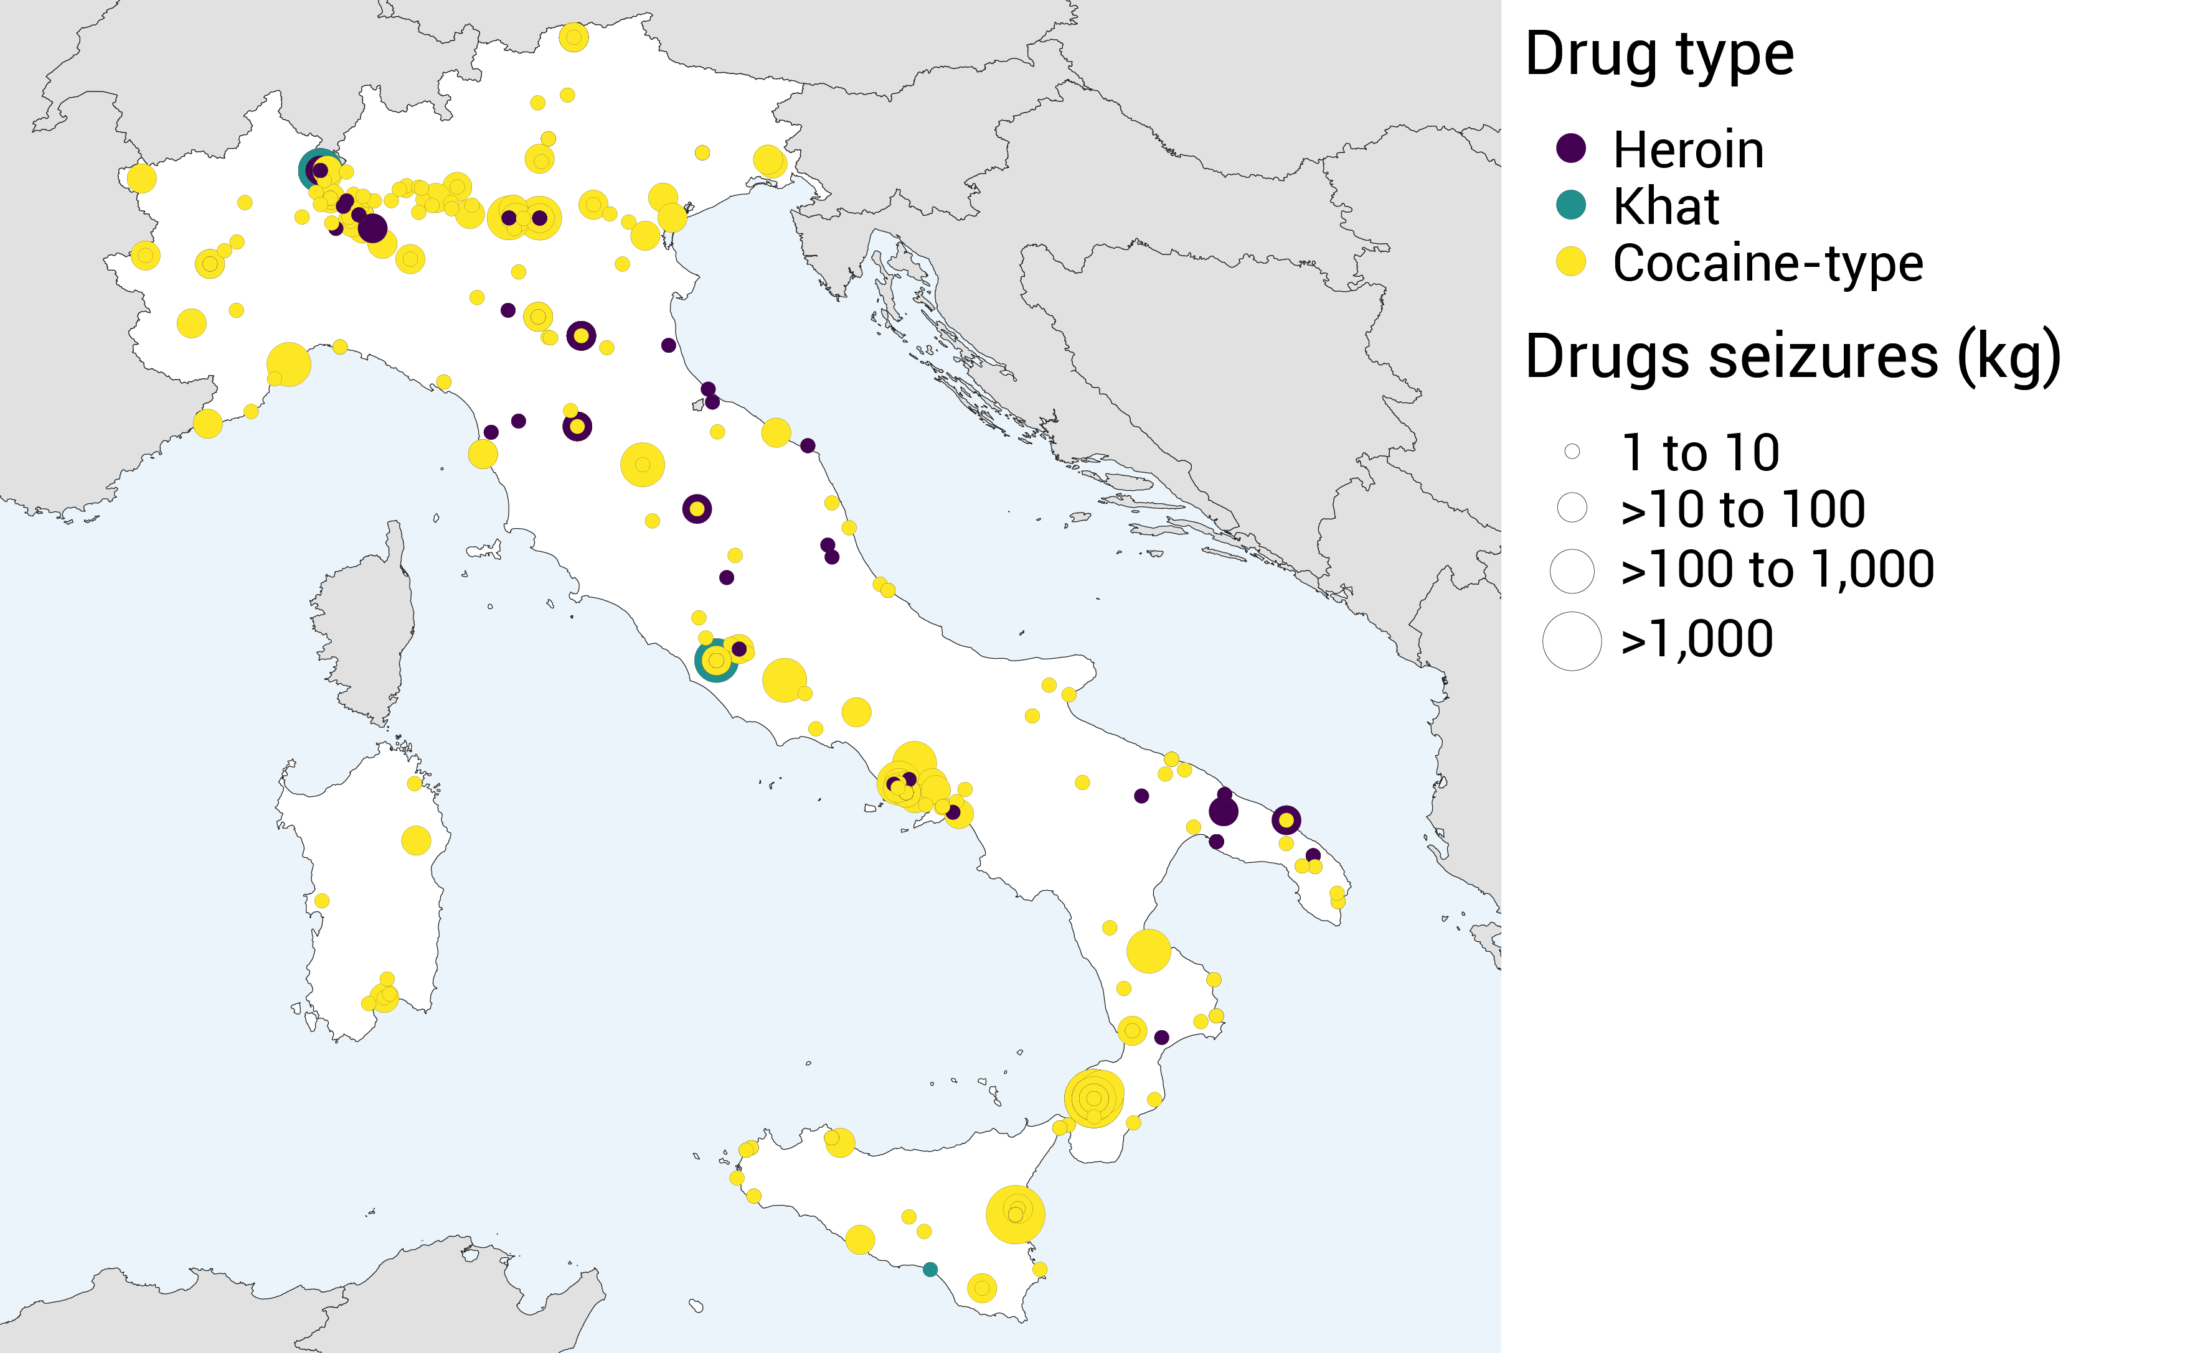
Country example – Italy
Individual drug seizures in Italy, by drug type and size of seizure, 2021
Note: The boundaries and names shown and the designations used on this map do not imply official endorsement or acceptance by the United Nations.
Source: UNODC, Drugs Monitoring Platform.
Notes:
The UNODC Individual Drug Seizures (IDS) data collection is an exercise mandated by the three international drug control conventions (1961, 1971, 1988). There is a yearly call for Member States to submit data on significant drug seizure cases of reported on their territory. These data are submitted to UNODC via email and the IDS data collection template gathers data on individual drug seizure cases that take place within the national territory of Member States. The data are reported to UNODC on a continuous basis throughout the year as soon as they are finalized at the country level.
The prompt provision of IDS data enables UNODC to inform the international community on significant trafficking cases in real-time and this information can be used as a tool for rapid policy responses targeted at combating the drug problem in each Member State as well as globally.
It is important to note that individual drug seizures differ from annual drug seizures reported to UNODC as part of the annual report questionnaire, which reflect aggregate seizure data (yearly) rather than case by case.
The map below highlights a selection of data reported by Italy during 2021, which include seizures larger than or equal to 1 kilogram of three types of drug (heroin, khat and cocaine-type), the quantity seized and the location in which the seizure was made.

Slide 16
Statistical framework – Prosecution & Courts
Resources | Human resources | Financial resources | Physical resources | Staff safety and well-being
Criminal justice statistics | Prosecution data | Court data | Pre-trial detention and non-custodial measures | Seizure operations
Other activities | Extradition and mutual legal assistance | Outreach
Conduct | Professional conduct | Disqualification / recusal
Notes:
Identified 4 thematic areas and 12 dimensions

Slide 17
Country example – Uruguay
Pre-trial detention and other non-custodial measures, 2020, Uruguay
Source: Uruguay, Suprema Corte de Justicia, Procesos Penales 2020: Código del Proceso Penal 2017 (Montevideo, 2020). Available at www.poderjudicial.gub.uy/penal.html.
Notes:
Information on the type of pre-trial detention and other non-custodial measures applied by criminal courts in Uruguay in 2020. The data are collected and published regularly by the Supreme Court of Uruguay based on information collected and processed from the Court Management System.
Other includes prohibition to leave the country, electronic monitoring and more

Slide 18
Statistical framework – Prison administrations
Resources | Human resources | Financial resources | Physical resources | Staff safety and well-being
Prisoner profile | Population registration
Reintegration | Visits | Health and rehabilitation | Programmes
Safety and security | Sanctions | Searches | Incidents
Conduct | Complaints | Use of force
Notes:
Identified 5 thematic areas and 13 dimensions

Slide 19
Country example – USA
Federal prisoners cited for prohibited acts that resulted in reduction in rewards, incentives or time credits, 2019-2020
Source: United States of America, Department of Justice, Bureau of Justice Statistics, Federal Prisoner Statistics Collected under the First Step Act 2021 (USA, 2021). Available at https://bjs.ojp.gov/library/publications/federal-prisoner-statistics-collected-under-first-step-act-2021
Notes:
Information is also available disaggregated by sex, race and ethnicity.

Slide 20
Thank you!
unodc-iccs@un.org
martijn.kind@un.org
rausis@un.org

