Slide 1

Regional workshop on the Strategic framework for improving civil registration and vital statistics systems in the Arab region 2021-2025: progress made and way forward
Amman – Jordan, 28-29 May 2024

Slide 2
Unfpa’s overall contributions
Unfpa is a key player in the strengthening of civil registration and vital statistics (CRVS) as part of population data systems.
Unfpa emphasizes a life course approach to civil registration and vital statistics and the use of a gender lens in the registration of all key vital events (births, deaths, marriage and divorce) and generation of vital statistics
Unfpa’s contributions and support address all the five pillars of the current regional crvs strategy: registration; quality assurance; digitalization; capacity development and crvs in unfavorable conditions.
Through the center of excellence for crvs, unfpa develops resources that are adaptable to the arab region. Some of these will be presented during this workshop.

Slide 3
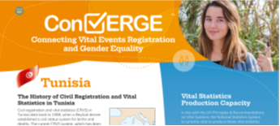

Knowledge products
Advancing civil registration for vital statistics in the Arab countries
Development of CRVS country briefs (Tunisia, Jordan and Morocco)

Slide 4
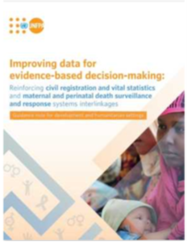
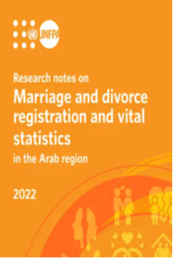
Knowledge products
Improving data for evidence-based decision-making: Reinforcing civil registration and vital statistics and maternal and perinatal death surveillance and response systems interlinkages
Research Notes on Marriage and Divorce Registration and Vital Statistics in the Arab region

Slide 5
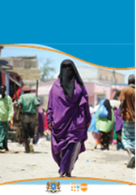
Technical support to countries
Lebanon-CRVS Situational Analysis (draft report)
Tunisia- Analytical papers Assessing demographic data quality and completeness of birth and death registration : A technical report
Jordan- Assessment of completeness of birth and death registration
CRVS Somalia country profile

Slide 6
Capacity building
Training workshop on demographic methods for assessing the quality and completeness of civil registration data and their uses.
CRVS capacity strengthening workshop scheduled this year

Slide 7



Linkages to Strategic frameworks
Country Programme Development; including seed funds for analytical work on CRVS developed jointly with national counterparts.
International Conference on Population and Development 30th review; recommendations on population data (including CRVS) strengthening and a Think Piece on the Future of Data Systems, emphasizing the role of CRVS in considerations on the transition to register-based censuses.
UNFPA global CRVS strategy (DRAFT)

