Slide 1
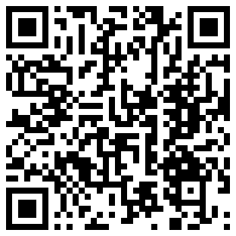
Supporting the Enhancement and Modernization of Demographic and Social Statistics in the Arab States

Slide 2
Projects on Demographic and Social Statistics
For 2022-2025
Activities based on previous TAG meetings + ESCWA streams of work
To enhance regional cooperation on improving availability of demographic and social statistics among NSOs and partners in the Arab Region
To support NSOs in the Arab region produce demographic and social statistics that are aligned with international standards and modern technologies

Slide 3
Projects on Demographic and Social Statistics
Areas of Work
Regional Cooperation
Census
CRVS
Others (labor, migration, crime, etc.)
Modernization (including new data sources: Big Data, Administrative Records, GIS)
Modalities
Expert Meetings
Regional/National Workshops
Reports/Guidelines
Advisory Missions/Study Tours

Slide 4
Projects on Demographic and Social Statistics
Work completed and ongoing
TAG Meeting (March 2023; Regional Cooperation)
Arab Society: Demographic and Social Trends (March 2023, Recurring; Regional Cooperation)
Regional workshop on registered based census in the Arab countries (December 2022; Census)
Update PHC and CRVS knowledge bases on ESCWA website (Recurring; Regional Cooperation)
Development of an e-platform the collection and processing data and metadata from NSOs (Ongoing; Regional Cooperation)

Slide 5
Projects on Demographic and Social Statistics
Work planned until end of 2023
Report on implementation of the regional CRVS strategy (2Q 2023; CRVS)
Regional workshop on implementation of the regional strategy on CRVS (3Q 2023; CRVS)
Regional training on the implementation of the International Classification of Crime for Statistical purposes (ICCS) in the Arab Region (3Q 2023; Other: Crime) Regional workshop on refugee statistics (4Q 2023; Other: Refugees)
Training workshop on measuring Middle Class (4Q 2023)
Advisory Missions (Upon Request; Census, CRVS, Modernization and Other)

Slide 6
Projects on Demographic and Social Statistics
Discussion points
TAG: What changes should be made in activities/dates/modalities?
Member States: What are the needs and requests for technical assistance?
TAG: What are the potential for joint activities?
Your inputs will be incorporated into the recommendations and project plans

