Slide 1
Capacity building program for national women’s machineries
Stephanie Chaban
Social Affairs Officer

Slide 2
Overview of the Training
First Session: Introduction and relevant terminology
Second Session: International legal frameworks
Third Session: Women’s legal status in Somalia
Fourth Session: Standards, mandates, and roles related to the work of national machineries

Slide 3
- The Importance of a Gender-Sensitive Lens - Foundational Concepts and Terminology - Relevant Tools
Overview:
Session One

Slide 4
Using a gender sensitive lens: Foundational concepts for gender equality
Notes:
We come from different societies and have different cultures and traditions but to work on an equal basis on gender equality we need to understand globally shared concepts and standards

Slide 5
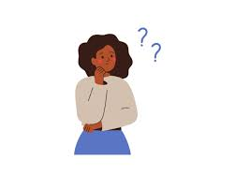
Discussion: Understanding Gender
What is the difference between sex and gender?
Notes:
10 min
Explain to the group that these statements were meant only to generate a discussion around how society promotes images of men and women, which result in gender biases and images.
Also explain why understanding the difference between sex and gender is critical for development work.
It helps us understand that the cause of inequity between men and women is not their biological characteristics, but socially constructed attributes of men and women.
However, make sure that you do not undermine the significance of biological differences between men and women and treat them as less significant.

Slide 6
What Is Gender?
"Gender" refers to the roles, behaviors, activities, and attributes that a society considers appropriate for both women and men.
These attributes, opportunities and relationships are socially constructed and are learned through socialization processes. They are context/time-specific and changeable.
Gender determines what is expected, allowed and valued in a woman or a man (or a boy or a girl) in a given context.
Notes:
Ask them to give examples (religion, culture and tradition)
Refers to the social attributes and opportunities associated with being male and female and the relationships between women and men and girls and boys, as well as the relations between women and those between men.
These attributes, opportunities and relationships are socially constructed. They are context/time-specific and changeable.
Gender determines what is expected, allowed and valued in a woman or a man in any given context.

Slide 7
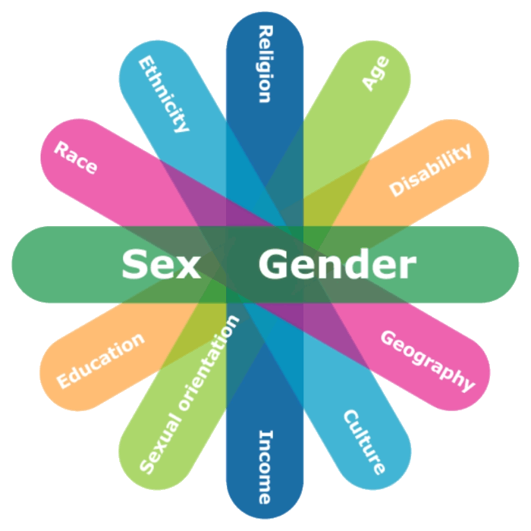
What Is Intersectionality?
It highlights the interconnected nature of social categorizations such as race, class, and gender, that are regarded as creating overlapping and interdependent systems of discrimination or disadvantage.
There is no monolithic woman or man.
Gender
Marriage status
Notes:
Activity – 5 descriptions
In complement, we need to also talk about intersectionality…
Kimberlee Crenshaw first publicly laid out her theory of intersectionality in 1989, when she published “Demarginalizing the Intersection of Race and Sex.”
“Consider an analogy for traffic in an intersection, coming and going in all four directions. Discrimination, like traffic through an intersection, may flow in one direction, and it may flow in another. If an accident happened in an intersection, it can be caused by cars travelling from any number of directions and, sometimes, from all of them. Similarly, if a Black woman is harmed because she is in the intersection, her injury could result from sex discrimination or race discrimination.” (Crenshaw, 1989: 149).
Intersectionality highlights the interconnected nature of social categorizations such as race, class, and gender, that are regarded as creating overlapping and interdependent systems of discrimination or disadvantage.
Ultimately this means that there is no monolithic woman – any intervention must take context, harms, discrimination, etc. into account;

Slide 8
Globally, gender impacts…
Access to health care
During the height of the pandemic, funds were directed away from women and girls’ health services and towards other life-saving services.
Access to employment
The current global labor force participation rate for women is just under 47%. For men, it's 72%.
Access to resources
Fewer than 15% of agricultural landholders around the world are women and 85% are men.
Access to decision-making
Access to safety
Access to justice
Only 26% of the world’s MPs are women
In many contexts, women have limited access to legal aid and knowledge of how it can be obtained.
1 in 3 women worldwide have been subjected to either physical and/or sexual intimate partner violence or non-partner sexual violence in their lifetime.

Slide 9
Concepts
- Gender Roles and Norms
Tools
- Gender Mainstreaming - Gender Data
Results
Gender Equality and Women's Empowerment
- Gender Stereotypes
- Gender-based Discrimination
- Gender-based Violence
- Gender Analysis
- Gender Sensitive Policies
Concepts and Tools for Gender Equality

Slide 10
Gender Norms, Roles and Stereotypes Can Create Lifelong Cycle of Inequality
Gender Norms
Gender Roles
Gender Stereotypes

Slide 11
Discussion: Understanding Gender Roles
What are the different roles for women and men in your society?

Slide 12
Gender-based Discrimination
“Any distinction, exclusion or restriction made on the basis of sex which has the effect or purpose of impairing or nullifying the recognition, enjoyment or exercise by women, irrespective of their marital status, on the basis of equality of men and women, of human rights and fundamental freedoms in the political, economic, social, cultural, civil or any other field.”
* Article 1 of CEDAW
Notes:
Gender norms, roles and stereotypes can lead to Gender-based discrimination.
Stereotypes result in Gender Bias and Gender-based Discrimination
Bias: making decisions that benefit one gender over the other
Discrimination: Directly or indirectly treating men/women, boys/girls differently that prevents them enjoying their lives/rights
Gender blindness prevents us from addressing our gender bias
Gender equity leads to gender equality

Slide 13
Direct Discrimination
Direct discrimination is when someone is treated unfairly because of a protected characteristic, such as gender, age, nationality, race, religion or belief, health or disability, compared to another person.
Indirect Discrimination
Indirect discrimination occurs when an apparently neutral provision, norm or practice places persons of one gender at a disadvantage compared to persons of the opposite gender unless the provision, norm or practice is objectively justified or by a legitimate aim.
de jure Discrimination
Discrimination that is defined by the law.
de facto Discrimination
Discrimination that exists in practice.
Notes:
Direct:
The difference in treatment that is intended and leads to a lack of recognition of women's rights in the private and public spheres.
Discrimination can stem from both law (de jure) or from practice (de facto).

Slide 14
Gender-based Violence
Gender-Based violence refers to harmful acts directed at an individual based on their gender. It is rooted in gender inequality, the abuse of power and harmful norms.
Gender-based violence can include sexual, physical, mental and economic harm inflicted in public or in private. It also includes threats of violence, coercion and manipulation.
Gender-based violence (including violence against women) is considered a form of discrimination according to the Convention on the Elimination of All Forms of Discrimination against Women (CEDAW).
Notes:
A significant form of discrimination is GBV, which disproportionately targets women and girls
Both men and women are subjected to gender-based violence, but the majority of victims are women and girls.

Slide 15
Continuum of Violence against Women
Adolescence
Femicide
Sexual assault and rape
Child marriage
Sexual harassment
FGM
Denial of opportunities/resources
Elderly
Elder abuse
Femicide
IPV
Sexual Assault
Rape
Denial of opportunities/resources
Childhood
Abuse
Child marriage
Neglect
FGM
Trafficking
Infancy
Neglect (health care,
nutrition)
Pre-Birth
Sex selective abortion
Adult - Reproductive Age
Femicide
IPV
Sexual Assault
Rape
Denial of opportunities/resources

Slide 16
Gender Inequality
Discrimination on the basis of gender results in gender inequality.
Gender inequality reinforces and exacerbates the unequal distribution of power between women and men.
Discriminatory laws, policies, institutions and social relations can impede the enjoyment of rights and the realization of gender equality.

Slide 17
Any Questions?

Slide 18
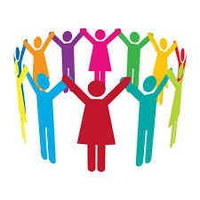
Using a gender sensitive lens: Tools used to work toward gender equality

Slide 19
Gender Equality
“… the equal rights, responsibilities and opportunities of women and men and girls and boys.
Equality does not mean that women and men will become the same but that women’s and men’s rights, responsibilities and opportunities will not depend on whether they are born male or female.
Gender equality implies that the interests, needs and priorities of both women and men are taken into consideration, recognizing the diversity of different groups of women and men.”
* UN General Assembly, 1979

Slide 20
Women’s Empowerment
Women’s empowerment is about their ability to gain power and control over their lives.
This concept involves raising awareness, building self-confidence, expanding choices and increasing access to and control over resources and actions, in order to change the structures and institutions that reinforce and perpetuate gender discrimination and inequality
Notes:
Not just economic empowerment

Slide 21
Why Not ‘Gender Equity’?
The preferred terminology within the United Nations is gender equality, rather than gender equity.
Gender equity denotes an element of interpretation of social justice, usually based on tradition, custom, religion or culture, which is most often to the detriment to women. Such use of equity in relation to the advancement of women has been determined to be unacceptable.
During the Beijing Conference in 1995 it was agreed that the term equality would be utilized.
Notes:
Mention
Gender Parity and Gender Balance

Slide 22
Ensuring Effective Legislation and Policies
Gender-Unequal
Uses and reinforces gender inequalities and stereotypes, resulting in flawed policies.
Gender-Targeted
Focuses on addressing women and/or men in the context of their gender norms, roles and relations but does not involve a gender analysis.
Gender-Sensitive
Takes gender sensitivity even further, and seeks to consider, challenge and transform discriminatory norms and relations through critical reflection and questioning.
Gender-Blind/Gender-Neutral
Ignores gender norms, roles and relations despite relevance to the topic and assumes policies and their outcomes will affect everyone equally, resulting in flawed policies.
Gender-Transformative
Takes gender into account in the policy initiation, design and methodology, and a gender analysis is conducted throughout the policy’s cycle.
Adapted from WHO, 2011 and UN Women, 2020.

Slide 23
Gender Mainstreaming
Mainstreaming a gender perspective is a planned assessment process that integrates the needs of both women and men, including legislation, policies or programs in all fields and at all levels.
This strategy aims to place the concerns and experiences of women and men at the center of the process of designing, implementing, monitoring and evaluating policies and programs in all political, economic and social arenas.
The ultimate goal of gender mainstreaming is to achieve gender equality.
Notes:
According to ECOSOC, gender mainstreaming is “the process of assessing the implications for women and men of any planned action, including legislation, policies or programmes, in all areas and at all levels. It is a strategy for making women’s as well as men’s concerns and experiences an integral dimension of the design, implementation, monitoring and evaluation of policies and programmes in all political, economic and societal spheres so that women and men benefit equally. The ultimate goal is to achieve gender equality.”
* A/52/3

Slide 24
A Twin-track Approach to Mainstreaming Gender
Mainstreaming
Systematically address gender throughout policies, legislation, programs or projects
Targeting
Develop targeted interventions and measures on gender within policies, legislation, programs or projects
A Comprehensive Approach to Addressing Gender Needs

Slide 25
What Mainstreaming Is Not
* Inserting women and girls into only one component of a policy, law, program or project.
* Adding the words “….and women and girls” within a policy, law, program or project without proper context, analysis and/or discussion.
* Collectively referring to women and girls solely as ‘vulnerable’ populations.
* Assuming that women and girls are a homogenous group with similar ambitions and needs.

Slide 26
A Gender Analysis…
* Serves as an essential dimension of any comprehensive analysis
* Identifies specifically how policies affect men and women, boys and girls differently
* Demonstrates that policy and implementation cannot be gender-neutral because society is gendered and women and girls are part of society
* Demonstrates that men and women, boys and girls do not lead homogenous lives and that that policies, programs, projects and research can have different effects
* Ensures that the different needs of men and women, boys and girls are clearly identified and addressed at all stages of the research and programming cycle
* Provides an opportunity for men and women, boys and girls to contribute to the development of policies, programs, projects and research.
Without a gender analysis, gender mainstreaming is not possible.

Slide 27
The Six Domains for a Comprehensive Gender Analysis
Access to and Control over Resources
Knowledge, Beliefs and Perceptions
Power and Decision-making
Legal Rights and Status
Time and Space
Practices and Participation
Macro
Meso
Micro

Slide 28
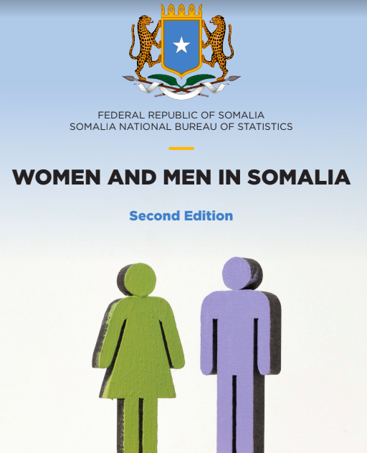
Gender Data

Slide 29
Collecting Data
Sources of Qualitative Data
- Open-ended interviews
- Oral histories / life histories
- Focus group discussions and consultations
- Reports
- In-depth case studies
- Discourse or content analysis
- Legal analysis
- Secondary data
Sources of Quantitative Data
- Surveys / polls / questionnaires
- Statistics
- Closed interviews
- Observations
- Document review and secondary data
Notes:
Inclusive research that is gender-transformative and disability-inclusive should make use of a variety of data collection methods (both quantitative and qualitative), a process that is referred to as triangulation. Triangulation allows a researcher to collect a wide array of data in order to: reduce bias that comes from using a single method; enhance validity by approaching the same topic with different tools; and establish credibility by providing a complete picture of the research problem. Increasing the sources of data allows for a more intersectional approach, especially when utilizing qualitative methods as they place the perspectives of marginalized persons/groups at the center of research. The addition of qualitative methods, such as life histories and case studies, allows researchers to delve deeper into the factors, processes and relationships that shape people’s opportunities, and allows for research to more thoroughly examine similarities and differences across groups and subgroups, and similarities and differences over time.

Slide 30
And Asking the Right Questions
Who has power?
Who owns/controls resources?
Who takes the decisions?
Who sets the agenda?
Who gains, and who loses?
Which men, and which women?

Slide 31
Discussion
In your Ministry, what work has been done to conduct a Gender Analysis?
What types of data or information is collected?

Slide 32
Any questions?

Slide 33
Mahadsanid!

