Slide 1
Workshop on Optimizing poverty reductions in Arab States: Measurement and tools to inform policies
Presentation
Multidimensional Poverty Index (MPI) Report
^{28th} November, 2023
Amman, Jordan

Slide 2
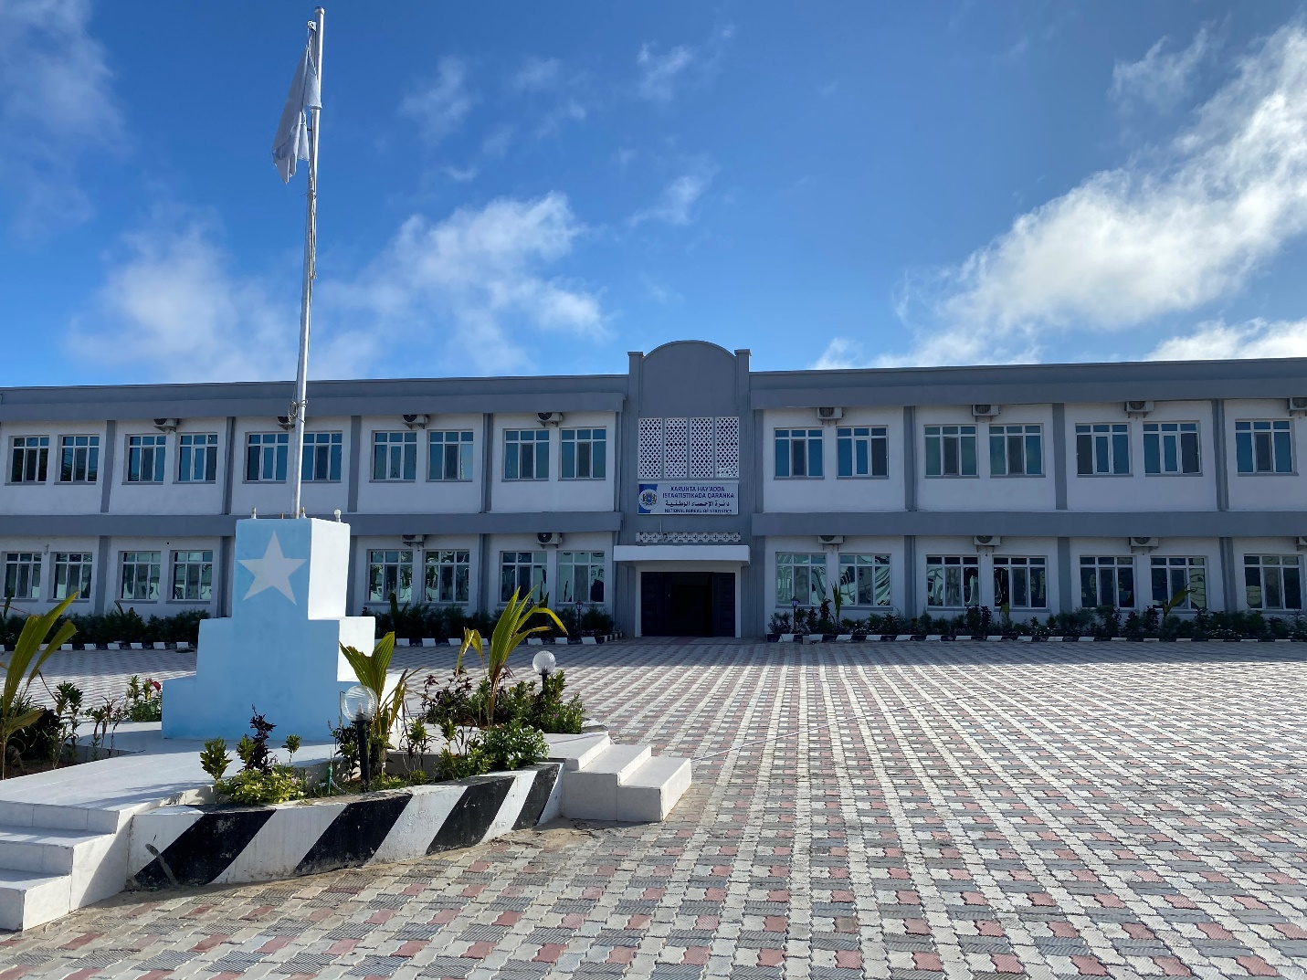
Somalia National Bureau of Statistics

Slide 3
Outline
Overview
Data, MPI Methodology
Somalia national MPI framework
Indicator Cut-offs
Headcount ratio (H), and average intensity (A) by subgroup
MPI scores by subgroup
Censored Headcount Ratios, National, Urban, Rural & Nomadic
Contribution of indicators to MPI
MPI by education of household head
Conclusion

Slide 4
Overview (1/2)
The MPI is an index designed to measure acute poverty.
it includes people living under conditions where they do not reach the minimum internationally agreed standards in indicators of basic functioning
it refers to people living under conditions where they do not reach the minimum standards in several aspects at the same time.

Slide 5
Overview (2/2
The MPI combines two key pieces of information to measure acute poverty:
the incidence of poverty, or the proportion of people (within a given population) who experience multiple deprivations
the intensity of their deprivation - the average proportion of (weighted) deprivations they experience.
MPI is highest with a score of 1 if all people are deprived in all indicators, and lowest with a score of 0 if no one is deprived in any of the chosen indicators

Slide 6
Data, MPI Methodology
The national MPI relies on data collected from the Somalia Health and Demographic Survey (SHDS)
MPI is based on the Alkire-Foster (AF) counting method. This method counts the various deprivations people face simultaneously
Based on a framework of such indicators, the AF-method applies a dual cut-off approach.
This first identifies whether a person is deprived in a certain indicator using indicator-specific cut-offs.
Applying the second cut-off, which is poverty cut- off k, determines whether a person is MPI-poor or not

Slide 7
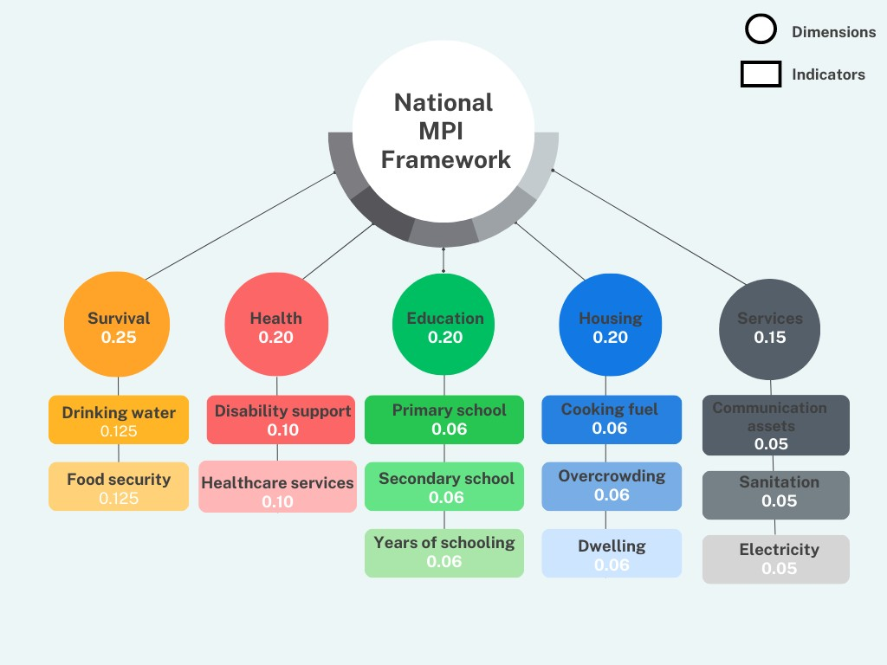
Somalia national MPI framework

Slide 8
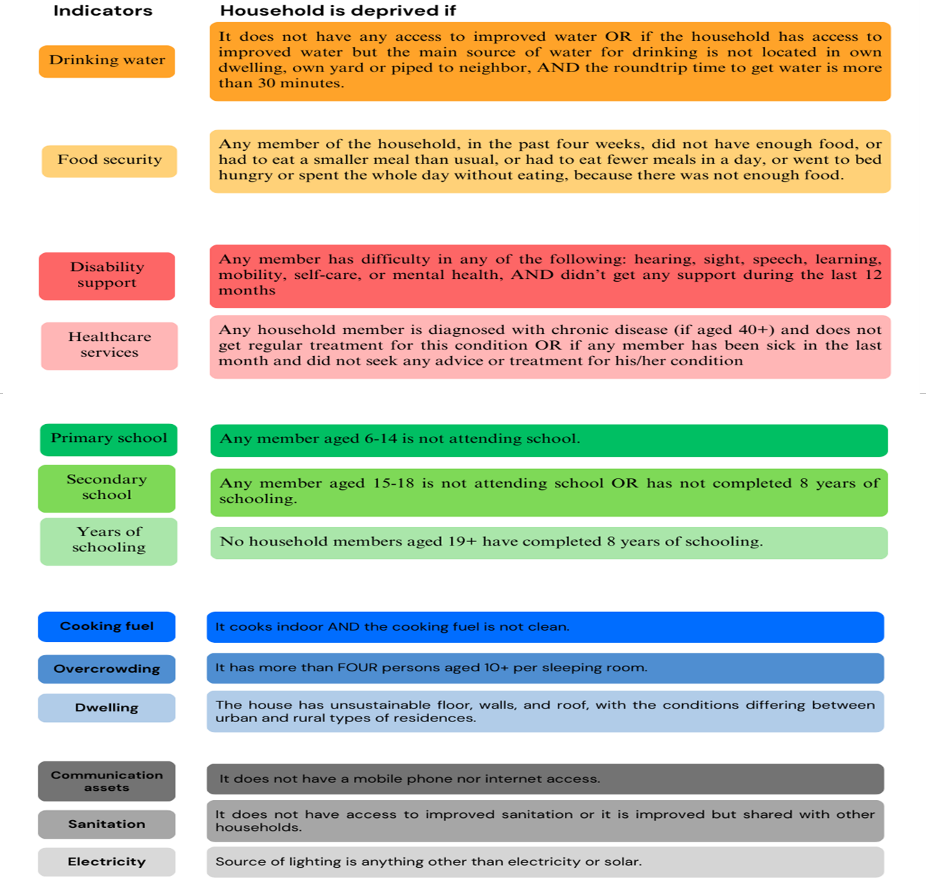
Indicator Cut-offs

Slide 9
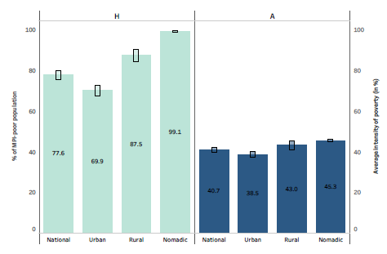
Headcount ratio (H), and average intensity (A)
by subgroup

Slide 10
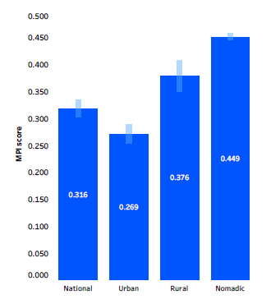
MPI scores by subgroup:

Slide 11
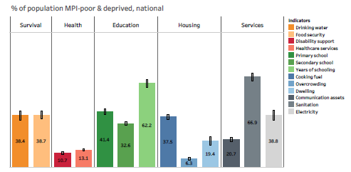
Censored Headcount Ratios, National

Slide 12
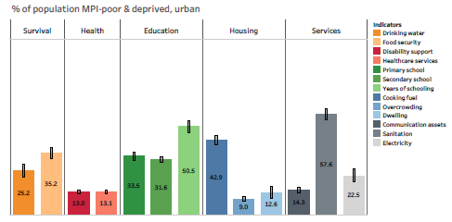
Censored Headcount Ratios, Urban

Slide 13
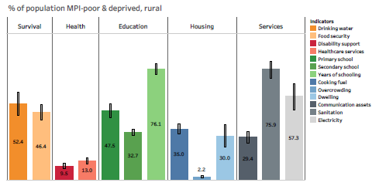
Censored Headcount Ratios, Rural

Slide 14
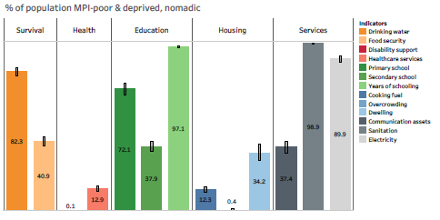
Censored Headcount Ratios, Nomadic

Slide 15
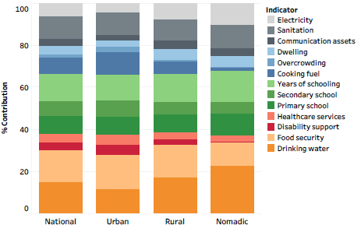
Contribution of indicators to MPI
Notes:
Percentage contributions of indicators for urban, rural and nomadic populations

Slide 16
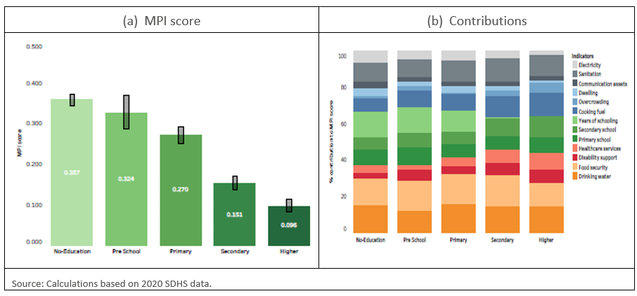
MPI by education of Household Head

Slide 17
Conclusion (1/2)
National MPI is widespread and intense, especially in rural areas and among nomadic populations
Another particularly vulnerable group is older people. Their MPI scores are higher than those of other age groups.
Food insecurity and lack of access to drinking water are the highest contributing factors, making three in four Somalis MPI-poor

Slide 18
Conclusion (2/2)
On average, the MPI-poor are deprived in 40 per cent of the 13 indicators that constitute the national MPI
Educational level of household head makes a significant difference in the incidence and intensity of poverty.
Those living in households where the household head does not have any education are most likely to experience multidimensional poverty.
In contrast, the higher the educational level of the household head, the less likely it is for household members to be MPI-poor.

Slide 19
Mahadsanidiin!

