Slide 1
Child poverty in the 2nd
Arab Multidimensional Poverty Report
Highlights
UNICEF MENARO – Amman - 29 November 2029

Slide 2
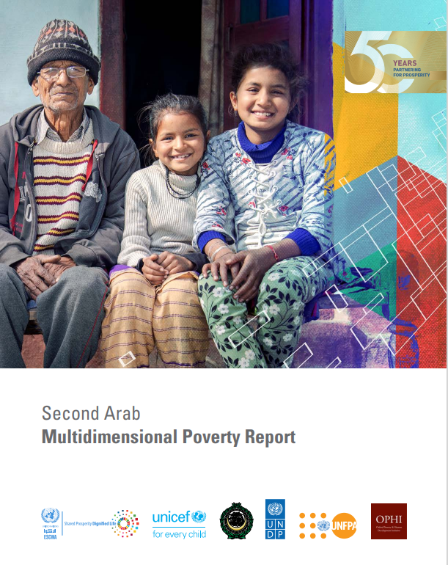
The Arab Multidimensional Poverty Report
First Arab Multidimensional Poverty Report – 2017, a cooperation between UNESCWA, LAS, UNICEF and OPHI
Regional initiative to measure progress towards the SDG 1.2.2
Arab Strategic Framework for the Eradication of Multidimensional Poverty (2018-19)
Plan for regular updates of the multidimensional poverty analysis
Second Arab Multidimensional Poverty Report – expanded partnership (+ UNDP and UNFPA)
Report Launch January 2023 at the Arab Ministerial Forum of Social Development Ministries.
Notes:
Process
Revised Arab MPI endorsed in the 40th in 17 December 2020 by the Arab Social Ministerial Council as the basis for measuring household multidimensional poverty in the report.
Preparatory Discussion held in Amman on 27 October 2021, which aimed to discuss the process and structure of the Report which was endorsed by the LAS Ministerial Council meeting held in Amman on 25 October 2021.
A high-level meeting was held in Amman on 16 October 2022 with the participation of partners and member states to discuss the first draft of the Second Arab Multidimensional Poverty report and receive suggestions from the member states.
Launched on 25 Jan 2023 in Doha at the High-Level Policy Event on child poverty and disabilities, side event to the Arab Ministerial Meeting of the Ministry of Social Development

Slide 3
The second Arab Multidimensional Poverty Report
Assess the multidimensional poverty in the Arab Region, comparing the early 2010s to the late 2010s, with a focus on the region’s Middle-Income countries (7 countries with suitable data – Separated analysis for the state of Palestine)
Two separate measures for multidimensional poverty, one for the household level and one for the child
Discuss the impact of COVID-19 on the determinants of poverty
Review the policy recommendations of the 1st Report, in view of the new findings and the impacts of COVID-19 and the spillover effects of the war in Ukraine.

Slide 4
Child poverty in the Arab Poverty report
The 1st Arab Poverty Report recognizes the importance of having a specific focus on children, along with the household level measurement (assessed through the Arab-MPI).
Child poverty is different from adult poverty (and different are their consequences). Poverty measured at the household level may hide childhood poverty (complementarity of household-level and child-level measurements).
Importance of having a measure with the child as unit of observation/measurement and based on the constitutive rights of poverty (material deprivation), grounded on the Convention on the Rights of the Child.

Slide 5
The Arab-MODA approach to measure child poverty
Based on the global ‘Multidimensional Overlapping Deprivation Analysis’ (MODA) approach developed by UNICEF in 2012
Adapted to the Arab context: Parameters defined reflecting those used in national child poverty measurement in Arab Countries [11]
Deprivation thresholds defined to reflect the socio-economic contexts of the Arab region
Focus on children aged 0-17 (with 2 sub-groups, children 0-4 and children 5-17)
A child is considered multidimensional poor if deprived in at least two essential dimensions of well-being
Statistics generated for children as individuals, and not for households

Slide 6
The Arab-MODA framework
Children 0-59 months
Dimension | Indicator
Health | No skilled birth assistance
 | No-ante natal care
 | Not fully immunized
Nutrition | Inadequate infant and young child feeding
 | Wasting
 | Stunting
 | Obesity
Water | No piped water inside the dwelling
Sanitation | Unimproved toilet facility
Housing | Shared toilet
Housing | Overcrowding
 | Poor floor & roof material
Children 5-17 years
Dimension | Indicator
Education | Not enrolled in school
 | Two or more grades behind school or did not complete primary (from age of end of primary to 17)
Information | No access to any information device
 | No access to any communication device
Water | No piped water inside the dwelling
Sanitation | Unimproved toilet facility
Housing | Shared toilet
Housing | Overcrowding
 | Poor floor & roof material

Slide 7
The child population in the Arab MICs covered in the analysis
Table 1 – Child population in the selected Arab Middle-Income countries (2020)
Child population | 0-4 years old | 5-17-year-olds | 0-17-year-olds | 0-17 years old as a share of the total population of each country | Share in the total child population of the seven countries
 | (in thousands) |  |  | % | %
Algeria | 5,042 | 10,250 | 15,292 | 34.9% | 16.2%
Egypt | 12,697 | 27,291 | 39,988 | 39.1% | 42.3%
Iraq | 5,380 | 12,322 | 17,702 | 44.0% | 18.7%
Jordan | 1,058 | 2,931 | 3,989 | 39.1% | 4.2%
Morocco | 3,381 | 8,490 | 11,871 | 31.6% | 12.6%
Palestine | 693 | 1,579 | 2,272 | 44.5% | 2.4%
Tunisia | 1,004 | 2,340 | 3,344 | 28.3% | 3.5%
Total | 29,255 | 65,203 | 94,458 | 37.6% | 100.0%
7 Arab Middle- Income countries are covered by the analysis of child multidimensional poverty
Available data covers slightly less than 95 million children, around 57% of the regional population aged less than 18.
Source: UN Population Division

Slide 8
Prevalence of child multidimensional poverty in 6 MICs, in the mid-to-late 2010s
Overall, in the 6 MICs covered by the analysis, 22.9% of children are deprived in at least two essential dimensions of their well-being
Around a child out of three in the age group 0-4 lives in multidimensional poverty
Pre-covid situation, many dimensions likely affected by the socio-economic impacts of the pandemic
Country coverage: Algeria, Egypt, Iraq, Jordan, Morocco and Tunisia

Slide 9
% of children deprived in the different dimensions of well-being, 6 MICs, mid-to-late 2010s
Still around one-third of children under-5 are deprived in the nutrition (inadequate diets, stunting, wasting and obesity)
A similar proportion of children under-5 is deprived in health (with growing numbers of children not completely immunized)
Almost one school-age child in five is deprived in education.
Nutrition, health and education are the
dimensions most likely affected by the socio-econ consequences of COVID-19

Slide 10
Changes in the prevalence of multidimensional child poverty in 6 Arab MICs, from early to mid-to-late 2010s

Slide 11
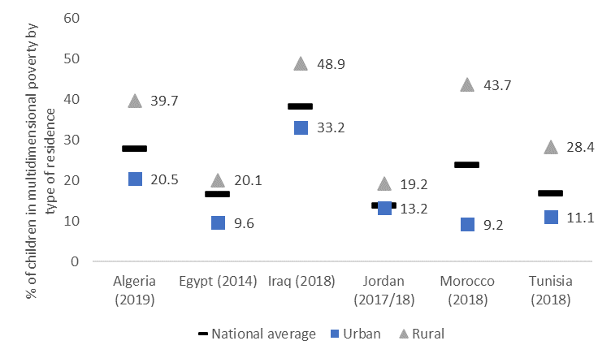
Disparities in dimensional child poverty within countries mid-to-late 2010s
The analysis confirmed the marked disadvantage of children living in rural and remote areas (see fig.), but with notable signs of improvement over time.
Other factors strongly associated with multidimensional child poverty are the household wealth, the level of education of the head of the hh (when it is below the secondary school) and the household size (more than 3 children in the hh)
The association between the sex of the hh head and poverty is not emerging strongly.

Slide 12
Multidimensional child poverty in the State of Palestine (using the Arab MODA framework)
Decline in child poverty prevalence (but virtual stagnation since 2014)
Highest rates in refugee camps, followed by urban areas
Highest levels of deprivation in water (46%). One child in five deprived in the nutrition dimension, and a similar share deprived in health.

Slide 13
Adding the MENA low-income countries to the picture

Slide 14
Adding the MENA low-income countries to the picture / 2

Slide 15
Elements for reflections
Importance to keep a child focus, with a complementary and distinct child-centred measure of multidimensional poverty
Despite important progress, around one child in four in Arab MICs was living in multidimensional poverty towards the end of the 2010s. Heterogeneity between MICs (headcount ratios ranging between 13% and 38%).
The large majority of children in Arab LICs are multidimensional poor (around 80%)
The situation has likely deteriorated since then due to compounding crises (COVID-19, Ukraine war, conflicts etc.)
Part of the progress in the 2010s is due to the reduction of inequalities. Still, they are persistent, especially between urban and rural areas, wealth quintiles and other socio-economic characteristics
Some common implications focusing on nutrition, access to health, education, equity in access to social infrastructure, reduction of inequalities

Slide 16
Recommendations of the 2nd Arab Poverty Report
Building on the recommendations of the first Arab Multidimensional Poverty Report, this report emphasizes some recommendations that are still relevant and introduces new necessary actions in light of the new developments. The report’s proposals in this respect can be summarized as follows:
A. Health
1- Strengthening the capacity of health systems to respond to existing health demands as well as unexpected shocks.
2- Prioritizing maternal and child health, along with sexual and reproductive health and investing in water, sanitation and child nutrition.
B. Education
1- A shift in focus from quantity to quality of education is needed.
2- Implementing inclusive policies that target educational attainment for all children, regardless of sex, socioeconomic background or ability

Slide 17
Recommendations of the 2nd Arab Poverty Report
C. Building resilience and the capacity to manage risks and vulnerability
1- A greater policy focus on incomes, expenditure, markets and prices to achieve food security objectives.
2- Strengthening disaster risks and early warning systems.
3- Managing risks and vulnerability which involves investing in social protection and scaling up effective coverage of protection.
4- In the longer term, empowering a healthy and inclusive labour market, and realizing the economic capacity to create decent jobs.
D. Spearheading digital transformation and narrowing the digital divides, particularly in Arab LDCs.
1- Investing in information and communications technology infrastructure in LDCs
2- Ensuring inclusion in access to digital services by promoting digital literacy and integrating digitalization into the school curriculum;
3- Re-examining policies and the regulatory environment.

Slide 18
Recommendations of the 2nd Arab Poverty Report
E. Striving towards a faster, greener, resilient and equitable recovery from current crises
1- Embarking on investing in an inclusive green economy and boosting a green and resilient recovery
2- Promoting community-based and community-owned solutions and approaches, particularly in indigenous communities, and accelerating the transition to green energy as part of the COVID-19 response.
F. Building Arab states’ institutional capacity
1- Strengthening the data collection system in Arab countries and encouraging regional collaboration for multidimensional poverty analysis.
2- Empowering the Arab Centre for Social Policy Studies and Eradication of Poverty in Arab States, with financial and human resources, and operationalizing the Arab Strategic Framework.
G. Strengthening cross-country economic ties.
1- Exchanging resources, including water, animal, agricultural, technological and petrochemical resources, as a pillar of safety for all societies.

Slide 19
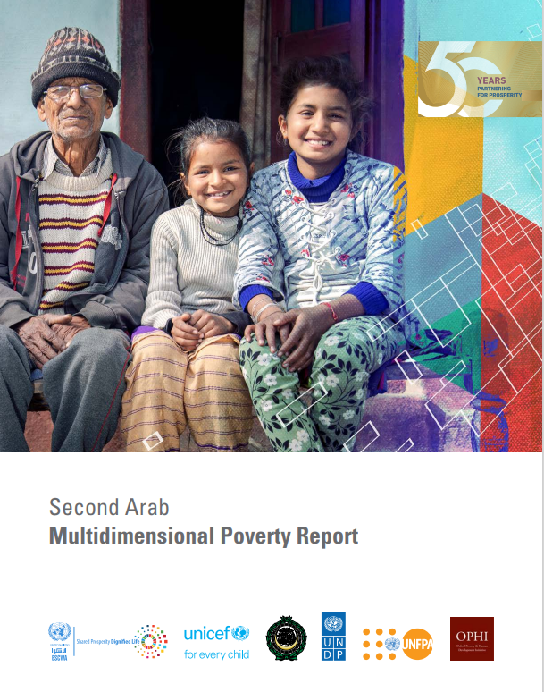
Thank you
The second Arab Multidimensional Poverty Report is available at:
https://www.unescwa.org/publications/second-arab-multidimensional-poverty-report

Slide 20
Annex
Status of multidimensional poverty measurement and analysis in MENA countries

Slide 21
The status of child poverty measurement in the MENA region
11 countries in the MENA region (out of 20) have carried out multidimensional child poverty measures (challenges, concerning: continuity in measurement, institutionalization in the context of monitoring the SDGs - inclusion in the NRV / national ownership)
2017 - Conference on Measuring Child Poverty in the MENA Region
2018 - Publication of the 1st report on child poverty in Arab countries (UNICEF, ESCWA, League of Arab States), using the MODA approach
2020 - Simulation analysis of the impact of COVID-19 on multidimensional child poverty
2023 - 2nd report on child poverty in Arab countries (UNICEF, ESCWA, League of Arab States)

Slide 22
The status of multidimensional child poverty measurement in the MENA region
Country | Status of the Measurement
Algeria | Measurement fully owned by national institutions (2019) and child multidimensional poverty reported in VNR – update of the measurement finalized in 2022 and report under review
Djibouti
Egypt | 4 studies using different methodologies, conducted with the national institutions. 2016 study with MoSS and CAPMAS. New measurement under finalization with MoPAD
Iran | Measurement conducted by the Government
Iraq | 2 studies using different methodologies – most recent finalized in 2022 – internal discussion to review the approach and the process (using MICS 2024)
Jordan | DoS approached to proceed with a national measure of multidimensional poverty for children, using the 2023 DHS data

Slide 23
The status of multidimensional child poverty measurement in the MENA region
Country | Status of the Measurement
Lebanon | Qualitative study on child multidimensional poverty conducted in 2022 – plan to produce a measure of MDCP with national partners in 2024, with the data of the new MICS
Libya | Child poverty measurement produced by UNICEF in partnership with national institutions, completed in 2022 – not institutionalized
Morocco | 2 measures of multidimensional child poverty conducted with national partners (ONDH) in 2017 and 2022 – report under finalization
Palestine | Measurement done in 2017 not approved by national partners – National process for producing a new child multidimensional poverty measures under discussion with MoDS, PCBS and Prime Minister Office
Sudan
Tunisia | National measurement of child multidimensional poverty produced by UNICEF with national partners – 2 reports, 2017 and 2022 – used in VNR, but not institutionalized – discussion ongoing on institutionalization
Yemen | Preparatory work for a process of establishing a measure using MICS

