Slide 1
Regional workshop on Multidimensional Poverty Indices for poverty Reduction Strategies Beirut 28-30 November 2022
Iraq’s Experience in Building an MPI
Mahdi Al-Alak Former Secretary General of the Iraqi Council of Ministers

Slide 2
The previous national efforts for measuring multidimensional poverty
Despite CSO being one of the advanced agencies in Iraq in conducting the social and economic household conditions surveys where these surveys have been conducted in 1961, 1971,1976,1979,1984, 1988, 1993, and 2000, and the results were not used in measuring poverty in any way. The interest in measuring poverty in Iraq started after 2003.
With the absence of new statistical indicators necessary for formulating development programs, CSO and KRSO conducted a large field survey in cooperation with UNDP and FAFO on living conditions in 2004. The survey covered 22000 households selected from the 18 Iraqi governorates.

Slide 3
Living conditions in Iraq 2004 A report of three volumes was released and used for some development programs. Below are some of the results;

Slide 4
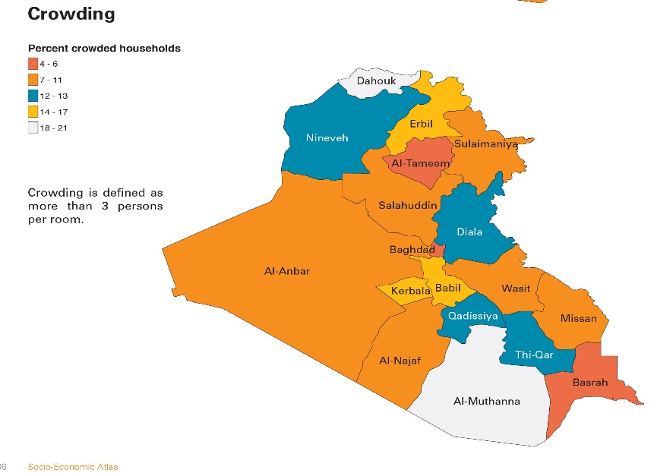
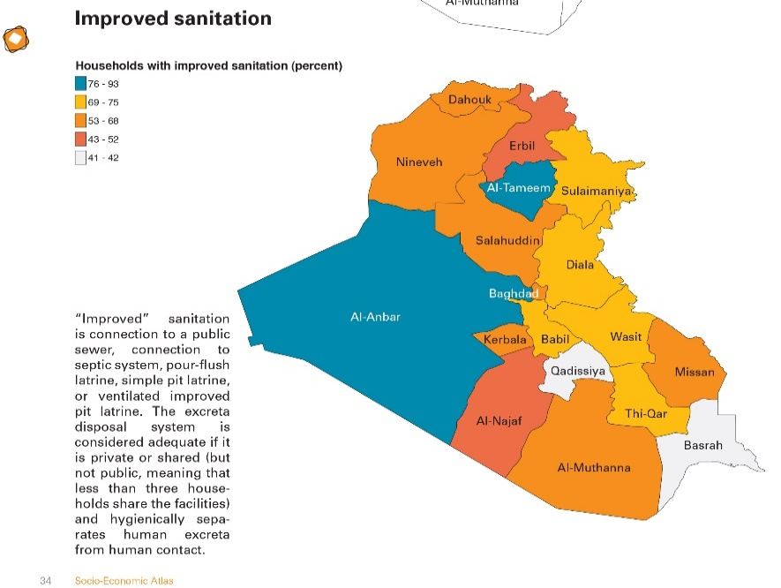

Slide 5
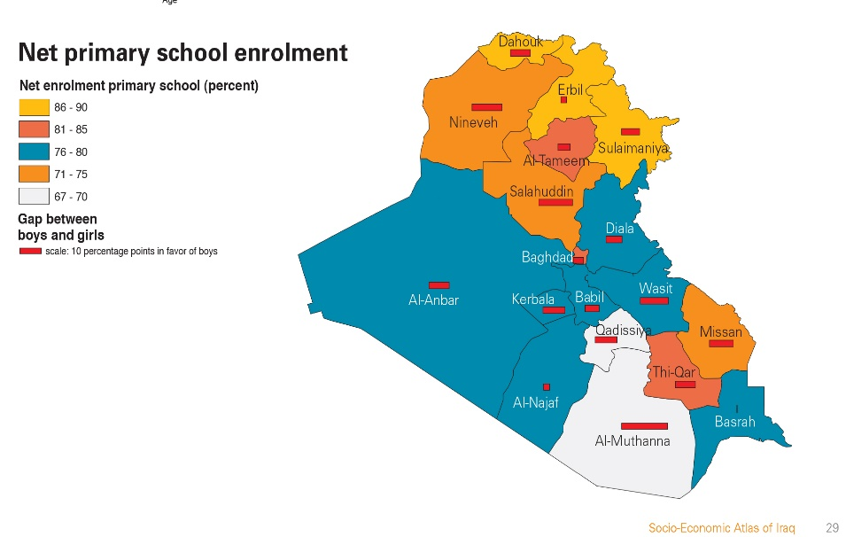
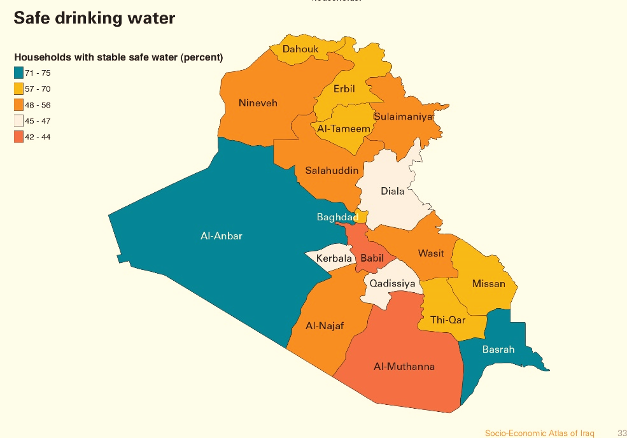

Slide 6
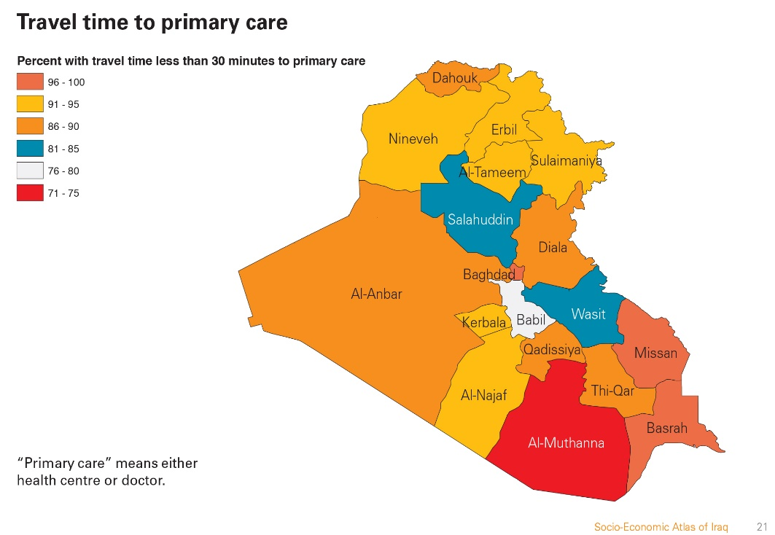
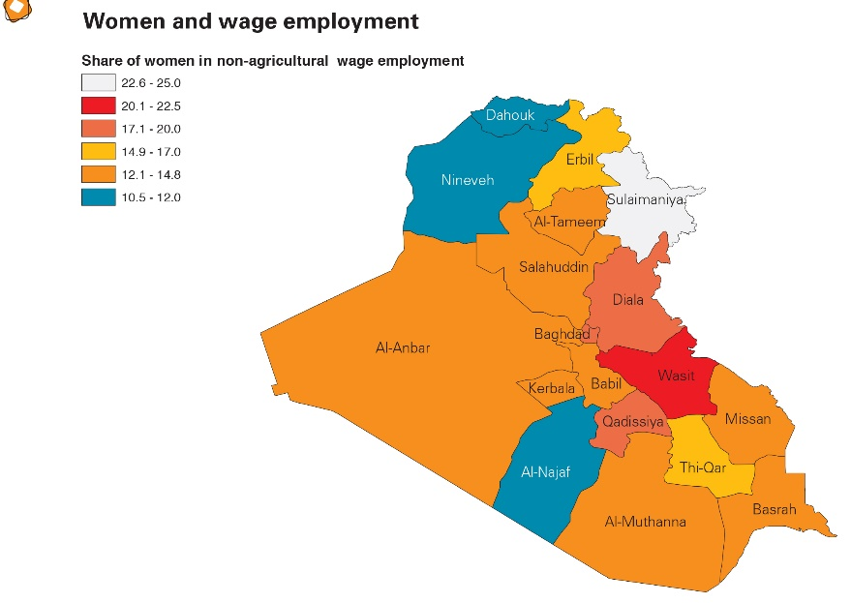

Slide 7
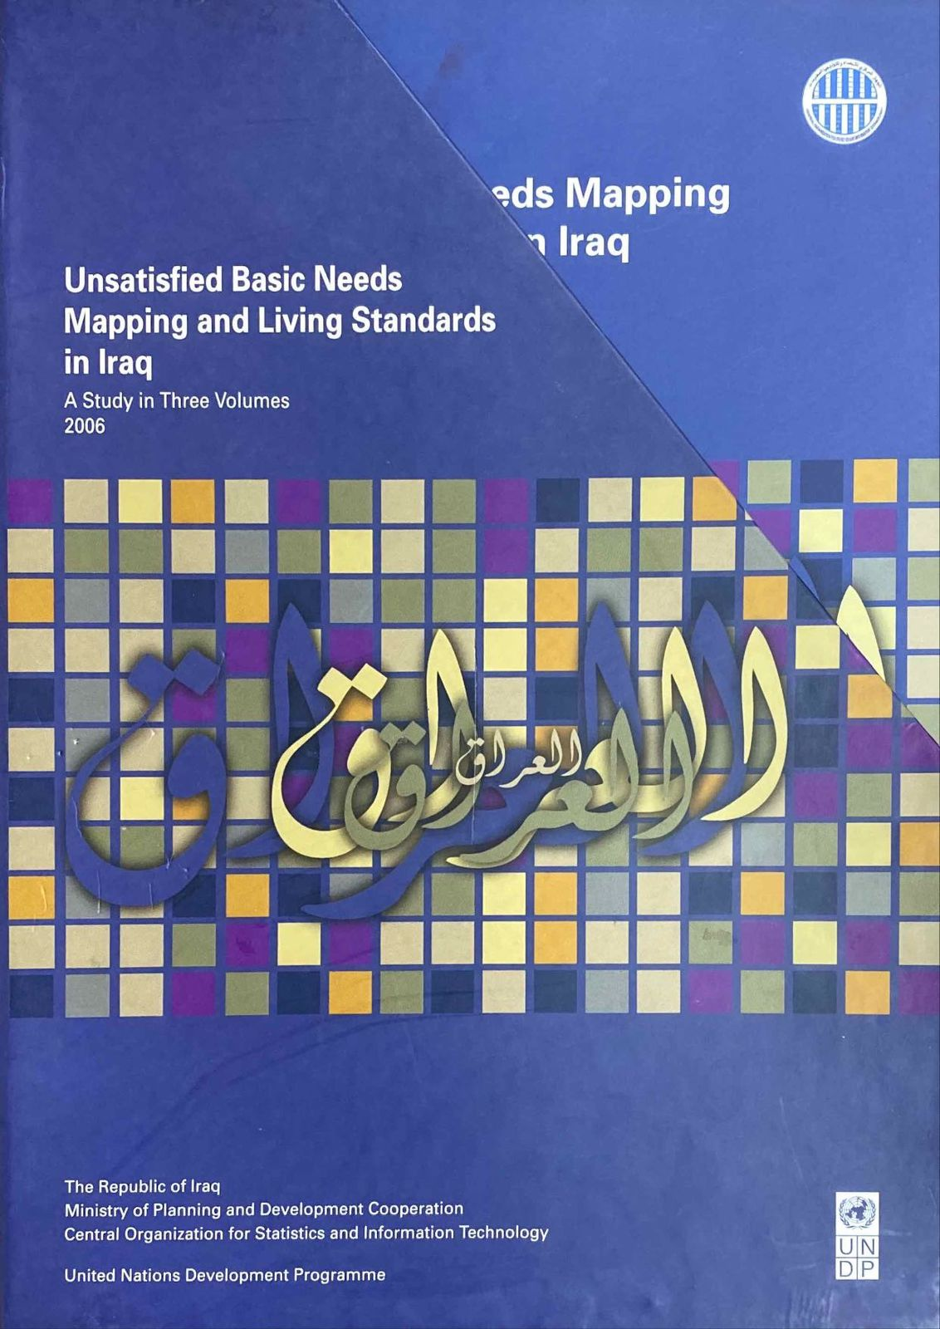
Unsatisfied basic needs Mapping and living Standard in Iraq, 2006
After publishing the survey results of the living conditions in Iraq, 2004 many questions raised about the possibility of carrying out further analysis to complete what was accomplished in the first analytical report, and to estimate an overall living index

Slide 8
The Aspects and indicators of the deprivation indices
Field | No. of Aspects | No. indicators
Education | 4 | 5
Health | 5 | 7
Infrastructure | 3 | 7
Housing | 5 | 5
Dwelling neighbored | 6 | 9
Household economic status | 5 | 9
Level of living index | 28 | 42

Slide 9
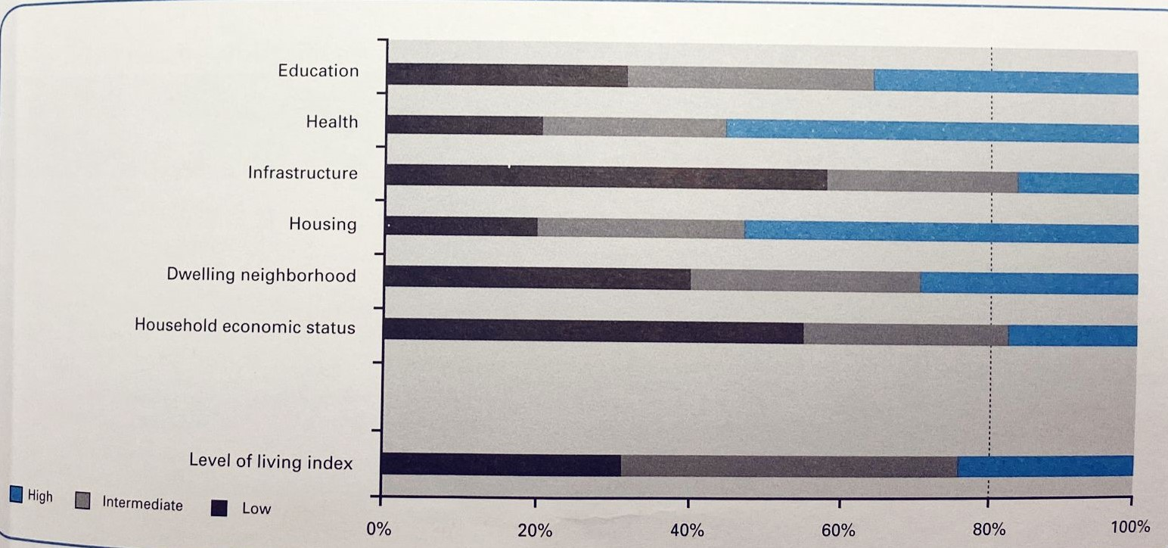
Level of deprivation :3-level classification , all Iraq (percent of households )

Slide 10
Deprivation level: 5- level classification, all Iraq ( percent of households )
Field | Level of Deprivation |  |  |  |  | Total
 | Very high | High | Intermediate | Low | Very low
Education | 13.8 | 18.0 | 32.7 | 28.0 | 7.5 | 100.0
Health | 7.9 | 12.8 | 24.2 | 29.5 | 25.6 | 100.0
Infrastructure | 28.3 | 29.9 | 25.5 | 13.1 | 3.2 | 100.0
Housing | 6.6 | 13.5 | 27.1 | 28.5 | 24.3 | 100.0
Dwelling neighborhood | 15.5 | 24.9 | 30.2 | 20.5 | 8.9 | 100.0
Household economic status | 23.8 | 31.3 | 27.4 | 13.4 | 4.1 | 100.0
Level of living index | 5.4 | 25.8 | 44.8 | 22.0 | 2.0 | 100.0

Slide 11
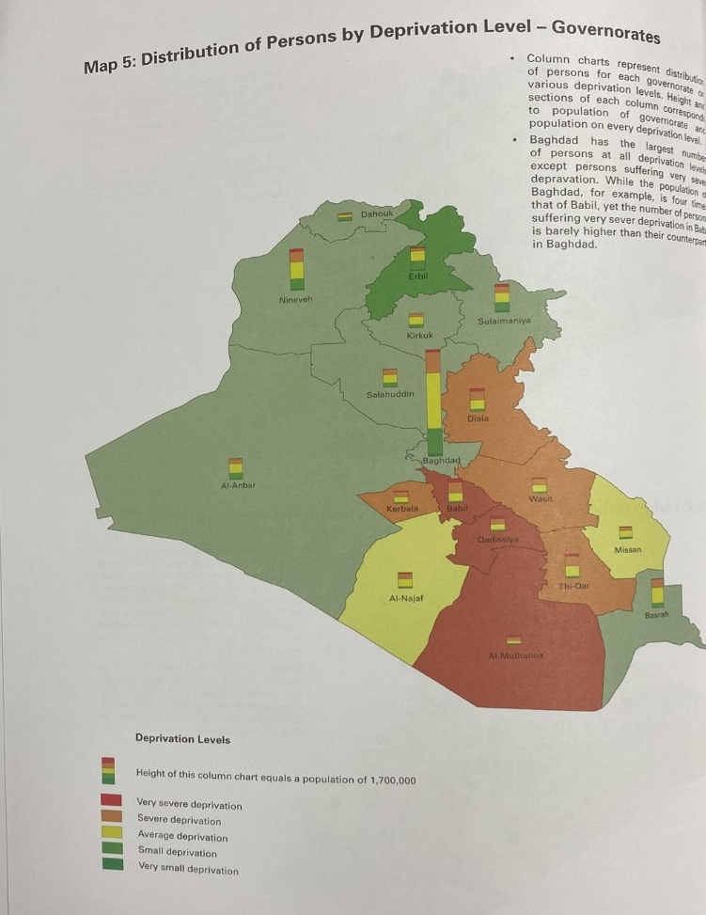
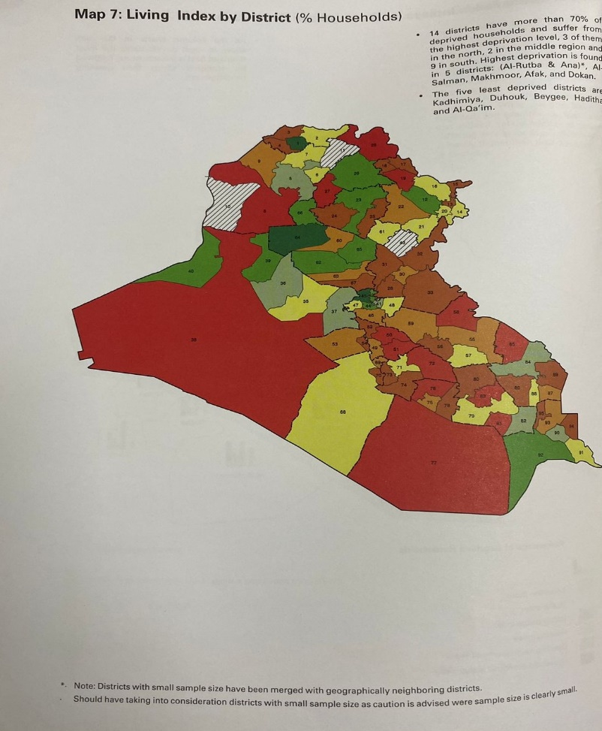

Slide 12
New Socio-Economic surveys in Iraq
Iraq Household Socio-Economic Survey ( IHSES I,2007)
Iraq Household Socio-Economic Survey ( IHSES II,2012)
Survey of Well-being via Instant and Frequent Tracking (SWIFT 2018)
Poverty indicators :
Followed by two poverty reduction strategies
IHSES I 2007 22.9%
IHSES II 2012 18.9%
SWIFT 2018 20.05%

Slide 13
Adoption of Multidimensional Poverty Methodology
After a number of capacity-building programs with OPHI, supported by UNICEF Iraq is currently finalizing the first NMPI in addition to a child-adjusted MPI by using;
Alkire-Foster Method:
The Alkire-Foster (AF) method is a way of measuring multidimensional poverty developed by OPHI’s Sabina Alkire and James Foster.
There are three key features for any MPI:
Incidence or headcount ratio (H) which is the proportion of the population who are multidimensional poor.
Average Intensity (A) is the average share of weighted indicators in which multidimensional poor people are deprived.
MPI or adjusted headcount ratio is the Multidimensional Poverty Index, which is the product of incidence and intensity (MPI = H × A).

Slide 14
Methodology
The Structure of the Iraq MPI
Unit of Identification and Analysis
Dimensions, Indicators and Deprivation Cut-offs
Weights and Poverty Cut-offs
Levels of Deprivation
Robustness of the Iraq MPI

Slide 15
The national MPI of Iraq - dimensions, indicators and deprivation cut-offs
Dimension | Indicator | Deprivation Cut -off: A household is deprived if…
Education | School attendance | Any school-aged child (6-17) in the household is not attending school
 | Years of schooling | No household member aged 15 and older has completed nine years of schooling
 | Access to internet | The household does not have access to the internet at home
Health | Child mortality | A child under 18 has died in the household in the five-year period preceding the survey
 | Nutrition | Any child under the age of 5 in the household is suffering from underweight, stunting or wasting
 | Early marriage | Any female in the household has married before turning 18
Housing | Home ownership | A member of the household does not own the dwelling
 | Overcrowding | The household has more than three members per sleeping room
 | Electricity | The household does not have access to electricity or only has access to electricity through the public grid
 | Clean energy | The household is using unclean fuels for cooking (gasoline, diesel, kerosene, paraffin, coal, lignite, charcoal, wood, crops, grass/straw, animal dung, sawdust, or other), heating (gasoline, diesel, coal, lignite, charcoal, wood, crops, grass/straw, animal dung, pellets, woodchips or other), or lighting (kerosene, paraffin, charcoal, wood, animal dung, oil lamp, candle, or other)
 | Drinking water | The source of drinking water for the household is not improved (unprotected well or spring, surface water from river, dam or lake, or other) or it takes 30 minutes or more round trip to collect the water or in the last month the household did not have sufficient quantities of water
 | Sanitation | The sanitation facility is not flush to piped system or septic tank, or it is shared with other households

Slide 16
Iraq’s National MPI UN Censored headcount ratios in Iraq

Slide 17
Iraq’s National MPI
Index | Value | Confidence Interval (95%)
MPI | 0.127 | 0.117 | 0.137
Incidence (H, %) | 26.6 | 24.7 | 28.6
Intensity (A, %) | 47.7 | 47.2 | 48.2

Slide 18
Iraq’s National MPI Censored headcount ratios in Iraq

Slide 19
Iraq’s National MPI by Area
Index | Rural |  |  |  | Urban
 | Population Share (%) | Value | Confidence Interval (95%) |  | Population Share (%) | Value | Confidence Interval (95%)
MPI | 30.7 | 0.189 | 0.161 | 0.217 | 69.3 | 0.100 | 0.090 | 0.109
Incidence (H, %) |  | 38.7 | 33.1 | 44.3 |  | 21.3 | 19.3 | 23.3
Intensity (A, %) |  | 48.9 | 48.1 | 49.6 |  | 46.8 | 46.2 | 47.3

Slide 20
Percentage contribution of each indicator to MPI by area

Slide 21
Iraq’s National MPI by Region
Index | Kurdistan |  |  |  | South/Central Iraq
 | Population Share (%) | Value | Confidence Interval (95%) |  | Population Share (%) | Value | Confidence Interval (95%)
MPI | 16.6 | 0.043 | 0.029 | 0.057 | 83.4 | 0.144 | 0.134 | 0.153
Incidence (H, %) |  | 9.3 | 6.3 | 12.4 |  | 30.1 | 28.2 | 32.0
Intensity (A, %) |  | 45.9 | 44.4 | 47.3 |  | 47.8 | 47.3 | 48.3

Slide 22
Percentage contribution of each indicator to MPI by region

Slide 23
Iraq’s National MPI by Governorate

Slide 24
Maps of incidence of multidimensional poverty and number of people who are poor by governorate

Slide 25
Percentage contribution of each indicator to MPI by governorate (ordered by MPI)

Slide 26
Iraq’s National MPI by Household Size
Household Size | Population Share (%) | MPI |  |  | Incidence (H, %) |  |  | Intensity (A, %)
 |  | Value | Confidence Interval (95%) |  | Value | Confidence Interval (95%) |  | Value | Confidence Interval (95%)
1-3 | 5.4 | 0.036 | 0.025 | 0.048 | 8.5 | 5.6 | 11.4 | 42.8 | 41.5 | 44.2
4-6 | 36.9 | 0.082 | 0.074 | 0.091 | 18.1 | 16.2 | 20.0 | 45.4 | 44.9 | 46.0
7-9 | 35.6 | 0.140 | 0.126 | 0.153 | 29.4 | 26.6 | 32.3 | 47.5 | 46.9 | 48.2
10+ | 22.2 | 0.203 | 0.183 | 0.223 | 40.7 | 36.8 | 44.7 | 49.8 | 48.9 | 50.7

Slide 27
Percentage contribution of each indicator to MPI by household size

Slide 28
Multidimensional poverty by education of household head
Education of Household Head | Population Share (%) | MPI |  |  | Incidence (H, %) |  |  | Intensity (A, %)
 |  | Value | Confidence Interval (95%) |  | Value | Confidence Interval (95%) |  | Value | Confidence Interval (95%)
Pre-primary | 15.6 | 0.197 | 0.176 | 0.219 | 39.3 | 35.2 | 43.3 | 50.2 | 49.1 | 51.3
Primary | 35.1 | 0.179 | 0.164 | 0.194 | 37.4 | 34.3 | 40.4 | 47.8 | 47.2 | 48.4
Lower secondary | 21.6 | 0.118 | 0.104 | 0.132 | 25.5 | 22.6 | 28.5 | 46.0 | 45.3 | 46.8
Upper secondary+ | 27.6 | 0.029 | 0.024 | 0.034 | 6.7 | 5.6 | 7.9 | 43.6 | 42.8 | 44.4

Slide 29
Percentage contribution of each indicator to MPI by education of household head

Slide 30
Iraq’s National MPI by Wealth Quintile
Wealth Quintile | MPI |  |  | Incidence (H, %) |  |  | Intensity (A, %)
 | Value | Confidence Interval (95%) |  | Value | Confidence Interval (95%) |  | Value | Confidence Interval (95%)
Poorest | 0.302 | 0.284 | 0.319 | 60.8 | 57.7 | 63.8 | 49.7 | 48.9 | 50.4
Second | 0.153 | 0.139 | 0.167 | 32.6 | 29.3 | 35.9 | 46.8 | 45.9 | 47.8
Middle | 0.103 | 0.087 | 0.119 | 22.0 | 18.7 | 25.3 | 46.7 | 45.8 | 47.6
Fourth | 0.053 | 0.046 | 0.061 | 12.2 | 10.5 | 14.0 | 43.7 | 42.9 | 44.6
Richest | 0.023 | 0.015 | 0.031 | 5.3 | 3.5 | 7.1 | 43.9 | 41.9 | 45.9

Slide 31
Percentage contribution of each indicator to MPI by wealth quintile

Slide 32
Child – Adjusted
Multidimensional Poverty Index- Iraq
Child-adjusted
MPI

Slide 33
Child-adjusted MPI
The child-adjusted MPI of Iraq - dimensions, indicators and deprivation cut-offs
Dimension | Indicator | Deprivation Cut-off: A household is deprived if…
Education | School attendance | As per national MPI
 | Years of schooling | As per national MPI
 | Access to internet | As per national MPI
Housing | Home ownership | As per national MPI
 | Overcrowding | As per national MPI
 | Electricity | As per national MPI
 | Clean energy | As per national MPI
 | Drinking water | As per national MPI
 | Sanitation | As per national MPI
Health | Child mortality | As per national MPI
 | Nutrition | As per national MPI
 | Early marriage | As per national MPI
Child | School lag | At least one school aged child (8-17) is two years or more behind in school
 | Child protection | At least one child (aged 1-14) has experienced severe physical punishment
 | Child labour | At least one child (aged 5-17) was involved in economic activities in the previous week

Slide 34
Child-adjusted MPI
Iraq’s Child-adjusted MPI – Key Results
Multidimensional poverty among children in Iraq
Index | Value | Confidence Interval (95%)
Child-adjusted MPI | 0.189 | 0.177 | 0.201
Incidence (H, %) | 46.9 | 44.1 | 49.6
Intensity (A, %) | 40.3 | 39.8 | 40.8

Slide 35
Child-adjusted MPI
Iraq’s Child-adjusted MPI by Area
Percentage contribution of each indicator to child-adjusted MPI by area

Slide 36
Child-adjusted MPI
Iraq’s Child-adjusted MPI by Region
Multidimensional poverty among children by region
Index | Kurdistan |  |  |  | South/Central Iraq
 | Population Share (%) | Value | Confidence Interval (95%) |  | Population Share (%) | Value | Confidence Interval (95%)
Child-adjusted MPI | 15.5 | 0.091 | 0.063 | 0.119 | 84.5 | 0.207 | 0.196 | 0.217
Incidence (H, %) |  | 24.0 | 16.9 | 31.2 |  | 51.1 | 48.8 | 53.4
Intensity (A, %) |  | 37.9 | 36.5 | 39.4 |  | 40.5 | 40.0 | 41.0

Slide 37
Child-adjusted MPI
Iraq’s Child-adjusted MPI by Region
Percentage contribution of each indicator to child-adjusted MPI by region

Slide 38
Child-adjusted MPI
Iraq’s Child-adjusted MPI by Governorate
Incidence of multidimensional poverty among children by governorate

Slide 39
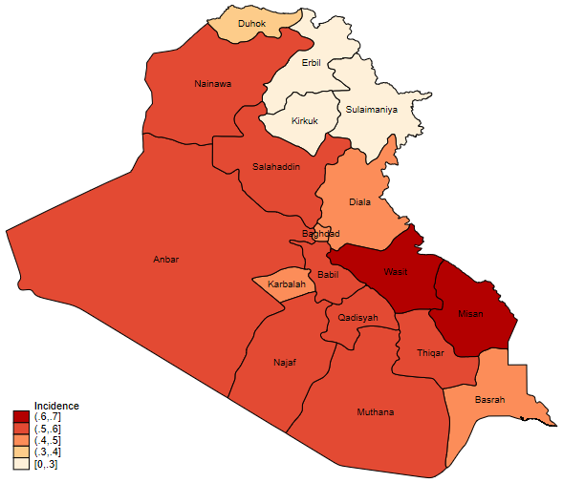
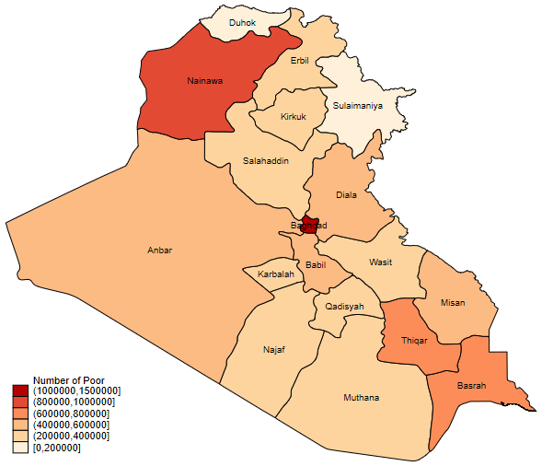
Child-adjusted MPI
Incidence of multidimensional child poverty and number of children who are poor by governorate

Slide 40
Child-adjusted MPI
Percentage contribution of each indicator to child-adjusted MPI by governorate (ordered by child-adjusted MPI)

Slide 41
Child-adjusted MPI
Iraq’s Child-adjusted MPI by Education of Mother
Multidimensional poverty among children by education of the mother
Education of Mother | Population Share (%) | MPI |  |  | Incidence (H, %) |  |  | Intensity (A, %)
 |  | Value | Confidence Interval (95%) |  | Value | Confidence Interval (95%) |  | Value | Confidence Interval (95%)
Pre-primary | 21.1 | 0.297 | 0.273 | 0.321 | 68.9 | 63.9 | 73.9 | 43.1 | 42.2 | 44.0
Primary | 45.5 | 0.217 | 0.204 | 0.230 | 54.8 | 51.7 | 57.9 | 39.7 | 39.3 | 40.1
Lower secondary | 17.7 | 0.122 | 0.109 | 0.136 | 32.9 | 29.3 | 36.5 | 37.1 | 36.4 | 37.9
Upper secondary+ | 15.1 | 0.027 | 0.021 | 0.033 | 8.0 | 6.3 | 9.6 | 33.9 | 33.0 | 34.8

Slide 42
Child-adjusted MPI
Iraq’s Child-adjusted MPI by Education of Mother
Percentage contribution of each indicator to child-adjusted MPI by education of mother

Slide 43
Lastly
Iraq, Ministry of Planning is working in cooperation with the World Bank to prepare for the third poverty reduction strategy.
The National MPI will be one of the main inputs for building the new strategy.
At the same time, CSO is working hard to implement IHSES III and MICS 7 which will be an important opportunity to update the measurement of monetary and multidimensional poverty.

Slide 44
THANKS

