Slide 1

Session 5: Poverty trends and challenges
Workshop on
Optimizing poverty reductions in Arab States:
Measurement and tools to inform policies
Hashemite Kingdom of Jordan, Amman
CLAUDIO SANTIBANEZ, DIVISION OF INCLUSIVE SOCIAL DEVELOPMENT
DESA

Slide 2
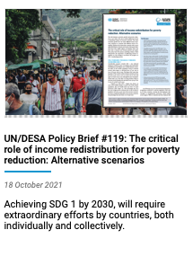
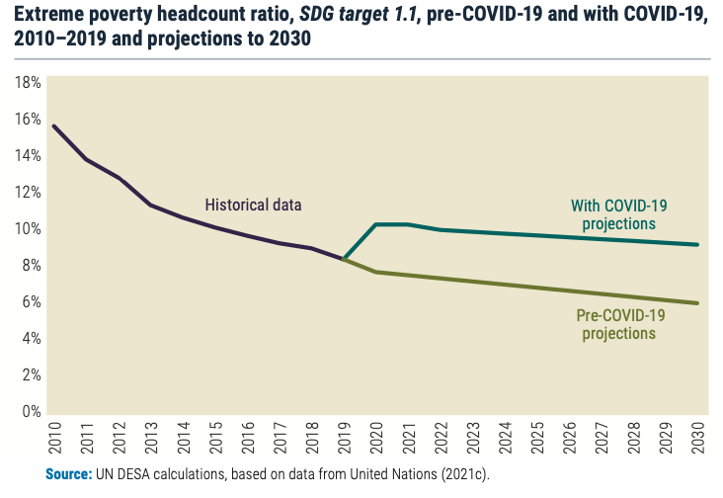

Slide 3
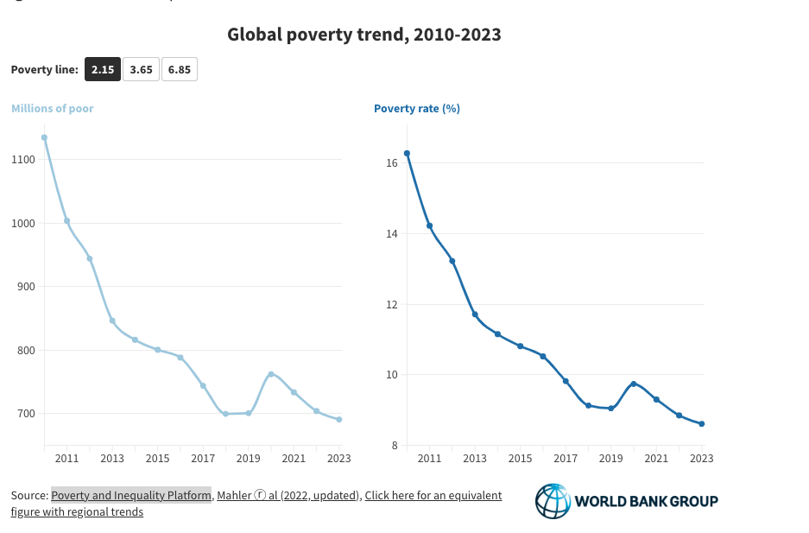
World Bank Data Blog: Poverty is back to pre-COVID levels globally, but not for low-income countries
NISHANT YONZAN
DANIEL GERSZON MAHLER
CHRISTOPH LAKNER
|OCTOBER 03, 2023

Slide 4
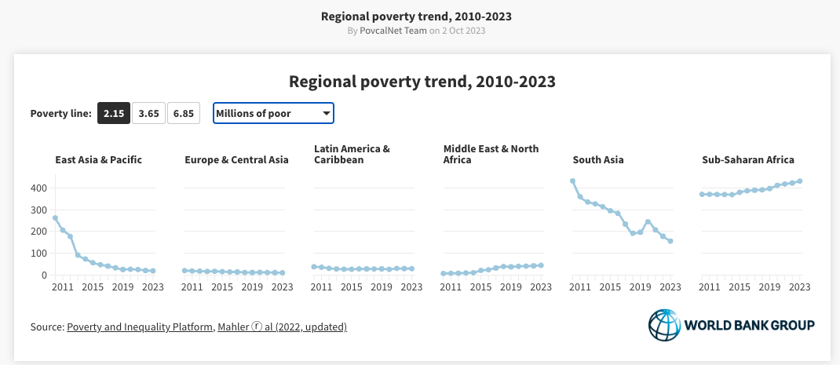
2023: 44.04
2010: 6.39

Slide 5
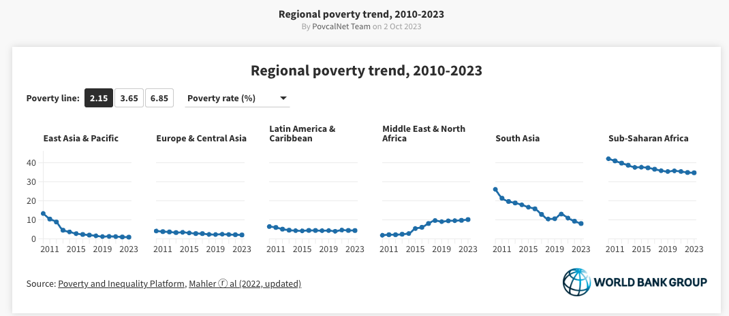
2023: 10.11
2010: 1.85

Slide 6
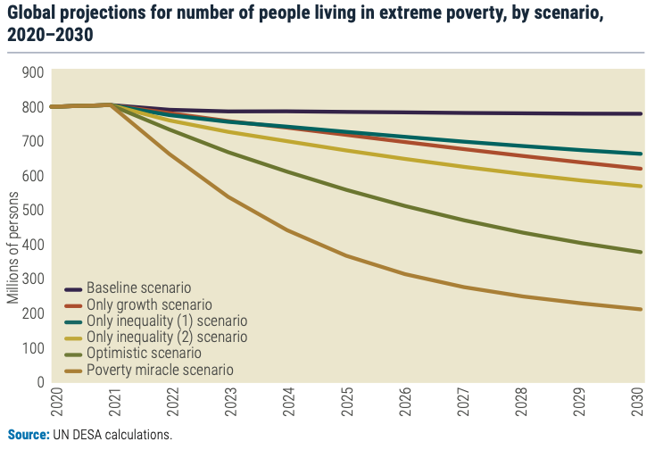
Notes:
A 1 per cent average annual reduction in income inequality in developing countries from 2022 to 2030, coupled with the UN DESA projected GDP per capita growth rate of 4.7 per cent, could bring down the global extreme poverty headcount by 100 million people by 2030.
Ending extreme poverty by 2030 (poverty miracle scenario) would require an average annual GDP per capita growth rate of 10 per cent in developing countries along with 7 per cent average annual reduction in income inequality.

Slide 7
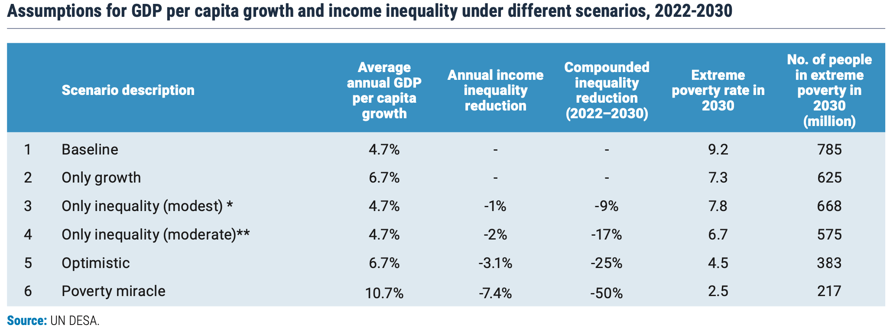

Slide 8
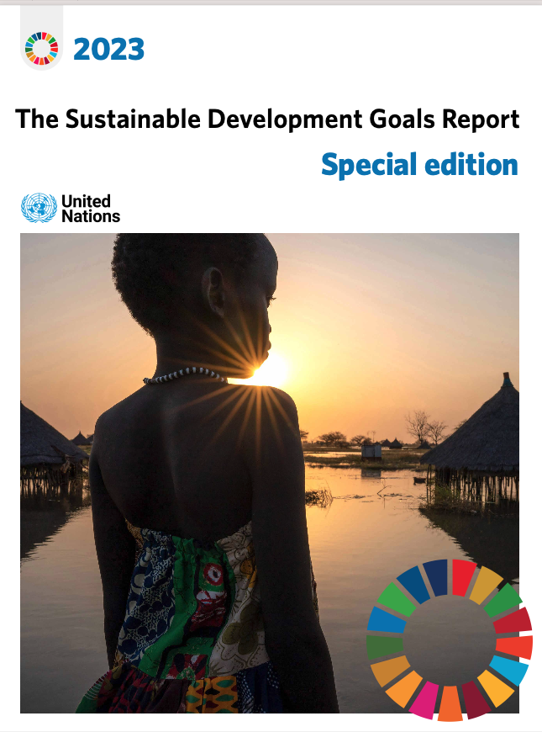
Projected Extent of Extreme Poverty (2030)
    If current trends persist, an estimated 575 million individuals will still endure extreme poverty by 2030.
National Poverty Reduction
    Only one-third of countries are on track to halve their national poverty levels by 2030.
Impact of COVID-19 Crisis
    Despite expanded social protection during the pandemic, over 4 billion people globally remain entirely unprotected.
Vulnerable Population Groups
    Many vulnerable demographics, such as the youth and the elderly, lack coverage in statutory social protection programs.
Disparity in Government Spending
    Advanced economies allocate a notably higher share of government spending to crucial services like education, health, and social protection compared to emerging and developing economies.
Need for Action and Investment
    Urgent action and increased investment are necessary to improve economic opportunities, enhance education, and extend social protection to all, especially the most marginalized.
Notes:
If current trends continue, 575 million people will still be living in extreme poverty and only one-third of countries will have halved their national poverty levels by 2030.
Despite the expansion of social protection during the COVID-19 crisis, over 4 billion people remain entirely unprotected. Many of the world’s vulnerable population groups, including the young and the elderly, remain uncovered by statutory social protection programmes.
The share of government spending on essential services, such as education, health and social protection, is significantly higher in advanced economies than in emerging and developing economies.
A surge in action and investment to enhance economic opportunities, improve education and extend social protection to all, particularly the
most excluded, is crucial to delivering on the central commitment to end poverty and leave no one behind.

Slide 9
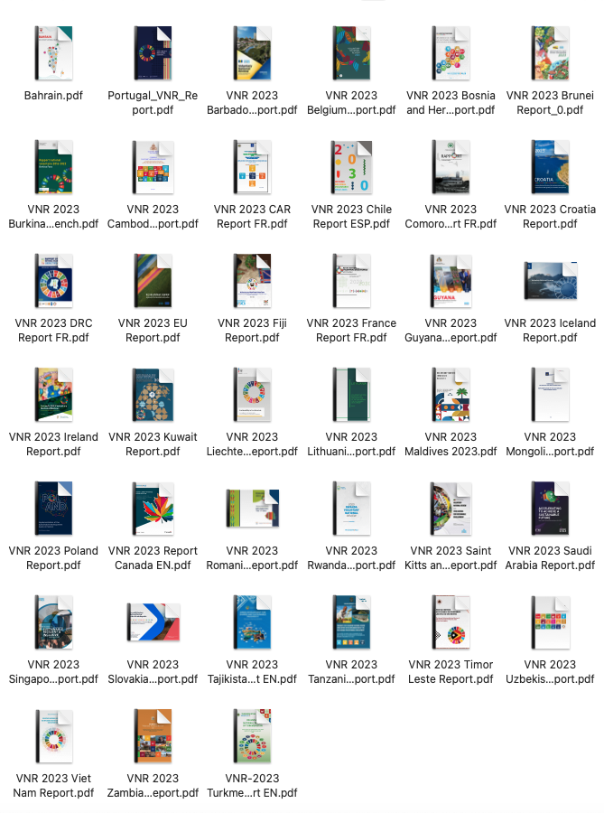
VNRs 2023

Slide 10
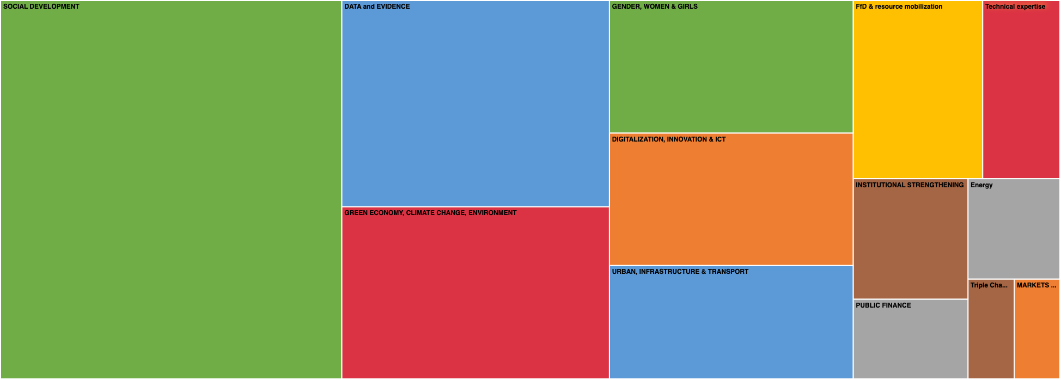

Slide 11
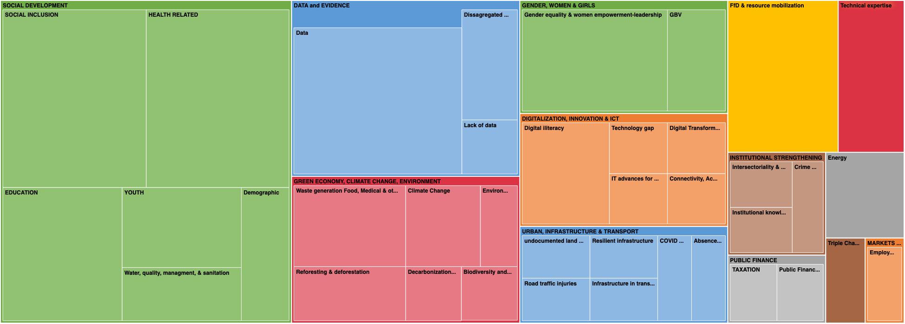

Slide 12
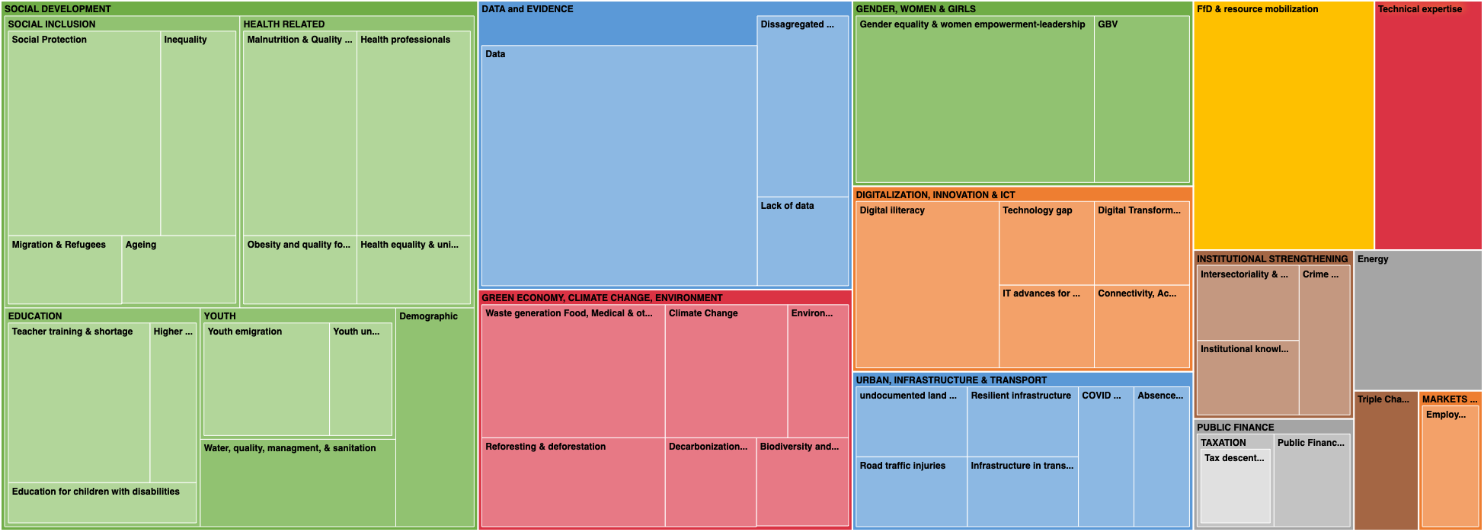

Slide 14
Measures taken by VNR 2023 countries to combat poverty and inequality include
Investments in social infrastructure and service provision
Strengthening social protection systems and safety nets
Creating an enabling environment for increased local and foreign direct investment
New national model of accounting
Targeted support for the poor and marginalized groups
Strategy for sustainable graduation from poverty
Establishing new initiatives in the areas of social insurance, social safety nets, and labor market support programs
Focusing on economic growth, job creation, improving livelihoods, and reducing vulnerabilities to climate change

Slide 15
Compare with literature suggestion (PB 107)
A progressive taxation system towards comprehensive public service provision.
Expanding social protection programs to vulnerable and marginalized groups.
Investing in education, health, and other basic services.
Promoting job creation and productive employment.
Encouraging equal access to productive assets for all individuals.
Increasing budget allocations and improving the efficiency of public expenditure.
Implementing policies to promote gender equality and improve economic participation of women.
Increasing transparency and participation in decision-making

Slide 16
Measures to Combat Poverty and Inequality:
1. Vietnam: Implemented general poverty reduction mechanisms and policies, gradually reduced and abolished subsidy policies, increased repayable and conditional support policies, and achieved impressive poverty reduction regardless of the measurement methodologies.
2. Zambia: Implemented investments in social infrastructure and service provision, enhanced capacities to withstand effects of climate change, strengthened social protection systems and safety nets, affirmative action for marginalized groups, and created an enabling environment for increased local and foreign direct investment.
3. Uzbekistan: Implemented state support for income growth, a new national model of accounting, targeted support for the poor, and employment opportunities for those from low-income families.
4. Rwanda: Implemented scaling up social protection interventions, developed a Covid-19 Social Protection Response and Recovery Plan, and developed a strategy for sustainable graduation from poverty.
5. Romania: Implemented policies and measures to reduce the number of citizens living in severe and relative poverty, encouraging participation in the labor market, and developing the protection and social assistance system.

Slide 17
Measures to Combat Poverty and Inequality:
6. Saudi Arabia: Implemented steps to reduce income inequality through social safety nets and poverty reduction programs, improving existing programs, and establishing new initiatives in the areas of social insurance, social safety nets, and labor market support programs.
7. Slovakia: Implemented measures to reduce poverty and inequality under SDGs 1, 2, and 10, with observed progress but challenges with the implementation of antidiscrimination laws and insufficient deterrence for discrimination.
8. Guyana: Implemented actions to expand access to technology, investments in the social sector, and infrastructure and incentives for private sector expansion.
9. Barbados: Implemented a multi-pronged approach to addressing systemic and structural challenges perpetuating poverty, focusing on economic growth, job creation, improving livelihoods, reducing vulnerabilities to climate change, and institutional strengthening of the social protection system.
10. Bahrain: Implemented policies and programs aimed at promoting job creation, reducing unemployment, and addressing the efficiency of social support and protection, including the allocation of government subsidies to eligible individuals.
11. Timor Leste: Aims to eradicate extreme poverty, reduce poverty by at least half, implement social protection systems, ensure equal rights to resources, build resilience to environmental, economic and social disasters, and fund the successful implementation of poverty eradication policies.

Slide 18
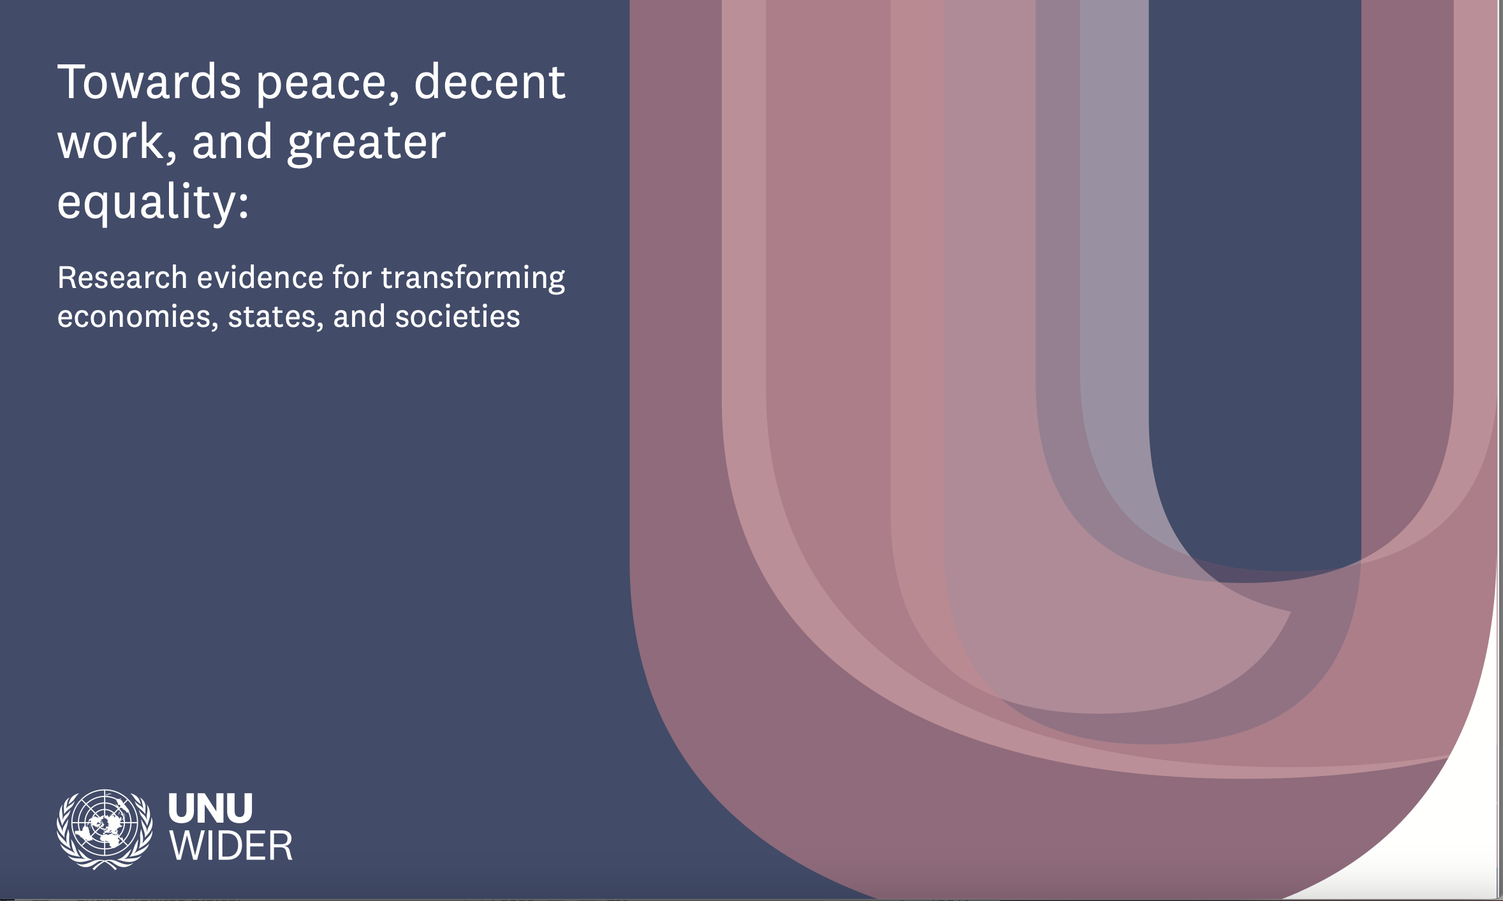
Peace, security, poverty and inequality
Wars and violent conflict
While poverty has been broadly reduced across the globe since 1990, it increased in conflict-affected countries. The gap between peaceful and conflict-affected countries in their progress on poverty reduction is predicted to widen further. By 2030, two-thirds of the world’s extreme poor will live in fragile and conflict-affected countries. Almost 70% of the 193 million people suffering from acute hunger live in countries with violent conflict and instability.

Slide 19
Peace:
Rebuilding the state, strengthening the social contract and social cohesion, and encouraging non-violent political participation are the critical elements for building peace in conflict-affected areas.
Decent Work:
Automation and digitization will continue to drive changes in the workplace and employment relationships, which should be managed in a way that ensures that gains in productivity are matched by wider social benefits.
Investment in skills is especially important in the face of automation and digitization to ensure workers remain competitive in the changing labour market.
Public policies play a crucial role in promoting Gender Equity and Labour Market Outcomes.
Greater Equality:
Horizontal inequalities based on group membership are associated with a range of negative political, social, and economic outcomes in diverse contexts, and data availability is a constraint to better measuring them.
Affirmative action can (and has) played a role in addressing both vertical and horizontal inequalities in different contexts, but implementation and design matter significantly, and policy learning would enhance their impact.

Slide 20
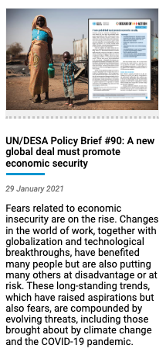
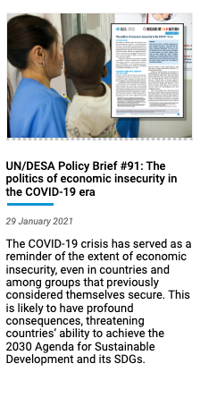
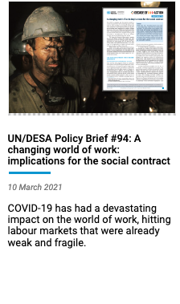
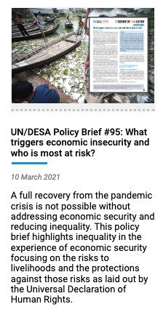
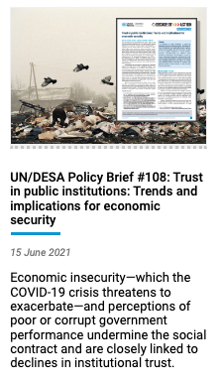
DESA Policy Briefs series on economic insecurity

Slide 21
Economic insecurity
Poverty
Inequality
Economic insecurity
Trust
Economic insecurity and poverty are interconnected issues that affect people's ability to cope and recover from economic shocks.
Structural factors such as employment instability and joblessness can contribute to rising economic insecurity and inequality.
Economic insecurity affects citizens’ policy preferences, including support for specific political parties and leaders, and even attitudes towards the role of government itself.
Economic insecurity, job instability, and dissatisfaction with the quality of public services can lead to reduced trust in public institutions, creating disengagement from public mandates and hinder compliance with laws and recommendations, affecting overall societal wellbeing and functioning.
Notes:
Poverty: Economic insecurity can directly lead to poverty. It mentions that lacking access to social protection systems resulted in millions of people falling into poverty due to the COVID-19 crisis. Moreover, the inability of comprehensive social protection systems to keep up with changes in the world of work contributes to economic insecurity, which can perpetuate or exacerbate poverty.
Inequality of Wellbeing: Economic insecurity contributes to inequalities in wellbeing across various segments of society. Vulnerable groups like women, youth, persons with disabilities, and indigenous peoples are overrepresented among informal workers, who faced the brunt of income losses during the pandemic. This exacerbates existing inequalities, impacting their overall wellbeing.
Job Insecurity and Working Conditions: The rise of poorly paid and precarious work, coupled with a lack of stable employment opportunities, contributes to economic insecurity. This insecurity not only affects income stability but also impacts mental and physical health. For instance, the text highlights how the COVID-19 crisis has heightened health risks for workers, particularly those in essential services, leading to increased rates of burnout, anxiety, and depression.
Social Identity and Collective Wellbeing: Decent employment provides more than just income; it also contributes to social identity and collective wellbeing. However, workers in temporary or non-standard contracts often face challenges in developing a strong social identity through their jobs. This vulnerability can impact their overall sense of wellbeing and inclusion within society.
Trust in Institutions: Economic insecurity, job instability, and dissatisfaction with the quality of public services can lead to reduced trust in public institutions. Low trust in governments and institutions can create disengagement from public mandates and hinder compliance with laws and recommendations, affecting overall societal wellbeing and functioning.
In summary, economic insecurity not only directly contributes to poverty but also exacerbates inequalities, impacts mental and physical wellbeing, influences social identity, and affects trust in institutions, all of which collectively contribute to individual and societal wellbeing.

Slide 22
Final points:
Address the several interlinkages of the SDGs affecting SDG1.
A comprehensive focus on poverty elimination may include an understanding on how economic insecurity, inequality and institutional trust accelerate poverty goals.
WSS 2025.

Slide 23
شكرا كتير

