Slide 1
Nigeria National MPI
Sola Afolayan
National Coordinator, MPI
The Presidency
Nigeria
solaafolayan@outlook.com
sola@nigeriapovertymap.com
MPI for poverty reduction strategies. UN, Beirut- Nov 2022

Slide 2
Nigeria’s Poverty Status
40%
82.9 million are monetary poor- live in households with less than $700 per capital annual expenditure (2018/19)
63%
133 million of 211 million population are multidimensionally poor (2022)

Slide 3
Nigeria MPI results (2022)
63%
Sixty-three percent of people- 133 million- are multidimensionally poor.
Multidimensional poverty is higher in rural areas where 72% of people are poor compared to 42% of people in urban. Approximately 70% of population live in rural areas.
72%
65%
Sixty-five percent of poor people- 86 million- live in the North, while 35%- nearly 47 million- live in the South.
71% of people living in households with at least one person living with a disability (PLWD), are poor compared to 62% of HHs without PLWD.
71%
Child MPI- 83.5% of children under 5 are poor (22.9 million). 29% of all school-aged children are not attending school. 94% of all out-of-school children are poor. Thus, 27% of all school-aged children are both poor & out-of-school.
83.5%
6 out of 10 girls aged 12-17 are poor; among those in child marriages, 80% (8 out of 10) are poor. Gender disparities: 19.1 million live in HHs where a man has completed pry school, but no woman has.
80%

Slide 4
MPI PROCESS
Consultations & Buy-in
Alignment
Government leadership: UNGA; 100 Million by 2030 Presidential Mandate
Leadership at Federal: Vice President; HMS MBNP
Sub-national buy-in: Nigeria Governors’ Forum; Individual State Governors.
Post survey use: MTNDPs; NPRGS, NSR (sustainability)
Policy Exchange: OPHI, India, Mexico, Columbia
Resource allocation
Partnerships
Technical: OPHI
Multilateral/Donors: UNICEF (MODA); World Bank (monetary); UNDP, Canada (GAC)
Media training & support
01
05
03
02
04
Funding
Sub-national support
Skin in the game both Govt & Partners; sustainability strategy
National Budget
State Budgeting (ongoing)
Training: State Statistician Generals & Commissioners of Finance
Validation of survey results pre- formal launch
Technical support for MPI Data Demand and Use (DDU) strategy

Slide 5
Ongoing strategy to reduce poverty with MPI
Data
Conduct sub-national MPI survey
Establish Poverty Dashboard & Situation Room (PDSR)
National Poverty Map
Project Design
Alignment with the National Social Register
Beneficiary targeting
Ministerial performance tracking
Deploy the Data Demand & Use (DDU) strategy at sub-national
Policy Action
Dialogue & Partnership
Buy-in of Multilaterals/Devpt. partners
Co-ownership of process with sub-nationals and MDAs
Technical partner: OPHI
National Poverty Roundtable
SDG Private Sector Advisory Group
Governance: Steering committee; Advisory Group; Technical Working Group; MPI Multisectoral Action Committee
Establish the Poverty Policy Action Lab (P-PAL)
SDG tracking tool: SDG 1, 2, 3, 4, 5, 6, 7, 8, 10, 11
Finance Bill: Use of MPI for resource allocation
Align/embed MPI within National/Sub-national plans: MTNDP (2021-25 & 2025-30); Food & Nutrition (NMPAFN 2021-25); National Action Plan for revitalization of WASH; National Social Investments Programme (NSIP)
Launch the 90-day Poverty Action Plan
Resource Allocation
Data driven; evidence-based; aligned with MPI
Top 5 sectors in 2023 Federal budget accounts for N8.074trillion of the total N20.5 trillion national budget
Support to 6 pilot States
Child linked MPI budget
Capacity Building
MPI as a poverty measurement tool
MPI as a policy action tool
Training of Federal & Sub-national
Validation exercise by Statistician Generals

Slide 6
MPI Governance structure
Chair: H.E Vice President, Federal Republic of Nigeria Champion: HMS Budget and National Planning Members: NBS; Ministers: Education, Health, Labour, Water Resources, Humanitarian, Women Affairs, Power, Works and Housing, OSSAP-SDG Secretary: National Coordinator, MPI - Presidency/support from NASSCO & National Poverty Reduction with Growth Strategy (NPRGS) secretariat
Steering Committee
Advisory Group
Technical Working Group
Lead: UNDP
Co-Lead: SDG Private Sector Advisory Group
Members: Global Affairs Canada, EU, Global Affairs Canada, UNDP, UNICEF, FCDO, RPA, WFP, Agence Francaise De Development (AFD), Tony Blair Institute, Innovations for Poverty Action, USAID, Save The Children, MacArthur Foundation, Ford Foundation and Gates Foundation.
Presidency (NSIO); Oxford Poverty Human Development Initiative (OPHI) ; National Bureau of Statistics (NBS); National Social Safety Nets Coordinating Office (NASSCO); UNDP, UNICEF
Multisectoral Action Committee
-- Implement Data Demand & Use (DDU) strategy
Data
Policy
Partnerships & Support
Lead: NBS
Support: OPHI, NASSCO
Activities: MPI survey; Poverty Dashboard Situation Room (PDRS); National Poverty Map (NPM); Dissemination; Accessibility; Tracking
Lead: MBNP; Presidency
Support: Nigeria Economic Summit Group (NESG)
Activities: Poverty Policy Action Lab (P-PAL)
Researches; Behavioural Insights
Policy Dialogues
Energy Transition Plan; others
Lead: Presidency
Support: MBNP-NPRGS; SDG; Nig. Governors’ Forum (NGF)
Activities: Support to sub-national
Capacity Building
Incentives: Ranking; Financial

Slide 7
MPI success journey
MILESTONE 01
MILESTONE 03
2018: Nigeria published first national MPI constructed within the Human Development Report (UNDP, 2018)
2019: At UNGA, Nigeria committed to implementing the MPI; OPHI visited Nigeria- consultations- The Presidency, SDG, State Government; MBNP; NASSCO, UNDP, UNICEF.
MPI adopted as poverty measurement & policy tool in National plans (MTNDPs 2021-25 & 2025-30)
MPI survey launched. Conducted in 109 senatorial districts; 56, 000 Households.
2019
2021
START
2020
2022
MILESTONE 04
MILESTONE 02
Survey completed; Co-hosted UNGA MPPN
Federal Executive Council approves MPI as one of flagship projects in NPRGS
1st sub-national Nigeria MPI report launched
MPI used for budget allocation
Established: Poverty Dashboard Situation Room (PDSR); National Poverty Map
Consultation on selection of Dimensions/Indicators commenced
Funding

Slide 8
MPI in the News

Slide 9
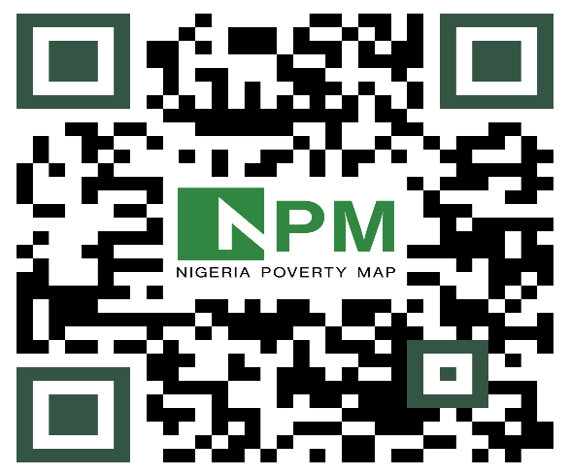
MPI assets
Top: QR code to download the Nigeria MPI (2022)
Below: QR code to access National Poverty Map website

