Slide 1
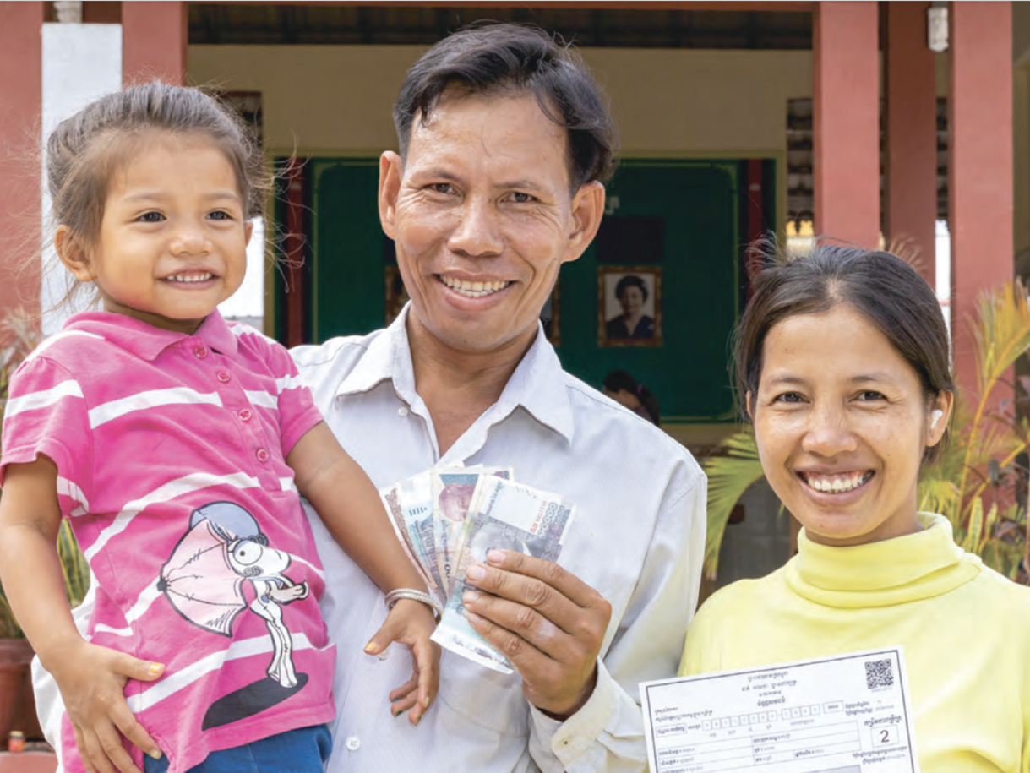
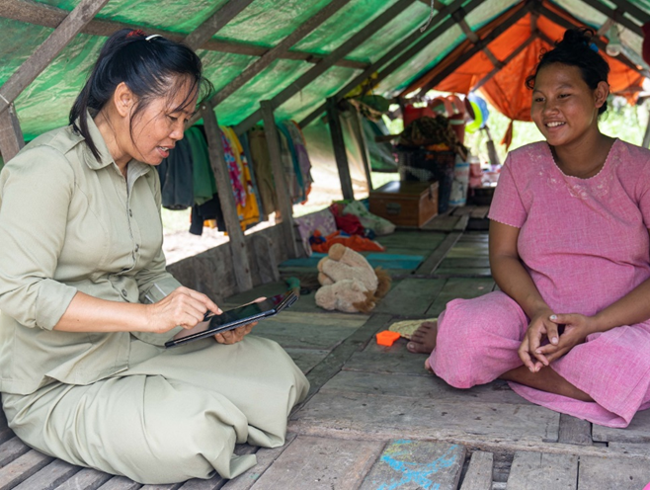
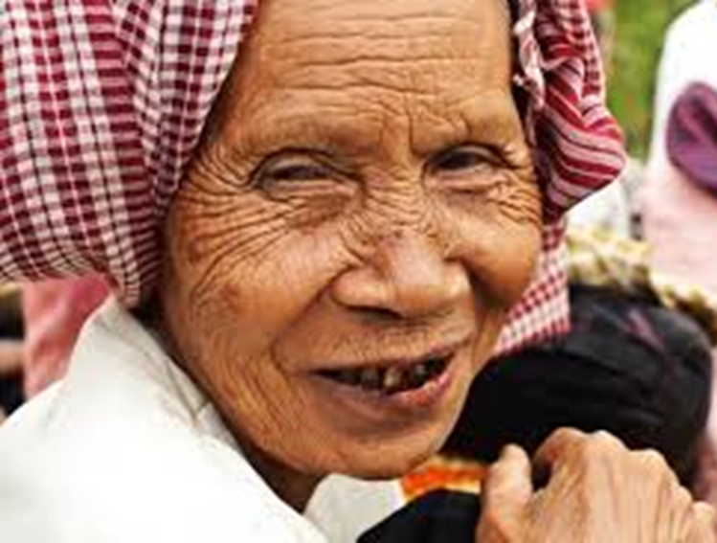
MVI for multidimensional poverty reduction strategy and social protection in Cambodia
HE Samheng Boros, Minister attached to Prime Minister and Secretary of State, Ministry of Social Affairs

Slide 2
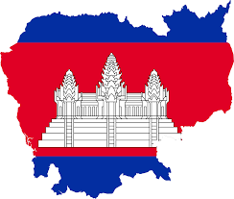
Cambodia’s Socio-Economic Profiles
Poverty Rate
2007
2014
2019
47.8%
26.3%
14.7%

Slide 3
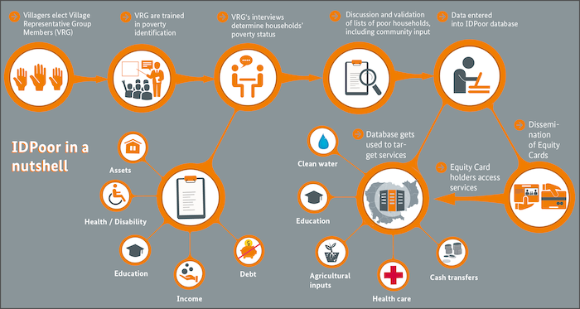
IDPoor Identification Procedures

Slide 4
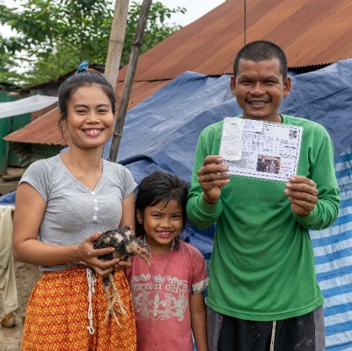
Cash transfer program for the poor as part of COVID-19 responses
First time in history, about 700,000 households (2.7 million people) received cash transfer in Cambodia
With On Demand-IDPoor, the program was rapidly scaled up to cover those recently falling into poverty due to Covid-19
Eligibility and payouts by four weighted factors – level of poverty, location, size of household and a vulnerability criteria
The Government has spent over $800 million since June 2020
Studies found to be an effective coping mechanism
Notes:
Around 50$ per month. Mostly spent on food, debt repayment, child education. But there’re some HHs spent on investment. Not forever; should consider post-cash transfer.
Positive impacts cross human development and socio-economic indicators - food security, nutrition, child education, saving, debt repayment, productivity, health utilization, gender empowerment and perception of local/national governments.

Slide 5
Existing Poverty Measures
Child
(Individual)
1. Nutrition
2. Health
3. Early childhood development
4. Education
5. Water
6. Sanitation
7. Housing
8. Information
National
(Household)
1. Food and non-food consumption
Multiple Overlapping Deprivation Analysis (MODA)
Monetary-based Poverty
CDHS
(Available every 5 years
CSES
(Available every 2 years)
Existing Poverty Measures
Unit of analysis
Methodology
Data
Dimensions

Slide 6
Monetary Poverty Measurement, MODA, and MVI make up the commitment to measure multidimensional poverty
CSDG framework: commitment to measure multidimensional poverty
Monetary poverty
Child multidimensional poverty (2018)
National multidimensional vulnerability Index (in the pipeline)

Slide 7
Why Cambodia moves towards MVI
Overlapping deprivations facing each local community can be viewed at the granular level
Understanding which households are deprived of accessing to clean water, to electricity, to employment, to food security, to education etc and the key intensity of the deprivation.
MVI makes a more collaborative, systematic approach whereby government ministries from national and sub-national level can sit down together to discuss priorities, collaboration, and budget alignment to address these deprivations to improve targeting and efficiency.

Slide 8
Progress of the development of MVI in Cambodia
Executive decision to use vulnerability: MPI => MVI
Led by the National Working Group on Poverty Measurement (NWGPM) of MoP and with formal written request of MoSVY, several technical consultation workshops have been organized (throughout 2021 and 2022)
Key dimensions and indicators of the national MVI has been finalized at technical level
As of 2022, a draft national MVI framework with initial decision on weights, threshold and deprivation cut-off has been drafted
Will be scrutinized by a series of three-level consultations – government, experts/CSOs, and local communities
Expect to be adopted after the next national elections in July 2023

Slide 9
Steps for Developing MVI
Select the unit of identification and analysis
Select the dimensions and indicators
Set the vulnerability cut-off for each indicator
Set the weights for each dimension/indicator
Set the vulnerability cut-off
Compute the AF measure

Slide 10
MVI Structure, dimensions, indicators, vulnerability cutoff and weights
For this measure, the vulnerability line was set at 35%
Dimension | Indicator | Vulnerability cutoff A household is vulnerable… | Weight
Education | Years of schooling | if there is no member of the household aged 12 years old and older who has completed at least six years of schooling. | 1/8
 | School attendance | if at least one child aged 6-14 years old as a household member is not currently attending to school. | 1/8
Health | Access to health care services | if at least one household member was sick/ill and had not access health care services in the last 30 days. | 1/20
 | Livelihood based coping strategies | if, during the past 30 days any household's member has to engage in any of the following activities because there was not enough food or lack off money to buy food. | 1/20
 | Access to clean water | if the main source of drinking water is not safe or 30-minute or longer walk from home (roundtrip). | 1/20
 | Access to Sanitation | if the household has unimproved or no sanitation facility or it shares the improved sanitation facility with other households | 1/20
 | Hand Washing | if there is no observed place of handwashing​ or soap and water are not observed at an observed place of handwashing. | 1/20
Living Standards | Overcrowding | If a room is shared with more than 4 people. | 1/20
 | Housing Materials | if the materials of the roof, walls or floors are non-improved (natural or rustic materials). | 1/20
 | Cooking Fuel | if the main source of cooking fuel is a natural product (charcoal or wood). | 1/20
 | Electricity | if the household has no access to electricity​ (sources from public electrical grid). | 1/20
 | Assets | if the household does not own more than two of these assets: radio, TV, telephone, computer, refrigerator animal cart, bicycle, motorbike, or​ machine boat, and does not own a car or truck. | 1/20
Monetary Poverty | Consumption and expenditure poverty | if​ consumption and expenditure are lower than national poverty line. | ¼

Slide 11
Uncensored headcount ratios

Slide 12
Incidence, intensity and MVI
Vulnerability Cutoff (k) | Index | Value | Confidence Interval (95%)
k value=35% | MVI | 0.108 | 0.101 | 0.115
 | Headcount Ratio (H, %) | 22.0% | 20.6% | 23.3%
 | Intensity (A, %) | 49.3% | 48.6% | 50.0%

Slide 13
Censored headcount ratios

Slide 15
Q&As

