Slide 1
The Multidimensional Poverty Indicator (in Mexico and other countries) Gonzalo Hernández Licona
November 2022

Slide 2
Measuring poverty in Mexico
Before 2000, no oficial poverty measurement in Mexico.
New government in 2000 willing to measure.
(More transparency in Mexico due to free elections and democracy).
First attempt: Income poverty (2002)
Political parties were not happy about the way poverty was measured: Only income and done by government.
All political parties agreed to have an independent poverty measurement, including Access to social rights: Multidimensional poverty measurement!! (2006)

Slide 3
Process
Exchange ideas, criteria & design of data sources
2007
2008
2009
Five
Specific consultations
Discussions
of
proposals
Bourguignon,Thorbecke, Kakwani, Lustig,Skoufias, Walton, Khander, Reddy, Feres, López-Calva, … among others.
Final discussions
& results of studies
Julio Boltvinik
Satya Chakravarty
James Foster, Sabine Alkire
David Gordon
Rubén Hernández and Humberto Soto
Consultation
about indicators, thresholds, questions with public inst.
Data
Collection
Data
delivery
Consultation
with
experts
National
and international seminars
Survey
Design
Presentation
(December)
Building the methodology

Slide 4
Multidimensional Poverty in Mexico
Information from the National Statistical Office
Social Development Law
Dimensions
Income
Educational gap
Access to health services
Access to social security
Housing quality and spaces
Access to basic services of housing
Access to food
Social cohesion grade
Measuring Poverty is a technical process, which needs political engagement…. all the time
States: 2 years
Municipality: 5 years
National Council for Poverty Measurement (CONEVAL)

Slide 5
Meaning of overcoming poverty on people’s life
Well-paid jobs with social benefits
Income
School
attendance and
basic education universal coverage
Enough food
for everybody (quantity, quality
and variety)
Educational
gap
Access to
food
Access
to health services
Water, drainage, electricity and
right conditions
for cooking
Formal rights to be granted
health care
Access to
basic services
of housing
Formal
employment and protection from accidents, diseases
According to the life cycle (pregnancy,
old age, etc.)
Housing
quality and
spaces
Access to
social
security
Enough space for household members and suitable materials for habitability
(ceilings, walls,
floors)

Slide 6
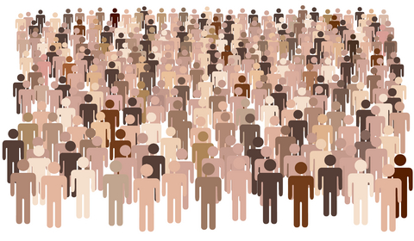
Methodology
Per capita current income
Population
Mexico
Education
Health
Social security
Housing
Basic services
Food
Well-being
Bidimensional Index
Social deprivation
Income
Territorial
Social cohesion grade
6
5
4
3
2
1
0
Social Rights

Slide 7
NO
SO C
I
A
L
DE
P R I VA T I ON
One or more social deprivation
Economic poverty Line
Income
EPL
Social deprivation
6
5
4
3
2
1
0
Social rights

Slide 8
Multidimensional Poverty in Mexico
A person is considered poor if has insufficient income for the satisfaction of food and non-food needs and has at least one social deprivation
A person is considered extreme poor if has insufficient income for the satisfaction of food needs and has at least three social deprivation

Slide 9
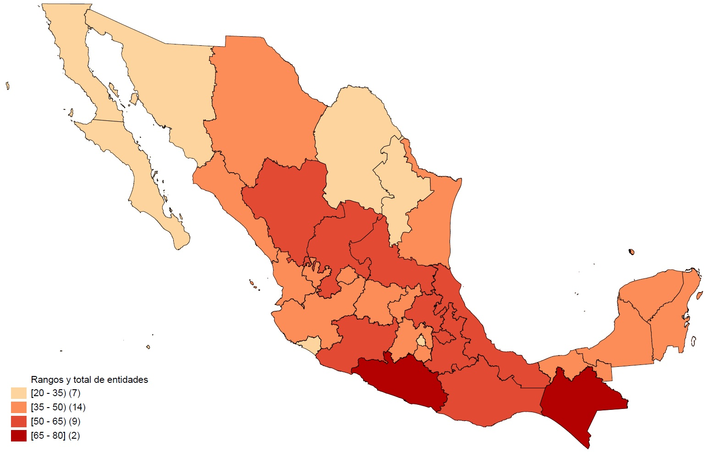
State Level Multidimensional Poverty in Mexico, 2020
Source: CONEVAL estimations based on the MCS-2012 ENlGH

Slide 10
MPI in Mexico: From a legal mandate to use
Constitutional
mandate:
Importance of
Social Rights
National Law: Independent Institution to measure poverty: CONEVAL
Multidimensional poverty measurement: Basic access to social rights; income
Monitor poverty in the country and regions; Accountabilty; Coordination of poverty strategies; Targeting; Budget allocations
National, State and Municipality level
Public policy is visible with this approach. Various dimensions in one indicator

Slide 11
MPI Uses
Mexico.
Monitoring Poverty without political bias
The political agreement about how to measure poverty led to the acceptance of poverty figures.
All political parties used these figures. Even in political processes.
Poverty reduction: Inclusion Strategy
National strategy to reduce poverty in a multidimensional way.
Objectives by ministry
Agreement with states.
The National budget process included this strategy.
2014-2018

Slide 12
Multidimensional extreme poverty in Mexico

Slide 13
MPI Uses
Mexico.
Oaxaca State. Puebla State.
MPI monitoring at state level.
Targeting: 20 municipalities highest MPI% and 20 municipalities with higher number of people in poverty.
Through geographical maps; coordination between federal government, state government, municipalities and ministries; better budget process.
Poverty 68%-60% in 6 years.
The poorest municipality in the country: Santos Reyes Yucuná: From 1 to 231

Slide 14
MPI Uses
Bhutan
From 2013, MPI was used in Bhutan as one of the five criteria for budget allocation.
It is one of the main considerations to allocate annual capital grants across districts.
Resource Allocation Formula: Population, 35%; Geographical Area, 10%; MPI, 45% and 10% for the Transport Cost Index.
Poverty was reduced from 12.7% to 5.8% between 2012 and 2017.
Costa Rica
In 2016 a Social Management Dashboard was developed to justify public spending to taxpayers using empirical evidence. It connected each indicator with its related responsible institution and included a traffic light system to monitor the correct use of resources.

Slide 15
MPI today and tomorrow
Multidimensional poverty is part of the SDGs. 1.2.
Important to have more countries with their own MPIs.
Technical skills and political engagement are needed to develop and use a national MPI.
Handbook for Policy Entrepreneurs: From metrics to Policy
COVID showed the importance of multidimensional approaches: with MPI and Multidimensional Vulnerability Indices, possible to see vulnerable social groups: Those having multiple deprivations on water, sanitation, access to health services, cooking with wood.. were the most vulnerable against COVID.
South-South exchange. Multidimensional Poverty Network (MPPN).

Slide 16
MPI in many countries, according to their needs
Colombia
Bhutan
Chile
Seychelles
Maldives
India
Panama
Costa Rica
Sierra Leone
Rwanda
Namibia…..

