Slide 1
Policy Uses of MPIs
Corinne Mitchell
ESCWA Regional Workshop
29 November 2023
Amman, Jordan

Slide 2
Policymakers are using their MPIs to:
Complement monetary poverty measures
Track poverty over time
Allocate resources by sector or region
Target marginalized regions, groups, or households
Coordinate policy across sectors and levels of government
Evaluate policies and adjust
Leave no one behind
Report to the SDGs and other national/international goals
Promote transparency and accountability

Slide 3
Policymakers are using their MPIs to:
Complement monetary poverty measures
Track poverty over time
Allocate resources by sector or region
Target marginalized regions, groups, or households
Coordinate policy across sectors and levels of government
Evaluate policies and adjust
Leave no one behind
Report to the SDGs and other national/international goals
Promote transparency and accountability

Slide 4
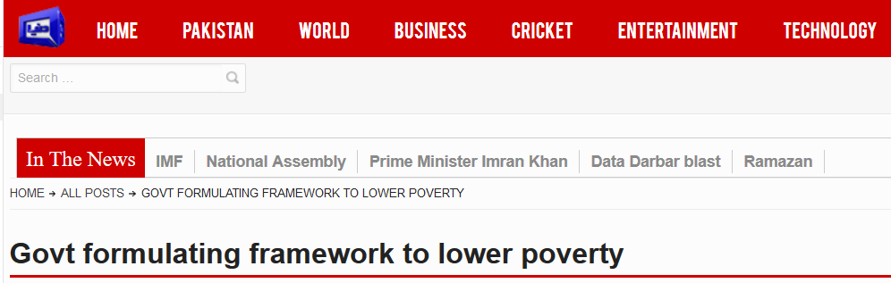
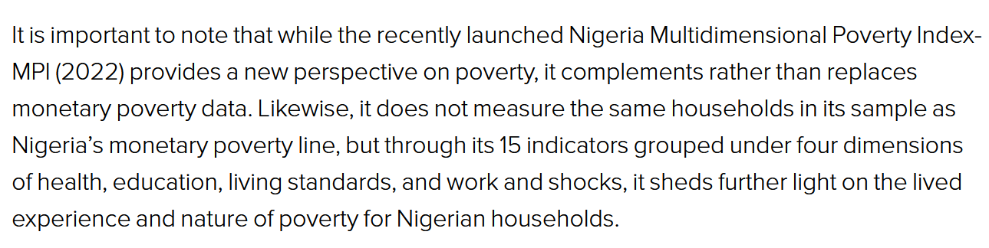
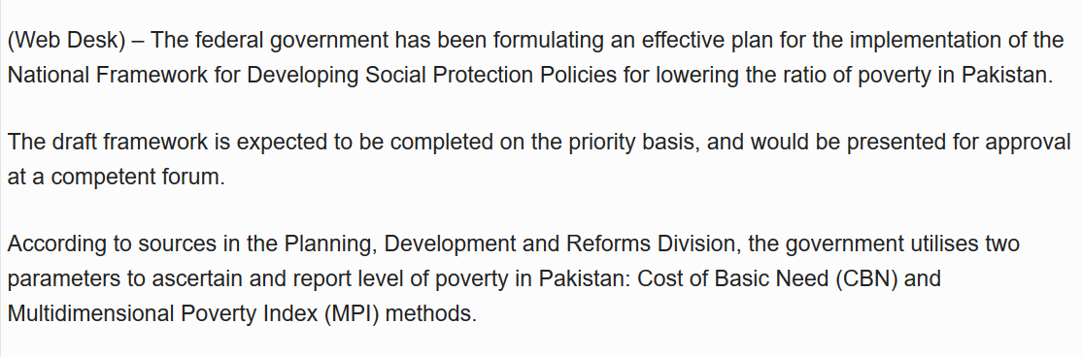
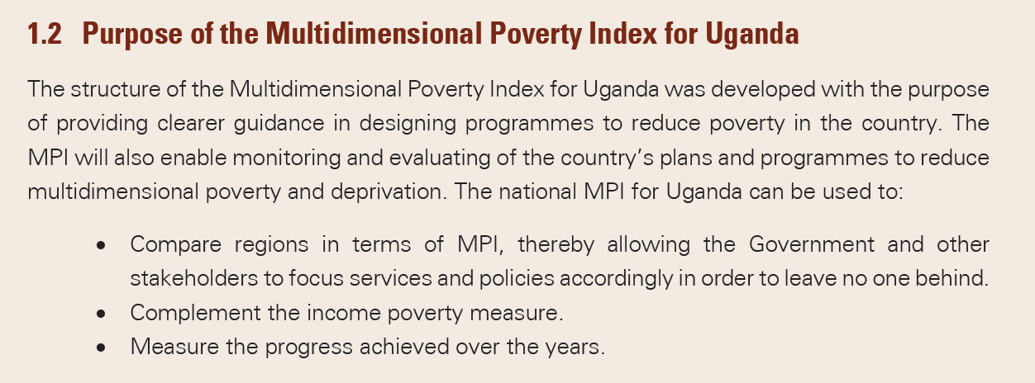
Complement Monetary Poverty Measures
Countries use both monetary and multidimensional poverty measures to inform policymaking.
Example: Nigeria National MPI
Example: Pakistan National MPI
Example: Uganda National MPI

Slide 5
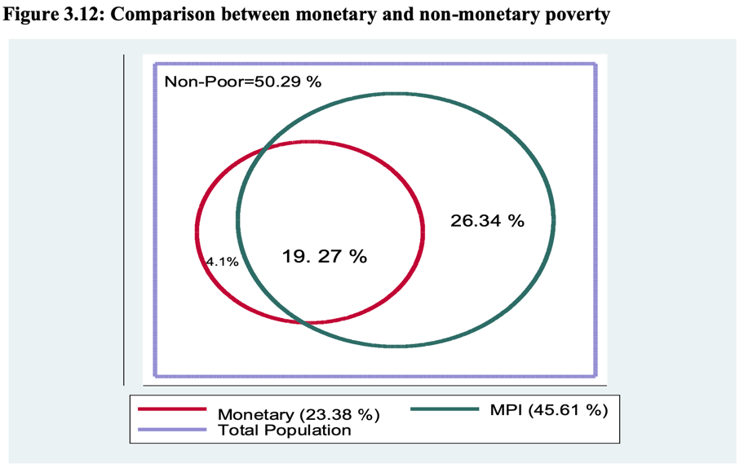
Complement Monetary Poverty Measures
In Ghana, most monetary poor were also multidimensionally poor, but more than 1/4 of population were multidimensionally poor, but not monetary poor

Slide 6
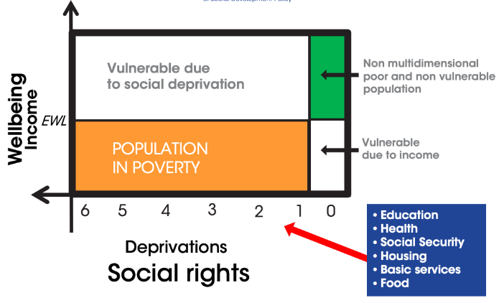
Complement Monetary Poverty Measures
Mexico defines national poverty as the intersection of income and multidimensional poverty

Slide 7
Policymakers are using their MPIs to:
Complement monetary poverty measures
Track poverty over time
Allocate resources by sector or region
Target marginalized regions, groups, or households
Coordinate policy across sectors and levels of government
Evaluate policies and adjust
Leave no one behind
Report to the SDGs and other national/international goals
Promote transparency and accountability

Slide 8
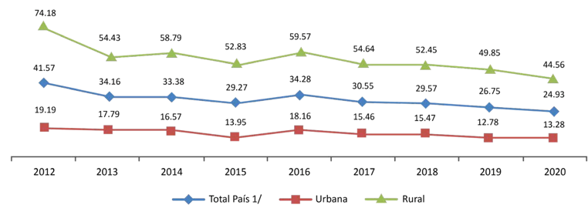
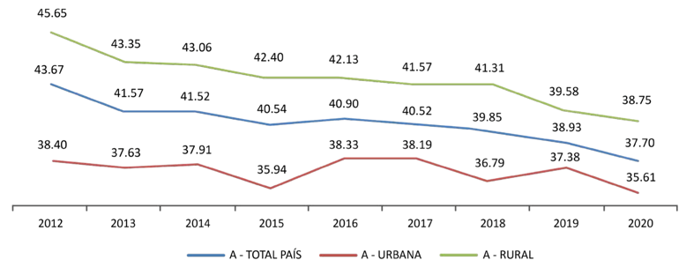
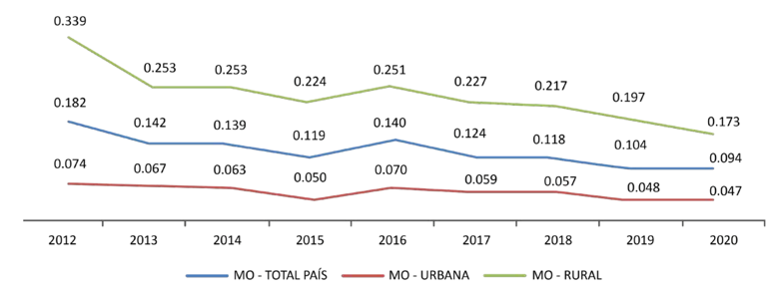
Track Poverty Over Time
Multidimensional poverty incidence in Paraguay reduced from 41.6% in 2012 to 24.9% in 2020.
The urban/rural gap also decreased.

Slide 9
Track Poverty Over Time
Armenia tracks multidimensional poverty reduction nationally, in the capital (Yerevan) and in urban and rural areas. The national incidence of multidimensional poverty decreased from 41.2% in 2010 to 23.6% in 2018.

Slide 10
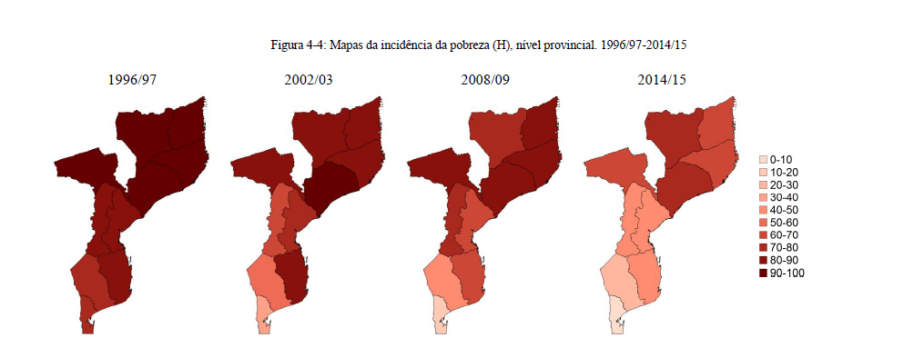
Track Poverty Over Time
Mozambique used historical data to analyze trends in poverty backwards in time, at the provincial level

Slide 11
Policymakers are using their MPIs to:
Complement monetary poverty measures
Track poverty over time
Allocate resources by sector or region
Target marginalized regions, groups, or households
Coordinate policy across sectors and levels of government
Evaluate policies and adjust
Leave no one behind
Report to the SDGs and other national/international goals
Promote transparency and accountability

Slide 12
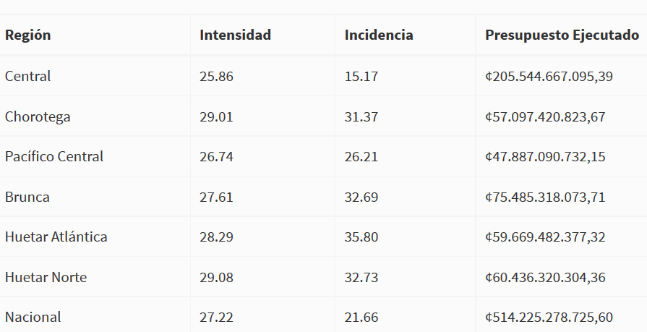
Allocate Resources by Sector/Region
Costa Rica analysed its regional MPI disaggregation figures vs the existing budget allocation and found large mismatches

Slide 13
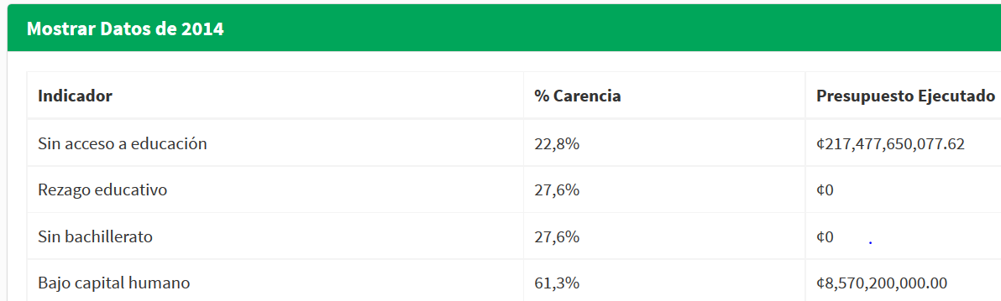
Allocate Resources by Sector/Region
Costa Rica also found mismatches by sector.

Slide 14
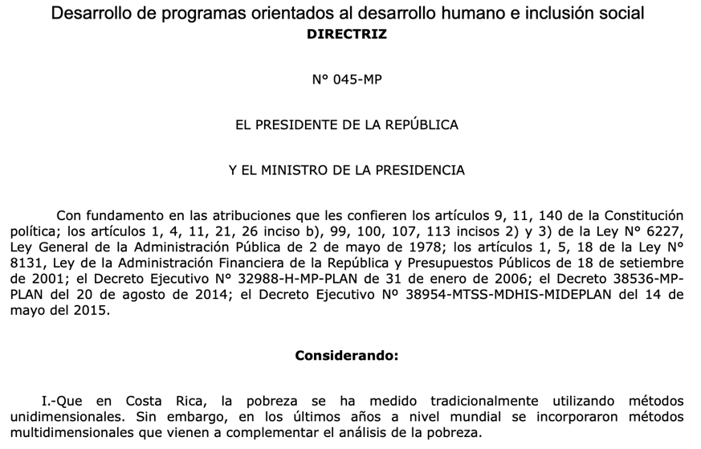
Allocate Resources by Sector/Region
Then-President Solis issued a decree that the MPI must be part of future budget allocation

Slide 15
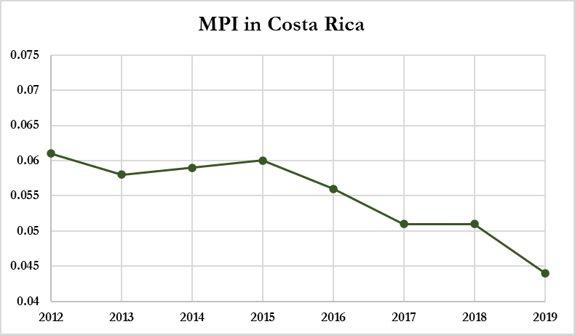
Allocate Resources by Sector/Region
After the decree, the MPI reduction accelerated while on a fixed budget (though this doesn’t identify a causal mechanism).

Slide 16
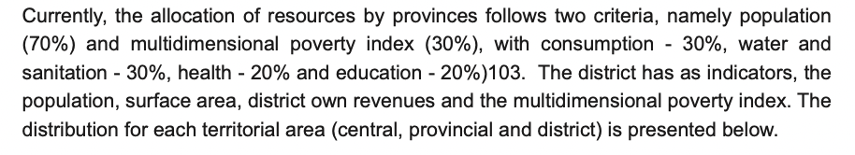
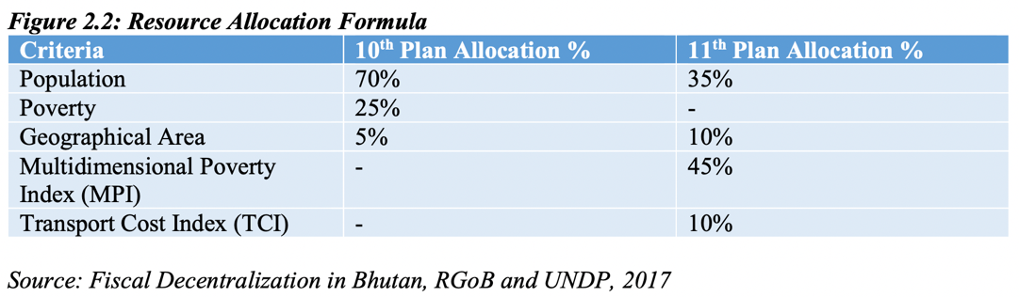
Allocate Resources by Sector/Region
Some countries mention their budget allocation formulae in their Voluntary National Reviews
Mozambique Voluntary National Review 2020
Bhutan Voluntary National Review 2018

Slide 17
Policymakers are using their MPIs to:
Complement monetary poverty measures
Track poverty over time
Allocate resources by sector or region
Target marginalized regions, groups, or households
Coordinate policy across sectors and levels of government
Evaluate policies and adjust
Leave no one behind
Report to the SDGs and other national/international goals
Promote transparency and accountability

Slide 18
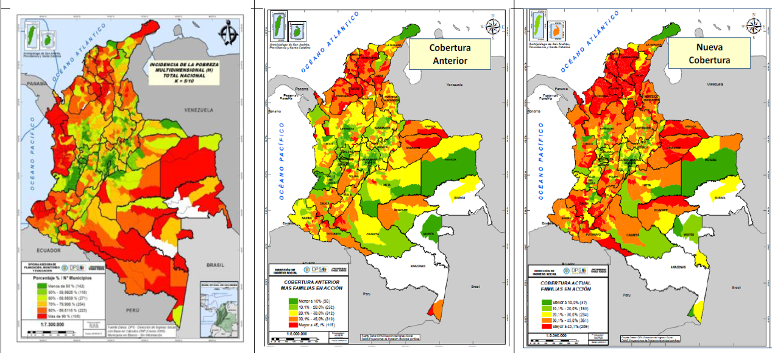
Target Regions/Groups/Households
Colombia used its National MPI to target coverage of its ‘Familias en Acción’ programme
MPI Poverty
Previous Coverage
New Coverage

Slide 19
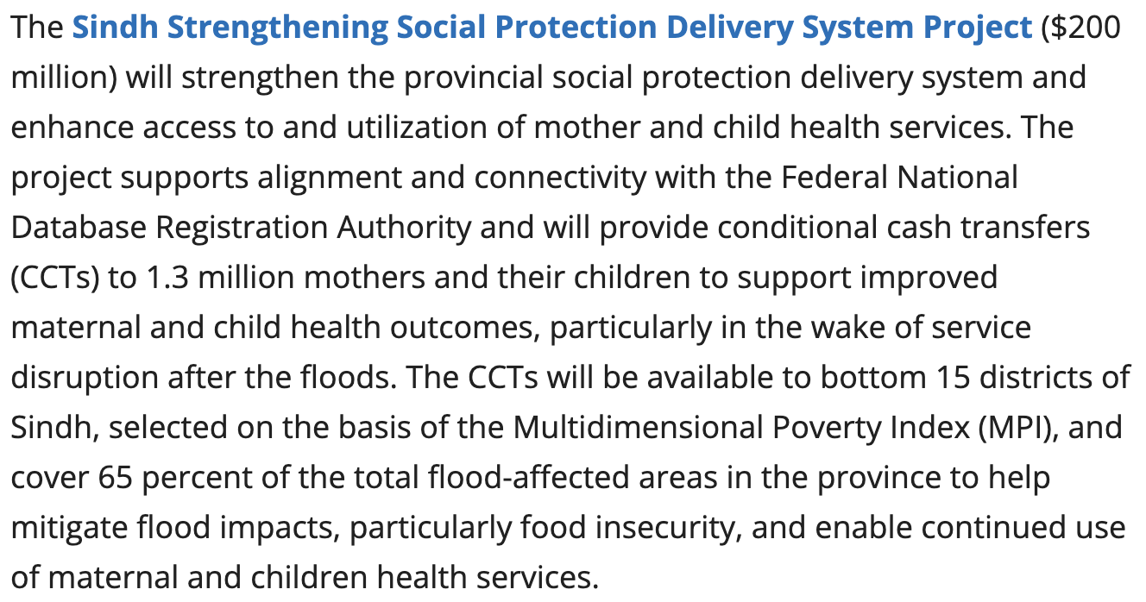
Target Regions/Groups/Households
The World Bank in Pakistan used its MPI to identify districts that would be eligible for cash transfers as part of flood relief efforts

Slide 20
Target Regions/Groups/Households
If an MPI is computed from census, administrative, or other data that is collected on all relevant individuals/households, it can be used for targeting at the individual or household level
During the COVID pandemic, Honduras developed an MVI using registry data, with additional questionnaires online and through community groups. This measure was then used to identify beneficiaries for a voucher that could be redeemed for food, medicine, and biosafety equipment.

Slide 21
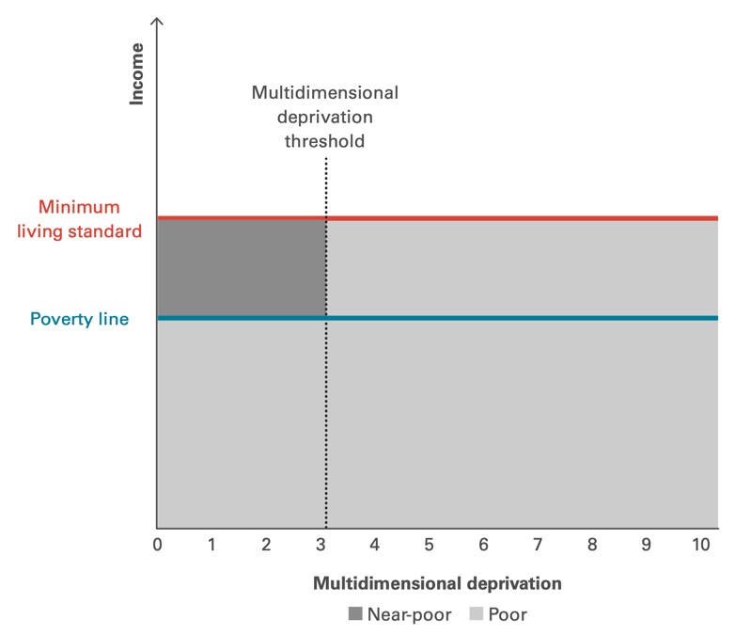
Target Regions/Groups/Households
Vietnam uses a Poverty Census to identify people living in multidimensional poverty. This is updated annually at the local level using information from registers, survey questionnaires, and community monitoring. This is used (along with monetary poverty) to identify priority groups of eligible beneficiaries for poverty reduction programs.

Slide 22
Policymakers are using their MPIs to:
Complement monetary poverty measures
Track poverty over time
Allocate resources by sector or region
Target marginalized regions, groups, or households
Coordinate policy across sectors and levels of government
Evaluate policies and adjust
Leave no one behind
Report to the SDGs and other national/international goals
Promote transparency and accountability

Slide 23
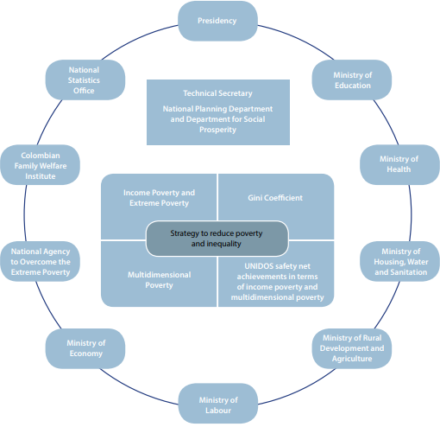










Coordinate Policy Across Sectors/Levels
Colombia formed a roundtable of Ministers and the President to meet and assess progress towards the MPI targets.

Slide 24
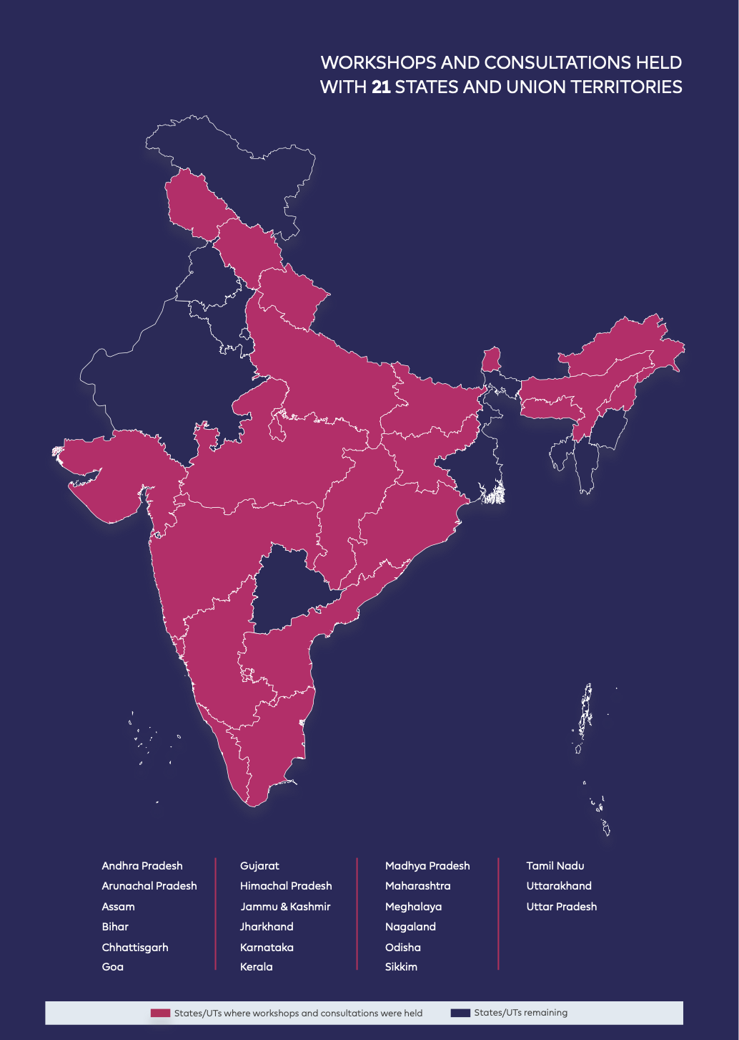
Coordinate Policy Across Sectors/Levels
India held workshops on the MPI in the capitals of more than 20 states and union territories.
In these workshops, a draft State Reform Action Plan with a set of reform areas and actions for each indicator was presented to the Chief Secretaries and Department Heads.

Slide 25
Policymakers are using their MPIs to:
Complement monetary poverty measures
Track poverty over time
Allocate resources by sector or region
Target marginalized regions, groups, or households
Coordinate policy across sectors and levels of government
Evaluate policies and adjust
Leave no one behind
Report to the SDGs and other national/international goals
Promote transparency and accountability

Slide 26
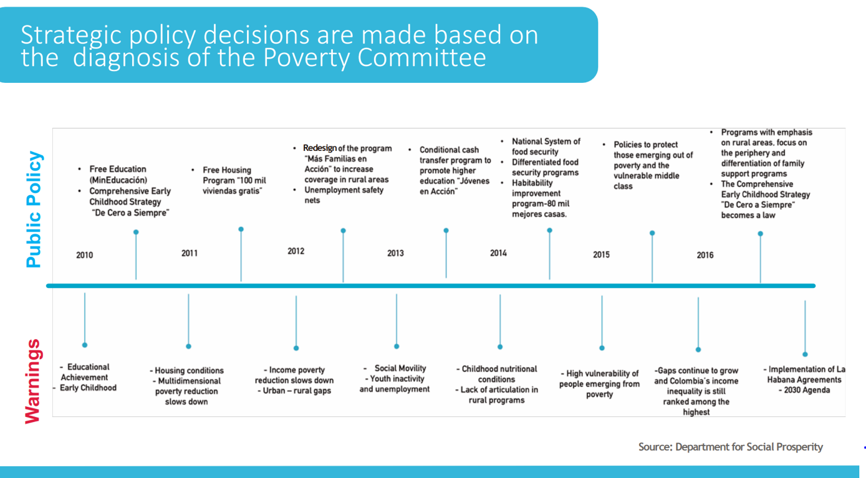
Evaluate Policies and Adjust
The Colombia roundtable identified warnings from MPI and developed policy responses

Slide 27
Evaluate Policies and Adjust
0%-10% avance
10%-25% avance
>25% avance
Pobreza | Línea Base PND 2008 | Dato 2011 | Dato 2012 | Análisis | Goal
MPI (Multidimensional Poverty) | 34.7% | 29.4% | 27.0% |  | 22.5%
Educational achievement (≥15 yrs) Literacy (≥15 yrs) | 58.8% | 54.6% | 53.1% |  | 52.8%
 | 14.2% | 12.0% | 12.1% |  | 12.0%
School attendance (6-16) No school lag (7-17) Access to child care services (0-5) Children not working (12-17) | 5.4% | 4.8% | 4.1% |  | 3.5%
 | 33.4% | 34.1% | 33.3% |  | 33.1%
 | 12.1% | 10.8% | 9.4% |  | 10.6%
 | 5.5% | 4.5% | 3.7% |  | 2.9%
Long-term unemployment Formal employment | 9.6% | 9.1% | 10.0% |  | 9.3%
 | 80.6% | 80.4% | 80.0% |  | 74.7%
Health insurance Access to health services | 24.2% | 19.0% | 17.9% |  | 0.5%
 | 8.9% | 8.2% | 6.6% |  | 2.4%
Access to water source Adequate sewage system Adequate floors Adequate external walls No critical overcrowding | 12.9% | 12.0% | 12.3% |  | 10.9%
 | 14.1% | 14.5% | 12.1% |  | 11.3%
 | 7.5% | 6.3% | 5.9% |  | 5.6%
 | 3.1% | 3.2% | 2.2% |  | 2.1%
 | 15.7% | 14.2% | 13.1% |  | 8.4%
A⁽¹⁾
The Colombia roundtable also tracked progress towards targets by indicator
***
B⁽²⁾
C⁽³⁾
***
D⁽⁴⁾
E⁽⁵⁾
OPHI Summer School 2022
27
***

Slide 28
Policymakers are using their MPIs to:
Complement monetary poverty measures
Track poverty over time
Allocate resources by sector or region
Target marginalized regions, groups, or households
Coordinate policy across sectors and levels of government
Evaluate policies and adjust
Leave no one behind
Report to the SDGs and other national/international goals
Promote transparency and accountability

Slide 29
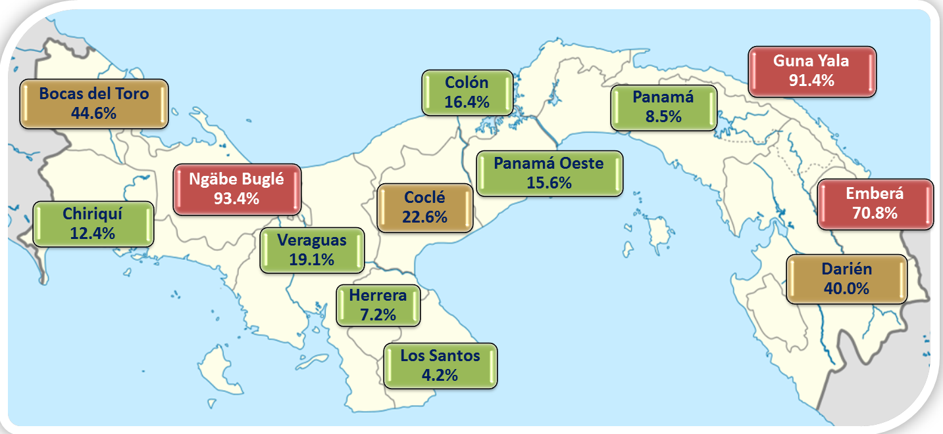
Leave No One Behind
Panama disaggregated its MPI by region to show regional disparities, especially in areas with large indigenous populations

Slide 30
Leave No One Behind
Looking at changes over time can show groups that are ‘catching up’ and those that are being left behind
Kenya global MPI ethnicity data, 2008/09-2014
Benin global MPI ethnicity data, 2006-2011/12

Slide 31
Policymakers are using their MPIs to:
Complement monetary poverty measures
Track poverty over time
Allocate resources by sector or region
Target marginalized regions, groups, or households
Coordinate policy across sectors and levels of government
Evaluate policies and adjust
Leave no one behind
Report to the SDGs and other national/international goals
Promote transparency and accountability

Slide 32
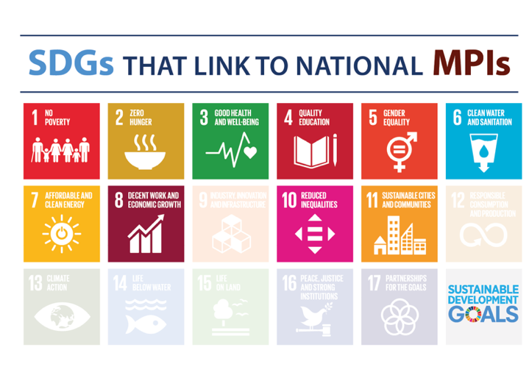
Report to the SDGs and Other Goals
The concept of poverty as a multidimensional phenomenon is fundamental to the 2030 Agenda.
The preamble to the 2030 Agenda calls “eradicating poverty in all its forms and dimensions... the greatest global challenge and an indispensable requirement for sustainable development”.
The MPI is connected to a number of different SDGs. It can be used to look at interlinkages across SDGs.

Slide 33
Report to the SDGs and Other Goals
In particular, SDG target 1.2 calls for countries to “reduce at least by half the proportion of men, women, and children of all ages living in poverty in all its dimensions, according to national definitions” by 2030.
SDG indicator 1.2.2 is the “proportion of men, women and children of all ages living in poverty in all its dimensions according to national definitions”.
It is the only SDG indicator for which national governments are the custodian agencies. World Bank, UNDP, and UNICEF are supporting agencies.
There are two ways in which countries report the MPI for SDG indicator 1.2.2:
  Global SDG Indicators Database
  Voluntary National Reviews

Slide 34
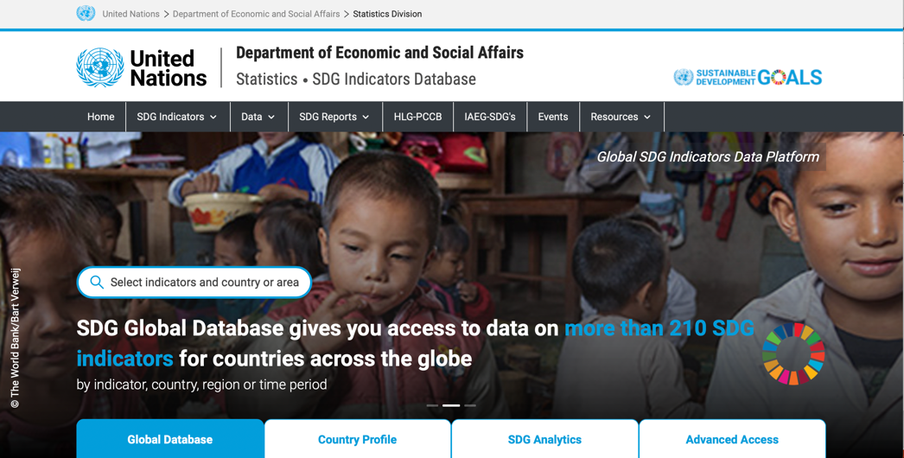
Report to the SDGs and Other Goals
The Global SDG Indicators Database is run by UN-DESA and UNSD.
For 1.2.2, the World Bank liaises with countries’ SDG Focal Points. It is important for whatever agency is responsible for the MPI to coordinate with their country’s SDG Focal Points to be sure that it is reported accurately.
The database captures information on intensity and headcount ratio for households, individuals, and children, with disaggregations by age, gender, and area (urban/rural).

Slide 35
Report to the SDGs and Other Goals
Voluntary National Reviews are encouraged for sharing of experiences in the implementation of the 2030 Agenda. They are shared each July at the HLPF and published online.
To date, 41 countries have submitted 53 VNRs reporting on multidimensional poverty.
The VNRs have reported national MPIs, global MPI, regional MPIs, national child MPIs, and MODA.
They also include information about policy use of the measures.

Slide 36
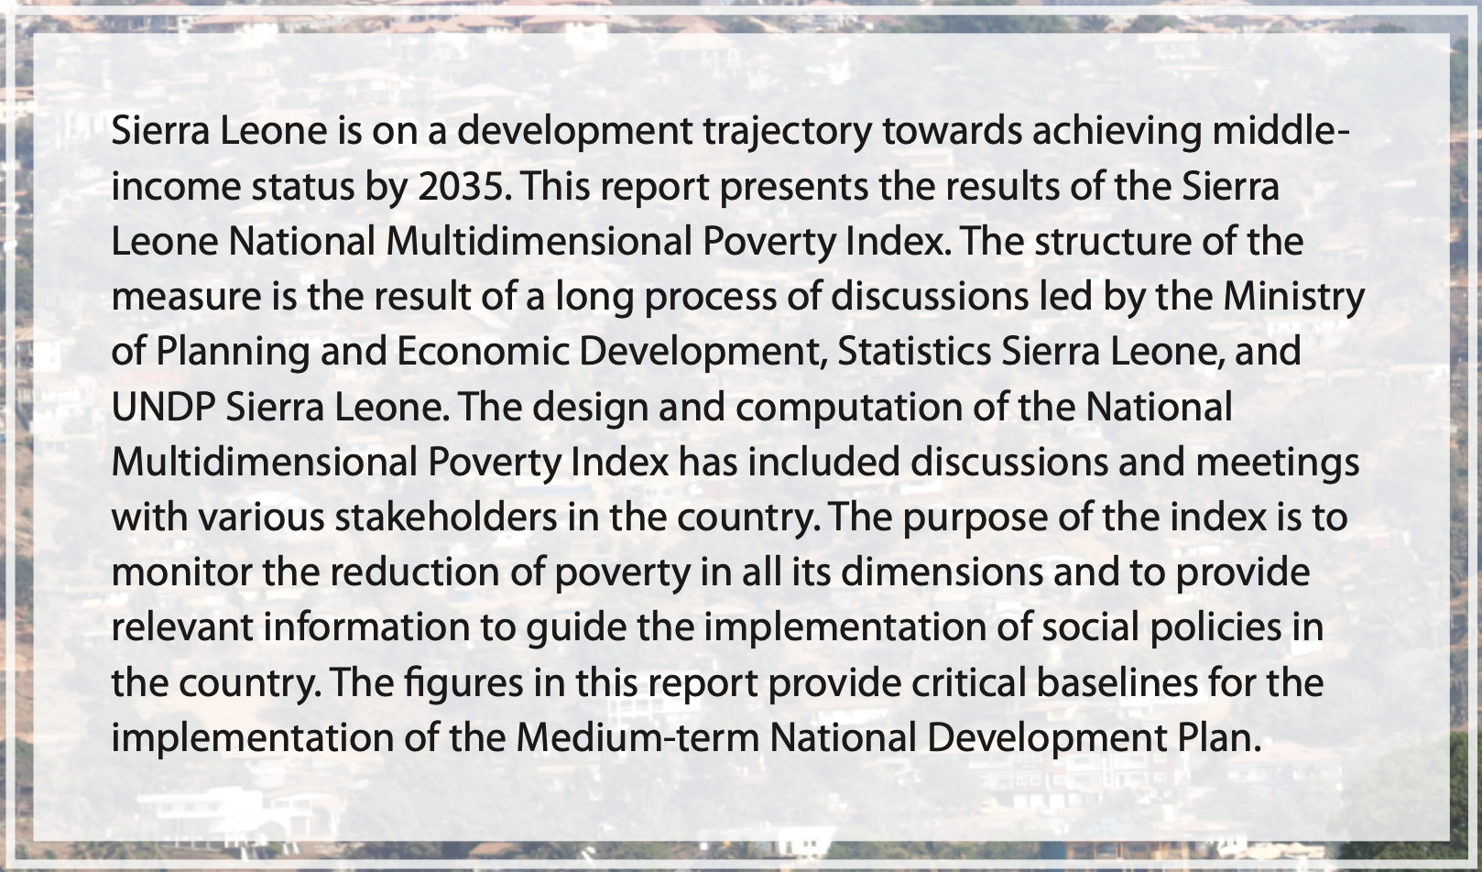
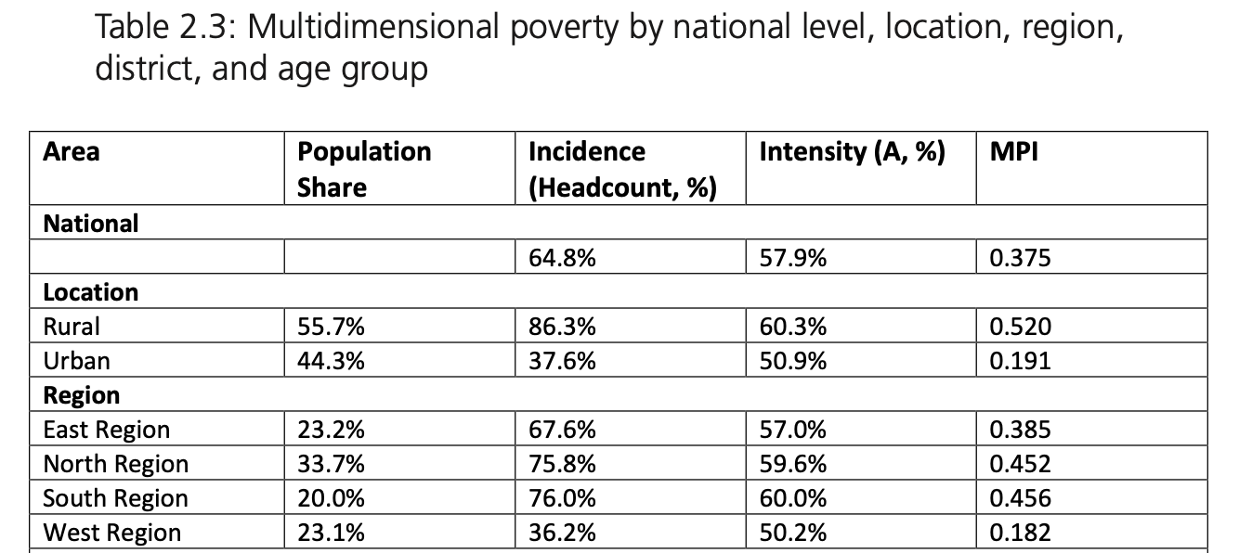
Report to the SDGs and Other Goals
Many countries also use their National MPIs to report progress towards National Development Plans and national goals.
Sierra Leone National MPI

Slide 37
Report to the SDGs and Other Goals
Many countries also use their National MPIs to report progress towards National Development Plans and national goals.
Colombia National MPI
”01 REDUCE POVERTY: Colombia will reduce the percentage of people in a situation of multidimensional poverty from 16% in 2021 to a range between 11.5% and 9.5%”

Slide 38
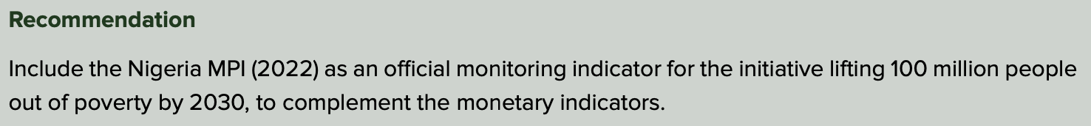
Report to the SDGs and Other Goals
Many countries also use their National MPIs to report progress towards National Development Plans and national goals.
Nigeria National MPI

Slide 39
Policymakers are using their MPIs to:
Complement monetary poverty measures
Track poverty over time
Allocate resources by sector or region
Target marginalized regions, groups, or households
Coordinate policy across sectors and levels of government
Evaluate policies and adjust
Leave no one behind
Report to the SDGs and other national/international goals
Promote transparency and accountability

Slide 40
Promote Transparency and Accountability
The MPI can be a tool for transparency and accountability of government poverty-reduction policies.
Example: Until 2002, Mexico did not have an official poverty measure. In 2001, as part of a restructuring process to increase credibility of poverty figures, the government consulted with national and international experts. In 2004, the Mexican Congress adopted the General Law of Social Development, which defined social rights and established the autonomous National Council for the Evaluation of Social Development Policy (CONEVAL), which was responsible for poverty estimations and had a Steering Committee of academic researchers. To increase credibility, CONEVAL publishes its calculation formula on its website and uses publicly available data.

Slide 41
MPI Policy Institutionalisation
To enable the sustainability and policy use of the MPI, it is important to think about the policy infrastructure for institutionalizing the measure.
Most national MPIs are developed with a Steering Committee, composed of representatives from different ministries and other stakeholder institutions (civil society, academia, development partners, etc.).
After it is launched, it is important to be clear about who has responsibility for what aspects of the measure (collecting data, computing, reporting for SDGs, using for policy coordination, targeting, etc.).
Some of the countries that have been most successful in using the MPI as a policy tool have set up a Social Cabinet or similar to monitor the MPI estimates and design social programmes to reduce it.

Slide 42
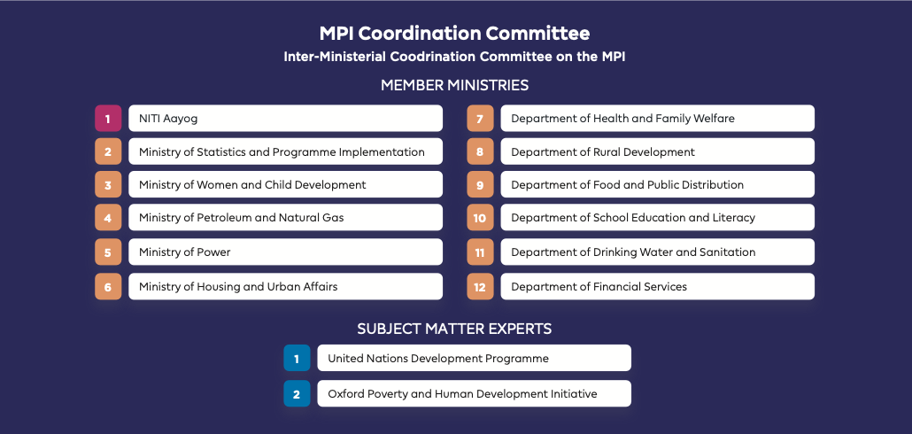
India National MPI

Slide 43
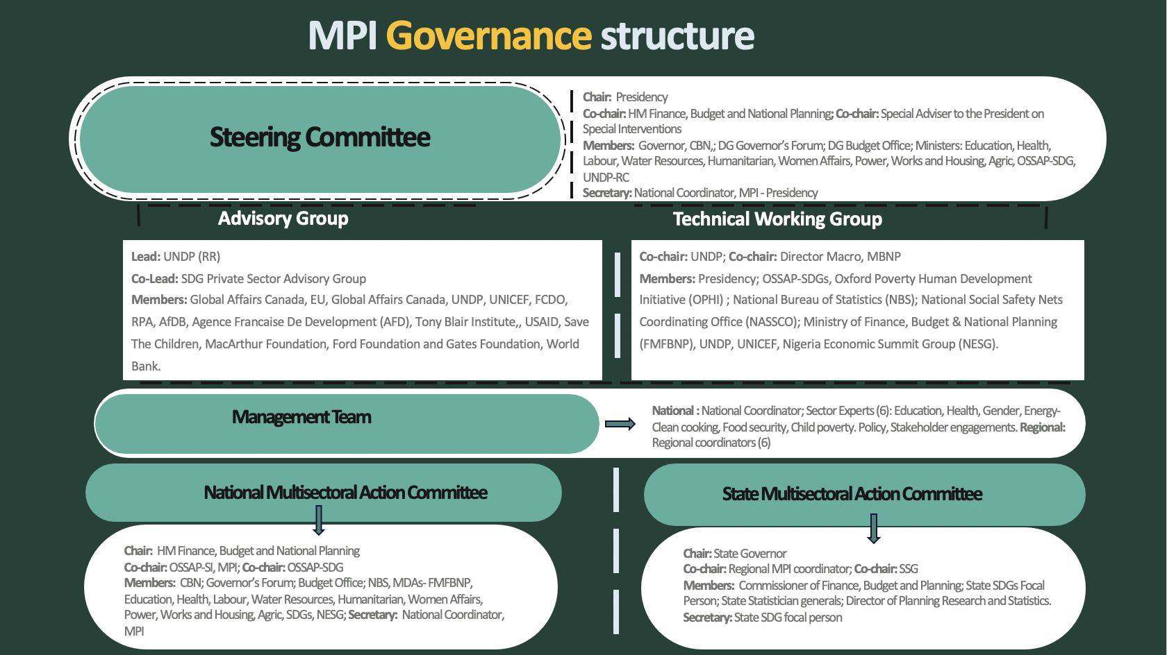
Nigeria National MPI

Slide 44
MPI Policy Institutionalisation
To further cement the sustainability of the measure, some countries have passed laws or official decrees that establish the MPI as an official statistic for the country or have included it explicitly into their National Development Plans:
  Mexico: General Law of Social Development created an independent institution to measure poverty and made its use mandatory for all state agencies
  Panama: Cabinet Decree Number 63, established the national MPI as the official instrument for multidimensional poverty measurement
  Honduras: two Executive Decrees for the MPI process and institutionalization
  Costa Rica: Presidential Decree that the MPI should be used for budget allocation
  Colombia: Decree to ensure the functions of the Equity Roundtable
  Angola: Presidential Decree to include MPI in budget allocation
  Vietnam: Prime Minister’s Decision and People’s Committee Decision applying MPI
  Many countries have included the MPI into their National Development Plans

Slide 45
Key Policy Stakeholders
The MPI reaches across sectors and institutions. Some key policymakers that engage with the MPI include:
Heads of State
Ministries (planning, finance, social development, education, health, housing, etc.)
National Statistics Office
Parliamentarians
Local government officials
Civil society
Academia
Media
NGOs
International agencies
Private sector
Others??

Slide 46
Beyond Governments
MPIs/AF Measures are also used by other stakeholders:
NGOs have used the global MPI to target their programs and ensure that they are reaching people living in poverty
UN agencies have used MPIs to evaluate the impact of their programs
Private sector has used a national/business MPI to address poverty among its employees and supply chain

