Slide 1
Optimization Model Development for Poverty Reduction
Multidimensional poverty and poverty reduction policies – Republic of Iraq
October 2022

Slide 2
Need for a Poverty reduction planning tool ~ SDG 1 Targets
Despite their strong assumptions, nowcasting and forecasting approaches to computing poverty indices remain an essential exercise from a policy perspective.

Slide 3
Assumptions
The overall goal is to reach a preset target MPI (lower than the existing MPI) while minimizing the total effort. $min\sum_{J}{E_{j} }$
For each indicator, the policy maker is able to specify a measure of effort required to remove a single household from deprivation.
The indicators that will be used in optimization are assumed to be independent.
The optimization model generates:
Total effort required per indicator
Total effort per demographic cell and per indicator

Slide 4
Optimization models – along two levels
Type of active input
A more realistic representation of the state assumes that the state can choose the indicators and demographic cells it aims to target (along with levels of efforts) when planning its interventions. The societal response is random.
Indicators are assumed to be independent
Individual indicators
It is assumes that the state can choose only the indicators at national level (along with the levels of efforts) when planning its interventions. The societal response is random.
The state is assumed capable of targeting specific household categories in its interventions across specific indicators of choice.
The original indicators are clustered and a new non-binary deprivation matrix is produced.
Clustered Indicators
Household-level
Demographic Cell -level
National-level
Type of intervention

Slide 5
Six optimization models
Type of active input
Deterministic
Probabilistic
Individual indicators
Clustered Indicators
Household-level
Demographic Cell -level
National-level
Type of intervention

Slide 6
Probabilistic models – Illustration
Resource units needed to raise a deprived household out of deprivation in this indicator (j=1) is equal to 4.5 units. Optimization model results in 9 resource units that should be allocated to this indicator.
Household # | Run 1 | Run 2
Household 1 (poor) | Flip | No-Flip
Household 2 (deprived and non-poor) | No-Flip | Flip
Household3 (deprived and non-poor) | Flip | Flip
Household 4 | BAU | BAU
Household 5 | BAU | BAU
Household 6 | BAU | BAU

Slide 7
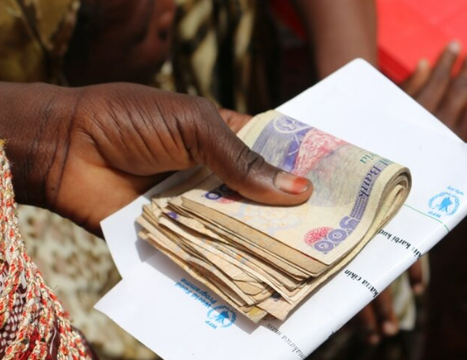
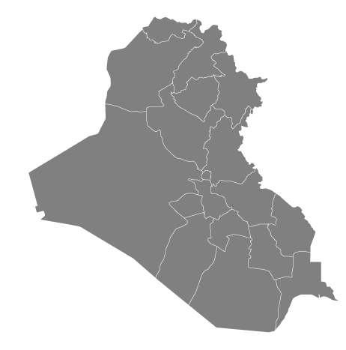
Additional optimization models
Type of Indicators
Private Indicators
Household-level
Geographic and income proxy clustering
Public Indicators
Demographic cell-level
Type of intervention

Slide 8
Optimization module ~ Brief summary
Scoping
A policy maker sets a target to reduce the MPI index, so that the model proposes the channels to attain this target. The computational method shall deploy exact mathematical algorithms or heuristic optimization to provide answers regarding how to reach an MPI target while respecting the AF proprieties, axioms, and assumptions. The activity is aimed at informing policymakers, and laying out key policy Reponses & actions.
Household model
Targets individual MPI poor households. Unrealistic, as the state has capabilities that are non-practical: 1) The state has the necessary capability to remove a specific household from its deprivation in one indicator, irrelevant of the socio-demographic context in which it belongs; 2) The state observes the deprivation status of households for all indicators in a certain region. $MPI_{p}\left(H_{p}=H_{s} \& I_{p}<I_{s}\right)> MPI_{p}{\left(H_{p}<H_{s} \& I_{p}<I_{s}\right)}^{ }$
Demographic Cell – level & National-level models
Both these models relax the restrictive assumption of the state’s perfect knowledge or targeting capacity. Targets indicators and demographic cells without consideration for the multidimensional poverty status of recipients. Practical and realistic
Demographic Cell for in-kind support, and Household level for in-cash support
The models are updated and consider two types of deprivations: in private versus public goods. The models’ objective is to achieve a target reduction in the aggregate MPI by adapting a country’s deprivation matrix in a way so as to minimize simultaneously the state’s outlay of cash for private-good deprivations, and of in-kind support for public-good deprivations at the level of population cells (e.g., governorates).
Demographic Cell for in-kind support, and cluster level for in-cash support
This model builds on this added complexity by focusing on minimizing simultaneously the in-kind transfers allocated to population cells to tackle public-good deprivations, and the cash transfers allocated to distinct household types for their private-good deprivations. Here, household types differ according to their tendency to use public assistance to alleviate the targeted deprivation versus for other welfare-increasing spending. The household types are identified by the clustering approach, taking into consideration common consumption patterns of the different households in order to define statistically homogeneous subgroups of households. The added complication here in relation to ‘private’ indicators – and source of waste – is that the state may have limited ability to enforce whether households use the public assistance to reduce the targeted deprivations, or how they allocate the assistance across their multiple deprivations
Notes:
بحاجة للتحديث في نهاية العرض التقديمي

Slide 9
Model(s) features
Poverty reduction action plan (from a modeler point of view)
Features of the models
MPI poor households targeted precisely Vs. Deprived households at National Vs. Geographical Vs. tailor cash transfers according to households’ consumption patterns
Type of transfers for active indicators
In-kind Vs. In-cash transfers tailored to households’ needs
Resource waste
Waste from aid going to: (D & $\overline{H})$ Vs. H (without lifting them from poverty) Vs. moral hazard (households using cash-transfers on non-deprived households)
Waste from aid going to: (D & 𝑯 ̅) Vs. H (without lifting them from poverty) Vs. moral hazard (households using cash-transfers on non-deprived households)
Targeting ability

Slide 10
Application on Egypt – Sample of a Survey 2018-19, target setting MPI reduction for the next 10 years

Slide 11
Data inputs
Binary deprivation matrix, 2018-19 survey:
12,486 Households and 22 Indicators
Each Household is characterized by a household size and by demographic information (governorate).
Indicators belong to seven dimensions.
Each dimension is equally weighted (in terms of contribution to the MPI) and each indicator within a dimension is equally weighted.
The poverty cut-off is 1/3.

Slide 12
Baseline MPI results for the sub-sample selected
Indicators | % Uncensored Headcount rate by Indicator | % contribution to MPI
School attendance | 6.0% | 3.5%
Electricity | 9.8% | 2.6%
Unemployment | 5.0% | 1.5%
Social assistance | 21.5% | 11.0%
MPI
0.176
H
38.23
A
46.21
Indicator | Marginal resources needed to lift a household above a cutoff for deprivation in an indicator | Feasible cumulative aggregate range of resources
School attendance | $$6$$ | 0 to $6,000$
Electricity | $$5$$ | 0 to $5,500$
Unemployment | $$3$$ | $$0 to 3,500$$
Social assistance | $$6$$ | $$0 to 6,500$$

Slide 13
Simulation Results

Slide 14
Results (1/2)
 | Baseline | Household | Demographic | National | Demographic level for public goods and National for private | Demographic level for public goods and cluster level for private | Demographic level for public goods and household level for private goods
 |  | $$HH$$ | $$D$$ | $$N$$ | $$D−N$$ | $$D−NC$$ | $$D−HH$$
Number of households lifted from poverty |  | 27 | 28 | 28 | 28 | 29 | 27
Number of households lifted from deprivation |  | 27 | 42 | 102 | 83 | 47 | 34
Maximum number of deprivations per household that are lifted |  | 1 | 2 | 2 | 2 | 2 | 1
Headcount poverty rate (H; %) | 35.5% | 27.5% | 27.9% | 28.9% | 28.9% | 27.9% | 27.7%
Intensity of poverty (A; %) | 36.4% | 37.6% | 37.1% | 35.6% | 35.8% | 37.0% | 37.1%
Change in MPI (%) |  | -20.1% | -20.0% | -20.4% | -20.0% | -20.0% | -20.2%

Slide 15
Results (2/2)
Private indicators uncensored deprivation rates disaggregated by clusters
Post optimization results
Clusters | I | II | III | IV | V | VI
Households that have changed poverty status, due to change(s) in deprivation scores in one or several indicators | 1 | 4 | 12 | 1 | 2 | 9
How many switches of deprivations scores have been recorded | 1 | 9 | 17 | 3 | 4 | 13
Average Income per cluster per capita (Survey period KLCU) | 3.2 | 5.6 | 1.8 | 4.1 | 1.4 | 1.6

Slide 16
Thank you

