Slide 1
Crime in Qatar 2023
2015-2022

Slide 2
content
Introduction
Meaning
Definitions
Types of crimes
CASES RAISED IN COURTS BY TYPE OF CRIME 2022
Graph of CASES RAISED IN COURTS BY TYPE OF CRIME 2019 – 2022
SDG’S indicators
Indicator 5.2.1
Indicator 5.2.2

Slide 3
Introduction
Crime is an act that is committed and is contrary to or against prevailing social systems and has a violation of the law. That is, it is not positive and unacceptable behavior in society, and requires a reaction of punishing the perpetrator.

Slide 4
Meaning
crime refers to violation of law or an act punishable and forbidden by law. Crime in Qatar is divided into three types, which are a felony, a misdemeanor or an infraction.

Slide 5
Definitions
. Felony cases: crimes punishable by death or life imprisonment or imprisonment in excess of 3 years.
Misdemeanour cases: crimes punishable by imprisonment for a term not exceeding 3 years or a monetary penalty of not more than 1000 Q.R.
Infraction cases: a monetary penalty.

Slide 6
Types of crime
Property Crime
Violent Crime
White-Collar Crime
Organized Crime

Slide 7
CASES RAISED IN COURTS BY TYPE OF CRIME 2022
Type of Crime | Felony cases: | Type of Crime | Felony cases:
Crimes against civil servants activities | 30 | Crimes of violation of environmental laws | 0
intellectual property rights offenses | 0 | Crimes violating the laws of immigration and residency | 0
Crimes against human body | 474 | Cheques cases | 0
Sexual and moral crimes | 603 | Crimes of violation of traffic laws | 11
Drugs and alcoholic crimes | 266 | Computer crimes | 70
Crimes against others money and property | 675 | Possession of property obtained by crime | 3
Crimes violating the laws of public trust | 79 | Crimes against animals | 0

Slide 9
SDG’S indicators
Target 5.2
Eliminate all forms of violence against all women and girls in the public and private spheres, including trafficking and sexual and other types of exploitation.

Slide 10
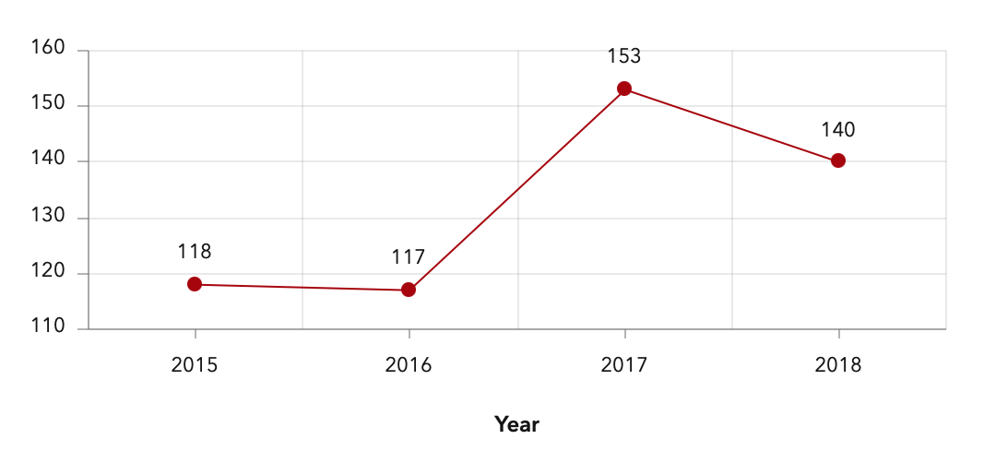
Indicator 5.2.1
The total number of young women and girls who have been subjected to violence by a current or former intimate partner in the past twelve months
The proportion of ever-partnered women and girls aged 15 years and older subjected to physical, sexual or psychological violence by a current or former intimate partner in the previous 12 months, by the form of violence and by age

Slide 11
The number of young women and girls who have been subjected to violence by a current or former intimate partner in the past twelve months, by place.

Slide 12
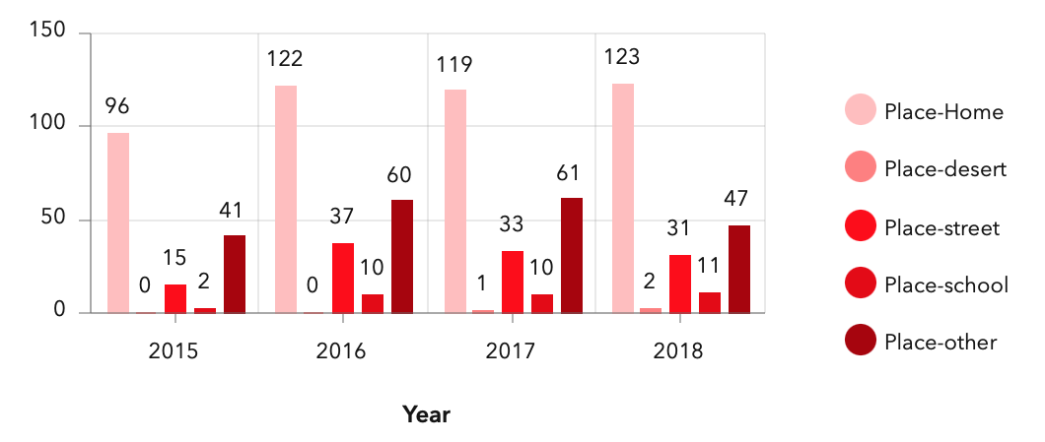
Indicator 5.2.2
The number of young women and girls who have been subjected to violence by persons other than an intimate partner in the past twelve months, by place.
The proportion of women and girls aged 15 years and older subjected to sexual violence by persons other than an intimate partner in the previous 12 months, by age and place of occurrence

Slide 13
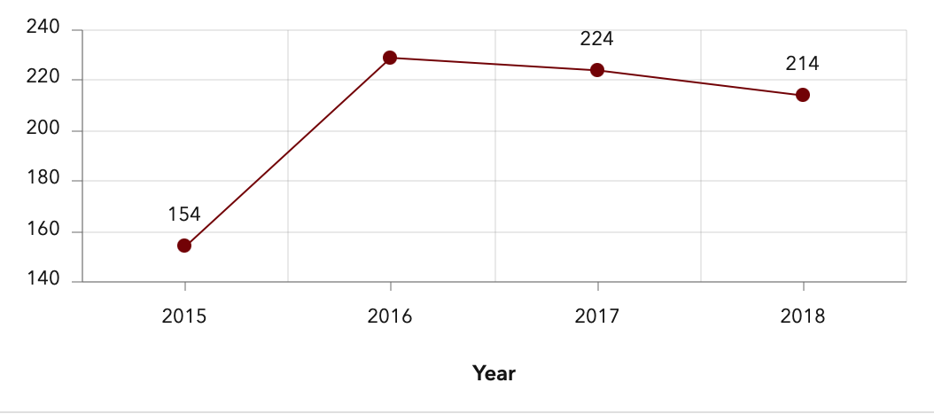
Total number of young women and girls who have been subjected to violence by persons other than an intimate partner in the past twelve months.

