Slide 1
Workshop on the Use of the "Indices Simulation Tool for Policy Makers in the Arab Region”
Nathalie PICASSO-GRAND, Data Scientist, ESCWA
17-18 May 2023, UN House, Beirut, Lebanon

Slide 2
Session I: Indices Simulation Tool for Policy Makers in the Arab Region (ISPAR)
The tool is ready
Coverage and features of the indexes simulation tool for evidence-based policymaking
Notes:
Governments can compare
We have a number of baseline included
Classic 2 countries
Then regional
More specific
Very flexible
You own

Slide 3
Session I: Indices Simulation Tool for Policy Makers in the Arab Region (ISPAR)
The tool is ready
What are the goals of developing ISPAR?
What is its coverage?
What are the main features?
of the indexes simulation tool for evidence-based policymaking
Notes:
Governments can compare
We have a number of baseline included
Classic 2 countries
Then regional
More specific
Very flexible
You own

Slide 4
https://ispar.unescwa.org/
Indices Simulation Tool for Policy Makers in the Arab Region (ISPAR)

Slide 5
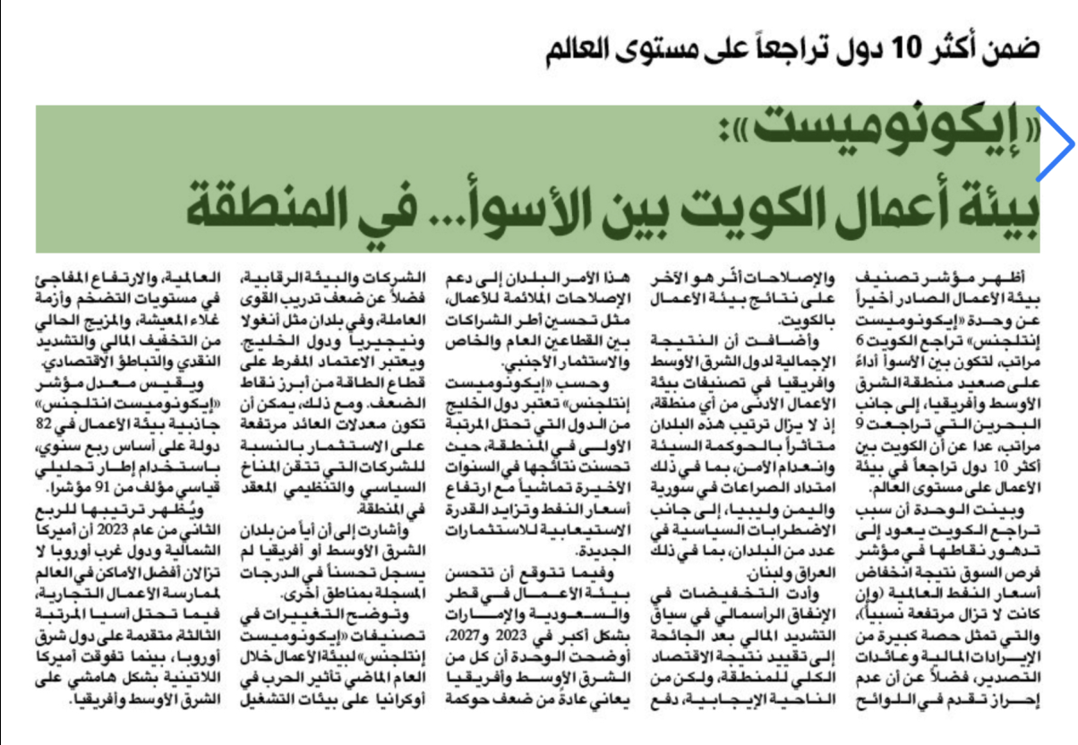
Indices Simulation Tool for Policy Makers in the Arab Region (ISPAR)

Slide 6
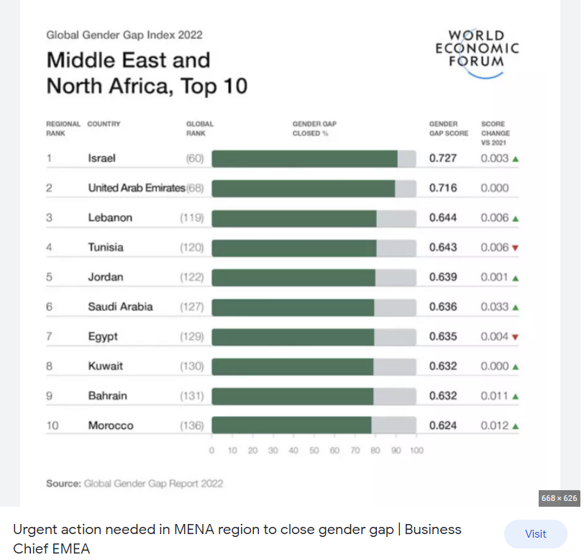
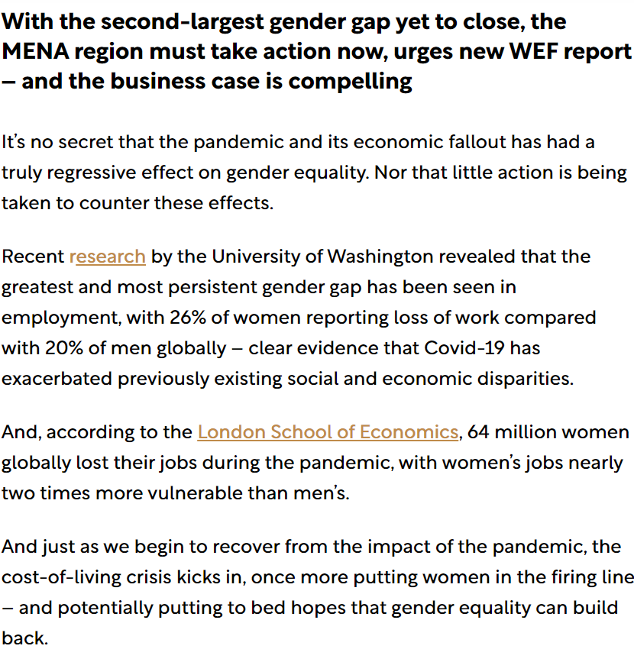
Indices Simulation Tool for Policy Makers in the Arab Region (ISPAR)

Slide 7
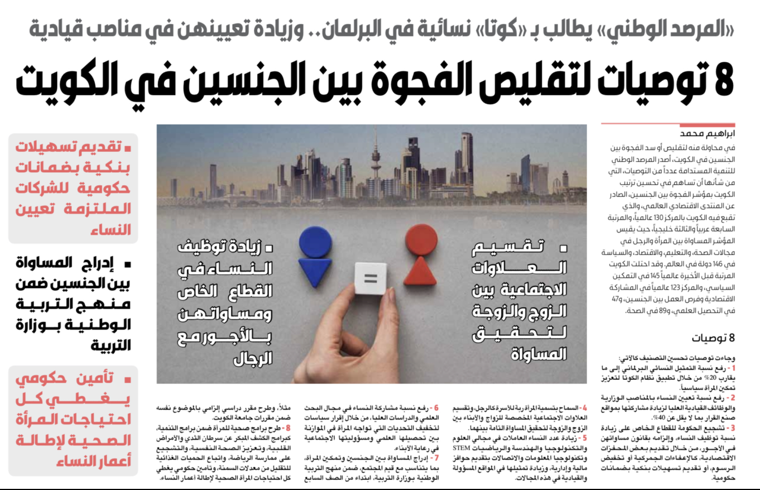
Indices Simulation Tool for Policy Makers in the Arab Region (ISPAR)
Member States showed concerns about international indices used to assess their performances

Slide 8
Indices Simulation Tool for Policy Makers in the Arab Region (ISPAR)
The Project’s Goal
Improving policymaking effectiveness using a series of international indices
Improving policymaking effectiveness
assist Member States in understanding the impact of specific policies
Improving policymaking effectiveness
assist Member States in understanding the impact of specific policies and identifying effective and efficient procedures that could be implemented in the short, medium and long term to enhance country’s ranking in selected international indicators and impact the socio-economic development on national level.
Improving policymaking effectiveness
assist Member States in understanding the impact of specific policies and identifying effective and efficient procedures that could be implemented in the short, medium and long term to enhance country’s ranking in selected international indicators
Improving policymaking effectiveness
assist Member States in understanding the impact of specific policies and identifying effective and efficient procedures
Improving policymaking effectiveness
assist Member States in understanding the impact of specific policies and identifying effective and efficient procedures that could be implemented in the short, medium and long term
The ISPAR project’s goal: develop a tool so International Composite Indicators can be used for evidence-based policymaking
https://ispar.unescwa.org/about.aspx

Slide 9
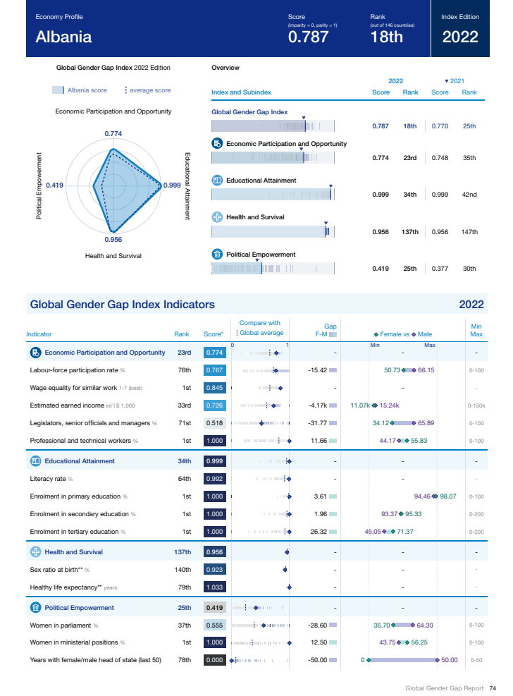
Are Indices as they are useful for policymaking?
NO
Data used for performance assessment are not accurate or not updated, or missing
Transparency (methodology)
how data are collected, how surveys are administered
the weight of experts’ judgment
other discretionary decisions
First issue : The DATA

Slide 10
Are Indices as they are useful for policymaking?
What is the impact of changes in policies on ranking?
NO
and in turn on economic and social performances or SDGs
Second issue :
no SIMULATION of change in
policy is possible

Slide 11
Are Indices as they are useful for policymaking?
NO
How to benefit from the experience of other countries?
How can countries learn from past experiences?
Third issue :
Policy Recommendations

Slide 12
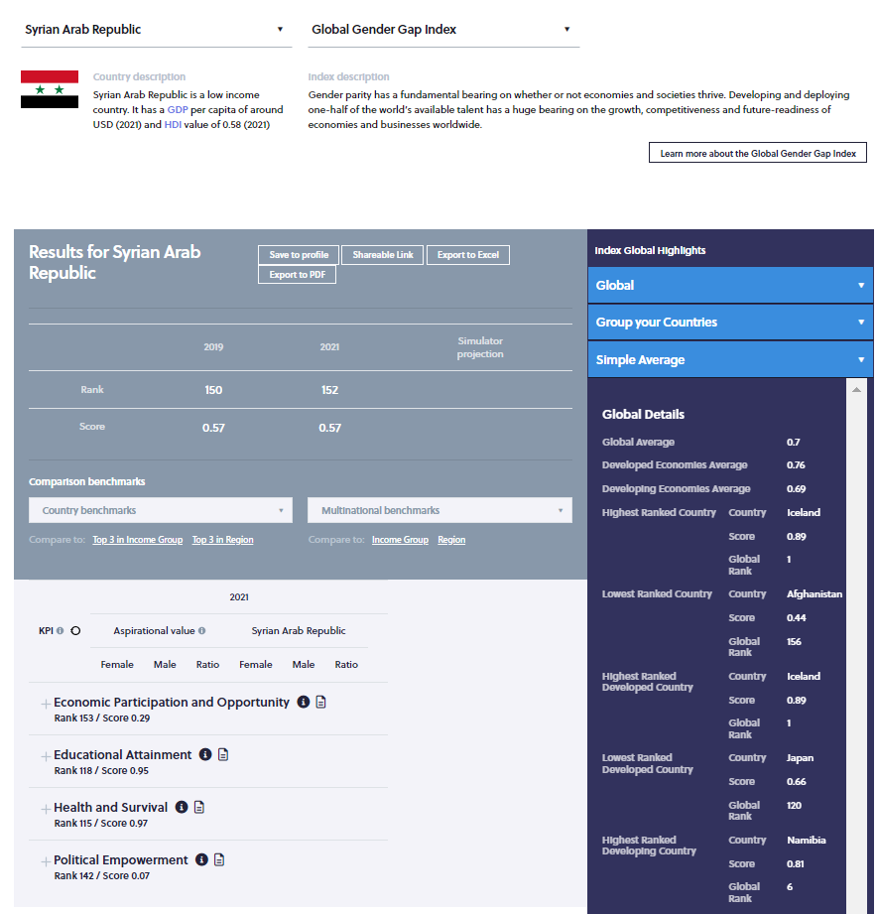
How ESCWA addressed the issues with Composite Indexes?
Monitoring and accuracy of performance assessment : the governance of data production and diffusion
YES
Development of Simulators to evaluate the impact of policy changes on achievements and rank
Go beyond the composite index and design a comprehensive strategy: Which aspects of the problem at hands are missing
Policy recommendation
Tools for goals prioritization
Tool for assessment of linkages between Composite indexes and the SDGs and the set developmental goals

Slide 13
Thank you for your time!
The tool is ready
Notes:
Governments can compare
We have a number of baseline included
Classic 2 countries
Then regional
More specific
Very flexible
You own

Slide 14
Workshop on the Use of the "Indices Simulation Tool for Policy Makers in the Arab Region”
Nathalie PICASSO-GRAND, Data Scientist, ESCWA
17-18 May 2023, UN House, Beirut, Lebanon

Slide 15
Session II: Introduction to global indicators in various fields
The tool is ready
This session aims to introduce participants to global indicators in the economic and social fields in general and those that are included on the ISPAR tool.
Notes:
Governments can compare
We have a number of baseline included
Classic 2 countries
Then regional
More specific
Very flexible
You own

Slide 16
Session II: Introduction to global indicators in various fields
The tool is ready
Generate a profile
Carry a first benchmarking analysis
Discover the various fields covered by the tool
Understand the linkages between Composite Indices
Notes:
Governments can compare
We have a number of baseline included
Classic 2 countries
Then regional
More specific
Very flexible
You own

Slide 17
Generating a profile
The tool is ready
Go to ISPAR / Countries / select your country (flag) / select “View the international index rankings”
Notes:
Governments can compare
We have a number of baseline included
Classic 2 countries
Then regional
More specific
Very flexible
You own

Slide 18
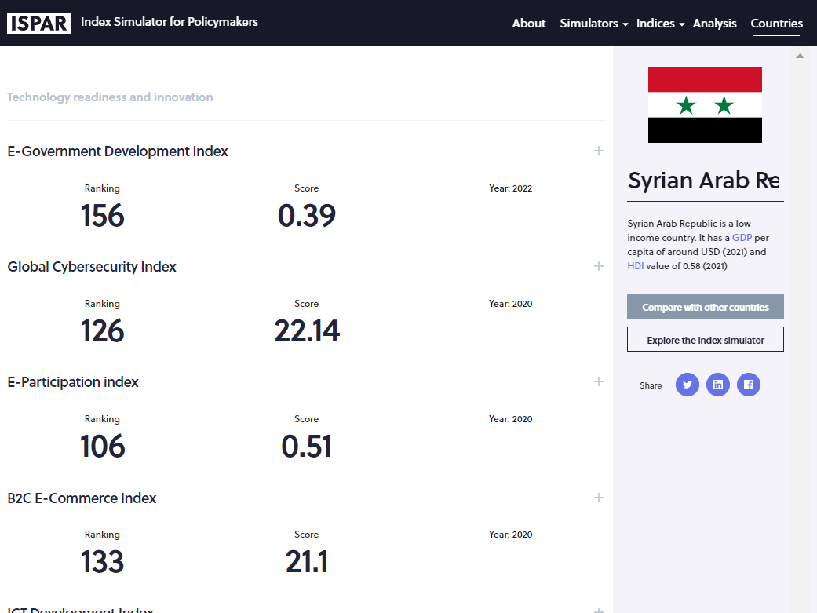
Generate a profile
Brief description of the country. The same information is provided for all countries to facilitate comparisons
View performances on multiples indices in one page
Score and rank are provided
And the year of publication of the index. This is very important

Slide 19
Generating a profile
Go to ISPAR / Countries / select your country (flag) / select “View the international index rankings”
The tool is ready
It shows the country’s performances and which Indices are available for which year. For these indices, a policy impact simulator is available. Comparison with other countries is possible
Notes:
Governments can compare
We have a number of baseline included
Classic 2 countries
Then regional
More specific
Very flexible
You own

Slide 20
Generate a profile
Compare with other countries

Slide 21
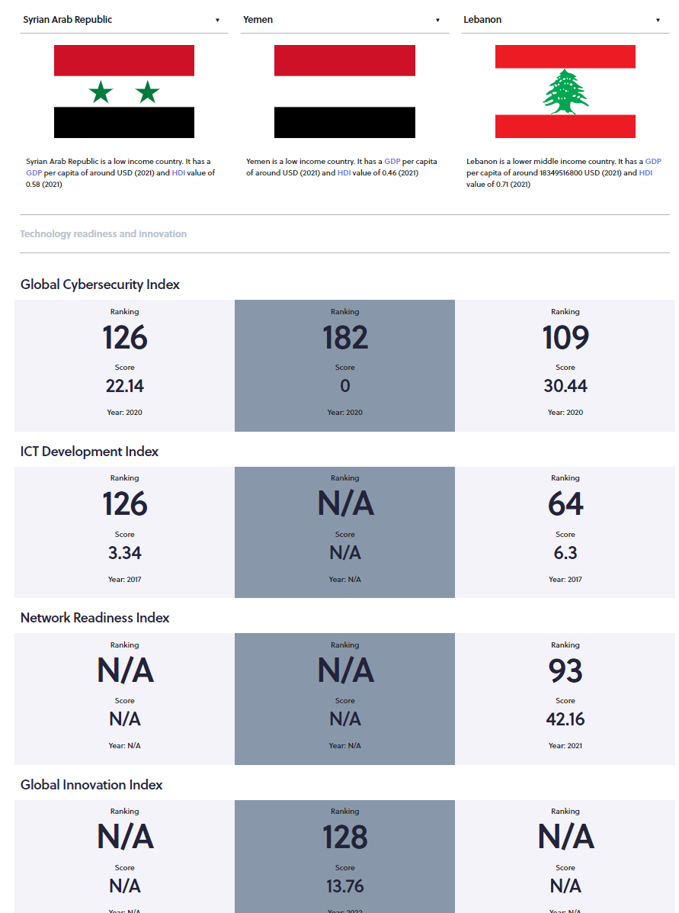
Generate a profile
View performances on multiples indices in one page
Compare with other countries.
By default, two countries with similar HDI and/or GDP per capita are randomly selected
Select benchmark using relevant info

Slide 22
A first general benchmarking can be done here
Conflict countries :
Rwanda, Bosnia, Croatia, Indonesia, Cambodia, …
Which best benchmark for ST, MT, LT
A more informative benchmarking should be done at the KPIs level and reflect the envisioned policies
Notes:
Governments can compare
We have a number of baseline included
Classic 2 countries
Then regional
More specific
Very flexible
You own

Slide 23
ISPAR coverage
For now
Gender Gap Index
AI readiness Index
Doing Business index
Competitiveness index
ITU ICT Development Index
e-Government Index
Global Cybersecurity Index
Global Innovation Index
Digital Accessibility Rights Evaluation Index
Women peace and Security index
Network Readiness Index
Women Business and the Law Index
Development Challenge Index
Global knowledge Index
B2C E-commerce Index
E-participation Index
Globalisation Index
Open Data Inventory Index
Wider than Gender Issues
22 indices included
Recently added
FDI restrictiveness index
Financial Inclusiveness index
Food security index
Human capital index
Are engendered
Notes:
This is bigger than the GGI
Because women life will be improved also by tackling issues such as
Globalization
E-government
Higher innovation capacities
Higher competitiveness
If something is missing in the list then send a request

Slide 24
The indexes are linked to each other
Or because the same KPIs are used to assess country’s performance
Or because of spillover effects across indices
That need to be assessed to hasten the achievement of sought goals
Go to ISPAR / Analysis /
Notes:
Governments can compare
We have a number of baseline included
Classic 2 countries
Then regional
More specific
Very flexible
You own

Slide 25
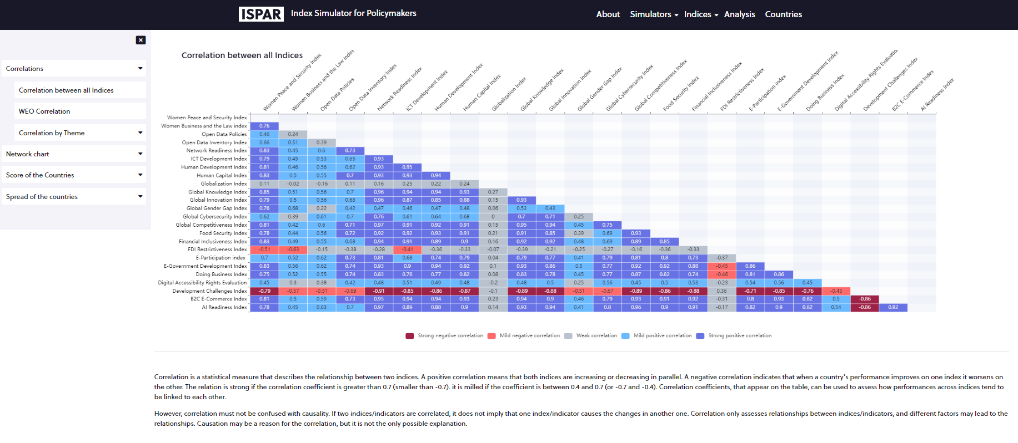
Understand and evaluate spillover effects
Under the tab ‘Analyses’
Correlations measure how closely indices move together, hence the spillover effects
Under ‘Correlations’ select ‘Correlations between all indices’
Correlations of all indices against each other

Slide 26
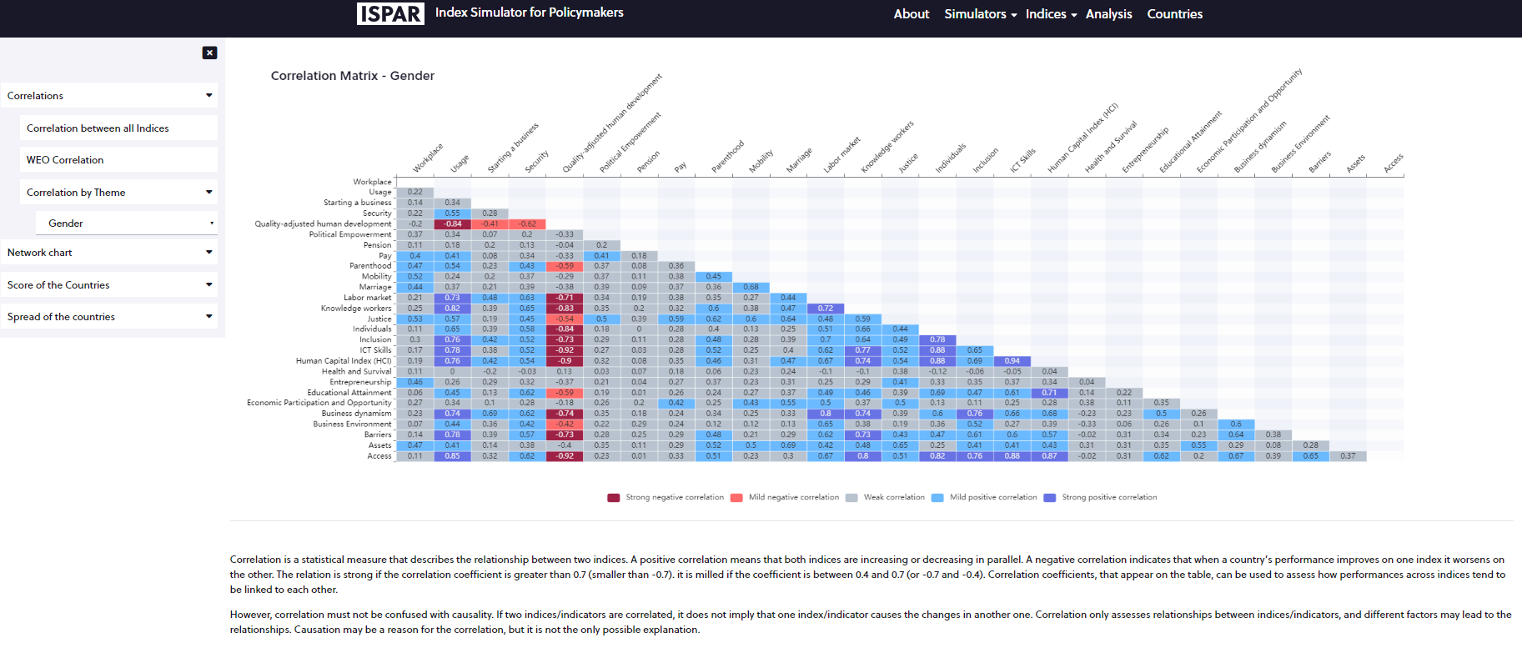
Understand and evaluate spillover effects
Under the tab ‘Analyses’
Correlations measure how closely indices move together, hence the spillover effects
Under ‘Correlations’ select ‘Correlations by Theme’ and ‘Gender’
Correlations of all sub-dimensions of all gender indices

Slide 27
Help identify
The potential for cooperation across Ministries
The tool is ready
How each can contribute to the achievements of another Ministry’s goals
Example: if a country improving on its ranking on the Women Business and the Law Index will positively affect its performances on a series of other indices (first column of the matrix) from innovation to competitiveness and so forth.
Notes:
Governments can compare
We have a number of baseline included
Classic 2 countries
Then regional
More specific
Very flexible
You own

Slide 28
Workshop on the Use of the "Indices Simulation Tool for Policy Makers in the Arab Region”
Nathalie PICASSO-GRAND, Data Scientist, ESCWA
17-18 May 2023, UN House, Beirut, Lebanon

Slide 29
Session III: Human Development Index
This session will introduce the UN Development Programme’s Human Development Index and the Gender Development Index and allow participants to use the ISPAR tool to retrieve country results. Participants will then present their experience around the use of ISPAR to analyse their rankings and scores.
The tool is ready
Notes:
Governments can compare
We have a number of baseline included
Classic 2 countries
Then regional
More specific
Very flexible
You own

Slide 30
First simulation: UNDP Human Development Index/Gender Development Index
The tool is ready
Go to
ISPAR / All / Human Development Index
Here we will use a simulator that is not yet engendered, which reduces the number of KPIs and is easy to use
Notes:
Governments can compare
We have a number of baseline included
Classic 2 countries
Then regional
More specific
Very flexible
You own

Slide 31
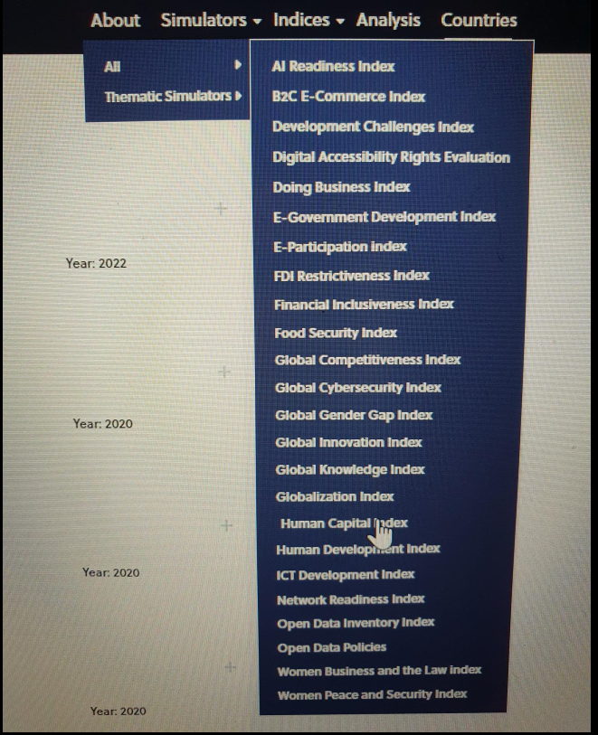
Human Development Index
Go to
Simulators
All
Select Human Development Index

Slide 32
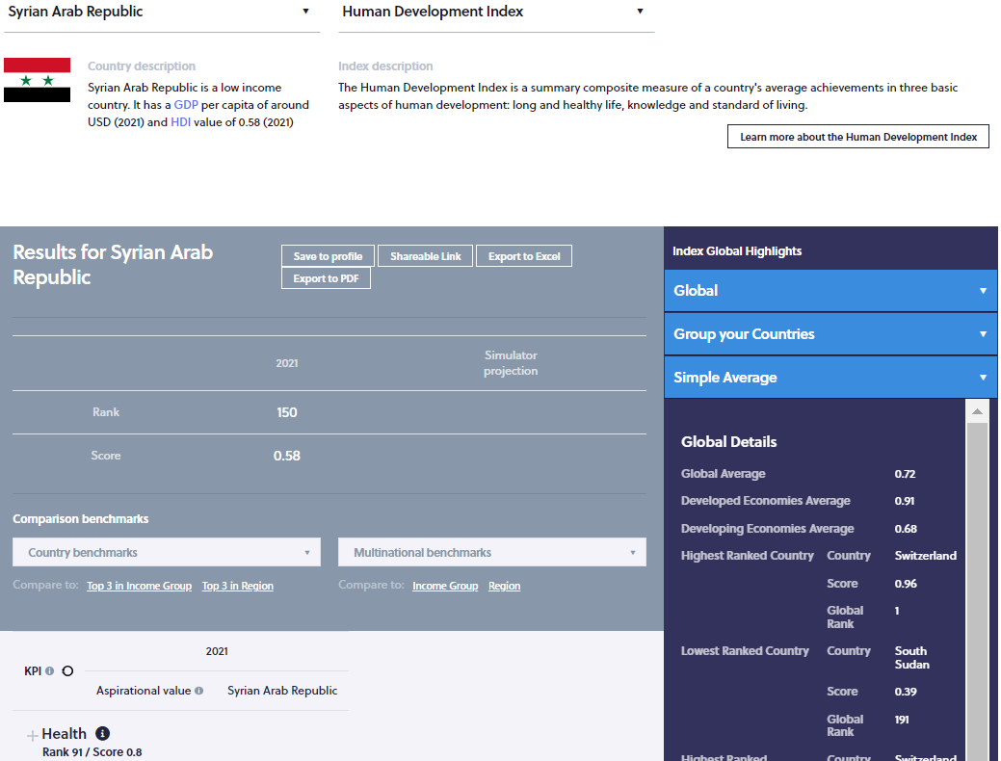
Human Development Index
Brief description of the country for benchmarking
Brief description of the selected index
Link to the webpage of the selected index
Year of the last ranking available
Rank and score
Dimensions with rank and score per dimension
Scroll down…

Slide 33
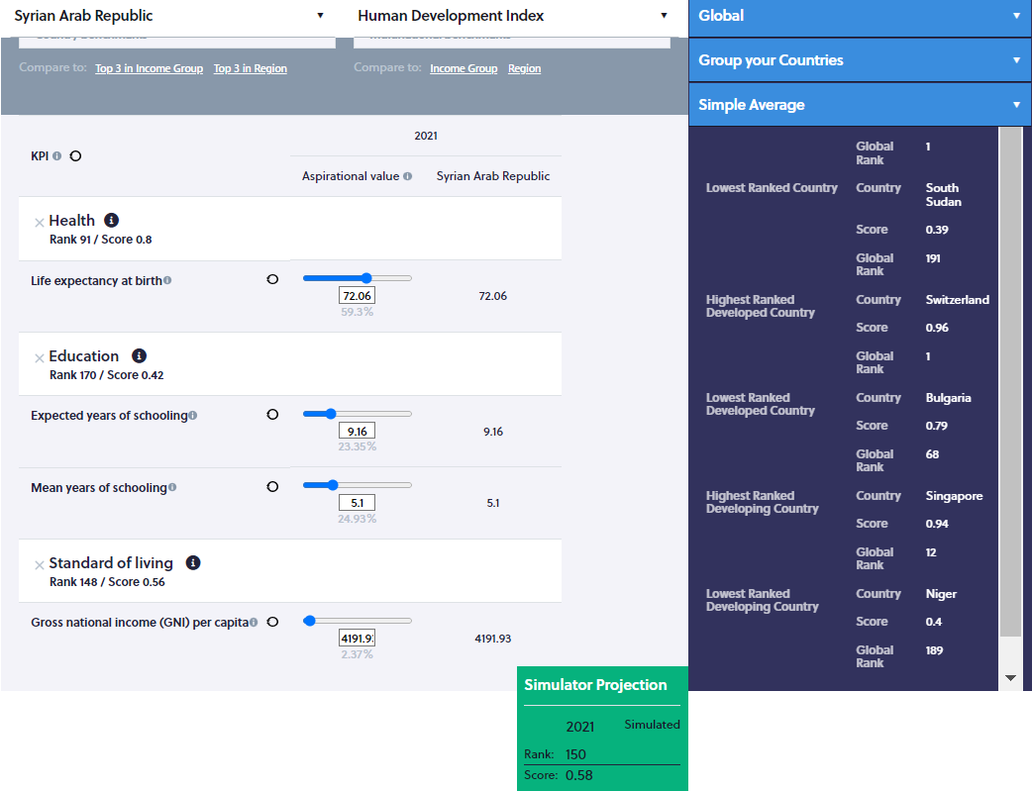
Human Development Index
Index’s name
Country’s name
Click on the dimension’s name to see the KPIs
Box in which the impact of the rank and score will be shown. For now, the year of the last ranking, the rank and score are provided for reference
Actual values of the KPIs
Input your aspirational values…

Slide 34
Human Development Index
Slide the cursor
Or input your data
The year of the last ranking, the rank and score are provided for reference
The simulated rank and score are displayed
Actual values of the KPIs are duplicated for reference
Aspirational values appear in RED
Select aspirational values using benchmarks…

Slide 35
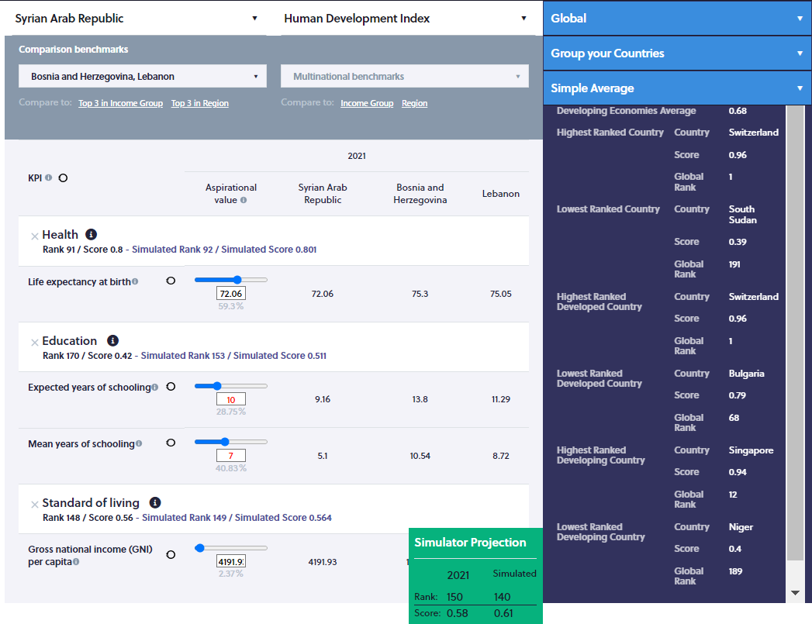
Human Development Index
Select benchmark countries
Or group
The year of the last ranking, the rank and score are provided for reference
The simulated rank and score are displayed
Actual KPIs values for the selected country and benchmarks are displayed
A strategy for a short, medium and long term can be designed
Aspirational values are selected in RED

Slide 36
This index will be engendered so stay tuned….
Notes:
Governments can compare
We have a number of baseline included
Classic 2 countries
Then regional
More specific
Very flexible
You own

Slide 37
Workshop on the Use of the "Indices Simulation Tool for Policy Makers in the Arab Region”
Nathalie PICASSO-GRAND, Data Scientist, ESCWA
17-18 May 2023, UN House, Beirut, Lebanon

Slide 38
Session IV: Global Gender Gap Index
This session will introduce the World Economic Forum’s Global Gender Gap Index and allow participants to use the ISPAR tool to retrieve country results. Participants will then present their experience around the use of ISPAR to analyse their rankings and scores.
The tool is ready
Notes:
Governments can compare
We have a number of baseline included
Classic 2 countries
Then regional
More specific
Very flexible
You own

Slide 39
The difficulties of an engendered index using ratios
Go to ISPAR / Countries / select your country (flag) / select “View the international index rankings” / go to the Global Gender Gap Index and select “Explore the index simulator”
Or,
go to ISPAR / Simulators / All / Global Gender Gap Index / select the country of interest
The tool is ready
Notes:
Governments can compare
We have a number of baseline included
Classic 2 countries
Then regional
More specific
Very flexible
You own

Slide 40
The Global Gender Gap Index
Short description of the index
Select a country
Link to the website of the index publisher
Select the index
See the country’s score and rank over time
The KPIs for ‘female’, ‘male’ and the ratio are displayed
Change the values of the KPIs for female…

Slide 41
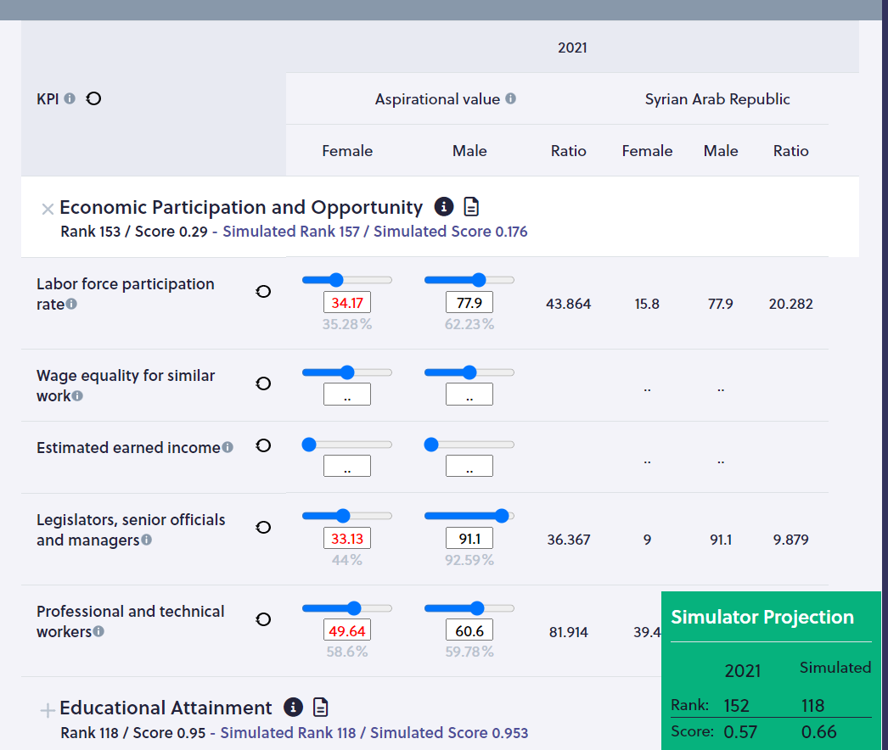
The Global Gender Gap Index
Open the tab:
you can see now all the KPIs
Enter your aspirational values per KPIS
or by sliding the cursor
or entering numbers
The modified KPIS appear in RED
Here you can change only the value of the KPIs for the ‘female’ population

Slide 42
The Global Gender Gap Index
Open the tab:
you can see now all the KPIs
Impact on score and rank will show here
Enter your aspirational values per KPIS
pillar score and rank
or by sliding the cursor
overall rank and score
or entering numbers
The modified KPIS appear in RED

Slide 43
The Global Gender Gap Index
Be careful:
If, for some KPIs, values are not available for your country then entering aspirational values is not possible and/or will not be reflected in the recalculations of the rank and score
Open the tab:
you can see now all the KPIs
Enter your aspirational values per KPIS
or by sliding the cursor
or entering numbers
The modified KPIS appear in RED

Slide 44
The Global Gender Gap Index
Be careful:
If values are not disaggregated into male and female and only the ratio is available, you can still change the values for the male and female and enter aspirational values. The simulator recalculate the ratio and the new score and rank
Open the tab:
you can see now all the KPIs
Enter your aspirational values per KPIS
or by sliding the cursor
or entering numbers
The modified KPIS appear in RED

Slide 45
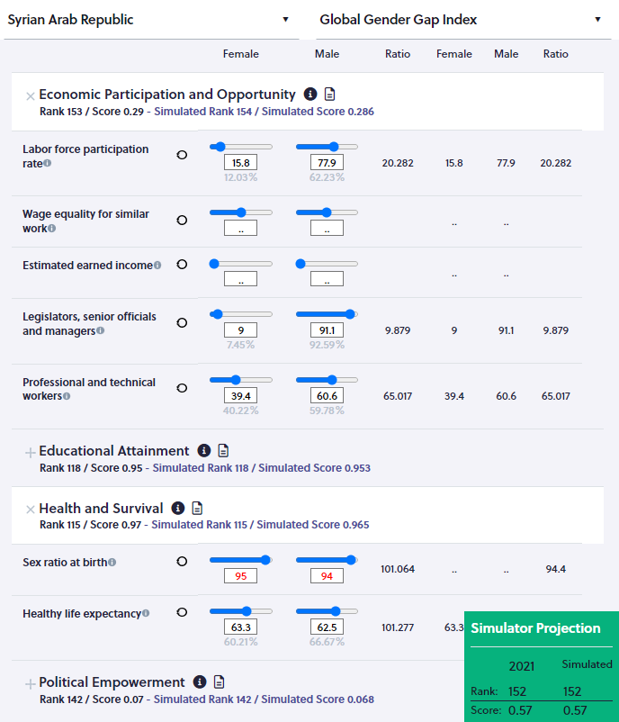
The Global Gender Gap Index
Open the tab:
you can see now all the KPIs
For those KPIs, no data is available, so it is impossible to enter aspirational values
Impact on score and rank will show here
For the sex ratio at birth, data for female and male are not available but the ratio is, hence data for male and female can be entered on the simulator

Slide 46
The Global Gender Gap Index
Be careful:
Using ratios can be misleading
Open the tab:
you can see now all the KPIs
Enter your aspirational values per KPIS
or by sliding the cursor
or entering numbers
The modified KPIS appear in RED

Slide 47
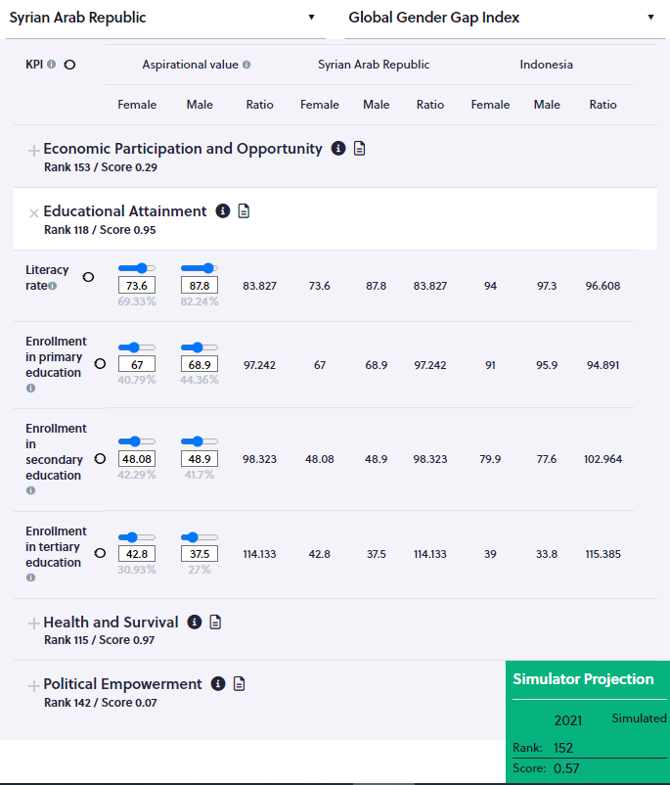
The Global Gender Gap Index
As a result, Syria and Indonesia will be considered as equally performant on those KPIs which is misleading
Open the tab:
you can see the KPIs for ‘Educational attainment’
KPIs in level must then be used instead of ratios
Compare to Indonesia (benchmark for LT achievements) Syria’s KPIs are low for male and female
New indices will be added to ISPAR to address this issue
More accurate assessments and recommendations can then be made using the Thematic simulator
But the ratios are similar

Slide 48
The difficulties of an engendered index using ratios
May be misleading
Need to use indicators in LEVEL to complement the ratio of indicators to get a good picture of performances
The tool is ready
Notes:
Governments can compare
We have a number of baseline included
Classic 2 countries
Then regional
More specific
Very flexible
You own

Slide 49
Workshop on the Use of the "Indices Simulation Tool for Policy Makers in the Arab Region”
Nathalie PICASSO-GRAND, Data Scientist, ESCWA
17-18 May 2023, UN House, Beirut, Lebanon

Slide 50
Session VI: The Global Index on Women, Peace and Security
The tool is ready
This session will introduce the Global Index on Women, Peace and Security Index and allow participants to use the ISPAR tool to retrieve country results. Participants will then present their experience around the use of ISPAR to analyse their rankings and scores.
Notes:
Governments can compare
We have a number of baseline included
Classic 2 countries
Then regional
More specific
Very flexible
You own

Slide 51
Women, Peace and Security Index:
The need to adopt a comprehensive approach
The tool is ready
For this index, the methodology was developed so a comprehensive approach of the issue at hand must be developed for policy changes to have an impact on the ranking.
Notes:
Governments can compare
We have a number of baseline included
Classic 2 countries
Then regional
More specific
Very flexible
You own

Slide 52
Simulations
The tool is ready
Go to ISPAR / Simulators / All / select ‘Women, Peace, and Security Index’
Notes:
Governments can compare
We have a number of baseline included
Classic 2 countries
Then regional
More specific
Very flexible
You own

Slide 53
Women, Peace, and Security Index
Go to
Simulators
All
Select Women, Peace, and Security Index

Slide 54
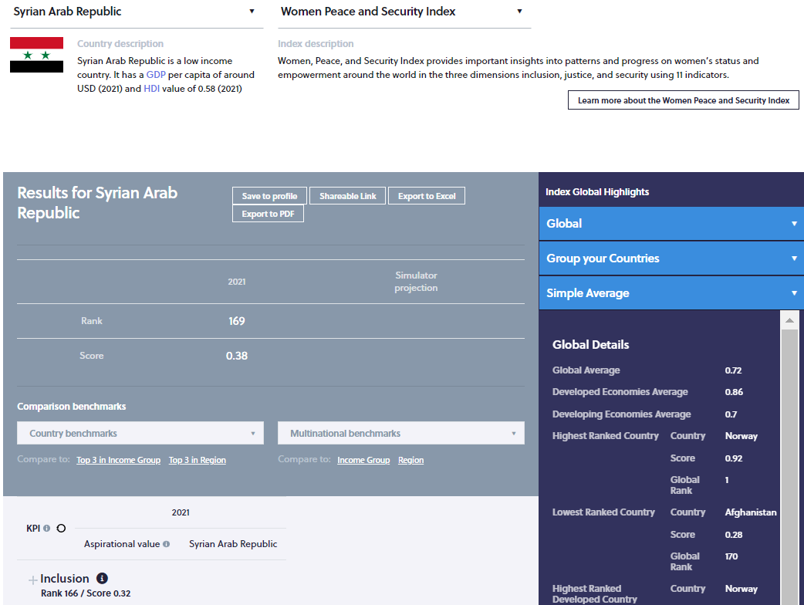
Women, Peace, and Security Index
Brief description of the country for benchmarking
Brief description of the selected index
Link to the webpage of the selected index
Year of the last ranking available
Rank and score
Dimensions with rank and score per dimension
Scroll down…

Slide 55
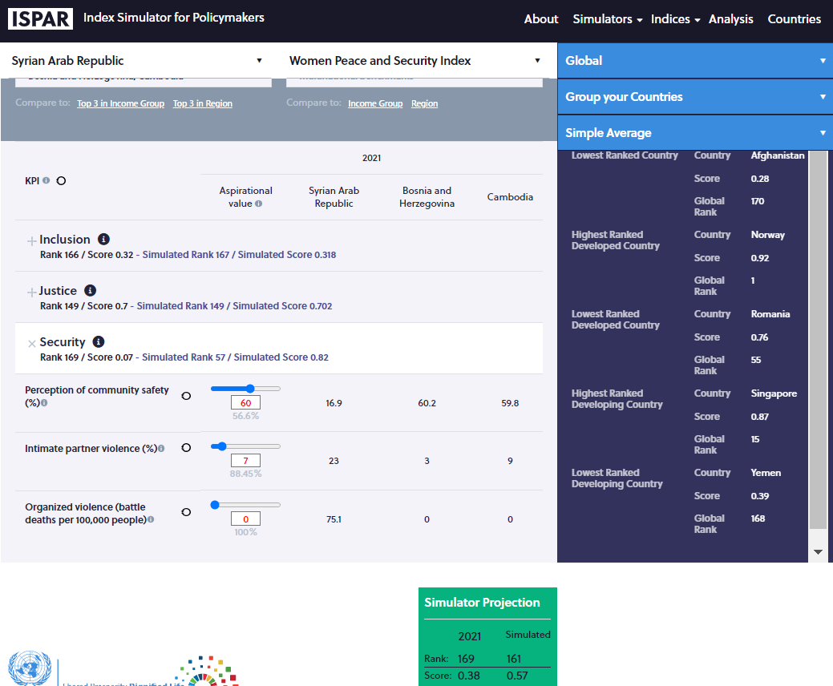
Women, Peace, and Security Index
Index’s name
Country’s name
Click on the dimension’s name to see the KPIs
Box in which the impact of the rank and score will be shown. For now, the year of the last ranking, the rank and score are provided for reference
Select benchmarks
Actual values of the KPIs
Aspirational values of the KPIs in Red
Exploring the interlinkages among KPIs…

Slide 56
The need to have a comprehensive approach
Some dimensions are ‘pre-requisites’ to improve on other dimensions
Improving on one indicator has a quite small if any impact on the ranking
Actions must be taken at various level to see a meaningful improvement on the ranking
Stresses the need for cooperation across Ministries
The tool is ready
Notes:
Governments can compare
We have a number of baseline included
Classic 2 countries
Then regional
More specific
Very flexible
You own

Slide 57
Quick visualization of performances
The tool is ready
Go to ISPAR / Simulators / All / select ‘Women, Peace, and Security Index’
Notes:
Governments can compare
We have a number of baseline included
Classic 2 countries
Then regional
More specific
Very flexible
You own

Slide 58
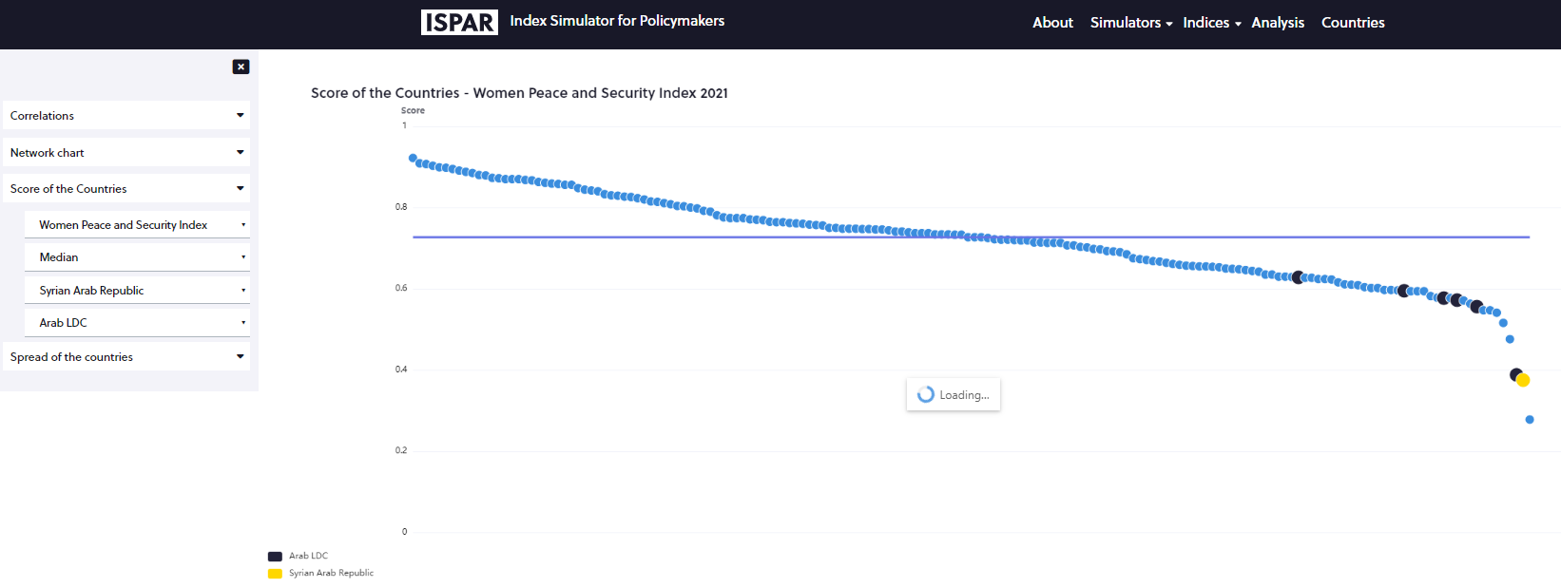
Quick visualization of performances
Go to ‘Analysis’
The tool is ready
Select
The dot is the selected country’s performance
Scroll over the dots and a line will appear, making it easier to read
The index of interest
A country
A benchmark group
Click on ‘Score of the countries’
The line indicate the performance for which half countries perform better, and half perform less well

Slide 59
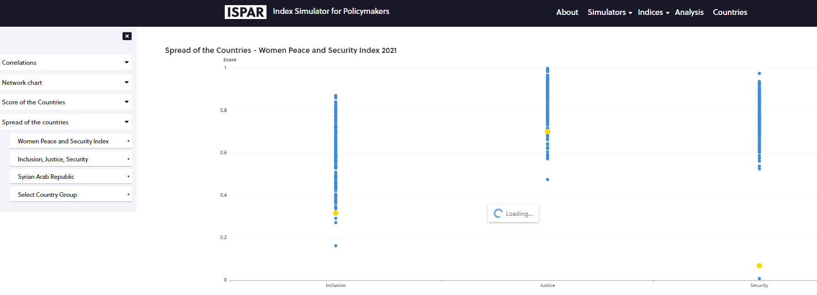
Quick visualization of performances
Go to ‘Analysis’
Select
The index of interest
A country
The dot is the selected country’s performance
Scroll over the dots and a line will appear, making it easier to read
Click on ‘Spread of the countries’
A benchmark group

Slide 60
Workshop on the Use of the "Indices Simulation Tool for Policy Makers in the Arab Region”
Nathalie PICASSO-GRAND, Data Scientist, ESCWA
17-18 May 2023, UN House, Beirut, Lebanon

Slide 61
Session VII: The World Bank’s Women, Business and the Law Index
The tool is ready
This session will introduce the World Bank’s Women, Business and the Law Index and allow participants to use the ISPAR tool to retrieve country results. Participants will then present their experience around the use of ISPAR to analyse their rankings and scores.
Notes:
Governments can compare
We have a number of baseline included
Classic 2 countries
Then regional
More specific
Very flexible
You own

Slide 62
Women Business and the Law Index: The specificities of a ‘discrete’ index
This index uses bullion indicators which take the value 0 or 1. It captures the content of the law and its intent through surveys.
It is important to identify the low-hanging fruits.
The tool is ready
Notes:
Governments can compare
We have a number of baseline included
Classic 2 countries
Then regional
More specific
Very flexible
You own

Slide 63
Simulations
The tool is ready
Go to ISPAR / Simulators / All / select ‘Women, Business and the Law’
Notes:
Governments can compare
We have a number of baseline included
Classic 2 countries
Then regional
More specific
Very flexible
You own

Slide 64
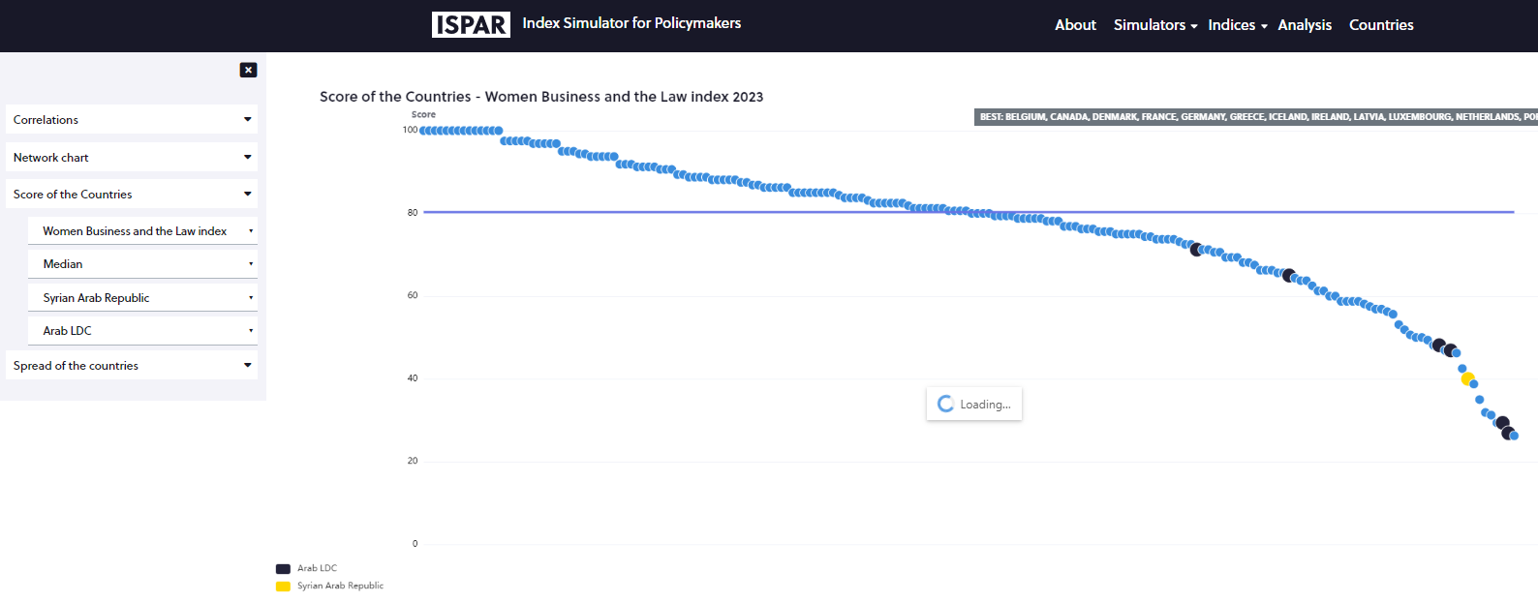
Quick visualization of performances
Go to ‘Analysis’
The tool is ready
Select
The dot is the selected country’s performance
The index of interest
A country
A benchmark group
The line indicate the performance for which half countries perform better, and half perform less well
Click on ‘Score of the countries’

Slide 65
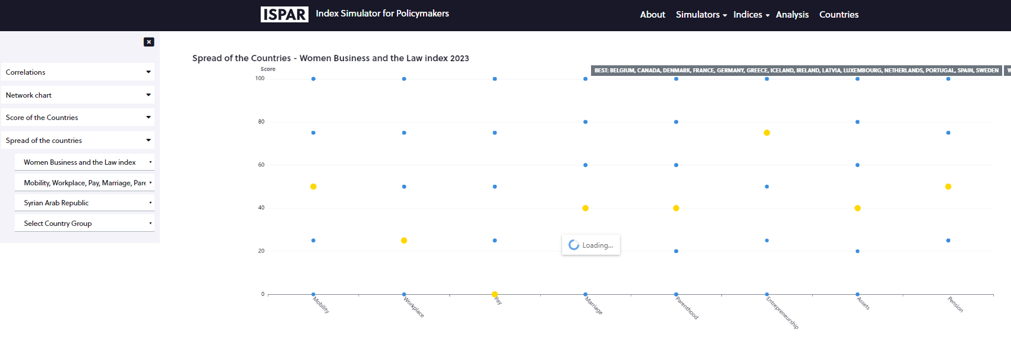
Quick visualization of performances
Go to ‘Analysis’
Click on ‘Spread of the countries’
Select
The dot is the selected country’s performance
Scroll over the dots and a line will appear, making it easier to read
Horizontal axis : dimensions of the index. Vertical axes: countries performances
The index of interest
A country
A benchmark group

Slide 66
Women, Business and the Law
Go to
Simulators
All
Select Women, Peace, and Security Index

Slide 67
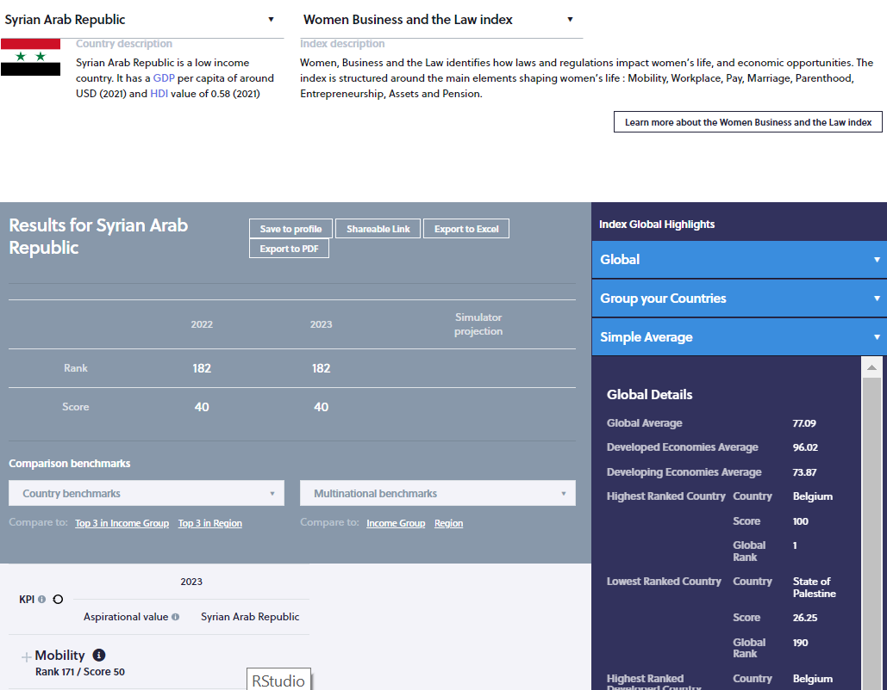
Women, Business and the Law
Brief description of the country for benchmarking
Brief description of the selected index
Link to the webpage of the selected index
Year of the last ranking available
Rank and score
Regularly updated
Dimensions with rank and score per dimension
Scroll down…

Slide 68
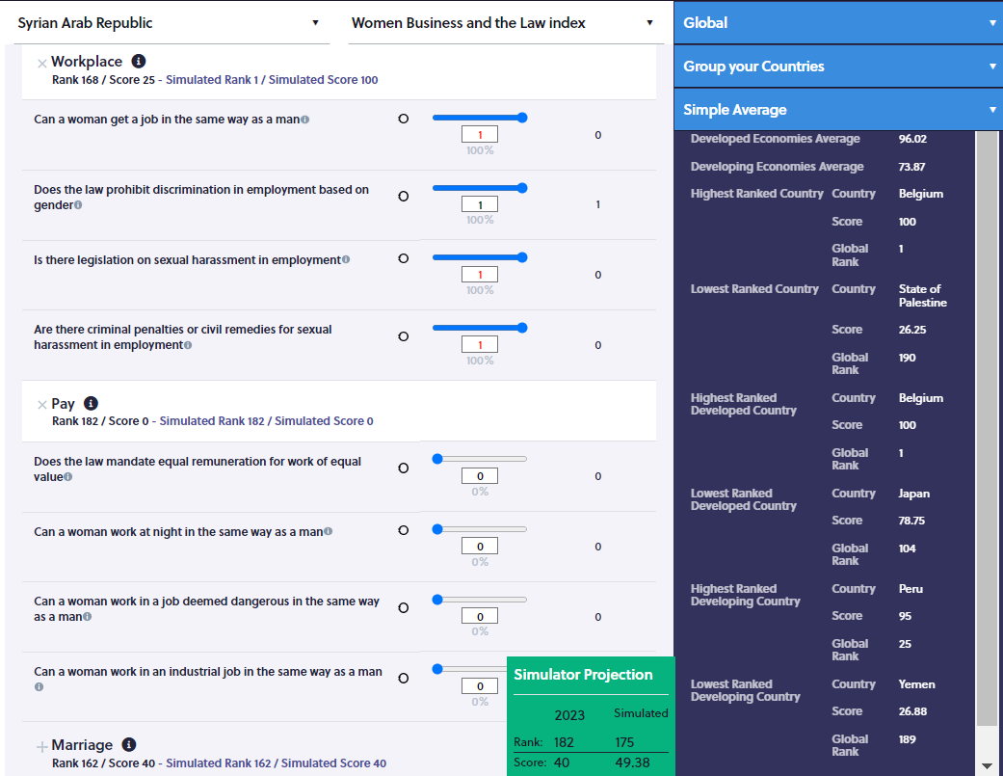
Women, Business and the Law
Index’s name
Country’s name
Click on the dimension’s name to see the KPIs
Box in which the impact of the rank and score will be shown. For now, the year of the last ranking, the rank and score are provided for reference
Actual values of the KPIs

Slide 69
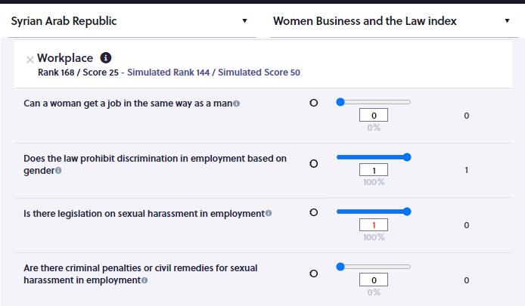
Women, Business and the Law
Improving on one KPIs improve the dimension score and rank by 20 to 25% depending on the number of KPIS per dimension
But here, the obstacles are laws which requires efforts and time to amend

Slide 70
Women Business and the Law Index: The specificities of a ‘discrete’ index
To improve on this kind of ranking, developing short, medium, and long-term strategies is needed as it takes time because of the nature of the obstacles that can be administrative, legislative, cultural and religious.
The tool is ready
Notes:
Governments can compare
We have a number of baseline included
Classic 2 countries
Then regional
More specific
Very flexible
You own

Slide 71
The advantage of ISPAR is that the tool allows to identify the NATURE of the obstacles and set a timeline for rankings improvement
The tool is ready
Having multiple Composite Indices on the platform allows developing a short-, medium-, and long-term strategy across all the Indices.
Notes:
Governments can compare
We have a number of baseline included
Classic 2 countries
Then regional
More specific
Very flexible
You own

Slide 72
Workshop on the Use of the "Indices Simulation Tool for Policy Makers in the Arab Region”
Nathalie PICASSO-GRAND, Data Scientist, ESCWA
17-18 May 2023, UN House, Beirut, Lebanon

Slide 73
Session VIII: The interdependence of global indicators
The tool is ready
This session discusses how developmental indicators intersect with gender equality indicators, such as in education, health, and the economy, and explains how strengthening policies and legislation related to gender equality may influence other areas of development.
Notes:
Governments can compare
We have a number of baseline included
Classic 2 countries
Then regional
More specific
Very flexible
You own

Slide 74
Let’s summarize what we have seen
How to generate a profile and compare our performances to other countries’
How Composite Indices are linked together, hence the need to use Indices beyond the ones focusing on gender to evaluate potential for cooperation and trickledown effects
How to carry simulations and how the methodology used calls for a certain type of strategy
And how to use the platform to develop a short, medium and long-term strategy depending on the nature of the obstacles
Notes:
Governments can compare
We have a number of baseline included
Classic 2 countries
Then regional
More specific
Very flexible
You own

Slide 75
What else the platform can help with?
As a same KPIs appear in more than one index, there is a need to understand interlinkages to get a full picture of the impact of gender policies on rankings
Notes:
Governments can compare
We have a number of baseline included
Classic 2 countries
Then regional
More specific
Very flexible
You own

Slide 76
Go to
The tool is ready
ISPAR / Simulators / Thematic Simulators / Gender
Chose a country (Syria)
Chose a theme
And eventually a sub-theme
Notes:
Governments can compare
We have a number of baseline included
Classic 2 countries
Then regional
More specific
Very flexible
You own

Slide 77
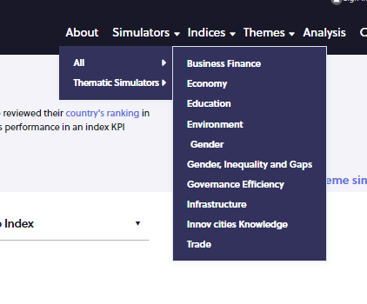
Thematic Simulators
Go to ‘Simulators’
then to ‘Thematic Simulators’
Select ‘Gender’
which is the theme

Slide 78
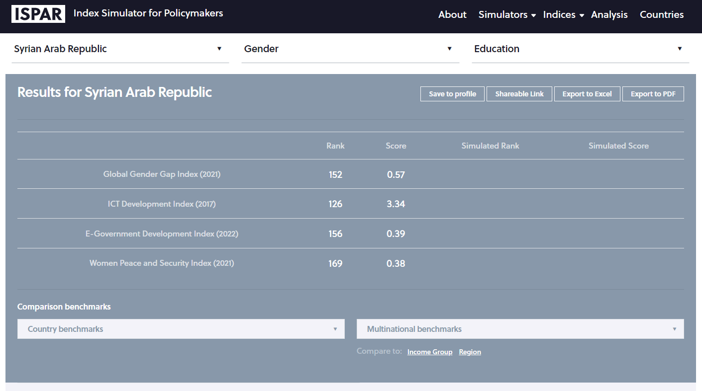
Thematic Simulators
Chose a sub-theme (education)
Select a theme (gender)
View indices that use education engendered or not KPIs

Slide 79
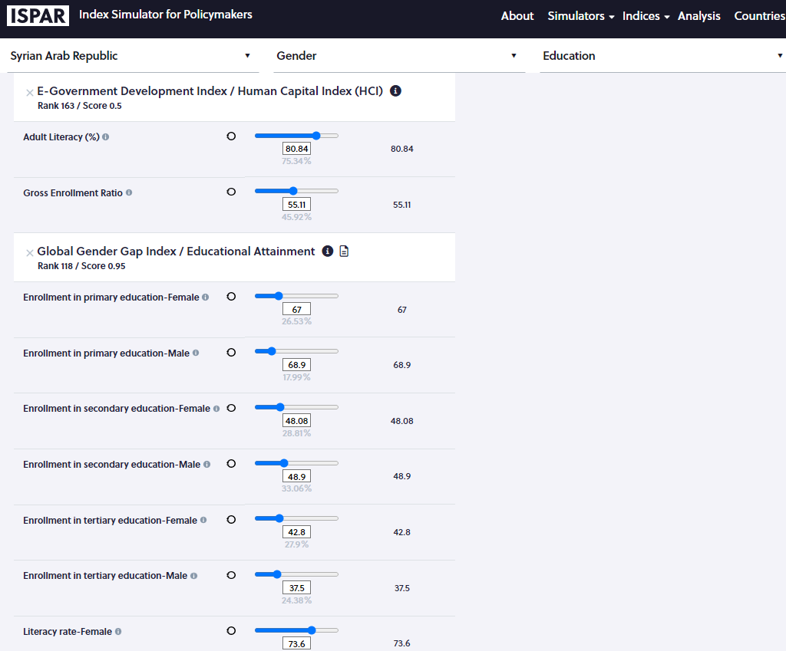
Thematic Simulators
Two indices use literacy rate.
One engendered, the other not
If the info is available the simulator takes into account the impact across all similar KPIS, hence across indices

Slide 80
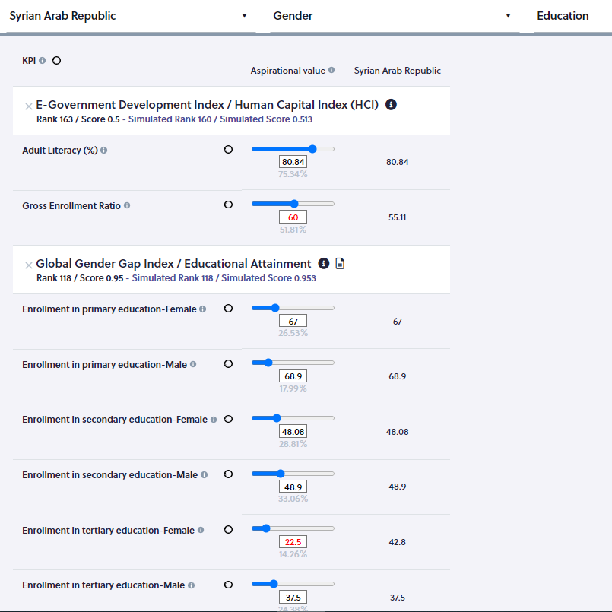
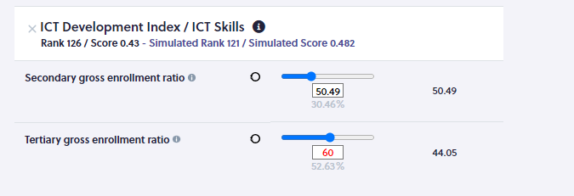
Thematic Simulators
Input 60 as the aspirational value for ‘Gross enrolment ratio’ for the E-government index
The impact of the policy across indices is
Changes will be made here and here

Slide 81
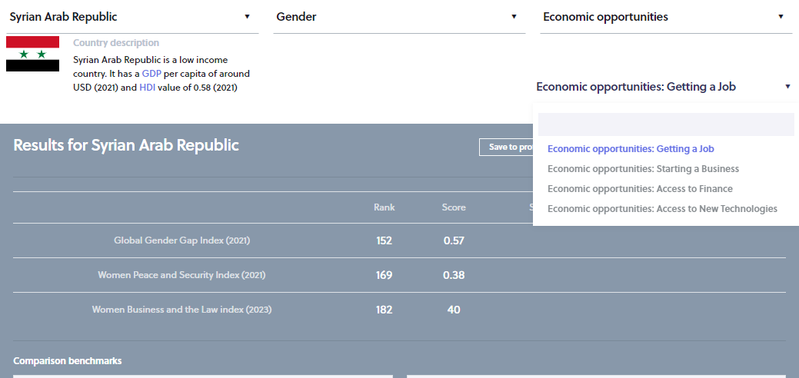
Thematic Simulators
Select a theme (gender)
Chose a sub-theme (education)
In order to develop a comprehensive gender strategy related to giving women economic opportunities several elements must be covered
All indices using KPIs related to getting a job

Slide 82
What else the platform can help with?
As a same KPIs appear in more than one index, there is a need to understand interlinkages to get a full picture of the impact of gender policies on rankings
How to learn from other countries experience?
Go to ISPAR / Countries / select your country (flag) / select “View the international index rankings” / go to the Global Gender Gap Index and select “Explore the index simulator”
Or,
go to ISPAR / Simulators / All / Global Gender Gap Index / select the country of interest
Notes:
Governments can compare
We have a number of baseline included
Classic 2 countries
Then regional
More specific
Very flexible
You own

Slide 83
The Global Gender Gap Index
Policy recommendations can be found be clicking on the icon

Slide 84
What else the platform can help with?
As a same KPIs appear in more than one index, there is a need to understand interlinkages to get a full picture of the impact of gender policies on rankings
How to learn from other countries experience?
How to evaluate the impact of an improvement on a ranking on end developmental goals?
Notes:
Governments can compare
We have a number of baseline included
Classic 2 countries
Then regional
More specific
Very flexible
You own

Slide 85
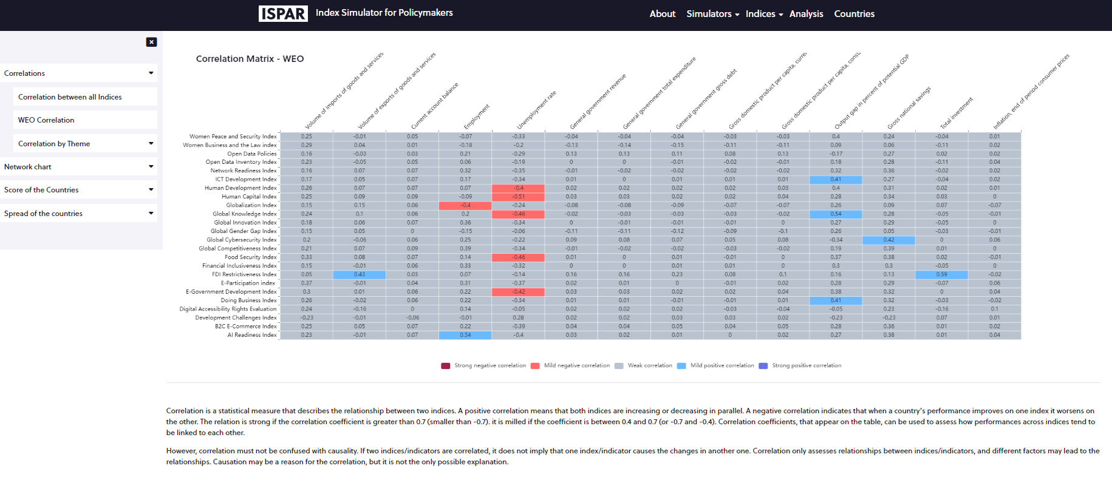
Understand and evaluate spillover effects
Under the tab ‘Analyses’
Correlations measure how closely indices move together, hence the spillover effects
Under ‘Correlations’ select ‘WEO Correlations’
Correlations of indices and macroeconomic outcomes

Slide 86
Build your own scenario
The tool is ready
Notes:
Governments can compare
We have a number of baseline included
Classic 2 countries
Then regional
More specific
Very flexible
You own

Slide 87
Thank you for your time!

