Slide 1
Monitoring and evaluation in OECD countries
Challenges and Opportunities
Titouan CHASSAGNE, Policy Analyst, Public Management and Budgeting
09 March 2023

Slide 2
Monitoring and evaluation: different but complementary practices
MONITORING
POLICY EVALUATION
To monitor implementation and the achievement of policy objectives against set targets
Ongoing and routinised processes
Attribution is generally assumed
Resources are usually part of the programme
To determine relevance, efficiency and effectiveness and learn what works, what does not, for who and why
Episodic and issue-specific
Attribution is usually a key question
Targeted resources needed for each evaluation
Creating a market for M&E requires solving complex challenges:
Need to generate political interest and linkages between policy planning and budgeting processes
Often low/fragmented capacity and data literacy inside public administration (especially in sub national governments).
Availability and access to high quality data is often a challenge.
The information to be taken into account by decision-makers is multiple and complex.
Notes:
Talk about how monitoring and evaluation and strategic planning are different functions that need to be given organically to different actors!!!
Talk about also the role of evaluation units that need to be at arm’s length of the implementation, whereas monitoring needs to be done by the implementing body.

Slide 3
The OECD approach to monitoring and evaluation
Longstanding OECD expertise
Performance and Results Working Party
OECD Recommendations on Public Policy Evaluation (2022)
Evaluation Expert Group
Survey on M&E 2019: 42 respondent countries
Lessons learned on state-of-the-art institutional arrangements, mechanisms and instruments for efficient allocation and management of resources in the public sector
Country specific projects
Set an institutional framework
Foster quality
Ensure impact
Notes:
How to foster use of performance information:
A strong institutional framework providing:
A framework (legal or policy) for M&E
Guidance on when and how to carry them out
Institutional actors with a clear mandate and resources to oversee/execute them
A culture of monitoring and evaluation:
Encouraging efforts to ensure their quality and impact
Supported by a qualified public service
Including mechanisms to engage stakeholders

Slide 4
Institutionalising monitoring and evaluation
Why does institutionalisation matter?
It helps promote performance management practices and routines increasing their sustainability.
It clarifies the responsibilities across several actors.
It ensures resilience following changes in government changes through legislation.
How to institutionalise M&E?
Establish a legal framework or a high-level guidance and establish support to the systematization of the practice.
Attribute clear mandates across actors.
Notes:
This is something that they have in the Law on Strategic Planning and Development Management System of the Republic of Croatia
And in the Ordinance on Deadlines and Procedures for Monitoring and Reporting on the Implementation fo Stategic Planning Documents (2018)

Slide 5
Attribute clear mandates for monitoring and evaluation
MONITORING: Delivery Units
EVALUATION: Evaluation Champions
Several countries have established delivery units in strategic positions
To ensure a good coordination and reporting of performance information to high-level decision makers
Delivery units help agencies work across organizational silos to achieve the key decision-makers targets (e.g. PM’s priorities)
They exist in different countries and can be very useful at different levels
Evaluation champions are institutions whose mandate is to coordinate policy evaluations across the government
They provide incentives to line ministries and agencies to conduct evaluations
Evaluation champions should be in strategic positions (e.g. Prime Minister’s Office or Ministry of Finance)
Notes:
Talk about how monitoring and evaluation and strategic planning are different functions that need to be given organically to different actors!!!
Talk about also the role of evaluation units that need to be at arm’s length of the implementation, whereas monitoring needs to be done by the implementing body.

Slide 6
Why is quality important and how to foster it?
Good quality M&E is important because it enables:
To determine whether the results produced represents credible evidence;
To foster trust and use of information collected;
Ultimately, it enables effective public policy design and better outcomes.
The quality depends on several determinants :
Defining the right indicators and targets (unit of analysis, definition of objectives, indicators, targets, etc.)
Data collection methods (frequency of data collection, cost vs. use, data sources, etc.)
Evaluation techniques
Human and financial resources (analytical and organizational skills)

Slide 7
How do OECD countries promote the quality of policy evaluations?
n= 35 OECD member countries
Source: OECD (2019) Survey on Policy Evaluation

Slide 8
Why ensure impact and how?
Why is use important?
Increase accountability as well as higher engagement towards collective results
Increase trust
Identify problems and lift roadblocks related to the implementation of a public policy.
How to foster it?
Link performance information to formal decision-making processes like budgetary processes.
Effectively communicate data with the general public.
Discuss results internally by establishing performance dialogues or management response mechanisms.

Slide 9
How do OECD countries promote the impact of policy evaluations?
n= 35 OECD member countries
Source: OECD (2019) Survey on Policy Evaluation

Slide 10
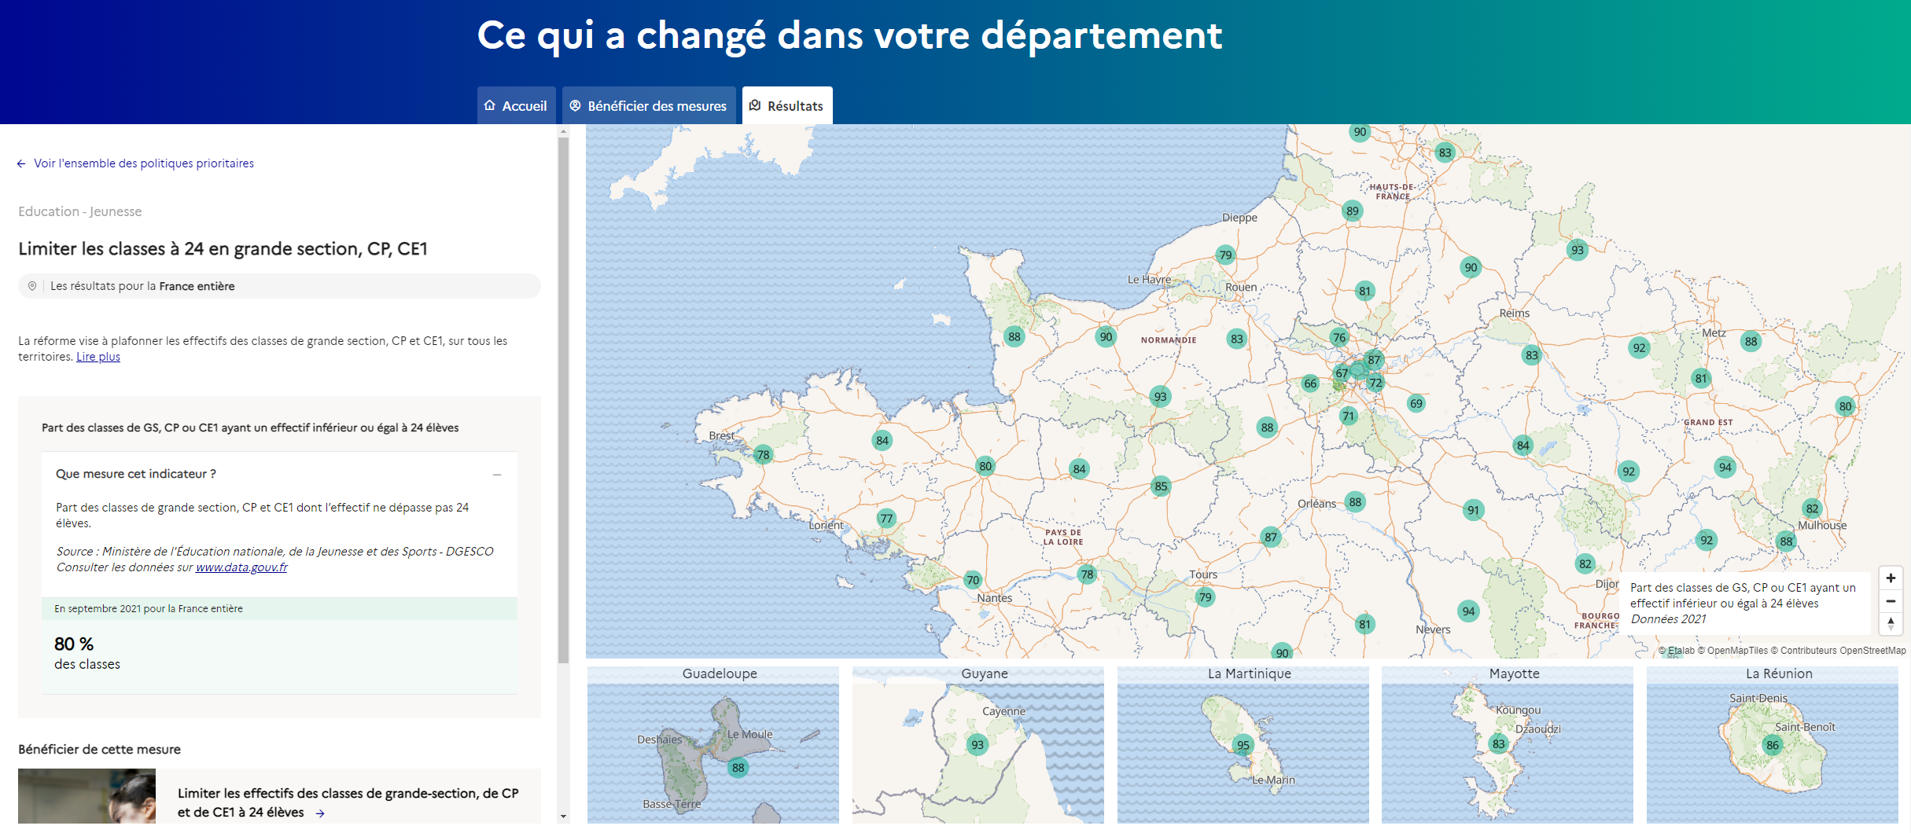
Communicating performance information
Publicly available dashboard to monitor progress of government priorities at the local level
The barometer includes information on the implementation progress of 43 policy priorities since 2017.
Result indicators are available at the national and local levels (both regional and departmental)
The dashboard also directs users to relevant information on how to benefit from each policy

Slide 11
Key takeaways
Laws and policy frameworks can be helpful to systematise monitoring and evaluation systems.
To ensure its usefulness, quality of monitoring and evaluation must be ensured by investing in the right data, skills, technologies and by involving stakeholders.
As performance information can serve different goals, it is important to clarify and understand which use is needed and adapt data collection, communication strategies and management tools accordingly.
Investment in linking, communicating, and reporting performance information to decision-makers is essential to promote its impact.
National governments have key roles in supporting sub-national governments in their performance measurement efforts (e.g. Colombia toolkit or Delivery Units in the UK).

Slide 12
Thank You!
Contacts:
claire.salama@oecd.org
titouan.chassagne@oecd.org
Find out more:
oe.cd/monitoring-and-evaluation
Further readings

