Slide 1
Statistical Framework for Measuring the Gender-Related Killing of Women and Girls (Femicide/Feminicide)

Slide 2
Femicide - definition
The 2015 report of the UNSG on referred to femicide as “the intentional murder of women and girls because of their gender"
According to the definition of intentional homicide provided in the International Classification of Crime for Statistical Purposes (ICCS) and the concept of violence against women and girls from the Statistical Framework for Measuring the Gender-Related Killing of Women and Girls, femicide/feminicide would include killings with the following characteristics:
the killing of a woman (person who identifies as a woman) by another person (objective criterion);
the intent of the perpetrator to kill or seriously injure the victim (subjective criterion);
the unlawfulness of the killing (legal criterion);
the gender-related motivation of the killing.
* UNODC and UN Women (2022), Gender-related killings of women and girls (femicide/feminicide), Global estimates of gender-related killings of women and girls in the private sphere in 2021 – Improving data to improve responses

Slide 3
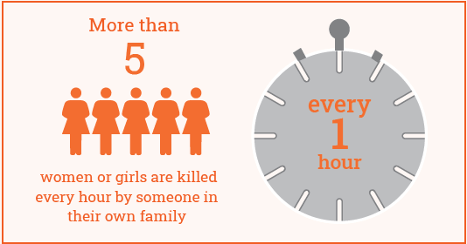
Femicide – global context
In 2021, around 45,000 women and girls worldwide were killed by their intimate partners or other family members. On average, more than five women or girls are killed every hour by someone in their own family.
Notes:
* UNODC and UN Women (2022), Gender-related killings of women and girls (femicide/feminicide), Global estimates of gender-related killings of women and girls in the private sphere in 2021 – Improving data to improve responses

Slide 4
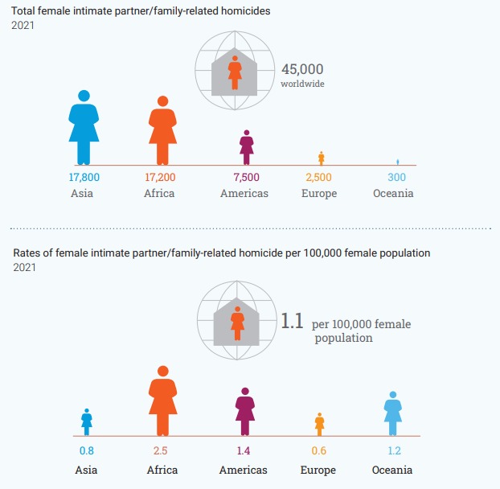
Female intimate partner/family-related homicides
Asia is the region with the largest
absolute number of killings;
Africa is the region with the highest level of violence relative to the size of its female population.

Slide 5
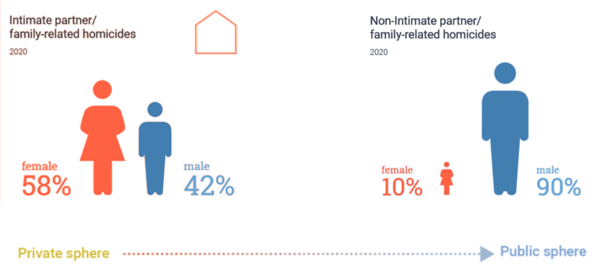
Situational context

Slide 6
What we need to know

Slide 7
Main problems:
No clear definition for statistical purposes had been agreed upon the gender-related killings of women and girls
Some countries have criminalized ”femicide/feminicide” with heterogeneous legal definitions
Many countries face deficiencies, gaps and lack of disaggregation in administrative records
Lack of international and regional comparability
Identification of the gender motivation

Slide 8
How is murder gendered?
Gender-related motivation – refers to root causes, such as stereotyped gender roles, discrimination, unequal power relations.
“Gender-related factors such as the ideology of men's entitlement and privilege over women, social norms regarding masculinity, and the need to assert male control or power, enforce gender roles, or prevent, discourage or punish what is considered to unacceptable female behaviour”
*United Nations, General Recommendation No. 35 on gender-based violence against women- CEDAW/C/GC/35)

Slide 9
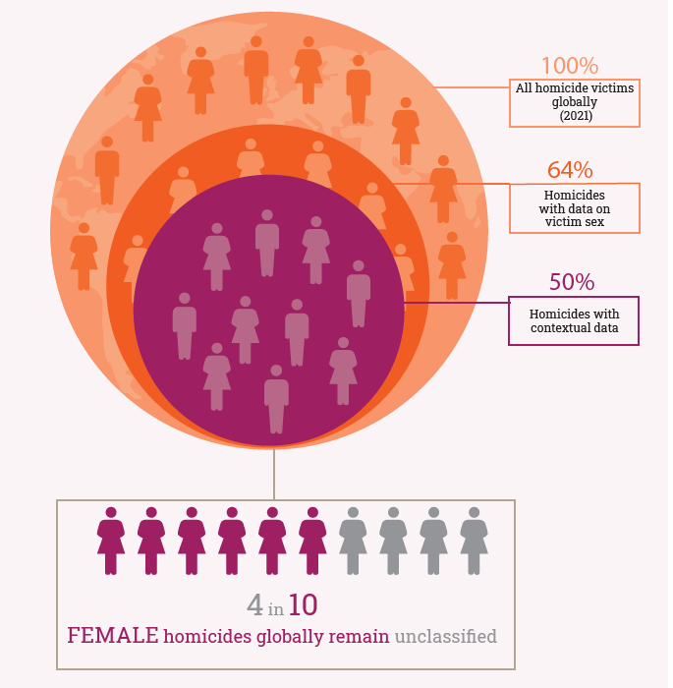
Femicide – data challenges
As of 2021, out of 193 UN Member States
173 have reported data on the total number of homicide victims or offences for at least one year since 2010;
133 have reported data with sex disaggregations;
97 provided information on the victim-perpetrator relationship or other information that would allow for the identification and counting of gender-related killings of women and girls.

Slide 10
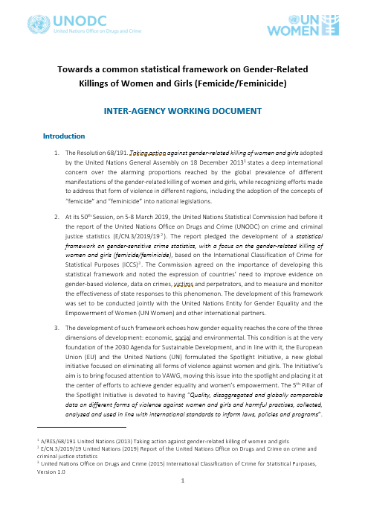
Statistical Framework for Measuring Femicide
The UN Statistical Commission requested UNODC and UN Women to create a statistical framework on gender-sensitive crime statistics with a focus on the GRKWG*.
The request was reiterated by the Secretary General through its Executive Committee
UNODC and UN Women started technical work in 2019
*Gender-related killing of women and girls (GRKWG)

Slide 11
Global consultations

Slide 12
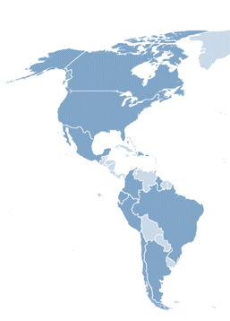
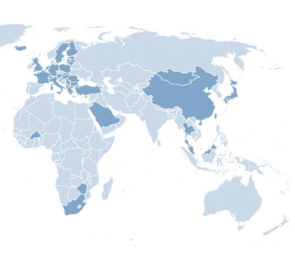
Global consultations
Institution | Europe | Americas | Asia | Africa | Total
National Statistical Office (NSO) | 46.2% | 26.9% | 11.5% | 15.4% | 100%
Police | 33.3% | 16.7% | 50.0% | - | 100%
Judiciary | 50.0% | 37.5% | 12.5% | - | 100%
Ministry of Interior | 80.0% | 20.0% | - | - | 100%
Civil Society | 50.0% | 50.0% | - | - | 100%
Prosecutor | 33.3% | 33.3% | 33.3% | - | 100%
International Organization | 66.7% | 33.3% | - | - | 100%
Other | 66.7% | 33.3% | - | - | 100%
Human Rights Institute | 100% | - | - | - | 100%
Health Institute | - | - | - | 100% | 100%
Total | 49.3% | 26.9% | 16.4% | 7.5% | 100%
Notes:
These factors can trigger violence by perpetrators when a woman’s behaviour is perceived not to be in line with social norms or stereotyped gender roles. In this context, the term “gender-related motivation” does not refer to the subjective intent of the perpetrator to commit the homicide, but to its underlying root causes. The subjective motive of the perpetrator to commit the crime – such as a specific bias against or hatred of women – may be present in some cases alongside the “gender-related motivation”.

Slide 13
Objectives and expected outcomes
The Statistical Framework aims to assist national statistical offices, institutions within the criminal justice and public health systems, mechanisms for the advancement of women and gender equality, civil society organizations and academia in harmonizing data collection within countries, across countries, regions and time.
Strengthen the monitoring of femicide at the global and national level;
Enhanced and comprehensive national data;
Sustainable mechanism to compare data internationally;
Strengthen the capacities of member states to collect, analyse and use quality, disaggregated and comprehensive femicide/feminicide data.

Slide 14
Validity
Institutions that consider the following criteria to be fully determinant in identifying gender-related crime motivation (%)

Slide 15
II. Relevance
Primary use that the institutions would give to the information collected for each criterion (%)

Slide 16
III. Feasibility
Institutions currently generating data related to each criterion (%)

Slide 17
IV. Needs
Main needs identified by the institutions to generate data related to the criteria contained in the questionnaire (%)

Slide 18
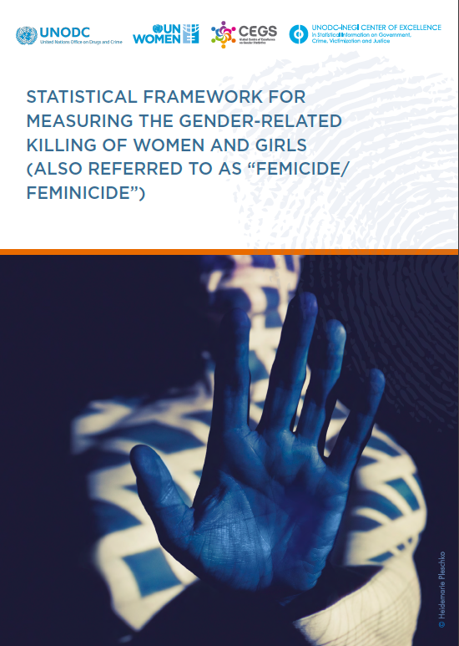
Statistical Framework for Measuring Femicide
Endorsed at the 53° Session of the UN Statistical Commission, March 2022

Slide 19
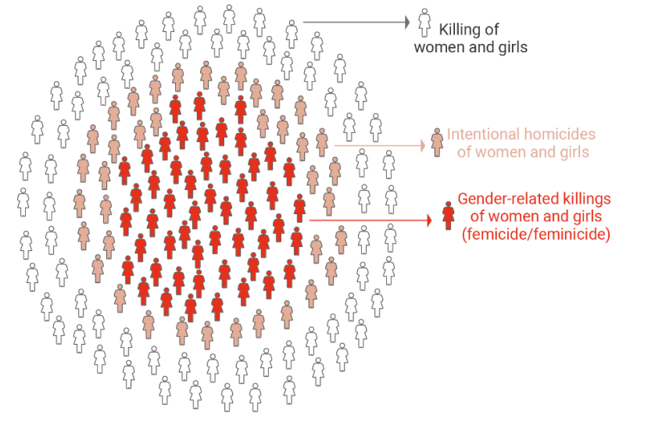
Intentional homicide subset
Correspondence with ICCS category 0101 "Intentional Homicide".

Slide 20
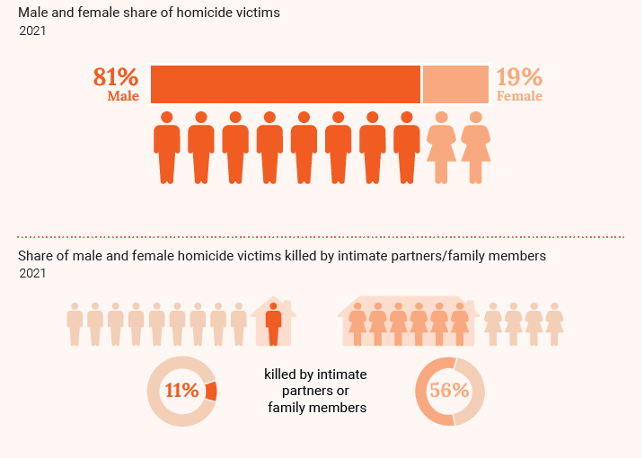
Share of male and female homicide victims

Slide 21
Initial criteria
<
the killing of a woman by another person (objective)
the intent to kill or seriously injure the victim (subjective)
the unlawfulness of the killing (legal)
the gender-related motivation of the killing

Slide 22
Challenge
The challenge is to measure the gender-related motivation in the killings of women and girls

Slide 23
Gender-related motivation
The term used to lay the foundation of the statistical definition of gender-related killings of women and girls (femicide/feminicide), refers to the root causes that characterize the specific context in which such killings take place.
Stereotyped gender roles
Unequal power relations between women and men in society
Discrimination towards women and girls
Inequality

Slide 24
Data blocks

Slide 25
Data blocks

Slide 26
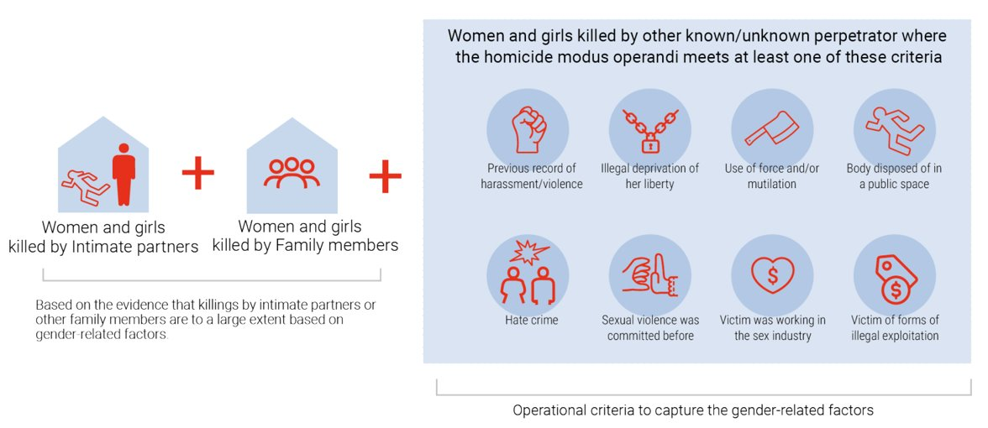
Femicide – Statistical definition

Slide 27
Additional data disaggregation
Additional data disaggregations to mainstream the gender perspective into the collection and registry of administrative data on crime and criminal justice.
VICTIM
Age
Marital status
Citizenship
Previous record of violence
Intoxication
Economic activity status
Gender identity
Sexual orientation
Pregnancy status
Disability status
Ethnicity status
PERPETRATOR
Sex
Perpetrator–victim relationship
Age
Citizenship
Intoxication
Economic activity status
Recidivism
Being the object of a restraining order by law enforcement/judicial authorities
EVENT
Geographical location of the crime
Location of the crime
Mechanism of killing
Date and time
Criminal offence according to national legislation (such as intentional homicide, femicide, dowry death, honour killing, etc.)
The disaggregating variables are an integral part of the International Classification of Crime for Statistical Purposes (ICCS) and are applicable to all crimes, not just femicide

Slide 28
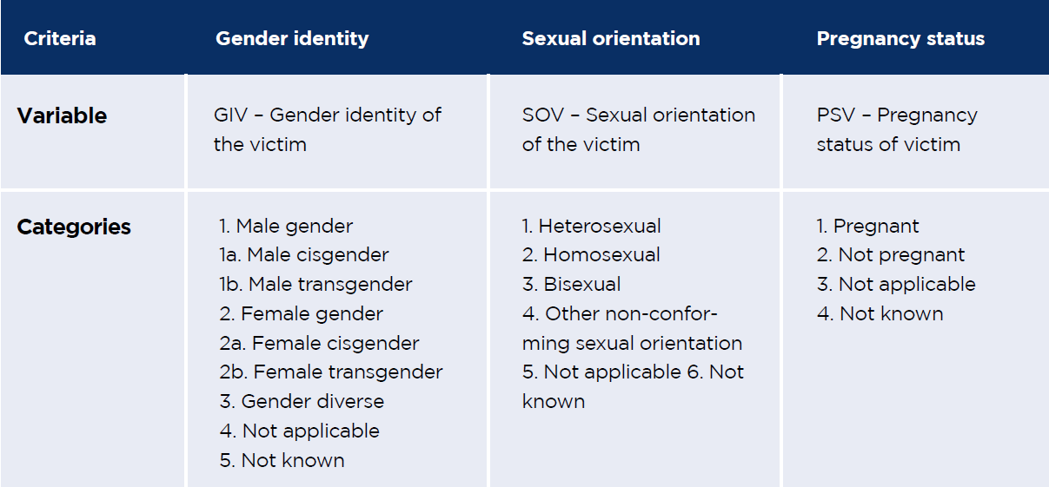
Examples of data disaggregation

Slide 29
What data can countries get?
Rate of victims of femicide
Persons investigated for femicide
Perpetrators convicted for femicide
Detainees sentenced for femicide
Disaggregated statistics and trends

Slide 30
What products can countries get?
Policies, planning and programming
Analytical reports
Indicators to monitor performance of interventions
Information on the compliance of international commitments
Standardized databases

Slide 31
Next steps:
Raise awareness
Pilot the framework in all 5 continents
Develop technical guidelines and trainings
Provide technical assistance
Report back to the UNSC in 2025

Slide 32
Key message
The incorporation of these variables does not only allow to measure femicide, but can also strengthen situational analysis, improve policies and prevent gender-based crime, particularly femicide.
Even in countries where femicide is not criminalized.

Slide 33
Thank you
Claudia Pontoglio / Associate Research Officer
claudia.pontoglio@un.org
Martijn Kind / Statistician
martijn.kind@un.org

