Slide 1
The UN-CTS and ICCS
Regional training, 4-6 July 2023

Slide 2
UN-CTS data submissions
Country | 2019 | 2020 | 2021 | 2022
Algeria | Y |  |  | Y
Egypt
Iraq |  |  | Y
Jordan |  | Y |  | Y
Lebanon |  | Y | Y | Y
Libya
Mauritania |  |  |  | Y
Morocco | Y | Y | Y | Y
Oman | Y |  | Y | Y
State of Palestine | Y |  | Y | Y
Qatar |  |  |  | Y
Saudi Arabia |  | Y
Somalia
Syrian Arab Republic | Y
Tunisia
Yemen
Notes:
CTS submission status as of 26 June 2023.
2022 best year to date with 8 countries reporting (out of 16 listed)

Slide 3
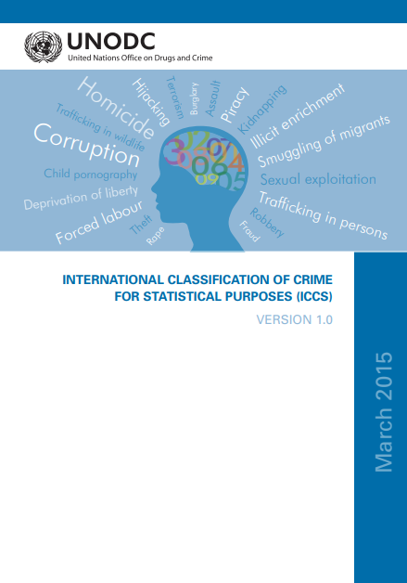
United Nations Survey on Crime Trends and the Operations of Criminal Justice Systems (UN-CTS)
Mandate
General Assembly Resolution A/RES/3021(XXVII) in 1972, further formalized through ECOSOC Resolution 1984/48.
Objectives
Harmonize data collection in the criminal justice system
Identify crime patterns
Improve monitoring of the criminal justice system
Improve monitoring of the SDGs
Improve international comparability of crime statistics
More information at this link

Slide 4
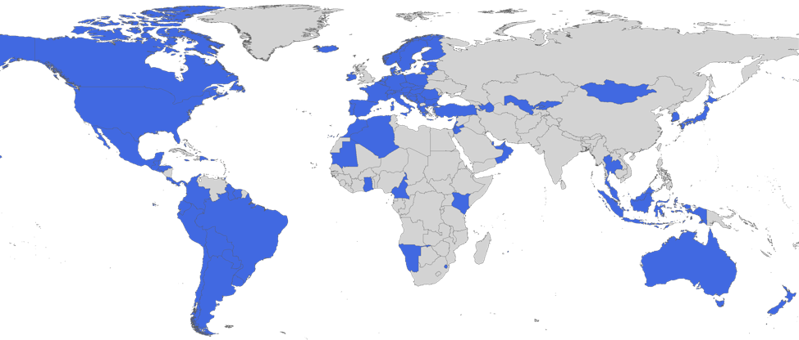
UN-CTS 2022 response
Some 103 countries submitted the CTS questionnaire. In general, survey response in the African region, Middle East and Asia are still sparse
Note: The boundaries and names shown and the designations used on this map do not imply official endorsement or acceptance by the United Nations

Slide 5
UN-CTS Structure

Slide 6
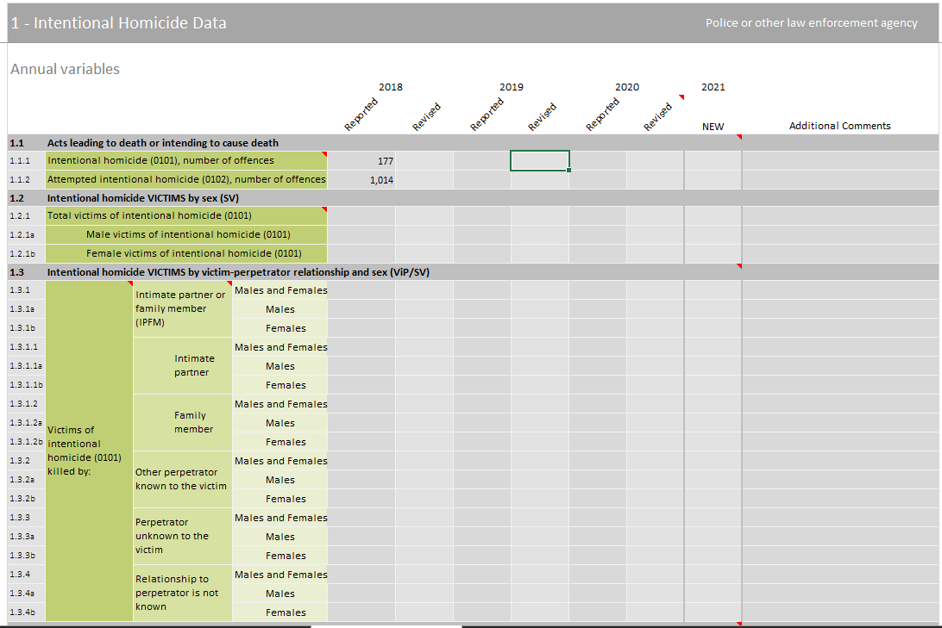
Section 1- Intentional homicide
Clarifying notes
Recommended counting rules
Link to definition

Slide 7
Trend
Note: Linear projection 2021-2030 based on trend 2015-2020.
Notes:
Preliminary data from 2021 shows a significant increase:
Intentional homicides cause more deaths globally than conflict and terrorist killings combined. In 2021, there were approximately 458,000 intentional homicides – the highest number in the past two decades. The noticeable spike in killings in 2021 can be partly attributed to the economic repercussions of COVID-related restrictions, as well as an escalation of gang-related and socio-political violence in several countries. Taking the growing population into account, the homicide rate was 5.8 per 100,000 population in 2021, marginally lower than the 2015 rate of 5.9 per 100,000. If the increase in 2021 reflects a long-lasting trend reversal, then the SDG target will certainly not be met. Even in the most optimistic scenario that 2021 was an exceptional year with no bearing on future trends, projections based on 2015-2020 suggest that the improvement achieved by 2030 will amount to just 24 per cent on the homicide rate in 2015, falling short of the target of halving 2015 levels.
This topic will be detailed in the upcoming global study on homicide set to be released later this year.

Slide 8
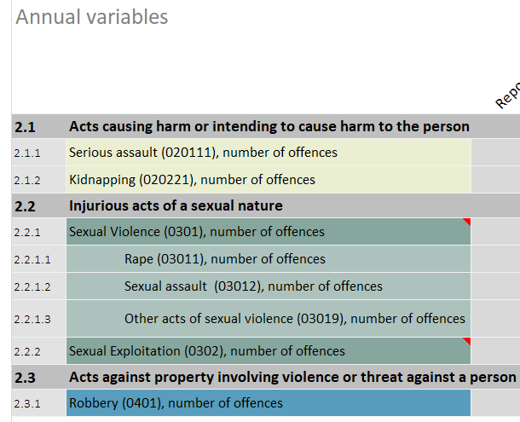
Section 2 – Violent crimes

Slide 9
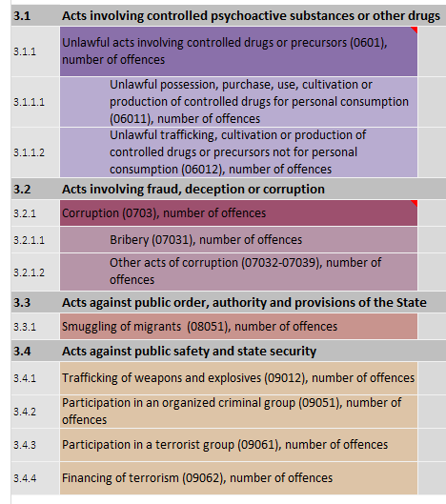
Section 3 – Other crimes

Slide 10
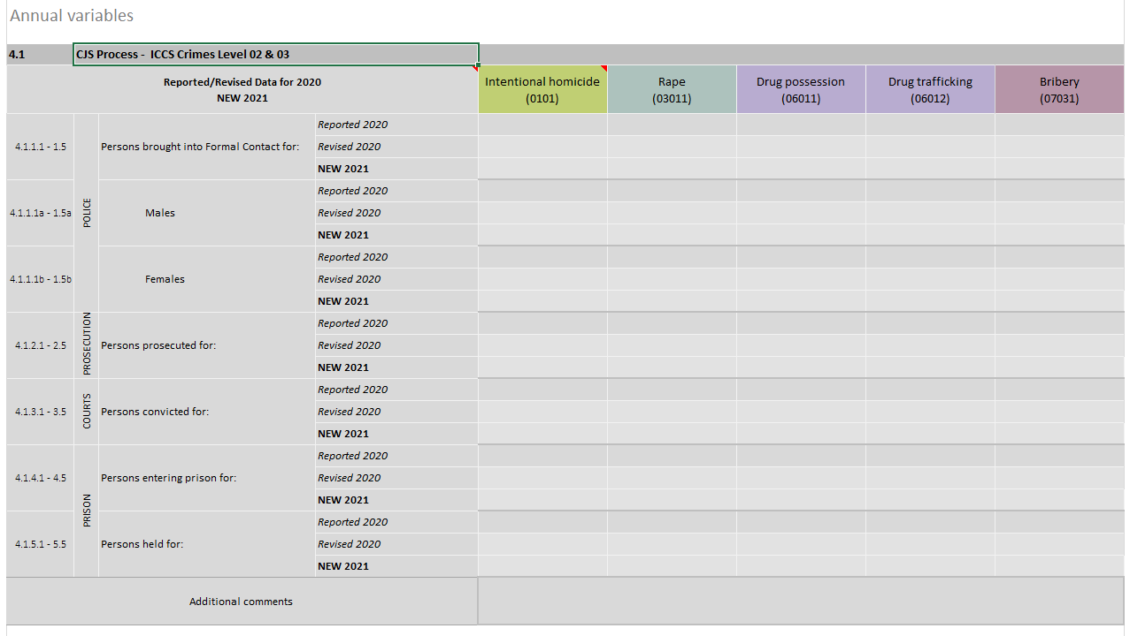
Section 4 – CJS Process
Actual incidence of violent crime
Reported in victimization survey
Detected by police
Registered by police
Persons prosecuted
Persons found guilty
Persons placed in detention

Slide 11
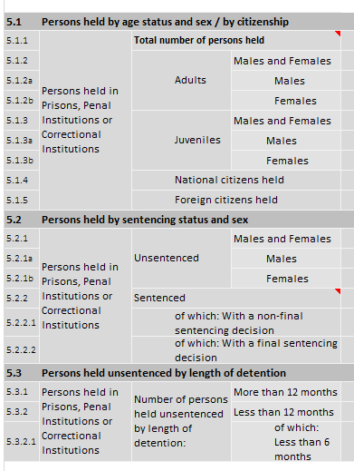
Section 5 - Prisons

Slide 12
UN-CTS Survey of experience
Effective coordination system to complete the UN-CTS that follows a clear process
However:
No possibility of reviewing and resubmitting data beyond the latest 4 years
Need to accelerate ICCS implementation to facilitate the completion of the UN-CTS
Long and detailed questionnaire => Time consuming to complete
Period of completion is not ideal
No consensus on possible use of a dedicated online platform
Results of the survey of experience will be used to prepare the consultations on the UN-CTS revision to be launched in the coming years.
Notes:
UNODC is considering revising the UN-CTS. This would be an opportunity to review both the content and the format of the data collection.
To get some initial feedback on the UN-CTS, a survey of experience of focal points and other relevant stakeholders in completing the questionnaire was launched. 80 persons, about half of them from Europe, responded to the survey. Thank you again for taking the time to complete it. This is really helpful.
A majority of respondents shared that their country benefited from an effective coordination system to complete the UN-CTS and that the process to complete it was clear. However, since 80% of the respondents were from Europe and the Americas, they are from countries that respond regularly to the UN-CTS.
Nevertheless, some respondents highlighted key points hampering the rapid and complete submission of the UN-CTS:
The questionnaire is very detailed, and thus takes time to be completed.
Many haven’t implemented the ICCS, which would make the completion of the questionnaire much easier (most respondents said the data publicly available in their country follows standards (definitions, counting rules) different from the UN-CTS).
The period to complete it is not ideal as it is during the summer vacations.
Only data for the previous 4 years can be submitted.
UNODC has moved its main questionnaire on drugs on an online platform. This will also be considered for the UN-CTS. The survey thus also included a question on whether the use of a dedicated online platform for the UN-CTS would facilitate its completion. About 50% of respondents said yes, 25% said no and 25% said they didn’t know, highlighting the fact that a revision will require more than just changing platform.
These findings will be used to prepare for a future consultation on the UN-CTS revision.

Slide 13
Example – Homework?
Source: UNODC, Data Portal. Available at https://dataunodc.un.org/

Slide 14
Example – UNODC data portal
Source: UNODC, Data Portal. Available at https://dataunodc.un.org/

Slide 15
Example – UNODC data portal
Source: UNODC, Data Portal. Available at https://dataunodc.un.org/

Slide 16
SDG 16 reporting
Indicator |  | Questionnaire | Data source
16.1.1. | Number of victims of intentional homicide per 100,000 population, by sex and age | UN-CTS | Admin data
16.1.3. | Proportion of population subjected to (a) physical violence, (b) psychological violence and (c) sexual violence in the previous 12 months | UN-CTS | Household survey
16.1.4. | Proportion of population that feel safe walking alone around the area they live after dark | UN-CTS | Household survey
16.3.1. | Proportion of victims of violence in the previous 12 months who reported their victimization to competent authorities or other officially recognized conflict resolution mechanisms | UN-CTS | Household survey
16.3.2. | Unsentenced detainees as a proportion of overall prison population | UN-CTS | Admin data
16.5.1. | Proportion of persons who had at least one contact with a public official and who paid a bribe to a public official, or were asked for a bribe by those public officials, during the previous 12 months | UN-CTS | Household survey

Slide 17
Q&A
Are these data available in your country?
Which data is not readily available but could possibly be made available with some support?
Where are the information gaps?
What are the limits to data collection?
How is data collection on criminal justice supported/hindered by existing legal frameworks?
How can the different institutions be encouraged to share more data?

Slide 18
Thank you!
martijn.kind@un.org
rausis@un.org

