Slide 1
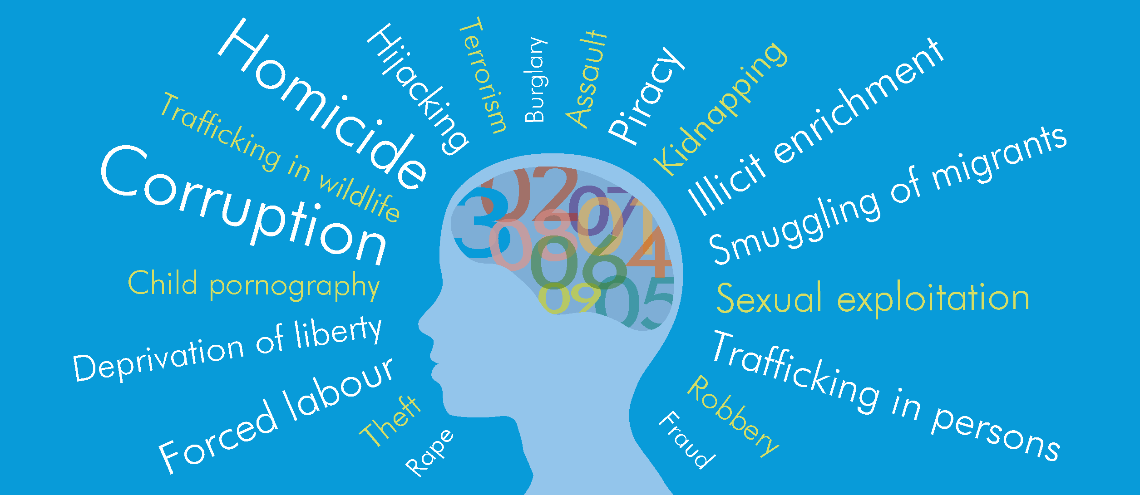
Production of Statistical Information on Crime and Criminal Justice

Slide 2
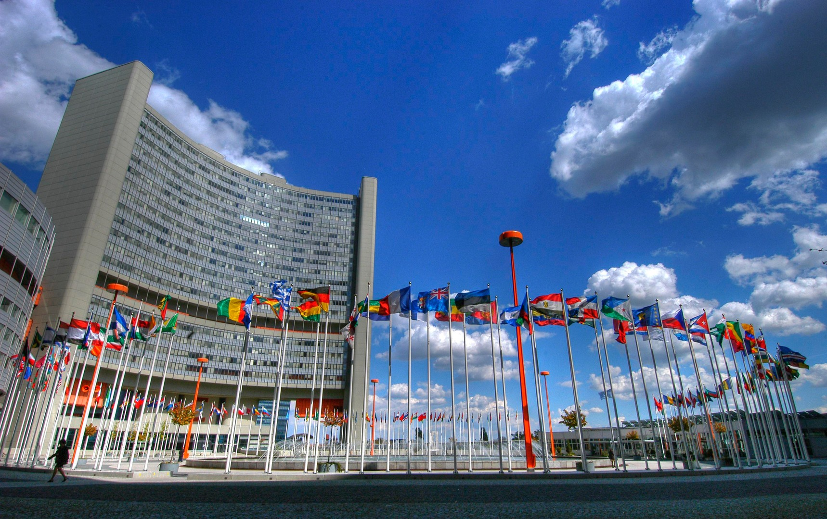
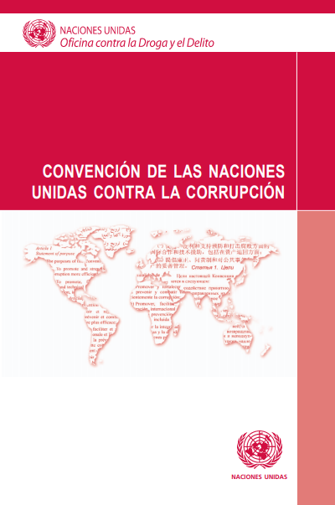
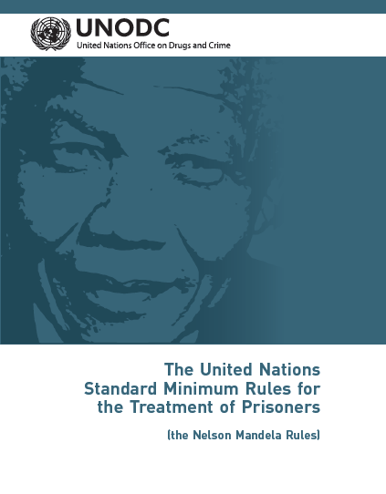
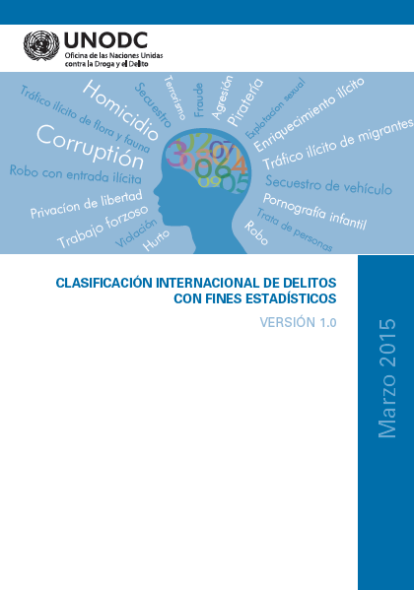
UNODC
Custodian of:
United Nations Office on Drugs and Crime
​
UNODC works to strengthen crime prevention policies, to achieve a secure society, strengthen the rule of law and the administration of justice, promote stable criminal justice systems, and combat threats from organized crime, corruption, terrorism and illicit drugs.
International Conventions
Protocols on crime and justice
International standards for crime
15 Indicators of the 2030 Agenda

Slide 3
Production of crime and criminal justice information

Slide 4
UNODC and Crime Statistics
Objective:
To help governments in monitoring crime dynamics and trends and the social impact of public policies and public expenditure.
Challenge:
Crime is NOT static, it adapts to human and social development changes. Particularly challenging for organized crime.
Notes:
Many of the benefits of globalization, such as easier and faster communication, movement of finances and international travel, have created novel opportunities for transnational organized criminal groups to flourish, diversify and expand their activities.

Slide 5
Data sources for crime and criminal justice statistics
Administrative Records
Other Sources
Housing services
Surveys
Police
Prosecution
Criminal Justice System:
Courts
Access to Justice surveys
Corruption surveys
Victimization surveys
Surveys of prisoners
Prisons
Emergency calls
Health statistics
Social services
Public defence
Ministries
Customs
Etc.
Notes:
Emergency rooms – increase in stabbing victims for example

Slide 6
Data sources for crime and criminal justice statistics
Police
Investigate allegations of criminal conduct, gather evidence.
Prosecution
Provided with evidence, prepares case for court and file charges.
Courts
Hold those convicted of a crime
Prison
Hears the case, including testimony and other evidence, determines the case, convicts the accused if found guilty
Notes:
Emergency romos – increase in stabbing vicitms for example

Slide 7
Use of crime and criminal justice statistics
Operational
To deal with a specific crime or case
To fight crime more broadly
Managerial
Monitor the performance of criminal justice agencies
Research and policy development
Better understand crime trends and patterns
Formulate evidence-based crime prevention policies
Accountability
Enhance public trust
Notes:
Operational: advance investigation, understand characteristics of victims/offenders, identify crime facilitators, where did it happen?
Managerial: Measure workload, resources, crimes solved, crimes unresolved, disaggregated by geographic regions, etc.
Research and policy development: How to better allocated resources, react to changes in crime patterns (population change, tourism, drugs, organized crime). What weapons are used for homicides?
Accountability: Show the public what is actually happening in the field of crime and criminal justice.
In sum: Better management of resources, assess efficiency and fairness of CJ institutions, assess trends and patterns, counter and prevent crime
Trend = change over time (i..e decrease in homicides from 2010-2023)
Pattern = Regularity in data, sequences of element (i.e. homicides mostly committed by young men aged 18-30 through the use of a sharp object in urban areas)

Slide 8
Why do we need international CJ data?
Highlight where statistics infrastructure needs development
Guideline for national agencies on which data to collect and how to prepare, use and present comparable statistics
Produce comparative analysis of crime and criminal justice statistics
Organized crime is often transnational in nature and does not respect national borders

Slide 9
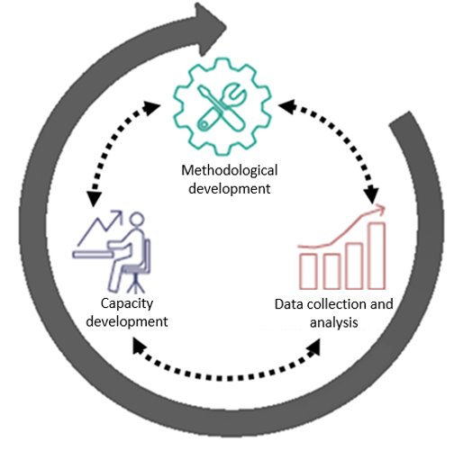
Improving Crime and Criminal Justice Statistics
Roadmap to improve the quality and availability of crime statistics​
at the national and international level (most recent update E/CN.3/2022/14)​
Commission on Crime Prevention and Criminal Justice​ (CCPCJ)​
United Nations
Statistical Commission (UNSC)
Updated at the 53rd UNSC 2022
Notes:
Methodology:
Manual on corruption surveys
Regional methodology for victimization surveys in Latin America
Measurement of illicit financial flows
Femicide framework
Etc.
Capacity building:
ICCS training
CVS trainings
Pilot femicide
Etc.
Int data collection and analysis:
Revised CTS
GLOTIP
Go beyond national lens, global perspective.
Etc.

Slide 10
Global Data Collections

Slide 11
Data collection cycle
Crime and criminal justice
UNODC Global Data collections
United Nations Crime Trends Survey (UN-CTS)
Drugs
Annual Report Questionnaire (ARQ)
Illicit Arms Flows Questionnaire
(UN-IAFQ, ‘Firearms’)
Individual Drug Seizures (IDS)
Questionnaire for the Global Report on Trafficking In Persons (GLOTIP)

Slide 12
We rely on national Focal Points
UNODC benefits from your support and contributions
You as the Member States benefit from more and better global data and analyses
UNODC Focal Points appointed by each Member State are the primary technical points of contacts in all data collection related matters
Focal Points are technical practitioners working in a national agency with responsibility for drugs, crime or criminal justice statistics

Slide 13
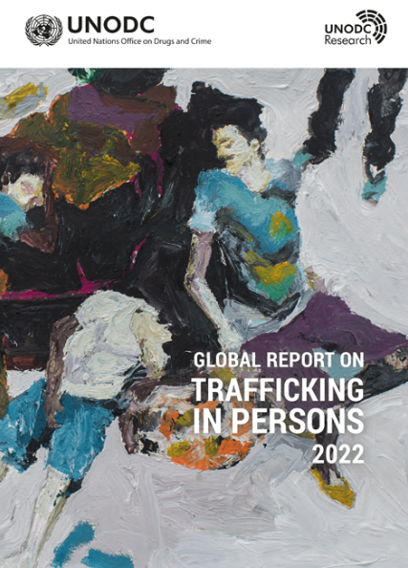
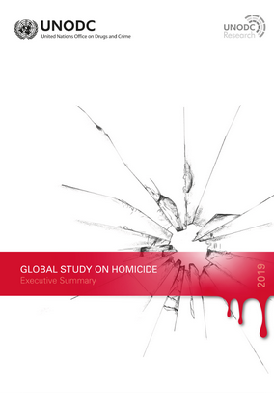
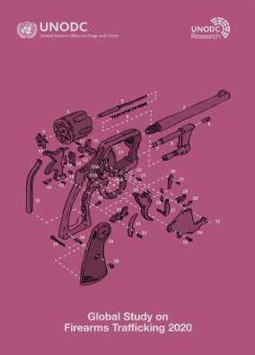
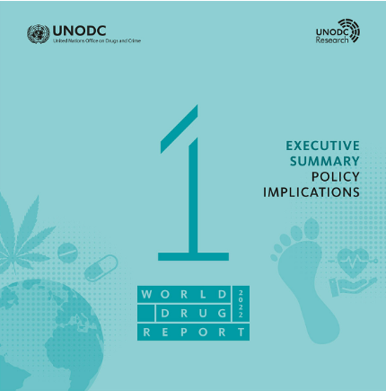
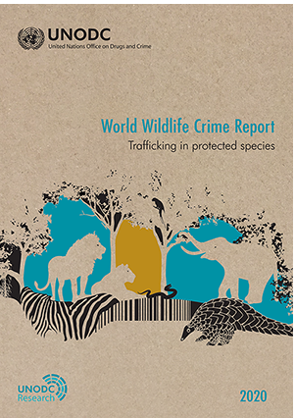
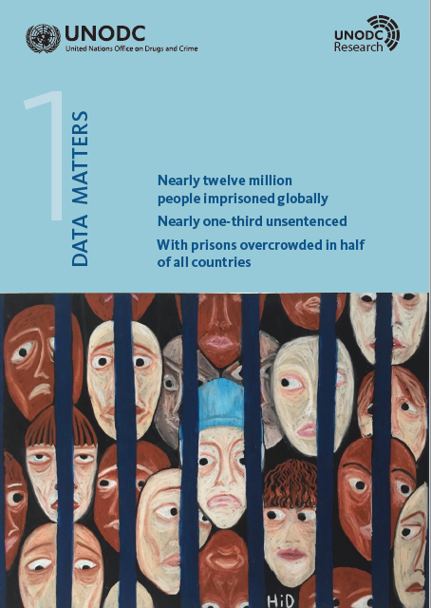
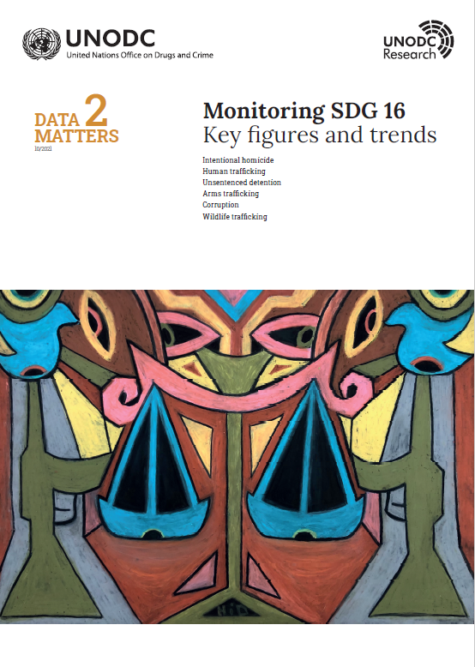
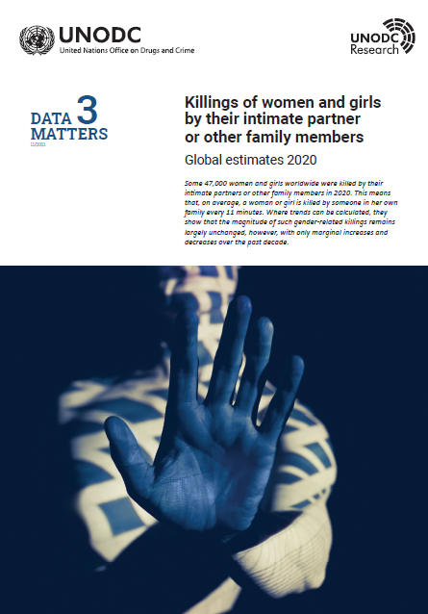
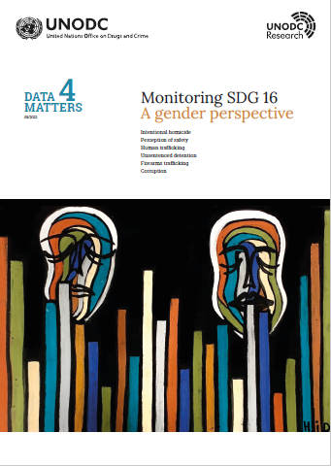
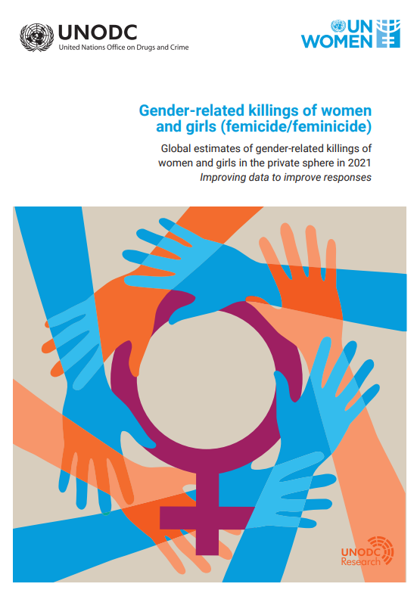
Our analytical publications
www.unodc.org/unodc/en/data-and-analysis/index.html
Notes:
Data Matters No. 3 - Killings of women and girls by their intimate partner or other family members - Global estimates 2020
Data Matters No. 2 - Intentional homicide - Human trafﬁcking - Unsentenced detention - Arms trafﬁcking - Corruption - Wildlife trafﬁcking - October 2021
Data Matters No.1- Nearly twelve million people imprisoned globally, nearly one-third unsentenced with prisons overcrowded in half of all countries - July 2021

Slide 14
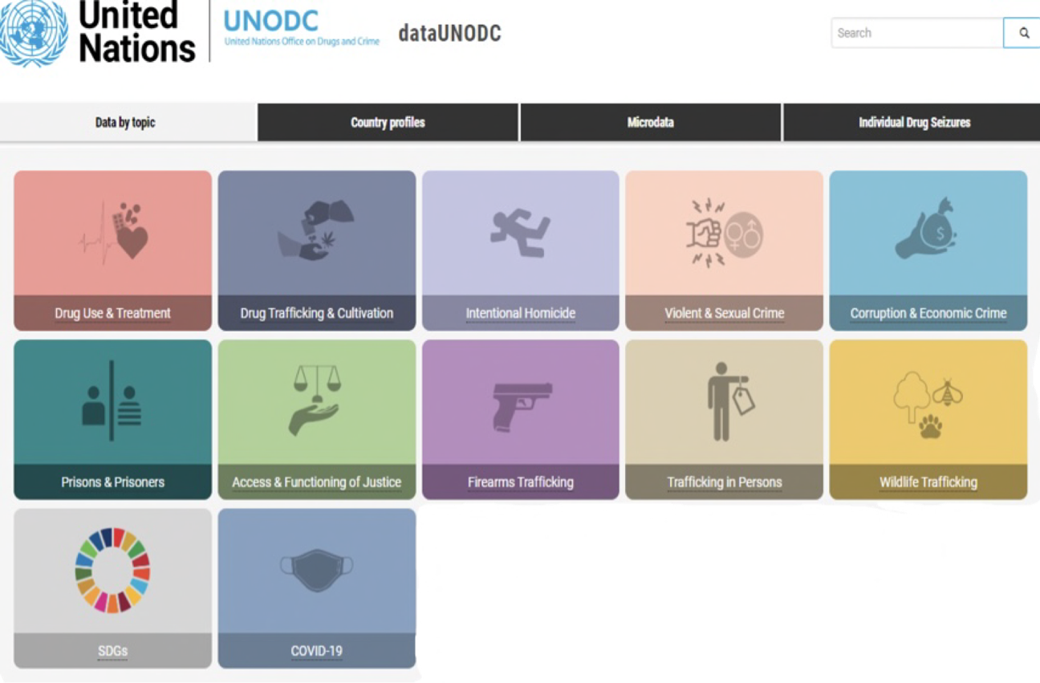
Data Portal
Relaunched in June 2022
https://dataunodc.un.org

Slide 15
Thank you
Martijn Kind / Statistician
martijn.kind@un.org
Claudia Pontoglio / Associate Research Officer
claudia.pontoglio@un.org

