Slide 1
Workshop on the Use of the "Indices Simulation Tool for Policymakers in Kuwait”
Nathalie PICASSO GRAND, Data Scientist, ESCWA

Slide 2
Session II: The Indices Simulator Tool for Policymakers in the Arab Region (ISPAR)
The tool is ready
Coverage and features of the ISPAR tool for evidence-based policymaking

Slide 3
Session II: The Indices Simulator Tool for Policymakers in the Arab Region (ISPAR)
The tool is ready
What are the goals of developing ISPAR?
What is its coverage?
What are the main features?
of the indexes simulation tool for evidence-based policymaking

Slide 4
https://ispar.unescwa.org/
Indices Simulation Tool for Policymakers in the Arab Region (ISPAR)

Slide 5
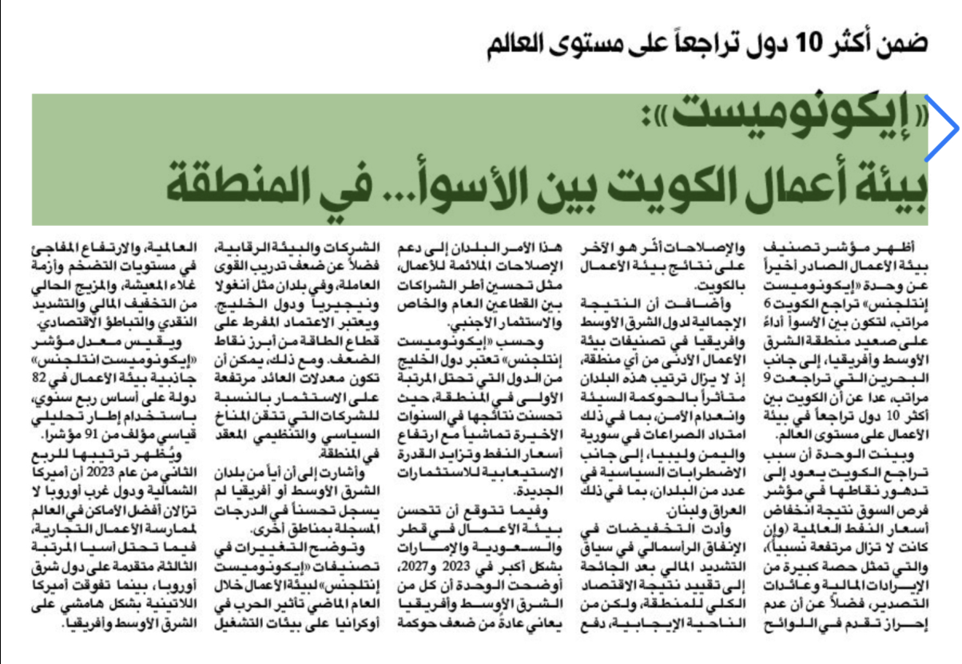
Indices Simulation Tool for Policymakers in the Arab Region (ISPAR)

Slide 6
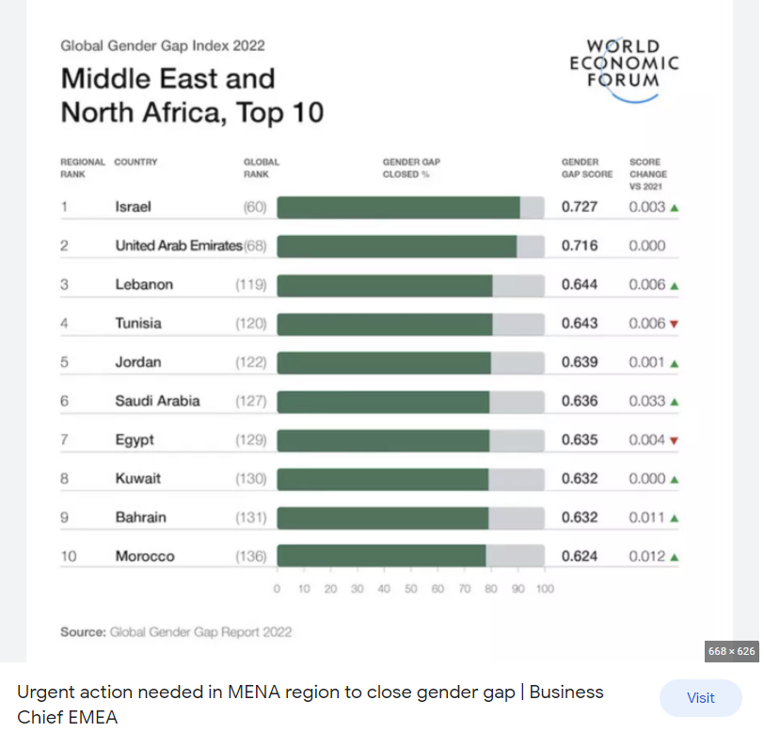
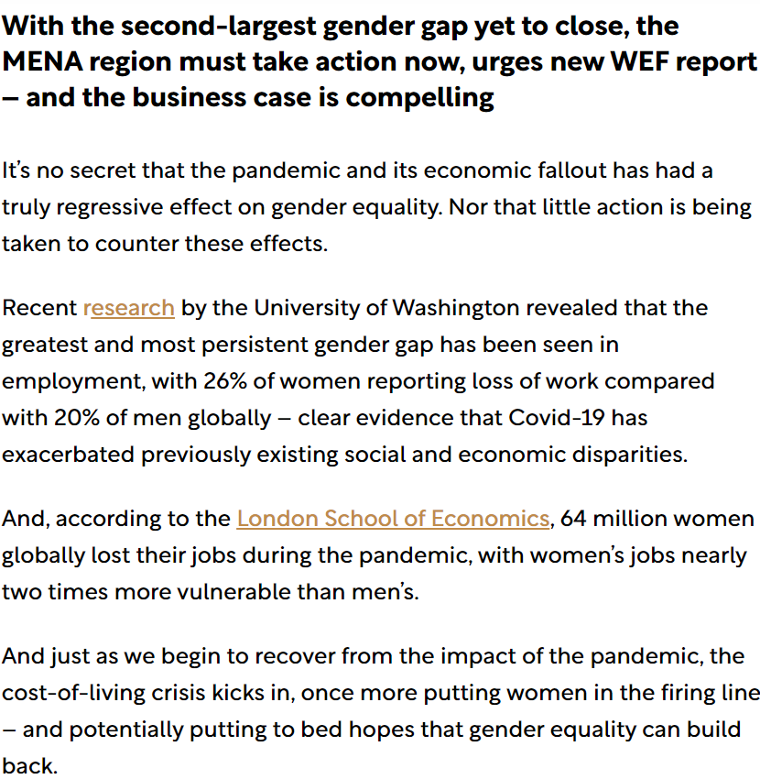
Indices Simulation Tool for Policymakers in the Arab Region (ISPAR)

Slide 7
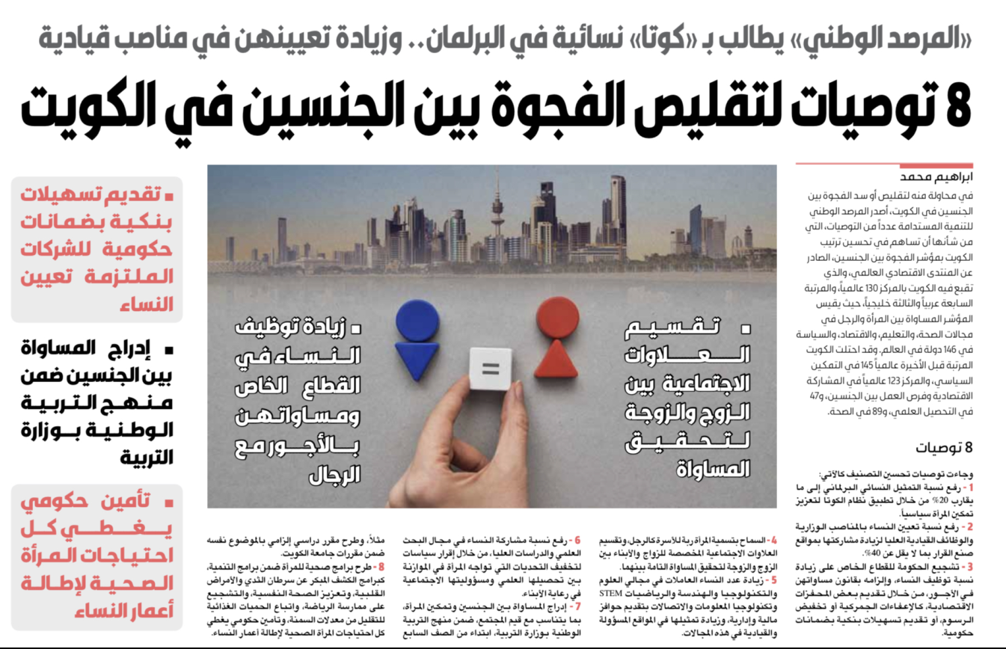
Indices Simulation Tool for Policymakers in the Arab Region (ISPAR)
Member States showed concerns about international indices used to assess their performances

Slide 8
Indices Simulation Tool for Policymakers in the Arab Region (ISPAR)
The Project’s Goal
Improving policymaking effectiveness using a series of international indices
Improving policymaking effectiveness
assist Member States in understanding the impact of specific policies
Improving policymaking effectiveness
assist Member States in understanding the impact of specific policies and identifying effective and efficient procedures that could be implemented in the short, medium and long term to enhance country’s ranking in selected international indicators and impact the socio-economic development on national level.
Improving policymaking effectiveness
assist Member States in understanding the impact of specific policies and identifying effective and efficient procedures that could be implemented in the short, medium and long term to enhance country’s ranking in selected international indicators
Improving policymaking effectiveness
assist Member States in understanding the impact of specific policies and identifying effective and efficient procedures
Improving policymaking effectiveness
assist Member States in understanding the impact of specific policies and identifying effective and efficient procedures that could be implemented in the short, medium and long term
The ISPAR project’s goal: develop a tool so International Composite Indicators can be used for evidence-based policymaking
https://ispar.unescwa.org/about.aspx

Slide 9
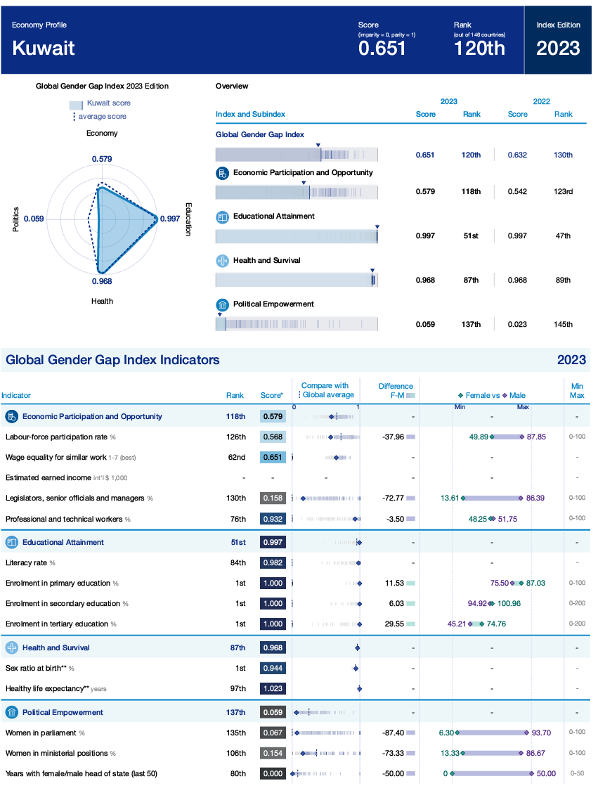
Are Indices as they are useful for policymaking?
Data used for performance assessment are not accurate or not updated, or missing
NO
Transparency (methodology)
how data are collected, how surveys are administered
the weight of experts’ judgment
other discretionary decisions
First issue : The DATA

Slide 10
Are Indices as they are useful for policymaking?
What is the impact of changes in policies on ranking?
NO
and in turn on economic and social performances or SDGs
Second issue :
no SIMULATION of change in
policy is possible

Slide 11
Are Indices as they are useful for policymaking?
NO
How to benefit from the experience of other countries?
How can countries learn from past experiences?
Third issue :
Policy Recommendations

Slide 12
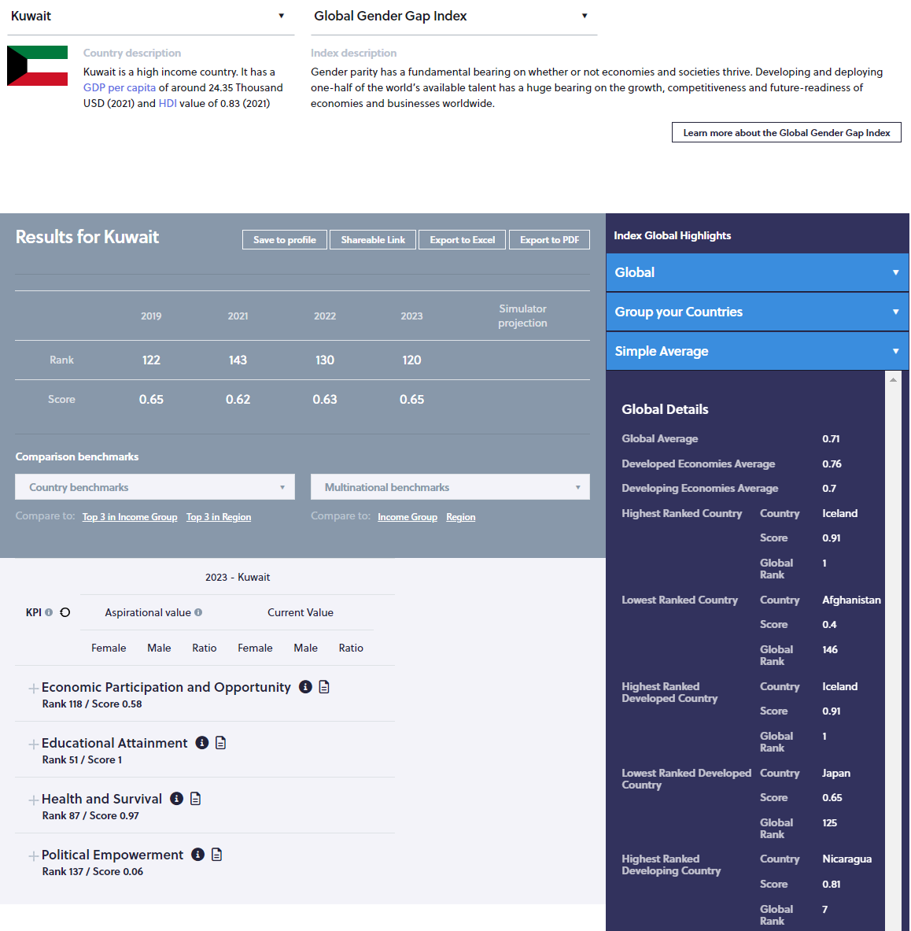
How ESCWA addressed the issues with Composite Indexes?
Monitoring and accuracy of performance assessment : the governance of data production and diffusion
Development of Simulators to evaluate the impact of policy changes on achievements and rank
YES
Go beyond the composite index and design a comprehensive strategy: Which aspects of the problem at hands are missing
Policy recommendation
Tools for goals prioritization
Tool for assessment of linkages between Composite indexes and the SDGs and the set developmental goals

Slide 13
Thank you for your time!
grand@un.org
The tool is ready

Slide 14
Workshop on the Use of the "Indices Simulation Tool for Policymakers in Kuwait”
Nathalie PICASSO-GRAND, Data Scientist, ESCWA

Slide 15
Session III: Introduction to global indicators in various fields
The tool is ready
This session aims to introduce participants to global indicators in the economic and social fields in general and those that are included on the ISPAR tool.

Slide 16
Session III: Introduction to global indicators in various fields
The tool is ready
Generate a profile
Carry a first benchmarking analysis
Discover the various fields covered by the tool
Understand the linkages between Composite Indices

Slide 17
Generating a profile
The tool is ready
Go to https://gender.unescwa.org
Click on the ‘Countries’ tab (up right corner)
select your country (flag)
select “View the international index rankings”

Slide 18
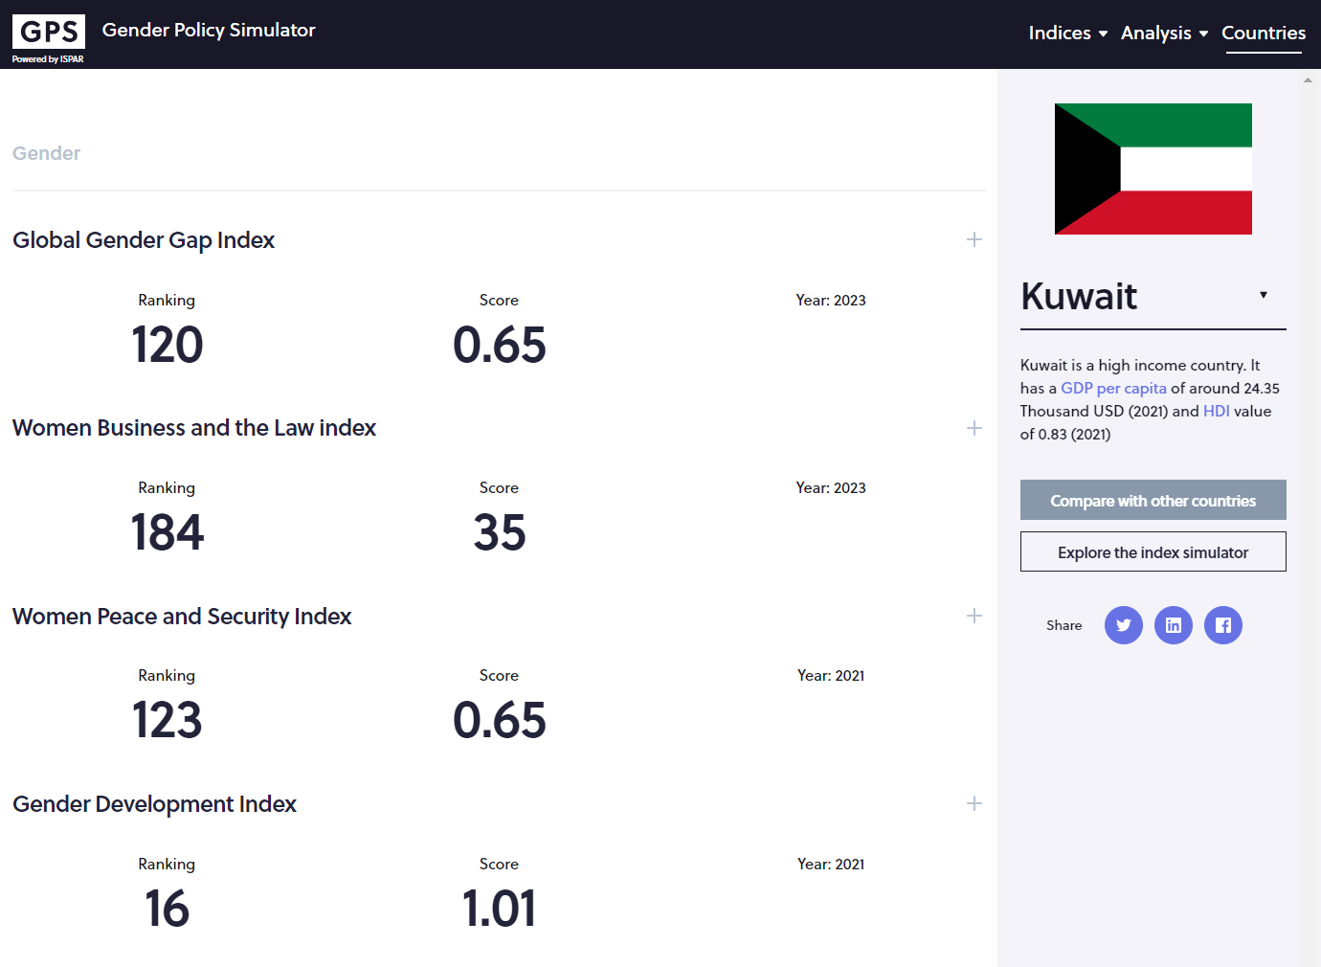
Generate a profile
Brief description of the country. The same information is provided for all countries to facilitate comparisons
View performances on multiples indices in one page
Score and rank are provided
And the year of publication of the index. This is very important

Slide 19
Generating a profile
Go to https://ispar.unescwa.org/gender/
Click on the ‘Countries’ tab (up right corner)
select your country (flag)
select “View the international index rankings”
The tool is ready
It shows the country’s performances and which Indices are available for which year. For these indices, a policy impact simulator is available. Comparison with other countries is possible

Slide 20
Benchmarking
Compare with other countries

Slide 21
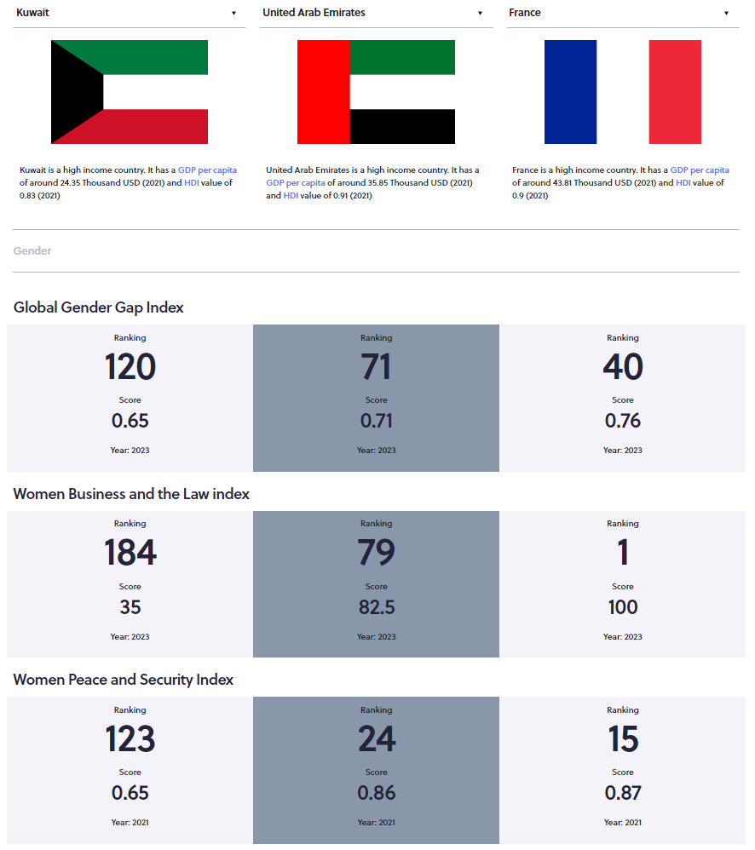
Benchmarking
View performances on multiples indices in one page
Compare with other countries.
By default, two countries with similar HDI and/or GDP per capita are randomly selected
Select benchmark using relevant info

Slide 22
A first general benchmarking can be done here
Which benchmark is best for Kuwait upon you?
What are the benchmark countries’ performances?
Which best benchmark for ST, MT, LT?
A more informative benchmarking should be done at the KPIs level and reflect the envisioned policies

Slide 23
ISPAR coverage
Wider than Gender Issues
22 indices included
For now
Gender Gap Index
AI readiness Index
Doing Business index
Competitiveness index
ITU ICT Development Index
e-Government Index
Global Cybersecurity Index
Global Innovation Index
Digital Accessibility Rights Evaluation Index
Women peace and Security index
Network Readiness Index
Women Business and the Law Index
Development Challenge Index
Global knowledge Index
B2C E-commerce Index
E-participation Index
Globalisation Index
Open Data Inventory Index
Recently added
FDI restrictiveness index
Financial Inclusiveness index
Food security index
Human capital index
Are engendered
To maximize the impact of gender policies on set goals, a comprehensive approach should include financial inclusiveness and other adjacent issues not covered by the selected gender indices

Slide 24
Thank you for your time!
grand@un.org
The tool is ready

Slide 25
Workshop on the Use of the "Indices Simulation Tool for Policymakers in Kuwait”
Nathalie PICASSO-GRAND, Data Scientist, ESCWA

Slide 26
Session IV: Human Development Index
This session will introduce the UN Development Programme’s Human Development Index and the Gender Development Index and allow participants to use the ISPAR tool to retrieve country results. Participants will then present their experience around the use of ISPAR to analyse their rankings and scores.
The tool is ready

Slide 27
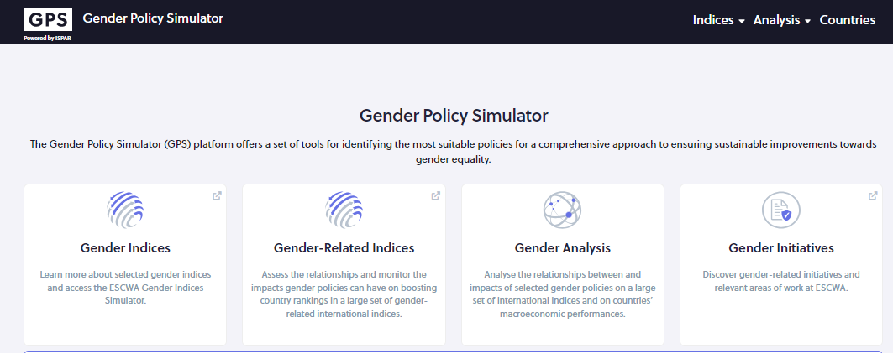
First simulation: UNDP Human Development Index/Gender Development Index
From
https://gender.unescwa.org
Click on ‘Gender Indices”
For this first simulation, we will use a simulator that is not engendered, which reduces the number of KPIs and is easier to use

Slide 28
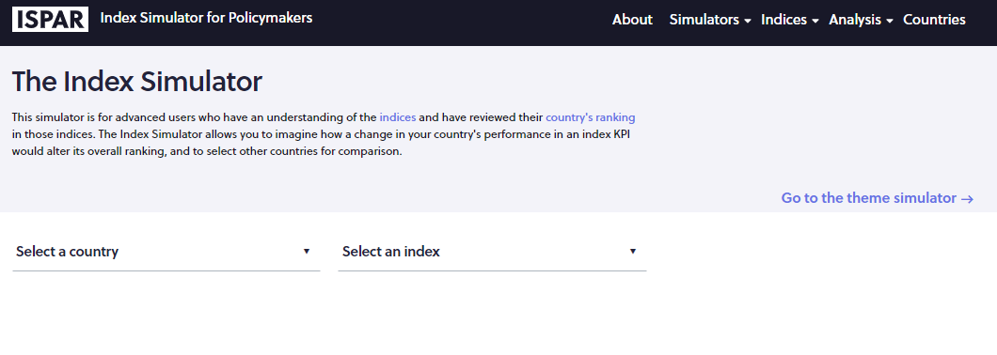
Human Development Index
Select ‘Human Development Index”
Select your country

Slide 29
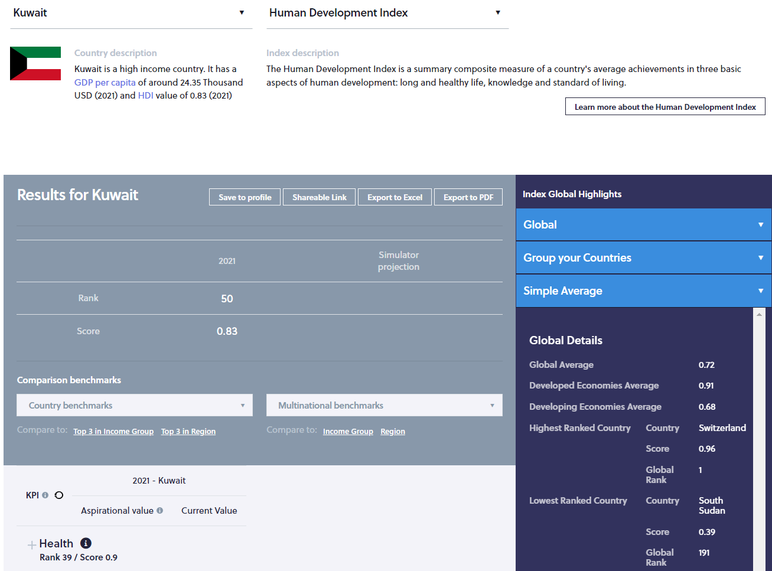
Human Development Index
Brief description of the country for benchmarking
Brief description of the selected index
Link to the webpage of the selected index
Year of the last ranking available
Rank and score
Dimensions with rank and score per dimension
Scroll down…

Slide 30
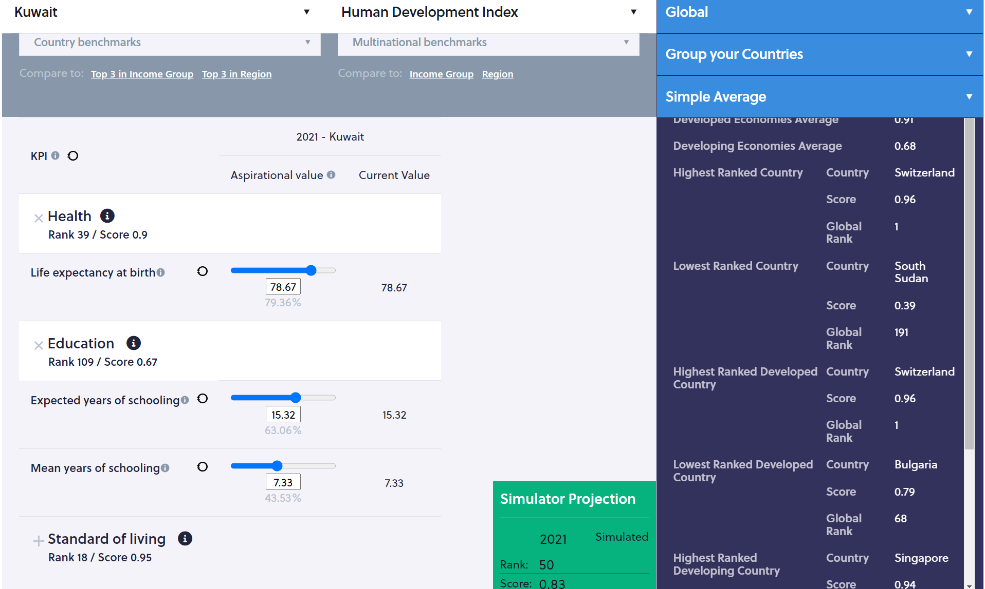
Human Development Index
Index’s name
Country’s name
Click on the dimension’s name to see the KPIs
Box in which the impact of the rank and score will be shown. For now, the year of the last ranking, the rank and score are provided for reference
Actual values of the KPIs
Input your aspirational values…

Slide 31
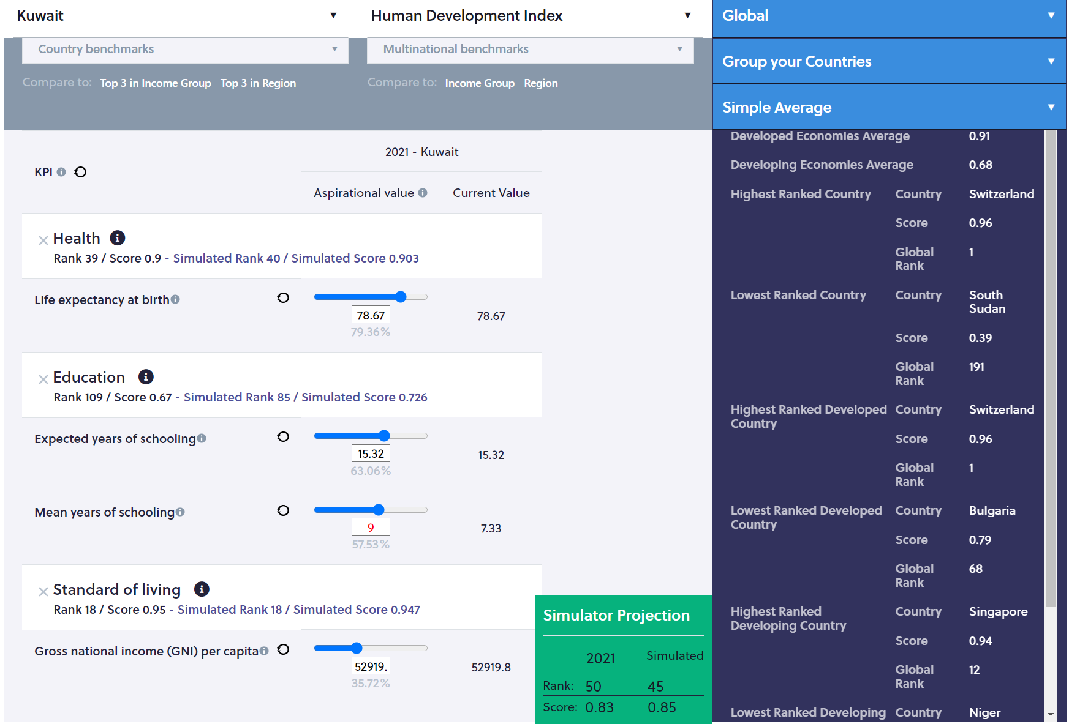
Human Development Index
Slide the cursor
Or input your data
The year of the last ranking, the rank and score are provided for reference
The simulated rank and score are displayed
Click on the icon next to the KPI’s name to see the definition
Actual values of the KPIs are duplicated for reference
Aspirational values appear in RED
Select aspirational values using benchmarks…

Slide 32
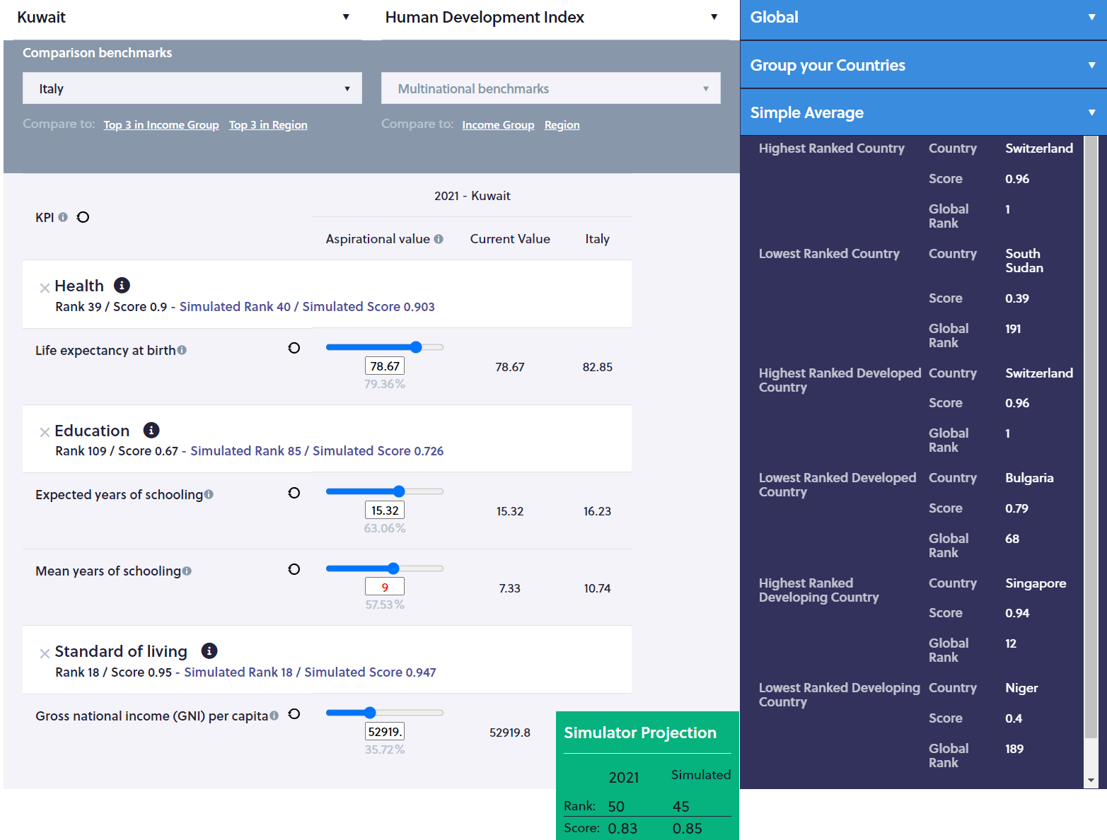
Human Development Index
Select benchmark countries
Or group
The year of the last ranking, the rank and score are provided for reference
The simulated rank and score are displayed
Actual KPIs values for the selected country and benchmarks are displayed
A strategy for a short, medium and long term can be designed
Aspirational values are selected in RED compared to benchmark

Slide 33
This index is engendered

Slide 34
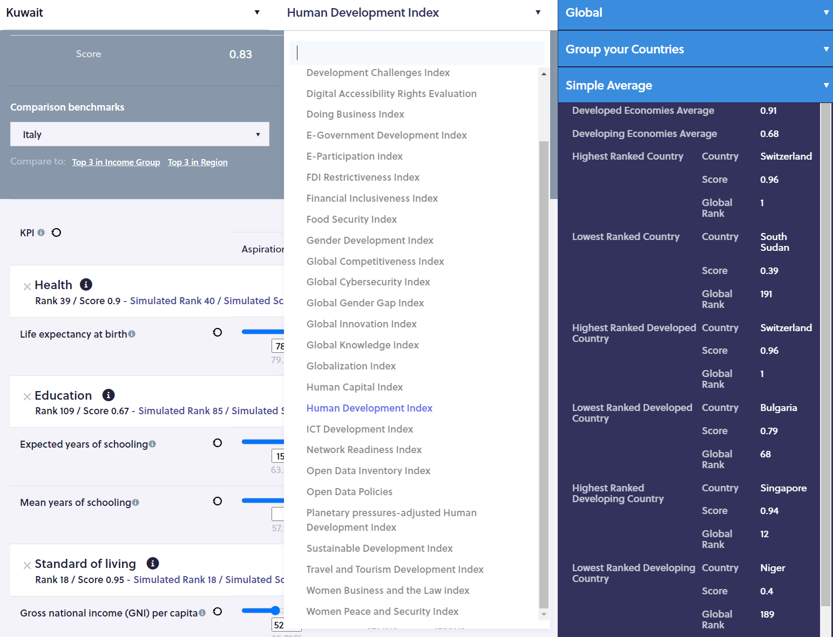
Gender Development Index
Select ‘Gender Development Index”

Slide 35
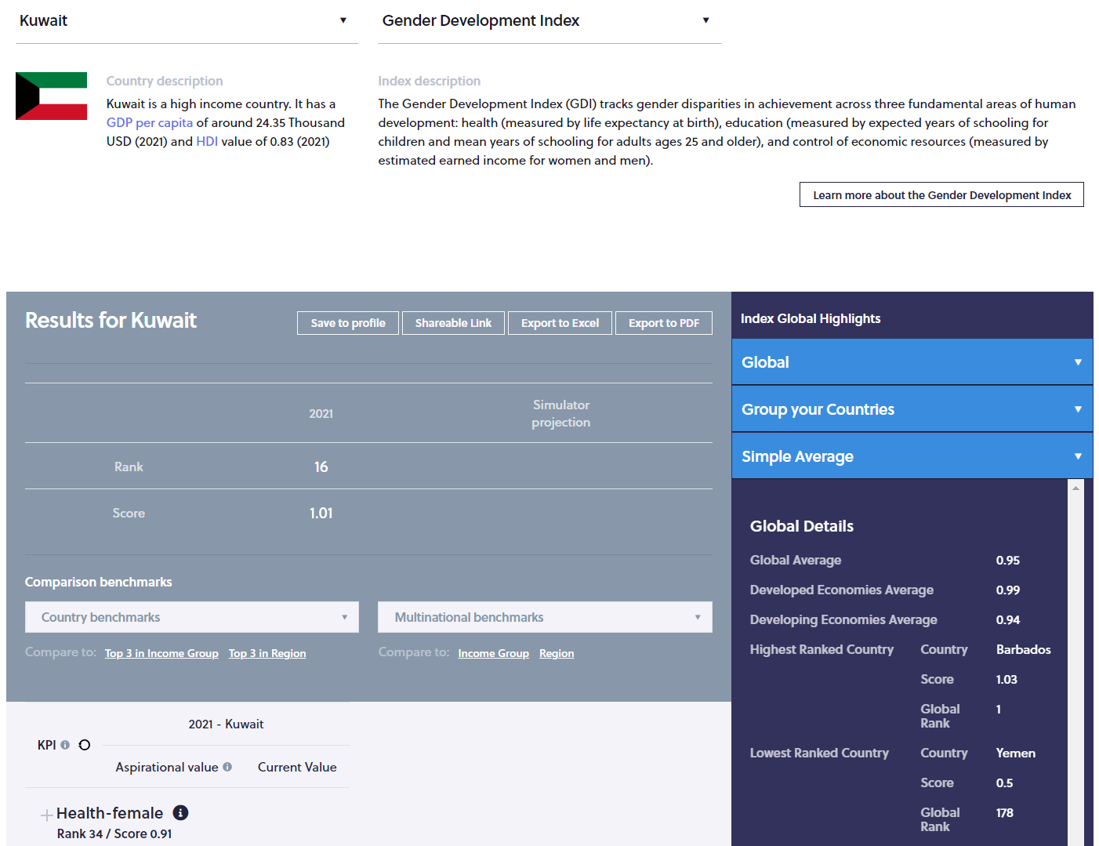
Gender Development Index
Brief description of the country for benchmarking
Brief description of the selected index
Link to the webpage of the selected index
Year of the last ranking available
Rank and score
Dimensions with rank and score per dimension
Scroll down…

Slide 36
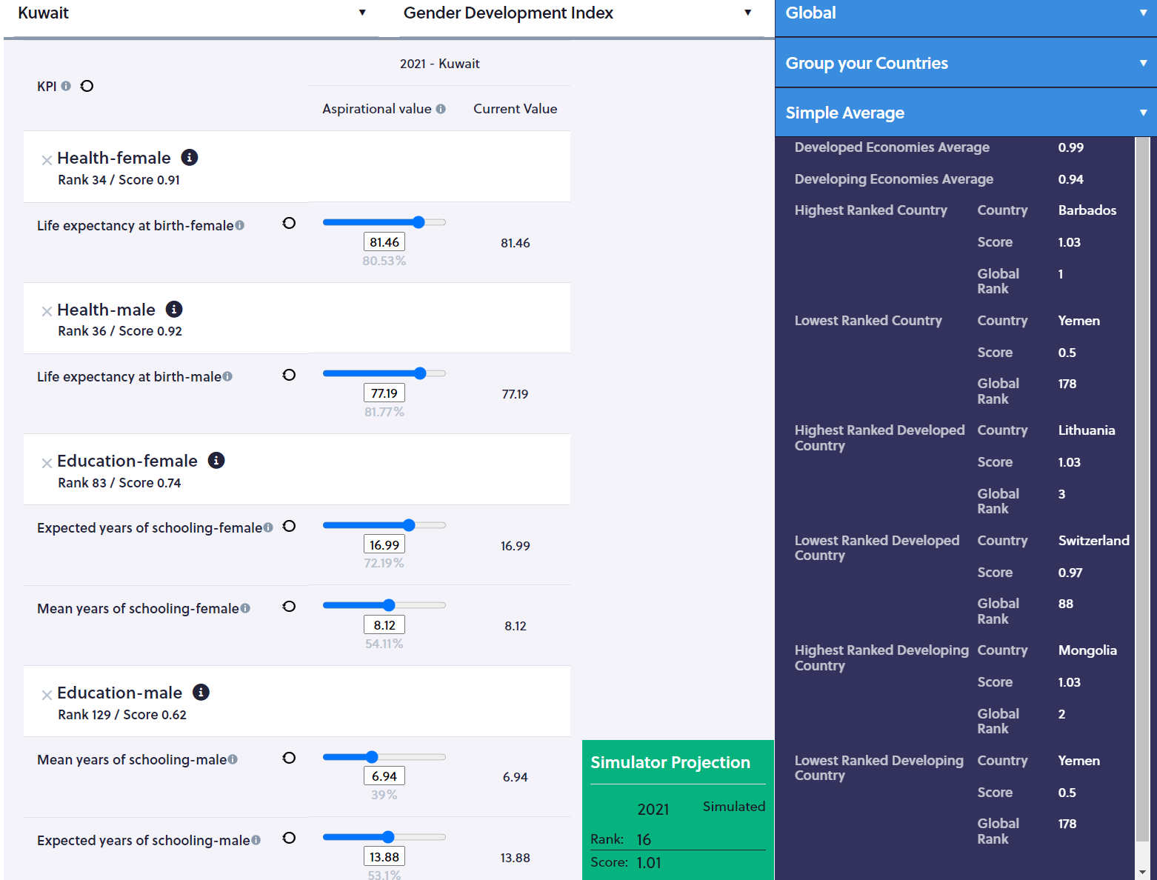
Gender Development Index
Index’s name
Country’s name
Click on the dimension’s name to see the KPIs
Box in which the impact of the rank and score will be shown. For now, the year of the last ranking, the rank and score are provided for reference
Actual values of the KPIs
Input your aspirational values…

Slide 37
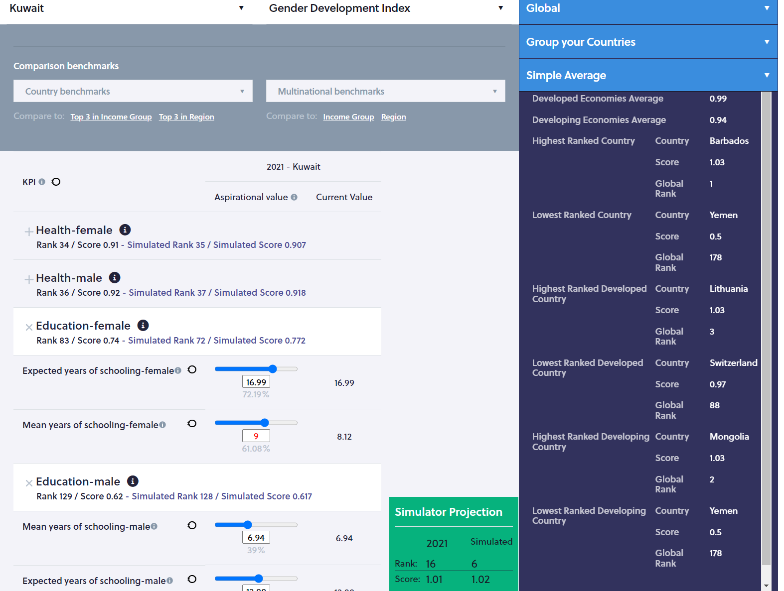
Gender Development Index
Slide the cursor
Or input your data
The year of the last ranking, the rank and score are provided for reference
The simulated rank and score are displayed
Click on the icon next to the KPI’s name to see the definition
Actual values of the KPIs are duplicated for reference
Aspirational values appear in RED

Slide 38
First simulation HDI and GDI: Help identify key indicators
At the national level
The tool is ready
And per gender
Help defining targeted actions
Example: action targeting education can help improve rapidly on the ranking, especially the means years of schooling
Specific actions have to target female achievements

Slide 39
Thank you for your time!
grand@un.org
The tool is ready

Slide 40
Workshop on the Use of the "Indices Simulation Tool for Policymakers in Kuwait”
Nathalie PICASSO-GRAND, Data Scientist, ESCWA

Slide 41
Session IV: Global Gender Gap Index
This session will introduce the World Economic Forum’s Global Gender Gap Index and allow participants to use the ISPAR tool to retrieve country results. Participants will then present their experience around the use of ISPAR to analyse their rankings and scores.
The tool is ready

Slide 42
The difficulties of an engendered index using ratios
Back to https://gender.unescwa.org
Select ‘Gender indices’
Select your country
Select Gender Gap Index
The tool is ready

Slide 43
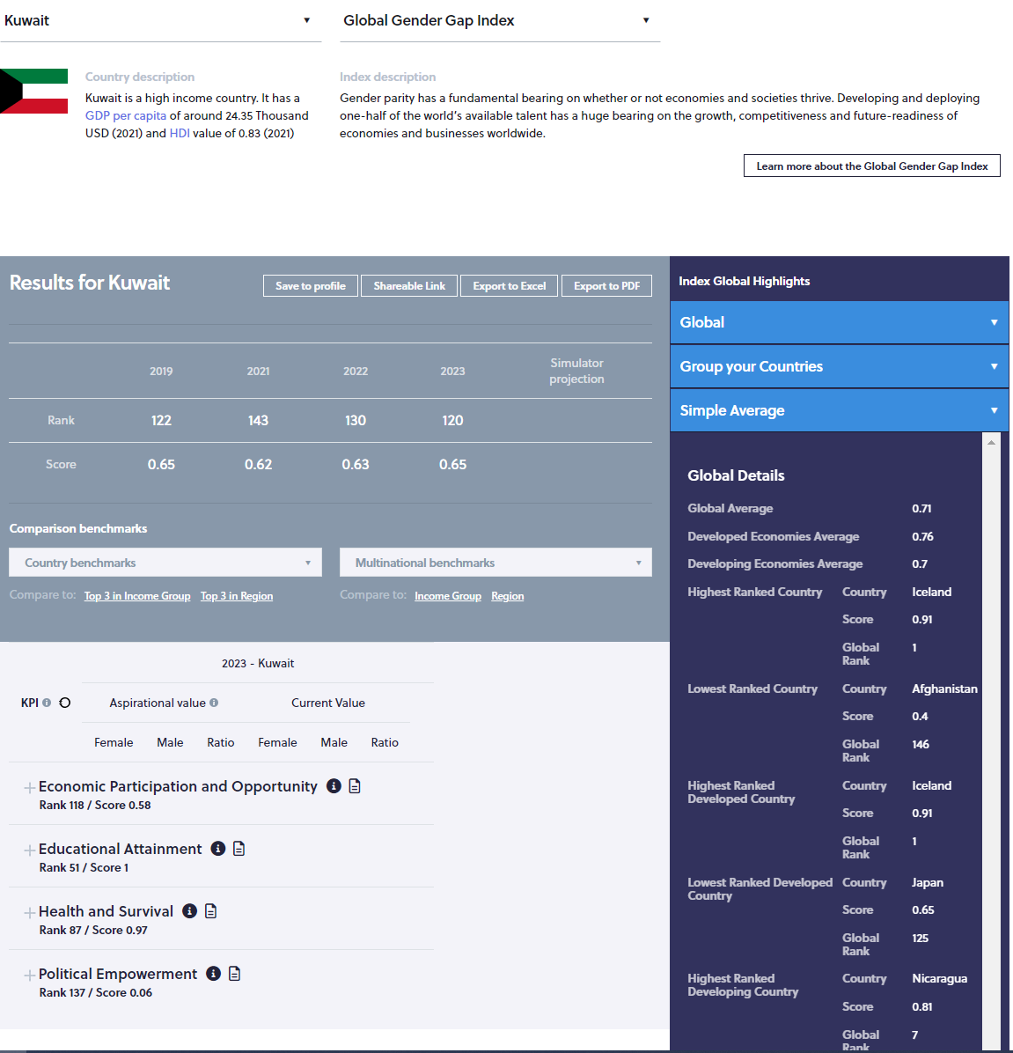
The Global Gender Gap Index
Short description of the index
Select a country
Link to the website of the index publisher
Select the index
See the country’s score and rank over time
The KPIs for ‘female’, ‘male’ and the ratio are displayed
Change the values of the KPIs for female…

Slide 44
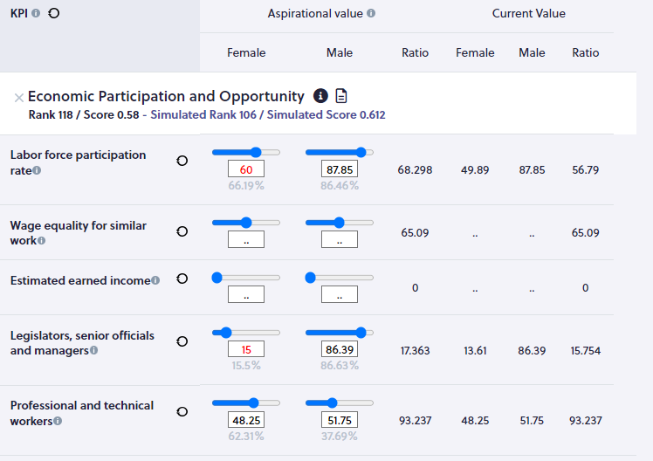
The Global Gender Gap Index
Open the tab:
Check the coverage of the dimension (I icon)
you can see now all the KPIs
Enter your aspirational values per KPIS
or by sliding the cursor
or entering numbers
The modified KPIS appear in RED
Here you can change only the value of the KPIs for the ‘female’ population

Slide 45
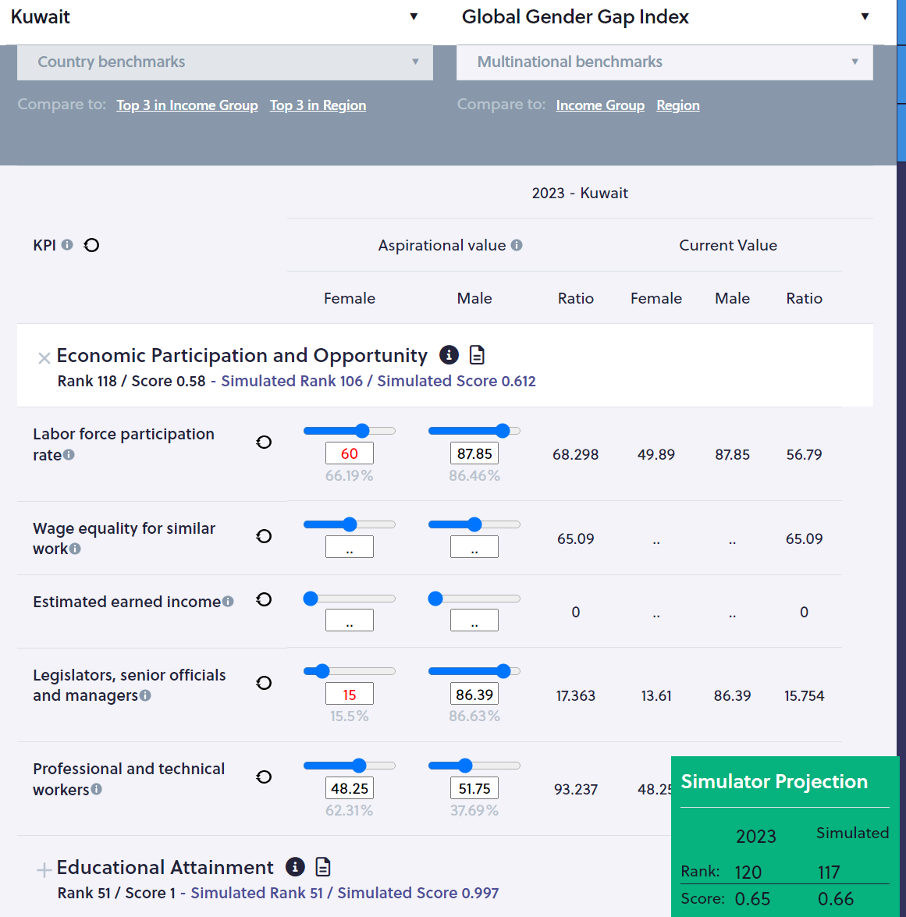
The Global Gender Gap Index
Open the tab:
Check the coverage of the dimension (I icon)
you can see now all the KPIs
Impact on score and rank will show here
Enter your aspirational values per KPIS
pillar score and rank
or by sliding the cursor
overall rank and score
or entering numbers
The modified KPIS appear in RED

Slide 46
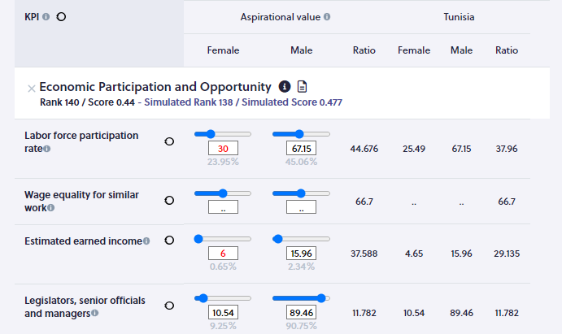
The Global Gender Gap Index
Be careful:
If, for some KPIs, values are not available for your country then entering aspirational values is not possible and/or will not be reflected in the recalculations of the rank and score
Open the tab:
you can see now all the KPIs
Enter your aspirational values per KPIS
or by sliding the cursor
or entering numbers
The modified KPIS appear in RED

Slide 47
The Global Gender Gap Index
Be careful:
If values are not disaggregated into male and female and only the ratio is available, you can still change the values for the male and female and enter aspirational values. The simulator recalculate the ratio and the new score and rank
Open the tab:
you can see now all the KPIs
Enter your aspirational values per KPIS
or by sliding the cursor
or entering numbers
The modified KPIS appear in RED

Slide 48
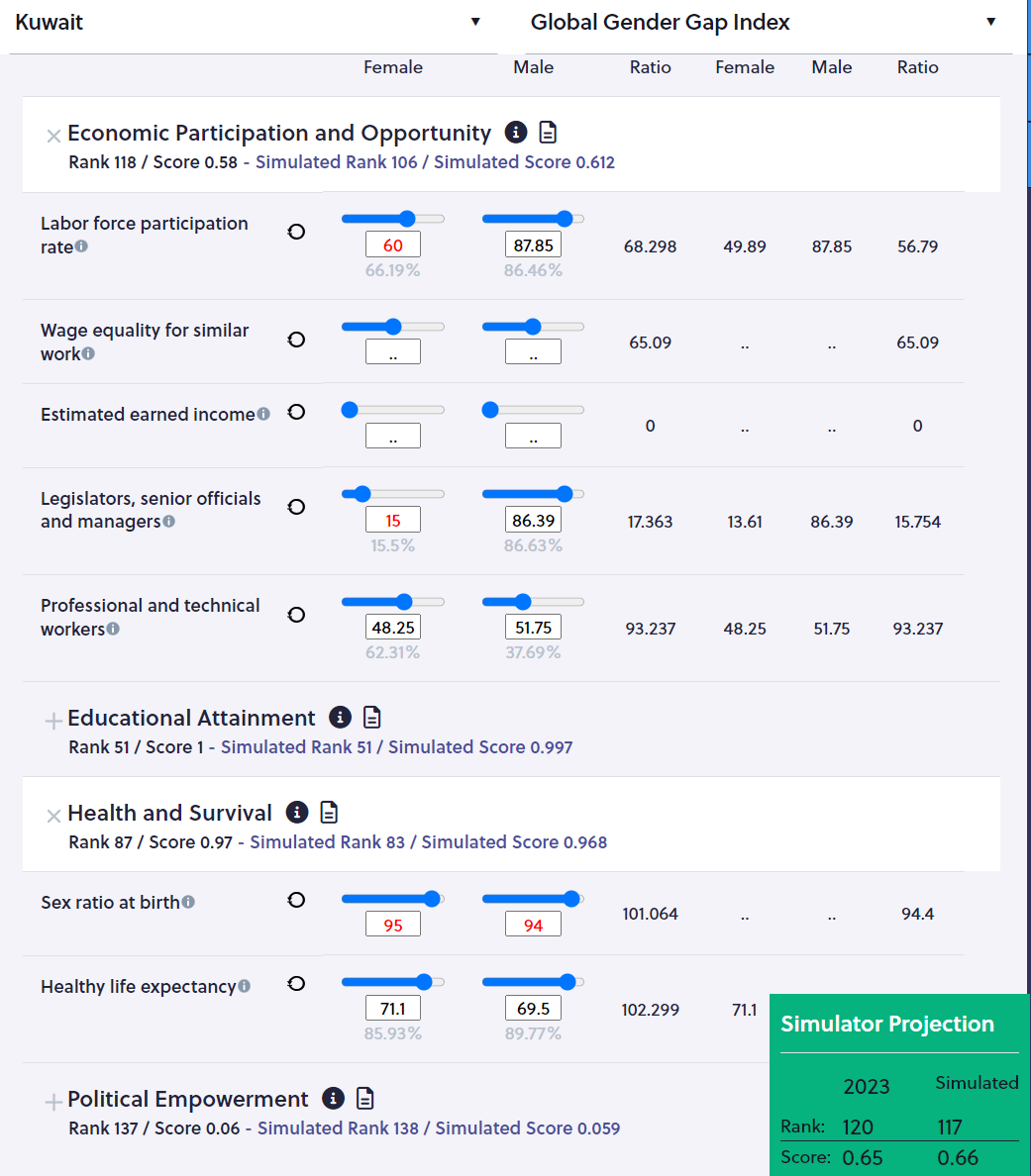
The Global Gender Gap Index
Open the tab:
you can see now all the KPIs
For those KPIs, no data is available, so it is impossible to enter aspirational values
Impact on score and rank will show here
For the sex ratio at birth, data for female and male are not available but the ratio is, hence data for male and female can be entered on the simulator

Slide 49
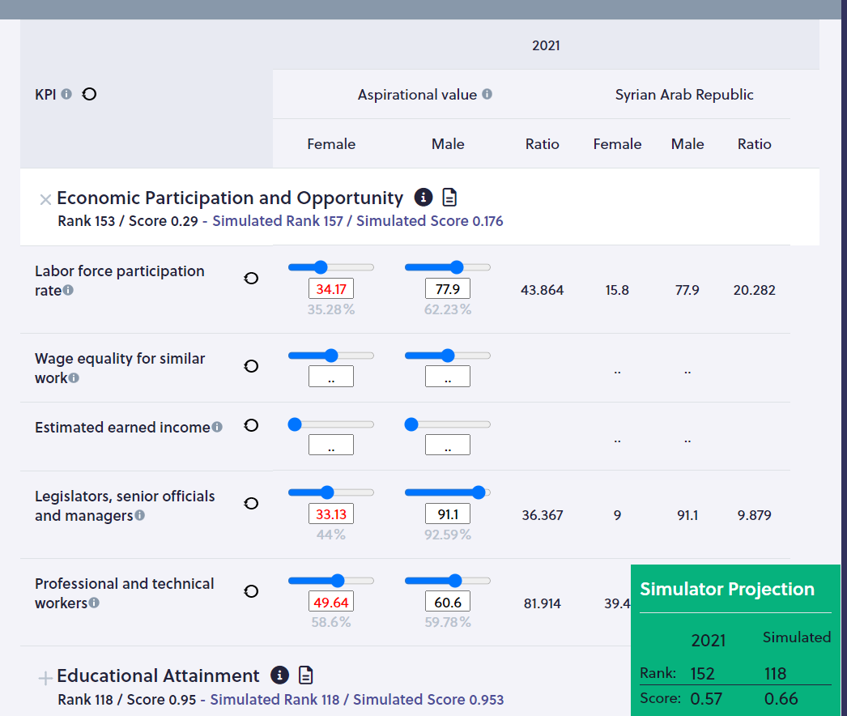
The Global Gender Gap Index
Be careful:
Using ratios can be misleading
Open the tab:
you can see now all the KPIs
Enter your aspirational values per KPIS
or by sliding the cursor
or entering numbers
The modified KPIS appear in RED

Slide 50
Develop your own strategy
Question 1: What is the impact of the quality, accuracy, availability of data on the ranking ?
Question 2: Which indicators/KPIs used to calculate the index are included in the NDP/Vision?
If the country meet the set expectations, what will be its ranking?
Question 3: Based on the strategy you are preparing, which progress can be achieved
in the sort run?
in the medium run?
In the long run?
The tool is ready

Slide 51
And what about policy recommendations?
As Kuwait performances are compared to more than 140 other countries, a policymaking tool should provide policy recommendations, lessons learnt, and other countries experience regarding the dos and don’ts. So, where to find them on GPS or ISPAR?

Slide 52
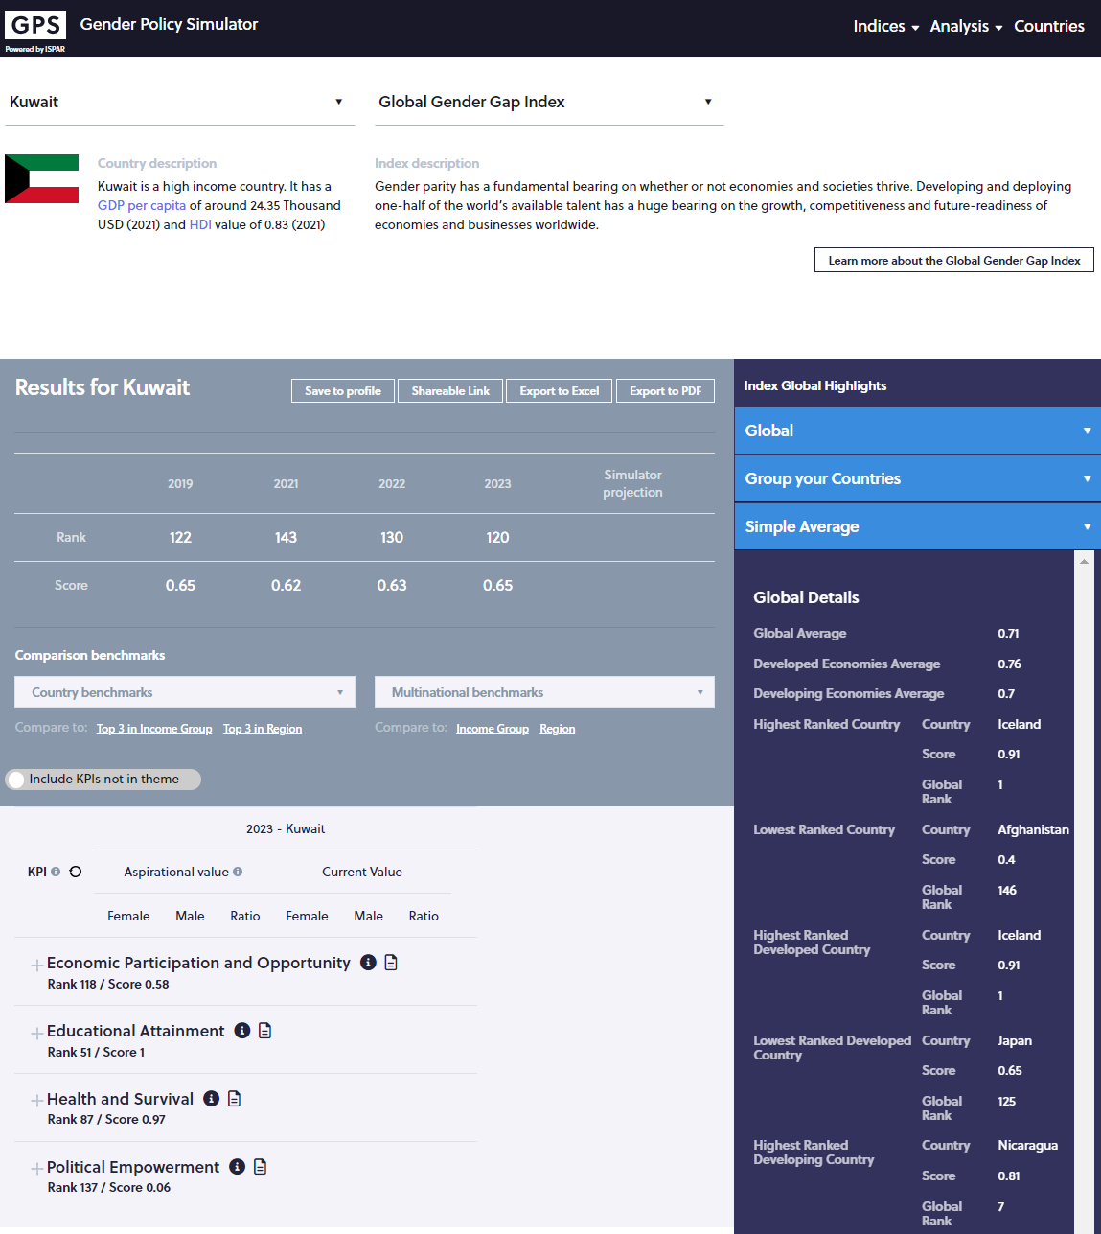
The Global Gender Gap Index
Policy recommendations can be found be clicking on the icon

Slide 53
The Global Gender Gap Index
Follow the icon
to get policy recommendations
Impact on score and rank will show here

Slide 54
Conclusion: an engendered index using ratios
May be misleading
Indicators in LEVEL need to be used to complement the ratio of indicators to get a good picture of performances
The tool is ready

Slide 55
Thank you for your time!
grand@un.org
The tool is ready

Slide 56
Workshop on the Use of the "Indices Simulation Tool for Policymakers in Kuwait”
Nathalie PICASSO-GRAND, Data Scientist, ESCWA

Slide 57
Session V: The Global Index on Women, Peace and Security
The tool is ready
This session will introduce the Global Index on Women, Peace and Security Index and allow participants to use the ISPAR tool to retrieve country results. Participants will then present their experience around the use of ISPAR to analyse their rankings and scores.

Slide 58
Women, Peace and Security Index:
The need to adopt a comprehensive approach
For this index, the methodology was developed so a comprehensive approach of the issue at hand must be developed for policy changes to have an impact on the ranking.

Slide 59
Simulations
Go to https://gender.unescwa.org
Click on ‘Gender Indices’
The tool is ready

Slide 60
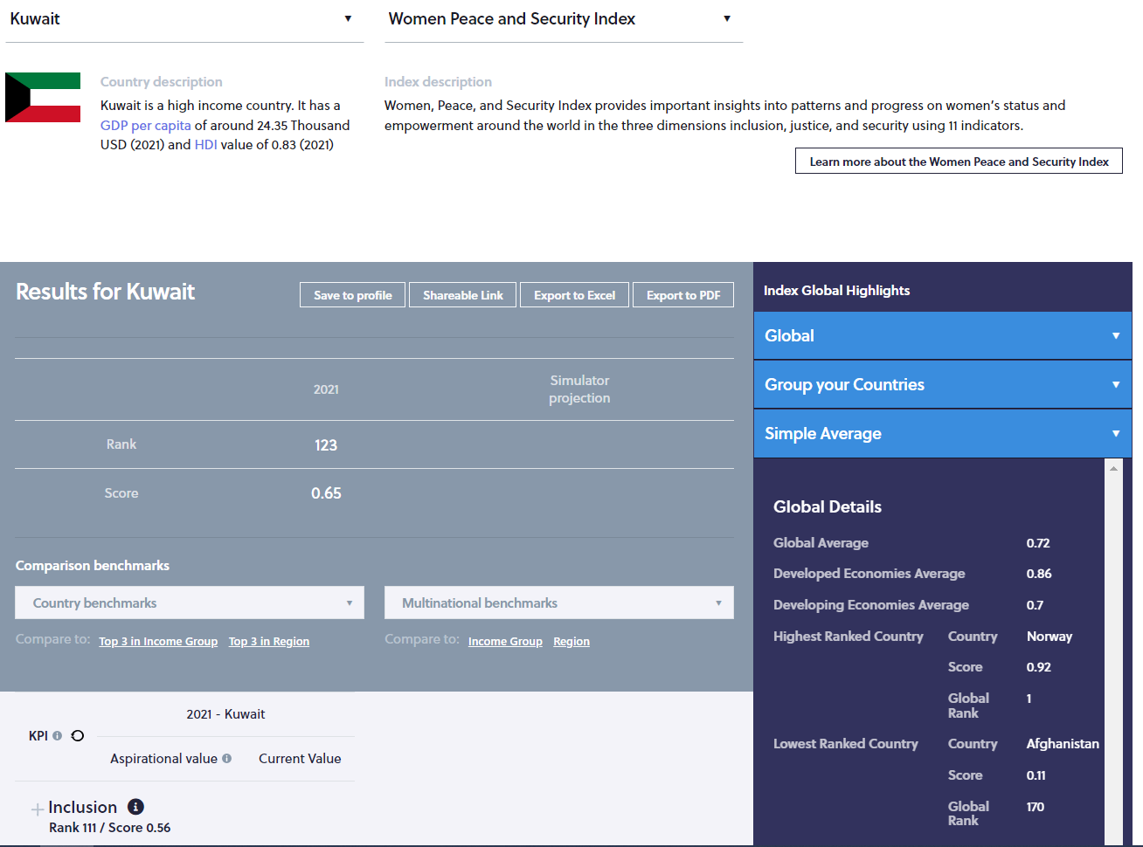
Women, Peace, and Security Index
Brief description of the country for benchmarking
Brief description of the selected index
Link to the webpage of the selected index
Year of the last ranking available
Rank and score
Dimensions with rank and score per dimension
Scroll down…

Slide 61
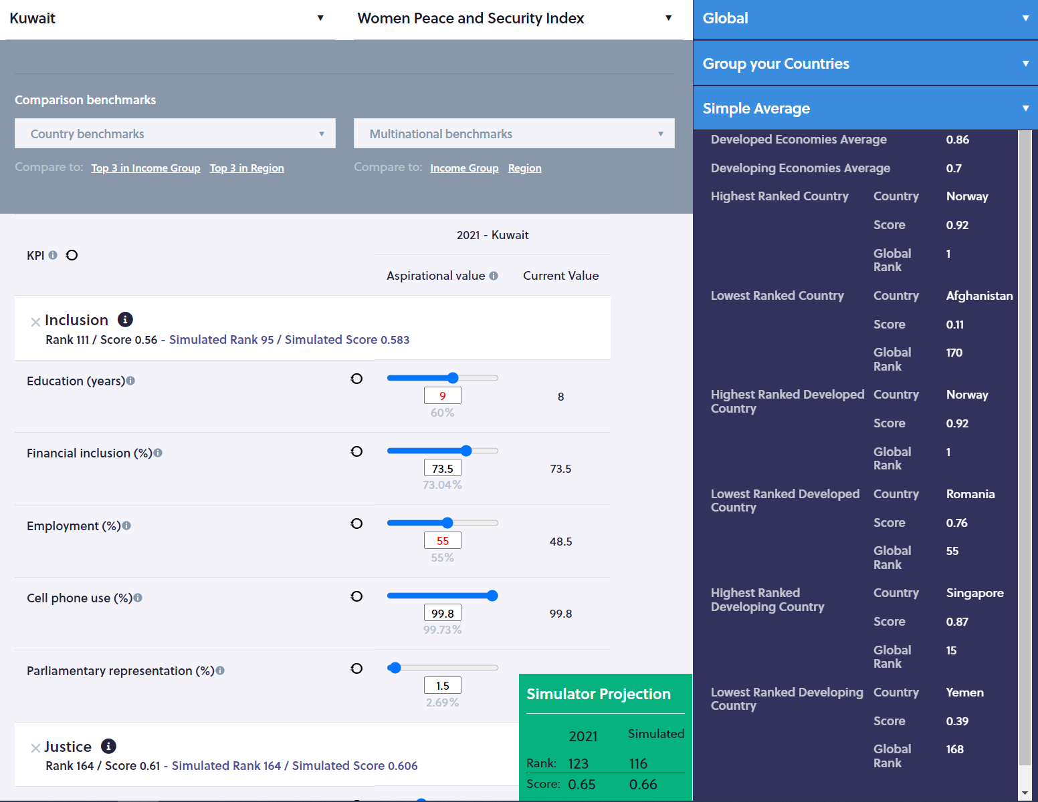
Women, Peace, and Security Index
Index’s name
Country’s name
Click on the dimension’s name to see the KPIs
Box in which the impact of the rank and score will be shown. For now, the year of the last ranking, the rank and score are provided for reference
Select benchmarks
Actual values of the KPIs
Aspirational values of the KPIs in Red
Exploring the interlinkages among KPIs…

Slide 62
The need to have a comprehensive approach
Improving on one indicator may have a quite small if any impact on the ranking while others have large impact on the ranking
Actions must be taken at various level to see a meaningful improvement on the ranking
Stresses the need for cooperation across Ministries
The tool is ready

Slide 63
Thank you for your time!
grand@un.org
The tool is ready

Slide 64
Workshop on the Use of the "Indices Simulation Tool for Policymakers in Kuwait”
Nathalie PICASSO-GRAND, Data Scientist, ESCWA

Slide 65
Session VI: The World Bank’s Women, Business and the Law Index
The tool is ready
This session will introduce the World Bank’s Women, Business and the Law Index and allow participants to use the ISPAR tool to retrieve country results. Participants will then present their experience around the use of ISPAR to analyse their rankings and scores.

Slide 66
Women Business and the Law Index: The specificities of a ‘discrete’ index
The tool is ready
This index uses bullion indicators which take the value 0 or 1. It captures the content of the law and its intent through surveys.
It is important to identify the low-hanging fruits.

Slide 67
Simulations
Go to https://gender.unescwa.org
Click on ‘Gender Indices’
The tool is ready

Slide 68
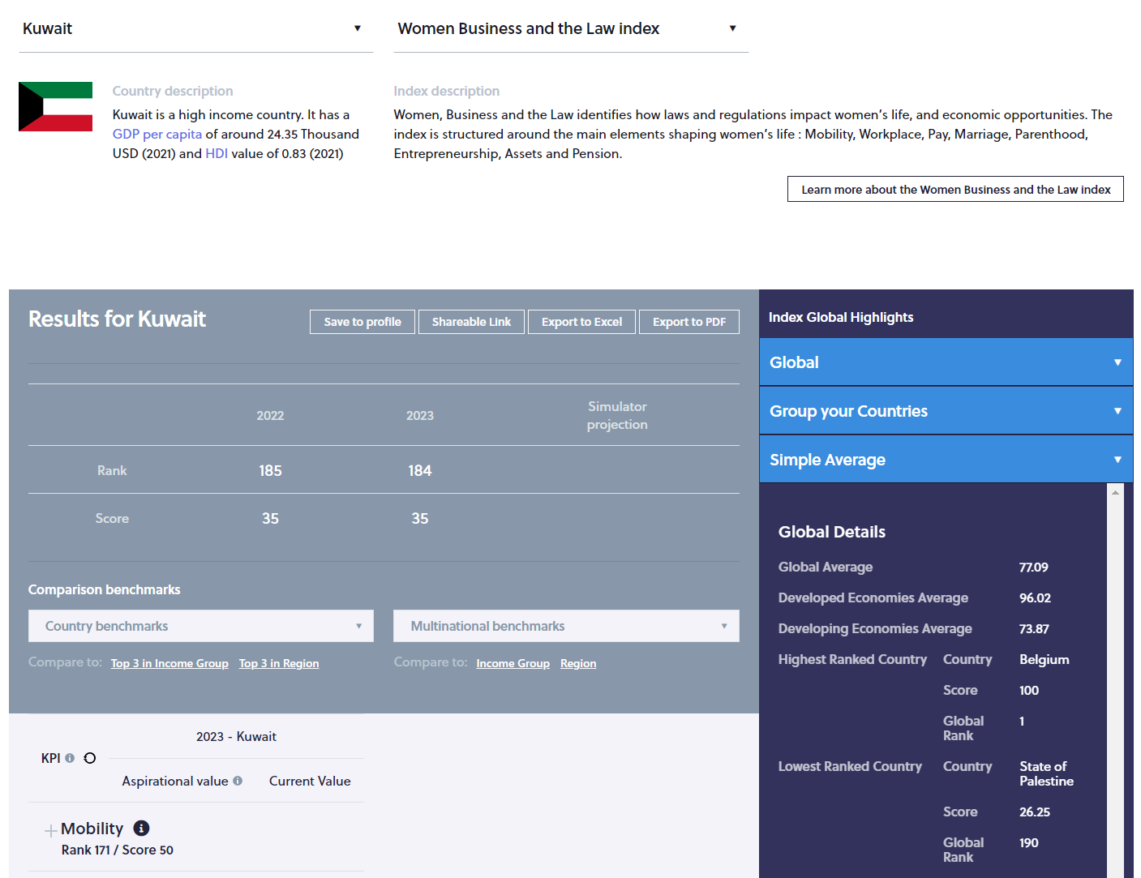
Women, Business and the Law
Brief description of the country for benchmarking
Brief description of the selected index
Link to the webpage of the selected index
Year of the last ranking available
Rank and score
Regularly updated
Dimensions with rank and score per dimension
Scroll down…

Slide 69
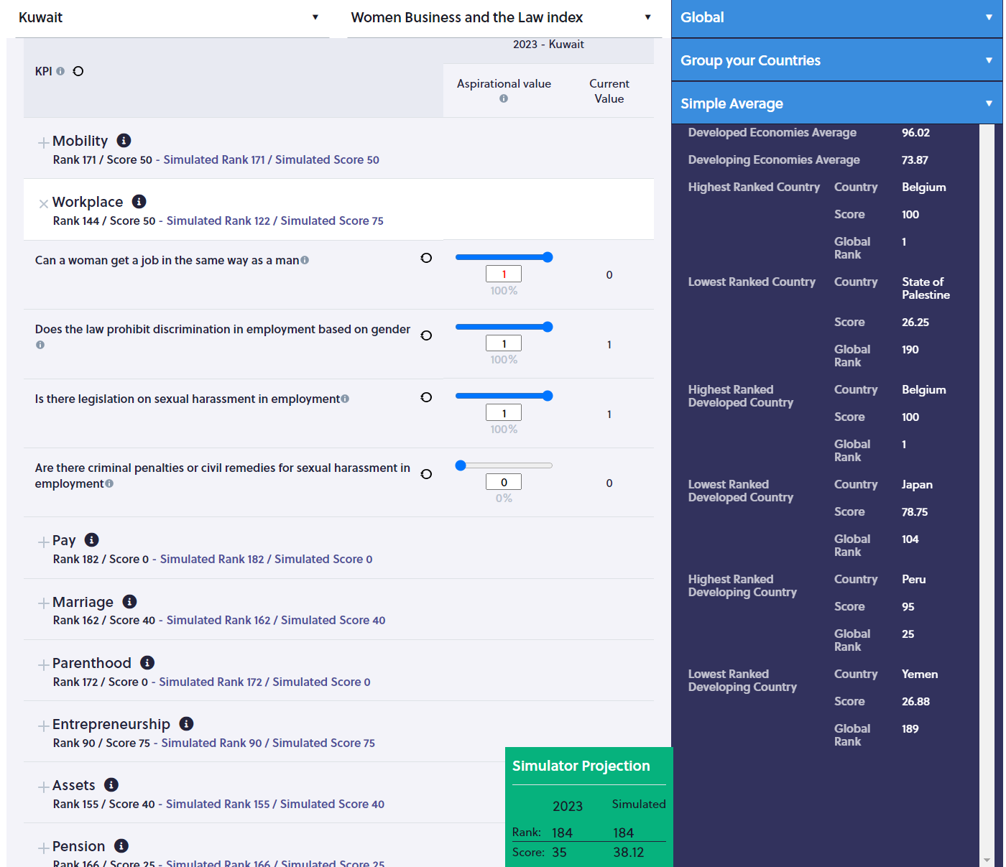
Women, Business and the Law
Index’s name
Country’s name
Click on the dimension’s name to see the KPIs
Box in which the impact of the rank and score will be shown. For now, the year of the last ranking, the rank and score are provided for reference
Actual values of the KPIs

Slide 70
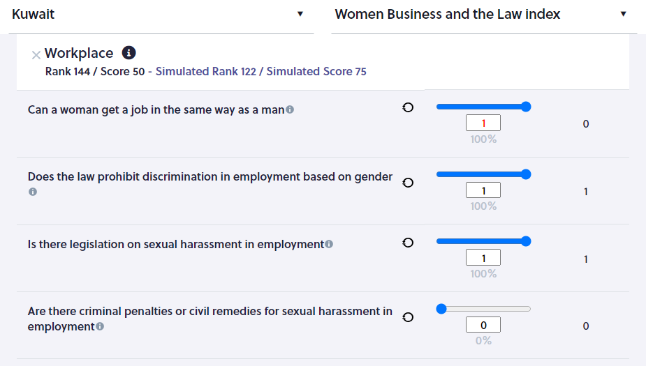
Women, Business and the Law
Due to the methodology used to calculate this index, improving on one KPIs increase the dimension score and rank by 20 to 25% depending on the number of KPIS per dimension
But here, the obstacles are laws which requires efforts and time to change

Slide 71
Women Business and the Law Index: The specificities of a ‘discrete’ index
The tool is ready
To improve on this kind of ranking, developing short, medium, and long-term strategies is crucial as it takes time to improve due to the very nature of the obstacles that can be administrative, legislative, cultural and religious.

Slide 72
The advantage of ISPAR is that the tool allows to identify the NATURE of the obstacles and set a timeline for rankings improvement
The tool is ready
Having multiple Composite Indices on the platform allows developing a short-, medium-, and long-term strategy across all the Indices.

Slide 73
Session VII: Technical issues related to ISPAR
This session introduces technical issues and possible adaptations related to the customization and localization of the Indicator Simulation Tool to the country’s national context.
The tool is ready

Slide 74
Thank you for your time!
grand@un.org
The tool is ready

Slide 75
Workshop on the Use of the "Indices Simulation Tool for Policymakers in Kuwait”
Nathalie PICASSO-GRAND, Data Scientist, ESCWA

Slide 76
Let’s summarize what we have seen
How to generate a profile and compare our performances to other countries’
How to carry simulations and how the methodology used calls for a certain type of strategy
And how to use the platform to develop a short, medium and long-term strategy depending on the nature of the obstacles

Slide 77
First, let’s explore a set of links
for quick report’s generation
The tool is ready

Slide 78
As part of the background you may prepare for your note/report/brief or any other document,
You can use tools to
Visualize performances

Slide 79
Simulations
Go to https://gender.unescwa.org
Click on ‘Gender Analysis’
The tool is ready

Slide 80
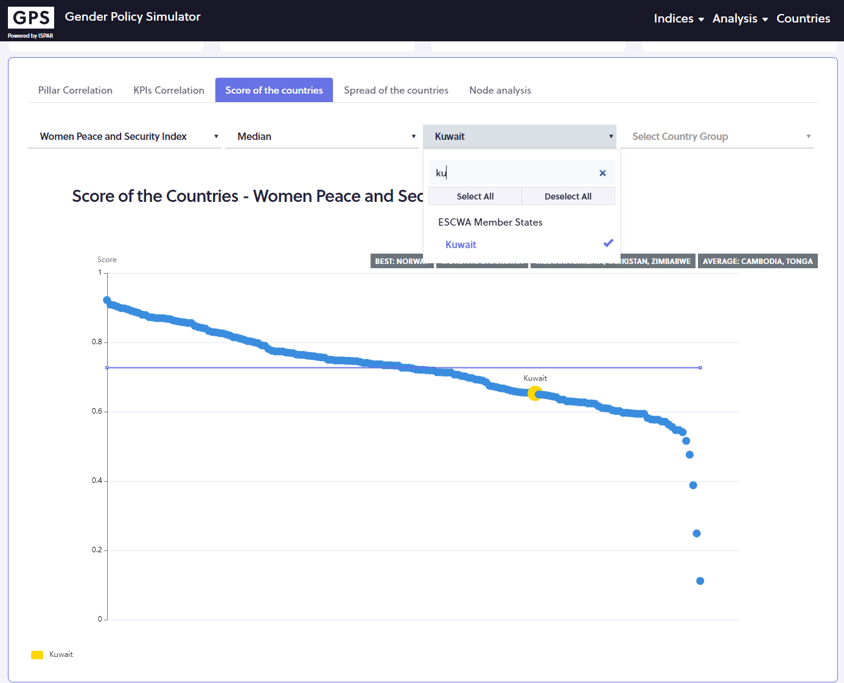
Quick visualization of performances
Click on ‘Score of the countries’
The tool is ready
Select
The index of interest
A country
A benchmark group
The dot is the selected country’s performance
Scroll over the dots and a line will appear, making it easier to read
The line indicate the performance for which half countries perform better, and half perform less well

Slide 81
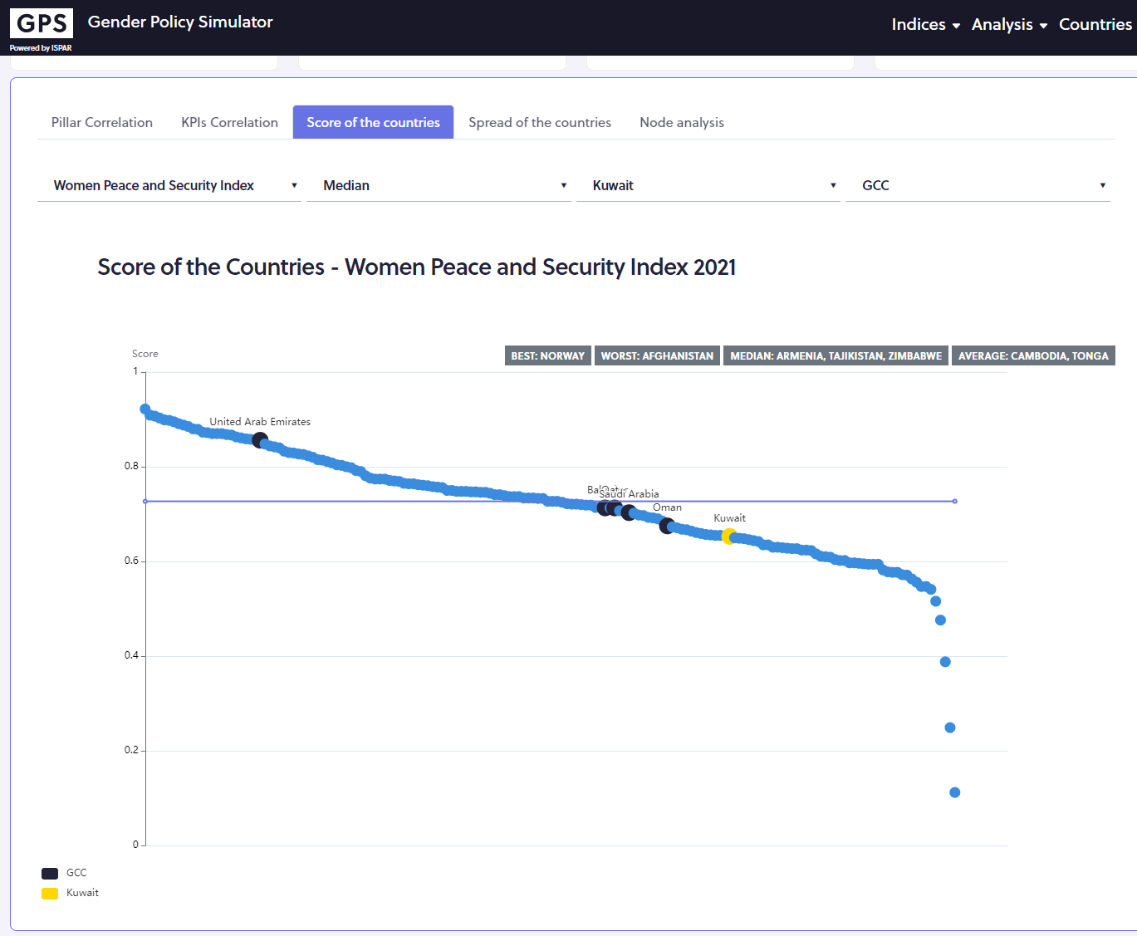
Quick visualization of performances
The tool is ready
The yellow dot is the selected country’s performance
The black dots are the benchmarks performances
Scroll over the dots to get more information about the benchmark’s performances

Slide 82
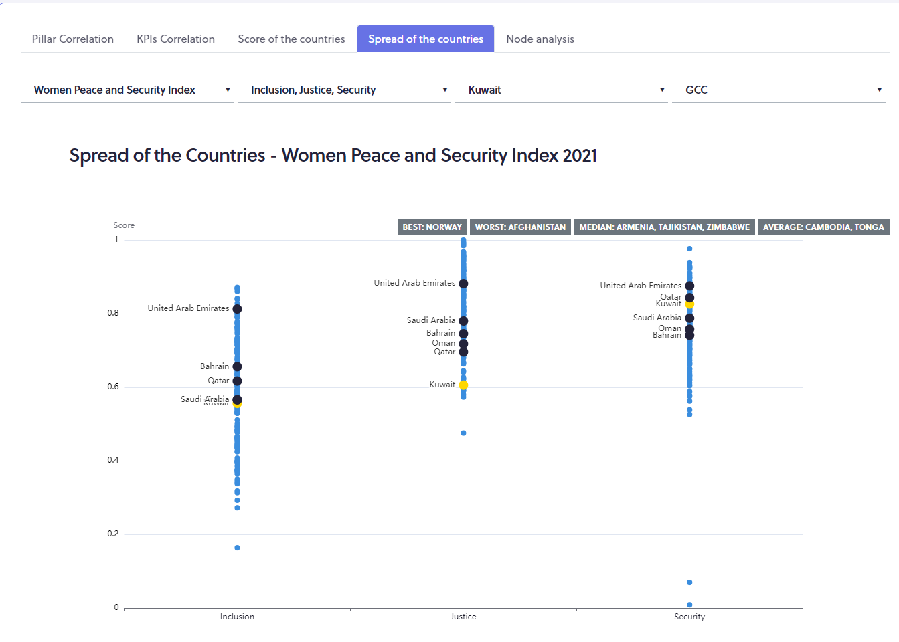
Quick visualization of performances
Now click on ‘Spread of the countries’
The tool is ready
Select
The yellow dot is the selected country’s performance
The black dots are the selected country’s performance
Scroll over the yellow dots and a line will appear, making it easier to read, scroll over the dots to get more information on the benchmarks’ performances
The index of interest
A country
A benchmark group
The dimensions of the index appear on the x axis

Slide 83
Session IX: Introduction on how to use correlations/projections feature on ISPAR
The tool is ready
This session will focus on participants’ use of the correlation feature on ISPAR to learn about their ranks and scores in comparison to other countries. This way, they can determine which countries they would like to use for benchmarking purposes to help them look at their policies for comparisons.

Slide 84
What else the platform can help with?
As a same KPIs appear in more than one index, there is a need to understand interlinkages to get a full picture of the impact of gender policies on rankings
The Thematic simulators
only redundancy of KPIs plays a role in the country’s performance improvement across indices

Slide 85
Simulations
Go to https://gender.unescwa.org
Click on ‘Gender-related Indices’
The tool is ready

Slide 86
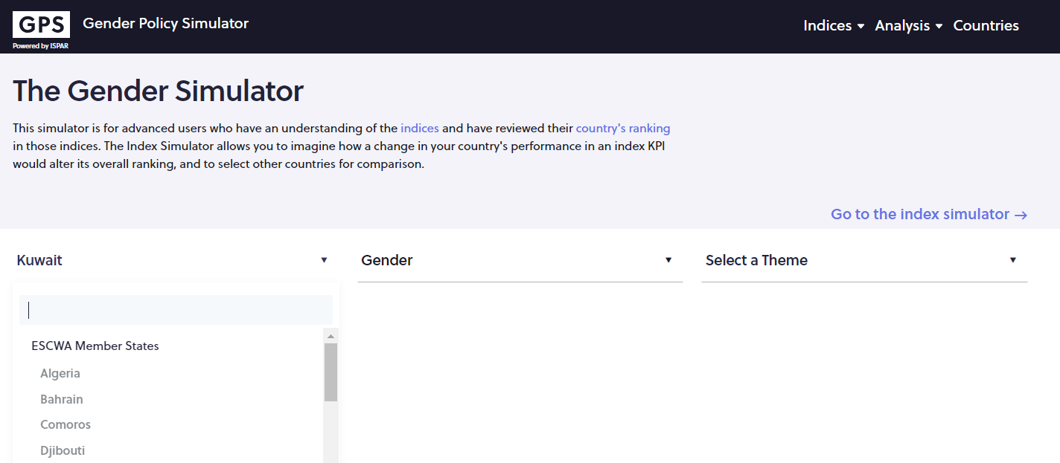
The tool is ready
Selected your country
Selected a sub-theme
The theme is preselected (gender)

Slide 87
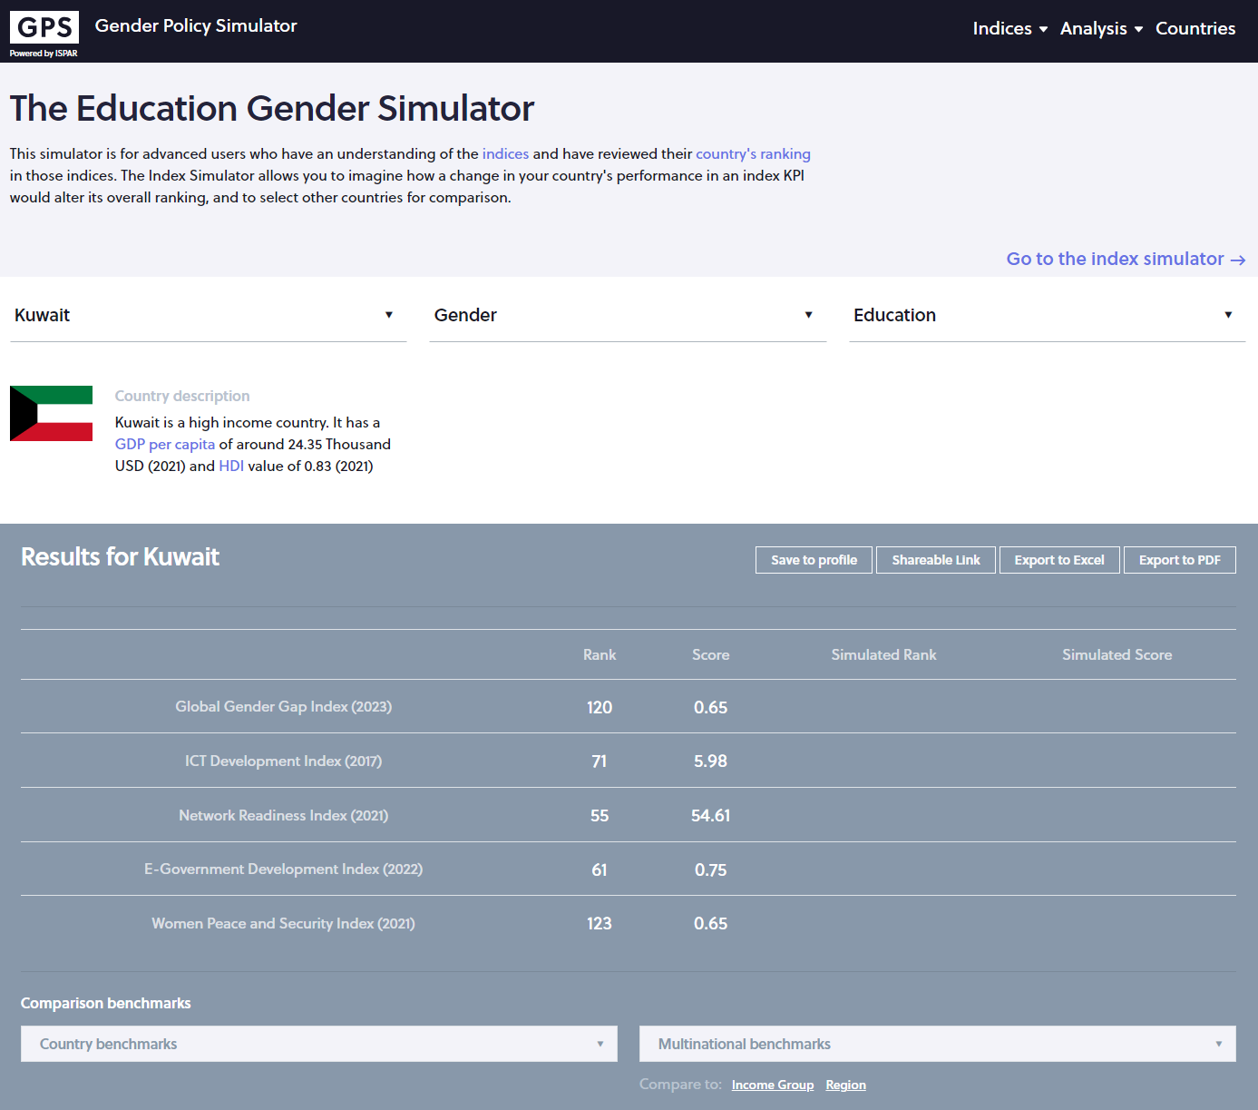
Thematic Simulators
Chose a sub-theme (education)
View indices that use education engendered or not KPIs

Slide 88
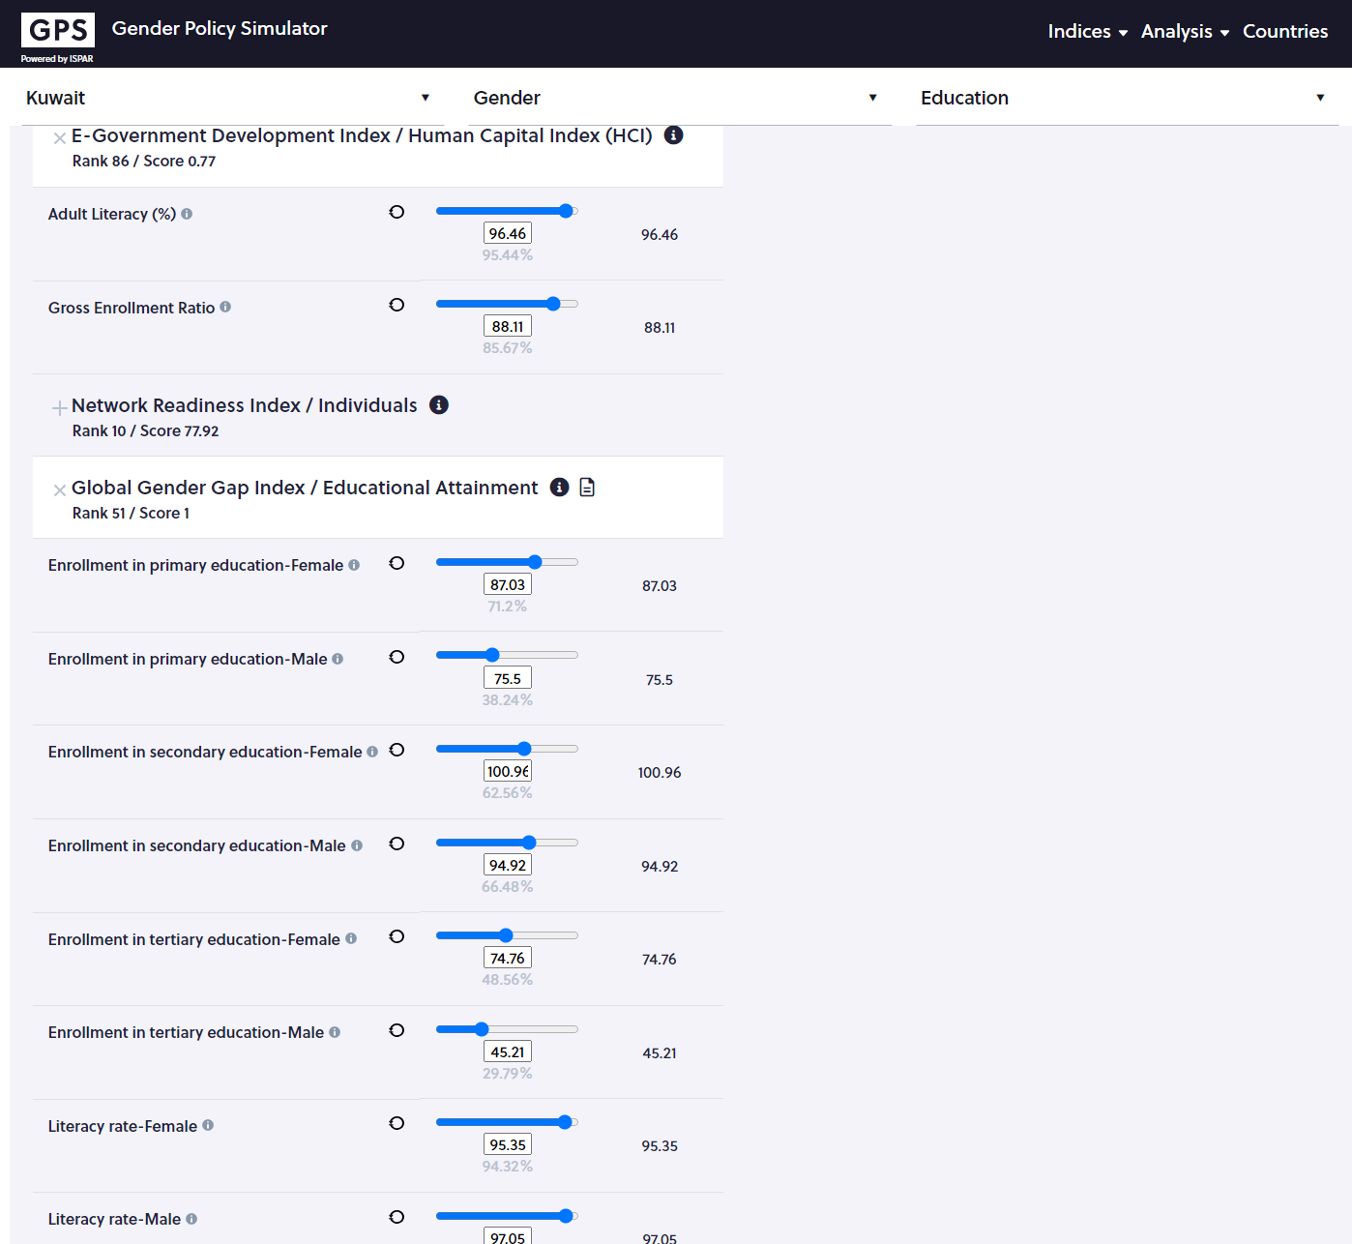
Thematic Simulators
Two indices use literacy rate.
One engendered, the other not
If the info is available the simulator takes into account the impact across all similar KPIS, hence across indices

Slide 89
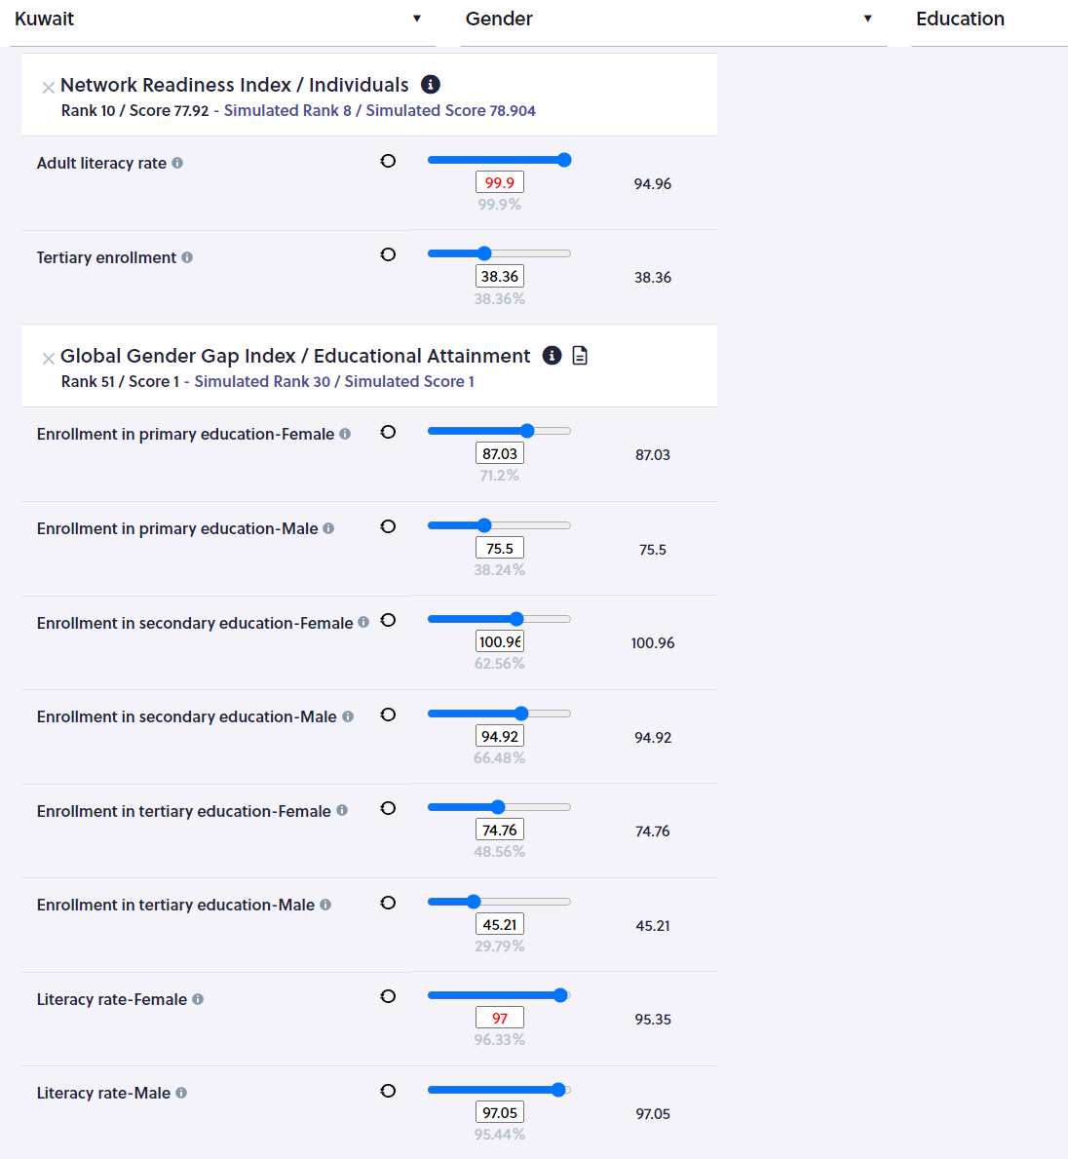
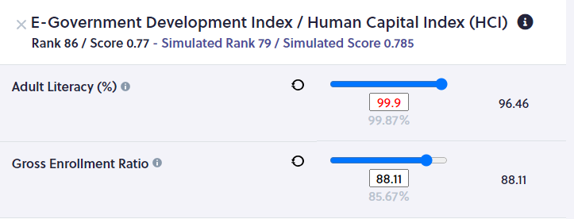
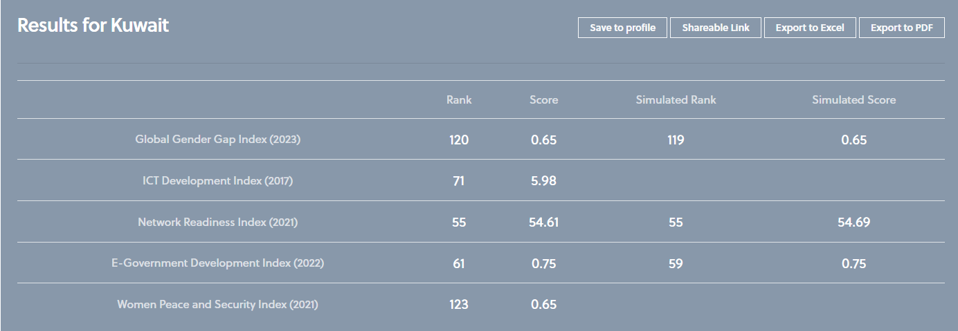
Thematic Simulators
Input 97 as the aspirational value for ‘Female Literacy rate’ on the Gender gap index
The impact of the policy across indices is
Changes will be made here and here

Slide 90
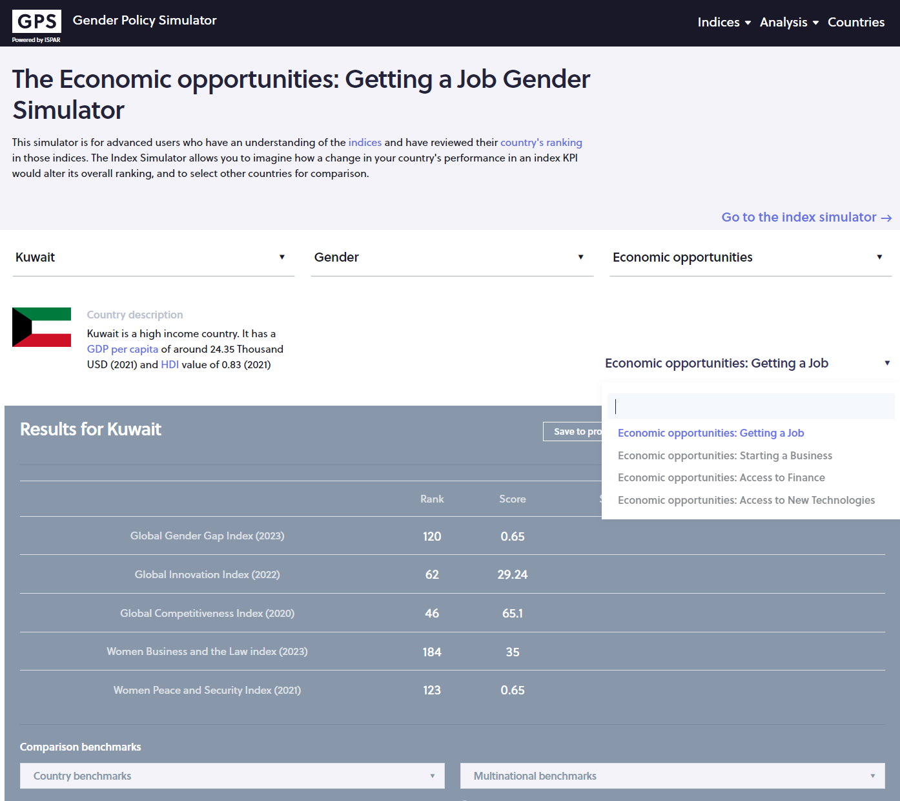
Thematic Simulators
Chose a sub-theme (education)
Select a theme (gender)
In order to develop a comprehensive strategy related to women economic opportunities several elements must be covered and are listed under the sub-theme
All indices using KPIs related to getting a job

Slide 91
What did we learn in this session so far?
As a same KPIs appear in more than one index, there is a need to understand interlinkages to get a full picture of the impact of gender policies on rankings
On the thematic simulators, only redundancy of KPIs plays a role in the country’s performance improvement across indices
BUT do not forget to take a look at the correlations and the performance improvement due to the indirect impact of policy changes across indices
Go to https://gender.unescwa.org
Then click on ‘Gender analysis’

Slide 92
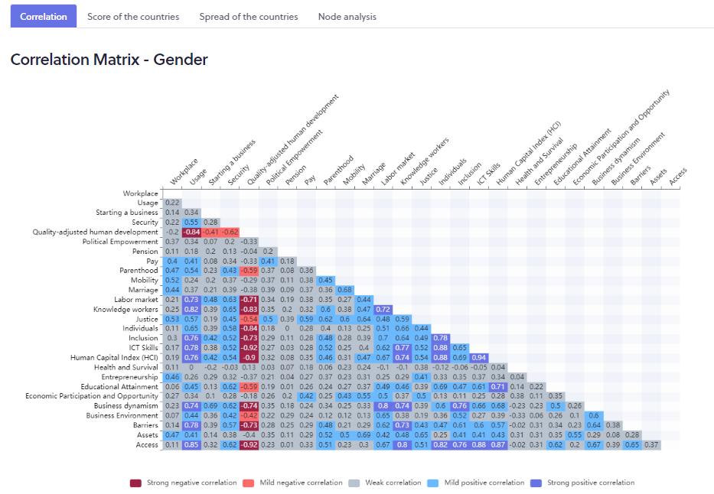
Understand and evaluate spillover effects
Select ‘Correlations’
Correlations measure how closely indices move together, hence the spillover effects
Correlations of all indices against each other

Slide 93
Understand and evaluate spillover effects
Select ‘Correlations’
Hover over the correlation matrix to get a definition of the dimension
Correlations measure how closely indices move together, hence the spillover effects
Correlations of all indices against each other

Slide 94
For a more comprehensive view of linkages across a larger set of indices go to the main tool
Go to https://ispar.unescwa.org/

Slide 95
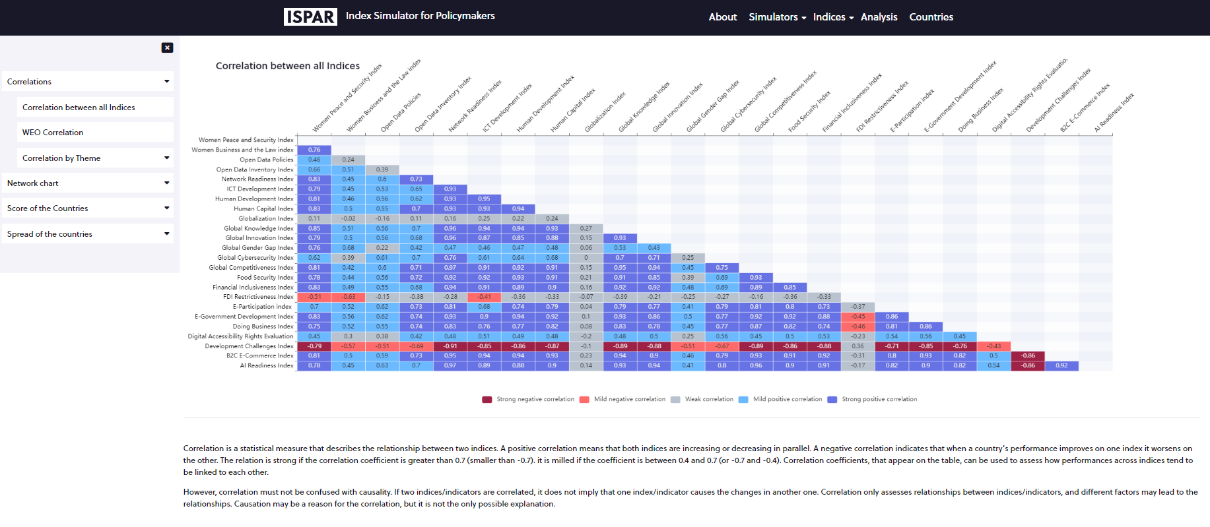
Understand and evaluate spillover effects
Under the tab ‘Analyses’
Correlations measure how closely indices move together, hence the spillover effects
Under ‘Correlations’ select ‘Correlations between all indices’
Correlations of all indices against each other

Slide 96
Select the gender index you like
Question 1: How strongly correlated is the Gender Index (dimension level) you selected to other Gender indices?
Through which channel upon you?
Question 2: How will an improvement on the index you selected affect the capacity of the country to innovate?
To become more competitive?
Question 3: Is there any negative correlation of the index you selected with another index?
Why, upon you?
How to best use this negative correlation?
The tool is ready

Slide 97
Select the gender index you like
Question 1: How strongly correlated is the Gender Index you selected to important macroeconomic indicators?
Through which channel upon you?
Question 2: Is there any negative correlation of the index you selected with another index?
Is it a good or a bad thing?
The tool is ready

Slide 98
Correlations analysis: Help identify
The potential for cooperation across Ministries
The tool is ready
How each can contribute to the achievements of another Ministry’s goals
Example: if a country improving on its ranking on the Women Business and the Law Index will positively affect its performances on a series of other indices (first column of the ‘all indices’ matrix) from innovation to competitiveness and so forth.

Slide 99
Let’s summarize what we have seen
How to generate a profile and compare our performances to other countries’
How to carry simulations and how the methodology used calls for a certain type of strategy
And how to use the platform to develop a short, medium and long-term strategy depending on the nature of the obstacles
How Composite Indices are linked together, hence the need to use Indices beyond the ones focusing on gender to evaluate potential for cooperation and trickledown effects

Slide 100
What else the platform can help with?
As a same KPIs appear in more than one index, there is a need to understand interlinkages to get a full picture of the impact of gender policies on rankings
How to learn from other countries experience?
How to evaluate the impact of an improvement on a ranking on end developmental goals?

Slide 101
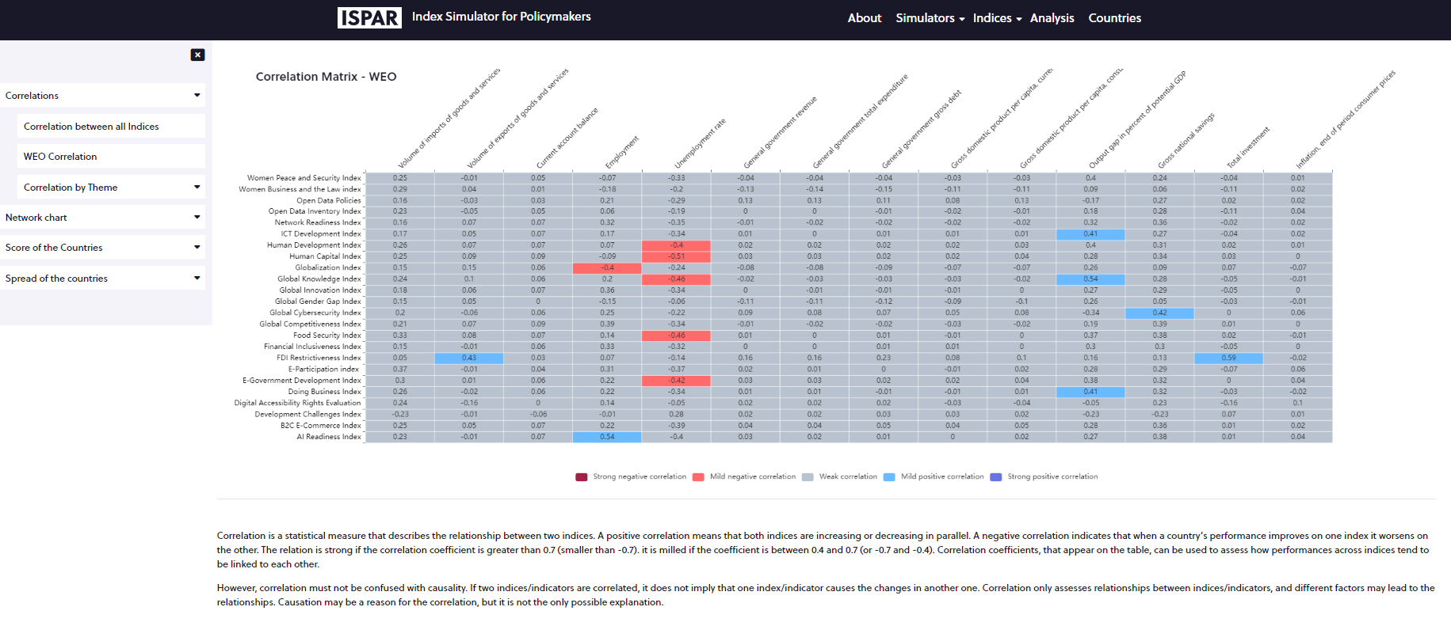
Understand and evaluate spillover effects
Under the tab ‘Analyses’
Correlations measure how closely indices move together, hence the spillover effects
Under ‘Correlations’ select ‘WEO Correlations’
Correlations of indices and macroeconomic outcomes

Slide 102
Build your own scenario
The tool is ready

Slide 103
Thanks for your time
Nathalie GRAND grand@un.org
request.unescwa.org
Nadya Khalife
Nadya.khalife@unescwa.org

Slide 104
Thank you for your time!

