Slide 1
ESCWA Estimations

Slide 2
Population
Table 1.1: Population estimates by year, age groups, nationals/non-nationals, urban/rural, sex and country
  Age based estimations were done through population size distribution per UN Population Prospects (UN PPs)
  National/Non-national estimations were made if national/non-national population size were reported by the country for the corresponding year.
  Urban/rural was not estimated
  Gender distribution was made through the UN PPs’ gender segregated projections.
  Special Note: No estimates were done for Saudi Arabia nor were there data imported. At least in my version, I am unaware of what Ipek ended up doing. This is because the estimations were far from what Saudi reported in their NSO data. However, I could not use there NSO data because of multiple reported contradictory numbers for the same year. Consider the year 2001 there were three different reported numbers (one in their data portal, one in their archived publication, and one in their visualization data portal). As this was going to be a primary starting point for estimations I chose to leave it. Hopefully Saudi can clarify which number they endorse during the TAG meeting.

Slide 3
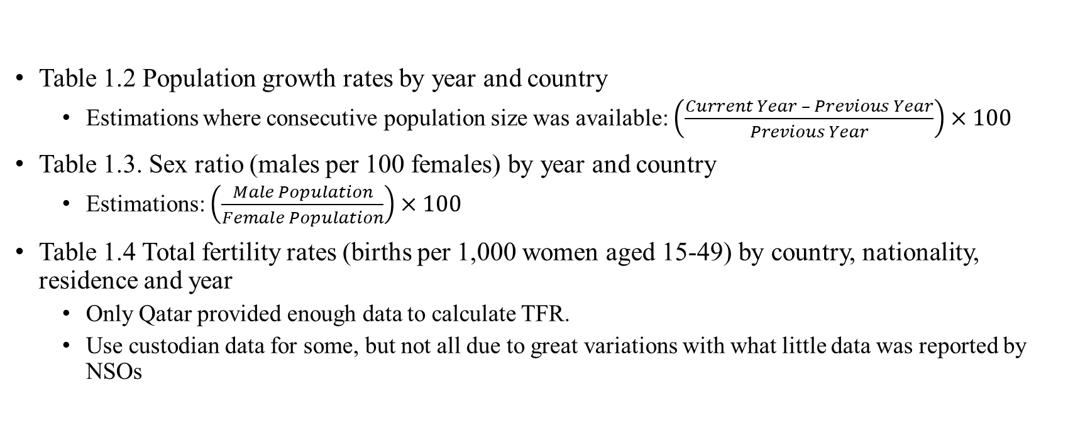
Population (Cont’d)
Table 1.2 Population growth rates by year and country
  Estimations where consecutive population size was available: $\left(\frac{Current Year – Previous Year}{Previous Year}\right)×100$
Table 1.3. Sex ratio (males per 100 females) by year and country
  Estimations: $\left(\frac{Male Population}{Female Population}\right)×100$
Table 1.4 Total fertility rates (births per 1,000 women aged 15-49) by country, nationality, residence and year
  Only Qatar provided enough data to calculate TFR.
  Use custodian data for some, but not all due to great variations with what little data was reported by NSOs

Slide 4
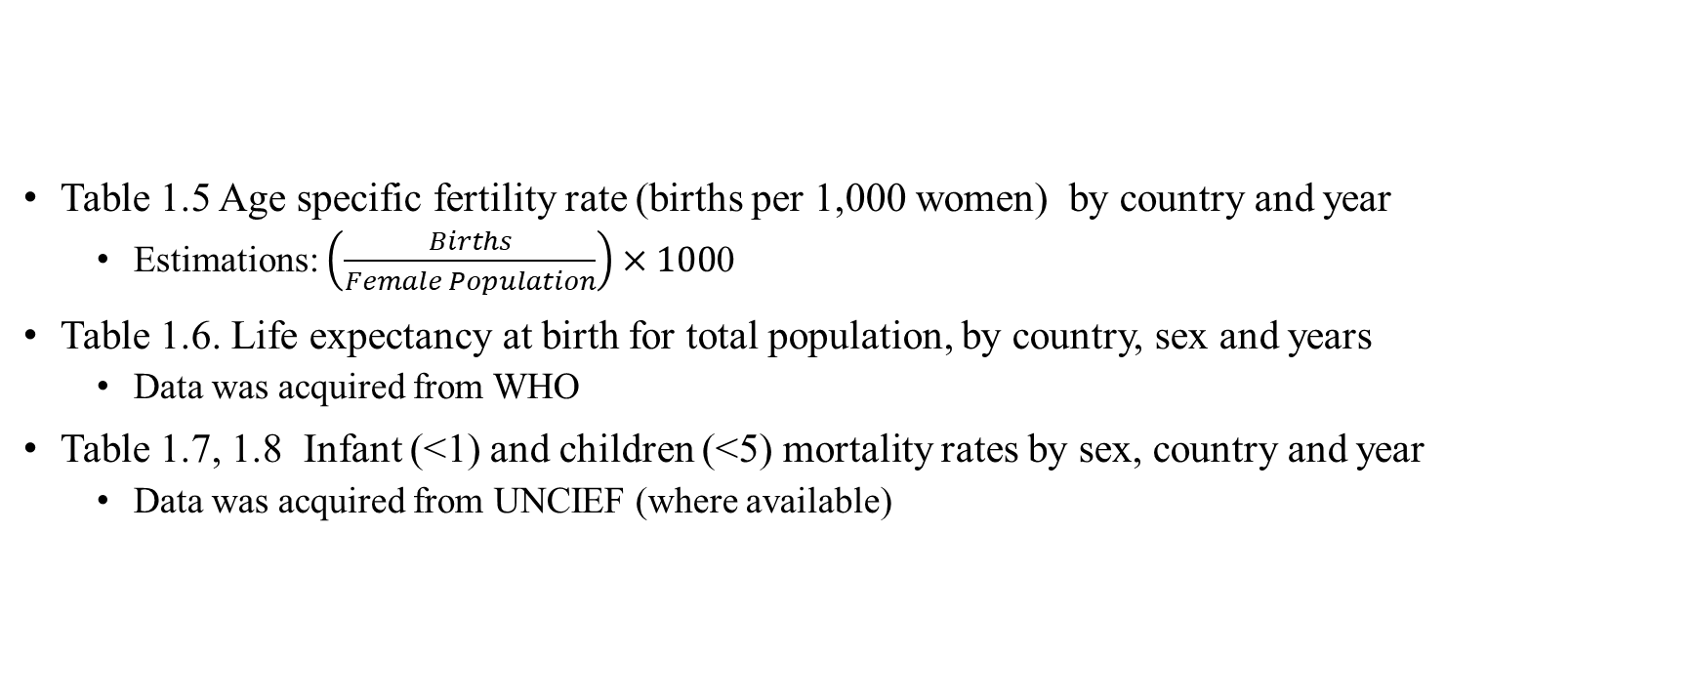
Population (Cont’d)
Table 1.5 Age specific fertility rate (births per 1,000 women) by country and year
  Estimations: $\left(\frac{Births}{Female Population}\right)×100$0
Table 1.6. Life expectancy at birth for total population, by country, sex and years
  Data was acquired from WHO
Table 1.7, 1.8 Infant (<1) and children (<5) mortality rates by sex, country and year
  Data was acquired from UNCIEF (where available)

Slide 5
Health
Table 2.1 Maternal mortality ratio (maternal deaths per 100,000 livebirths) by country and year
  Calculated for nations that provided
Table 2.2 Percentage of births attended by skilled health personnel by country, residence and year
  I only calculated births in Saudi Arabia using data from a separate table that listed births by location, including hospitals and an "others" category. I assumed births in hospitals had skilled attendants, while those in the "others" category did not. I compared my calculated numbers to reported numbers for years with available data and found a close match, so I used the same method for other years.
Table 2.5 Percentage of contraception use (any method vs. modern method) by country and available years during the 2000s
  I performed similar calculations for Egypt, UAE, and Qatar using data available in past NSO reports.

Slide 6
Health (Cont’d)
Table 2.6 Percentage of Diphtheria, Pertussis and Tetanus (DPT), measles, BCG, polio and hepatitis percentage immunization status for children aged 12-23 months, by country, sex and year
  No estimates. Used some WHO data were available.
Table 2.20 Percentage distribution and number of disabilities by type, country and year
  Not estimates, WHO provided some of this data; however, reports of same years varied greatly from NSO data, so it was disregarded.
Table 2.24,25.26 Density of Personnel by country, and year
  Calculated. Number of population per one personnel and health personnel per 100,000 population.
Table 2.27,28 Density of Assets by country, and year
  Calculated. Example: Number of beds available, so it’s used to calculate the average number of population per bed.

Slide 7
Vitals
Table 1.14,15 Population Registered marriages and divorces by year nationals/non-nationals, urban/rural and country
  Mainly from NSO; no estimates were attempted here
Table 1.14, Registered marriages, (2000-2016)
  Mainly from NSO; no estimates were attempted here
Table 1.15, Registered divorces by country (2000-2016)
  Mainly from NSO; no estimates were attempted here
Table 1.19 Number of registered livebirths by sex of the child, nationals/non-nationals, urban/rural country and year
  NSO Data or UNICEF Data

Slide 8
Vitals (Cont’d)
Table 1.23 Number of registered deaths by age, sex, nationals/non-nationals country and year
  NSO Data
Table 1.27 Life expectancy at birth for total population, by country, sex and years
  UNICEF Data
Table 1.28 Selected causes of death (percent) by country and year
  Before 2009, countries reported ICD-9 categories. To convert them to the current standard, I matched and re-categorized the ICD-9 codes.

