Slide 1
Model Life Tables
Uses of Model life Tables
Coale and Demeny Model life tables
UN model life tables
Recent Developments
Using MORTPAK to identify model life tables

Slide 2
Use of model life tables
Model life tables useful for:
  estimating mortality when incomplete/faulty data
  modeling demographic processes
  projections

Slide 4
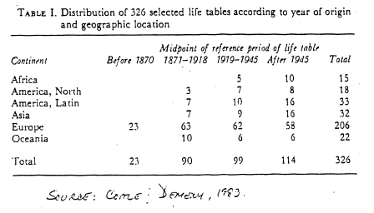

Slide 7
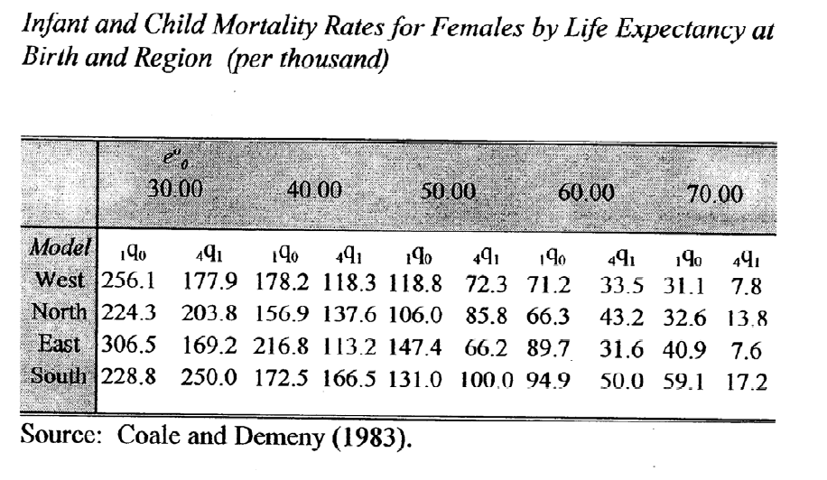

Slide 8
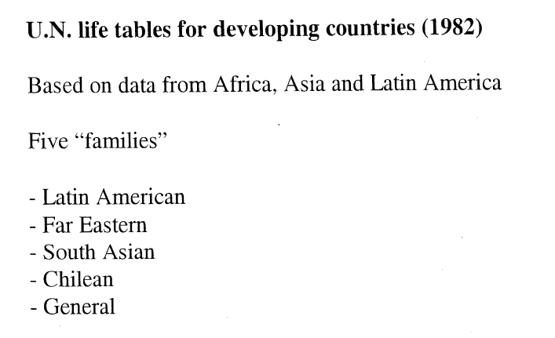

Slide 11
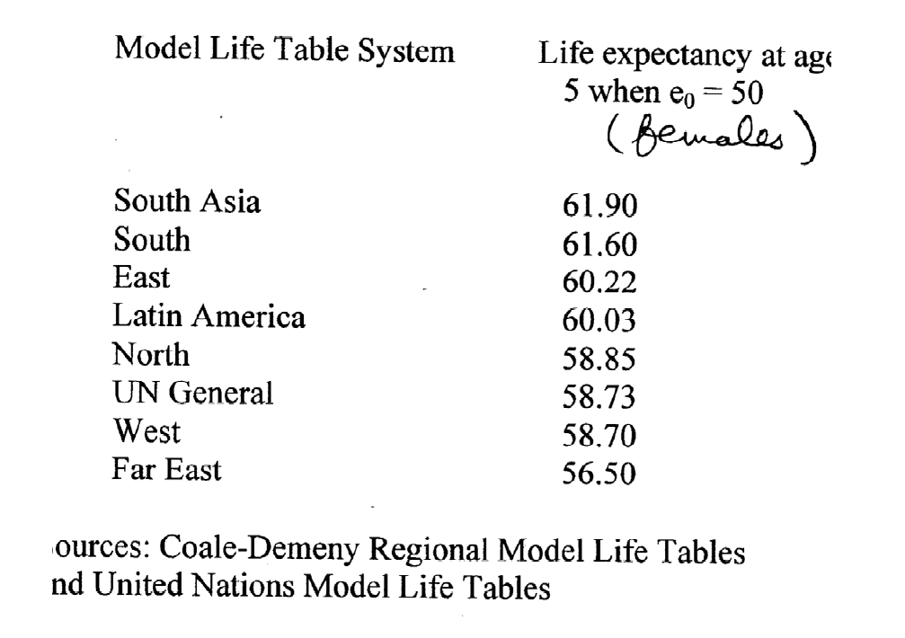

Slide 12
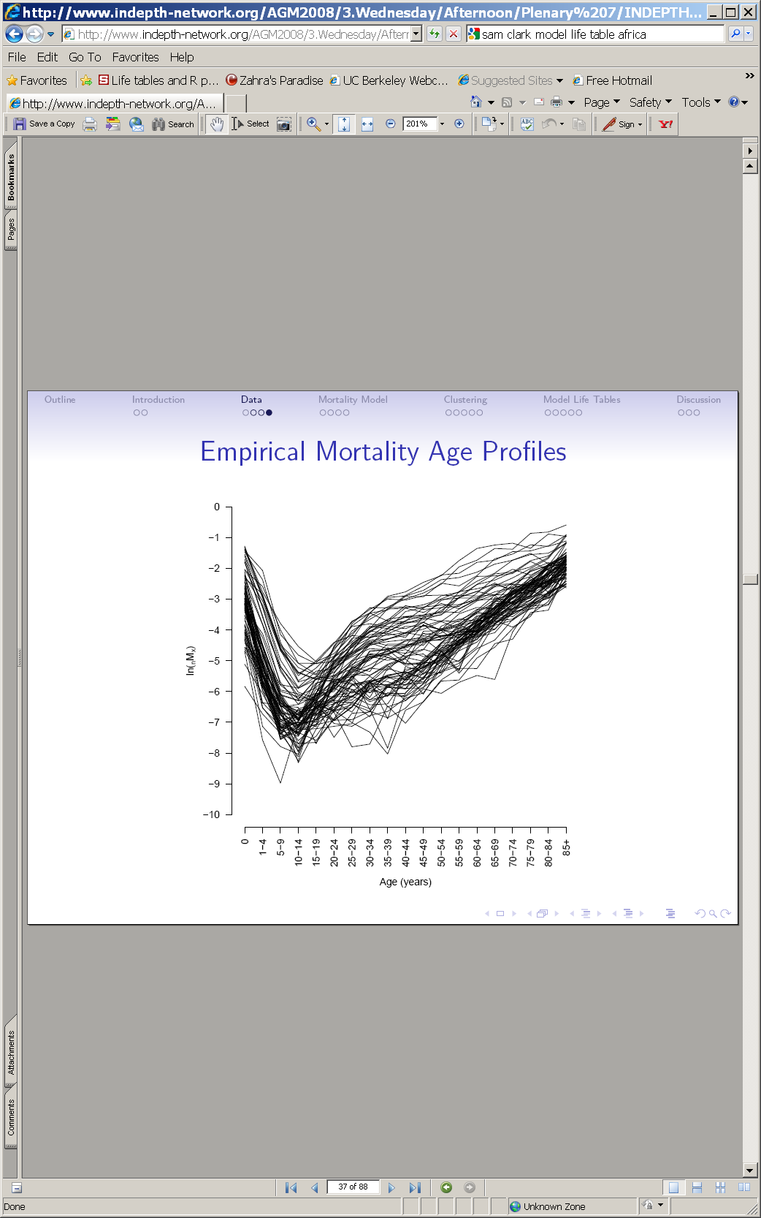
Model life tables for Africa
Sam Clark
University of Washington
INDEPTH program
Collect data from 26
DSS sites
Develop a mathematical
model to smooth
clusters of data, create
model life tables for African countries

Slide 13
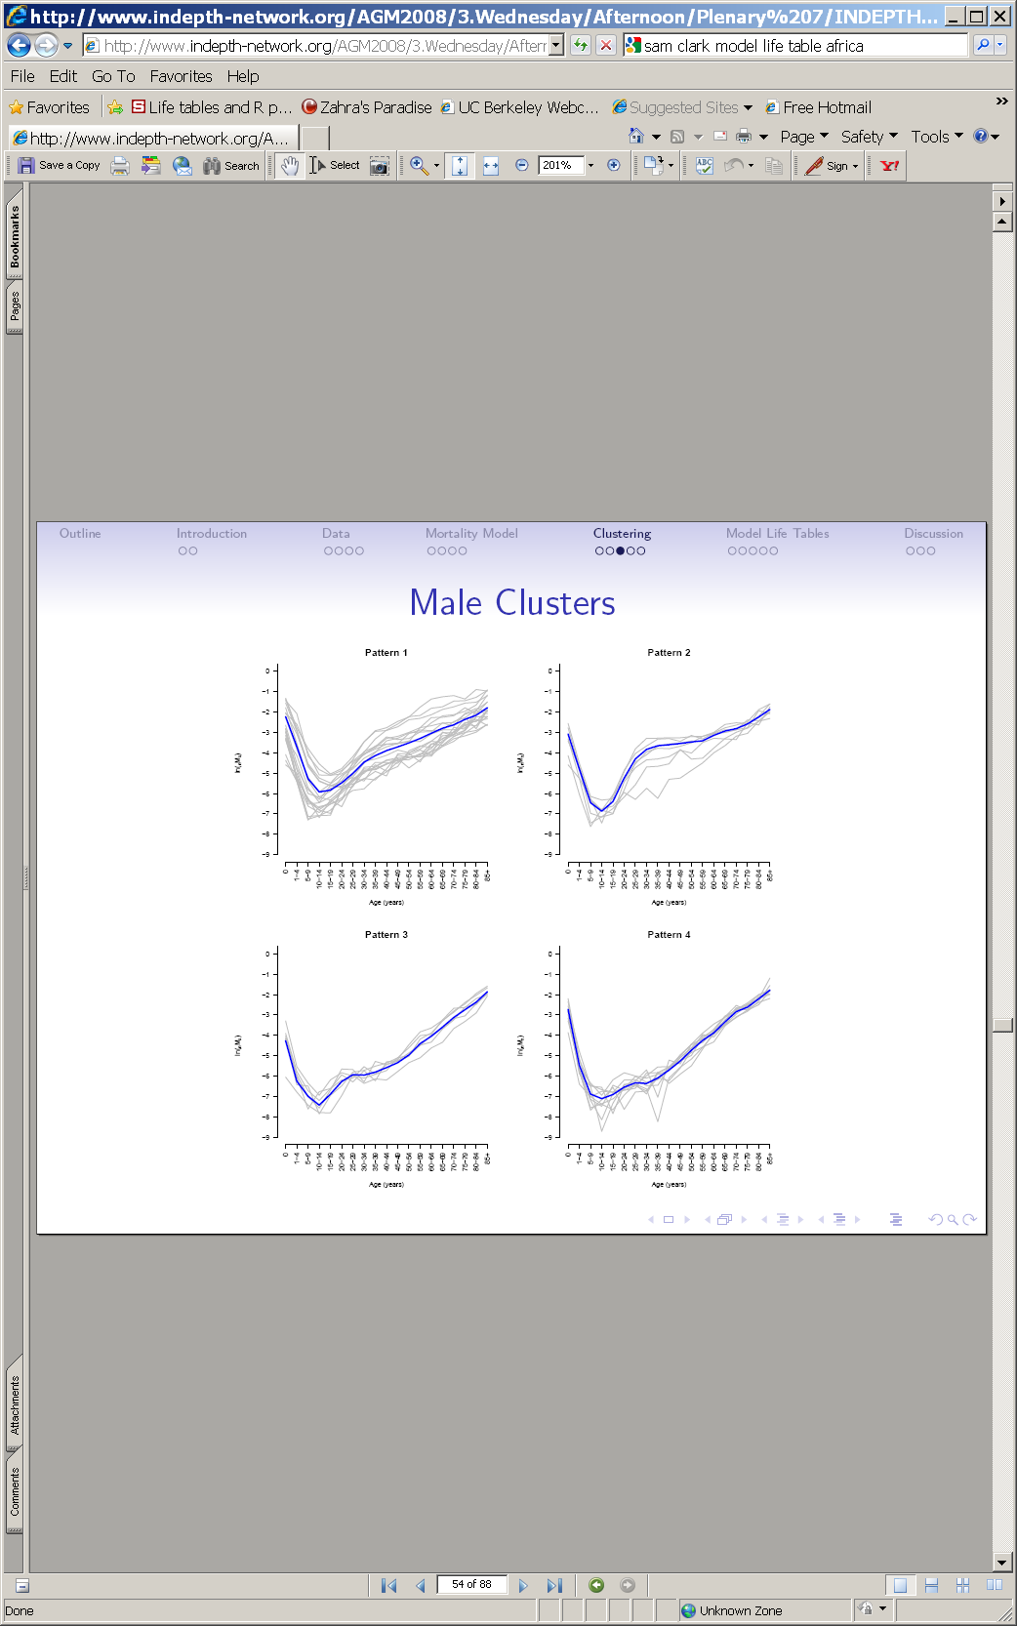
Model life tables for Africa
Sam Clark
University of Washington
INDEPTH program
Collect data from 26
DSS sites
Develop a mathematical
model to smooth
clusters of data, create
model life tables for African countries

Slide 14
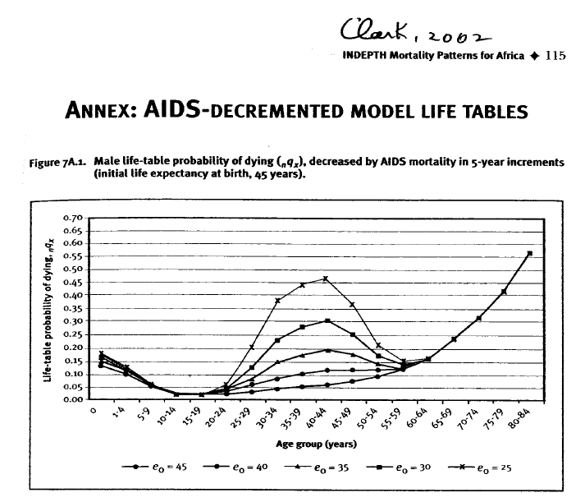

Slide 15
Using MORTPAK
1. Choose the “MATCH” procedure by selecting “Application” and then “MATCH” from the drop down menu
2. Select Sex (males or females)
3. Select Model life table pattern
4. Type in your input life table value in the cell “has value of”
5. Choose the column of the life table to which your input value pertains (_{n}m_{x}, _{n}q_{x}, e_{x} or l_{x})
6. Type in the age (beginning of interval) to which your input value pertains
7. Click on “Run”

