Slide 1

Statistical Committee
Thirteenth session
Beirut, 29-30 January 2019
Item 5 The prospects of Innovation and Technology in Official Statistics
Priority Technologies for the Arab region
E/ESCWA/C.1/2019/4
Amor Laaribi, PhD
Former UNSD Senior Statistician/UN-GGIM Coordinator

Slide 2
Table of Contents
Introduction/Context
The need for Modernization
Innovative Technologies/Methodologies
Current Situation in the Region
Priority Technologies/Methodologies for the region
Integration of Statistical and Geospatial Information
Recommendations/Conclusion

Slide 3
Introduction/Context
2030 Agenda for Sustainable Development
    17 Goals, 169 Targets, 232 Indicators
    Sustainable Development Goals (SDGs) Indicator Framework
2020 Round of Censuses
    Adoption of GIS should be a major strategic decision
    See: UN Principles and Recommendations – Revision 3, 2017, United Nations Publications, New York. Available at: https://unstats.un.org/unsd/publication/seriesM/Series_M67Rev3en.pdf

Slide 4
The Need for Modernization
Technological developments are revolutionizing data collection, analysis and dissemination in fundamental ways;
Increasing access to/use of geospatial technology has drastically increased the quantity and quality of multi-sources geospatial data (e.g. satellite imagery);
Increasing demand of data on small geographic areas to monitor the development goals and indicators at local and community levels;
NSOs need to transform and modernize their statistical systems to use these technologies and provide better access and quality of data at every level.
The need to modernize the national statistical systems, and which technologies are available for NSOs

Slide 5
Innovative Technologies/Methodologies for Census/Statistical Operations
Geospatial Technologies
  RS: Satellite Imagery/Aerial Photography
  GPS/GNSS
  GIS
Mobile Technology
  Handheld-devices/CAPI
Internet-based Data Collection
Cloud-Computing
Web Mapping/Web GIS
Mobile Apps
Geo-Portals
Open Data/Big Data

Slide 6
Integrated Geospatial Technologies

Slide 7
Mainstreaming Geospatial Information Technologies into Census processes (Source: UNECA)

Slide 8

Mobile Technology
Fundamental Components:
  Electronic Forms
  Inbuilt validations for data
  Highly Secure: Biometrics and Wireless
  Data are then electronically transmitted to an NSO database for further processing:
  Range of connectivity options: WiFi, CDMA / GSM Radio
  Capability to work offline & online to connect to a central database
  Other characteristics:
  Ease of use
  Multi-lingual capability

Slide 9
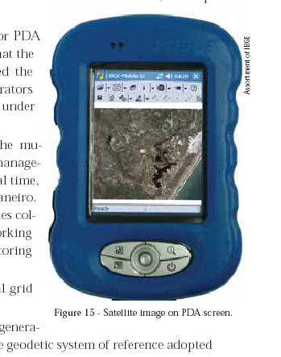
Mobile Technology…
The device can be enabled with GPS to:
  Allow the enumerators to understand their current location and to capture the geographical location of where census data was collected;
  Allow the local supervisors and/or those at the NSO to track the enumerators and check whether the capture of the data was actually done at the right place of the household, avoiding any false data entry;
  Captured GPS locations can be used as a reference point for other post-enumeration activities;
  Using the EA maps and the electronic questionnaires filled out by enumerators allows to verify whether the EAs were fully covered.

Slide 10

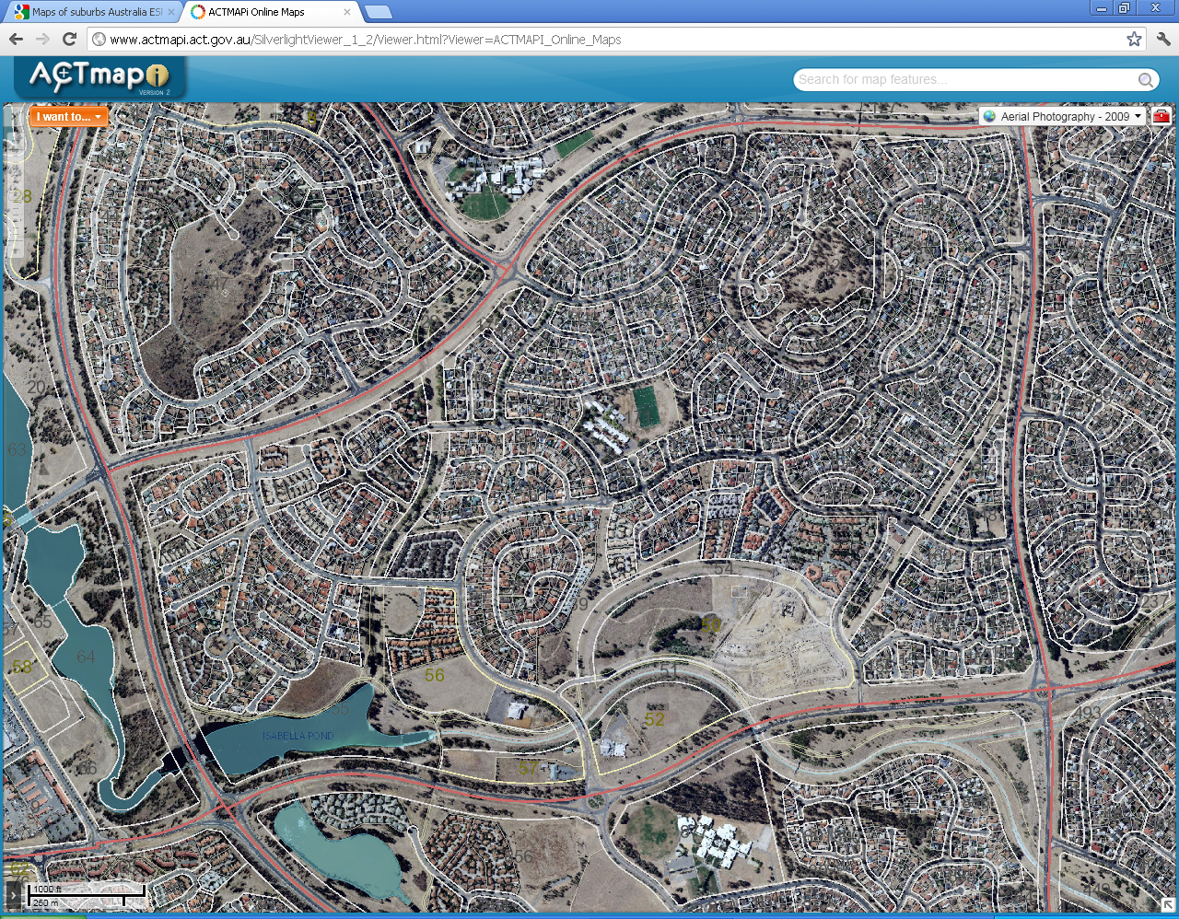
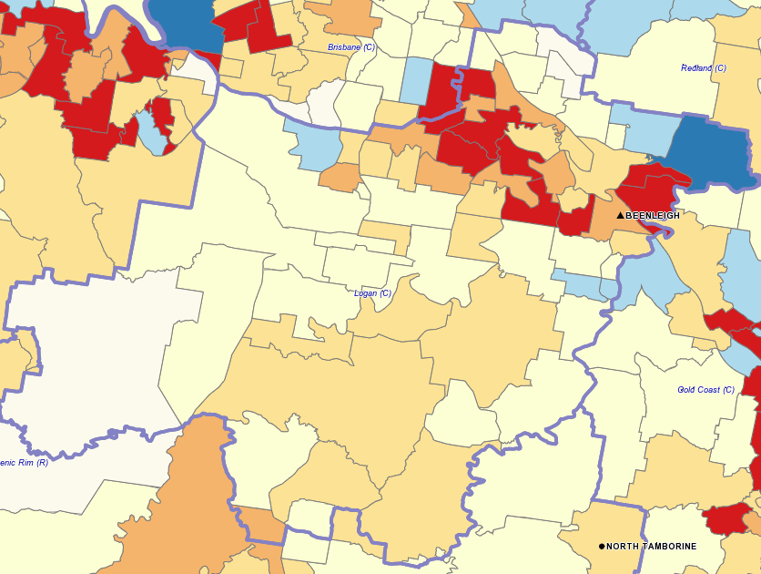
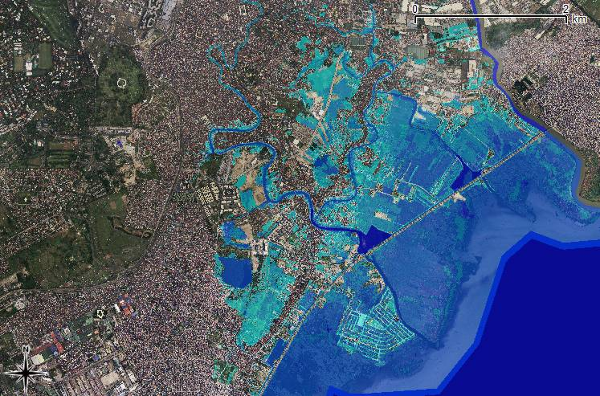
Investigation of the Current Situation in the Region
Questionnaire on the Experiences and Practices of Arab countries regarding the Use of Geospatial Methodologies and Technologies, and the Dissemination of Statistical Data
ESCWA short questionnaire on "Assessing the Status and Needs of Arab Countries to Produce and Utilize Geospatial Information as a Data Source for the SDGs
EU-designed survey on environment-related SDGs was conducted for selected Arab countries in cooperation with The European Topic Centre of the University of Malaga, Spain (ETC‐UMA) mainly on population, human settlements and infrastructure; land use and land cover; biodiversity; water; air quality and marine ecosystems

Slide 11
Organizational Structure of Geospatial Capability – Questionnaire Results

Slide 12
NSO Role in Geospatial Information – Questionnaire Results

Slide 13
Geospatial Framework – Questionnaire Results

Slide 14
Types of Geospatial Frameworks used in the Organization’s Activities – Questionnaire Results
Response | Number of countries
YES – Basic layers: Administrative boundaries/Hydrography/Roads Blocks/Establishments/Land Parcels Administrative boundaries/Hydrography/Roads Buildings/Establishments/Urban areas/Slums/Rural Settlements Administrative boundaries/Settlements/Urban and populated areas/Roads Blocks/Buildings/Land Parcels Landmarks/Industrial Establishments/Farms/ WGS84/Imagery National Statistical Spatial Framework (NSSF)/Global Statistical Geospatial Framework (GSGF) | 9 2 1 3 2
NO – Geospatial Framework | 1

Slide 15
Priority Technologies/Methodologies
Building a Statistical-Geospatial Infrastructure
Use of Satellite imagery/Earth Observations Data
Point-based Data Collection
Mobile Technology/ Hand-held Devices
Internet-based Technologies

Slide 16
Example: Use of Satellite Imagery
Only 3 countries mentioned imagery as basic layer of their geospatial framework (19%).
Imagery is generally considered as a fundamental layer of any national spatial data infrastructure.
Only relevant data sources
Example: (SDG) Indicator 15.1.1:
    Forest area as a percentage of total land area
Indicator = Geospatial data

Slide 17


Indicator 15.1.1
Forest area as a percentage of total land area
Forest Area from Earth-observing
Environmental Satellites
Target 15.1
By 2020 ensure the conservation, restoration and sustainable use of terrestrial and inland freshwater ecosystems and their services, in particular forests, wetlands, mountains and drylands...
2000 % tree cover
2013 Tree Cover
100
% tree
cover
0
0
Credit: Matthew C. Hansen, Univ. Maryland, et al.

Slide 18
Integration of Statistical and Geospatial Information
It is now readily accepted that integrating statistical and geospatial information is critical for:
Local, sub-national, national, regional, and global decision making processes;
Measuring and monitoring the targets and global indicator framework for SDGs of the 2030 Agenda for Sustainable Development;
Supporting data sharing between institutions and enhancing the interoperability of geospatial and statistical information;
Unlocking new insights and data relationships that would not have been possible by analyzing socio-economic, environmental or geospatial data in isolation;
Promoting investment and capability building in geospatial and statistical information;
Building institutional collaboration between geospatial and statistical communities; and,
Examining new sources of data that includes geospatial information, for example mobile phone data.

Slide 19
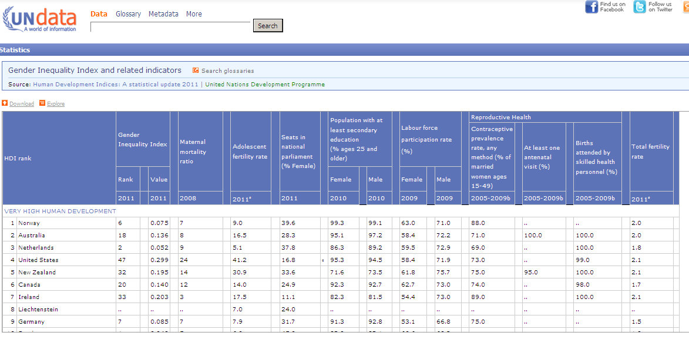
Matrix: Data Structure for Statistics
This data structure may explain to some degree why it took a long time to adopt the geographic approach

Slide 20
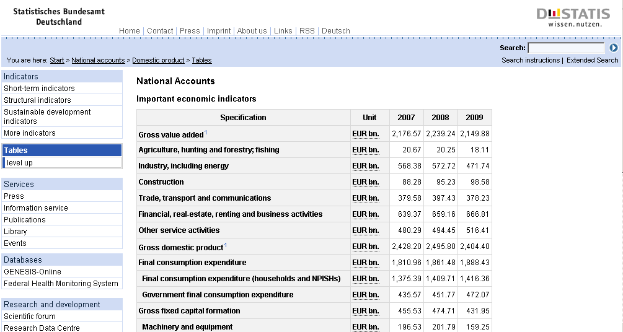
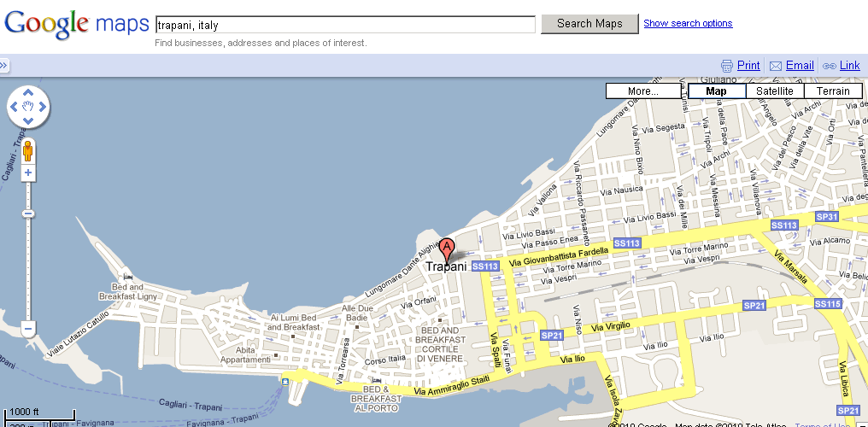
Two different views of the same reality
Statistical
world
Physical world
Source: Eurostat
Statistics are about human characteristics and activities which are geographic in nature.

Slide 21
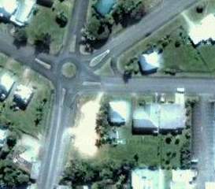
Location as Basic Unit of Observation
25 Dupont St, Town T
x,y: 35.5676, 135.6587
Address / Geocode
Enumeration Areas
(operational geographic units for data collection)
Geographic Data Structure: Points, Lines, and Polygons

Slide 22



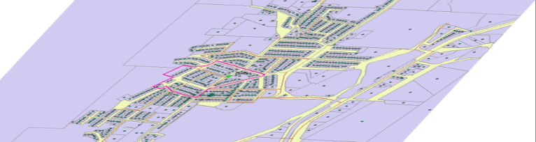
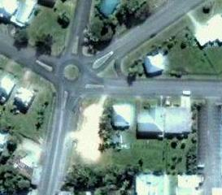
Need for a Statistical Spatial Framework
Aggregated to Local Government area or higher
Analysis and aggregation across geographies
Geocoded unit level data
Aggregated to an administrative unit
25 Dupont St = x,y: 35.5676, 135.6587
Aggregated to a district level
A common geographic framework is fundamental to integration
Need for appropriate standards to support the linking of socio-economic information to location

Slide 23

UN Recommendations
Linking geospatial information to statistics through geocoding.
  [2nd Session of UN-GGIM, August 2012]
International standard for linking socio-economic information to location—an international statistical geospatial framework.
  [UNSC Programme Review. February 2013]
Notes:
23

Slide 24
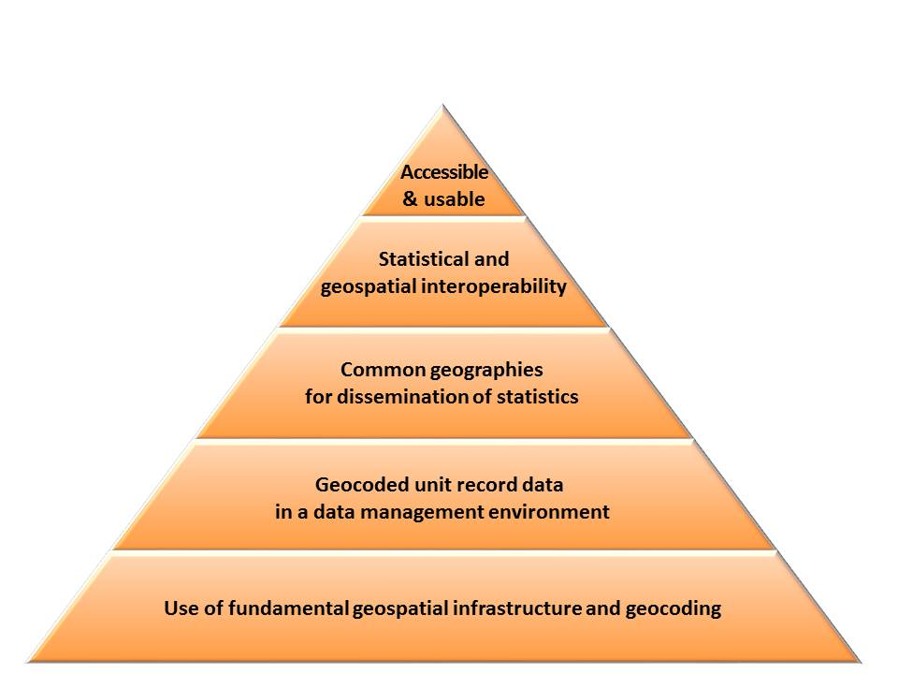
Global Statistical Geospatial Framework

Slide 25
Geocoding of statistical and administrative data at unit record level is the most important
Traditional geocoding limits: Output areas, such as enumeration areas, districts or other small areas, do not meet the user demands on territorial flexibility.
Building the production of geospatial statistics at the level of geocoded address information and/or building information, is believed to increase the flexibility of the output data as well as increase the spatial resolution of the data.
A production system with single coordinate points as the spatial key-element will be able to deliver aggregations at any spatial unit.

Slide 26
Institutional Coordination/Partnerships
Institutional arrangements: facilitate partnership for data standards and interoperability, data access and sharing;
Building statistical-geospatial information infrastructures requires effective partnerships and co-operation amongst a wide variety of multi-disciplinary stakeholders in the public and private sectors and the end user communities;
Developing a partnership for cooperation with the National Mapping Agency (NMA) can be mutually beneficial;
NMA provides the NSO with basemaps updated and appropriate for the census operations and, in return, the mapping agency may benefit from the improvements provided by the field work undertaken by the NSO, and the geographic products derived from the census.

Slide 27
Recommendations
Recognizing geography as key to statistics, providing a structure for collecting, processing, storing, aggregating and disseminating data, and significantly improving the quality of official statistics.
Embedding geography into the national systems and processes, NSO transforms its statistical infrastructure, thus it can contribute to the modernization of official statistics.
It is recommended that ESCWA adopt a course of action in support of Arab countries in need for building and developing their statistical-geospatial information infrastructures for the 2020 Round of Censuses and the 2030 Sustainable Development Agenda.
NSOs in the region are encouraged to collaborate with respective national mapping authorities, and extend their involvement and active participation, in partnership with other national authorities, in the development of a national geospatial information capacity, including the NSDI.

Slide 28
Recommendations…
The use of hand-held devices equipped with GPS can especially contribute to the geocoding of schools, hospitals and other important reference elements, as a side benefit of the census operations. It is recommended to use mobile technology, ‘GPS’, satellite imagery, and UAV, as they are facilitating data collection at the individual level, provided we take into account the privacy/confidentiality issues.
The use of geospatial and other Internet-based technologies is recommended to all NSOs in the region for the 2020 round of censuses; it is however of paramount importance to ensure these activities on a continuous basis as they are crucial for many more applications other than censuses and Official Statistics.
The UN Expert Group on the Integration of Statistical and Geospatial Information has developed a Global Statistical-Geospatial Framework which can significantly improve the quality of official statistics/population censuses, and support the SDGs. Arab countries are encouraged to develop their national statistical-geospatial framework in accordance with the guidelines and principles agreed upon internationally.

Slide 29

Thank you شكرا جزيلا
Email: amorlaaribi7@gmail.com

