Slide 1
Updates on the System of Environmental-Economic Accounting (SEEA)
United Nations Statistics Division

Slide 2
Mandate of the UN Committee of Experts on Environmental-Economic Accounting (UNEEA)
Established by UN Statistical Commission at 36th session in 2005
Functions as an intergovernmental body to provide overall vision, coordination, prioritization and direction in environmental economic accounting and supporting statistics
Three broad objectives
Mainstream environmental-economic accounts and supporting statistics
Elevate the SEEA to an international standard
Advance country implementation

Slide 3
UNCEEA Work Programme
United Nations Statistical Commission
UNSC
UN Committee of Experts of Environmental-Economic Accounting (UNCEEA)
1. Coordination and communication
2. Methodological development
3. Development of databases
4. Implementation and statistical capacity building
Main achievements of the UNCEEA:
SEEA EA adopted by UNSC in 2021
SEEA CF adopted as an international statistical standard in 2012
Thematic handbooks: (e.g. energy, water, measuring sustainable tourism, ocean)

Slide 4
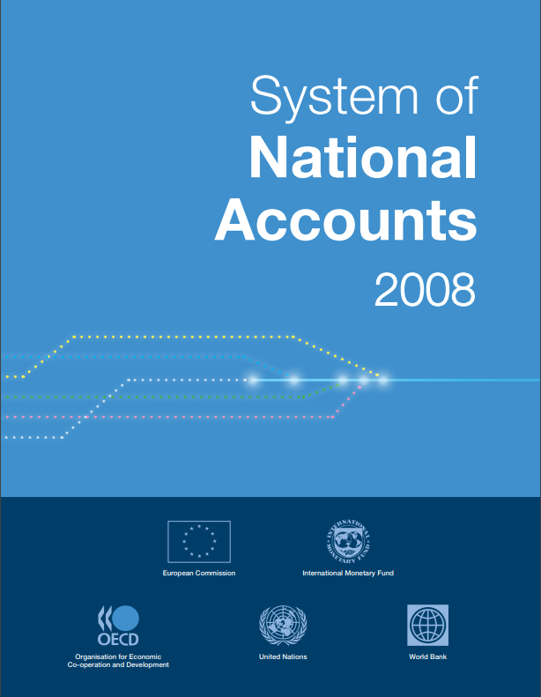
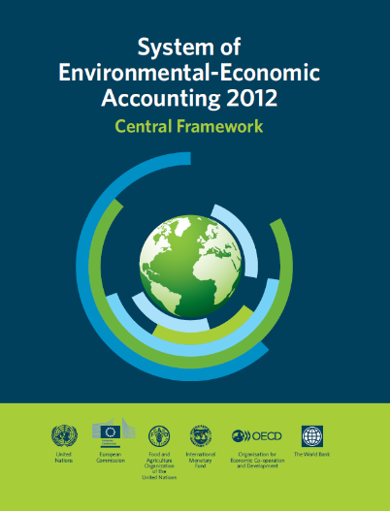
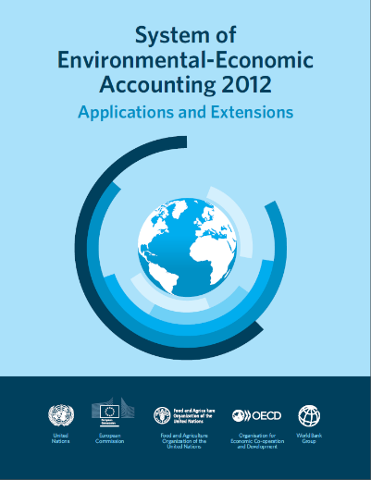
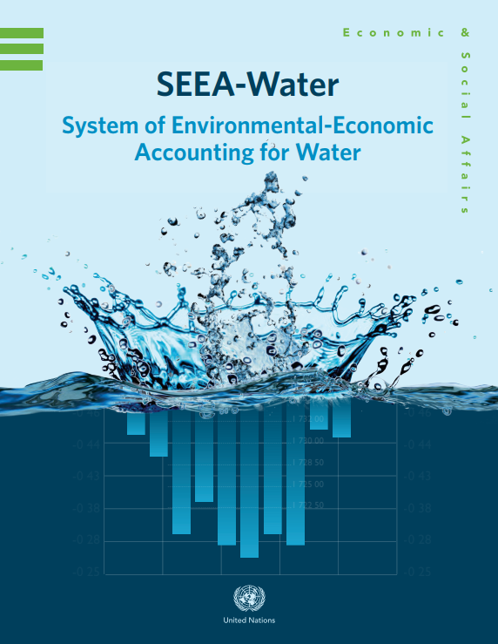
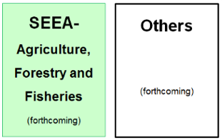
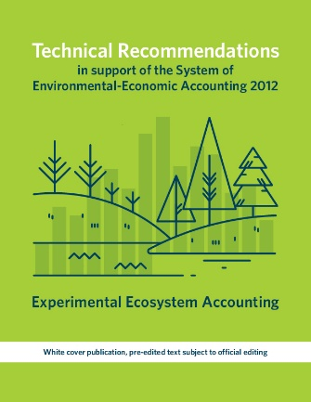
The SNA and SEEA: Systems of integrated information

Slide 5
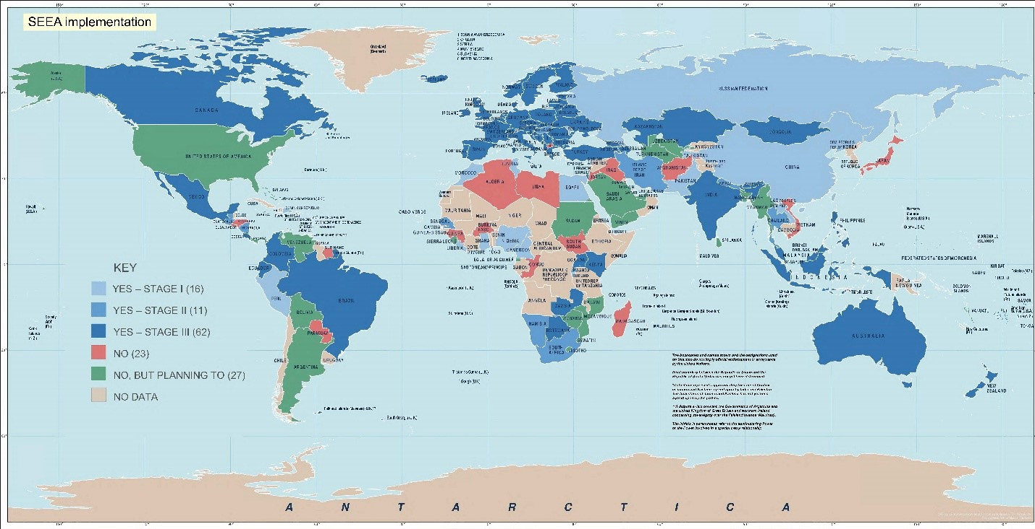
SEEA implementation
2020 Global Assessment for Environmental-Economic Accounting and Supporting Statistics
89 countries implementing the SEEA Central Framework
34 countries compiling SEEA Ecosystem Accounts
27 countries planning to start implementation of the SEEA

Slide 6
Adoption of SEEA Ecosystem Accounting

Slide 7
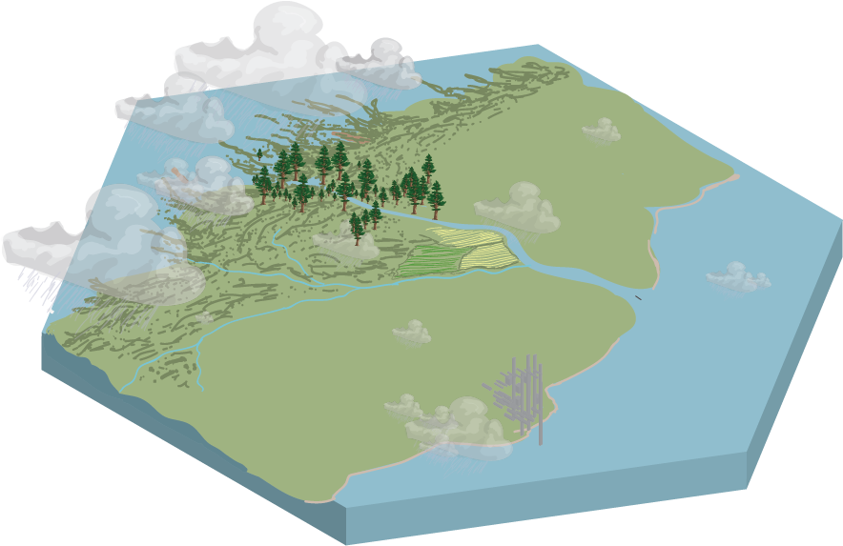
SEEA Conceptual Framework
Economy
Imports
Exports
Economic units
Activities
Instruments
Territory of reference
Natural inputs
Ecosystem services
Residuals
(emissions,
waste)
Environment
Transboundary Environmental Flows

Slide 8
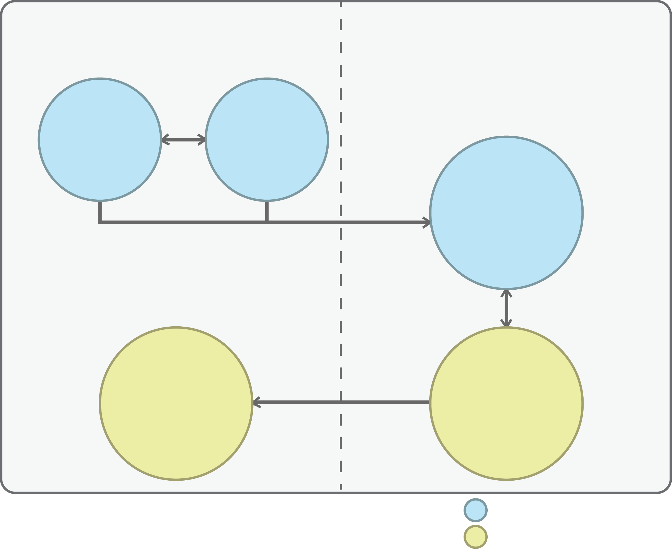
SEEA EA - Core Accounts
Stock accounts
Flow accounts
and change in stocks
Ecosystem extent
Ecosystem condition
Ecosystem services flow
Monetary ecosystem
asset
Ecosystem services flow
Physical accounts
Monetary accounts
Notes:
Figure 2.2 – added border for accessibility, editable text. Refined style to match other figures

Slide 9
Decision from UNSC 2021
The United Nations Statistical Commission at its 52nd session in March 2021
Agreed to remove the “Experimental” from the title of the revised SEEA Ecosystem Accounting, adopt chapters 1-7 describing the accounting framework and the physical accounts as an international statistical standard, keep all chapters together in one document, with chapters 8-11 describing monetary valuation and integrated accounting for ecosystem services and assets, and chapters 12-14 describing the applications and extensions, and regularly evaluate and report on the usefulness and pertinence of the accounts; (decision 8c)
Recognized that, Chapters 8-11 of the SEEA Ecosystem Accounting describe internationally recognized statistical principles and recommendations for the valuation of ecosystem services and assets in a context that is coherent with the concepts of System of National Accounts for countries which are undertaking valuation of ecosystem services and/or assets, and requested the Committee to promptly resolve the outstanding methodological aspects in chapters 8-11 as identified in the research agenda; (decision 8d)
Source: https://unstats.un.org/unsd/statcom/52nd-session/documents/decisions/Draft-Decisions-Final-10March2021.pdf

Slide 10
SEEA Ecosystem Accounting
Section: A
Introduction and overview
Ch.1: Introduction
Ch.2: Principles of ecosystem accounting
Section B
Accounting for ecosystem extent and condition
Ch.3: Spatial units for ecosystem accounting
Ch.4: Accounting for ecosystem extent
Ch.5. Accounting for ecosystem condition
Section C: Accounting for ecosystem services
Ch.6. Ecosystem services concepts for accounting
Ch.7. Accounting for ecosystem services in physical terms
Section D: Monetary valuation and integrated accounting of ecosystem services and assets
Section E: Complementary valuations, thematic accounting and indicators
Ch.13: Accounting for specific environmental themes
Ch.14: Indicators and combined presentations
Ch. 9 Accounting for ecosystem services in monetary terms
Ch. 10 Accounting for ecosystem assets in monetary terms
Ch. 11. Integrated and extended accounting for ecosystem services an assets
Ch. 8 Principles of monetary valuation for ecosystem accounting
Ch.12: Complementary approaches to valuation
One integrated document, remove “Experimental”
Chapters 1-7 on accounting framework and physical accounts adopted as an international statistical standard to measure ecoystsems, their condition and services
Chapters 8-11 on valuation as internationally recognized statistical principles and recommendations on monetary accounts and valuation of ecosystem services and assets
Chapters 12-14 describing applications and extensions

Slide 11
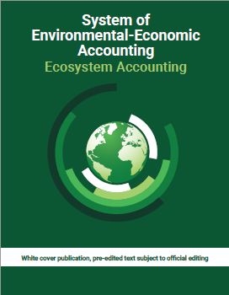
Next step
‘White cover’ version is currently being finalised, it will be released in July 2021, formal UN edited version probably early 2022
Extended Technical Committee is continuing
Further work at world level will focus on implementation
implementation strategy
interoperability strategy (better (access to) data/models)
In parallel, work on UN guidelines continues
Biophysical modelling guidance (global consultation completed)
Valuation guidance (-> working group on valuation))
Technical report on policy scenarios
ARIES for SEEA (https://seea.un.org/content/aries-for-seea)

Slide 12
Elements of the SNA update Source: Catherine Van Rompaey and Joe St. Lawrence (2021) Well-being and Sustainability in the SNA update – Environmental-Economic Accounts Status and Governance Presentation to the UNCEEA, June 2021 https://seea.un.org/sites/seea.un.org/files/wbstt_unceea_june_2021.pdf

Slide 13
SNA Update
Committee (AEG and ISWGNA): approve 2025 SNA
UNSC: adopt 2025 SNA
UNSC: launch update process
Development of guidance notes & country consultation and testing
UNSC: adopt recommendations
Draft 2025 SNA, incl. country consultation on new text
Iterative drafting of the update of the 2008 SNA 2022 - 2024
Mar. 2020
2020-2023
Mar. 2024
2024
Oct. 2024
Mar. 2025
Key SNA Governance Bodies
Inter-secretariat Working Group on National Accounts (ISWGNA)
Participation from UN, IMF, OECD, Eurostat, World Bank; Chair rotates every two years (currently UNSD)
Advisory Expert Group on National Accounts (AEG)
Approx. 20 country experts, providing technical guidance to the ISWGNA
Overall coordination and management of SNA update process: Economic Statistics Branch, UNSD

Slide 14
Task Teams and Guidance Notes
Task Teams
A number of workstreams were launched to resolve issues related to priority areas.
The workstreams are organized by Task Teams
SNA and joint Task Teams led by members of the AEG while ISWGNA members provide secretariat services
Guidance notes will be developed for each of the prioritized issues covering both conceptual and practical guidance.
Guidance notes
Clearly identify issues affecting the central framework compared with those that would be addressed in supplementary tables or satellite accounts.
Not only the conceptual implications but also the feasibility of implementing the proposed conceptual solutions.
The practical guidance reflects on the experimentation and testing of the compilation issues.
Notes:
Over 300 experts across 10 Task Teams
Cooperation
Consistency

Slide 15
Wellbeing and sustainability task team
Co-chairs: Catherine Van Rompaey (World Bank) and Gabriela Saborio (Central bank of Costa Rica) Secretariat: Jorrit Zwijnenburg, Virginie Elgrably (OECD)
Six area groups:
A Broader SNA framework for Wellbeing and Sustainability
Catherine Van Rompaey, World Bank
Distributions of household income, consumption saving and wealth
Amanda Seneviratne, Australian Bureau of Statistics
Unpaid household service work
Chris Payne, UK Office for National Statistics
Labour, education and human capital
Michael Smedes, Australian Bureau of Statistics
Health and social conditions
Dylan Rassier, US Bureau of Economic Analysis
Environmental-economic accounting – multiple guidance notes on specific issues
Joe St-Lawrence, Statistics Canada

Slide 16
Area Group on Environmental Economic Accounting
Lead: Joe St. Lawrence, Statistics Canada
Membership:
Alessandra Alfieri (UNSD), Nils Brown (Statistics Sweden), Adam Dutton (UK ONS), Bram Edens (UNSD), Dennis Fixler (US Bureau of Economic Analysis), Raúl Figueroa Díaz (INEGI, Mexico), Aldo Femia (Istat),Joao Carlos Fonseca (IPSASB), Francisco Guillen (INEGI, Mexico), Mark de Haan (Statistics Netherlands), Ivo Havinga (UNSD), Greg Legoff (IMF), Emmanuel Manolikakis (IMF) Carl Obst (consultant), Philippe Samborski (Statistics Canada), Sjoerd Schenau (Statistics Netherlands), Anton Steurer (Eurostat), Phil Stokoe (IMF), Jim Tebrake (IMF), Gemma Thomas (UK ONS), Peter van de Ven (former OECD), Catherine Van Rompaey (World Bank), Michael Wolf (Statistics Sweden).

Slide 17
SNA guidance for environmental-economic accounts
Endorsed by Advisory Expert Group for global consultation:
Ownership and depletion of natural resources
Emissions permits
In progress:
Accounting for biological resources
Provisions
Valuation methods
Renewable energy resources
SEEA classifications
Under consideration:
Recording of losses
Distinction between tax and service transaction
methodological aspects in chapters 8-11 as identified in the research agenda; (decision 8d)

Slide 18
Alignment of SNA with SEEA
SNA discussions will have implications for the SEEA-CF
Need to ensure alignment with updated standards
SEEA experts participate on area group
Remaining draft SNA guidance targeted for this Fall
Discussions in course on best mechanism to ensure review and formal endorsement within SEEA governance process
Must work within timeframes for SNA revision

Slide 19
Minutes of the UNCEEA meeting 2021
Stressed the importance of ensuring coherence between the SEEA CF and the revised SNA and other macroeconomic statistics (BoP/IIP, GFS, MFS, etc), noting the need for formal joint governance between the Committee and the AEG/ISWGNA noting that several experts from the environmental accounting community are involved in the subgroup on SEEA as part of the Well Being and Sustainability Task Team;

Slide 20
Discussion on the SEEA Central Framework update

Slide 21
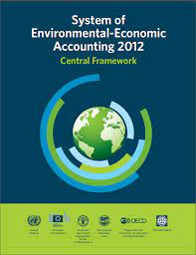
Background
Background
Ongoing work on the SEEA CF research agenda since 2012
June 2019: first discussion in UNCEEA on possible update of SEEA CF
2021: adoption of SEEA EA and endorsement work programme of the SNA update by UNSC
Why SEEA CF update was brought into discussion
General user needs
Responding to policy needs
Alignment to SNA research agenda
Alignment with SEEA EA

Slide 22
Minutes of the UNCEEA meeting 2021
Noted that the SEEA Central Framework (SEEA CF) is broadly up to date and stressed the importance of updating the SEEA CF to maintain its relevance for policy and consistency with other macroeconomic statistical standards, noting however the resource requirements and need for prioritization in view of the many activities on the UNCEEA agenda;
Emphasized the importance of making progress on the SEEA CF research agenda and agreed with the four work streams proposed to prioritize the work on the SEEA CF research agenda: 1) classifications; 2) links between the SEEA CF and SEEA Ecosystem Accounting (SEEA EA); 3) valuation issues (together with the SEEA EA); and input-output and indicators linked to the frameworks;
Agreed that outputs of the SEEA CF research agenda should take the form of technical notes which are released through the SEEA website and SEEA News & Notes as they are completed, and noted that a decision on a revision of the SEEA CF could be made in 2023 on the basis of the status of the SNA update and progress on the SEEA CF research agenda;

Slide 23
Priority work programme - Classification
SNA revision
The current version of the SNA has not incorporated these advances in environmental accounting since the adoption of the SEEA CF.
Uses of the SNA are increasing demanding data related to climate change, the management of natural resources, sustainability, biodiversity.
An important part of this work includes updating the SNA-based and SNA-utilized classification systems and reference lists to better align with the SEEA-CF and address emerging data needs.
ISIC and CPC revision
Decision of the UNSC at its 52th session endorsed the recommendation of the Expert Group on International Statistical Classification to revise ISIC Rev. 4 and CPC Ver.2.1
See E/CN.3/2021/30

Slide 24
Priority work programme - Classification
Minutes of the UNCEEA meeting 2021 on classification
Agreed on the importance of the Committee formally engaging in the revision processes for classifications, in particular the ongoing processes for ISIC and CPC and functional classifications (e.g. COFOG), to ensure that these classifications are fit for purpose for compiling the SEEA;
Next step
Develop the first draft for the concept note/background document that surveys the classification issue and identifies priority areas where advances could be made.
Potential scope
ISIC, CPC
COFOG, Classification of Environmental Activities
Other classifications
Biodiversity
Climate Change
Sustainable finance

Slide 25
SEEA and Post-2020 Global Biodiversity Frameworkk

Slide 26
GBF Monitoring Framework
During the fifteenth meeting of the Conference of the Parties to the Convention on Biological Diversity will adopt a post-2020 global biodiversity framework (GBF) as a stepping stone towards the 2050 Vision of "Living in harmony with nature".
Proposed Framework
https://www.cbd.int/doc/c/705d/6b4b/a1a463c1b19392bde6fa08f3/sbstta-24-03-en.pdf
Preference to existing indicators, but not at the expense of measuring what is important
Preference for existing national methodologies which have been agreed by an intergovernmental body
SEEA and FDES
Source: Jillian Campbell– Post-2020 Global Biodiversity Framework Monitoring Framework. Presentation to the UNCEEA, June 2021. https://seea.un.org/sites/seea.un.org/files/unceea_cbd.pdf

Slide 27
GBF Monitoring Framework
Group 1 - Headline indicators:
A minimum set of high-level indicators to capture the overall scope of the goals and targets.
Attempting to develop goal datasets/models which can be used in absence of national data sources.
For National Reporting (mandatory under the Convention.)
Group 2 - Component indicators
More detailed, often a disaggregation of the Headline indicators
Group 3 - Complementary indicators
For thematic or in-depth analysis, may be less relevant some countries.
Source: Jillian Campbell– Post-2020 Global Biodiversity Framework Monitoring Framework. Presentation to the UNCEEA, June 2021. https://seea.un.org/sites/seea.un.org/files/unceea_cbd.pdf

Slide 28
Why SEEA?
Makes nature count within economic planning and decision-making
Standardization is important in order to obtain high-quality, and comparable statistics
SEEA catalyzes collaboration due its multi-disciplinary nature between different stakeholders--statistical office and universities, line ministries, businesses, etc
Provides framework for deriving indicators to support various monitoring and reporting frameworks such as SDGs, Biodiversity, Climate Change, Green Economy

Slide 29
Decision from UNSC 2021
The United Nations Statistical Commission at its 52nd session in March 2021
Welcomed the progress of the Committee in mainstreaming the use of the SEEA in policy, including climate change, circular economy, sustainable finance, and biodiversity policy, and particularly encouraged the Committee to engage in the monitoring framework of the post-2020 global biodiversity agenda and participate in the proposed expert group under the auspices of the Secretariat of the Convention on Biological Diversity to provide the connection between the biodiversity and official statistical communities; (decision 8g)
Source: https://unstats.un.org/unsd/statcom/52nd-session/documents/decisions/Draft-Decisions-Final-10March2021.pdf

Slide 30
SBSTTA-24
The Subsidiary Body on Scientific, Technical and Technological Advice (SBSTTA) at its recent meeting in May 2021 :
“Recognizes the value of aligning national monitoring with the United Nations System of Environmental-Economic Accounting statistical standard in order to mainstream biodiversity in national statistical systems and to strengthen national information and monitoring systems and reporting”
Source: Non-Paper on SBSTTA-24 Agenda item 3
https://www.cbd.int/doc/c/13e9/73d6/0de346d7d3433024a3ef1441/sbstta-24-nonpaper-item-03-v1-en.pdf

Slide 31
SEEA and Post-2020 GBF
The discussion on the headline indicators for the post-2020 global biodiversity framework is ongoing. Below is a selected list of proposed headline indicators that can be derived from the SEEA accounts:
A.01 Extent of selected natural ecosystem
B.0.1. Value of all final ecosystem services (Gross Ecosystem Product)
6.01 Proportion of water with good ambient water quality
7.01 Total climate regulation services provided by ecosystems
8.0.1 Number of people using wild resources for energy, food or culture
10.0.2 Ecosystems providing reduced coastal erosion flood protection and other services
11.0.1 Average share of the built-up area of cities that is green/blue space for public use for all
13.0.2 Integration of biodiversity into national accounting and reporting systems, defined as implementation of the System of Environmental-Economic Accounting
15.0.1 Biomass material footprint per capital
18.0.1 Official development assistance, public expenditure and private expenditure on conservation and sustainable use of biodiversity and ecosystem system

Slide 32
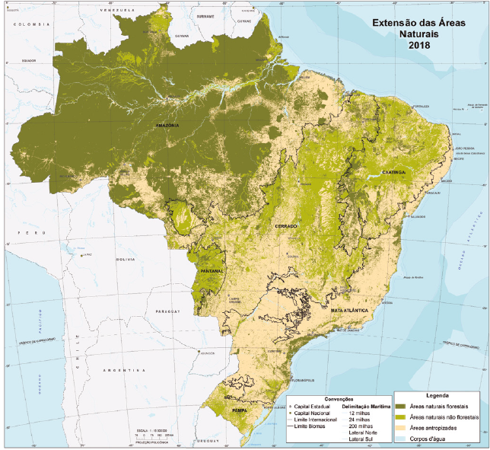
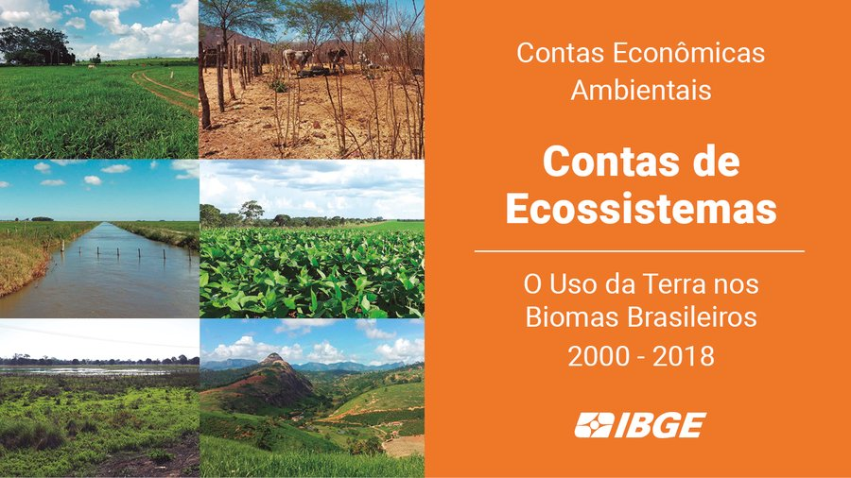
Example – SEEA and Goal A monitoring
2050 Goals, milestones and Targets | Headline indicators
Goal A: The area, connectivity and integrity of natural ecosystems increased by at least [X%] supporting healthy and resilient populations of all species while reducing the number of species that are threatened by [X%] and maintaining genetic diversity; 2030 Milestones: (i) The area, connectivity and integrity of natural systems increased by at least [5%]. (ii) The number of species that are threatened is reduced by [X%] and the abundance of species has increased on average by [X%]. | A.0.1 Extent of selected natural ecosystems (forest, savannahs and grasslands, wetlands, mangroves, saltmarshes, coral reef, seagrass, macroalgae and intertidal habitats) A.0.2 Living Planet Index A.0.3 Red list index A.0.4 Species habitat index A.0.5 The proportion of populations maintained within species
Ecosystem extent accounts
in Brazil (2000-2018)
The ecosystem extent accounts (2000-2018), by biomes, show that Brazilian terrestrial biomes lost about 500 thousand km² of their natural areas, due to conversion into modified areas such as land used for crops and grazing.
Source: (IBGE 2020), Ecosystem Accounts: Land Use in Brazilian Biomes 2000-2018

Slide 33
Example: SEEA and Goal B monitoring
First-level indicators | Second-level indicators | Third-level indicators | 2016 | 2017 | Net change
Provisioning services | Food/material provisioning | Agricultural /forestry/hay/ aquatic /seafood products | 1405.6 | 1389.4 | -16.2
Summation of provisioning services |  |  | 1405.6 | 1389.4 | -16.2
Regulating services | Global climate regulation services | Carbon sequestration | 20.3 | 20.4 | 0.1
 | Local climate regulation services | Regulating temperature | 117.7 | 126.1 | 8.4
 | Air fltration services | Absorbing sulfur dioxide | 20.9 | 19.4 | -1.5
 |  | Absorbing fluoride | 0.3 | 0.2 | -0.1
 |  | Absorbing nitrogen oxides | 3.9 | 3.4 | -0.5
 |  | Dust retention | 380.4 | 347 | -33.4
 | Water purification services | Inorganic nitrogen purification | 0.2 | 0.4 | 0.2
 |  | Active phosphate purification | 0 | 0 | -
 |  | Chemical oxygen demand (COD) treatment | 4.7 | 7.3 | 2.6
 |  | Petroleum disposal | 0 | 0 | -
 | Water flow regulation services | Conserving water resources | 3688.4 | 3374.5 | -313.9
 | Mitigation services | Farmland protection | 42.1 | 38.5 | -3.6
 |  | Flood mitigation | 31.3 | 26.8 | -4.5
 | Soil and sedime retention services | Soil retention | 18.5 | 17.2 | -1.3
 | Nursery population and habitat maintenance services | Biological conservation | 3050.9 | 3011.9 | -39
Summation of regulating services |  |  | 7379.6 | 6993.1 | -386.5
Cultural services | Recreation-related services | Agricultural tourism | 74.3 | 94.4 | 20.1
 |  | Forest tourism | 54.9 | 50.5 | -4.4
 |  | Water conservancy tourism | 14.6 | 21.7 | 7.1
 |  | Marine tourism | 59.9 | 61.1 | 1.2
 |  | Urban tourism | 152.2 | 184.3 | 32.1
Summation of cultural services |  |  | 355.8 | 412 | 56.2
Total |  |  | 9141 | 8794.5 | -346.5
Highlighted results:
- Regulating services accounts for 60% of total ecosystem services in Guangxi
- The total value of ecosystem services (GEP) as % of GDP in Guangxi
2016: 56.7%
2017: 49.4%
Monetary flow accounts for ecosystem services in Guangxi, China (Unit: 100 million CNY)
Source: NBS China 2021. Ecosystem Accounts for China. Results of the NCAVES Project.

Slide 34
Next step
Submit an information note documenting the linkage of SEEA EA with the GBF monitoring framework to Open-Ended Working Group on the GBF scheduled for August 2021.
Analyze existing metadata developed by the scientific community with regard to consistency with SEEA in collaboration with the relevant agencies (e.g. GEOBON on genetic diversity, BIP indicators and their partners, etc.)
Prepare Metadata sheets for selected SEEA EA indicators in the current list, for example, indicators related to Goal A (size and condition of natural ecosystems) and Goal B (nature’s contribution to people) of the monitoring framework

Slide 35
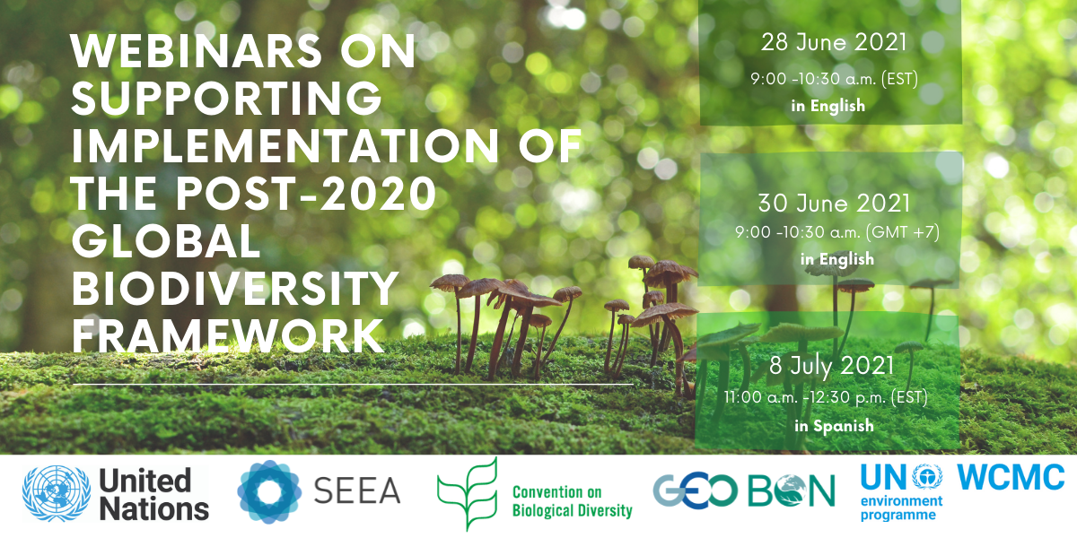

Slide 36
Webinar series - Save the date!
July 12: Species populations and area-based conservation (Lead GEO BON)
July 26: Genetic diversity (Lead GEO BON)
August 18: Ecosystem services - ARIES- GEP (Lead SEEA)
September TBD: Ecosystem extent/integrity + Connectivity (Lead GEO BON)
October TBD: Tools for national reporting (Lead WCMC)
More information at https://seea.un.org/events/webinars-supporting-implementation-post-2020-global-biodiversity-framework

Slide 37
Data

Slide 38
ARIES for SEEA for rapid, standardized account creation
Global, customizable models approach enables SEEA EA compilation anywhere & improvement with local data where available
Faster & easier to learn than other biophysical modeling approaches
Automate production of maps & accounting tables for all accounts
Support adoption of SEEA EA as statistical standard by providing a consistent, easy-to-use application enabling ecosystem accounting anywhere on Earth
Infrastructure for the SEEA community to share & reuse interoperable data & models.
More information at https://seea.un.org/content/aries-for-seea

Slide 39
ARIES for SEEA for rapid, standardized account creation
ARIES for SEEA Explorer allows users to compile ecosystem accounts for any user specified context
Current Explorer functionalities are restricted to assessing:
Ecosystem extent (based on the IUCN Global Ecosystem Typology
Condition (for forest ecosystem types)
Selected ecosystem services in physical and/or monetary units using basic models as a starting point
Proposal is to do pilot with ecosystem extent accounts
Different versions of extent accounts possible: using the same global data sources to ensure comparability or using best available data sources.
Essential that all country data would be validated by countries before placed in the global database, in line with the data flow process agreed

Slide 40
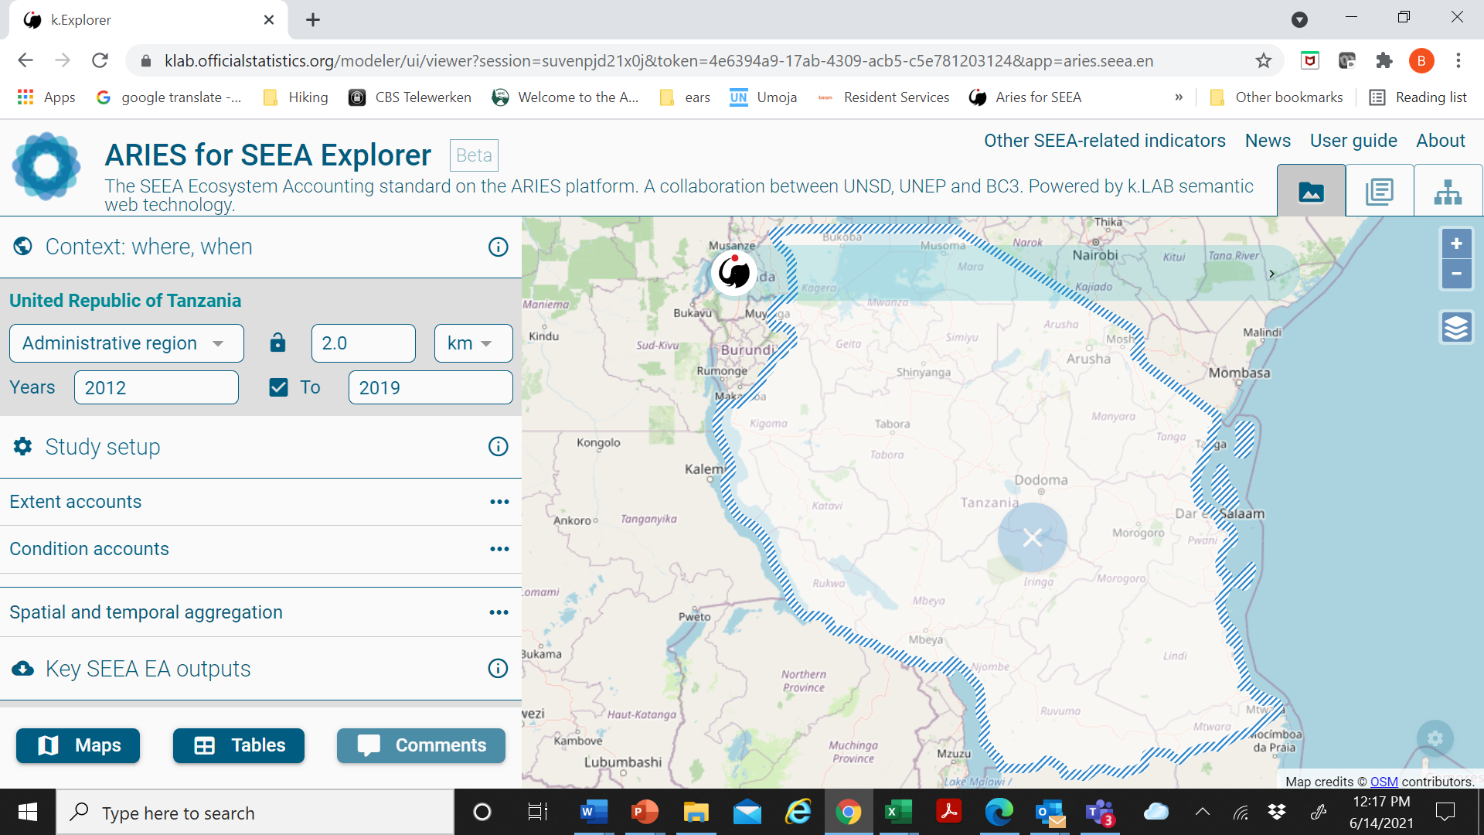
Example

Slide 41
Capacity development

Slide 42
E-learning
Coordination of training and E-learnings. https://seea.un.org/content/seea-e-learning-resources
Maintaining close communication with SEEA focal points in countries, organizing webinars for relevant topics

Slide 43
Development of Community of Practice for NCA
Development of Community of Practice for NCA
Brought together practitioners and users of different areas.
Opportunities for NSOs to share experiences (webinars, newsletters, WhatsApp/Telegram groups) useful for knowledge and information sharing.
Existing COPs:
Africa Natural Capital Accounting COP was established at the end of 2019 and now includes over 300 participants from African countries and organisations and is supported by 11 partner organizations; the COP had a dedicated website, a whatsapp/telegram group and an active secretariat and a steering committee; to date 11 webinars were organized
ECLAC Regional Network on Environment Statistics was established in 2017 and has a very active whatsapp group with over 200 participants, a website and holds regular webinars
Latin American Community on NCA (ComLAC) was established as an informal network, it has an active whatsapp group, a website and organizes monthly webinars

