Slide 1
Technical Advisory group for Economic Statistics (TAGES)
6 -7 July 2021
United Nations Economic and Social Commission for Western Asia
Activities on SEEA, Climate Change Statistics and Disaster-related Statistics
      Wafa Aboul Hosn, Chief Economic Statistics
      aboulhosn@un.org

Slide 2
NEW Update of the SNA 2025
A broader framework for wellbeing and sustainability in the System of National Accounts
Proposed guidance for a broader framework therefore elaborates the SNA in 5 key areas:
Distributions of household income, consumption, saving and wealth
2. Unpaid household service work
3. Labour, education and human capital
4. Health and social conditions
5. Environmental-economic accounting

Slide 3
System of Environmental Economic Accounting-SEEA
Mandate to work on SEEA from Countries: Recommendations from expert groups and intergovernmental meetings Requests for Assistance from countries in environmental accounting and focus on water, energy and land accounts, material flow accounts(SUT for SDG 12 on Domestic Material Consumption) SDGs: UN High-level Political Forum webinar on measuring comprehensive/inclusive wealth in the post-pandemic era
Partner with UNSD on International work on SEEA UNCEEA (NO Arab Country is member!!!!) London Group International Recommendations and Sub-accounts on Water (IRWS & SEEA-Water) and on Energy (IRES & SEEA-Energy) GCC-Stat and Oman established Units for SEEA
Methodological Studies Study on SEEA Framework for Arab region
Wafa A. HOSN UNESCWA

Slide 4

SEEA: Regional Partnership and Capacity Building
https://seea.un.org/content/seea-e-learning-resources
  Arab Working Group on Environment and Sustainable Development Indicators Third Meeting 13-15 March 2017 Amman, Jordan
  Consultative Meeting on the Implementation Framework for the Environmental Dimension of the 2030 Agenda in the Arab Region 18-21 September 2017
  E-learning Course on the System of Environmental-Economic Accounting 2012 - Central Framework (SEEA CF)
  National and Regional Workshop on Integrated Environmental and Economic Accounting Systems Sustainable Development Goals (SDGs) in the Arab Region 26 to 29 March 2018.Amman, Jordan
  Workshop on Environment Statistics and Information for Sustainable Development in the Arab Region (UNSD UNESCWA UNEP and EEA) 11-16 Nov 2018 Beirut, Lebanon

Slide 5
ESCWA Provided training material in Arabic
E-learning course on the System of Environmental-Economic Accounting 2012 - Central Framework (SEEA CF) Arabic
SEEA - In Depth Training on Energy Accounting (Arabic)
SEEA - IN DEPTH TRAINING ON WATER ACCOUNTING (ARABIC)
Framework for the Development of Environment Statistics (FDES 2013) (Arabic)
Version of the International Recommendations of Energy Statistics (IRES ) Arabic)
elearning-cms.unstats.un.org/ and learning.officialstatistics.org

Slide 6
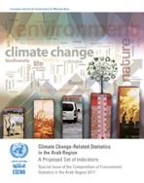
Change-Related Statistics in the Arab Region A Proposed Set of Indicators Special Issue of the Compendium of Environment Statistics in the Arab Region 2017
E/ESCWA/SD/2017/3 Climate Change-Related Statistics in the Arab Region A Proposed Set of Indicators Special Issue of the Compendium of Environment Statistics in the Arab Region 2017 With a view to improving climate change-related statistics collected by national statistical offices (NSOs) in the Arab region, this report proposes a set of climate change-related indicators for compilation by all countries in the region. The set has been chosen to be relevant to the region, not so large as to be burdensome to compile, feasible given existing data and methods and consistent with international recommendations in this area. The indicators are summarized in a table at the end of the report. Original Study prepared by Robert Smith

Slide 7
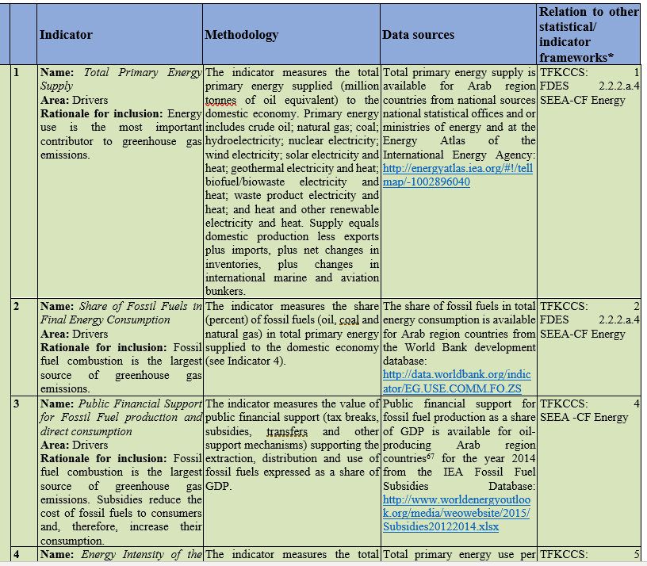
Drivers | Emissions | Impacts | Mitigation | Adaptation
(Total 30 Indicators)
Example of list of Drivers for CC

Slide 8
Global Consultation on the draft Global Set of Climate Change Statistics and Indicators launched by UNSD June 2021
https://unstats.un.org/unsd/envstats/ClimateChange_globalconsultation.cshtml
discussion session dates:
…
English - Wednesday, 14 July, 08:00 a.m. (New York time)
Objectives:
1. Define a Global Set from a list of proposed indicators based on relevance to countries;
2. Consolidate the available methodology for climate change statistics and indicators based on reviews by specialized agencies and countries' expertise;
3. Define improvement needs and gaps in methodology to prioritize future work on the Global Set;
4. Assess existing capacities to compile climate change statistics and indicators.

Slide 9
Official Statistics for DRS
NSOs collecting official socio economic data
  POPULATION DATA: PHH Census-Geospatial (Population numbers and Characteristics and locations Vulnerable people living in high risk natural environment)
  Economic data: Establishment Census –GIS -National Accounts –Regional Accounts Concentration of Production
ENVIRONMENT DATA: Meteorology-Climate- Natural Resources-NSOs (Satellite Imagery/Earth Observations/Land cover water and mineral resources, etc…)
GOVERNMENT FINANCES STATISTICS: Expenditures- Budgets for Disaster risk and for disaster relief
Maps of Infrastructure/Services/
Short-term relief objectives vs official quality data 4 planning

Slide 10
Partnership and Cooperation
Partnership and Cooperation with UN and Regional Organizations: UNSD, regional Commissions, OCHA, UNDRR
The Inter-agency and Expert Group (IAEG) on disaster-related statistics established. UNDRR co-chairs the IAEG with ESCAP and manages the Secretariat.
First Meeting of Inter-Agency and Expert Group on Disaster-related Statistics (IAEG-DRS) online 25 May 2021 - 26 May 2021
First Expert Forum for Producers nd Users of Disaster-related Statistics, online 07 - 10 June 2021 (Main sessions on Classification of Disasters, Health, Climate Change and Geosptial Information
Second Forum to be hosted by UNESCWA next year

Slide 11

Pilot project: ESCWA’s Google Earth Engine using remote sensing for monitoring disaster impact on land cover in Egypt
Objectives
  Explore the effectiveness of remote sensing for detecting disaster areas
  Estimate disaster areas
  Estimate the area of affected land cover types (urban vs vegetation)
  Estimate the number of affected population

Slide 12
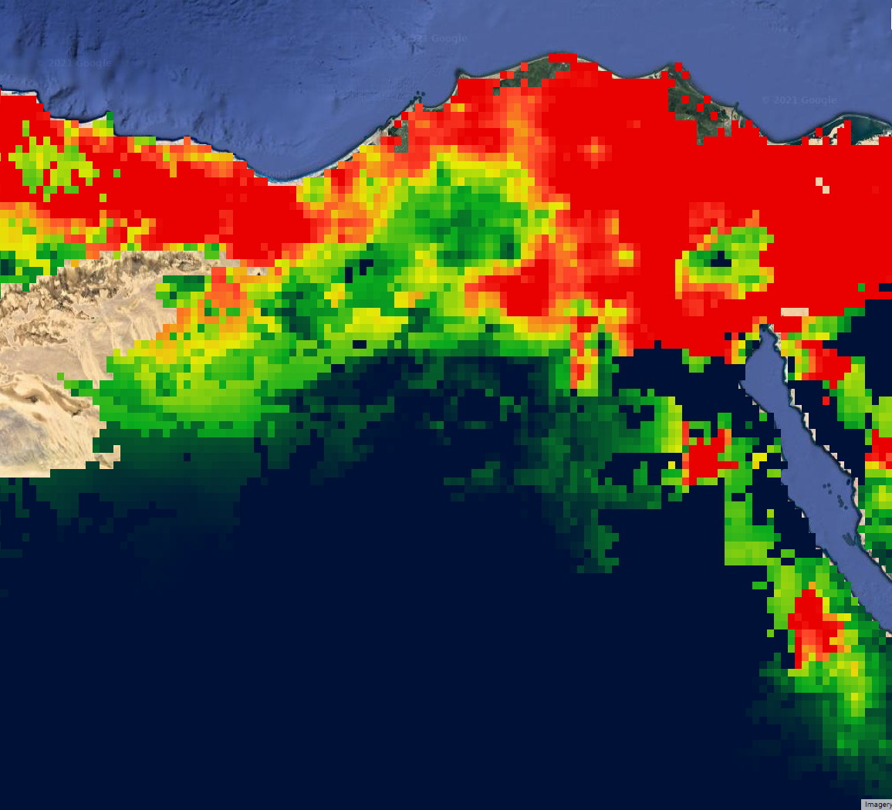
2020 Floods Background
State of emergency declared.
Airports and ports were shut.
Heavy precipitation on March 12, 2020.
Maximum estimated daily precipitation: 139 mm.
https://reliefweb.int/report/egypt/egypt-flash-floods-emergency-plan-action-epoa-dref-operation-n-mdreg015​
https://www.aljazeera.com/news/2020/3/13/storms-bring-widespread-floods-to-egypt-killing-5

Slide 13
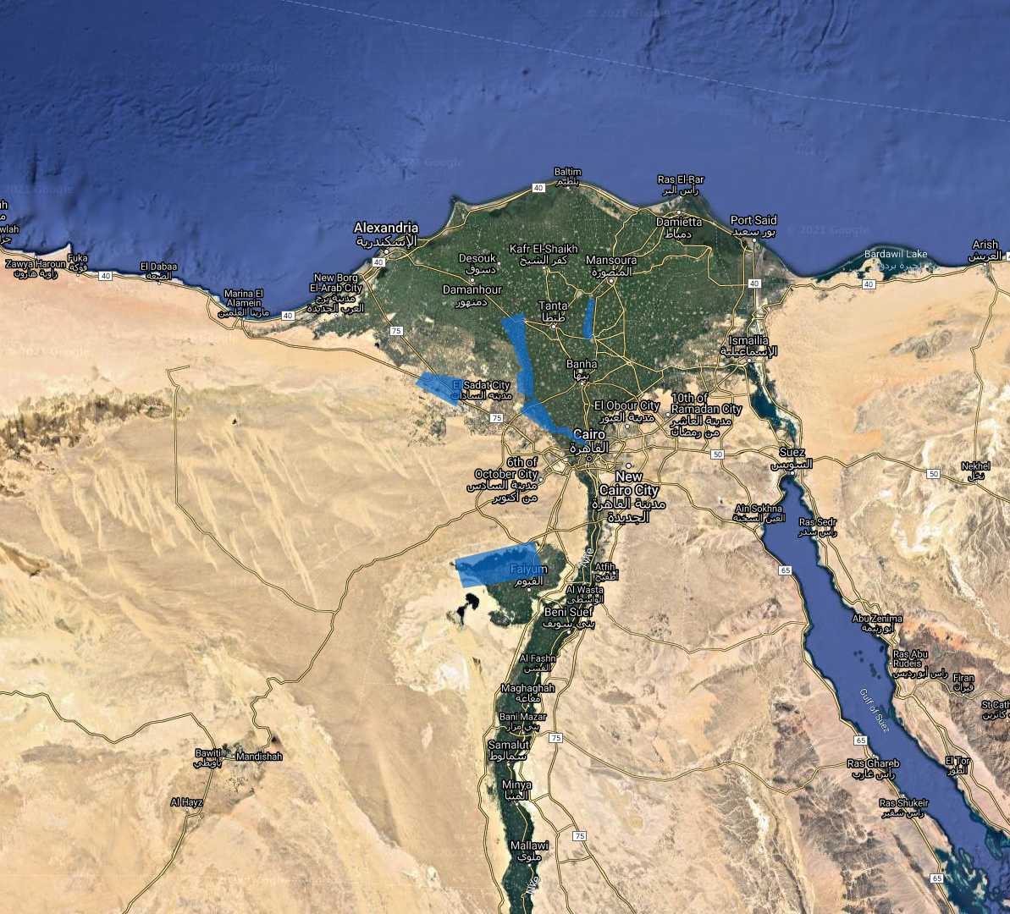
Affected Areas
Al Natron Valley
Qarun Lake
Along the Nile river

Slide 14
Recommendations
Integrate Environmental Accounts, Climate Change and disasters statistics within NSO as main Actor/Partner
Coordinate with for data exchange with main stakeholders
Benefit from geospatial data (Remote Sensing) to integrate them into the official statistics and SDG monitoring: Population, National Accounts, Agriculture, etc. . Information to enable better link between Economy and the Environment, Climate Change Impacts and anticipating disasters, improving preparedness and relief.

