Slide 1
Regional Accounts: Uses, Approaches, and Challenges
United Nations Statistics Division

Slide 2
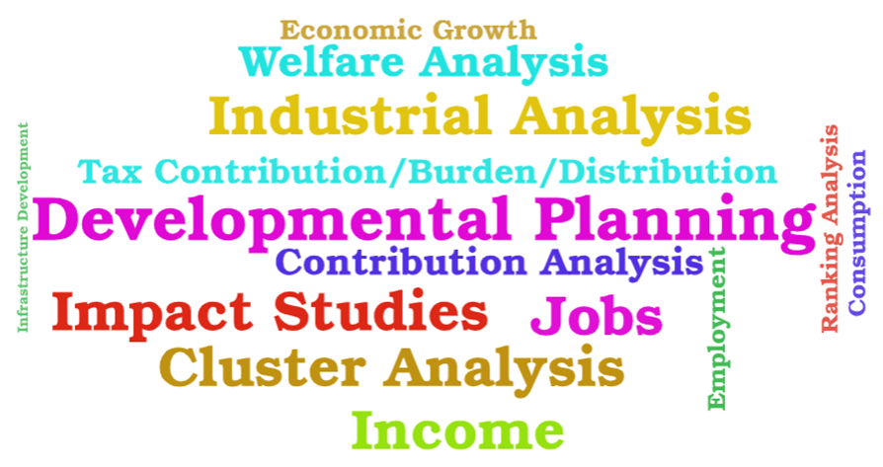
Why do we need Regional Account?

Slide 3
Developing/Enhancing Regional Account
1 – Identify the needs
2 – Determine the accounts to address those needs
=> Aggregates (National Accounts?)
3 – Sources and methods
Consistency with the national levels
Data requirements
Approaches and Methods

Slide 4
How to compile Regional Account?
Approaches
GDP/VA by industry
GFCF data by industry
Household statistics:
Income
Labour/Employment
Consumption expenditure
Methods
Bottom-up
National = Σ Regions
Top-down
Region(i) = 1/i x National
Hybrid
Mix of methods

Slide 5
Some of the challenges when compiling Regional Account?
Allocation of cross-regional economic transactions
Production may occur in more than one region (e.g., transport)
Wages or salaries can be recorded in different regions
Enterprise v/s establishment (overhead costs)
Temporary activities
Non-observed economy
Statistical discrepancies (employment/production/consumption)

Slide 6
Some of the challenges when compiling Regional Account?
Concepts Accuracy/Data availability (e.g., VA)
Population and demographic statistics availability
Allocation of taxes
Distribution of FISIM
Survey representativity
Price and Volume dimensions
Compilation frequency

Slide 7
Regional Accounts
How to compile Regional Account?
Policy Needs
Sources and Methods

Slide 8
Thank you!

