Slide 1
Guidance Notes and the Experimental Estimates
United Nations Statistics Division

Slide 2





Guidance Notes - Cycle
Task Teams
Guidance Notes
(Final Version)
AEG/ISWGNA
Global Consultation
Feedback
Clearance
Endorsement
Guidance Notes
Recommendations
Experimental Estimates

Slide 3
The impact of the new recommendations
Task Team on issues relating Communication
The SNA update work is in full swing:
Most of the research work has been conducted;
Some Guidance Notes (GN) have been endorsed for publication;
Other GNs are in the process to be cleared for global consultation (GC);
Currently, there is just ono GN in GC
The recommendations can be categorized in terms of their impact on the NA concepts and definitions, nonetheless it is important to be aware of their potential impact on the current compilation practices, for instance:
Type 1: | Proposes a change to the 2008 SNA boundaries
Type 2: | Proposes a change to the 2008 SNA Central Framework
Type 3: | Proposes supplementary tables (within boundaries)
Type 4: | Proposes extended/satellite accounts (beyond boundaries)
Type 1: | Proposes a change to the 2008 SNA boundaries
Type 2: | Proposes a change to the 2008 SNA Central Framework
Type 3: | Proposes supplementary tables (within boundaries)
Type 4: | Proposes extended/satellite accounts (beyond boundaries)

Slide 4
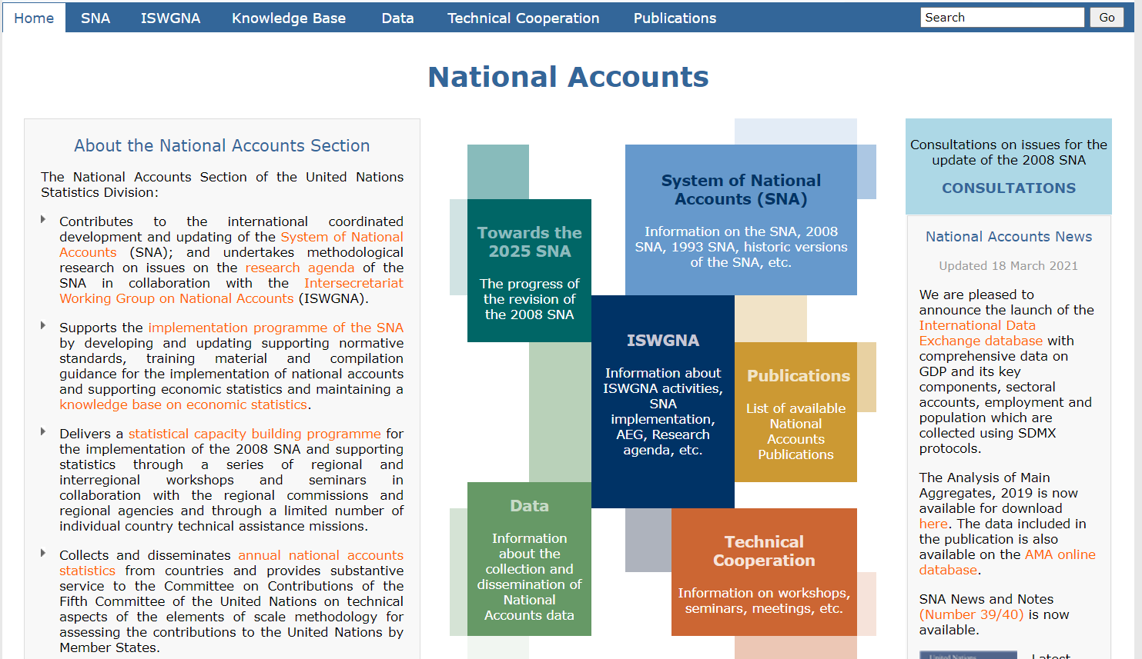
https://unstats.un.org/unsd/nationalaccount/default.asp

Slide 5
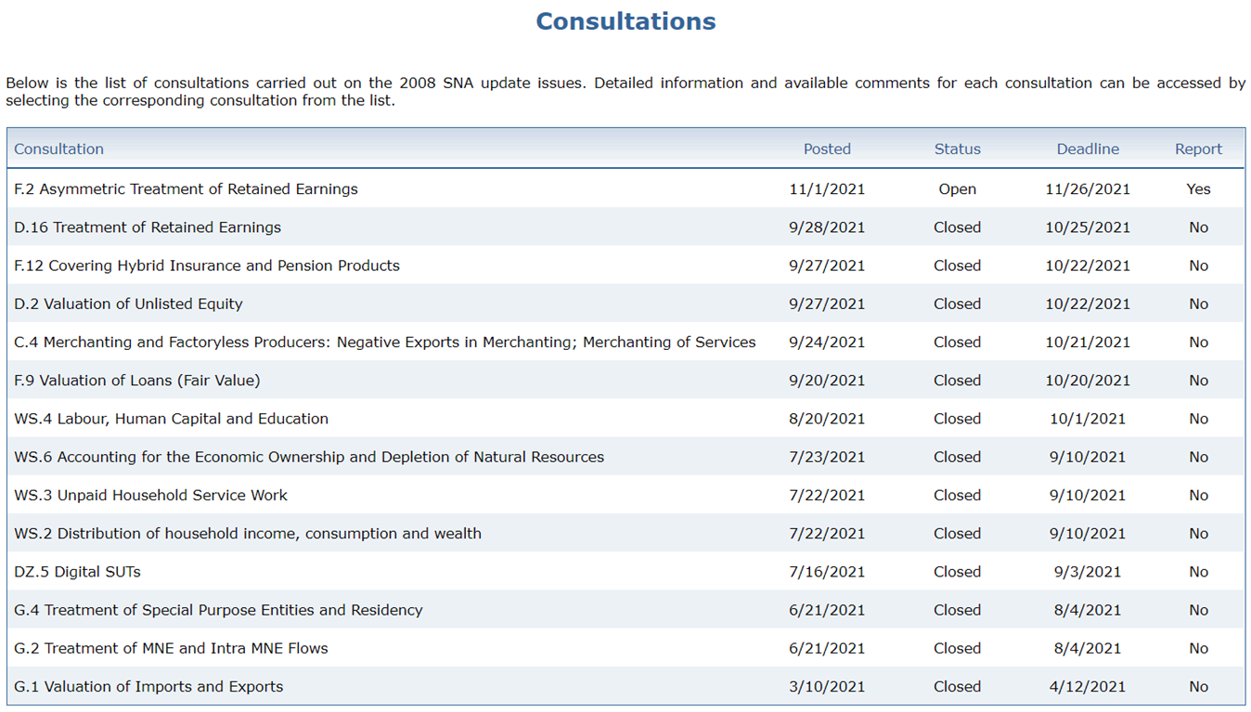
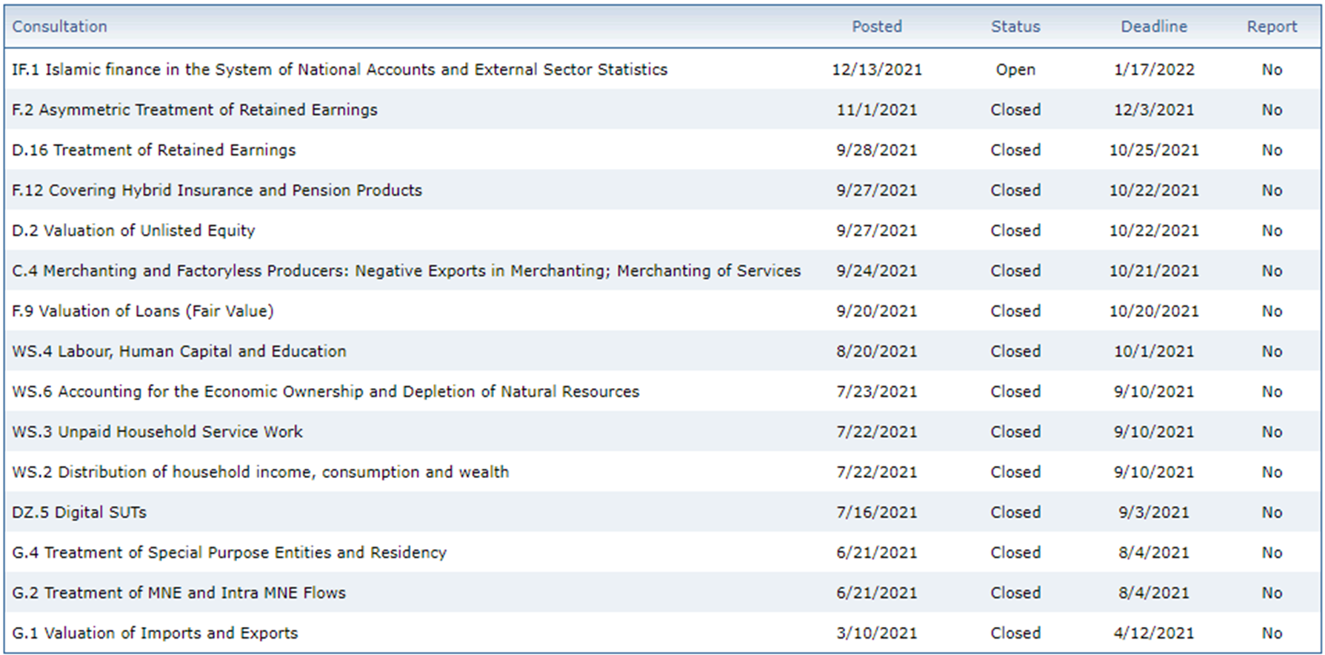
Guidance Notes and Global Consultation
Soon to come:
Informal Economy
Wellbeing and Sustainability
Globalization

Slide 6
Guidance Note Life Cycle
Guidance Note (GN) drafted by TT
Draft GNs reviewed by the committees AEG/ISWGNA, BOPCOM BPTT, etc. => Clearance
Early Implementation
(next 2 years)
Public/Global consultation including
experimentation and testing
Second round review [Only if significant changes]
TT sends GN to the committees AEG/ISWGNA, BOPCOM, etc.
Joint Endorsement
Divergence
Decision by
BOPCOM for BPM6 Update
UNSC for 2008 SNA update
Dispute resolution

Slide 7
Experimental Estimates – proposed flow
[2] Country request: Verint form sent to UNSD
Specific Topic and GN
[3] Country selection procedure
3W
BA - feasibility
[4] Response letter (acceptance or rejection): from RC/UNSD
+2W
Opening meeting proposal
Country commitments acknowledgement
Specific Resources Committed (staff/time)
Intended data to be used/developed
Filled online BA form
AEG/ISWGNA/TTs
RC/UNSD seeks clearance (by email)
Timeline proposal
[5] Project definition
Project plan - timeline
Expert search/selection/appointment
Launching meeting
[6] Mission reporting
Implementation
Results
Feedback
[7] Database – analytical outputs
Reasons for the rejection (if)
[1] Kick-off letter, followed by specific letters with GNs subject to experimentation (Batches)
Harmonized templates

Slide 8
Experimental Estimates – Country request
The starting point of this exercise will be an informative letter (mail) that the regional organization will send to the heads of the statistics offices indicating that during the following weeks, a notification will be sent to the specific NA areas with a call of interest to participate as a volunteer in this component (by a standard request letter):
The standard letter (that will accompany the notification to the NA areas) will require to contain the following information:
  Specific topic(s) and revelated Guidance Note(s) subject to experimentations
  Human recourses that will be devoted to the project (staff and time)
  Type and source of the data to be used in or developed for the estimates
  In addition, the letter will include the baseline assessment metadata form for volunteering countries to review and complete (as necessary) for the selection process

Slide 9
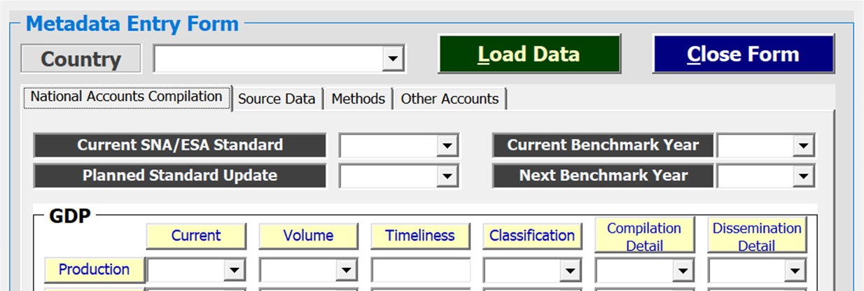
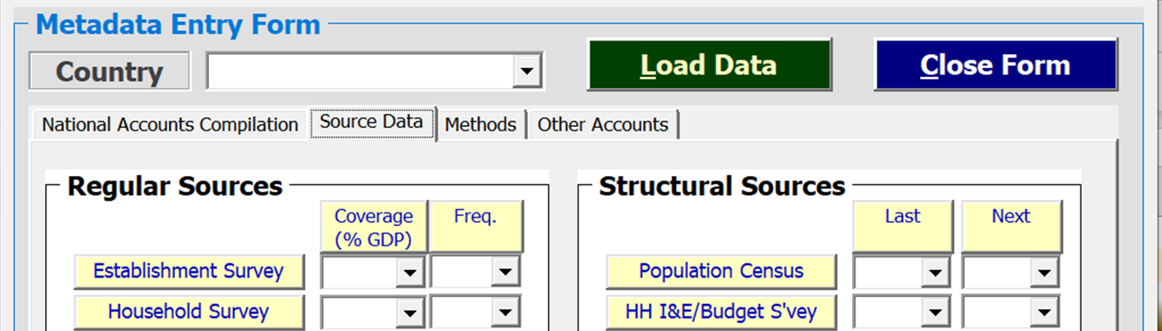
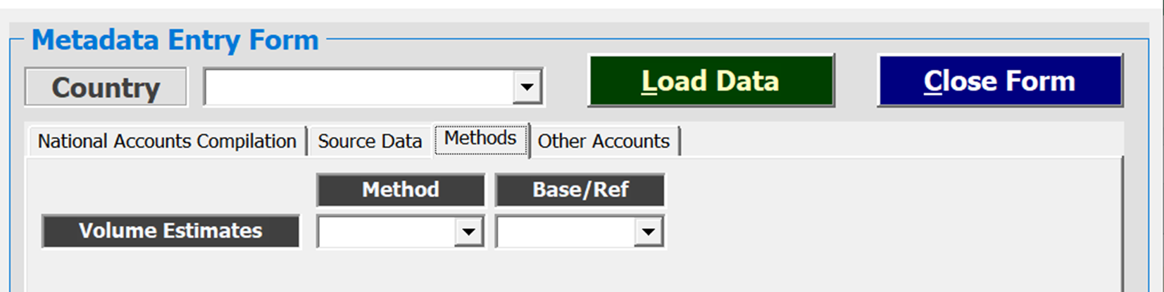
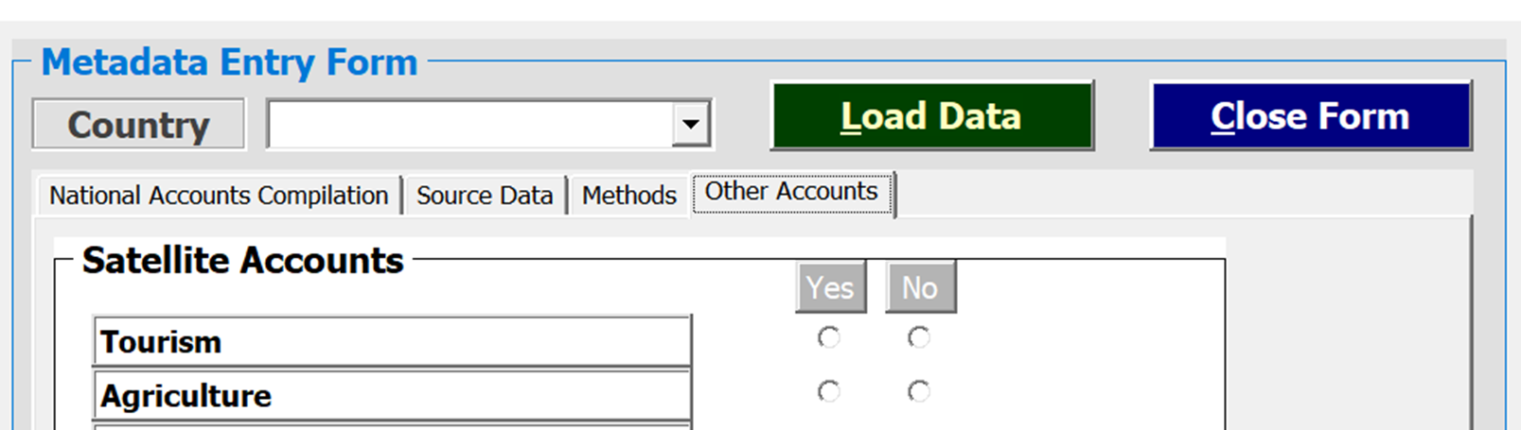
Structural information / Baseline assessment
Sample Form
Online version available during Q1 2022

Slide 10
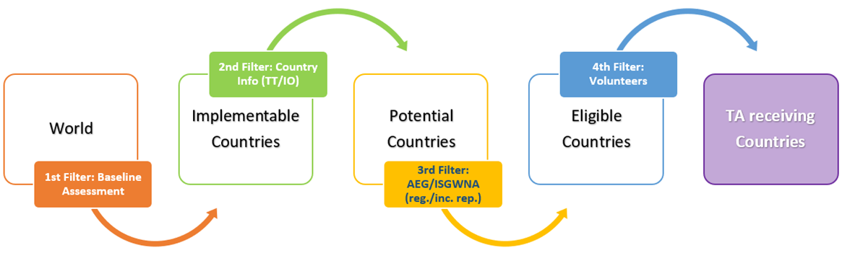
Experimental Estimates – Country selection
Principles
Countries from diverse geographical and statistical development groups
The baseline assessment, on the other hand is intended to be global
Countries needing support will receive technical assistance
Selection Criteria
Baseline assessment
Input from Task Teams and I/R organizations
Current countries’ development plans
Final list of potential countries endorsed by the AEG/ISWGNA

Slide 11
Experimental Estimates – Response to Countries
Official letter informing the selection (or not) from the regional organization, which Will contain the following information:
  Proposed agenda and date for the opening meeting with the team in charge of the project
  Acknowledgement of the time and staff requirements/committed to carry out the project
  Detailed outline and timeline proposal for the project (ideally between 6 and 9 months)
  If a requests in not selected, the letter will clearly state the reasons (e.g., geographical overrepresentation), and may propose alternative arrangements

Slide 12
Experimental Estimates – Following steps
Project definition: terms of Reference
Project report with the details of the project outcomes and process (feedback)
  Future guidance
Results reporting/sharing: centralized database – analytical tables/reports

Slide 13
Thank you!

