Slide 1
General recommendations and online questionnaire
Webinar on the Statistical Treatment of Islamic Finance in the National and International Accounts
16 December 2021
Benson Sim
United Nations Statistics Division

Slide 2
Outline
Issues
General recommendations
Online questionnaire

Slide 3


Issues
Islamic finance is invisible in highly-aggregated macroeconomic statistics
Recording Islamic financial activities in the macroeconomic accounts may be daunting

Slide 4
Recommendations
Include a special section or an appendix on Islamic finance in the updated SNA and BPM to
Highlight the differences between conventional and Islamic finance
Consolidate all the entries in the accounts connected with Islamic finance and
Explain their interconnections
Develop Islamic finance compilation guide to provide
Guidance on developing an Islamic finance satellite account to enhance statistical visibility
Practical guidance and illustrative numerical examples on recording Islamic financial activities in the macroeconomic accounts

Slide 5
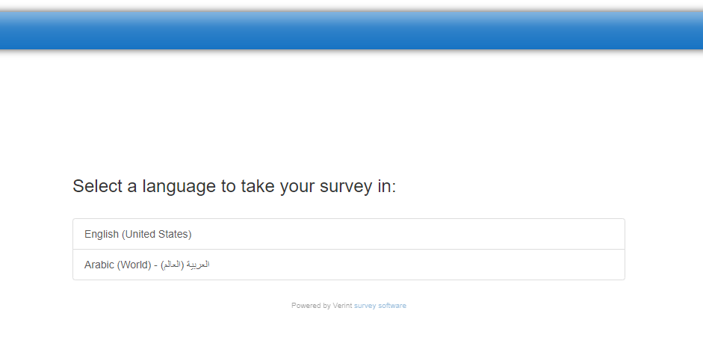
Online questionnaire
Online questionnaire in Arabic and English for global consultation is available

Slide 6

Online questionnaire
Please use online questionnaire to provide responses by 25 January 2022
Once-in-a-lifetime opportunity as update of SNA and BPM does not occur often
Your inputs will help us to refine the recommendations on Islamic finance for the updated SNA and BPM

Slide 7

Thank you for your attention
sna@un.org

