Slide 1
Amman, 12 December 2019
Initiative to mesure
SDG 16
National Institute of Statistics, Tunisia
National household Survey

Slide 2
01
Content
Context and Objectives
Design and methodology
Modules
Disagregation
Some key results
Learned Lessons
Further step
Conclusion

Slide 3
02
Context and Objectives
indicators
Decentralize
Develop strategy to enhance local governace
Promote Citizen engagement
Specify citizen needs at
local level
Monitoring &
Evaluation
Reduce region disparity
Governance
SDG’s 16

Slide 4
03
Context and Objectives
National Institute of Statistics and UNDP partnered in developing a national citizen survey, the first in its kind in Tunisia, in 2014,
The project conceived as a part of regional initiative focusing on transitioning countries (UNDP) and SHaSa-GPS initiative ( Strategy for Harmonization of Statistics in Africa on Governance, Peace and Security,
Tunisia is member of Praia Group ( Africa)
Tunisia was one of the five pilot countries of the UNDP initiative to pilot
illustrative work on Governance within the framework of the SDGs.
Civil society
Institutions
Rule of Law

Slide 5
04
Context and Objectives
The Survey aims to :
Establish better understanding of local governance
Explore the dynamic between state and non-state actors in governance and social benefits,
Develop strategic recommendations for strengthening democratic governance at local level,
Respond the needs of Tunisian pilot Governance SDG
Provide tools for measuring, monitoring and assessing Governance, Peace , and Security.

Slide 6
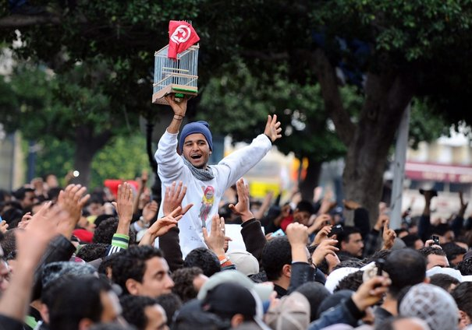
05
Octobre 2014::Financed by UNDP
Octobre 2017 : Financed by Tunisian Government
October 2021: Planned, Financed by Tunisian Government
Design and Methodology

Slide 7
06
Design and Methodology
Title:” Citizen Perception for Peace, Liberties and Local Governance”
Representativeness: National and Regional level (7 big regions), Urbain/Rural
Targeted population: aged 18 years and above
Sample size: average of 4800 households ( 10.000-12.000 persons)
Sampling frame: Census
Data Collection period : September – October ( 2014, 2017, 2021,…)
Establishment of :
National committee :national stakeholders to identify country priorities
Technical Committee: conceptualize and implement the survey

Slide 8
06
Modules
Questionnaire modules:
individual charecteristics
Engagement in civil society and political participation
Perception for freedom, humain rights, discrimination in Tunisia
Perception for public health and social protection services at local level
Perception for public education services at local level
Perception to peace and security at local level
Perception for administration, judiciary and tax collection and customs authorities other services at local level
Perception and satisfaction of local authorities
Perception for corruption at local level
Three sets of indicators adopted: Objective, Capacities, Perception

Slide 9
07
Disaggregation
All indicators are disaggregated by:
Gender
Age
Level of Education
Professional status
Urbain / rural
7 Big regions
Provide larger apportunities for tabulation and analysis

Slide 10
08
Some key Results
Corruption in health sector
Limited participation of youth in politics and civil society activities
About 90% of citizens are not engaged in activities in their localities
The parliament, the civil society consider survey results for monitoring and
evaluation of the government effort to fight corruption

Slide 11
09
Some key results: Discrimination (16.b.1 )

Slide 12
10
Some key results: Governance (16.6.2.a)

Slide 13
11
Some key results: Governance (16.5.1)
Proportion of persons who paid a bribe to a public official, during the previous 12 months is 11%

Slide 14
12
Some key results: Violence (16.1.3.a)
Proportion of victims of violence ( physical) in the previous 12
2.5%
Yes :
65%
Yes:
55%
No:
45%
No:
35%
Proportion of victims of violence in the previous 12 months
Reporting to competent authorities
Satisfaction

Slide 15
13
Lessons Learned
Citizen show interest in responding in such kind of surveys and look forward to see results concretization,
Enthusiasm of citizen for being consulted and expressing their point of view,
Gather suggestions from citizen to promote the life at local level
Citizen concerns at local level is different from governorate (24 governorate) to another, having a larger sample to produce results at governorate level is one of the capital recommendations for future surveys
NSO’s should begin courageously collecting and producing data on governance, peace and democracy, to improve and assess democratic processes

Slide 16
14
Further Steps
Ongoing: Pilot Survey in the governorate of Tataouine (South of Tunisia) to test the SDG’s 16 survey modules proposed by UNDP.
2020: integration of extra modules to bridge SDG 16 data gaps ( learned lessons from the pilot survey mentioned above) .
October 2021: Implementation of the national survey

Slide 17
Conclusion
15
NIS Tunisia is leader in producing Governance, Peace and Democracy statistics at national level: undetaken a national survey on local governance
NIS Tunsia is leader in piloting the Africain initiative : SHaSa-GPS initiative
NIS is the president of the elected bureau of the STG – GPS created by AU
NIS will provide statistics and indicators to work on Governance within the framework of the SDGs.
NIS Tunsia ready to share her experience with the other NIS, as a step to encourage NIS’s producing statistics on governance , Peace and Democracy.
Producing tools to measure governance, peace and democracy is capital for decision makers

