Slide 1
SDMX Converter
Rabih El Habta
First National Training on the Use of SDMX in SDG Reporting
28-30 August 2023

Slide 2
SDMX Converter
Software developed by Eurostat
Can be used to convert data from a variety of formats into SDMX and vice versa
Supports CSV, Excel, DSPL, and others
Can be used to transform….
  Non-SDMX data to SDMX
  SDMX to non-SDMX
  SDMX format to another SDMX format

Slide 3
SDMX Converter: Applications
SDMX Converter is available as
  Desktop application with a Graphical User Interface
  Command-line application
  Web service
  Java library
  Web application
Download from: https://bit.ly/3qDa7Br

Slide 4


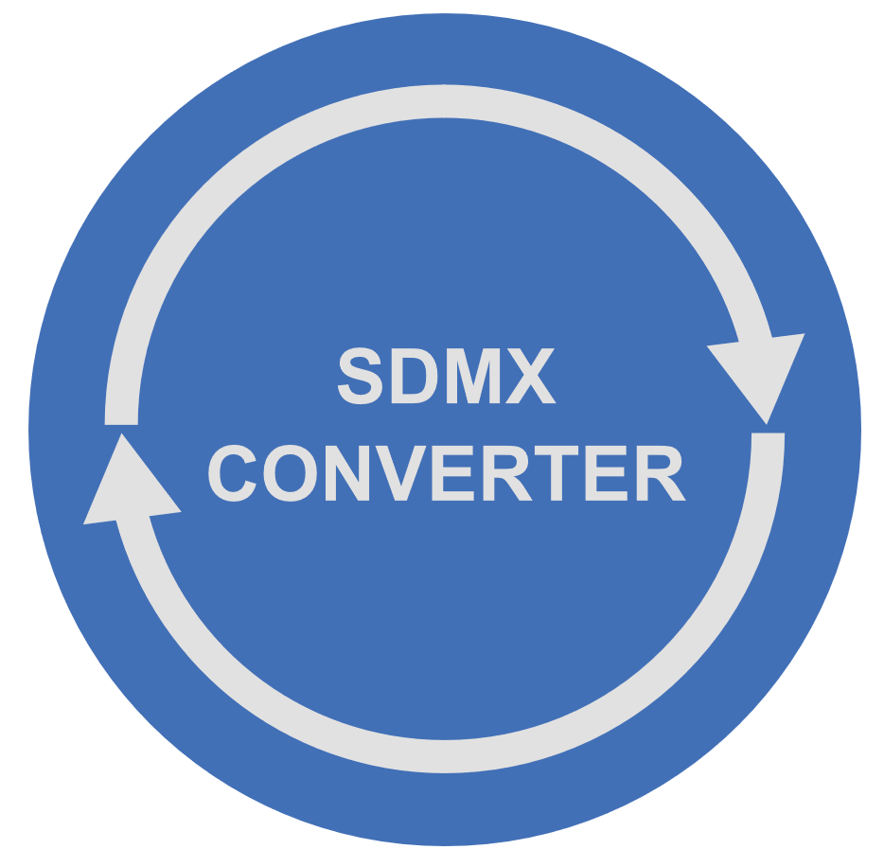


Converting data to SDMX
To transform data to SDMX using the SDMX Converter, you need
  Source data as CSV, DSPL, Excel, etc.
  A Data Structure Definition (DSD) according to which the SDMX dataset will be structured
  Mappings that show how the source data maps to the concepts of the Data Structure Definition
  As always in setting up SDMX exchange, configuring mappings takes the most time and effort

Slide 5
Using SDMX Converter with Excel
Data and mappings can be placed into the same spreadsheet
  Mappings can also be supplied from an external file
Additional information can be added to facilitate data entry
  E.g. code lists for validation and display of descriptions

Slide 6
Worksheet names
Worksheet named Parameters contains mappings
  Shows how cells, rows, and columns map to the DSD dimensions and attributes
Multiple parameter sheets can be used if worksheets have different mappings.
  In that case, worksheet named Parameter_mapping must show which parameter worksheets apply to which data worksheets
  Parameter worksheet names must start with Parameter
Worksheet names starting with VAL are ignored
  Can be used to store code lists or other ancillary information
Transcoding worksheet names must start with Trans
All other worksheets are considered to contain data and will be processed

Slide 7
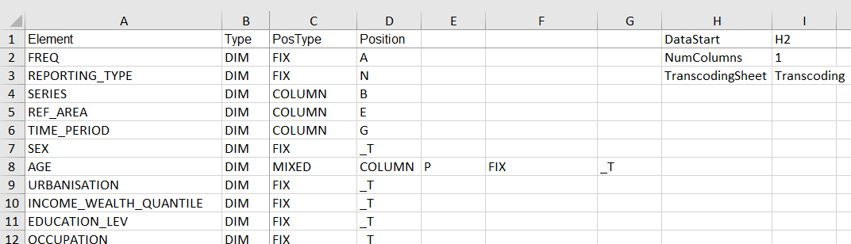
Excel Mappings: the Parameters worksheet
Mapping type
Cell where
data starts
Concept
Number of
obs. columns
Position or value
Concept
Role

Slide 8
Excel mappings worksheet
Element: name of the DSD concept
Type: role of the concept
  DIM: Dimension
  ATT: attribute
PosType: Mapping or position type
Position: position or value
DataStart: the first cell containing an observation
NumColumns: number of observations per row

Slide 9
Column PosType: mapping or position type
The following mapping/position types are supported:
  CELL
  ROW
  COLUMN
  FIX
  OBS_LEVEL
  MIXED
  SKIP

Slide 10
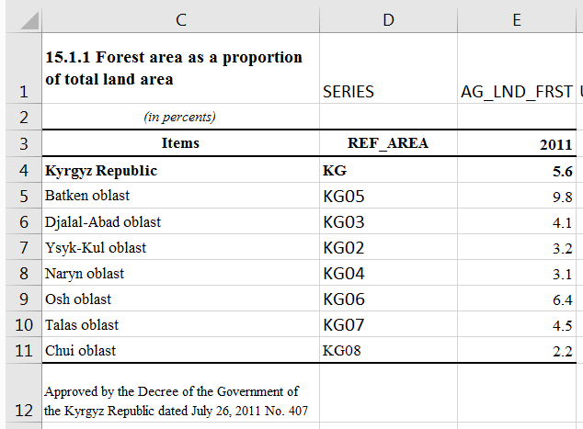
Mapping type: CELL
The value for the entire worksheet is specified in the cell provided in the column Position
E.g. if the worksheet is expected to only contain data for a single indicator, its code can be provided in a cell.

Slide 11
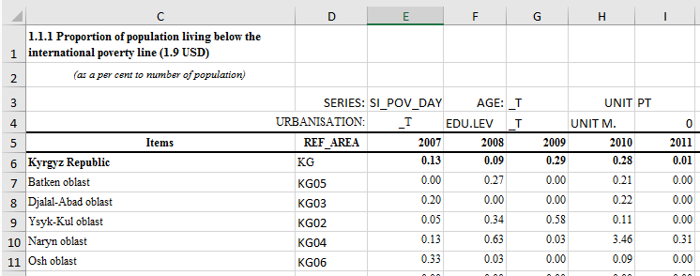
Mapping type: ROW
Values for the concept are stored in the row specified in
column Position

Slide 12
Mappings type: COLUMN
Values for the concept are stored in the column specified in column Position

Slide 13
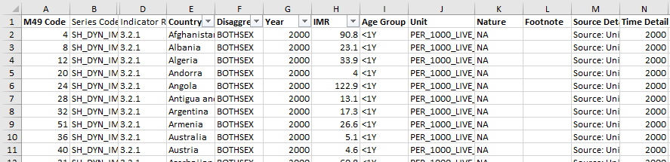
Mapping type: COLUMN (2)
Also used with record-based representation, when each row contains one record or observation, and each column holds values for one concept.

Slide 14

Mapping type: FIX
Fixed value for the entire dataset is stored in the column Position and does not appear in the data spreadsheet
  E.g. if the data is always expected to be annual, frequency can be coded for the entire spreadsheet

Slide 15
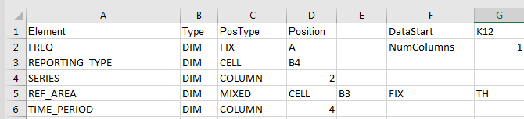
Mapping type: MIXED
The concept value is conditional
Can be used to provide a default value
“Use cell B3 for concept REF_AREA. If the cell is empty, use fixed value TH”

Slide 16

Mapping type: OBS_LEVEL
Can be used in to specify attributes attached at the observation level relative to the cell containing the observation.
  E.g. when each row has multiple observations and their attributes.
“For attribute OBS_STATUS, use cell that is 1 column to the right of the cell containing the observation value. If that cell is empty, use the value in cell H14.”

Slide 17
Mapping type: SKIP
The concept value is not mapped
Can only be used with optional attributes

Slide 18
Using DSDs and dataflows
SDMX Converter can use either a DSD or a dataflow to validate or convert datasets
Using datataflows is typically more strict because content constraints are usually attached to dataflows
  For example, a structurally valid national SDG dataset will pass validation against the SDG DSD and country global dataflow DF_SDG_GLC, but will fail validation against the harmonized global dataflow DF_SDG_GLH
  In addition, a structurally valid national SDG dataset will fail validation against the country dataflow DF_SDG_GLC if it contains invalid relationships among dimensions, e.g. Female sex with indicator “Land area covered by forest”.

Slide 19
Using SDMX registries
SDMX Converter can load structures from either a file or a registry
If structure is loaded from a file, it must be complete with all required references.
  At least, the file must contain a DSD, its Concept Scheme, and all reference code lists
If structure is loaded from a registry, all referenced structures will be used automatically
Addresses of commonly used registries are provided by default. Address of any registry-compliant web service can be entered manually.

Slide 20
Exercise: Using SDMX Converter
Use SDMX Converter to retrieve data from a pre-mapped spreadsheet and convert it to SDMX

Slide 21
THANK YOU!

