Slide 1

Expert Group Meeting
“Towards a Regional Monitoring Framework for
Enhancing Institutional Effectiveness, Advancing Inclusiveness
Ending Violence, and Strengthening Anti-Corruption”
Relevance and Limitations of Secondary Data Analysis
Amman - Jordan
12-13 December 2019
Farah Choucair
Regional Programme, UNDP RBAS
farah.choucair@undp.org

Slide 2
SDG 16: Relevance and Limitations of Secondary Data Analysis
1. SDG 16: Selected Targets & Indicators
2. Global and Regional Databases
3. Relevance and Limitations

Slide 3
1. SDG 16: Selected Targets and Indicators

Slide 4
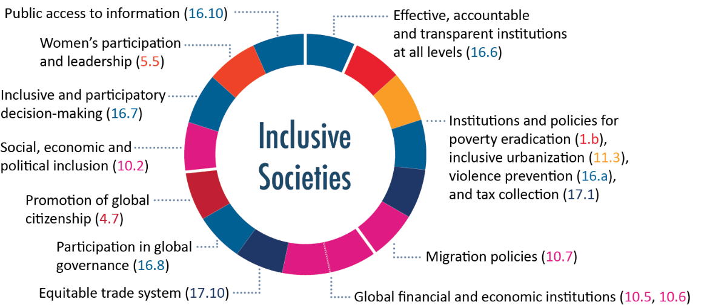
SDG 16: Selected Targets and Indicators

Slide 5
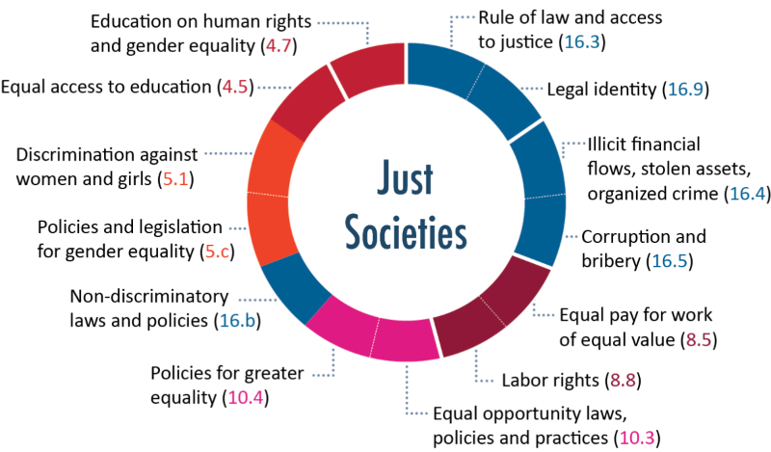
SDG 16: Selected Targets and Indicators

Slide 6
2. Global and Regional Databases
32 sources
440 governance indicators
193 SDG indicators

Slide 7
16.3 Promote the rule of law at the national and international levels and ensure equal access to justice for all
Global and Regional Databases (1)
16.3.1 Proportion of victims of violence in the previous 12 months who reported their victimization to competent authorities or other officially recognized conflict resolution mechanisms | Public trust in the public security apparatus | Arab Barometer
 | Public trust in the armed forced (the army) | Arab Barometer - ALSO WVS
 | Public confidence in the police | WVS
 | Public opinion on involvement in corruption of the police | Global Corruption Barometer
 | Public opinion on involvement in corruption of judges and magistrates | Global Corruption Barometer
 | Correctional system is effective in reducing criminal behavior | WJP Rule of Law Index
 | Public trust in the courts and legal system | Arab Barometer - AND WVS
 | Police services | Ibrahim Index of African Governance (IIAG)
16.3.2 Unsentenced detainees as a proportion of overall prison population | Criminal adjudication system is timely and effective | WJP Rule of Law Index
 | Detention without a charge | Arab Democracy Index

Slide 8
16.5 Substantially reduce corruption and bribery in all their forms
Global and Regional Databases (1)
16.5.1 Proportion of persons who had at least one contact with a public official and who paid a bribe to a public official, or were asked for a bribe by those public officials, during the previous 12 months | Public opinion on whether corruption has increased over the past year | Global Corruption Barometer
 | Public opinion on involvement in corruption of the President/Prime Minister and Officials in his office | Global Corruption Barometer
 | Public opinion on involvement in corruption of Representatives in the Legislature (i.e. Members of the Parliament or Sentators) | Global Corruption Barometer
 | Public opinion on involvement in corruption of government officials | Global Corruption Barometer
 | Public opinion on involvement in corruption of local government councilors | Global Corruption Barometer
 | Public opinion on involvement in corruption of the police | Global Corruption Barometer
 | Public opinion on involvement in corruption of Tax Officials, like Ministry of Finance officials or Local Government tax collectors | Global Corruption Barometer
 | Public opinion on involvement in corruption of judges and magistrates | Global Corruption Barometer
 | Public opinion on involvement in corruption of religious leaders | Global Corruption Barometer
 | Public opinion on involvement in corruption of business executives | Global Corruption Barometer
 | Total bribery rate | Global Corruption Barometer
 | Public opinion on level of corruption in state agencies | Arab Barometer
 | Public opinion on obtaining employment through connections | Arab Barometer
 | Public opinion on use of wasta (favoritism) in public employment | Arab Democracy Index
 | Government offcials in the executive branch do not use public office for private gain | WJP Rule of Law Index+B18:C18
 | Government offcials in the judicial branch do not use public office for private gain | WJP Rule of Law Index
 | Government officials in the police and military do not use public office for private gain | WJP Rule of Law Index
 | Government officials in the legislative branch do not use public office for private gain | WJP Rule of Law Index

Slide 9
16.5 Substantially reduce corruption and bribery in all their forms
Global and Regional Databases (1)
16.5.2 Proportion of businesses that had at least one contact with a public official and that paid a bribe to a public official, or were asked for a bribe by those public officials during the previous 12 months | Bribery incidence (percent of firms experiencing at least one bribe payment request) | Enterprise surveys (World Bank)
 | Bribery depth (% of public transactions where a gift or informal payment was requested) | Enterprise surveys (World Bank)
 | Percent of firms expected to give gifts in meetings with tax officials | Enterprise surveys (World Bank)
 | Percent of firms expected to give gifts to secure government contract | Enterprise surveys (World Bank)
 | Value of gift expected to secure a government contract (% of contract value) | Enterprise surveys (World Bank)
 | Percent of firms expected to give gifts to get an operating license | Enterprise surveys (World Bank)
 | Percent of firms expected to give gifts to get an import license | Enterprise surveys (World Bank)
 | Percent of firms expected to give gifts to get a construction permit | Enterprise surveys (World Bank)
 | Percent of firms expected to give gifts to get an electrical connection | Enterprise surveys (World Bank)
 | Percent of firms expected to give gifts to get a water connection | Enterprise surveys (World Bank)
 | Percent of firms expected to give gifts to public officials "to get things done" | Enterprise surveys (World Bank)
 | Percent of firms identifying corruption as a major constraint | Enterprise surveys (World Bank)

Slide 10
16.6 Develop effective, accountable and transparent institutions at all levels
Global and Regional Databases (1)
16.6.1 Primary government expenditures as a proportion of original approved budget, by sector (or by budget codes or similar) | Quality of Budgetary and Financial Management | Country Policy and Institutional Assessments (CPIA) by the World Bank
 | Budget Oversight, Participation | Open Budget Survey
16.6.2 Proportion of the population satisfied with their last experience of public services | Public opinion on performance of public institutions | Arab Democracy Index
 | People's satisfaction with the educational system | Arab Barometer
 | Puplic opinion about the current government’s performance in addressing educational needs | Arab Barometer
 | People's satisfaction with the healthcare system | Arab Barometer
 | Public opinion about the current government’s performance in improving basic health services | Arab Barometer
 | Public opinion about government employees' awareness of citizens' needs | Arab Barometer
 | Public satisfaction with government performance | Arab Barometer
 | Public confidence in the civil service | WVS

Slide 11
16.7 Ensure responsive, inclusive, participatory and representative decision-making at all levels
Global and Regional Databases (1)
16.7.1 Proportions of positions (by sex, age, persons with disabilities and population groups) in public institutions (national and local legislatures, public service, and judiciary) compared to national distributions | Women in the judiciary | Ibrahim Index of African Governance (IIAG)
 | Political Empowerment Sub-Index | World Economic Forum
 | Women's political participation | Ibrahim Index of African Governance (IIAG)
 | Gender balance in rural decision-making | Ibrahim Index of African Governance (IIAG)
 | Women in national parliaments | Inter-Parliamentary Union
 | Youth in national parliaments (30 years or younger) | Inter-Parliamentary Union
 | Youth in national parliaments (40 years or younger) | Inter-Parliamentary Union
 | Youth in national parliaments (45 years or younger) | Inter-Parliamentary Union
 | Egalitarian democracy index | V-Dem

Slide 12
16.7 Ensure responsive, inclusive, participatory and representative decision-making at all levels
Global and Regional Databases (1)
16.7.2 Proportion of population who believe decision-making is inclusive and responsive, by sex, age, disability and population group) | Public opinion about government employees' awareness of citizens' needs | Arab Barometer
 | Deliberative Component Index | V-Dem
 | Participatory component Index | V-Dem
 | Complaint mechanisms | WJP Rule of Law Index

Slide 13
16.10
Global and Regional Databases (1)
Ensure public access to information and protect fundamental freedoms, in accordance with national legislation and international agreements
16.10.2 Number of countries that adopt and implement constitutional, statutory and/or policy guarantees for public access to information | Open Government | WJP Rule of Law Index
 | Right to information | WJP Rule of Law Index
 | Global Right to Information Rating | Access Info Europe (AIE) and the Centre for Law and Democracy (CLD)
 | Access to information | Ibrahim Index of African Governance (IIAG)
 | Publication of draft laws | Arab Democracy Index
 | Publicized laws and government data | WJP Rule of Law Index
 | Global Open Data Index | Open Knowledge Network
 | Open Budget index | International Budget Partnership

Slide 14
16.10
Global and Regional Databases (1)
Promote and enforce non-discriminatory laws and policies for sustainable development
16.b.1 Proportion of population reporting having personally felt discriminated against or harassed in the previous 12 months on the basis of a ground of discrimination prohibited under international human rights law | Public opinion on feeling treated equally compared to others | Arab Barometer
 | Public opinion on acceptability of other religions than mine | WVS
 | Public opinion on likelihood of racist behavior in the neighborhood | WVS
 | Equal treatment and absence of discrimination | WJP Rule of Law Index
 | Protection against discrimination | Ibrahim Index of African Governance (IIAG)

Slide 15
3. Relevance & Limitations

Slide 16
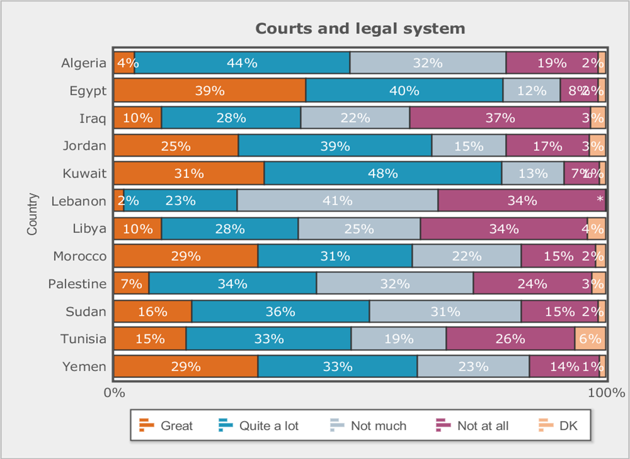
16.3.1 Proportion of victims of violence in the previous 12 months who reported their victimization to competent authorities or other officially recognized conflict resolution mechanisms
N= 26,721
45.5%: not much trust or no trust at all
N= 26,721
45.5 % لا نثق بالمحاكم والنظام القانوني كثيرا أو لا نثق فيها اطلاقا

Slide 17
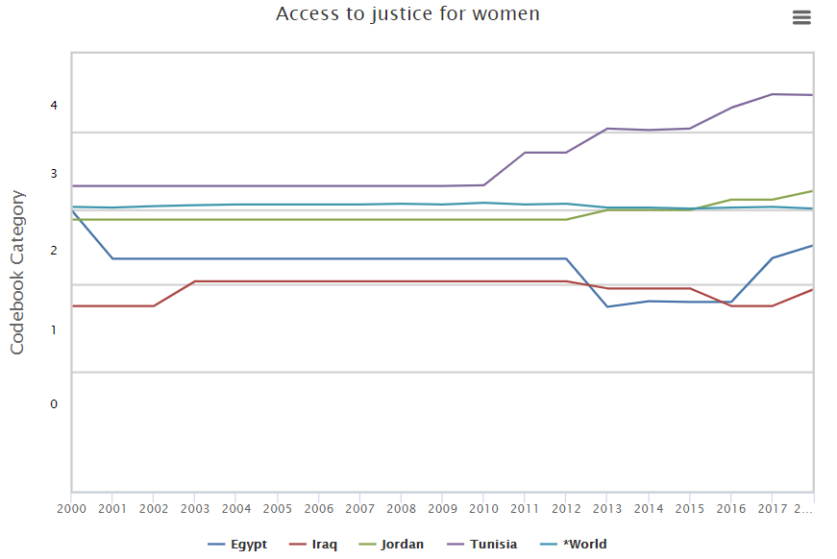
Source: V-Dem Institute, University of Gothenburg.
الوصول إلى العدالة للنساء
تونس
الأردن
العالم
مصر
العراق
Countries: 202 countries
Year coverage: 1789-2018
450+ V-Dem indicators, 81 indices and 5 high-level indices

Slide 18
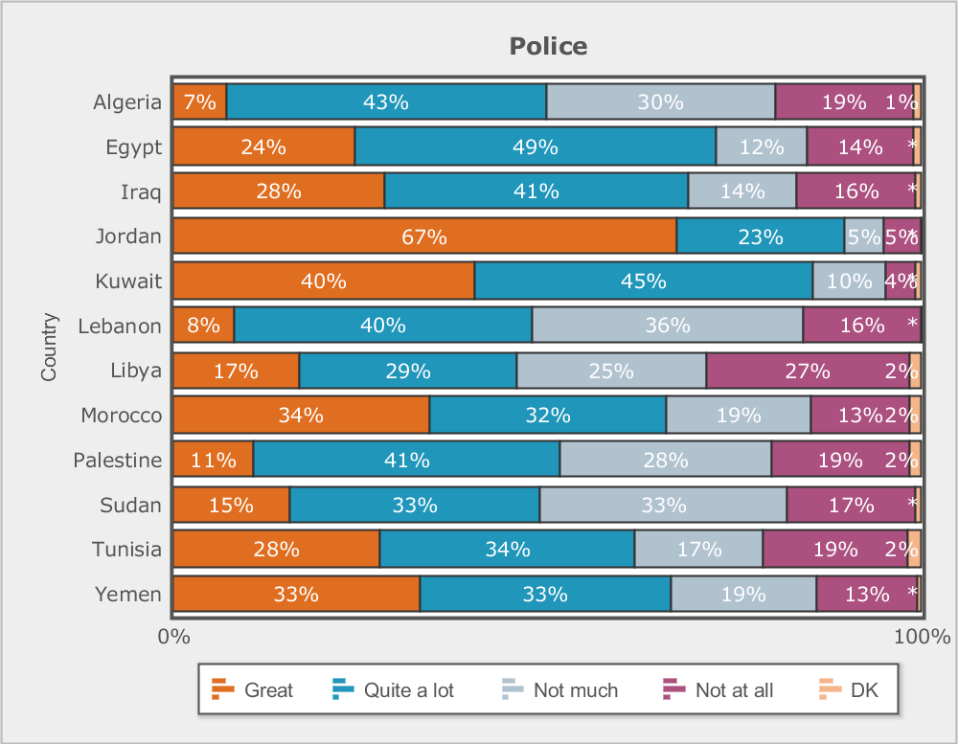
16.3.1 Proportion of victims of violence in the previous 12 months who reported their victimization to competent authorities or other officially recognized conflict resolution mechanisms
N= 26,721
36.5% not much trust or no trust at all
N= 26,721
36.5% لا نثق بالشرطة كثيرا أو لا نثق فيها اطلاقا

Slide 19
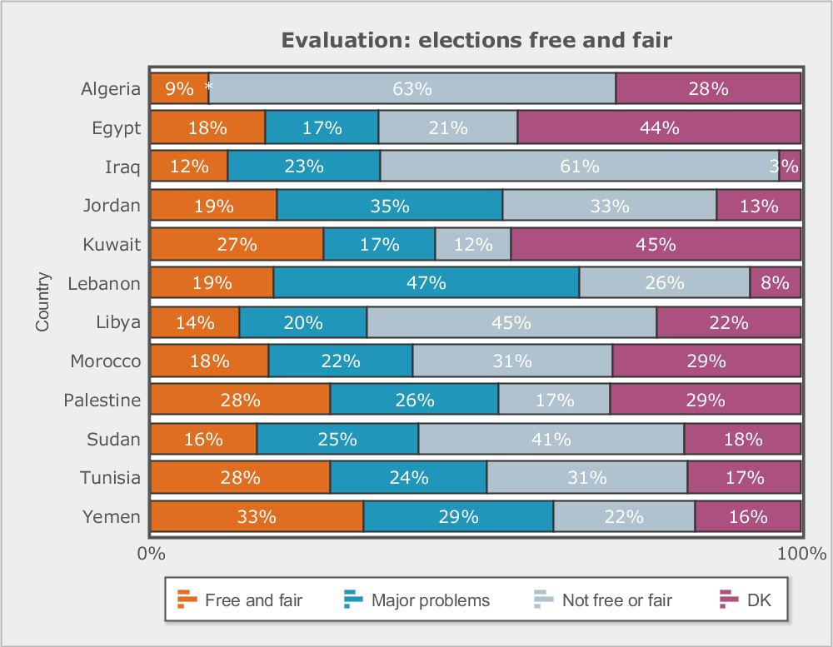
16.7.2: Proportion of population who believe decision-making is inclusive and responsive, by sex, age, disability and population group
N= 26,721
Free and fair, with major problems: 24%
Not free and fair: 34%
Don’t know: 22%
24%: حرة وعادلة ولكنها تعاني من مشاكل كبيرة
34%: ليست حرة وعادلة
لا أعرف: 22%

Slide 20
The World Justice Project Rule of Law Index measures how the rule of law is experienced and perceived by the general public in 126 countries and jurisdictions worldwide based on more than 120,000 household and 3,800 expert surveys.
Featuring primary data, the WJP Rule of Law Index measures countries’ rule of law performance across eight factors: Constraints on Government Powers, Absence of Corruption, Open Government, Fundamental Rights, Order and Security, Regulatory Enforcement, Civil Justice, and Criminal Justice
4.1 Equal treatment & absence of discrimination: Measures whether individuals are free from discrimination—based on socio-economic status, gender, ethnicity, religion, national origin, sexual orientation, or gender identity—with respect to public services, employment, court proceedings, and the justice system
More countries declined than improved in overall rule of law performance for a second year in a row, continuing a negative slide toward weaker rule of law around the world.
7 Arab countries: Algeria, Egypt, Jordan, Lebanon, Morocco, Tunisia and UAE

Slide 21

On 23 October 2018, Law no. 50 was approved by the Parliament. The law envisages up to three years of prison and fines for acts of racial discrimination (depending on the gravity of the act) and includes protection of migrants from such acts.
Is this useful?
Source: WJP 2019

Slide 22
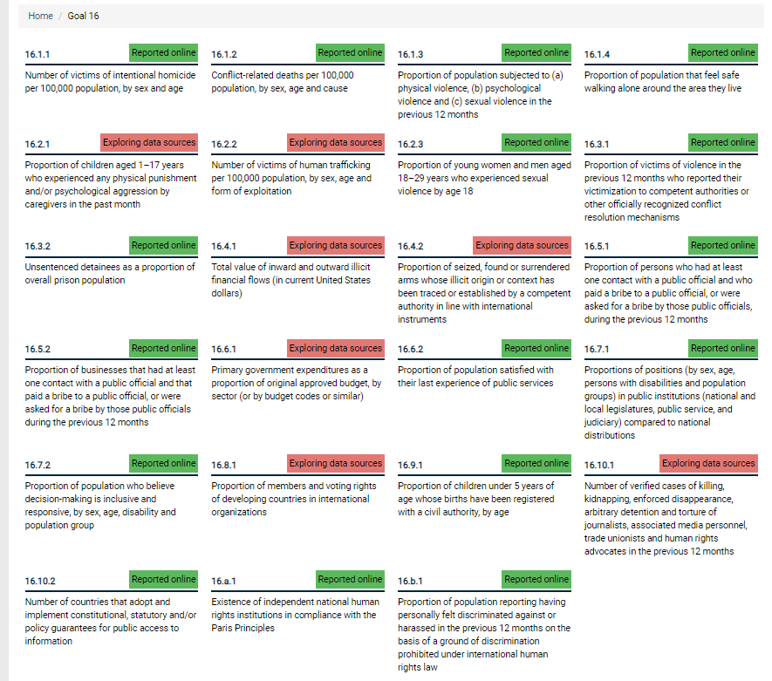
How to make use of secondary data analysis?
  (16) البيانات متاحة على الانترنت Reported online
  جاري البحث عن مصادر جديدة
  Exploring data (7) sources
Source: UK SDG Platform, Office of National Statistics

Slide 23

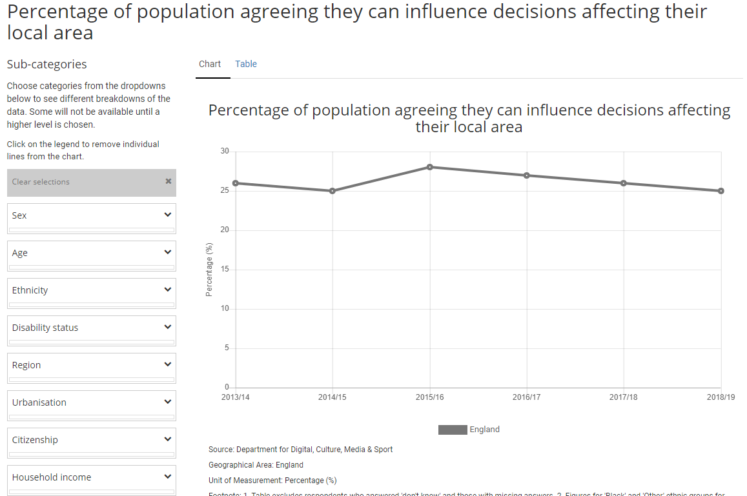
25%
النوع الاجتماعي
نسبة الذين اعتبروا أنه يمكنهم التأثير على القرارات في مناطقهم
العمر
الاثنية
نوع التحديات الجسدية
المنطقة
حضر-ريف
المواطنة
دخل الأسرة
Source: UK SDG Platform, Office of National Statistics

