Slide 1
CRVS in Asia and the Pacific
Tanja Sejersen
Statistician and CRVS Lead
Statistics Division, ESCAP

Slide 2
Asia Pacific CRVS decade: 2015-2024
Building on the agreements from 2014 to achieve our shared vision:
“…by 2024, all people in Asia and the Pacific will benefit from universal and responsive CRVS systems that facilitate the realization of their rights and support good governance, health and development”

Slide 3
The regional ambition for the Decade
Goal 1: Universal registration of births, deaths & other vital events
Goal 2: All individuals are provided with legal documentation of civil registration of births, deaths and other vital events, as necessary, to claim identity, civil status and ensuing rights
Goal 3: Accurate, complete and timely vital statistics (including on causes of death) are produced based on registration records and are disseminated

Slide 4
CRVS Decade:​ Organisation
Regional Steering Group
Consist of 22 countries and 8 development partners
Oversight and guidance for implementation of the Regional Action Framework
Taskforces can be established
CRVS Partnership
Development partners
Discuss and coordinate partners’ activities to avoid replication
Standardize partners’ message about the CRVS decade
National Focal Points
Country representatives (1 per country)
Responsible for reporting to ESCAP
Ideally coordinate technical assistance to their country

Slide 5
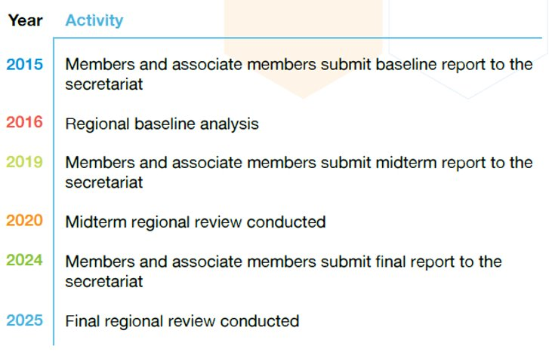
So how far have we come ?

Slide 6
Report on progress
Baseline (2015):
Report to the 72nd Commission
www.getinthepicture.org –country profiles
Midterm (2020)
Report to the Committee on Statistics in 2020
Midterm report and website launched in 2021
Foundation for discussions during the Second Ministerial Conference on CRVS held in 2021
Information used by development partners to provide support to countries
Highlighting where countries need more assistance

Slide 7
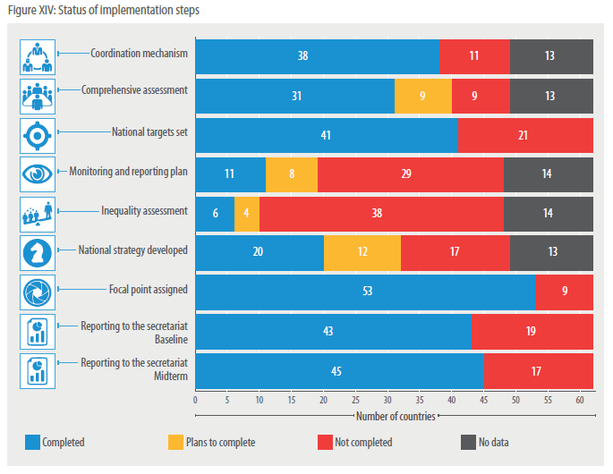
Implementation Steps
Notes:
Countries have fully taken advantage of Decade and the momentum created around CRVS to strengthen their CRVS systems
The support of development partners was key in implementing these steps
But few countries have conducted an inequality assessment
Check: Pakistan did it
Orange light: Ongoing

Slide 8
Birth Registration Completeness
More information on progress in the region: https://bit.ly/37LQtaz
Notes:
Rapid improvements in birth and death registration, but efforts need to be maintained or even accelerated if countries want to reach their targets by 2024, especially for death registration
Universal means 100%, not 99%. Assessments of inequalities experienced by subgroups of the population are needed to make sure every one gets in the picture
Pakistan (2018): National Database & Registration Authority (NADRA). Incomplete flow of information from union councils under local government departments to NADRA.

Slide 9
Death Registration Completeness
More information on progress in the region: https://bit.ly/37LQtaz
Notes:
Pakistan (2018): NADRA. Incomplete capture of data from union councils, field staff and field health facilities
Interesting fact: Pakistan is one of the few countries in the region where death registration completeness is higher than birth registration completeness.

Slide 10
2024 Review
Countries report on progress in achieving the goals of the RAF (i.e., universal registration; legal documentation for all; and accurate, complete and timely production of vital statistics) using the review questionnaire (2024);
Compilation of country reports in a regional synthesis report; to serve as the basis for the 2024 review of progress by the Ministerial Conference in 2025;
Ministerial Conference to celebrate the end of the Asian and Pacific Civil Registration and Vital Statistics Decade (2015– 2024), review progress and consider the direction and focus of efforts during a potential extension of the Decade until 2030.

Slide 11
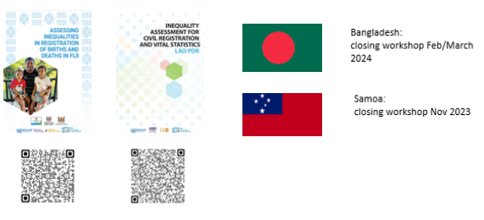
CRVS inequality assessments
Notes:
Provide technical support and capacity strengthening to facilitate the implementation of CRVS inequality assessments using secondary data sources
Refine further guidance which can be used in other countries in the region and globally
Build capacity for demographic analysis to allow countries to undertake inequality assessments in the future

Slide 12
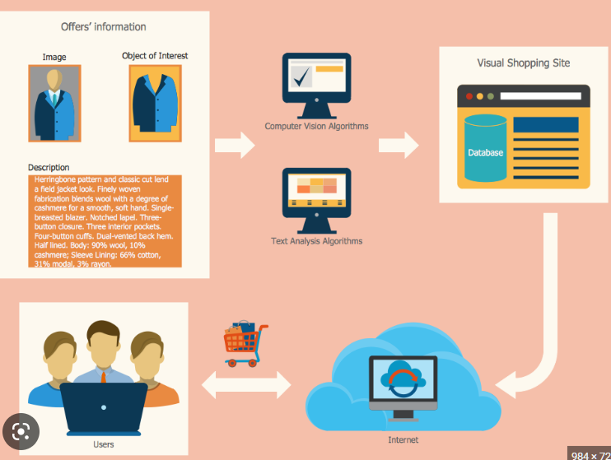
What is a business process map?
Visualisation of a business process by taking into account roles and responsibilities
Similar to a flow chart of the tasks that organization members do every day
Notes:
A crucial part of business process improvement is the development of business process maps which visualize the entire process of for example birth registration or death registration. It depicts who is involved in which step of the process, which documents are needed and how data/information travels between each entity or stakeholder. It is similar to a flow chart of the tasks that an staff members of an organization complete every day.

Slide 13
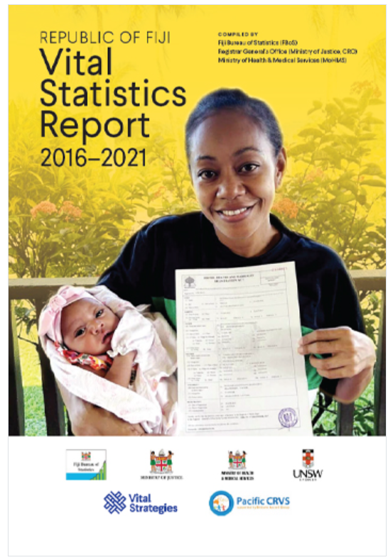
Vital Statistics report –Fiji example
It is recommended that all countries produce an annual vital statistics report, even if relatively low number of vital events are registered.
Vital Strategies, ECA, ESCAP, Statistics Norway (2020). Production of a Vital Statistics Report: Guide.
The Fiji Bureau of Statistics began by collecting paper records from health facilities across the country to fill gaps in data
Data was compared across sources, analyzed and cleaned, providing valuable insights into systems and process performance
The resulting report encapsulate the vital events that have shaped the nation over these critical five years, shedding light on our citizens' health, well-being, and progress

Slide 15
Extension of the Asia Pacific CRVS Decade
The Regional Steering Group for CRVS in Asia and the Pacific is recommending an extension of the Decade to align with the 2030 Agenda for Sustainable Development
Additional focus on inclusion and resilience
Third Ministerial Conference on CRVS in Asia and the Pacific to be held in June 2025

