Slide 1
Sixth Regional Workshop on Data and Metadata Exchange (SDMX) - Advanced Level III
ESCWA SDMX Converter
Jordan-Amman
5 June 2023
Notes:
Rabih El Habta
Economist
Team Assistant - UN-ESCWA, Cluster 4- Statistics, Information Society & Technology Cluster

Slide 2
Content
Intro to ESCWA SDMX Converter
Part I: What is SDMX and how it relates to SDGs?
Part II: Using SDMX Converter with Excel – what you should know
Part III: most common mistakes encountered

Slide 3
Intro to ESCWA SDMX Converter

Slide 4
ESCWA SDMX Converter for SDGs
Facilitates the timely exchange and dissemination of quality national SDG data to Arab SDG Monitor National Reporting Platforms including the use of validation tools as per SDG metadata standards.
Arab SDG Gateway
ESCWA SDMX Converter for SDGs*
* Access to the converter is only granted to nominated ITC SDMX experts by NSOs.
Notes:
What is ESCWA SDMX Converter, and why it is important?

Slide 5
https://datacatalog.unescwa.org/sdmx/converter
Note: To use the ESCWA SDMX Converter, please ensure that JavaScript (JS) is enabled on your browser.
Notes:
Once, you are logged in to your account, and press on the SDMX Converter tab, and download the template.

Slide 6
ESCWA SDMX SDGs Template
The template is very useful as it resolves issues:
1) Missing or incorrect mapping of mandatory concepts in sheet “Parameters”
2) Enter the wrong REPORTING_TYPE or NATURE
3) Use SKIP for mandatory concepts
4) Use of incorrect UNIT_MEASURE & UNIT_MULT
Notes:
Remaining issues pertains to copy and paste, here, country must be accurate in entering the data.

Slide 7
Sheet Data

Slide 8
Sheet Data

Slide 9
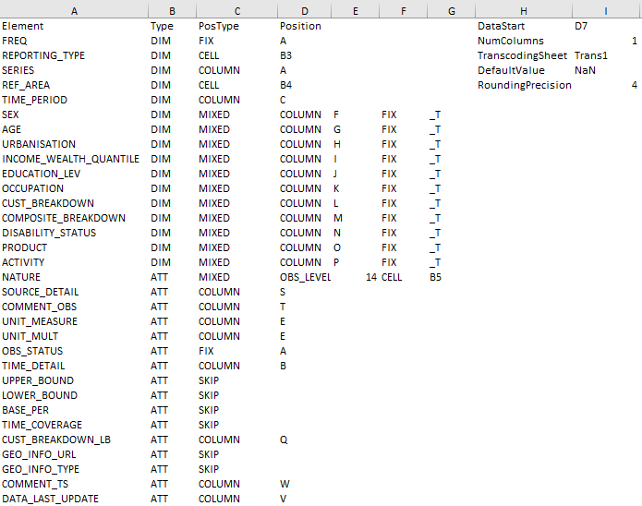
Sheet Parameters
in the template

Slide 10
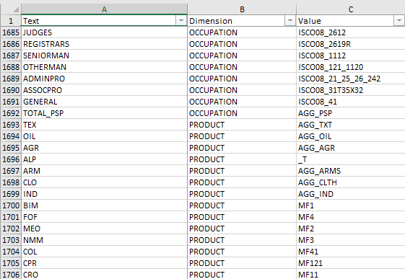
Sheet Trans in the template
The sheet structure must contain three columns:
Text: to store local codes
Dimension: to store the SDMX name for the dimension
Value: to store the equivalent SDMX code.

Slide 11
File Upload and Successful Conversion
Click on Choose File

Slide 12
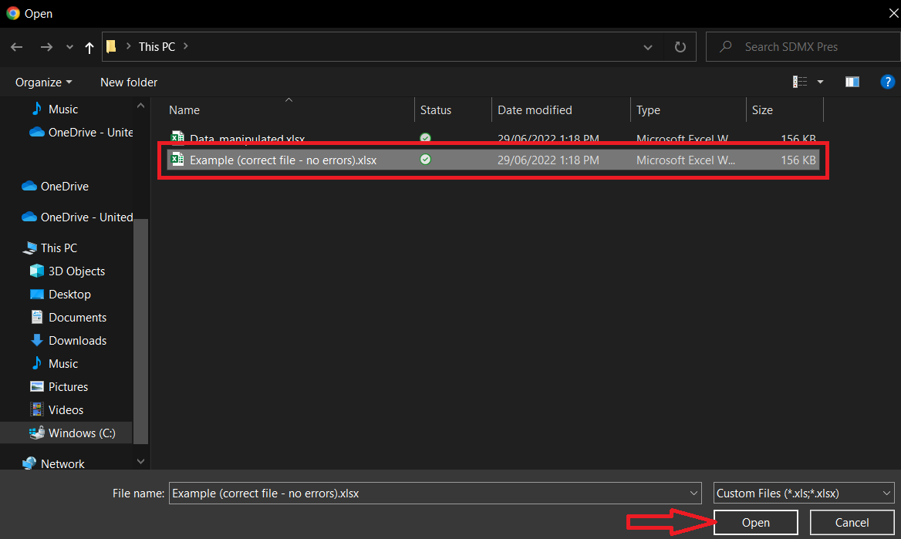
File Upload and Successful Conversion
Browse to your excel file to select it
Click Open
Notes:
Note: Converter displays a maximum of 100 errors, yet more errors can be found.
Here use the converter to walk participants through and show how to make the correction step by step.

Slide 13
File Upload and Successful Conversion
Click Start Converting
Notes:
Note: Converter displays a maximum of 100 errors, yet more errors can be found.
Here use the converter to walk participants through and show how to make the correction step by step.

Slide 14
File Upload and Successful Conversion
If there are no errors, we will get the download links. We can also share the displayed link with colleagues if needed.
Data is transferred to our database and sent to relevant entities for validation

Slide 15
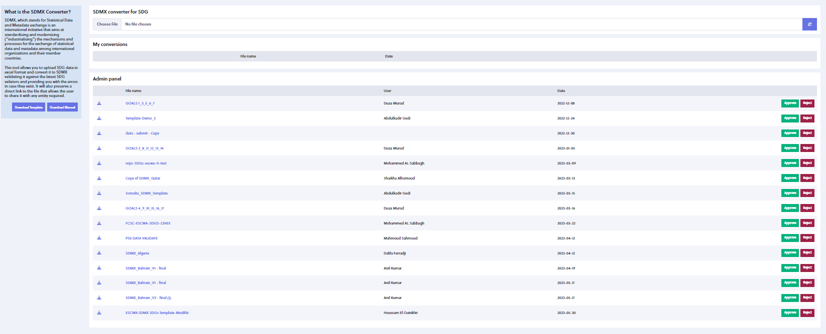
When the conversion is successful, your file is submitted to admin for review and approval.

Slide 16
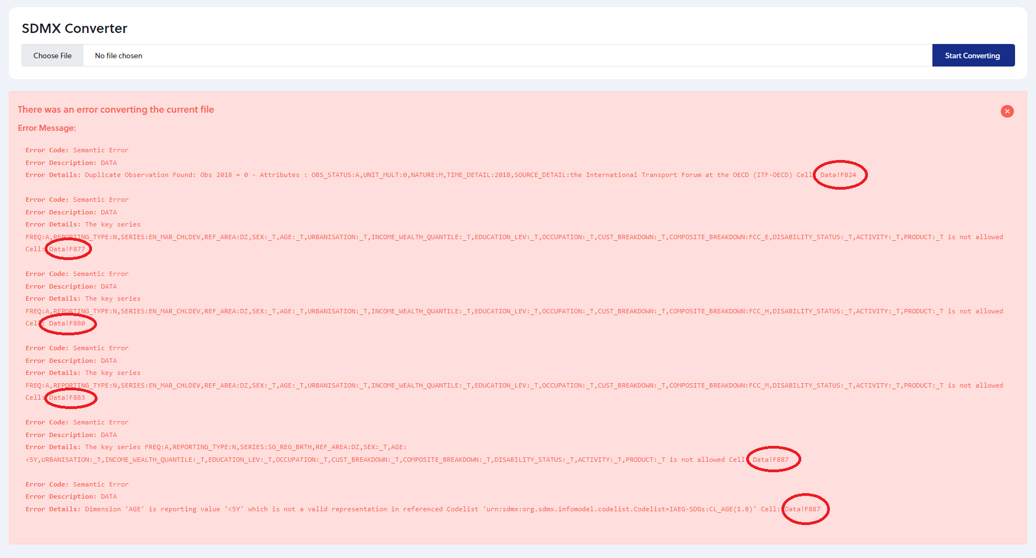
File Upload and Failed Conversion
ESCWA SDMX Converter uses the Country Global Dataflow for validating national data
In case there are errors in the file, a message stating details about each one, including the cell in the Excel as highlighted, will appear on the screen.
Notes:
Note: Converter displays a maximum of 100 errors, yet more errors can be found.

Slide 17
Part I: What is SDMX and how it relates to SDGs?
Notes:
For those that are participating for the first time and are new to SDMX, let us understand what is SDMX, and what is its role in SDGs data, this can be also helpful for senior participants that already have knowledge and background about SDMX and SDGs.

Slide 18
Statistical Data and Metadata Exchange (SDMX)
What is SDMX?
SDMX is an ISO standard designed to describe statistical data and metadata, normalize their exchange, and improve their efficient sharing across statistical and similar organizations.
SDMX sets statistical and technical standards to facilitate the exchange of statistical data and metadata using modern information technology.
Why SDMX is important for SDGs?
SDMX enables the automation of SDG data and metadata exchange between two or more entities.
SDMX also facilitates the validation, dissemination, and reporting of SDG data.
Notes:
SDMX enables the automation of data and metadata exchange by setting the statistical standards i.e., normalization, it also facilitates the validation of the data.
i.e., if the data follows the international standards, this is very important for SDGs as well as it will validate the allowed disaggregation.

Slide 19
SDMX and Standardization
Standardization & Data Modeling
The process of standardizing requires:
Selecting the “characteristics” that help in unambiguously identifying the “data observation”;
Selecting the “properties” that help in describing the “data observation” in a meaningful way;
Deciding how this information should be formally codified -represented;
The process of selecting relevant characteristics of the data and the relation among them is called:
“Data Model”
In SDMX, the data model is represented by:
“Data Structure Definition (DSD)”
Notes:
So now, what is needed to work with SDMX?
In short, the most important artifact in SDMX is the DSD.

Slide 20
Data Structure Definition (DSD)
To design a DSD, we first need to find concepts that identify (for use as dimensions) and describe (for use as attributes) our data.
Each dimension, measure, and attribute encapsulates a concept.
Dimensions
A set of uniquely identifying characteristics.
Primary Measure
Observed values on one or more variables of interest.
Attributes
A set of additional characteristics that further describe it.
Data Cube
So, What is a DSD?
A DSD is a set of structural metadata associated with a dataset, which includes information about how concepts are associated with the Measures, Dimensions, and Attributes of a data cube, along with information about the representation of data and related descriptive metadata.
Notes:
So now, we know that we need to have a DSD, from where should we start, what are the first steps for creating a DSD?
The first step must be to determine which concepts will serve to identify our dataset, and which one will describe it, then each concept must be represented in a certain format.

Slide 21
SDMX SDG Concepts
Dimensions (16 concepts)
Attributes (15 concepts)
* Mandatory Attributes
Concept ID | Concept Name | Concept Restriction
FREQ | Frequency of observation | String
REF_AREA | Reference area | String
SEX | Sex | String
AGE | Age | String
EDUCATION_LEV | Education level | String
OCCUPATION | Occupation | String
TIME_PERIOD | Time period | YYYY
SERIES | SDG Series | String
URBANISATION | Degree of urbanisation | String
INCOME_WEALTH_QUANTILE | Income or wealth quantile | String
CUST_BREAKDOWN | Custom Breakdown | String
COMPOSITE_BREAKDOWN | Composite breakdown | String
DISABILITY_STATUS | Disability status | String
REPORTING_TYPE | Reporting type | String
ACTIVITY | Economic activity | String
PRODUCT | Type of product | String
Concept ID | Concept Name | Concept Restriction
OBS_STATUS* | Observation status | String
UNIT_MULT* | Unit multiplier | Integer
UNIT_MEASURE* | Unit of measure | String
BASE_PER | Base period | Date Time
NATURE | Nature of data points | String
TIME_DETAIL | Time period details | String
COMMENT_OBS | Observation-level footnotes | String
TIME_COVERAGE | Time period or range (ISO8601) | Date Time
UPPER_BOUND | Upper bound value | Double
LOWER_BOUND | Lower bound value | Double
SOURCE_DETAIL | Source details | String
COMMENT_TS | Time series-level footnotes | String
GEO_INFO_URL | Geoinformation URL | String
GEO_INFO_TYPE | Geoinformation type | String
CUST_BREAKDOWN_LB | Label for custom breakdown | String
DATA_LAST_UPDATE | Date of the most recent change of the series. | Date Time
Primary Measure (1)
Note: all dimensions are mandatory
OBS_VALUE | Observation value | Double
Notes:
So, what are the concepts that pertain to SDG data using SDMX?
The DSD for SDG encompasses 32 concepts, of which 16 are dimensions, 15 are attributes (3 of which are mandatory), and one is a primary measure.
Each concept has a “Concept ID”, a “Concept Name” and a Concept Restriction.
Notice that all dimensions are mandatory, i.e., “must not be empty or missing from your Excel file”.
Also notice that all dimensions are string, except for the time period which follows the “YYYY” format year with four digits.
On the other hand, notice that some attributes are restricted to be a “date” data type, “integer”, “double”, and “string”.
While the primary measure always must double, the default precision in SDMX is 6 decimal digits, but it can go up to 15.

Slide 22
Data Types used in SDMX
String: A sequence of characters used to represent text.
Ex: “MICS”, LFS, Household Budget Survey
Double: Used to define numeric variables holding numbers with decimal points, which accommodate fractions.
Ex: 10.2 ≠ 10,2
Date Time: The code identifies dates it could be YYYY-MM-DD pattern. If hours, minutes, and seconds are also needed the following pattern is used: YYYY-MM-DDThh:mm:ss.
Ex: 2020-02-22
Integer: non-decimal numbers
Ex: 0, 1, 2, -1,-2, etc.
Notes:
Just quickly, what is a string data type, double data type, date data type and integer data type?

Slide 23
SDMX Concept Scheme & Concept representations
The Set of concepts that are used to exchange, disseminate or report statistical information (data, metadata), is known as a Concepts Scheme.
Each concept has a different mode of representation, a concept can be :
Coded
Drawn from a code list* (for e.g., “country ISO code”), for example, AGE, SEX, URBANISATION, REF_AREA, NATURE, etc.
Required to adhere to a specific data format (Year = “YYYY”)
TIME_PERIOD 2023
DATA_LAST_UPDATE 2022-10-01
BASE_PER 2015
TIME_COVERAGE 2000-2010
e.
Required to be contained within a specific range of values ( “numerical values between 0 and 1”).
Q
OBS_VALUE 2.5
UPPER_BOUND 100
LOWER_BOUD 0
Uncoded
Drawn from a type of values (e.g., “text”, “number”, etc.), for example, SOURCE_DETAIL, COMMENT_OBS, COMMENT_TS, CUST_BREAKDOWN_LB, TIME_DETAIL$, etc.
Free-text
Notes:
So now we learned what are the concepts used in SDMX, for SDGs, but we still don’t know how each one is represented?
Before, we look at the representation of each concepts used for SDGs, let us see what the different possible representations used in SDMX?
Three different representation can be used for a concept, either coded, uncoded, and free-text.
*: A predefined list from which some statistical coded concepts take their values.
$: It can be a date, also a footnote, e.g., "Survey ran from 1 Jul 2021 - 30 Jun 2022"

Slide 24
Representation of SDG Concepts*
Dimensions
*code lists version pertains to DSD 1.13
Dimension Id | Representation | Code list | Text Type
FREQ | codelist | SDMX:CL_FREQ(2.0) | String
REF_AREA | codelist | IAEG-SDGs:CL_AREA(1.13) | String
SEX | codelist | IAEG-SDGs:CL_SEX(1.1) | String
AGE | codelist | IAEG-SDGs:CL_AGE(1.12) | String
EDUCATION_LEV | codelist | IAEG-SDGs:CL_EDUCATION_LEV(1.10) | String
OCCUPATION | codelist | IAEG-SDGs:CL_OCCUPATION(1.8) | String
TIME_PERIOD | uncoded |  | YYYY
SERIES | codelist | IAEG-SDGs:CL_SERIES(1.13) | String
URBANISATION | codelist | IAEG-SDGs:CL_URBANISATION(1.10) | String
INCOME_WEALTH_QUANTILE | codelist | IAEG-SDGs:CL_QUANTILE(1.1) | String
CUST_BREAKDOWN$ | codelist | IAEG-SDGs:CL_CUST_BREAKDOWN(1.4) | String
COMPOSITE_BREAKDOWN$ | codelist | IAEG-SDGs:CL_COMP_BREAKDOWN(1.13) | String
DISABILITY_STATUS | codelist | IAEG-SDGs:CL_DISABILITY(1.0) | String
REPORTING_TYPE | codelist | IAEG-SDGs:CL_REPORTING_TYPE(1.0) | String
ACTIVITY | codelist | IAEG-SDGs:CL_ACTIVITY(1.6) | String
PRODUCT | codelist | IAEG-SDGs:CL_PRODUCT(1.0) | String
SDMX Registry
$ wildcards
Guidelines for the Customization of the Global SDG DSD
Notes:
Let us look first at the representation of the dimensions used in the SDG-DSD.
Notice that dimensions that are drawn from a code list, have the agency name, code list name, as well as its version number.
Before exploring the code lists from the SDMX registry, notice that some code lists are taken from different agencies i.e., FREQ.
Wildcards are useful for adding disaggregation → very useful for adding breakdowns with SERIES or COMPOSITE BREAKDOWN // Please check session 6 on customizing a national DSD – 4th regional SDMX workshop.
Now open the SDMX registry, and let is check a code list.

Slide 25
Attributes
Attribute Id | Representation | Code list | Text Type
OBS_STATUS | codelist | SDMX:CL_OBS_STATUS(2.1) | String
UNIT_MULT | codelist | SDMX:CL_UNIT_MULT(1.1) | String
UNIT_MEASURE | codelist | IAEG-SDGs:CL_UNIT_MEASURE(1.8) | String
BASE_PER | uncoded |  | Date Time
NATURE | codelist | IAEG-SDGs:CL_NATURE(1.0) | String
TIME_DETAIL | free-text |  | String
COMMENT_OBS | free-text |  | String
TIME_COVERAGE | uncoded |  | Date Time
UPPER_BOUND | uncoded |  | Double
LOWER_BOUND | uncoded |  | Double
SOURCE_DETAIL | free-text |  | String
COMMENT_TS | free-text |  | String
GEO_INFO_URL | free-text |  | String
GEO_INFO_TYPE | codelist | IAEG-SDGs:CL_GEO_INFO_TYPE(1.0) | String
CUST_BREAKDOWN_LB | free-text |  | String
DATA_LAST_UPDATE | uncoded |  | Date Time
Primary Measure
Concept Id | Representation | Codelist | Text Type
OBS_VALUE | uncoded |  | Double
Notes:
What are the representations used for attributes / primary measures concepts for SDG data?

Slide 26
Generic cross-domain codes
Recommended Code Value | Recommended Code Description
_L | Local extension (can be used as a prefix)
_N | Non-response
_O | Other
_S | Subtotal
_T | Total or no breakdown
_U | No data/unknown
_X | Not allocated/unspecified
_Z | Not applicable
These codes are recommended to be used in all code lists as appropriate.
* Source: Guidelines for the creation and Management of SDMX Code Lists
Notes:
Some code lists use generic cross-domain codes, such for example _T, _O.
These cross-domains are very important, especially _L for customizing national DSD.
//Please check session 6 on customizing a national DSD – 4th regional SDMX workshop //the recommendation on writing the codes, for example, with AGE, it is recommended to use LE (Less or Equal), GE (Greater or Equal) instead of LT (Less Than) or GT (Greater Than).

Slide 27
DSD In a nutshell (1)
Concept Scheme
Reference
DSD
Reference
Code lists
Concept | Concept ID | Role | Attachment | Representation | Code list ID
Age | AGE | Dimension |  | Code List | CL_AGE
Series | SERIES | Dimension |  | Code List | CL_SERIES
Time period | TIME_PERIOD | Dimension |  | YYYY
Unit multiplier | UNIT_MULT | Attribute | Time series (Values) | Code List | CL_UNIT_MULT
⁞ | ⁞ | ⁞ | ⁞ | ⁞ | ⁞
Obs. value | OBS_VALUE | Pr. Measure |  | Number
Notes:
So, now in a nutshell, let us summarize what we have learned so far about DSD.

Slide 28
DSD In a nutshell (2)
The global SDG DSD has 32 concepts, including 16 dimensions, 15 attributes, and the primary measure.
dimensions include 2 “wildcard” (multi-purpose) dimensions, COMPOSITE_BREAKDOWN and CUST_BREAKDOWN, which can be used to support multiple breakdowns.
The multi-purpose dimensions play a key role in the customization of the DSD.
The code lists for SDMX SDG DSD concepts are available in the SDG_DSD_MATRIX.xlsm excel macro file.
Notes:
Continued.

Slide 29
SDG Validation with SDMX (1)
Validation with DSD
Validation against the DSD verifies that all dimensions and mandatory attributes are in place.
Does not verify relationships between the dimension values. If you have the series “Forest area as a proportion of total land area” with Sex=Female, it will pass the validation.
Ex: 1.2.1
SERIES=SI_POV_NAHC (Proportion of population living below the national poverty line)
AGE, SEX, URBANISATION, EDUCATION_LEV, DISABILITY_STATUS, OCCUPATON =ALL
COMPOSITE_BREAKDOWN=_T,MS_MIGRANT,MS_NOMIGRANT,MS_EUMIGRANT, or MS_NONEUMIGRANT
PRODUCT, INCOME_WEALTH_QUANTILE, ACTIVITY=_T
TIME_ PERIOD | OBS_ VALUE | UNIT_ MEASURE | UNIT_ MULT | NATURE | ACTIVITY | AGE | SEX | URBANISATION | EDUCATION_ LEV | DISABILITY_STATUS | QUAN-TILE | PROD-UCT | OCCUP- ATION | COMP_ BREAKDOWN | CUST_ BREAKDOWN
2002 | 20 | PT | 2 | E | ISIC4_C | _T | _T | _T | _T | _T | _T | _T | _T | _T | _T
2008 | 11.8 | PT | 2 | E | ISIC4_D | _T | _T | _T | _T | _T | _T | _T | _T | _T | _T
2015 | 11 | PT | 2 | E | ISIC4_E | _T | _T | _T | _T | _T | _T | _T | _T | _T | _T
Notes:
Recall that among the objectives of SDMX, is to facilitate the validation of SDG data.
How can we use SDMX to validate the data?
Can we use the DSD, or there are other artifacts?
Given the allowed dimensions for indicator 1.2.1, please find what are the mistakes in the table below?

Slide 30
SDG Validation with SDMX (2)
SDMX Dataflows (DF)
Dataflow defines a “view” on a Data Structure Definition (DSD).
It is a structure that can help describe, categorize, and constrain datasets.
Each data flow is linked to one DSD.
Each DSD may have one or more dataflows linked to it.
In its simplest form defines any data valid according to a DSD.
Notes:
By now, we know that the DSD is not useful to validate the relationship among dimensions, thus, how can we resolve that issue?
Another artifact is created, i.e., the dataflow, so what is a dataflow?

Slide 31
SDG Validation with SDMX (2)
Types of SDMX SDG Global Dataflows (DF)
DF_SDG_GLH – Harmonized Global Dataflow. This data flow is used by the Custodian Agencies to report SDG indicators that are part of the global dataset, regardless of how the data was obtained.
DF_SDG_GLC – Country Global Dataflow. This data is used by countries to report data to UNSD and ESCWA, as well as to disseminate national data in compliance with the SDG Global DSD.
Can be downloaded from the SDMX registry
DF_SDG_GLH
Can be downloaded from the SDMX registry
DF_SDG_GLC
Notes:
There are two types of dataflows used for SDGs, one is used for global reporting, while the other is used for country reporting.

Slide 32
SDG Validation with SDMX (3)
SDMX Content Constraints (CN)
Content constraints define restrictions on code lists or series, it can be used to define which combinations of codes are allowed:
For example, SERIES= “ Proportion of Women in National Parliament “ → SEX must be “FEMALE”.
For example –code list REPORTING_TYPE, data reported by countries to UNSD and ESCWA → REPORTING_TYPE must be “N”.
While data reported by custodian agencies to UNSD → REPORTING_TYPE must be “G”.
Are often attached to the Dataflow but can also be attached to DSD, but wherever content constraints are attached, code lists that they restrict are defined in the underlying DSD.
The content constraint can be downloaded from the IAEG-SDGs SDMX working group
SDG Series Content Constraints Matrix.csv.
Notes:
So, are there any other artifacts that are used for data validation with SDMX?

Slide 33
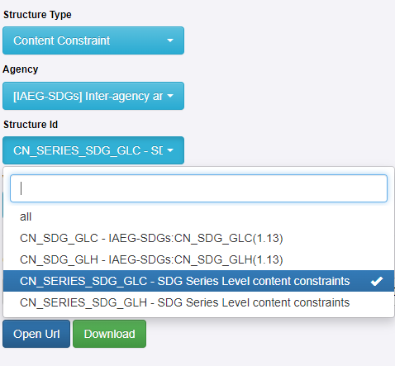
SDG Validation with SDMX (3)
Types of SDMX SDG Content Constraints (CN)
Cube Region: Define allowed (or disallowed) codes from DSD code lists.
e.g., for the Country Global SDG Dataflow, the only valid value for dimension REPORTING_TYPE is N (“National”).
Series: Define allowed (or disallowed) combinations of codes from DSD code lists.
SERIES=SH_STA_STNT (Proportion of children moderately or severely stunted)
AGE=Y0T4 (Under five years old)
COMPOSITE_BREAKDOWN=_T,MS_MIGRANT,MS_NOMIGRANT,MS_EUMIGRANT, or MS_NONEUMIGRANT
PRODUCT=_T
ACTIVITY=_T
The content constraint is often attached to a dataflow.
Notes:
There are two types of content constraints used for SDGs, cube region and cube series.

Slide 34
Validation of SDG datasets In a nutshell
Validation against the DSD verifies that all dimensions and mandatory attributes are in place.
Does not verify relationships between the dimension values.
Validation against a data flow, in addition, verifies relationships among dimension values.
Will flag invalid combinations such as the above, gender indicators with Sex=Male, and similar coding errors.
Helps validate the dataset before submitting it to the SDG Lab, which will reject invalid datasets.
Countries should always validate against dataflow DF_SDG_GLC for the data used by countries to report data to UNSD and ESCWA, as well as to disseminate national data in compliance with the SDG Global DSD.

Slide 35
Part II: Using SDMX Converter with Excel – what you should know
Notes:
By now, you should be familiar with key SDMX SDG-related artifacts, how you can now exchange your data?
What is the SDMX tool?
i.e., SDMX Converter
The input used for the SDMX converter can be an XML file (specific structures) can be a CSV Excel file, or an Excel file.
However, the most widely used input is Excel files, so let us now have a wholistic review the structure of the Excel.

Slide 36
Using SDMX Converter with Excel
Data and mappings can be placed into the same spreadsheet
Mappings can also be supplied from an external file
Worksheet named Parameters contains mappings
Shows how cells, rows, and columns map to the DSD dimensions and attributes
Multiple parameter sheets can be used if worksheets have different mappings.
In that case, a worksheet named Parameter_mapping must show which parameter worksheets apply to which data worksheets
Parameter worksheet names must start with Parameter
Additional information can be added to facilitate data entry
e.g., code lists for validation and display of descriptions
Transcoding worksheet names must start with Trans
Worksheet names starting with VAL are ignored
Can be used to store code lists or other ancillary information
Notes:
So, what are the main sheets that can be used in the Excel file?
1- Data
2- Parameter
3- Parameter_mapping (optional) → two columns: Data sheet & Parameter sheet
4- Transcoding
5- Val

Slide 37
the Data worksheet: Data presentation types (wide “cross-tab” and long “time series”)
Long “time series” format
Notes:
Here is an example of a structure for sheet “data”, it could be built differently, also the position of the concepts can be altered based on user preference, however, any changes in the position of any concept, must be reflected on sheet parameter, and this is what we will look at in the next slides.

Slide 38
Excel Mappings: the Parameters worksheet
Mapping type
Cell where
data starts
Concept
Number of
obs. columns
Position or value
Concept
Role
Notes:
Let us review the notions used in sheet parameter and their role.

Slide 39
Mapping and Position Types
SDMX supports the following position types:
COLUMN: When a value for the entire dataset is provided in the cell provided in the column Position.
ROW: Values for the concept are stored in the row specified in column Position.
FIX: Fixed value for the entire dataset is stored in the column Position and does not appear in the data spreadsheet.
SKIP: The concept value is not mapped, it can only be used with optional attributes*, and it can’t be used for dimensions or mandatory attributes.
MIXED: Allows to use of two types of mapping interchangeably, reducing the burden of transcoding for all datasets.
CELL: The value for the entire worksheet is specified in the cell provided in the column Position.
OBS_LEVEL: Can be used in to specify attributes attached at the observation level relative to the cell containing the observation.
Notes:
What are the positions types supported in SDMX?

Slide 40
Additional Parameters
SDMX supports the following parameters - can be defined to the left of the Elements or at the end of the file-:
DataStart: This parameter is mandatory; it indicates the position where the actual data starts.
NumColumns: This parameter is mandatory; it indicates the number of columns containing data.
MaxEmptyRows: This parameter is optional; it indicates the maximum row allowed to be empty before finishing reading data, must be provided.
MaxEmptyColumns: This parameter is optional; it indicates the maximum number of empty cells allowed in the current row before starting to read the next row. If not present the default is 1000.
DefaultValue: This parameter is optional; if present and all the mandatory dimensions can be resolved when parsing the empty observation cell, the Converter will create an observation with the observation value equal to the value specified in the DefaultValue parameter (this could be either a 0, a " " or a "NaN" for example
RoundingPrecision: This parameter is optional; the parameter value should be an integer between 0 and 15. If it is 0 the numbers will be rounded without decimals.
Notes:
In Parameter sheet, mandatory parameters must be presented.

Slide 41
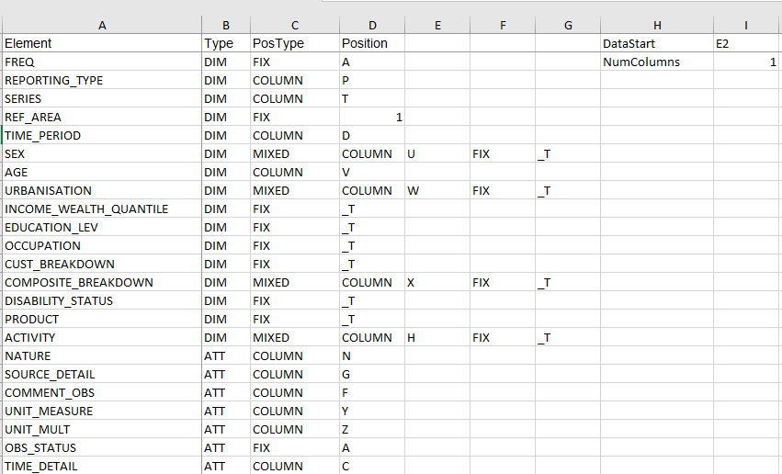
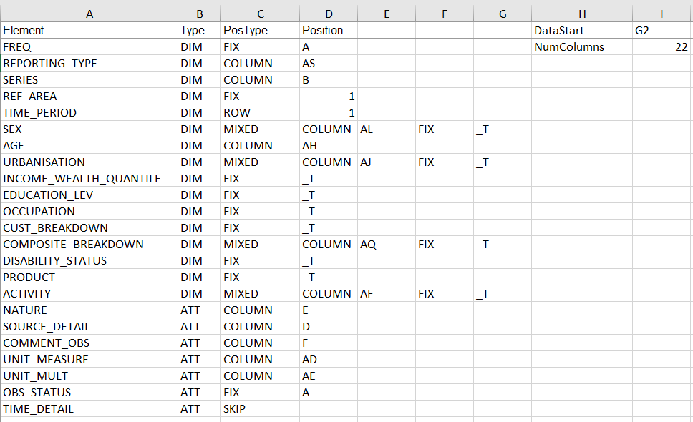
Mapping with Long format
Mapping with Wide format
Notes:
Examples of different mappings, mainly in time-period.

Slide 42
Transcoding
Transcoding refers to code mapping when internal codes are different from DSD codes.
For conversion to work, internal codes need to be replaced with DSD codes.
Transcoding can also be stored in external files. This is very useful when multiple sheets need to be mapped and reused.
The use of a single code for no breakdown (e.g., for Total and Not Applicable) simplifies the mappings.
Inconsistent mappings and transcoding lead to duplications and other anomalies.
Notes:
So, now, sheet transcoding, what is the objective of it?

Slide 43
Part III: most common mistakes encountered
Notes:
The list here is not exhaustive, and does not cover all possible errors, but rather covers the most recurrent and encountered by countries.

Slide 44
1- Data Entry Mistakes, such as
Error
Semantic Error:
Primary Measure 'OBS_VALUE' is reporting value ‘10,2'
Enter string characters in the observation value
Ex: 10,2
Enter additional –unnecessary space(s).
Ex1:Y0T4.
Ex2:.PWD
Ex3:.COLUMN
Key Series is not allowed:
Use of invalid representation
Ex3:ExcelPostionType.COLUMN
Enter the wrong REPORTING_TYPE or NATURE.
Ex: G instead of N for National Data
Illegal specification in dimension REPORTING_TYPE, i.e., the result of using the wrong data flow for validation.
Copy and Paste mistakes, such as forgetting to change the year, or age, sex, etc.
Duplicate observation
Notes:
Bullet 3 → (recall validation with SDMX - Cube Region)

Slide 45
2- Incorrect or missing information.
Error
a) Missing information in Mandatory concepts in sheet “Data”
Ex: Forget to add the SERIES.
Not allowed specification
b) Missing or incorrect mapping of mandatory concepts in sheet “Parameters”
Ex2: mapping AGE to a wrong Column
(i.e., wrong position type)
Illegal specification in dimension
c) Use SKIP for mandatory concepts

Slide 46
Error
3-use of non-standard codes / retires SERIES.
Key Series is not allowed:
Use of invalid representation
4-use of incorrect UNIT_MEASURE & UNIT_MULT
What is the error?
SDMX 2.1 does not validate attributes.
Notes:
Ask participants what is the error for bullet 4

Slide 47
Coding Nature & Reporting Type
Do the coding for the following scenarios:
S1- You have in the dataset data retrieved from the global database with nature “Country Adjusted”, what would you expect in the attribute NATURE, and the dimension REPORTING_TYPE?
S2- You have in the National data retrieved from the MICS report, how would you code the attribute NATURE, and the dimension REPORTING_TYPE?
For the two scenarios above, you are using the dataflow to convert the data, which dataflow you should use for each scenario?

Slide 48
Coding Nature & Reporting Type – solution
Do the coding for the following scenarios:
S1- You have in the dataset data retrieved from the global database with nature “Country Adjusted”, what would you expect in the attribute NATURE, and the REPORTING_TYPE?
Answer: REPORTING_TYPE: G || NATURE: CA
S2- You have in the National data retrieved from the MICS report, how would you code the attribute NATURE, and the REPORTING_TYPE?
Answer: REPORTING_TYPE: N || NATURE: C
For the two scenarios above, you are using the dataflow to convert the data, which dataflow you should use for each scenario?
Answer: S1-DF_SDG_GLH || S2- DF_SDG_GLC

Slide 49
Coding Unit Measure & Unit Multiplier
series | indicator | UNIT_MEASURE | UNIT_MULT
SI_POV_DAY1 | [1.1.1] Proportion of population below international poverty line (%)
SN_ITK_DEFCN | [2.1.1] Number of undernourished people, thousands
AG_PRD_XSUBDY | [2.b.1] Agricultural export subsidies, billion USD dollars
SH_STA_MORT | [3.1.1] Maternal mortality ratio, per 100,000 live births
SH_STA_TRAF | [3.6.1] Death rate due to road traffic injuries, per 100,000 population
SH_ACS_UNHC | [3.8.1] Universal health coverage (UHC) service coverage index
EN_WBE_PMNR | [6.6.1] Water body extent (permanent) (square kilometres)
EN_ATM_CO2 | [9.4.1] Carbon dioxide emissions from fuel combustion, in million tones
GB_POP_SCIERD | [9.5.2] Researchers (in full-time equivalent) per million inhabitants
EN_LND_CNSPOP | [11.3.1] Ratio of land consumption rate to population growth rate
AG_LND_TOTL | [15.1.1] Land area (thousands hectares)
GR_G14_XDC | [17.1.1] Total government revenue, in trillion local currency
IT_USE_II99 | [17.8.1] Internet users per 100 inhabitants

Slide 50
Coding Unit Measure & Unit Multiplier – solution
series | indicator | UNIT_MEASURE | UNIT_MULT
SI_POV_DAY1 | [1.1.1] Proportion of population below international poverty line (%) | PT | 0
SN_ITK_DEFCN | [2.1.1] Number of undernourished people, thousands | NUMBER | 3
AG_PRD_XSUBDY | [2.b.1] Agricultural export subsidies, billion USD dollars | USD | 9
SH_STA_MORT | [3.1.1] Maternal mortality ratio, per 100,000 live births | PER_100000_LIVE_BIRTHS | 0
SH_STA_TRAF | [3.6.1] Death rate due to road traffic injuries, per 100,000 population | PER_100000_POP | 0
SH_ACS_UNHC | [3.8.1] Universal health coverage (UHC) service coverage index | IX | 0
EN_WBE_PMNR | [6.6.1] Water body extent (permanent) (square kilometres) | KM2 | 0
EN_ATM_CO2 | [9.4.1] Carbon dioxide emissions from fuel combustion, in million tones | T | 6
GB_POP_SCIERD | [9.5.2] Researchers (in full-time equivalent) per million inhabitants | PER_1000000_POP | 0
EN_LND_CNSPOP | [11.3.1] Ratio of land consumption rate to population growth rate | RO | 0
AG_LND_TOTL | [15.1.1] Land area (thousands hectares) | HA | 3
GR_G14_XDC | [17.1.1] Total government revenue, in trillion local currency | CUR_LCU | 12
IT_USE_II99 | [17.8.1] Internet users per 100 inhabitants | PER_100_POP | 0

Slide 51
Exercise (1)
indicator | series | age | sex | locat* | educat* | activity | quantile | comp_break* | unit_measure | mult.
[2.2.1] Number of children stunted (thousands) | SH_STA_STNT | Y0T5 | _T | _T | _T | _T | _T | _T | NUMBER | 0
[4.1.1] Children in secondary school achieving a minimum level in reading (%) | SE_TOT_PRFL | _T | _T | _T | ISCED11_2 | _T | _T | SKILL_READ | PERCENT | 0
[9.2.1] Manufacturing value added per capita (million constant USD) | NV_IND_MANF | _T | _T | _T | _T | ISIC_C | _T | _T | CON_USD | 0
[[3.2.1] Under-five mortality rate per 1,000 live births, female | SH_DYN_MORTN | 0T4Y | _F | _T | _T | _T | _T | _T | PER_1000_POP | 0
[3.2.1] Infant mortality rate per 1,000 live births, rural | SH_DYN_IMRT | Y1 | _T | _U | _T | _T | _T | _T | PER_1000_POP | 0
[3.2.1] Number of neonatal mortality, male urban | SH_DYN_NMRT | M0 | _M | _R | _T | _T | _T | _T | NUMBER | 0
[5.3.1] Urban women aged 20-24 years married before age 18 (%) | SP_DYN_MRBF15 | Y20T24 | _F | _T | _T | _T | _T | _T | PER_MARW_20T24Y | 0
[9.1.1] The rural population who live within 2 km of an all-season road (%) | SP_ROD_R2KM | _T | _T | _R | _T | _T | _T | _T | PERCENT | 0
[11.1.1] Urban population living in slums (number) | EN_LND_SLUM | _T | _T | _U | _T | _T | _T | _T | NUMBER | 0
[17.8.1] Users of the internet (256 kbps to 2 Mbps)per 100 inhabitants | IT_USE_ii99 | _T | _T | _T | _T | _T | _T | IS_2MT10M | PERCENT | 0

Slide 52
Exercise (1) - solution
indicator | series | age | sex | locat* | educat* | activity | quantile | comp_break* | unit_measure | mult.
[2.2.1] Number of children stunted (thousands) | SH_STA_STNTN | Y0T4 | _T | _T | _T | _T | _T | _T | NUMBER | 3
[4.1.1] Children in secondary school achieving a minimum level in reading (%) | SE_TOT_PRFL | _T | _T | _T | AGG_2_3 | _T | _T | SKILL_READ | PT | 0
[9.2.1] Manufacturing value added per capita (million constant USD) | NV_IND_MANFPC | _T | _T | _T | _T | ISIC4_C | _T | _T | CON_USD | 6
[3.2.1] Under-five mortality rate per 1,000 live births, female | SH_DYN_MORT | Y0T4 | F | _T | _T | _T | _T | _T | PER_1000_LIVE_BIRTHS | 0
[3.2.1] Infant mortality rate per 1,000 live births, rural | SH_DYN_IMRT | Y0 | _T | R | _T | _T | _T | _T | PER_1000_LIVE_BIRTHS | 0
[3.2.1] Number of neonatal mortality, male urban | SH_DYN_NMRTN | M0 | M | U | _T | _T | _T | _T | NUMBER | 0
[5.3.1] Urban women aged 20-24 years married before age 18 (%) | SP_DYN_MRBF18 | Y20T24 | F | U | _T | _T | _T | _T | PT | 0
[9.1.1] The rural population who live within 2 km of an all-season road (%) | SP_ROD_R2KM | _T | _T | R | _T | _T | _T | _T | PT | 0
[11.1.1] Urban population living in slums (number) | EN_LND_SLUMN | _T | _T | U | _T | _T | _T | _T | NUMBER | 0
[17.8.1] Users of the internet (256 kbps to 2 Mbps)per 100 inhabitants | IT_USE_II99 | _T | _T | _T | _T | _T | _T | IS_256KT2M | PER_100_POP | 0

Slide 53
Exercise (2)
Validation scenarios
Among the scenarios in the table below –using SDMX 2.1- indicate if the observation will pass with:
A. DSD B. Dataflow (specify country or harmonized) C. Both (DSD and dataflow) D. None
indicator | series | age | sex | locat* | comp_break* | Reporting_type | unit_measure | mult. | answer
[3.2.1] Under-five mortality rate per 1,000 live births, female | SH_DYN_MORT | Y0T5 | F | _T | _T | G | PER_1000_LIVE_BIRTHS | 0
[3.2.1] Infant mortality rate per 1,000 live births, rural | SH_DYN_IMRT | Y0 | _T | R | _T | G | PER_1000_LIVE_BIRTHS | 10
[3.2.1] Number of neonatal mortality, male urban | SH_DYN_NMRTN | M0 | M | U | _T | N | NUMBER | 0
[5.3.1] Urban women aged 20-24 years married before age 18 (%) | SP_DYN_MRBF18 | Y20T24 | F | u | _T | N | PT | 0
[9.1.1] The rural population who live within 2 km of an all-season road (%) | SP_ROD_R2KM | _T | _T | _T | _T | N | PT | 2
[11.1.1] Urban population living in slums (number) | EN_LND_SLUMN | _T | _T | U | _T | G | NUMBER | 0
[17.8.1] Users of the internet (256 kbps to 2 Mbps)per 100 inhabitants | IT_USE_II99 | _T | _T | _T | IS_256KT2M | R | PER_100_POP | 0

Slide 54
Exercise (2) - solution
indicator | series | age | sex | locat* | comp_break* | Reporting_type | unit_measure | mult. | answer
[3.2.1] Under-five mortality rate per 1,000 live births, female | SH_DYN_MORT | Y0T5 | F | _T | _T | G | PER_1000_LIVE_BIRTHS | 0 | A
[3.2.1] Infant mortality rate per 1,000 live births, rural | SH_DYN_IMRT | Y0 | _T | R | _T | G | PER_1000_LIVE_BIRTHS | 10 | C (harmonized)
[3.2.1] Number of neonatal mortality, male urban | SH_DYN_NMRTN | M0 | M | U | _T | N | NUMBER | 0 | C (country)
[5.3.1] Urban women aged 20-24 years married before age 18 (%) | SP_DYN_MRBF18 | Y20T24 | F | u | _T | N | PT | 0 | D
[9.1.1] The rural population who live within 2 km of an all-season road (%) | SP_ROD_R2KM | _T | _T | _T | _T | N | PT | 2 | A
[11.1.1] Urban population living in slums (number) | EN_LND_SLUMN | _T | _T | U | _T | G | NUMBER | 0 | C (harmonized)
[17.8.1] Users of the internet (256 kbps to 2 Mbps)per 100 inhabitants | IT_USE_II99 | _T | _T | _T | IS_256KT2M | R | PER_100_POP | 0 | A

Slide 55
Homework
indicator | series | age | sex | locat* | quantile | disability_status | comp_break* | unit_measure | mult.
[2.c.1] Countries recording moderately high food prices (%)
[4.6.1] Population achieving a fixed level of proficiency in writing a computer program in specialized languages (%)
[8.10.2] Account ownership at a financial institution, richest 60% ( age 25+) (%)
[1.1.1] Youth rural population below the international poverty line (%)
[1.3.1] Mothers with newborns receiving a maternity cash benefit (%)
[3.7.2] Adolescent birth rate per 1,000 women aged 15-19, urban
[7.1.1] Urban population with access to electricity (%)
[8.5.2] The unemployment rate, for male disabled youth in the rural area -- 19th ICLS (%)
[15.1.1] Forest area (hectares)
[16.9.1] Rural children under 5 years of age with birth registered (%), female

Slide 56
Homework- solution
indicator | series | age | sex | locat* | quantile | disability_status | comp_break* | unit_measure | mult.
[2.c.1] Countries recording moderately high food prices (%) | AG_FPA_HMFP | _T | _T | _T | _T | _T | SPL_M | PT | 0
[4.6.1] Population achieving a fixed level of proficiency in writing a computer program in specialized languages (%) | SE_ADT_FUNS | _T | _T | _T | _T | _T | SKILL_ICTPRGM | PT | 0
[8.10.2] Account ownership at a financial institution, richest 60% ( age 25+) (%) | FB_BNK_ACCSS | Y_GE25 | _T | _T | R60 | _T | _T | PT | 0
[1.1.1] Youth rural population below the international poverty line (%) | SI_POV_DAY1 | Y14T25 | _T | R | _T | _T | _T | PT | 0
[1.3.1] Mothers with newborns receiving a maternity cash benefit (%) | SI_COV_MATNL | _T | F | _T | _T | _T | _T | PT | 0
[3.7.2] Adolescent birth rate per 1,000 women aged 15-19, urban | SP_DYN_ADKL | Y15T19 | F | U | _T | _T | _T | PER_1000_POP | 0
[7.1.1] Urban population with access to electricity (%) | EG_ACS_ELEC | _T | _T | U | _T | _T | _T | PT | 0
[8.5.2] The unemployment rate, for male disabled youth in the rural area -- 19th ICLS (%) | SL_TLF_UEMDIS_19ICLS | Y14T25 | M | R | _T | PD | _T | PT | 0
[15.1.1] Forest area (hectares) | AG_LND_FRSTN | _T | _T | _T | _T | _T | _T | HA | 3
[16.9.1] Rural children under 5 years of age with birth registered (%), female | SG_REG_BRTH | Y0T4 | F | R | _T | _T | _T | PT | 0

Slide 57
Dos & Don’ts
Map internal code lists to DSD code lists.
Preferably store transcoded codes in external files.
Familiarity with the SDG DSD code lists.
Familiarity with SDG Content Constraint.
Use a Standard Excel template.
For attributes; avoid adding unnecessary columns, if they can be mapped using FIX as the type of the position.
It is recommended to use MIXED as the position type for dimensions.
For data with non-standard codes, move to sheet “VAL”
Check if the attribute UNIT_MULT is specified correctly.
Validate against dataflow DF_SDG_GLC → REPORTING_TYPE= N.
Adding the date of the last update when you updated your datasets.
Review SDMX converter error messages and correct them, until you get no error.
Review your coding and transcoding, even if the converter doesn’t report any error.
Practice, Practice, and Practice!
Notes:
Note: give an example on the review of coding and transcoding example Egypt (HW)

Slide 58
Useful Links
 | Link
ESCWA SDMX Converter for SDGs | https://datacatalog.unescwa.org/
Java | https://java.com/en/download/
Desktop SDMX Converter | https://bit.ly/3CwdjiA
Europa SDMX Online Converter | https://bit.ly/3HA28cg
ESCWA - Series of SDMX Trainings | https://bit.ly/3y51Kzg
ESCWA - SDMX Crash Course I | https://bit.ly/3MZQ5Gc
ESCWA - SDMX Crash Course II | https://bit.ly/3xXnhse
SDMX Global Registry | https://registry.sdmx.org/overview.html
SDMX SDG Page | https://bit.ly/3zSWUX9
SDG Metadata Template | https://bit.ly/3N9B1ps
SDG Metadata SDMX Converter | https://bit.ly/39Fvmdc
User Manual Desktop SDMX Converter | https://bit.ly/3ozvbYw

Slide 59
Questions

Slide 60
Thank you

