Slide 1
Registration with UNHCR
Rana G. Ksaifi
Senior Regional Registration and Data Analyst Officer
20 December 2016

Slide 2
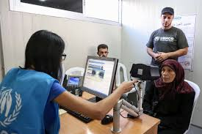
Definition & Instruments

Slide 3
Definition
  “Refugee registration is the recording, verifying, and updating of information on persons of concern to UNHCR with the aim of protecting and documenting them and of implementing durable solutions”.
  UNHCR Registration Handbook, p.6

Slide 4
International Instruments on Registration
  UNHCR Statute
  1969 OAU Convention
  1984 Cartagena Declaration
  UNHCR’s Agenda for Protection (Goal 1, Objective 11)
  Executive Committee No. 91, reaffirms the importance of registration as a protection tool and sets guidelines for all registration processes, which led to the development of UNHCR’s ‘unified approach’.

Slide 5
UNHCR Registration is conducted to:
Key protection tool for UNHCR as a protection agency
Identify persons of concern
Identity vulnerabilities and needs
Provide data for planning and programming
Provide access to services and assistance
Provide access to documentation- in some cases to seek asylum with Governments
Registration is a means to an end- saves lives

Slide 6
Data collected
Bio data
Family composition and breakdown
Military service, political affiliations
Specific needs
Reason for leaving country of origin (claim)
Relatives in country of origin, asylum and other
Entry into country of origin
Available documents
Biometrics

Slide 7
Issues addressed through in-depth protection interviews
Data collection in emergency situations vs. non-emergency
Ensuring credibility for range of issues
Child marriage
Establishing family composition, including marriage of adults
Persons with specific needs: identification and referral

Slide 8
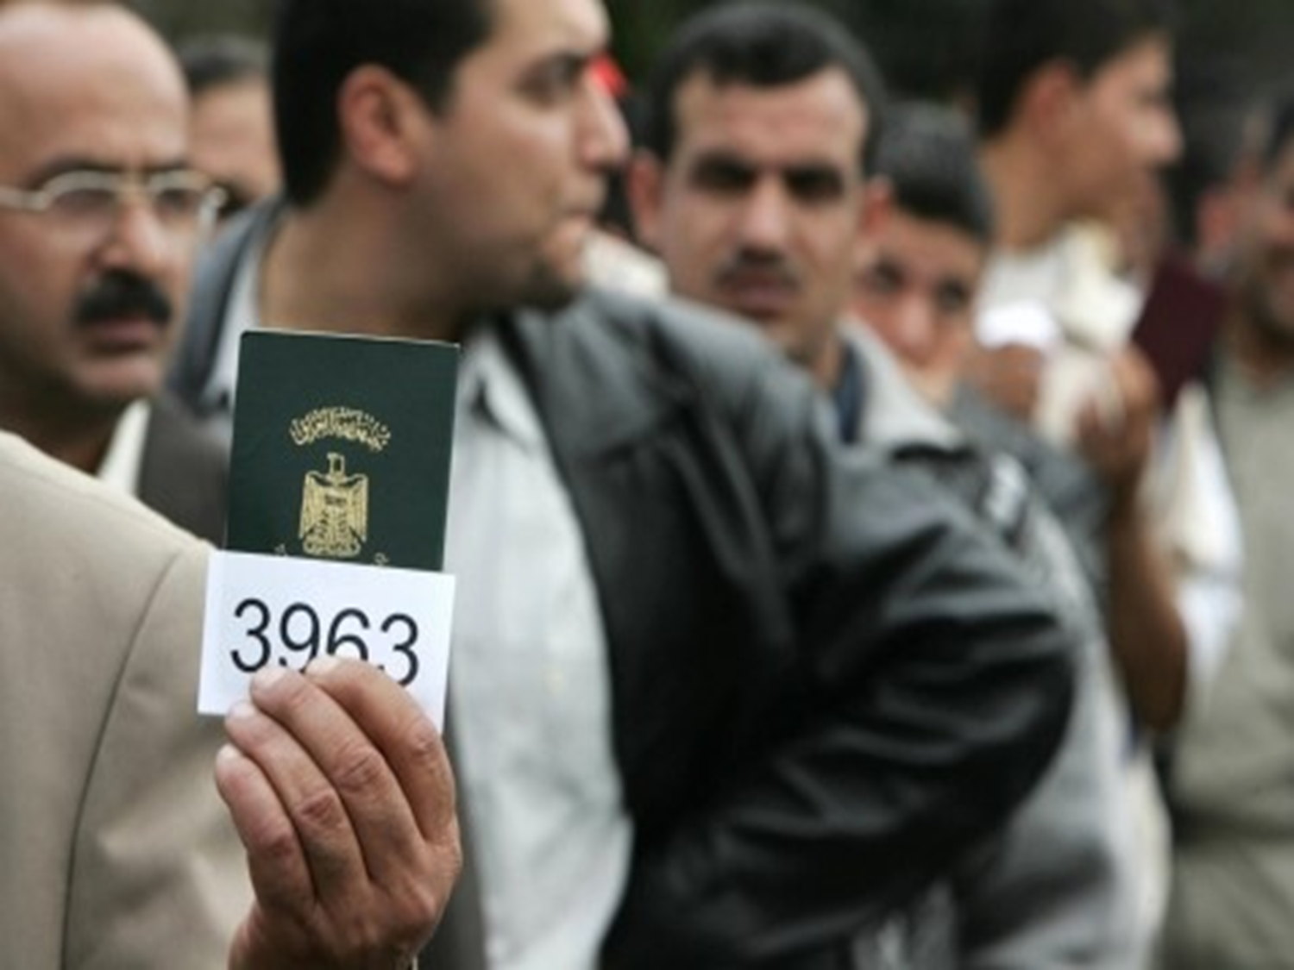
Registration & Continuous Registration

Slide 9
Registration & Continuous Registration
To ensure updated data, figures and information
Completes information gaps from emergency situations
Provides chance to refugees to report on changes
Provides information to refugees for informed decision making
Allows programming and planning to update budgets and activities accordingly, including contingency planning

Slide 10
The Syria Crisis in Jordan & Lebanon

Slide 11
Issues for discussion
Evolution of Syrians over past 5 years
Lessons learnt from surveys of Syrian refugees
Birth, marriage and death registration of Syrians with UNHCR
2015 Jordanian Census
Sensitivities with Host Governments

Slide 12
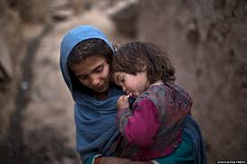
Questions

