Slide 1
Measuring statelessness in Kenya
Civil Registration in Refugee Settings:
Advancing Assessment of CRVS in Unsettled Environments
Technical Meeting on Design and Implementation Issues
December 19-20, 2016
United Nations House, Beirut
Helge Brunborg
Helge.Brunborg@gmail.com

Slide 2
Links between Civil Registration and Statelessness
Stateless and other non-nationals often have problems registering their vital events
Lack of birth registration (and marriage) documents may make it more difficult to obtain a nationality and ID documents
It is natural to investigate civil registration in a survey (or census) on statelessness – and vice versa

Slide 3
Sources and methods for data on CR (and statelessness)
CR system
Administrative registers
Censuses
Surveys

Slide 4
Administrative registers
Established for administrative purposes
Some administrative registers have information about nationality/citizenship
Population registers
Births
Identity cards
Immigrants
Refugee camp population
Regular updating required. Additions easier to identify than deletions (deaths and out-migrations)
Usually not straightforward to make statistical tables from a register

Slide 5
Civil Registration and Vital Statistics (CRVS)
Civil Registration (CR) is the recording of vital events: live births, deaths, marriages, and divorces
CR is usually followed by issuance of a birth certificate
Registration of births can be important for nationality/citizenship
Usually not sufficient for nationality but often necessary
Migration is not considered to be a vital event but is equally important and should be treated as a vital event – if possible

Slide 6
Examples of census questions on nationality/citizenship
Kenya 2009: Q15 Tribe/ Nationality
For Kenyans write code for tribe
For non-Kenyans write code for nationality
No specific code for No tribe, No nationality or Doesn’t know
-> All these responee are bundled together
-> Cannot use census to find no. of stateless persons
Cote d’Ivoire 2014, 1999, 1989: Q on Ethnicity/ Nationality
-> The censuses do not provide reliable data on stateless persons, but include proxy variables (country of birth, birth registration, tribe, etc.)

Slide 7
Survey on statelessness in Kenya
Need for more reliable estimates of the number of stateless persons in Kenya
Estimate: 20,000 stateless in a population of 40 mill.
Several relatively small groups with stateless persons: Makonde, Nubians, Rwanda, Pemba, Galjeel, Shona, ….
Random sample?
-> Only about 5 stateless in a random national sample of the Kenya population, with a sample size of 2000 households
Key informants helped to identify
Areas with households with members of group
Households with members of group
Houses marked and numbered on census maps (from 2009)
Number written in chalk on door
Survey partly based on 2009 census questionnaire
Testing questions for the 2019 census

Slide 8
Survey design and questionnaire
Households with at least one member with links to Pemba in Tanzania
Household questionnaire:
Background: Age, sex, marital status, relationship to head of household
Country of birth, year of immigration to Kenya
Also asked about previous spouse and parents
Education and work
Identification papers
Birth certificate, Kenyan ID, Foreign documents …
Visits to country of origin
Difficulties
Problems with neighbours

Slide 9
Survey of Pemba households in Kenya
Pilot study in April 2016
Report from Pilot Survey in May, including recommendations
Mapping of households in July 2016
Questionnaire revised and translated into Swahili
Census code lists revised
Training of interviewers and supervisors mid August
Interviews end of August in two counties on the coast
Focus Groups Discussions 24-26 August
Training of data clerks 30 August
Data entry 31 Aug – 2 Sept
Data checking and cleaning 3-6 Sept
Making tables and graphs 7-9 Sept
Analysis and report: ongoing
Report to be published jointly by UNHCR and KNBS

Slide 10
Examples of results from a survey of Pemba households in Kenya
Based on pilot survey in April 2016 and full survey in August 2016
2,627 individuals in 429 households
Results cannot be published yet

Slide 11
Population pyramid of the enumerated population

Slide 12
Population pyramid of the enumerated population

Slide 13
Sum-mary of res-ults
Variable | Population | Per cent
Interview language Swahili | HH respondents | 99
Male head of household | HH heads | 88
Nationality Kenyan | All | 62
Nationality Tanzanian | All | 17
No nationality | All | 11
Born in Kenya | All | 76
Religion Islam | All | 100
Main language Swahili | All | 95
No additional language | All | 80
Kenyan Certificate of Primary Education | 14+ years | 30
Kenyan marriage certificate | Married | 59
Kenyan birth certificate | Born in Kenya | 53
Kenyan birth notification | Born in Kenya | 44
Health/Clinic card | All | 61
Kenyan ID card | 18+ years | 53
Kenyan passport | All | 3
Other passport | All | 3
Alien card | All | 1
Other travel/ consular documents | All | 3
Visiting country of origin once a year or more often | All | 18
Problems with neighbours | 18+ years | 7
One or more difficulties due to lack of ID documents | 18+ years | 10

Slide 14
Birth certificate

Slide 15
Kenya ID card, per cent
 | Has Kenya ID card | Never applied | Not allowed to apply | Applied, rejected | Waiting slip
Born in Kenya reporting Kenya tribe | 60 | 35 | 0 | 2 | 3
Born in Kenya reporting Pemba tribe | 38 | 32 | 4 | 19 | 7
Born outside Kenya reporting Pemba tribe | 17 | 30 | 20 | 23 | 10
All | 35 | 32 | 10 | 16 | 7

Slide 16
Questions that may be relevant for the Civil Registration project
Nationality/citizenship
National ID card
Birth noti­fication
Birth certifi­cate
Health or clinic card
Passport
Marriage certificate
Year of birth
Marital status
No. of children
Year of migration
…..

Slide 17
How many stateless persons in Kenya with links to Pemba?
Question on citizenship
Kenya: 62%
Tanzania: 17%
No citizenship: 11 %
Not applicable: 9%
Don’t know: 1%
Question on Kenyan ID card
Yes: 35%
No: 65%
Never applied: 32%
Not allowed to apply: 10%
Applied and rejected: 16%
Waiting slip: 7%

Slide 18
Kenya ID status by place of birth and reporting tribe

Slide 19
Kenya ID card by migration period

Slide 20
Difficulties as a result of lack of ID documents
 |  | Number | Per cent
1 | Education | 84 | 28
2 | Health services | 21 | 7
3 | Owning land | 60 | 20
4 | Buying property | 42 | 14
5 | Marrying | 22 | 7
6 | Travelling | 123 | 40
7 | Employment | 77 | 25
8 | Business | 92 | 30
9 | Practicing religion | 5 | 2
10 | Participation in local leadership | 20 | 7
11 | Access to bank services | 91 | 30
12 | Joining organisations | 49 | 16
13 | Voting in elections | 55 | 18
14 | Standing for elections | 21 | 7
15 | Other difficulties | 10 | 3
16 | No difficulties | 129 | 42
17 | No answer | 49 | 16
18 | Harassment by police/other authorities | 9 | 3
19 | Getting relief and other supplies | 7 | 2

Slide 21
Constitution of Kenya 2010 and Kenya Citizenship and Immigration Act 2011
Children with one or two Kenyan parents are Kenyan citizens, regardless of the country of birth
Citizenship by marriage if married to a Kenyan citizen for at least seven years
but often difficult to get a marriage certificate (59%)
Naturalised persons (at least 7 years)
but difficult to provide evidence of residence in Kenya
Local administrative routines for naturalisation not implemented
No register where nationality is recorded for all residents, but the Immigration Department probably keeps a register of naturalised citizens
Operational definition: Having a Kenyan ID card
Survey: 429 households with 2,527 household members
1,178 adults: 537 of these no Kenyan ID card or no other ID card or passport
→ About 50 % of adult Pemba population in Kenya stateless

Slide 22
Constitution of Kenya 2010 and Kenya Citizenship and Immigration Act 2011
Children with one or two Kenyan parent are Kenyan citizens
Citizenship by marriage if married to a Kenyan citizen for at least seven years
but often difficult to get a marriage certificate (59%)
Naturalised persons (at least 7 years)
but difficult to provide evidence of residence in Kenya
Local administrative routines for naturalisation not implemented
No register where nationality is recorded for all residents, but the Immigration Department probably keeps a register of naturalised citizens

Slide 23
Conclusions on percentage of stateless Pemba
11% Stateless
47% No ID card
63% Risk of statelessness (no ID card) for children <18

Slide 24
Photos from the Kenyan survey

Slide 25
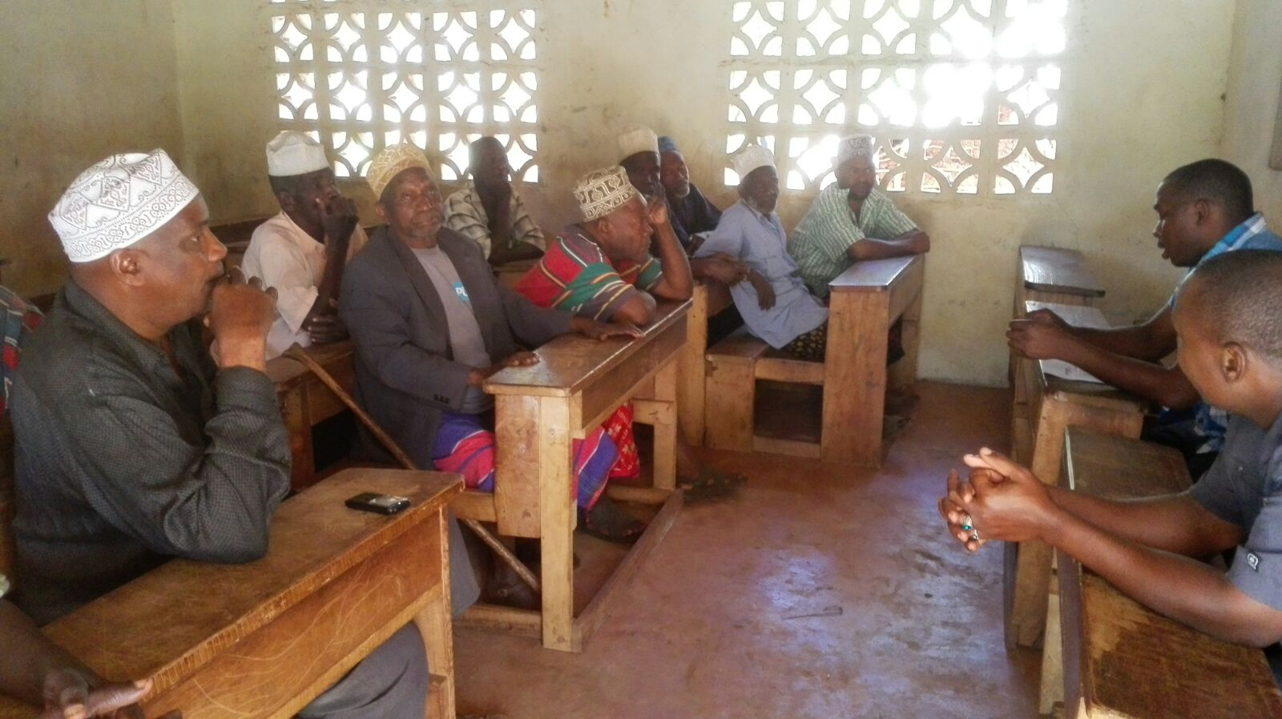
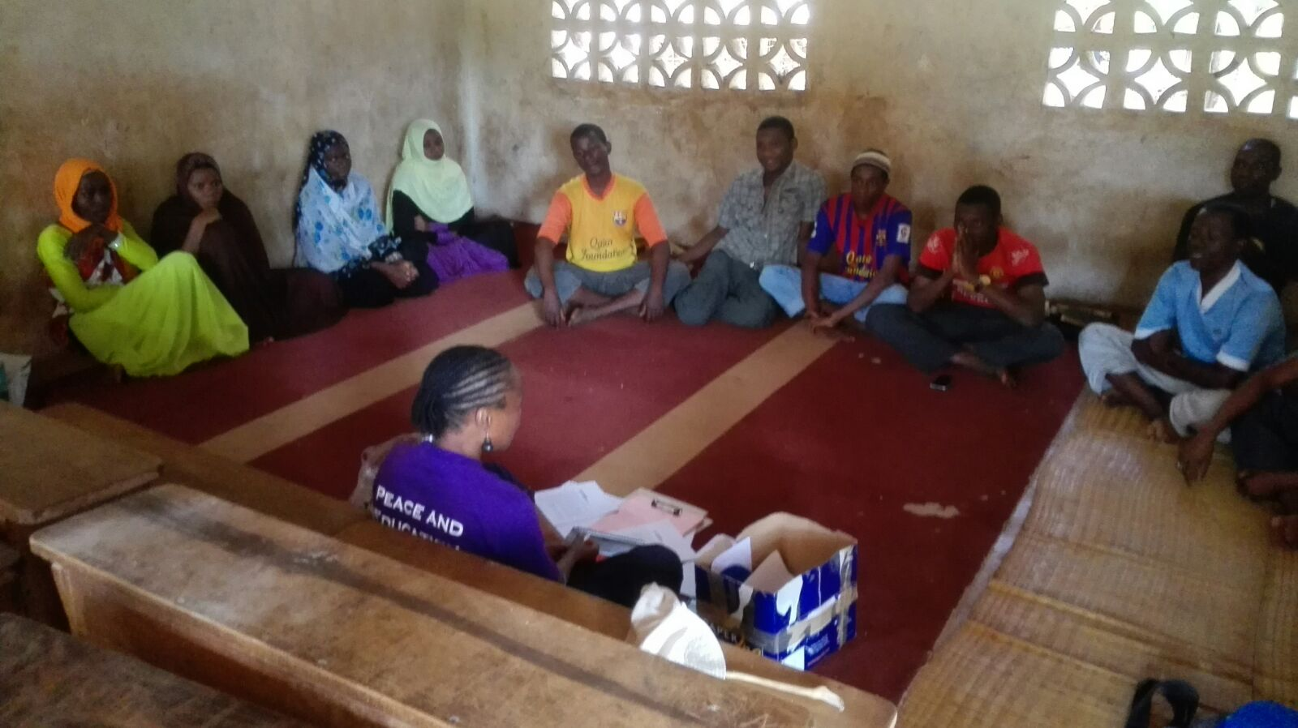
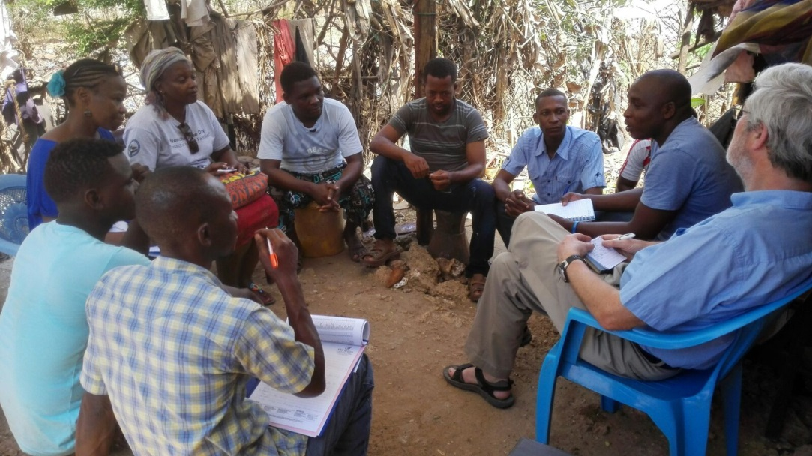
Focus groups

Slide 26
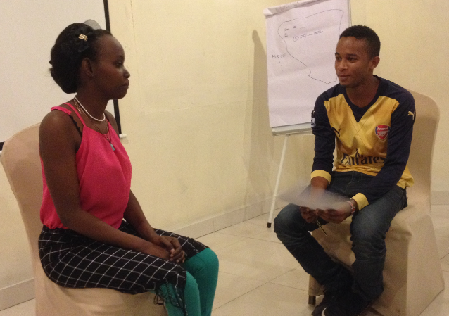
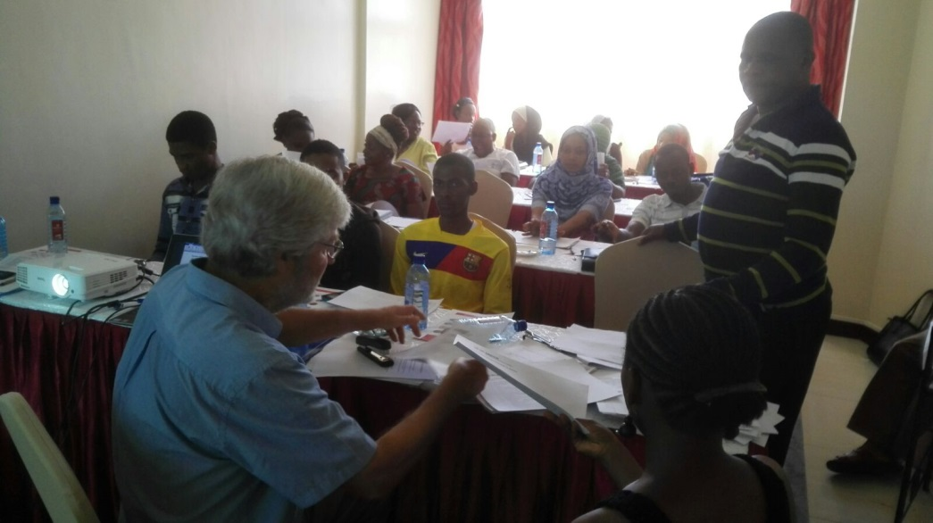
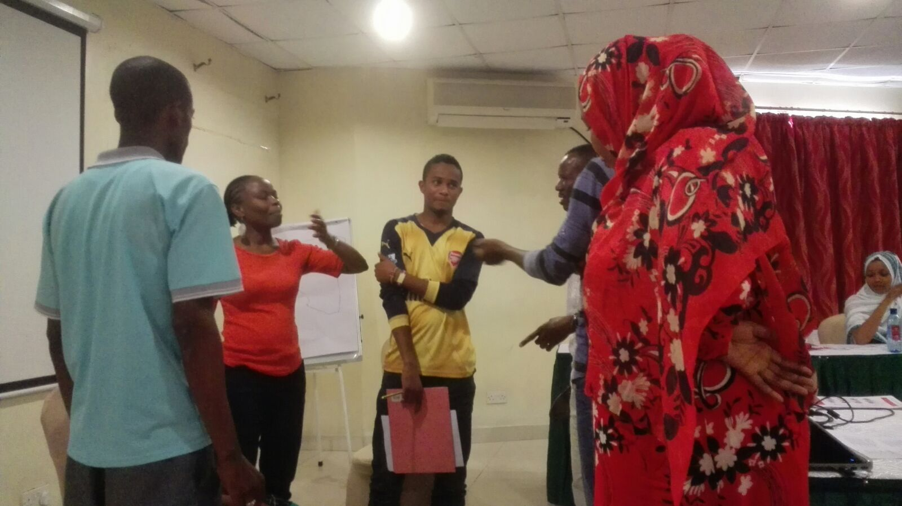
Training

Slide 27
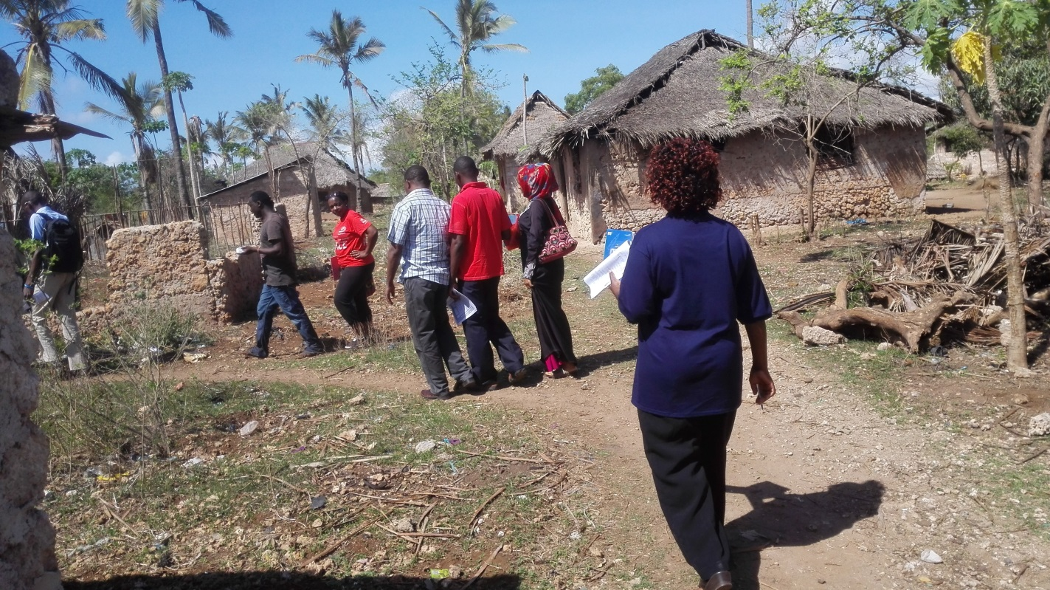
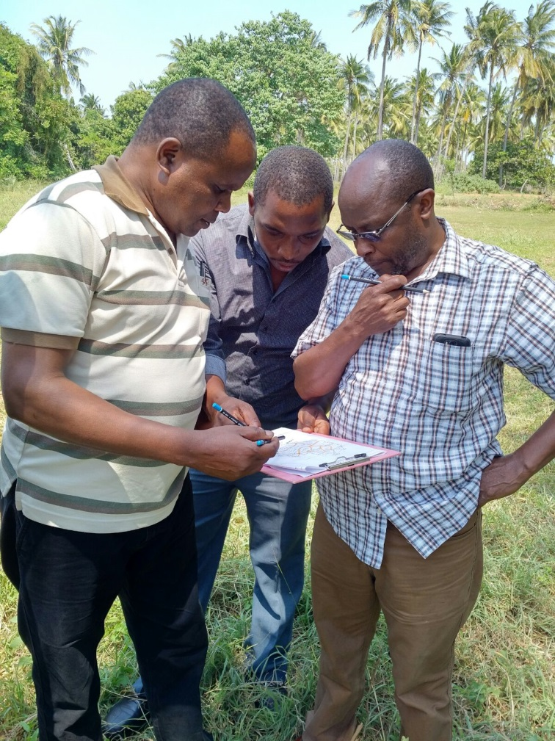
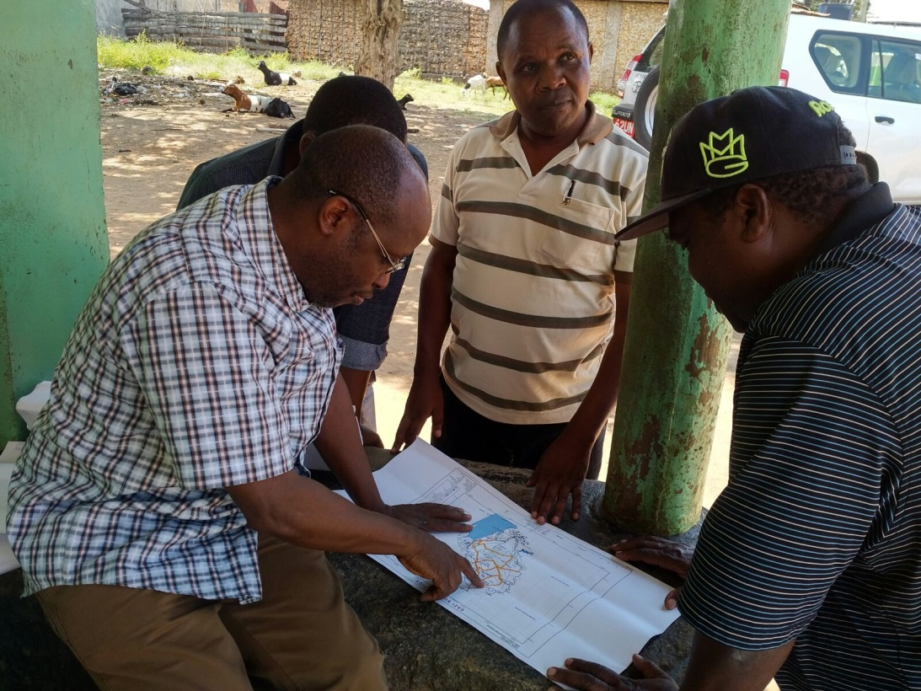
Finding the households

Slide 28
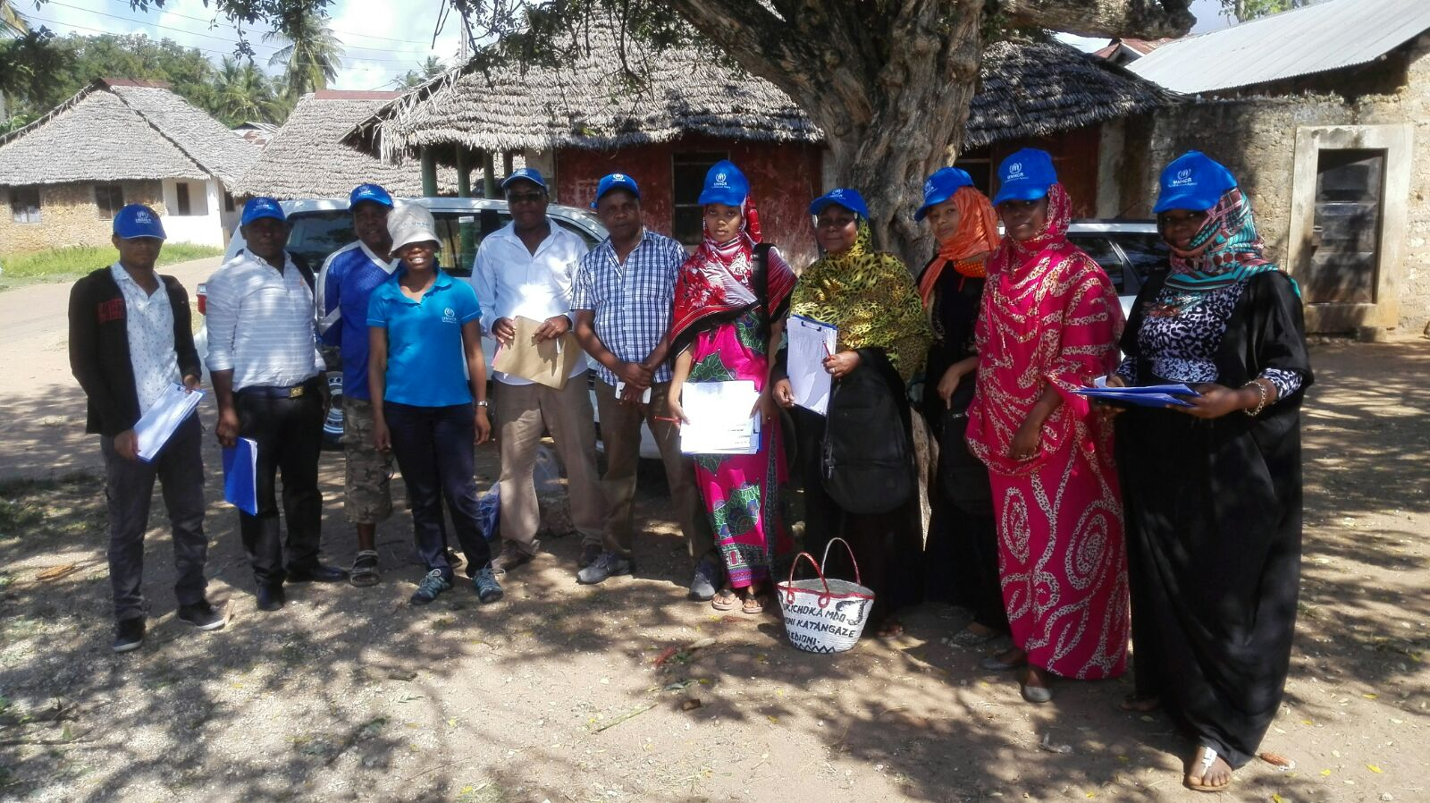
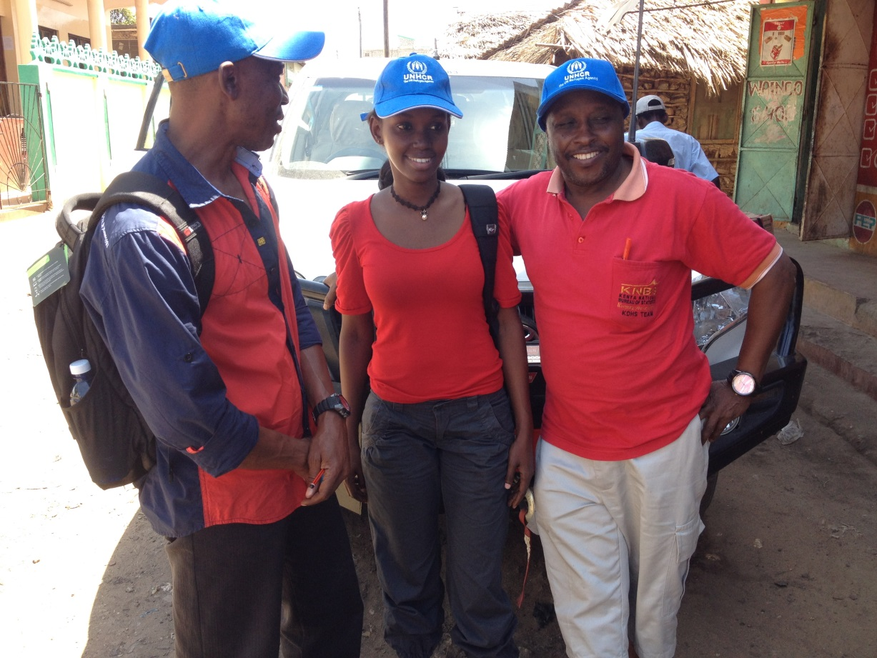
Inter-viewers

Slide 29
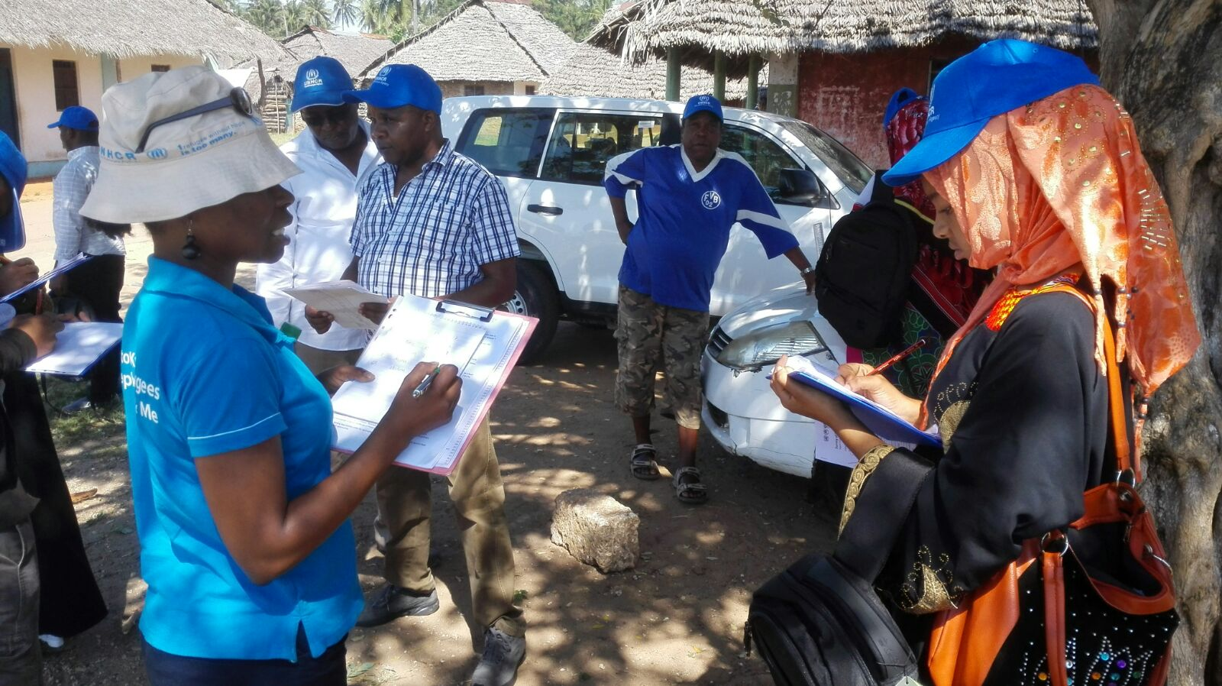
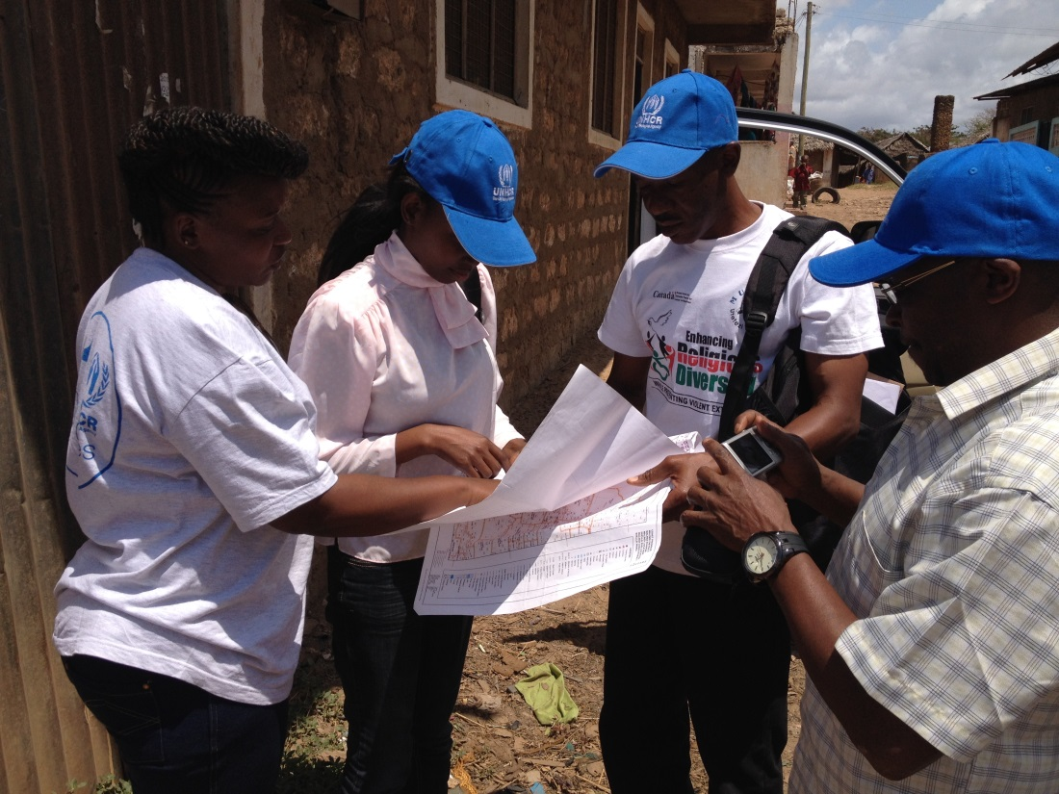
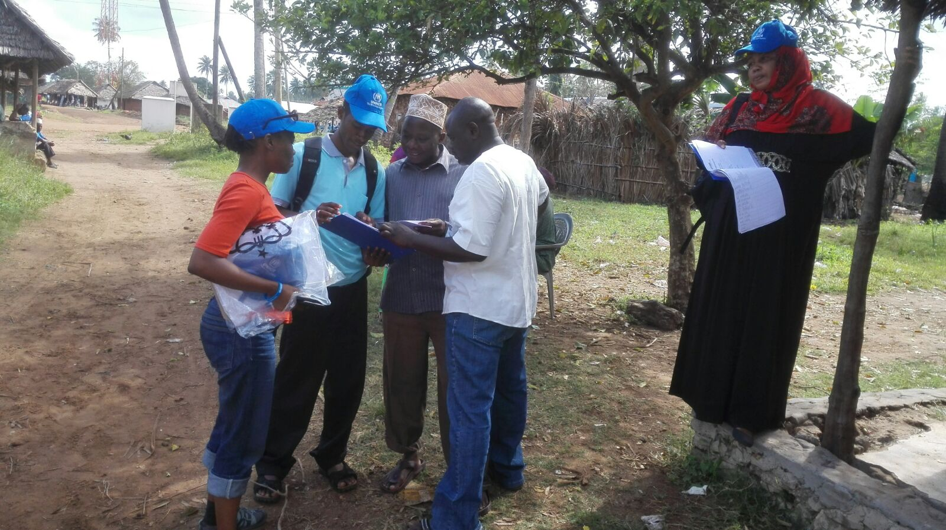
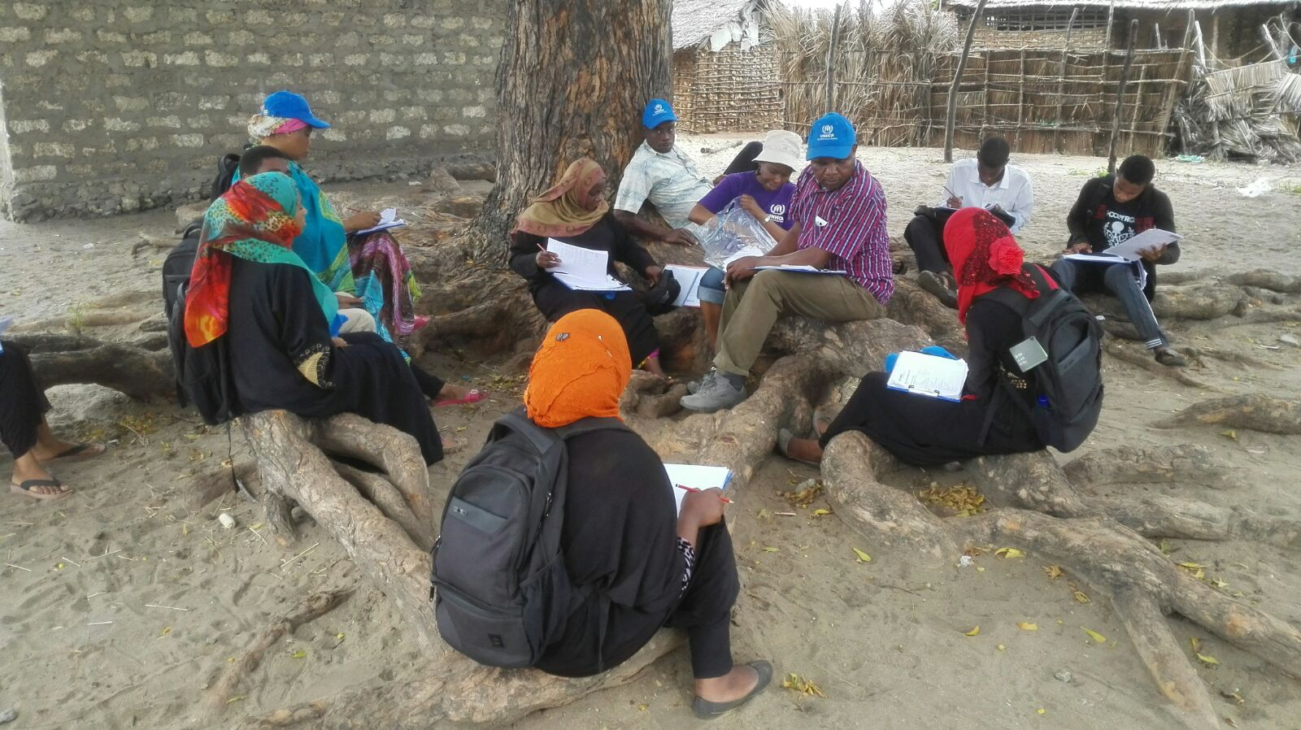
Organization of field work

Slide 30
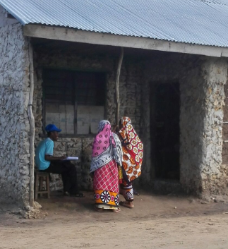
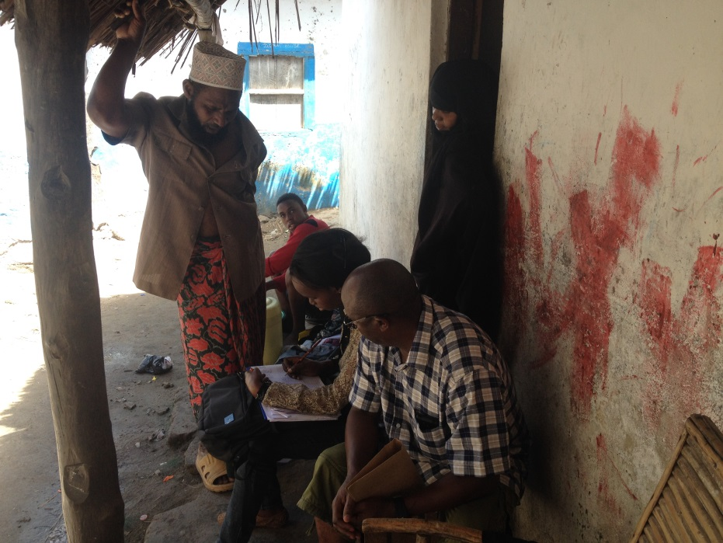
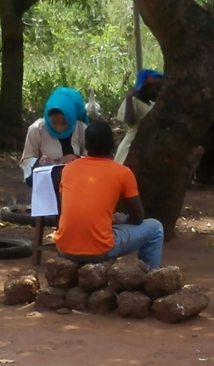
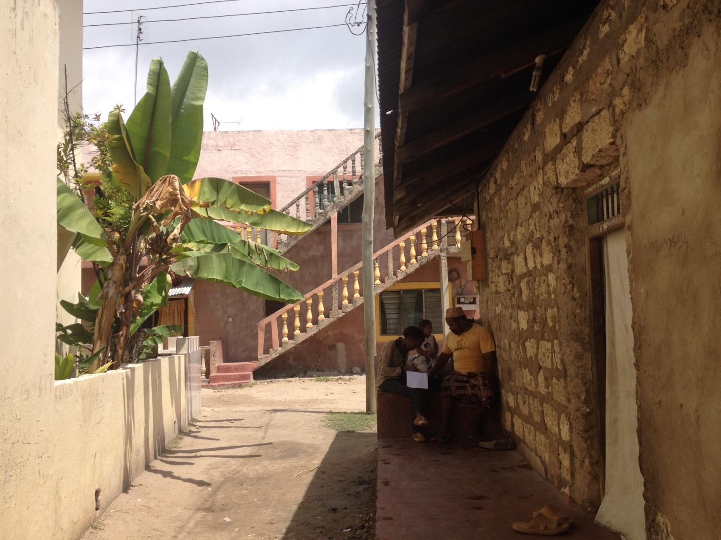
Interviewing

Slide 31
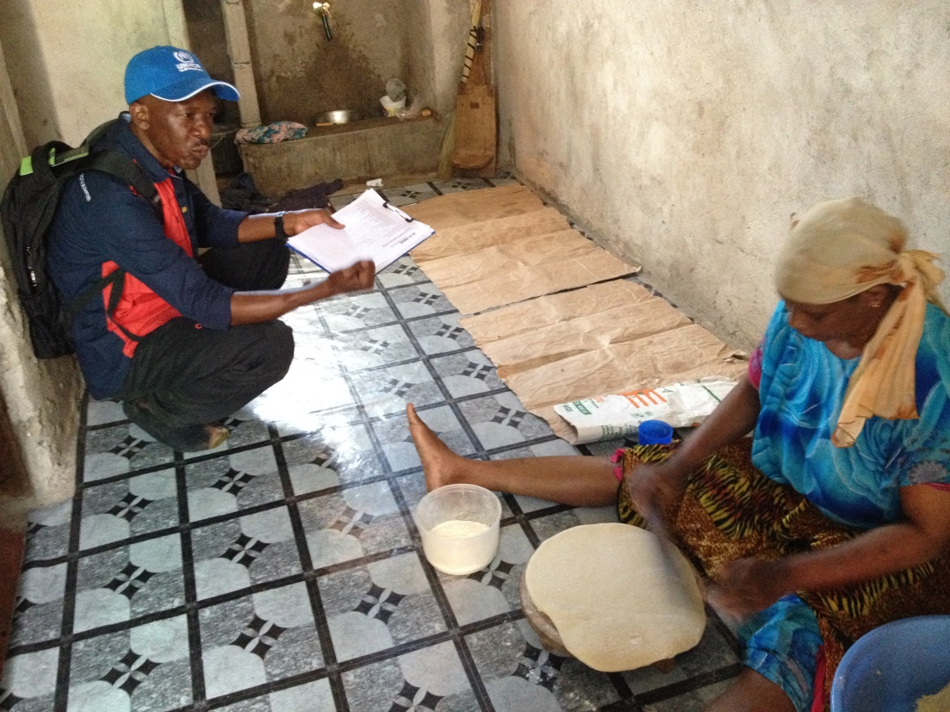
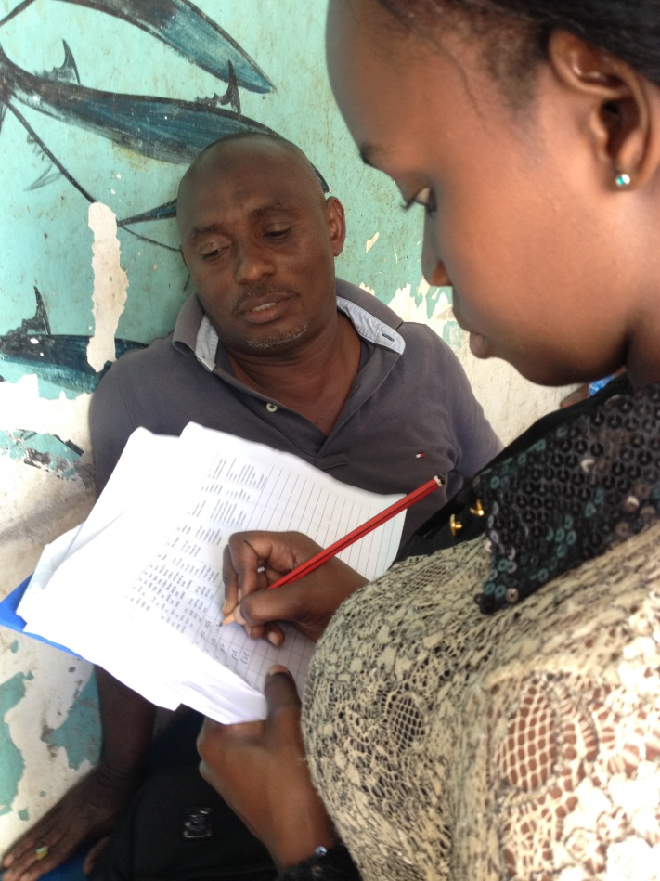
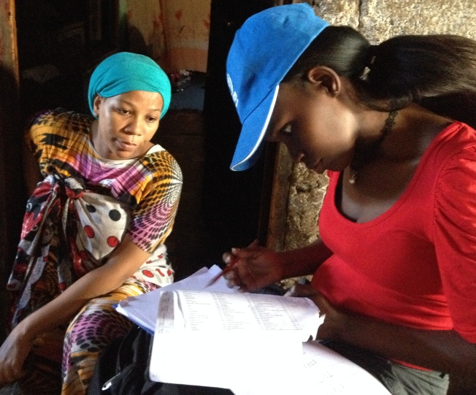
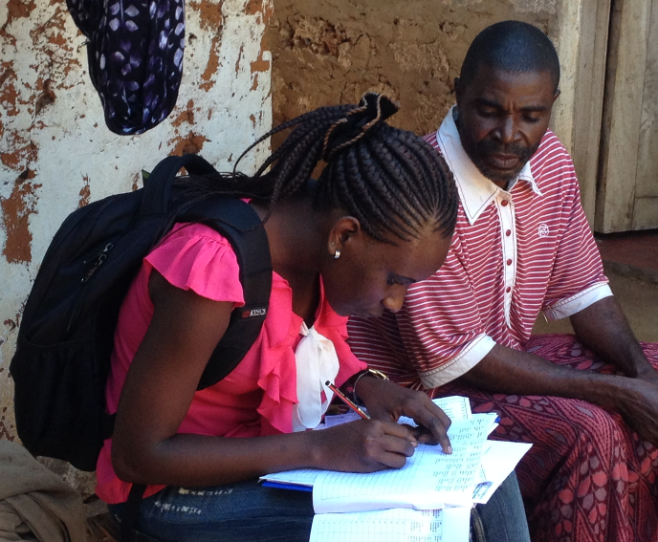
Inter-view-ing

Slide 32
Constitution of Kenya 2010 and Kenya Citizenship and Immigration Act 2011
Children with one or two Kenyan parents are Kenyan citizens, regardless of the country of birth
Citizenship by marriage if married to a Kenyan citizen for at least seven years
but often difficult to get a marriage certificate (59%)
Naturalised persons (at least 7 years)
but difficult to provide evidence of residence in Kenya
Local administrative routines for naturalisation not implemented
No register where nationality is recorded for all residents, but the Immigration Department probably keeps a register of naturalised citizens
Operational definition: Having a Kenyan ID card
Survey: 429 households with 2,527 household members
1,178 adults: 537 of these no Kenyan ID card or no other ID card or passport
→ About 50 % of adult Pemba population in Kenya stateless

