Slide 1
Advancing Civil Registration and Vital Statistics in the Service of Syrian Refugees
Romesh Silva, Ph.D.
Demographic and Social Statistics Section
Statistics Division
UN-ESCWA Expert Group Meeting
December 19-20, 2016

Slide 2
Outline
Short Introduction & Motivation
Project Idea
Inception Phase
Initial Project Launch

Slide 3
Civil Registration and Vital Statistics (CRVS) Systems
Civil Registration (CR) is the compulsory, continuous, universal and permanent recording of vital events such as births and deaths.
Foundational basis of legal identity and social inclusion
From these records, vital statistics (VS) on births, deaths, causes of death, fertility and mortality (and where migration data is also available – population estimates) can be produced for policy and planning.
In order to make people count, we need to count people.

Slide 4
Why are Civil Registration and Vital Statistics (CRVS) Systems important?
Substantive level: critical mechanism for supporting good governance (through data driven planning and accountability, links with electoral rolls etc.), a tool for financial management (linkages with social security) and data linkages (through identity management) and a key element in supporting human rights (through the recognition of identity and associated rights, and the accountability of measuring and recording deaths).
Technical level: CR is the preferred source of vital statistics. Accurate vital statistics are critical in understanding population dynamics and development progress of populations

Slide 5
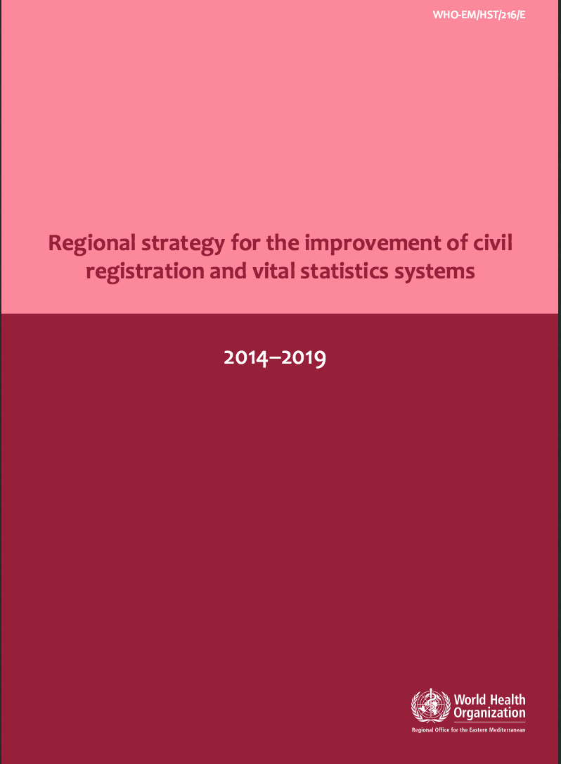
CRVS Connections for ESCWA
2030 Development Agenda
‘Leave no one behind’
SDG 16 – calls for universal civil registration and recognizes ‘legal identity’ as a critical driver of development progress
Connections to several other SDGs
Peace, justice, strong institutions
Health and well-being
Gender equality
ESCWA thematic prioritization of social justice
2014-2019 Strategic plan for improvement of CRVS systems in the Arab region (jointly with WHO-EMRO & UNFPA-ASRO)

Slide 6
Project Motivation
Syrian conflict and resulting displacement have obstructed the complete and accurate registration of vital events for an increasing number of Syrians.
Impediments and challenges include
lack of understanding of the importance of vital registration and of how to access and navigate vital registration processes.
some persons are unable to provide the supporting documents required to register a vital event
large numbers of refugees can overwhelm public authorities and the functioning of their administrative systems.

Slide 7
Project Objective
To evaluate the completeness, strengths and weaknesses of vital registration for Syrian refugees in Jordan and Lebanon and to guide policy and practice.
Such evaluation is important to identify gaps, blockages and weaknesses of existing civil registration practices and subpopulations of Syrian refugees that are currently invisible to these systems.
This kind of systematic evaluation is a critical input to improve plans civil registration and vital statistics systems for Syrian refugees in Lebanon and Jordan.
To enhance knowledge sharing and coordinated efforts amongst national authorities and international agencies seeking to improve the responsiveness of civil registration and vital statistics systems in Lebanon and Jordan to refugee needs.

Slide 8
Project Strategy
Four-part assessment of birth and death registration practices for Syrian refugees in Jordan and Lebanon
Qualitative mapping of laws, procedures and processes of vital registration vis-à-vis refugees in Lebanon and Jordan.
How has the current CRVS system been designed and implemented?
A technical assessment of the completeness and quality of birth registration and death registration for Syrian refugees
How complete and usable are current CR records?
Series of in-depth interviews and focus groups to assess knowledge, attitude, and perceptions of the importance, accessibility and performance of civil registration processes for Syrian refugees
How is the current CRVS system and practices understood by stakeholders?
Stakeholder consultation, coordination and dissemination of findings with key stakeholders.
Capitalize on the cross-cutting nature of CRVS and the multi-stakeholder environment of both CRVS and humanitarian settings.

Slide 9
Expected Outputs
Updated mapping of current procedures and practices will provide a detailed overview of how current vital registration practices have evolved
Quantitative assessment of the completeness and quality of registered births and deaths to Syrian refugees.
In-depth interviews and focus groups on knowledge, attitudes and perceptions of vital registration laws, procedures and practices will provide insight about the perceptions of policy-makers and practitioners on current vital registration processes.

Slide 10
Expected Outcome
Project outputs will provide a basis to guide policy discussions and practice improvements to enhance civil registration processes for Syrian refugees in Jordan and Lebanon.
Project outputs will also provide a basis for the production of vital statistics on Syrian refugee population in Jordan and Lebanon
Lessons that can inform CRVS practices and policies in other refugee settings in the region.

Slide 11
Critical Questions & Tasks for this EGM
Review of available (qualitative) studies on vital registration issues for Syrian refugees in Jordan and Lebanon,
Define and discuss the conceptual and definitional challenges associated with measurement of vital registration processes for Syrian refugees,
Explore the validation challenges of birth and death registration completeness and quality – particularly for non-camp Syrians in Jordan and Lebanon
What are the possibilities for using existing data sources (such as 2015 Jordanian Census and UNHCR registration records) for the purposes of completeness/quality assessment?
Is there a role for survey-based validation/completeness measurement? If so, what are the key design and implementation challenges for such a survey?
Outline logical next steps in launching this initiative

