Slide 1
Islamic Finance Task Team (IFTT)
Islamic Finance in the update of 2008 SNA and BPM6:
Drivers & challenges
Webinar on the Statistical Treatment of Islamic Finance in the National and International Accounts
16 December 2021

Slide 2
Outline
Importance of Islamic Finance
Principles of Islamic Finance
Existing Standards and Materials
Main Challenges in national and international accounts
Research Topics
Islamic Finance Task Team

Slide 3
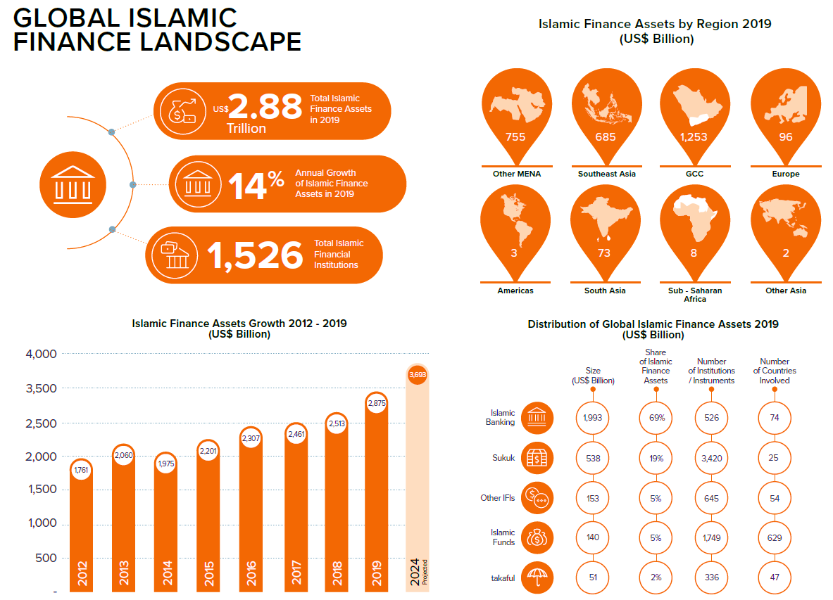
Importance of Islamic Finance
Islamic banking is considered as systemically important in 15 jurisdictions
(Islamic Financial Services Industry Stability Report 2021)
Islamic Finance Development Report 2020

Slide 4
Principles of Islamic Finance
Islamic Law (Shari’ah) does not permit the receipt and payment of "riba" (interest), "gharar" (excessive uncertainty), "maysir" (gambling), and short sales or financing activities that it considers harmful to society
Parties must share the risks and rewards of a business transaction
Transaction should have a real economic purpose without undue speculation or any exploitation of either party
Islamic financial institutions developed innovative financing arrangements to comply with its principles :
Undertake various economic activities
Offer alternative range of financial instruments and assets backed financing
Set up specific entities which may be unique to them

Slide 5
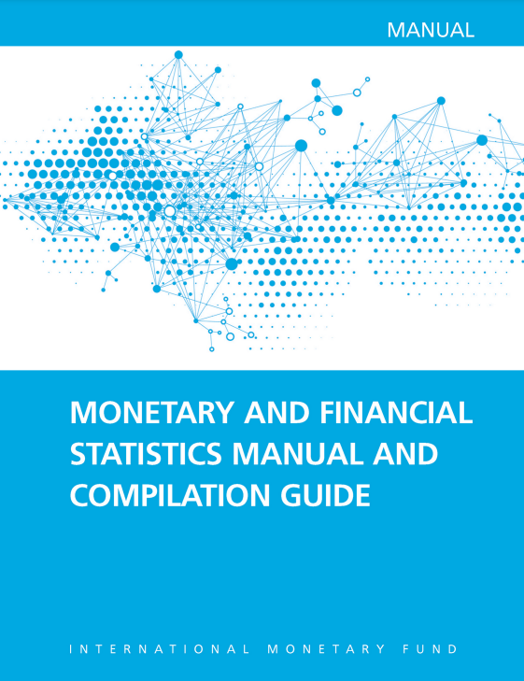
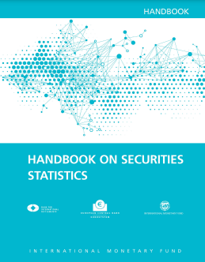
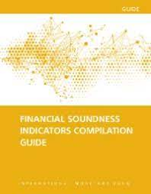
Existing Standards and Materials
Statistical manuals and compilation guides:
Islamic financial standard-setting bodies:
(2016) Annex 4.3
(2015) Annex 3
(2019) Annex 7.4
Need for comprehensive internationally-agreed recommendations on treatment of Islamic Finance within integrated macroeconomic statistical framework based on 2008 SNA

Slide 6
Main Challenges in national and international accounts
To comply with Shari’ah principles, how to describe the investment income for Islamic deposits, loans and debt securities other than SNA terminology of Interest?
How to sectorize and calculate the output of a number of entities which are rather unique to Islamic finance?
Who is the economic owner of non-financial assets underlying various sales, equity and leasing arrangements under Islamic finance?
How to classify the Islamic financial instruments underlying the various types of financing arrangements according to SNA framework?
How to measure the Islamic financial intermediation services consistently with the core SNA concept and formula of FISIM?
How can the fully reshaped model of Islamic insurance and reinsurance fit with SNA framework?

Slide 7
Six research topics
Issue 01
Terminology for the investment income for Islamic deposits, loans and debt securities
Issue 06
Issue 02
Islamic Insurance (Takaful and Retakaful)
Sectorization and output of Islamic financial entities
Issue 05
Reference rates and terminology to calculate Islamic FISIM
Issue 03
Economic ownership of non-financial assets related to sales, lease, and equity financing which are legally owned by Islamic financial corporations
Issue 04
Classification of Islamic financial instruments and corresponding investment income

Slide 8
A consolidated Guidance note for a holistic Global consultation
Joint Task Team
Research topics sub-task teams
GN’ Consolidation
AEG/ISWGNA and BPTT endorsement
Global Consultation
14 December 2021 to 25 January 2022
16 December 2021

Slide 9
Islamic Finance Task Team
01
10th AEG meeting noted differences between Islamic and conventional banking and agreed further research is needed
.
2016
ESCWA & UNSD formed ISWGNA Task Force on IF which held two face-to-face meetings in 2017 (Beirut) and 2018 (Ankara)
2017
02
03
(2017-2018-2019) AEG Meetings (11th-12th-13th) discussed progress of work of TF and provide guidance on way forward.
2017-2019
UNSC requested the ISWGNA to prepare a roadmap to update the 2008 SNA at its 51st session (targeted release date is March 2025)
IMF BOPCOM launch a parallel process to update the BPM6
March
2020
04
05
ISWGNA & BOPCOM formed the Joint Task Team on Islamic finance (IFTT)
April 2020

Slide 10
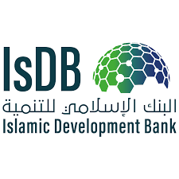
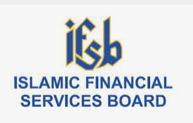
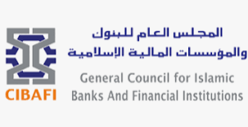
Governance - Membership
A global
collaborative
Initiative
Chaired By State of Palestine & Morocco
Secretariat: UNSD & ESCWA
Experts from relevant international/regional organizations
Experts from countries where IF is prevalent -various statistical areas-
Ms. Amina Khasib (PCBS, State of Palestine)
Mr. Mounir Rhandi (FEO, Morocco)
Dr. Muhammad Amir Hossain (Bangladesh Bank)
Ms. Pujiastuti Abassuni (Bank Indonesia)
Mr. Suswandi (Statistics Indonesia)
Mr. Mohd Yazid Kasim (Department of Statistics, Malaysia)
Ms. Norhayati Razi (formerly, Central Bank of Malaysia)
Ms. Bouchra Farghsaoui (HCP, Morocco)
Ms. Derya BAŞ Sonbul (TurkStat, Turkey)
Mr. Abd El Shafi El Ashmawy (FCS Authority, UAE)
Mr. Perry Francis (Bank of England, United Kingdom)
Mr. Michael Lyon (Bank of England, United Kingdom)
Mr. Ragheed I. Moghrabi (RH University, Lebanon)
Dr. Tawfik Azrak (Social Sces University of Ankara, Turkey)
Mr. Russell Krueger (Independent Expert)

Slide 11
Thanks for your attention
For further questions, please feel free to ask at:
amina@pcbs.gov.ps / rhandi@oc.gov.ma

