Slide 1
Progress with the SNA and BPM update process Webinar on the Statistical Treatment of Islamic Finance in the National and International Accounts 16 December 2021

Slide 2
SNA update process as approved by the 2020 UNSC
Identification of conceptual solutions subject to practical testing
Iterative improvement of guidance notes
Coordination between NA and other domains (incl. classifications) & alignment with other macroeconomic standards
User input
SNA extension (supplementary tables / satellite accounts)
Incremental research work
Principles
Guidance notes
Editing system
Reinforce communication
Dedicated website
SNA ‘branding’
Digitize the SNA
Support to developing countries
Human and financial resources
Issue 1
Major Update
Necessary Elements
Issue 2
Consultation & Testing
Critical Mass
Issue 3
Issue n

Slide 3
BPM6 update process was endorsed by BOPCOM at it 33rd meeting
March 2020–March 2022
Finalization of the research issues identified in the Compendium of Research Issues
Phase I
April 2022–March 2025 Finalization of the Annotated Outline and drafting of the BPM7, and extensive consultations about the proposed changes
Phase II

Slide 4
The Update Process
AEG and ISWGNA: approve 2025 SNA
UNSC: adopt 2025 SNA
UNSC: launch update process
Development of guidance notes & country consultation and testing
UNSC: adopt recommendations
Draft 2025 SNA, incl. country consultation on new text
Iterative drafting of the update of the 2008 SNA 2022 - 2024
Mar. 2020
2020-2023
Mar. 2024
2024
Oct. 2024
Mar. 2025
SNA
Several common issues
BPM
BOPCOM: launch update process
Research work, leading to
draft annotated outline (AO)
BOPCOM: endorse draft AO after public consultation
Draft BPM7, including country consultation on new text
BOPCOM:
agree on BPM7
IMF Chief Statistician:
approve BPM7
Mar. 2020
2020-2022
June 2022
July 2022-Mar. 2025
Mar. 2025

Slide 5
Three-pronged approach
Technical research
Task teams/sub-task teams/ joint task teams
Specific timeline and outputs
Draft guidance notes:
clarification, interpretation or change;
central system, supplementary tables, or satellite accounts;
implementation tested through country experimentation and testing
Broad consultation
Involve broad set of users in the discussion, including policymakers, academia and private sector representatives
Regular regional and global consultancies;
Global user conferences on economic statistics
Ensuring overall consistency
Collaborate with experts in:
classifications, BPM, GFSM, MFSM, SEEA, labour, prices, agriculture, and
business and trade statistics, classifications, etc.

Slide 6
Priority areas
Joint priority areas
BPM
priority areas
Globalization
Financial
Issues
IIP
BOP
SNA
priority areas
Digitalization
Islamic
Finance
Informal
Economy
Current
Account
Wellbeing and
Sustainability
Communication
Statistical
Units
Classifications
Direct
Investment

Slide 7
Task teams
Workstreams were launched to resolve issues related to priority areas
Workstreams are organized by Task Teams led by country members of the AEG/BOPCOM
ISWGNA/IMF provide secretariat
Guidance are being developed for each of the priority issues covering both conceptual and practical guidance

Slide 8
Guidance note process
Guidance Note (GN) drafted by TT
Draft GNs reviewed by AEG-ISWGNA/BOPCOM BPTT /Other Committees of Experts
Public consultation including
experimentation and testing
Second round review [Only if significant changes]
TT sends GN to AEG-ISWGNA/BOPCOM BPTT/Other Committees of Experts
Joint Endorsement
Divergence
Decision by
BOPCOM for BPM6 Update
UNSC for SNA update
Depute resolution

Slide 9
https://unstats.un.org/unsd/nationalaccount/default.asp

Slide 10
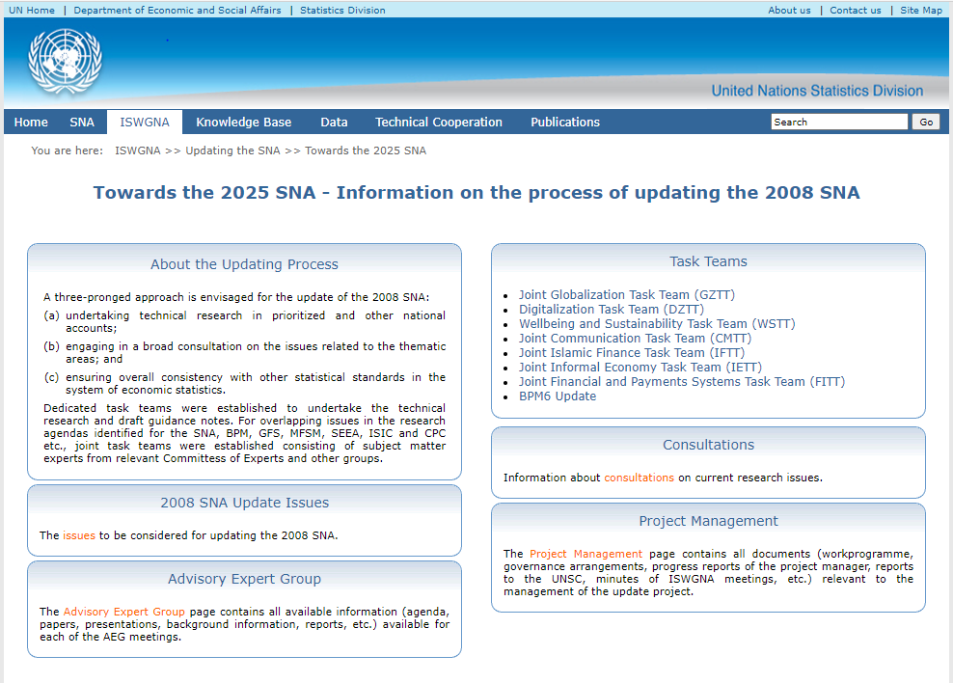
SNA update website

Slide 11
SNA update website

Slide 12
Global consultations website

Slide 13
Global consultations - BPM
https://www.imf.org/en/Data/Statistics/BPM

Slide 14
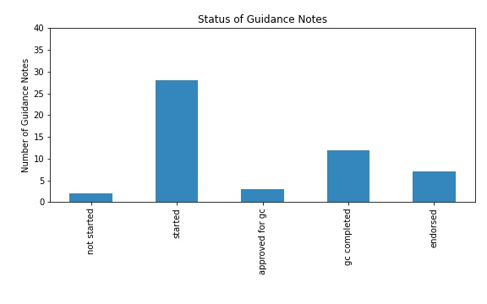
Progress
Current Status of Guidance Notes
Task Team | Dropped/ Consolidated | Not started | Started but not yet approved for consultation | Approved for consultation | Consultation completed | Endorsed | Total
WSTT | 1 | 0 | 8 | 1 | 4 | 0 | 13
DZTT | 0 | 0 | 5 | 2 | 0 | 2 | 9
CMTT | 0 | 0 | 0 | 3 | 0 | 0 | 3
GZTT | 2 moved to CATT 1 consolidated |  | 1 | 2 | 3 | 0 | 6
IETT | 3 consolidated | 0 | 1 | 0 | 0 | 0 | 1
IFTT | 6 consolidated | 0 | 0 | 1 | 0 | 0 | 1
FITT | 1 | 0 | 6 | 0 | 3 | 7 | 16
Other | 0 | 0 | 0 | 0 | 4 | 1 | 5
Total | 14 | 0 | 21 | 9 | 14 | 10 | 54

Slide 15
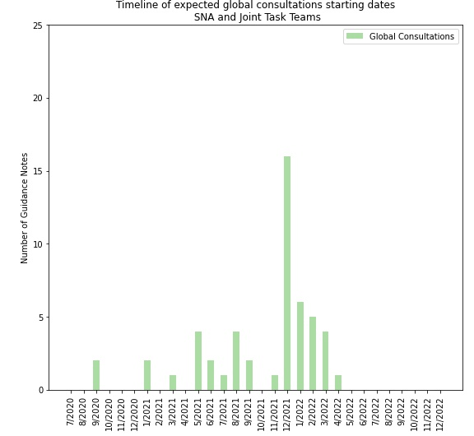
Global Consultations
Task Teams expect most guidance notes to launch their global consultations in December 2021 and early 2022.
The ISWGNA will monitor and, if necessary, stagger consultation launches to avoid overburdening countries.

Slide 16
Progress Report
Main Takeaways
A total of 54 guidance notes are being prepared by SNA and Joint Task Teams.
Work on additional guidance notes relevant to the SNA update is being led by BPM Task Teams (BPTT, CATT, DITT).
Measurable rate of progress since July 2021.
Q4 2021 and Q1 2022 are crucial phases in the work of Task Teams and countries.

Slide 17
Thank you!

