Slide 1
Disaggregation of SDG Indicators Using Census Data
Seiffe Tadesse
United Nations Statistics Division

Slide 2
Outline
Data disaggregation and SDG indicators
General recommendations for disaggregation of SDG indicators
Disaggregation of SDG indicators using PHC and CRVS data
Key policy groups for data disaggregation
Identifying the poor, international migrants, persons with disabilities
List of SDG indicators that can be disaggregated by disability and/or migration status
Conclusion

Slide 3
Data Disaggregation and SDG Indicators
Data disaggregation is one of the overarching principles of the global SDG indicators framework
studying the geographical and social distribution of population groups for each indicator
SDG indicators should be disaggregated, where relevant, by:
Sex
Age
Income
Race, ethnicity
Migratory status
Disability status
Geographic location (urban/rural)
Other characteristics
Ensure data confidentiality
in accordance with 6th item of Fundamental Principles of Official Statistics

Slide 4
General recommendations for disaggregation of SDG indicators
In 2016, the UN Statistical Commission requested the IAEG-SDGs to form a working group on data disaggregation
The IAEG-SDGs document on data disaggregation submitted to the 50th session of the UN Statistical Commission in 2019
The IAEG-SDGs document on disaggregation:
Compilation of data disaggregation dimensions and categories for SDG indicators
Defined the minimum set of disaggregation required for each SDG indicator
Available at: https://unstats.un.org/sdgs/iaeg-sdgs/disaggregation/

Slide 5
Disaggregation of SDG indicators using PHC and CRVS data
Technical Report discusses the possibilities for disaggregation of each SDG indicator covered in the report:
recommendations in the Technical Report give focus to main census variables such as urban/rural area of residence, major/small geographical areas, sex, age, educational strata, migration status, disability status, employment, etc
recommendations in the Technical Report are provided taking into account the work of IAEG-SDGs, recommendations in the P&R Censuses Rev 3 and P&R CRVS Rev 3
One of the major advantages of using PHC/CRVS data, even when they provide only proxy information for SDG indicators, is that they can usually be disaggregated to much finer levels than is the case with survey data

Slide 6
Key policy groups for data disaggregation
The poor
Women and girls
Children
Older persons
Persons with disabilities
International migrants
Forcibly displaced people (refugees and IDPs)
Geographical location (urban/ rural)
PHC provides data for all key policy groups
CRVS data allows disaggregation for geographical areas

Slide 7
Identifying the poor from census data
Different measurements can be used for identifying poor people
Monetary approaches
Non-monetary approaches
Monetary approach
Income per capita
Income quintiles
Personal or household income data are collected only in a minority of PHCs due to data quality problems
Non-monetary approaches
If income data is not available in census, estimation through broad classification of households into categories of economic status (poor, non-poor) using non-monetary approaches:
Multidimensional Poverty Index (MPI)
Unsatisfied Basic Needs
Wealth Quintiles

Slide 8
Non-monetary approaches
Multidimensional Poverty Index
UNDP launched this index for monitoring poverty in all its dimension (SDG indicator 1.2.2 Proportion of men, women and children of all ages living in poverty in all its dimensions according to national definitions)
This index is constructed used 3 key dimensions and 10 indicators:
HEALTH:
1. Any child under age 18 has died; 2. Any maternal death
EDUCATION:
3. No household members completed 6 years of schooling (age 12 and over); 4. Any school age child is not attending school
STANDARD of LIVING:
5. No electricity; 6. No access to improved sanitation system; 7. No access to improved source of drinking water; 8. Housing unit constructed with inadequate materials; 9. Household cooks with dung, wood, charcoal or coal; 10. Household does not own a truck, TV, refrigerator, computer, bicycle

Slide 9
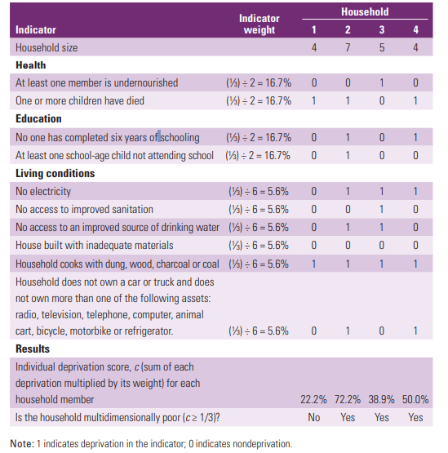
Hypothetical example
Any maternal death
HH1-Not poor
HH2, HH3 and HH4-multidimentional poor
HH2-severe multidimensional poor

Slide 10
Non-monetary approaches
Unmet Basic Needs
The methodology for this approach is similar to MPI
The method involves:
Identify basic needs, where lack of satisfaction of a basic need is considered to be an indicator of deprivation or poor living conditions
Select indicators for measuring the extent to which these ‘basic needs’ are satisfied
Specify a measurement scale/ define a threshold value for each indicator, to be used as a basis for giving a score to the household, denoting either deprivation or non-deprivation
Construct an index for measuring the extent of satisfaction of household needs with respect to each indicator
On the basis of the overall index score, classify households into categories, and calculate the proportion of households in each category
Wealth Quintiles
Follows a similar methodology that has been developed in the context of the DHS, that is potentially applicable to PHC data
Involves the computation of wealth quintiles based on the characteristics of households such as their access to source of drinking water, type of toilet, construction material of floors/walls/roof, cooking fuel, household assets, etc.

Slide 11
Identifying international migrants from census data
Country of birth or citizenship
Country of birth: foreign-born (migrants ) vs native born population (non-migrants)
Country of citizenship: foreigners (migrants) vs citizens (non-migrants)
Countries interested in other migration-related population groups, could further disaggregate the data by:
Country of birth of parents
Duration of stay in country
Reason for migration
Internal migrants and internally displaced persons could also be considered if the topic of population mobility within a country is of policy interest
UN Recommendations for Improving Migration Data in the Context of the 2030 Agenda: https://unstats.un.org/unsd/statcom/49th-session/documents/BG-Item4a-MigrationEGMRecommendations-E.pdf

Slide 12
Identifying persons with disabilities from census data
Disability status using Washington Group approach*
Disability status is measured with four response categories for questions related to disability domains (walking, seeing, hearing, cognition, self-care, communications)
No difficulty at all
Yes, some difficulty
Yes, a lot of difficulty
Yes, cannot do at all
Using these categories every individual can be classified into two groups: persons with disabilities and persons without disabilities
See P&R for Population and Housing Censuses Revision 3
Disability status is determined
based on these two categories

Slide 13
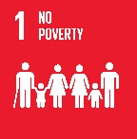
SDG indicators that can be disaggregated by migratory status and/or disability status
 | 1.1.1 Proportion of population below the international poverty line, by sex, age, employment status and geographical location
 | 1.3.1 Proportion of population covered by social protection, by sex, distinguishing children, unemployed persons, older persons, persons with disabilities, pregnant women, newborns, work-injury victims and the poor and the vulnerable
 | 3.1.1 Maternal mortality ratio
 | 3.2.1 Under-five mortality rate
 | 4.2.2 Participation in organised learning (one year before the official primary entry age)
 | 4.3.1 Participation rate of youth and adults in formal and non-formal education and training
 | 4.6.1 Proportion of population in a given age group achieving at least a fixed level of proficiency in functional (a) literacy and (b) numeracy skills, by sex
Source: United Nations Expert Group Meeting on Improving Migration Data in the Context of the 2030 Agenda for Sustainable Development, June 2017, New York

Slide 14
SDG indicators that can be disaggregated by migratory status and/or disability status
 | 5.3.1 Proportion of women aged 20-24 years who were married or in a union before age 15 and before age 18
 | 5.5.2 Proportion of women in managerial positions
 | 8.3.1 Proportion of informal employment in non‑agriculture employment, by sex
 | 8.5.2 Unemployment rate, by sex, age and persons with disabilities
 | 8.6.1 Proportion of youth not in education, employment or training
 | 10.2.1 Proportion of people living below 50 per cent of median income, by sex, age and persons with disabilities
 | 11.1.1 Proportion of urban population living in slums, informal settlements or inadequate housing
 | 16.9.1 Proportion of children under 5 years of age whose births have been registered with a civil authority, by age

Slide 15
Conclusion
Use of census data provides opportunities for disaggregation of SDGs (by various demographic / social / economic characteristics and geographic areas) and hence contribute towards improved monitoring of the SDGs at the global, national and subnational levels
Linking relevant SDG indicators with the policy needs of national and local governments can offer enhanced capability to:
monitor the situation of various population groups and the disparities among them
drive policy reform and allocate resources effectively towards the socioeconomic development of a country

